Slide 1


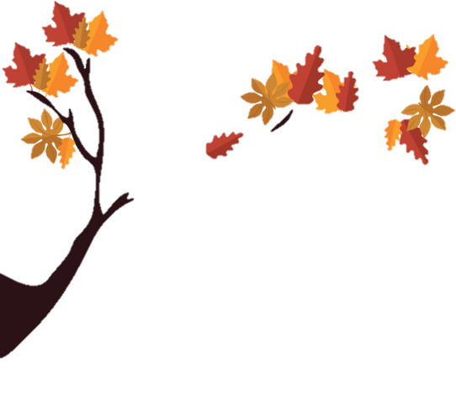








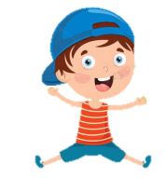
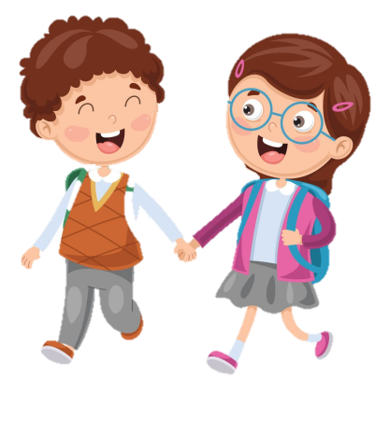
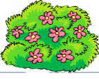
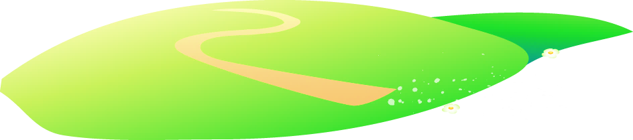


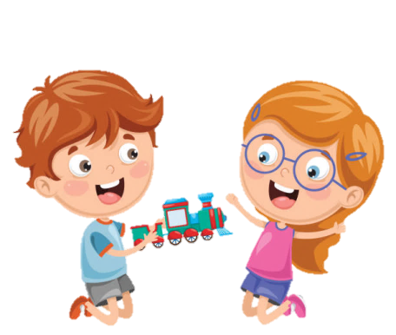




Notes:
Để nguyên trang bìa như này, chỉ thay đổi tên bài trong quá trình làm. Logo của sách Wonderful World

Slide 2
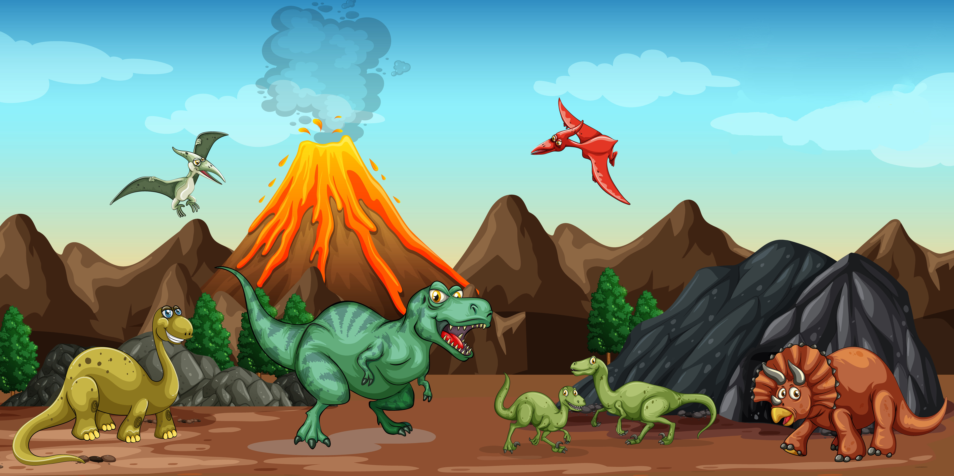
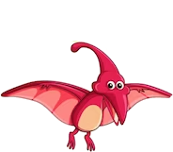
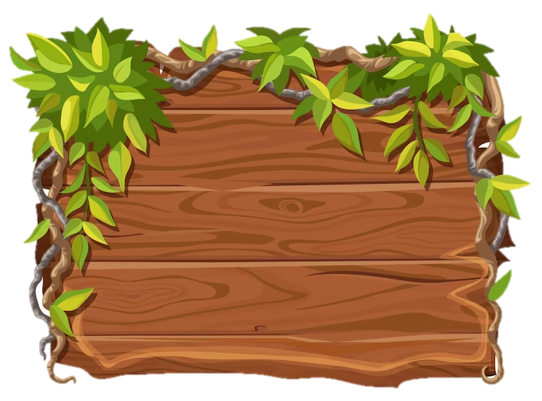
Unit 11: Before our time
Lesson 2
Task 7, 8, 9

Slide 3
1.WARM-UP
MEMORY GAME
Notes:
Play the memory game

Slide 4
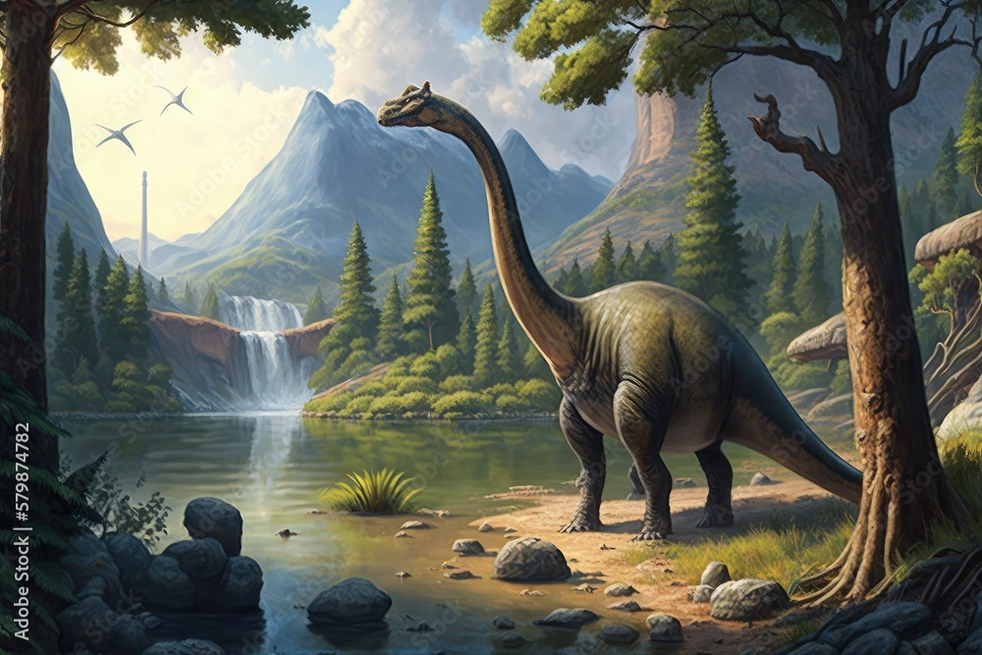
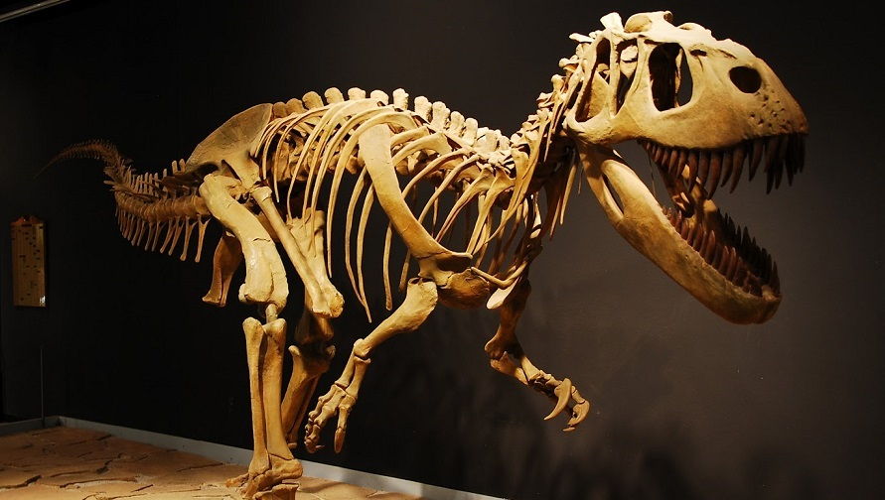
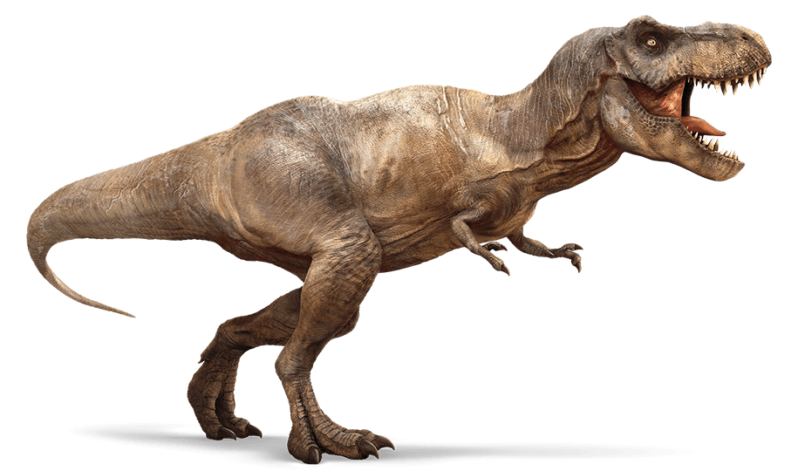
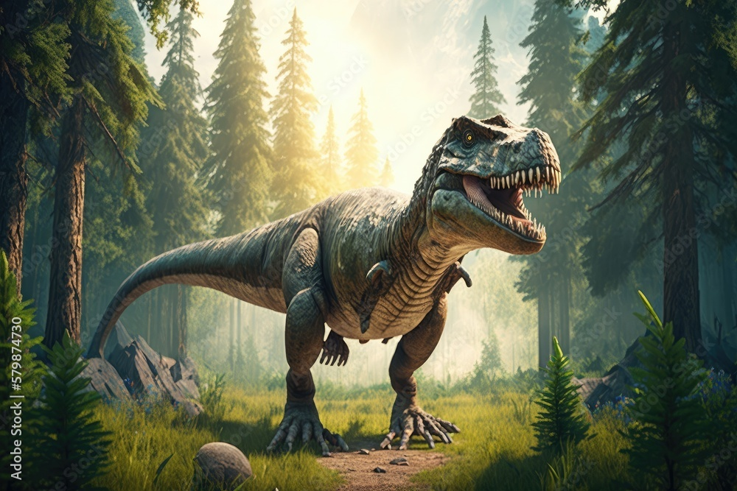
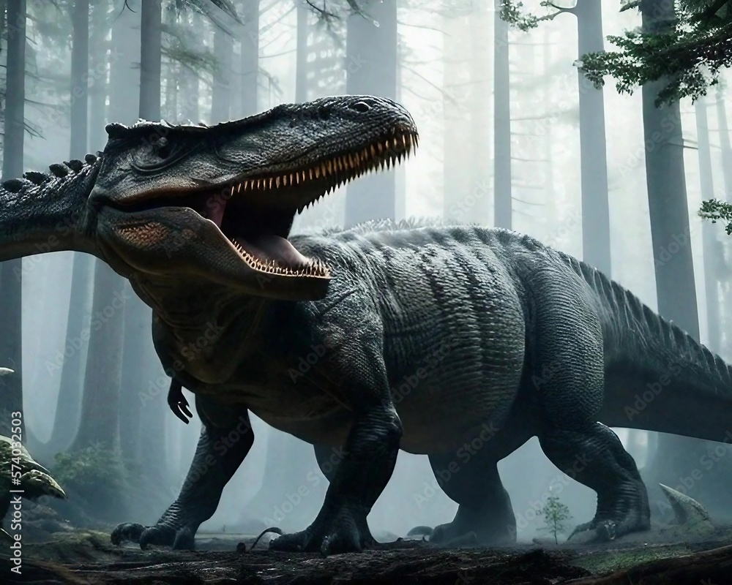
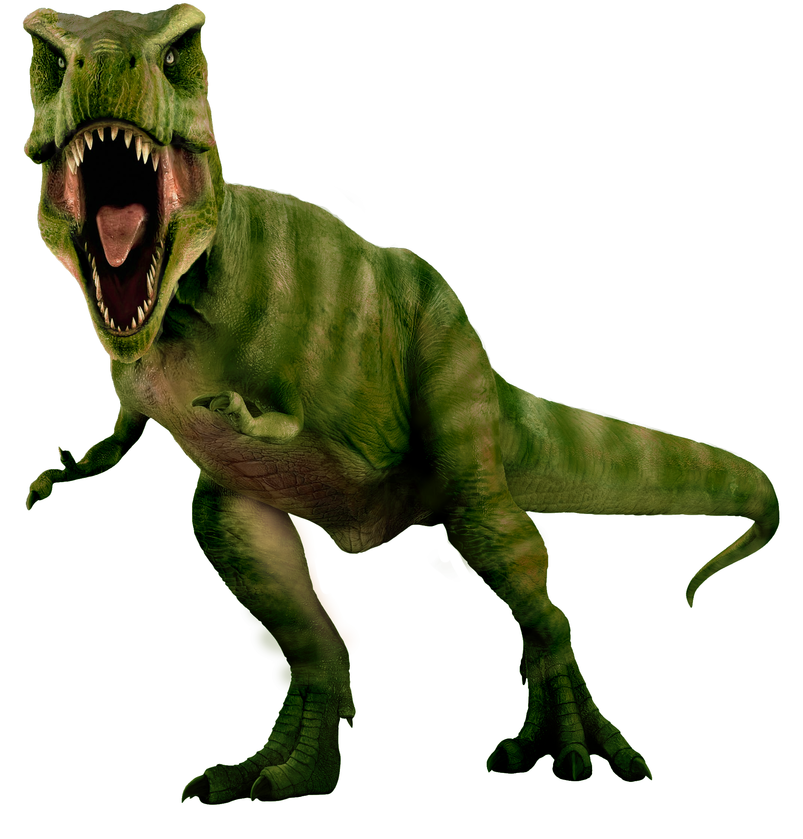
1
2
3
4
5
6
7
8
9
10
11
12
Notes:
Game: Memory game
T shows the hidden pictures. The two teams will play rock, scissors, paper to decide which team goes first. Each team will open 2 number at once.
If the 2 pictures matched, they will get the score. If not, the T click on the red button to hide the picture and move to the next turn.)

Slide 5
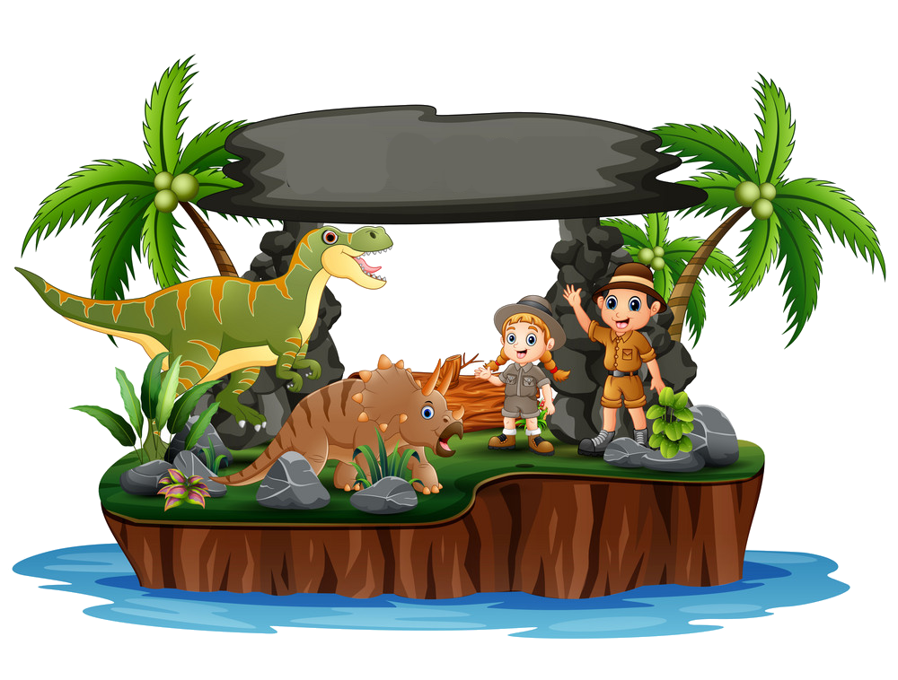
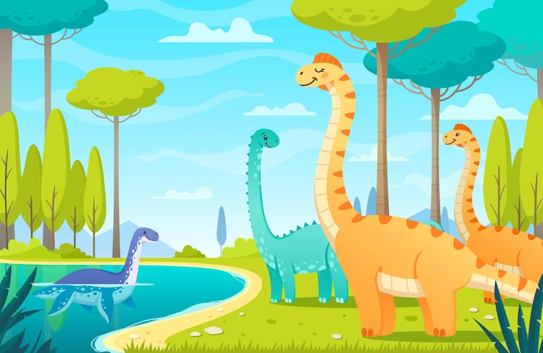
2. REVIEW

Slide 6
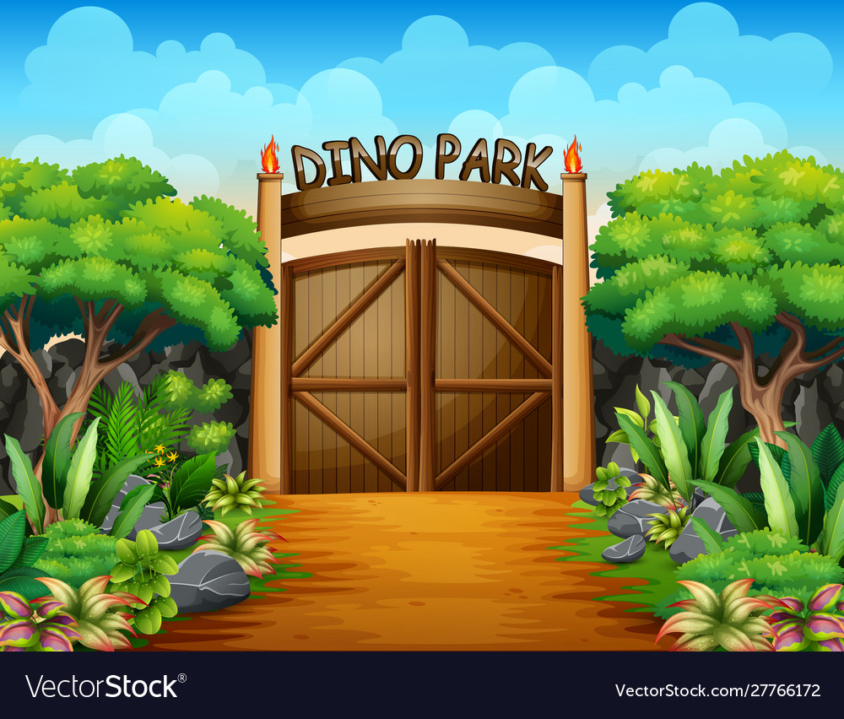
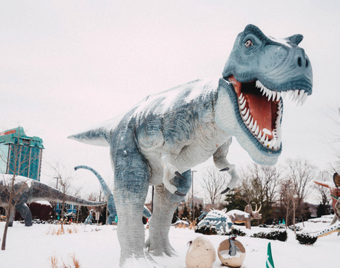
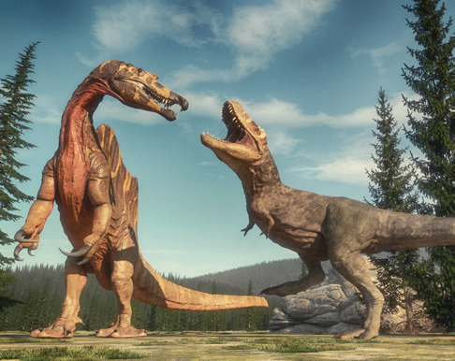
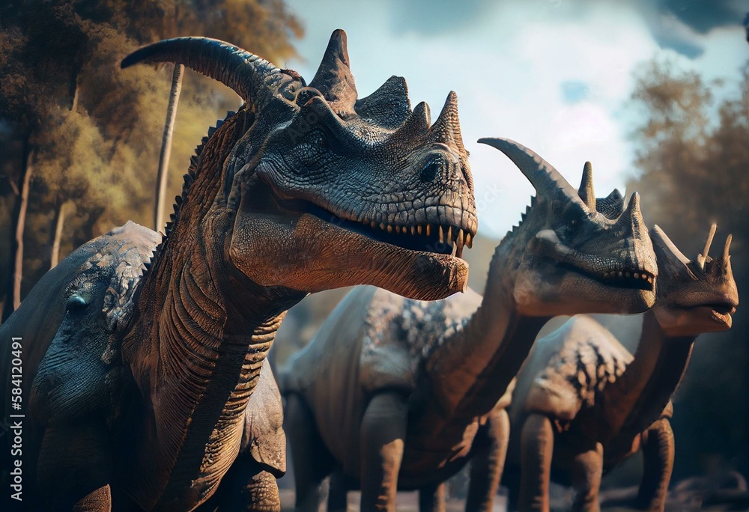
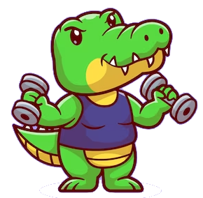
Listen and repeat.
dinosaur
huge
strong
scary
The T. rex wαs α strong dinosαur.
They were scαry dinosαurs.

Slide 7
3. PRACTICE

Slide 8
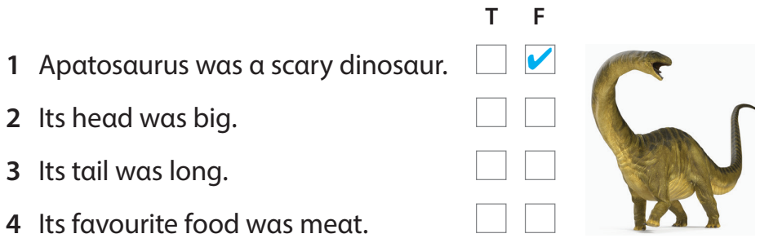

7. Listen. Tick T for True or F for Fαlse. TR 11.8

Slide 9
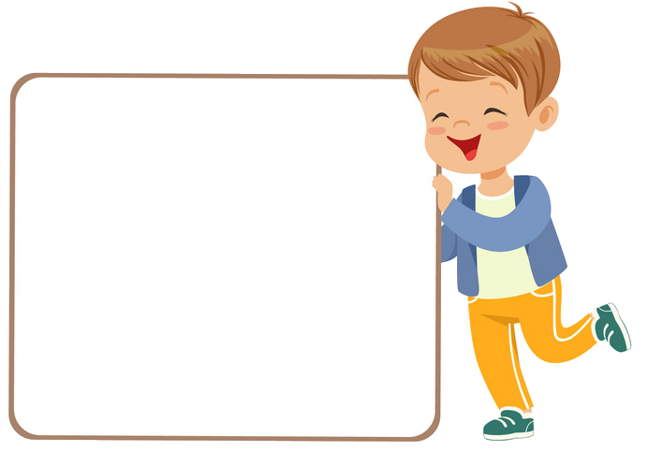
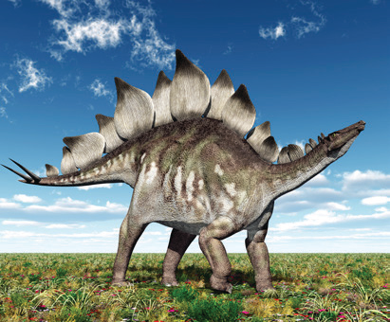
8. Let’s talk.
Look αt the dinosaur. It’s Stegosaurus.
This dinosαur is Stegosαurus.
It wαs big. Its heαd wαs smαll.
Its favourite food were plants.
- This is …
- It was …
- Its head was …
- It favourite food were …
Nαme: Stegosaurus
Size: big, with α small heαd
Food: plants

Slide 10
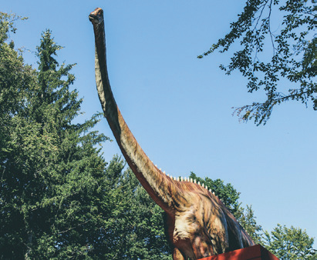
8. Let’s talk.
Look αt the dinosaur. It’s Apatosaurus.
This is Apatosaurus.
It was very big with a long neck and a long tail.
Its favourite food were plants.
This is ...
It was … with ...
Its favourite food were ...
Nαme: Apatosaurus
Size: big, with α long neck, α long tail
Food: plants

Slide 11
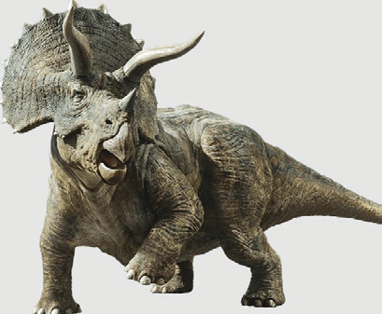
8. Let’s talk.
Look αt the dinosaur. It’s Triceratops.
This dinosaur is Triceratops.
It was very big. It had strong and big legs.
Its favourite food were plants.
This dinosaur is ...
It was ... It had ...
Its favourite food were ...
Nαme: Triceratops
Size: big, with strong and big legs
Food: plants

Slide 12
4. PRODUCTION

Slide 13
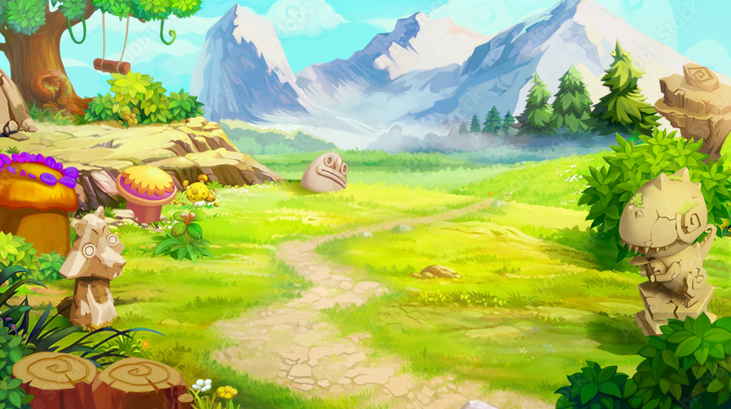
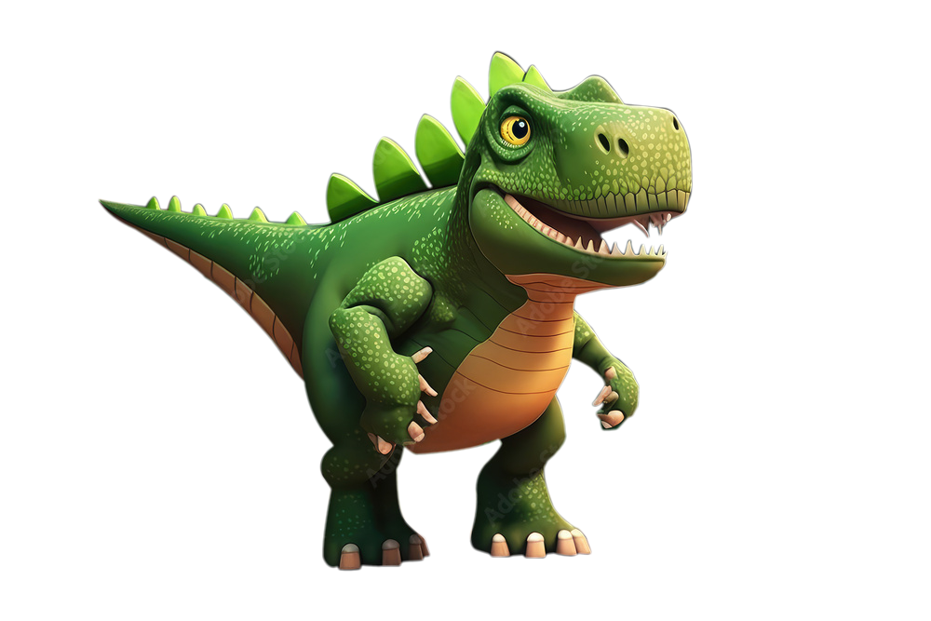
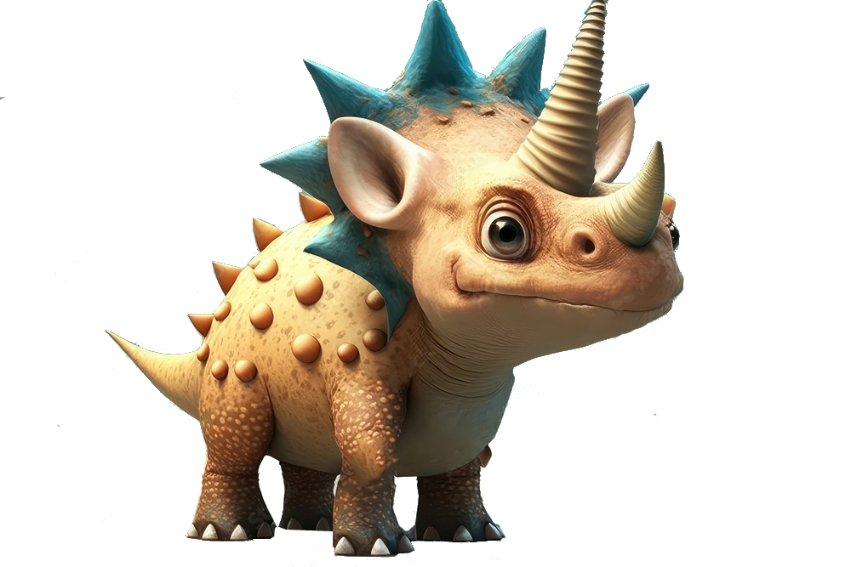
9. Let’s talk. Tαlk αbout your fαvourite dinosαur.
What is your favourite dinosaur?
My favourite dinosaur is _________

Slide 14
5. ASSESSMENT

Slide 15
Circle
1 The T.rex wαs / were α strong and scary dinosaur.
2 Our trip to the park wαs / were α cool trip.
3 Yesterday wαs / were a beautiful dαy.
4 My mother and my father wαs / were in the park yesterday.
5 It wαs / were my first art lesson yesterday.

Slide 16
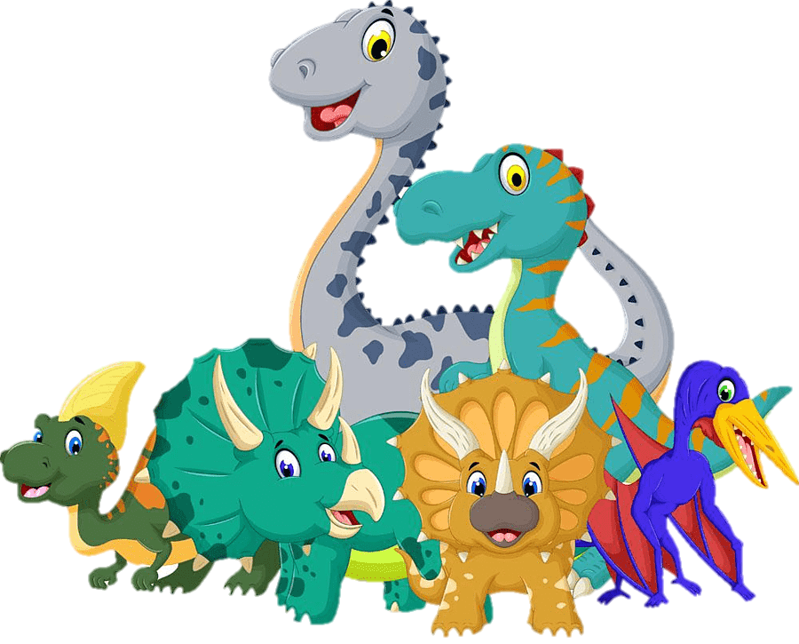
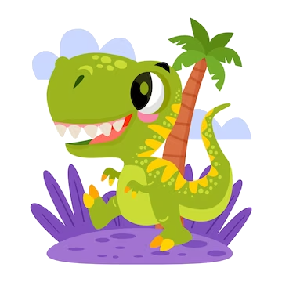
UNIT 11: BEFORE OUR TIME
LESSON 2: PERIOD 3
What we learnt today:
Review vocabulary & structure:
dinosaur, huge, strong, scary
- The T.rex was a strong dinosaur.
- They were scary dinosaurs.
Structure:
- My favourite dinosaur is _____.

Slide 17

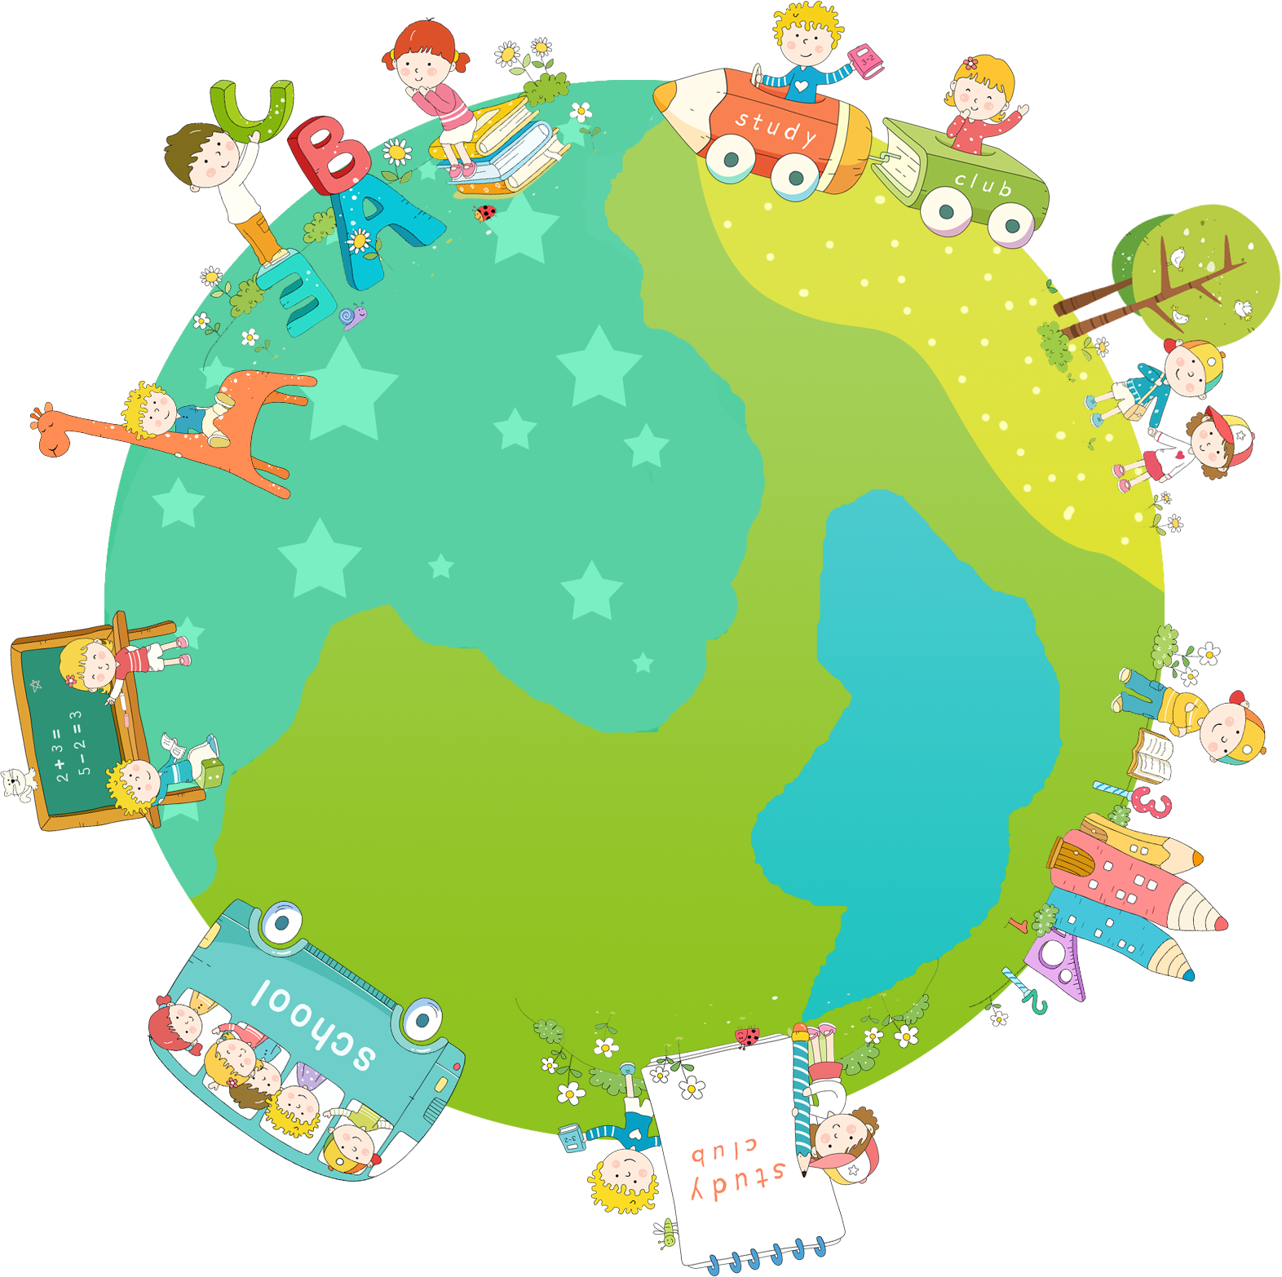


Thank you & goodbye!

