Slide 1









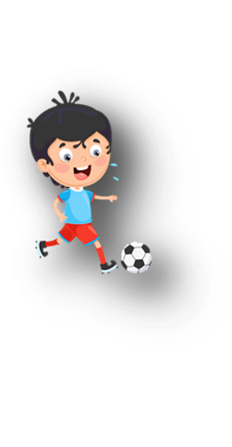











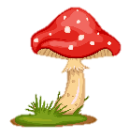
Unit 11
My day
Lesson 1 – Task 1,2,3

Slide 2






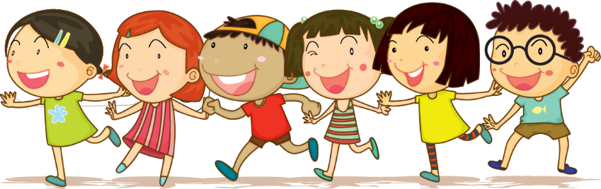



1 Warm-up

Slide 3


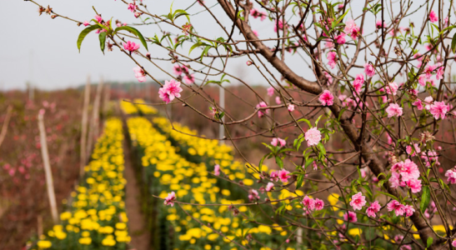
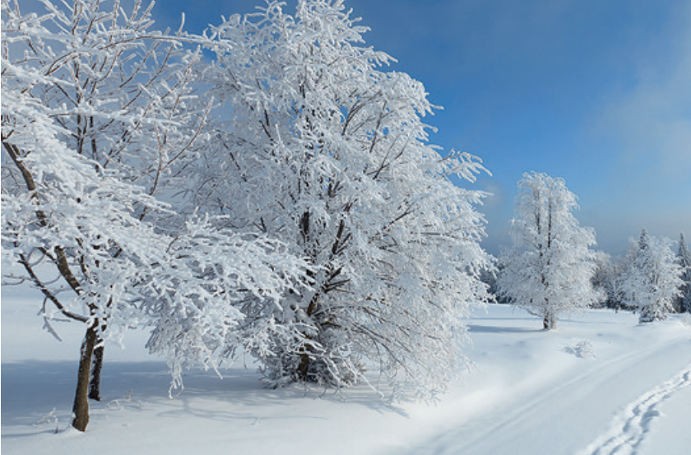
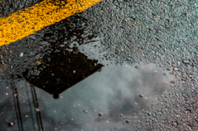
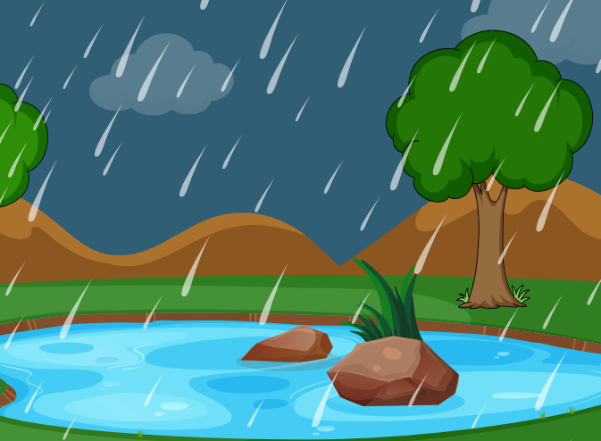
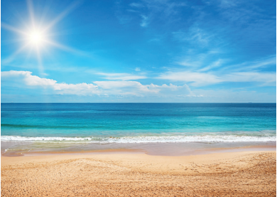
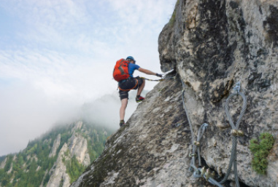
Word search game
f | c | f | w | e | t | c | k | d | v
l | w | d | i | k | p | l | x | h | b
o | e | a | n | o | b | i | a | g | n
w | s | n | t | s | u | m | m | e | r
e | u | c | e | c | r | b | z | y | m
r | r | e | r | a | i | n | y | i | h

Slide 4
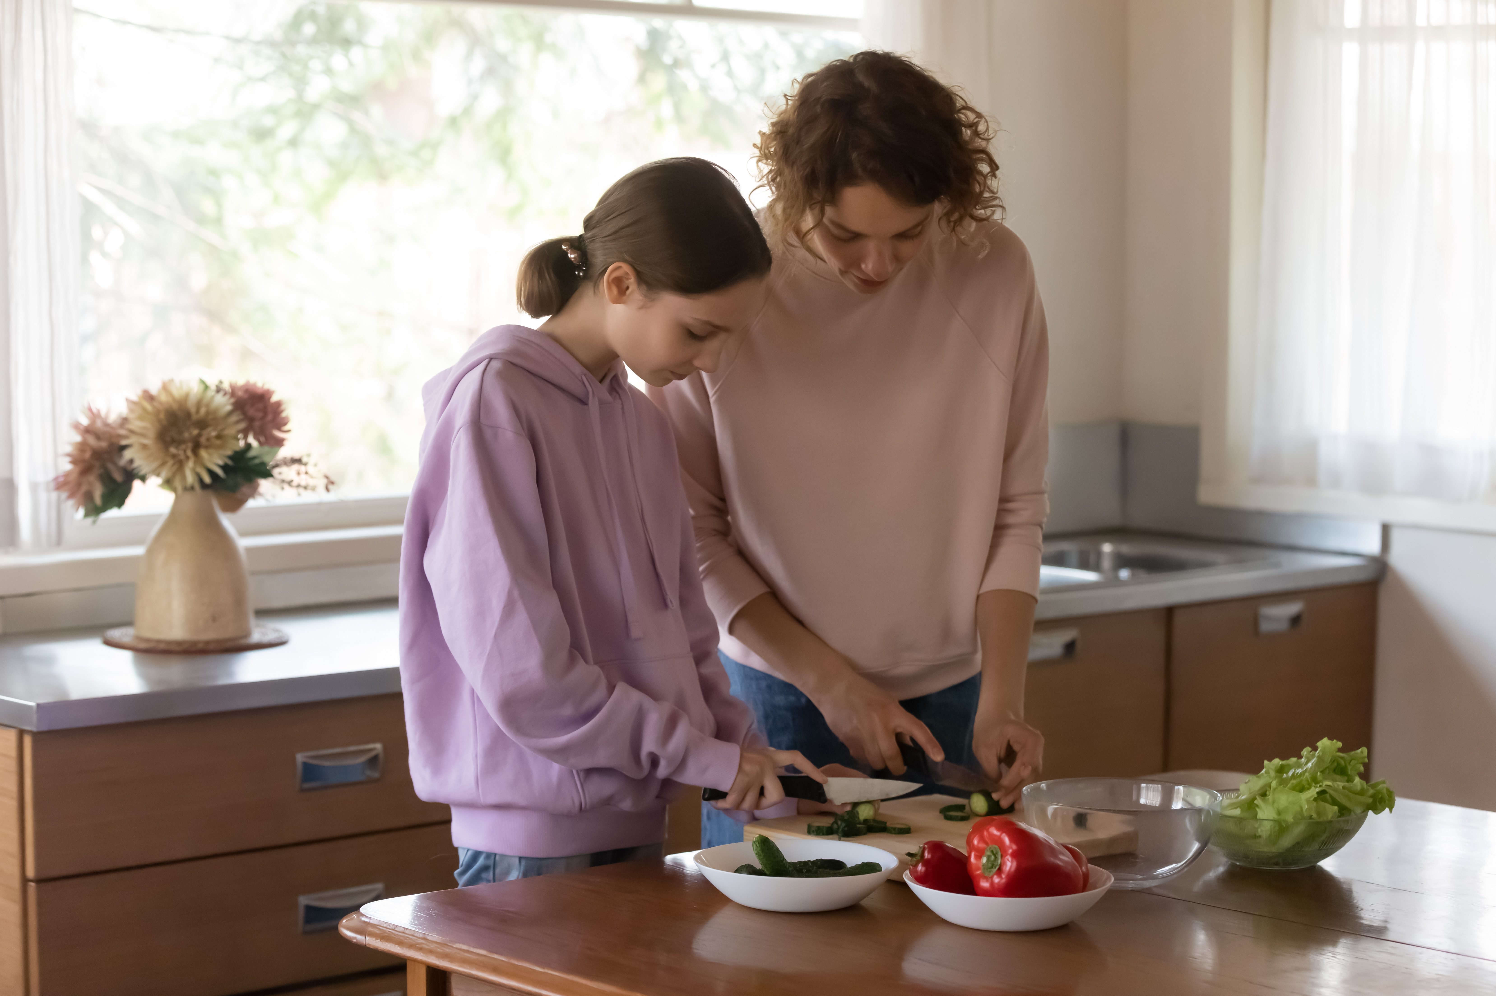
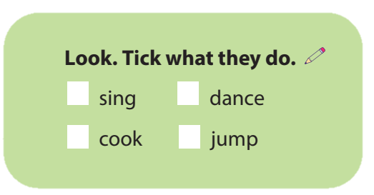
A mother and a daughter in the kitchen
✓

Slide 5
2 Presentation

Slide 6

Vocabulary
Monday | Tuesday | Wednesday | Thursday | Friday | Saturday | Sunday

Slide 7
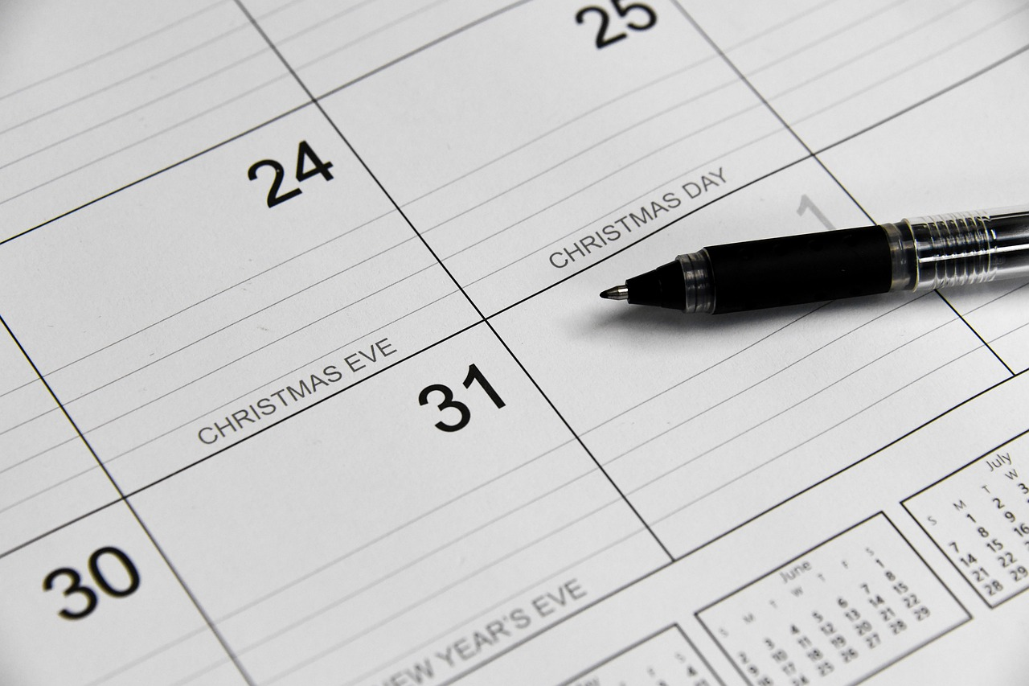


Monday

Slide 8
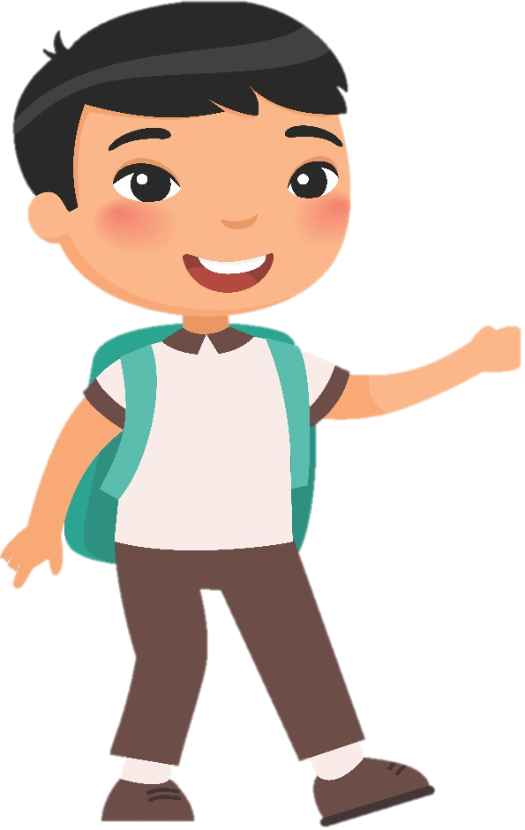
Tuesday

Slide 9
Wednesday

Slide 10
Thursday

Slide 11
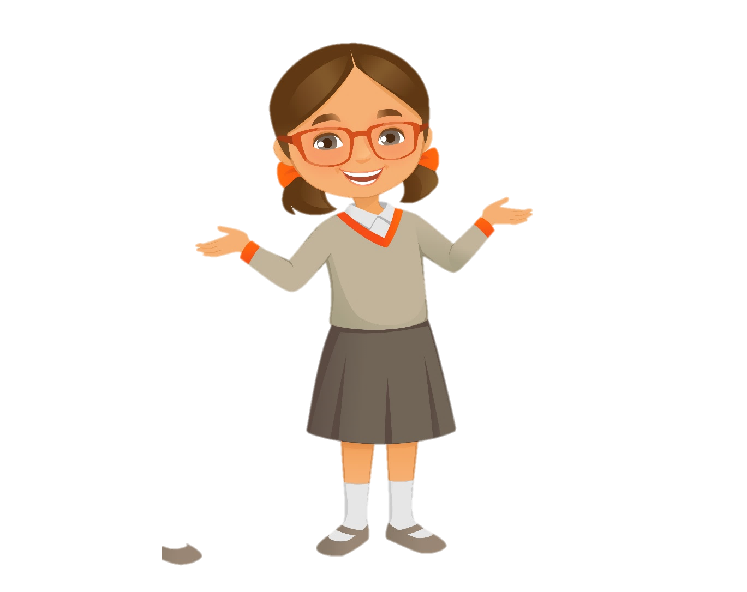
Friday

Slide 12
Saturday

Slide 13
Sunday

Slide 14
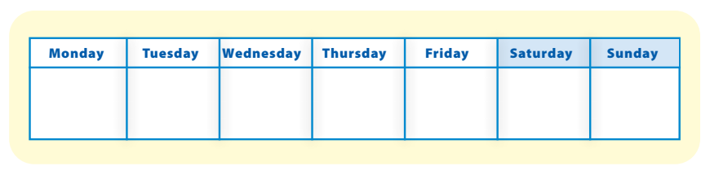
Task 1 Listen and point. Repeat.
Task 1 Listen and point. Repeat.

Slide 15








Vocabulary checking
Jump and say
Task 1 Listen and point. Repeat.
Notes:
- T invites 4 Ss from each group go to the board and arrange in a line.
- T shows all vocabulary ,point and say.
+ If T says incorrect word, Ss will jump in the left and say the right word.( the Students who jump slowest wil be the losers)
+ If T says correct word ,Ss will jump in the right (the Students who jump slowest wil be the losers.
-Give stars for the best Ss.

Slide 16
3 Practice

Slide 17
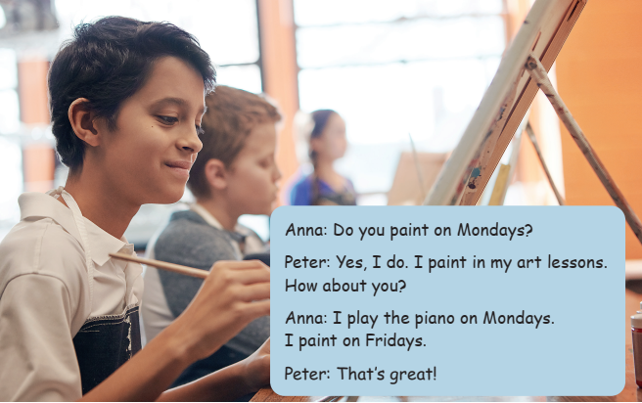
Task 2 Listen and write.
Task 1 Listen and point. Repeat.

Slide 18

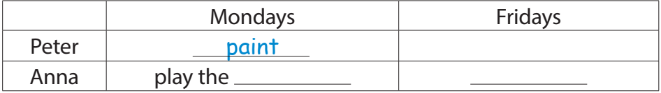
Task 2 Listen and write.
piano
paint

Slide 19
4 Production

Slide 20
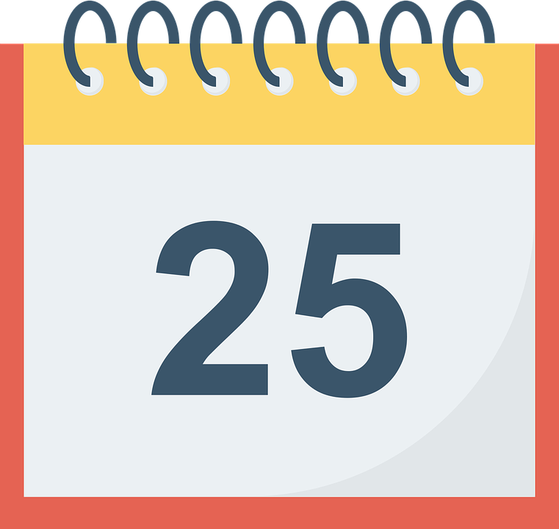
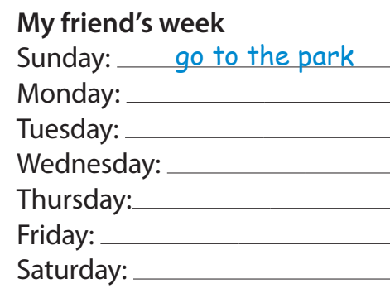
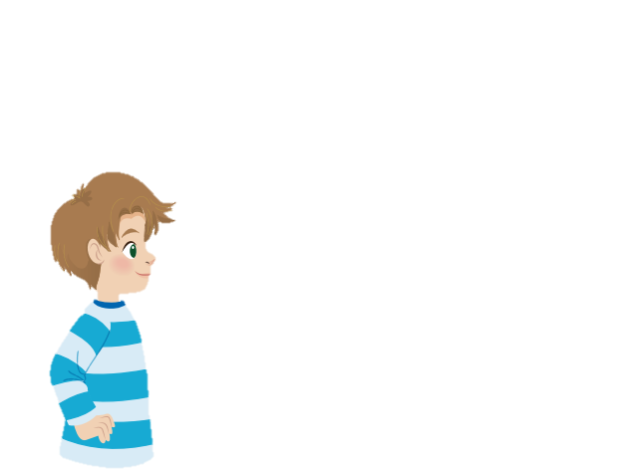
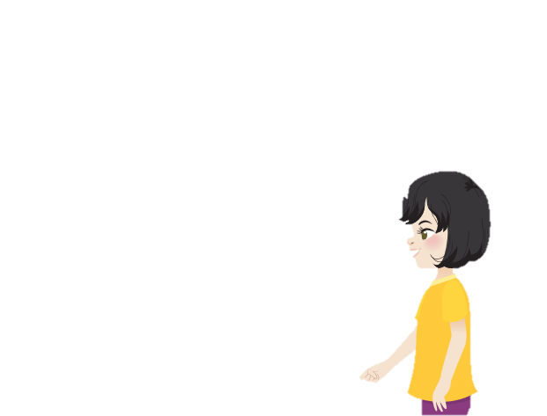
Task 3 Ask and answer. Write.
Task 1 Listen and point. Reat.
Do you go to school on Sundays?
No, I don’t.
I go to the park.

Slide 21
5 Assessment

Slide 22
Completes the sentences.
=
The day before Tuesday is __________.
The day after Friday is __________.
The day between Monday and Wednesday _________.
The day beginning with “F” is ________.
The day after Wednesday is _________.
Monday
Tuesday
Wednesday
Thursday
Friday
Saturday
Sunday

Slide 23




Thank you & goodbye!

