Slide 1









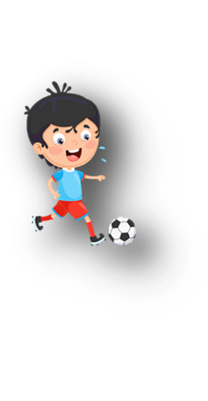











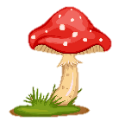
Unit 11
My day
Lesson 2 – Task 1,2,3

Slide 2






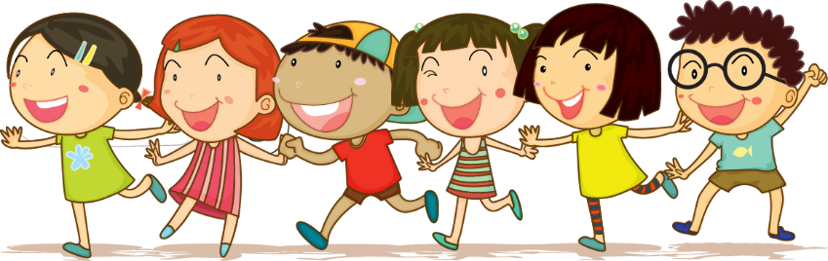



1 Warm up

Slide 3

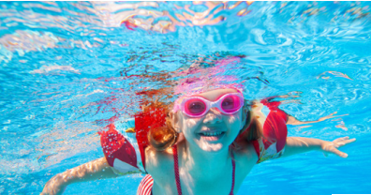
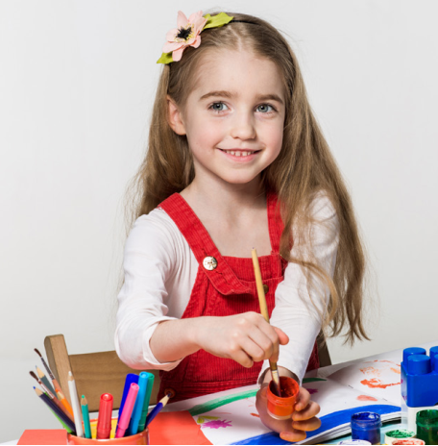
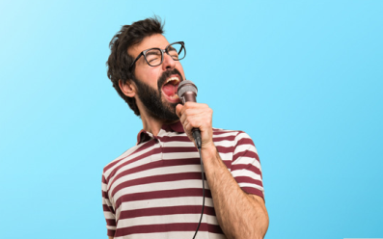
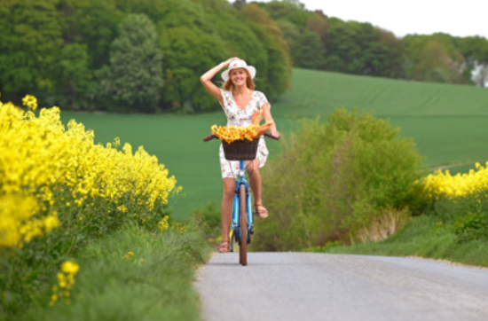
swim
take photos
paint
eat
sing
ride a bike

Slide 4
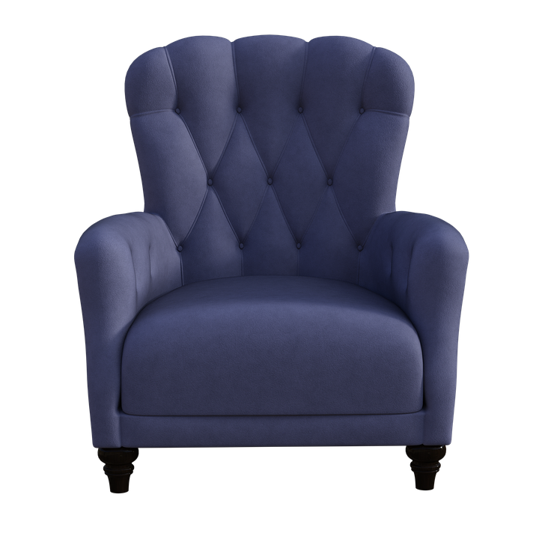

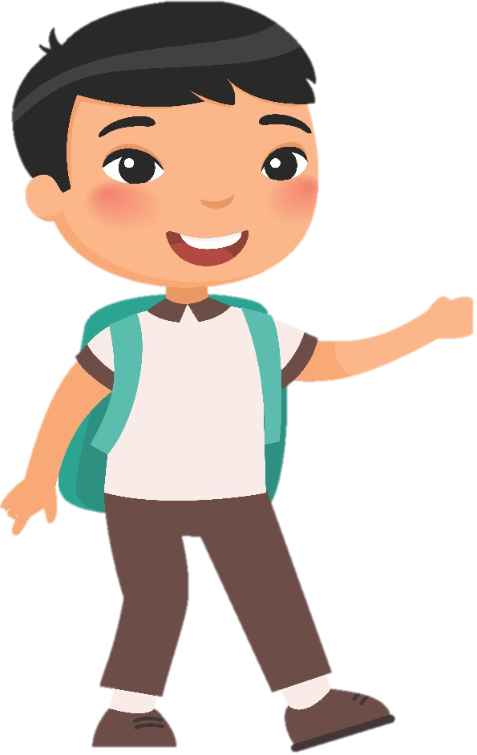
Let’s play ‘Hot seat’!
Notes:
T has a list of vocabularies about actions to use in this game ( swim, take photos, eat, sing, ride a bike….)
One student in each team will sit in the hot seat, looking at their teammates describing the activities (using body language) and trying to guess the word.

Slide 5
2 Presentation

Slide 6

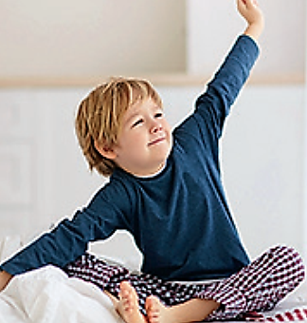
get up

Slide 7
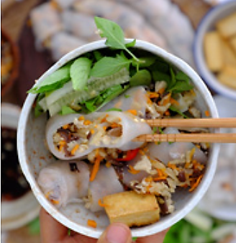
have breakfast

Slide 8
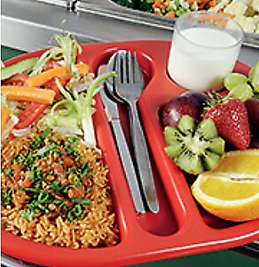
have lunch

Slide 9
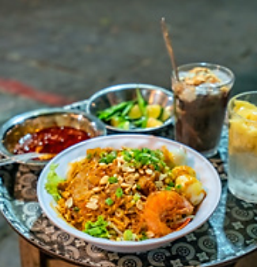
have dinner

Slide 10
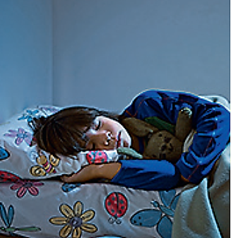
go to bed

Slide 11
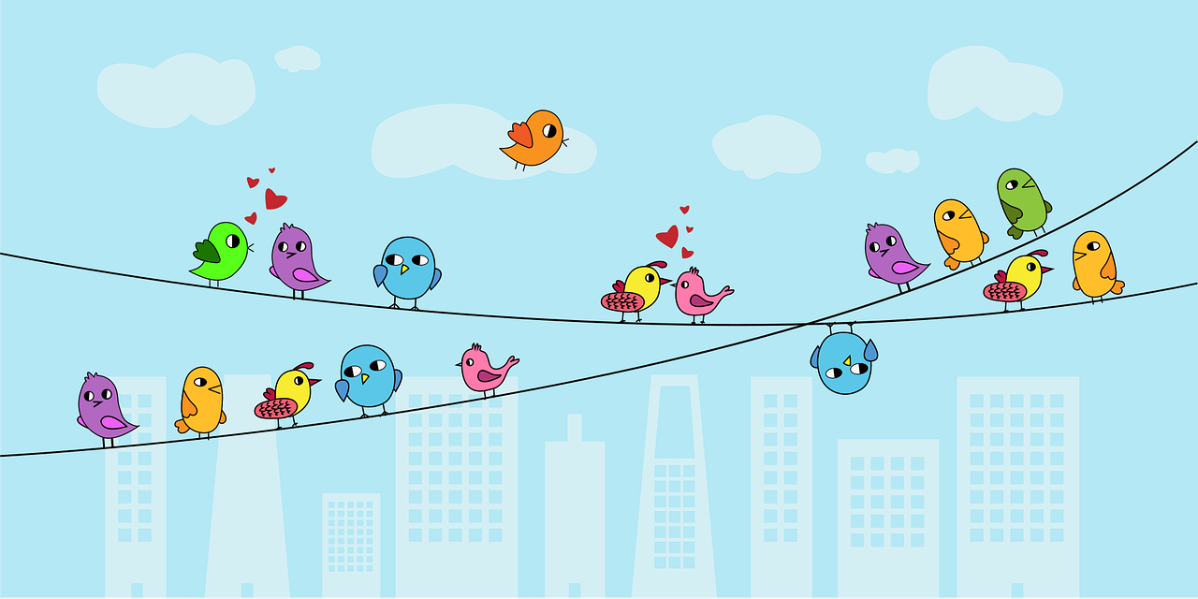
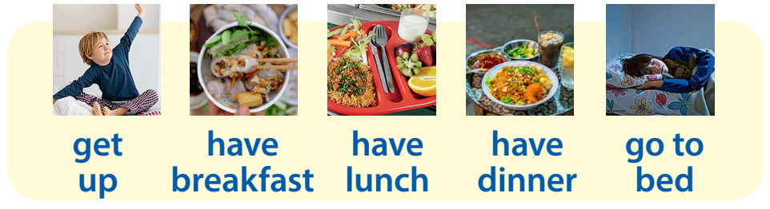
Task 1 Listen and point. Repeat.

Slide 12
Checking game
Quick look

Slide 13
Look and say
have breakfast

Slide 14
Look and say
go to bed

Slide 15
Look and say
have dinner

Slide 16
Look and say
get up

Slide 17
Look and say
have dinner

Slide 18
3 Practice

Slide 19

Match
1 have breakfast
2 get up
3 have lunch
4 have dinner
5 go to bed

Slide 20
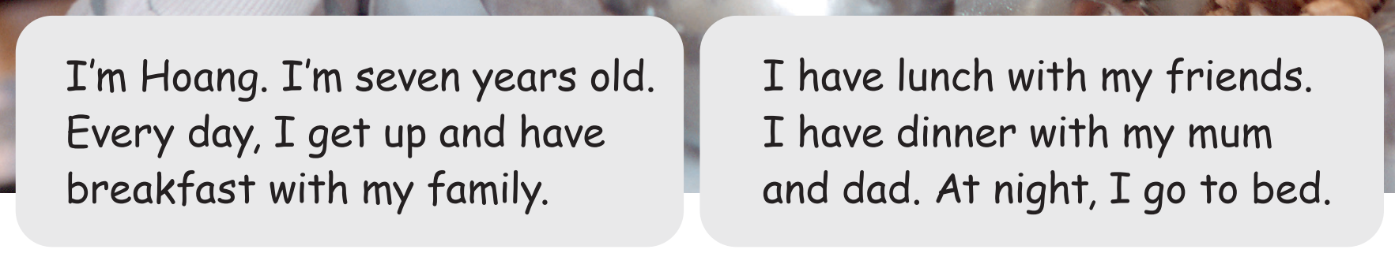
Task 2 Listen and number in order.

Slide 21
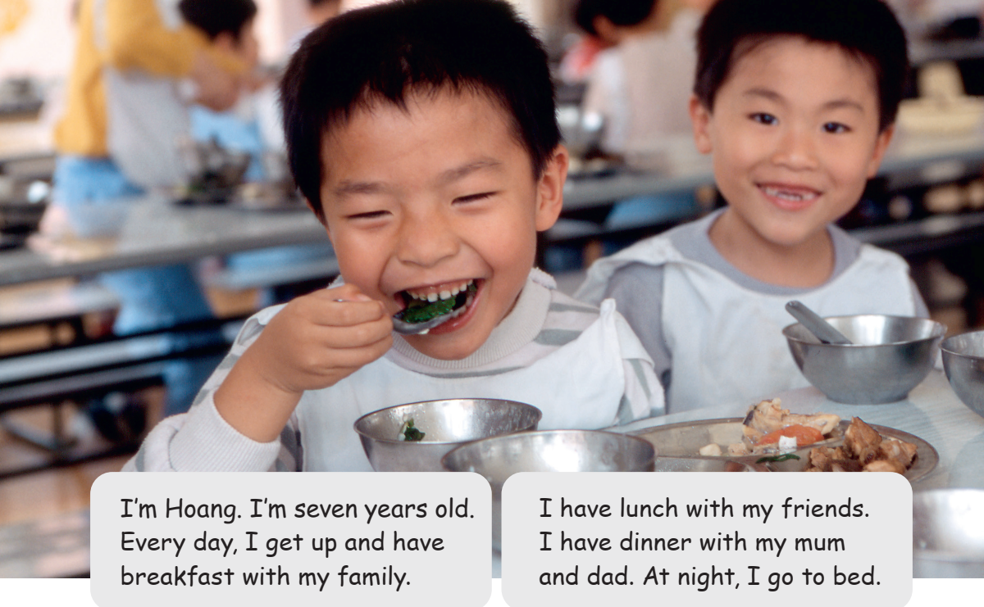
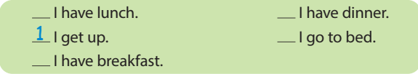
Task 2 Listen and number in order.
3
4
5
2

Slide 22
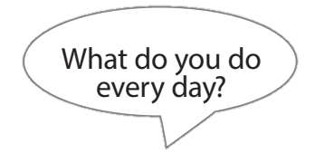
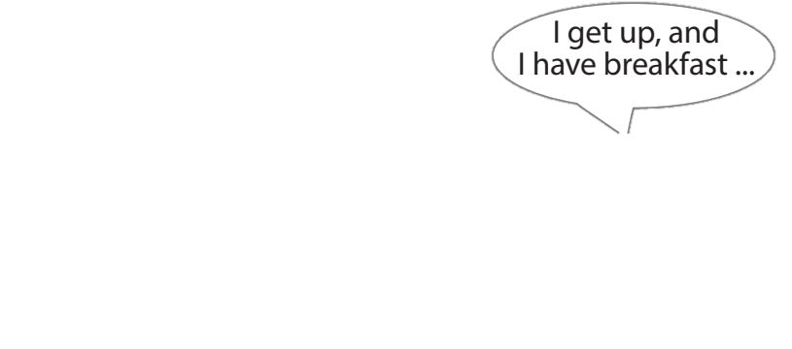

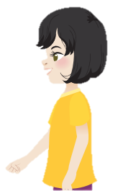
Task 3 Ask and answer.

Slide 23
4 Production

Slide 24
Fill in the blank
have breakfast
2 ___________
1 _______
get up
have lunch
3 ___________
4 ___________
go to bed
have dinner
5 ___________

Slide 25
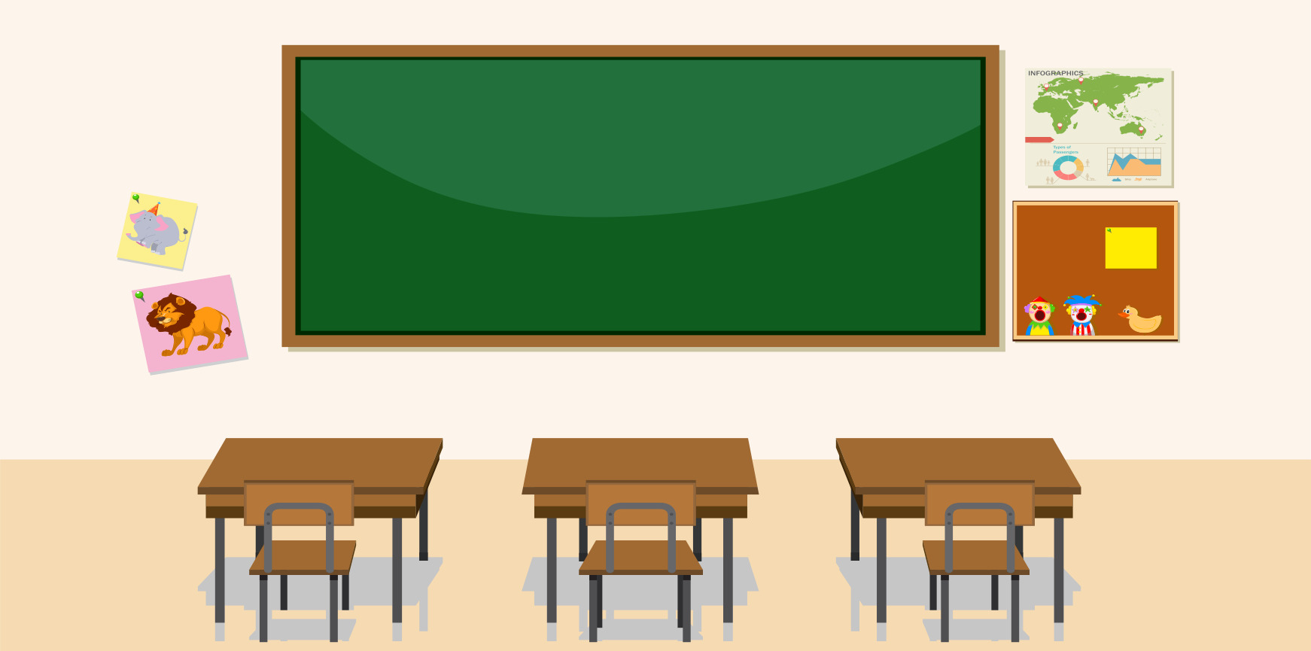
Ask and write
Anna, what do you do at noon?
I have lunch.
Name | In the morning | At noon | In the afternoon | In the evening | At night
Anna
have lunch

Slide 26
5 Assessment

Slide 27
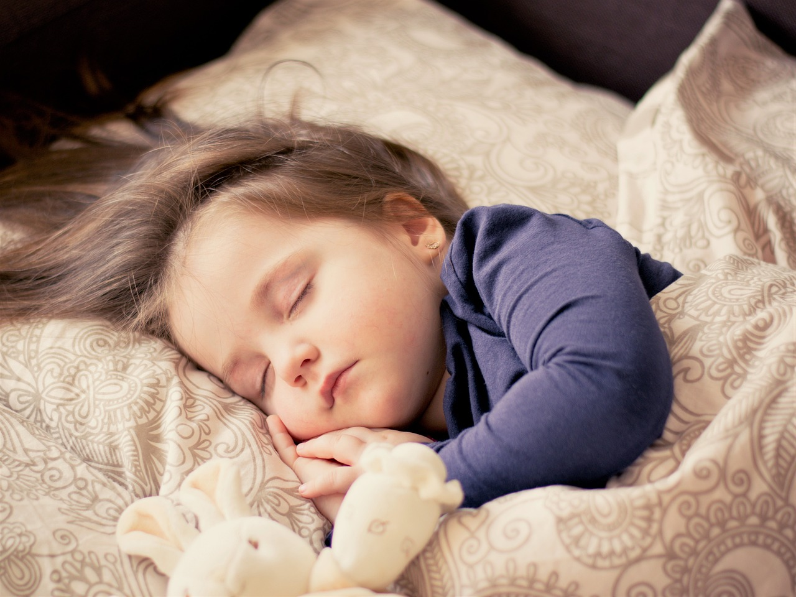
Look and say.
What do you do at night?
I go to bed.

Slide 28
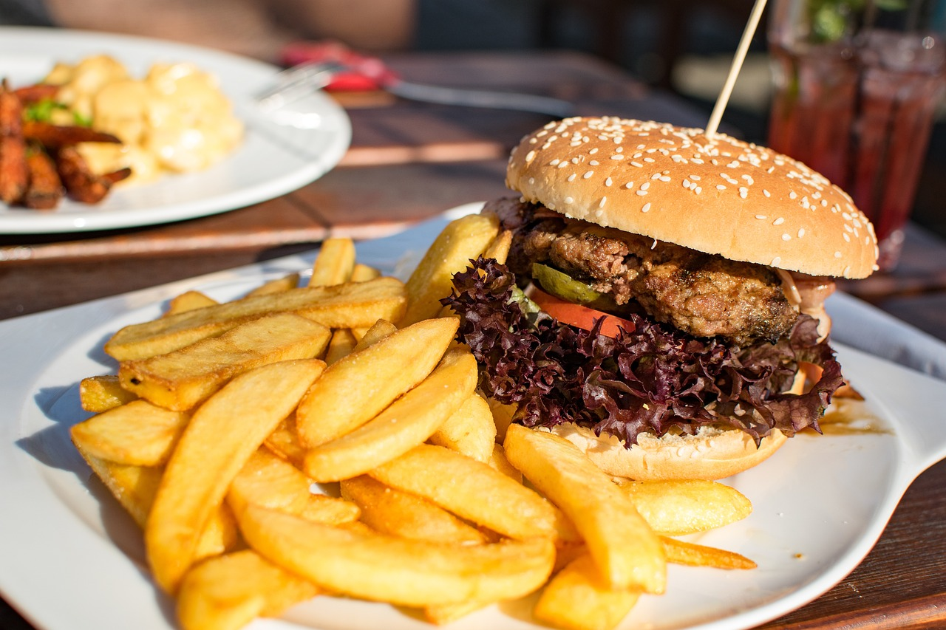
Look and say.
What do you do in the evening?
I have dinner.

Slide 29
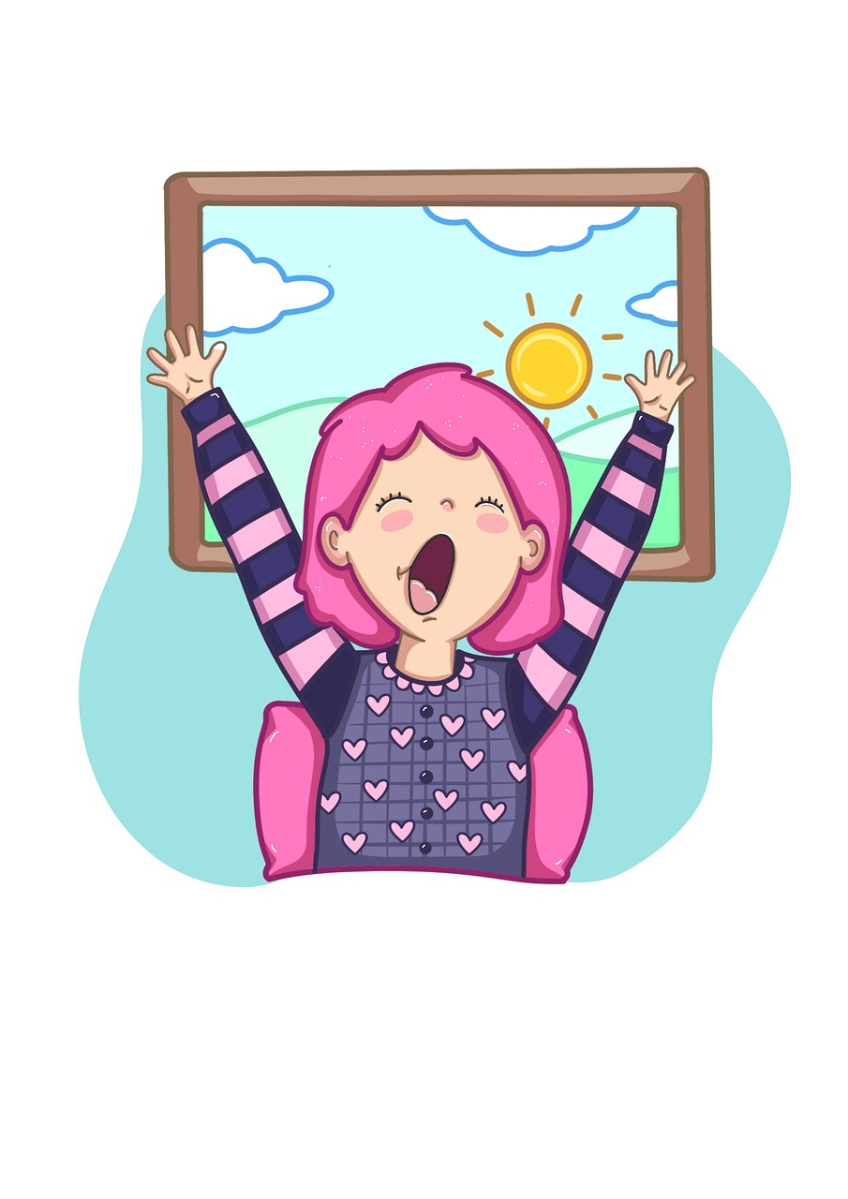
Look and say.
What do you do in the morning?
I get up.

Slide 30
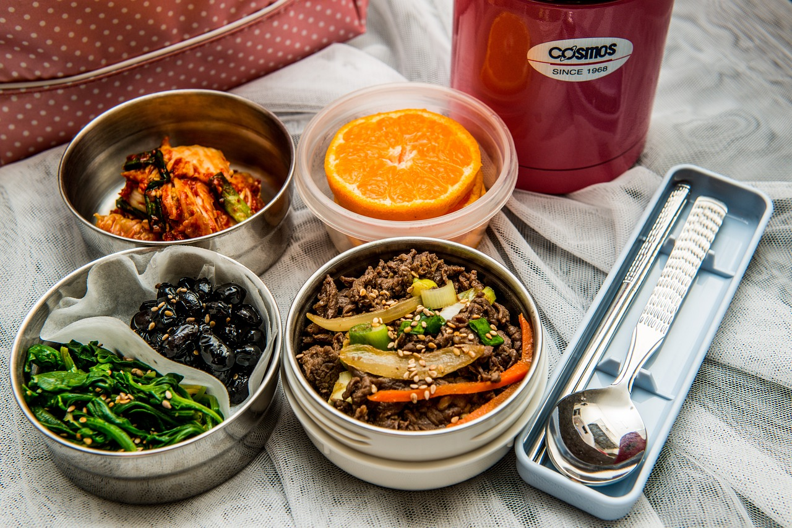
Look and say.
What do you do at noon?
I have lunch.

Slide 31
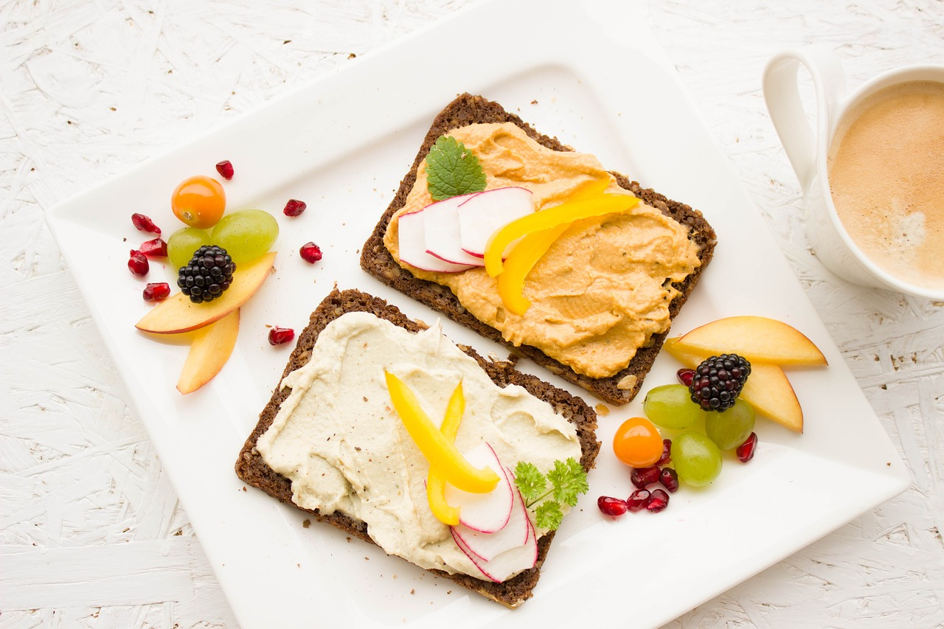
Look and say.
What do you do in the morning?
I have breakfast.

Slide 32




Thank you & goodbye!

