Slide 1









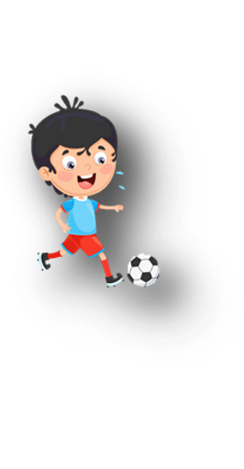












Unit 11
My day
Lesson 2 – Task 4,5,6

Slide 2






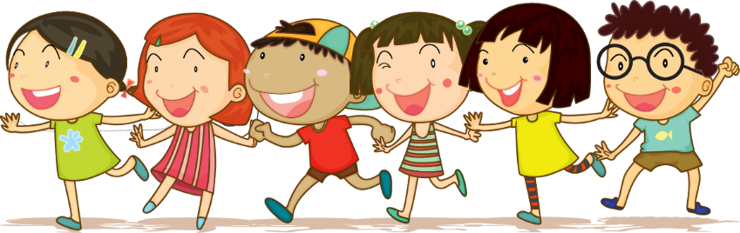



1 Warm up

Slide 3

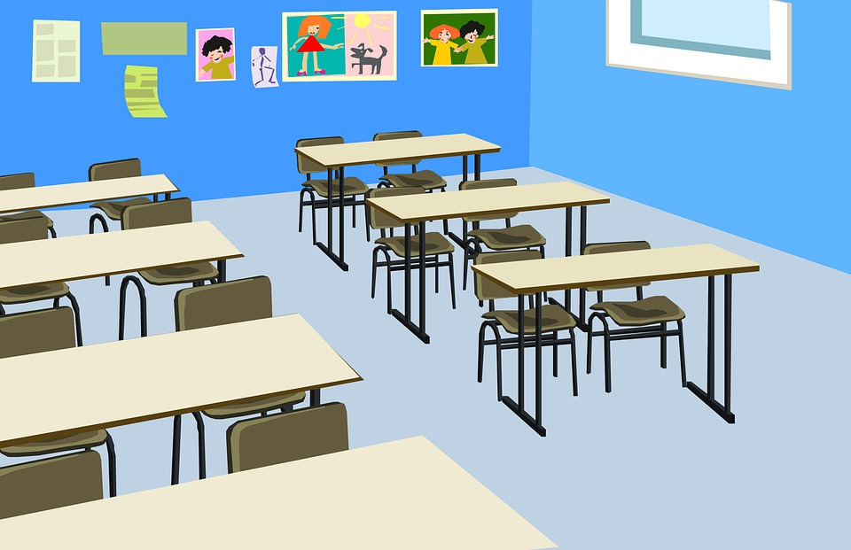
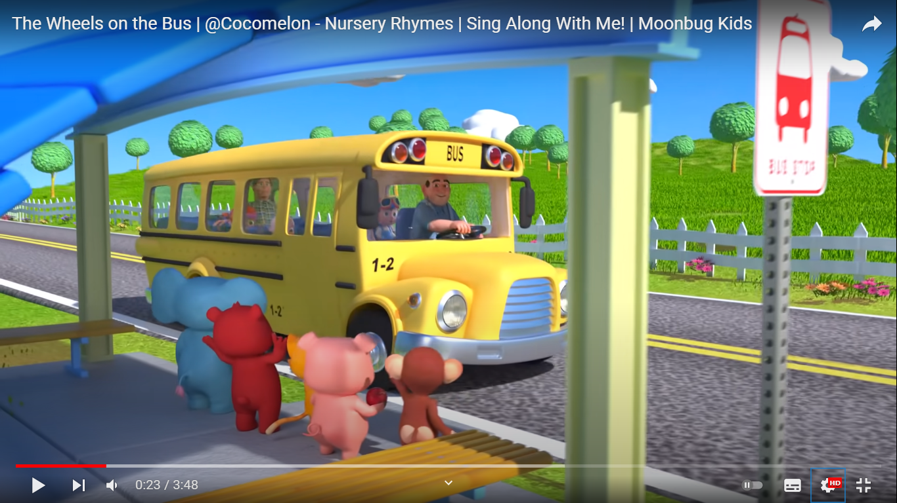
https://www.youtube.com/watch?v=QUFauUR6qa0
The wheels on the bus

Slide 4
2 Presentation

Slide 5

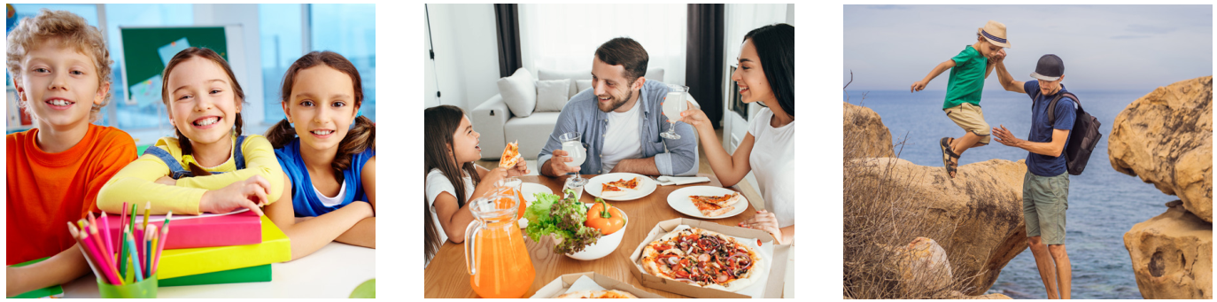
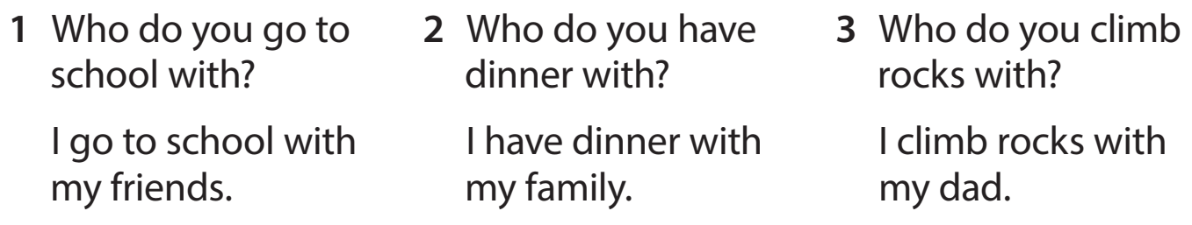
Task 4 Listen and repeat.

Slide 6


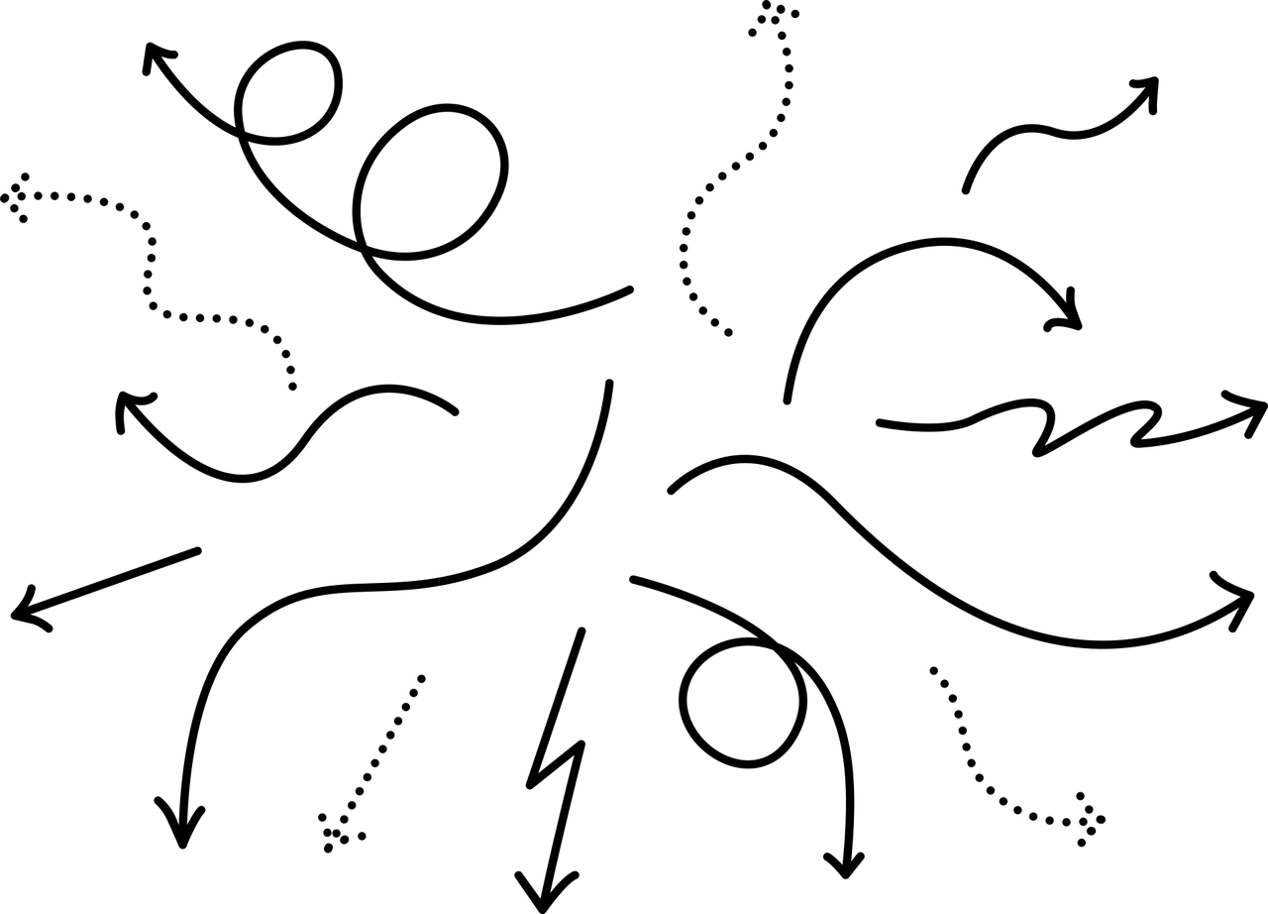
New structure
Who do you ______ with?
I _______ with _______.

Slide 7
Checking game
Look and choose

Slide 8
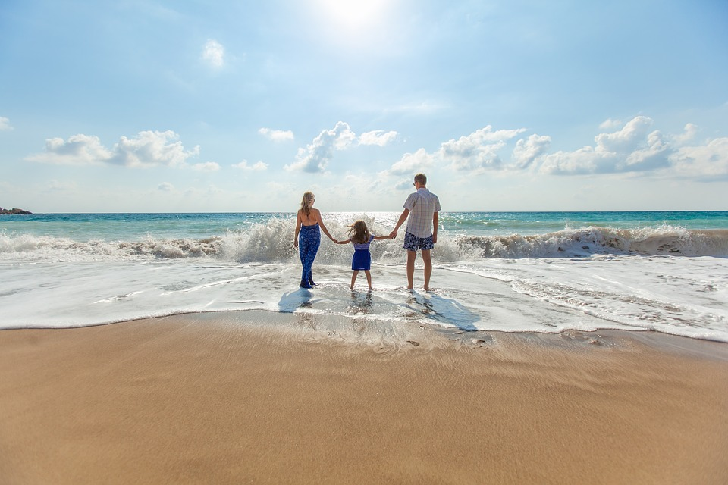
Who do you go to the seashore with?
1 I go to the seashore with my family.
2 I go to the seashore with my friends.

Slide 9
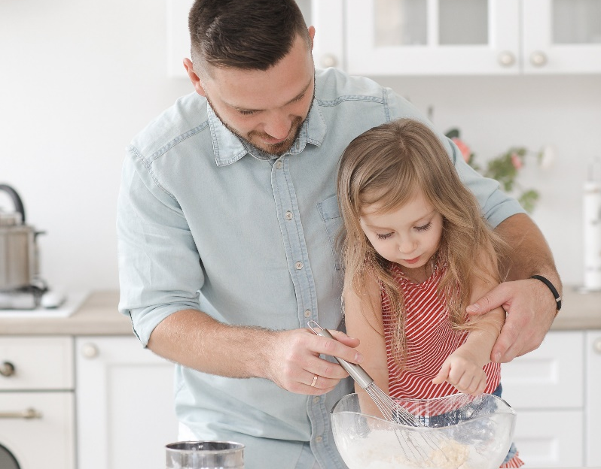
Who do you cook with?
1 I cook with my mum.
2 I cook with my dad.

Slide 10
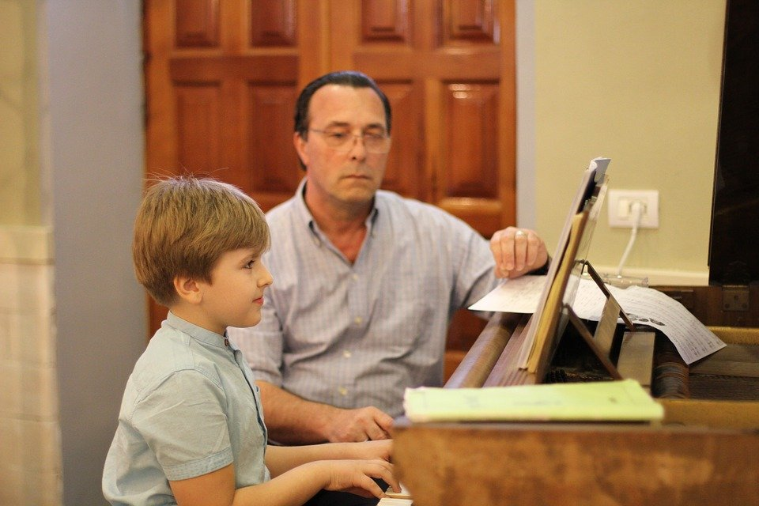
Who do you play the piano with?
1 I play the piano with my grandpa.
2 I play the piano with my grandma.

Slide 11
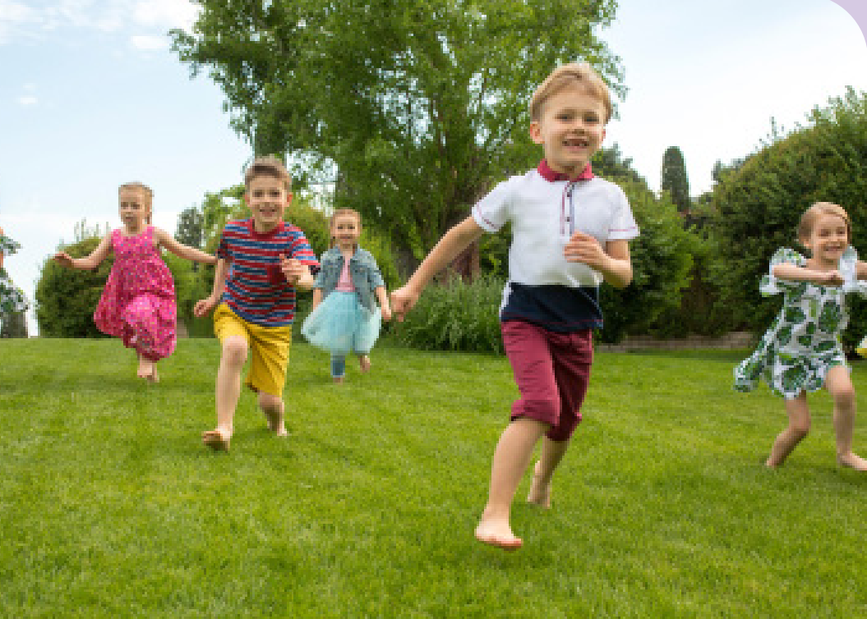
Who do you run with?
1 I run with my teachers.
2 I run with my friends.

Slide 12
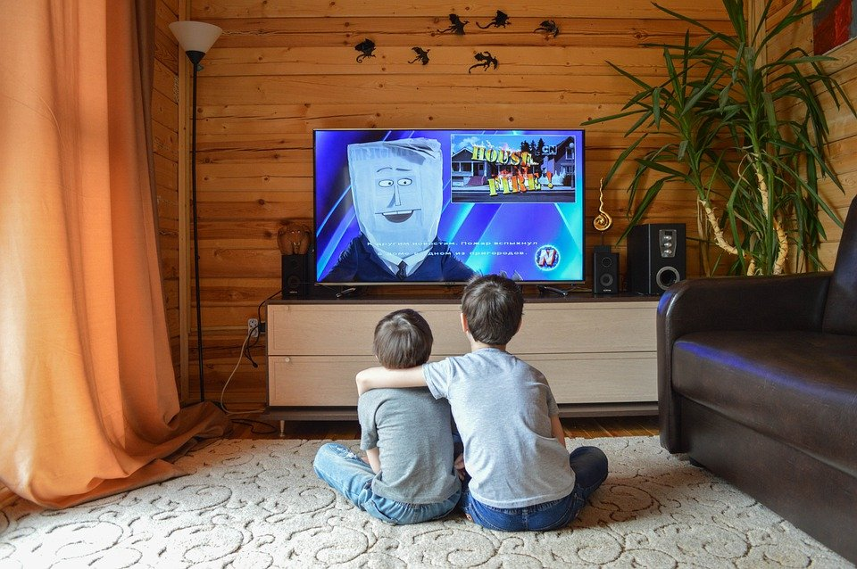
Who do you watch TV with?
1 I watch with my sister.
2 I watch with my brother.

Slide 13
3 Practice

Slide 14
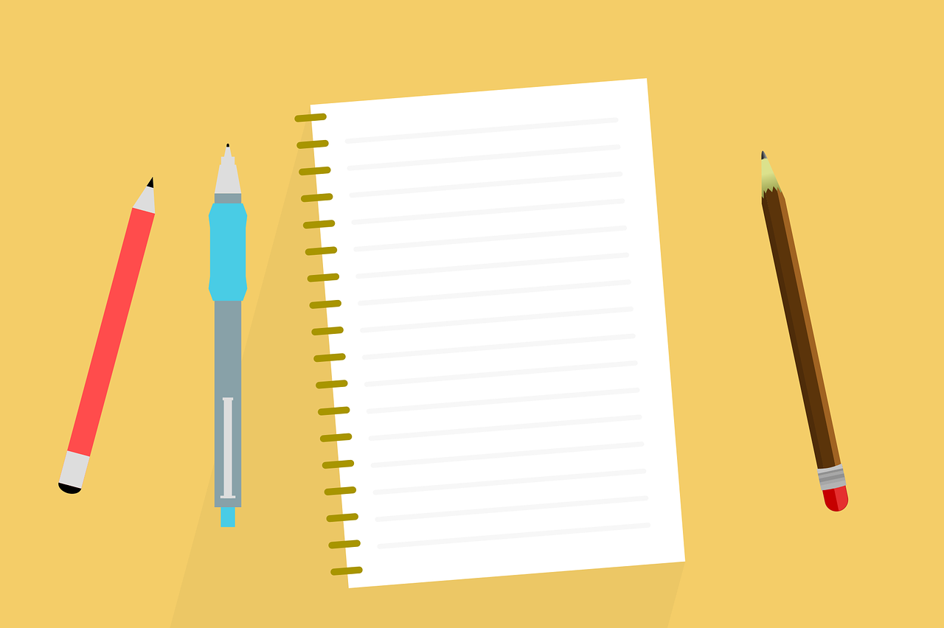

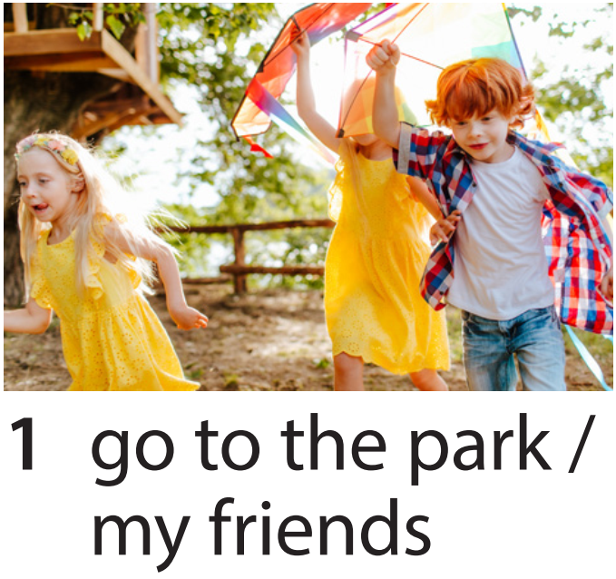
Task 5. Look. Ask and answer.
Who do you go to the park with?
I go to the park with my friends.

Slide 15
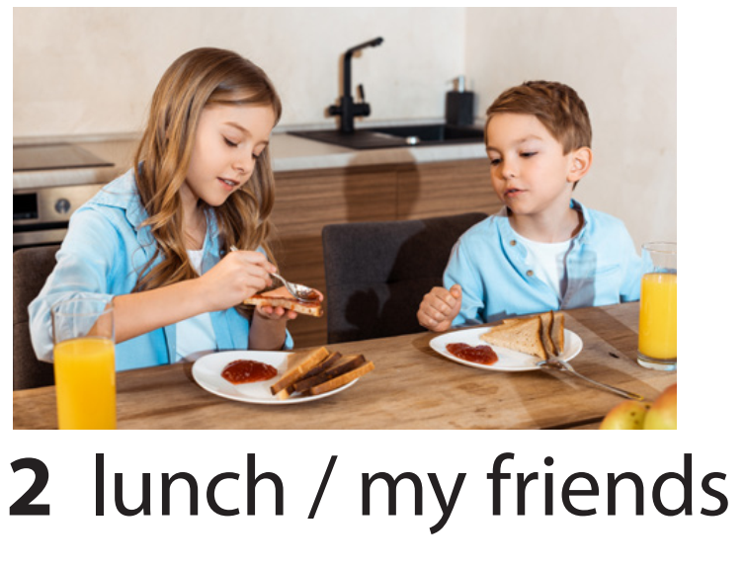
Who do you have lunch with?
I have lunch with my friends.

Slide 16
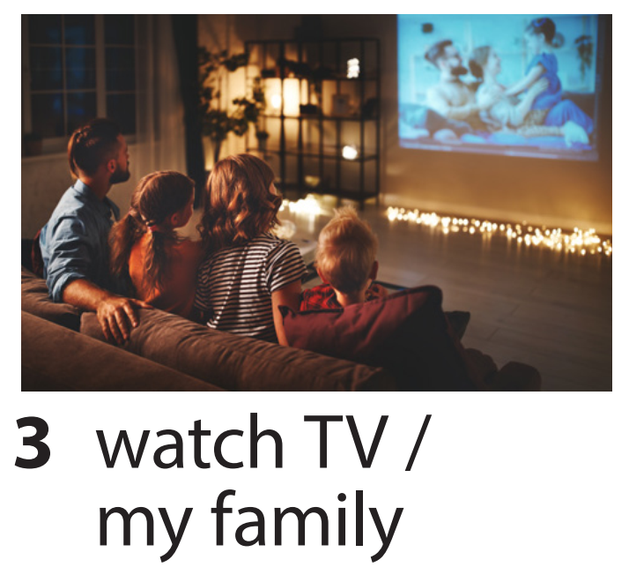
Who do you watch TV with?
I watch TV with my family.

Slide 17
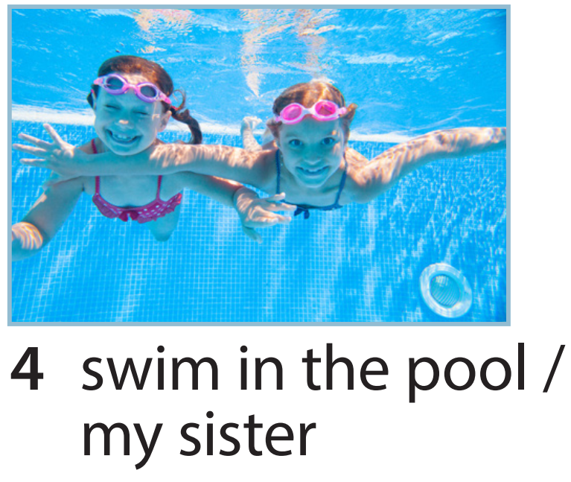
Who do you go swimming with?
I go swimming with my sister.

Slide 18
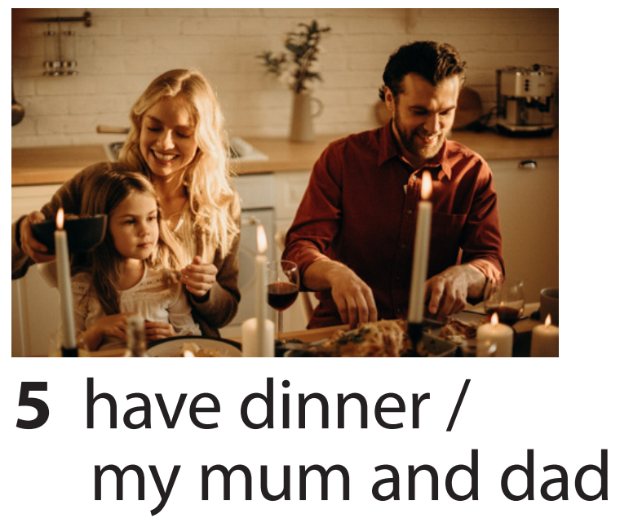
Who do you have dinner with?
I have dinner with my mum and dad.

Slide 19

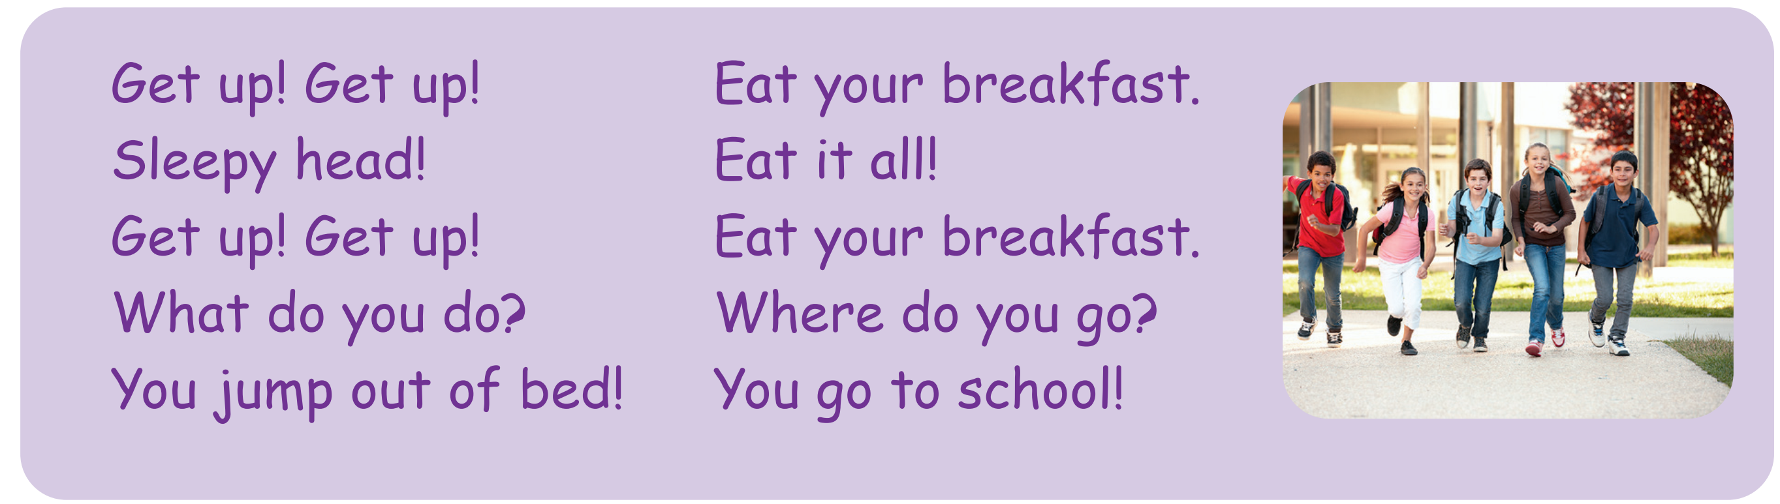

Task 6 Listen and sing.

Slide 20
4 Production

Slide 21

Ask and write
What do you do on Tuesdays?
I go to the park.
Who do you go to the park with?
I go to the park with my sister.
Name | What do you do on _____? | Who do you ______ with?
Mai
go to the park (Tuesdays)
sister

Slide 22
5 Assessment

Slide 23

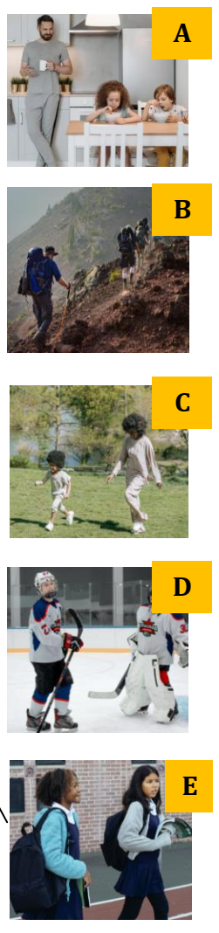
Look and match.
Who do you go to school with?
=> I go to school with my friends.
2. Who do they have breakfast with?
=> They have breakfast with their dad.
3. Who do you go to the park with?
=> I go to the park with my mum.
4. Who do you play hockey with?
=> I play hockey with my brother.
5. Who do you climb rocks with?
=> I climb rocks with my family.

Slide 24




Thank you & goodbye!

