Slide 1









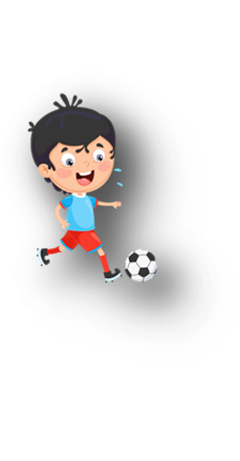












Unit 11
My day
Lesson 2 – Task 7,8,9

Slide 2






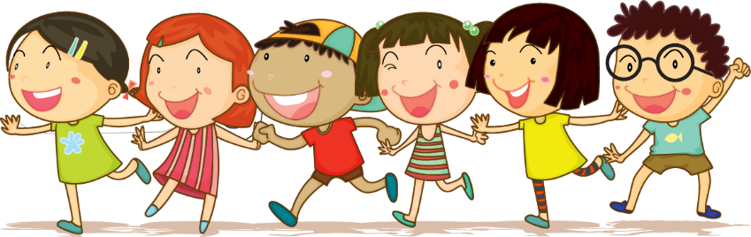



1 Warm up

Slide 3

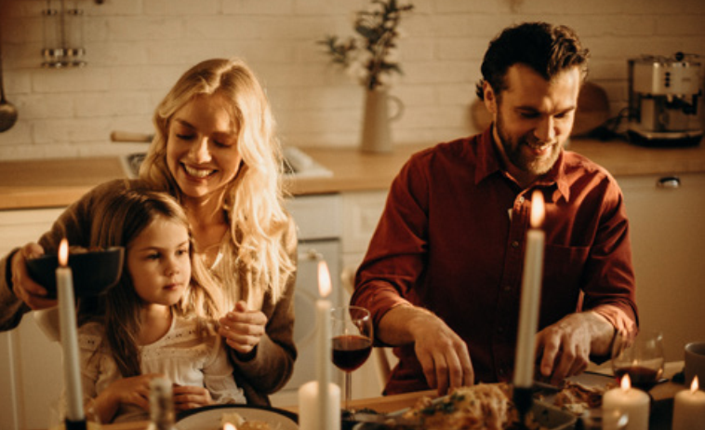
Rearrange the words/ phrases.
h | e | v | a |  | d | i | n | e | r | n
have dinner

Slide 4
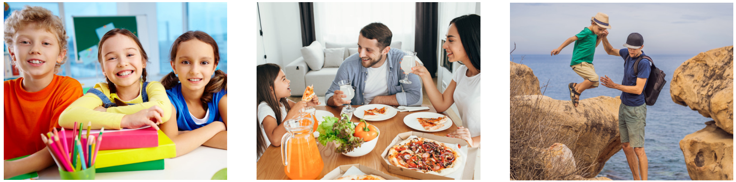
c | l | i | b | m |  | t | h | e |  | r | c | o | k
climb the rock

Slide 5
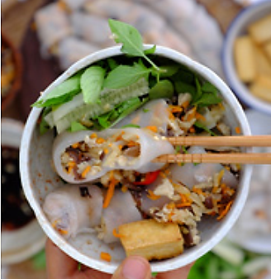
h | e | v | a |  | b | r | e | f | a | s | t | k
have breakfast

Slide 6

g | o |  | o | t |  | s | c | o | o | h | l
go to school

Slide 7
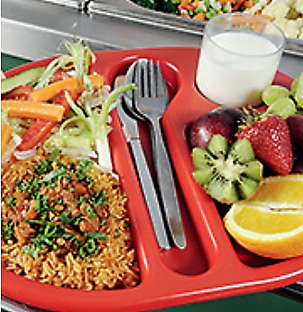
h | e | v | a |  | l | u | c | h | n
have lunch

Slide 8
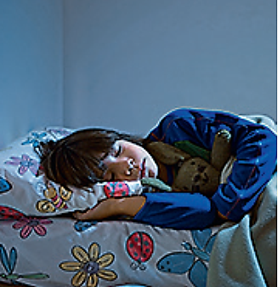
g | o |  | o | t |  | d | e | b
go to bed

Slide 9
2 Practice listening

Slide 10

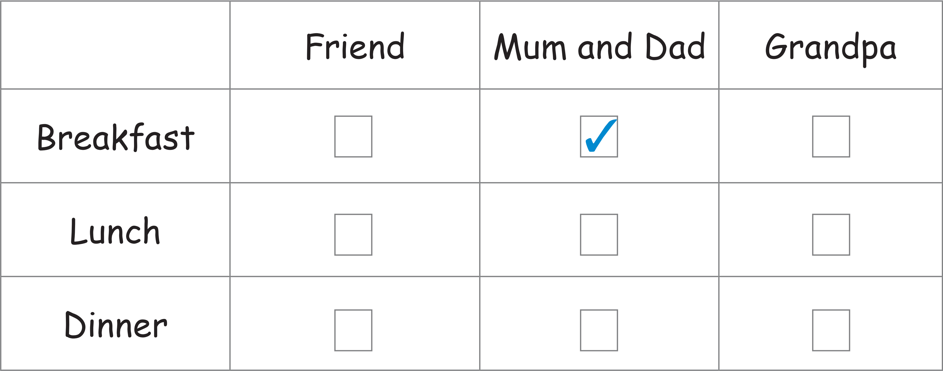
Task 7 Listen and tick.
✓
✓

Slide 11
3 Practice speaking

Slide 12
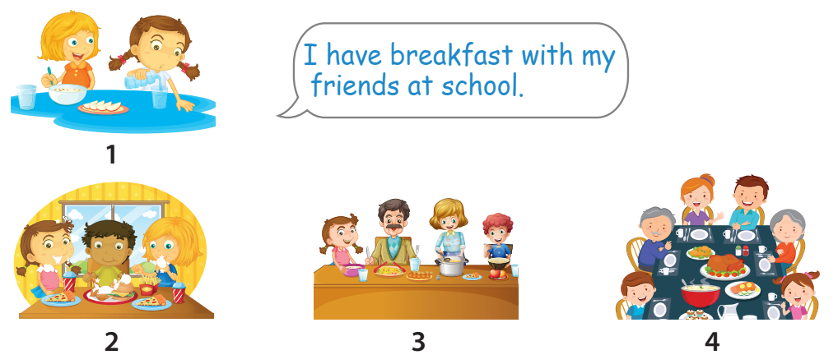
Task 8 Look and say.

Slide 13
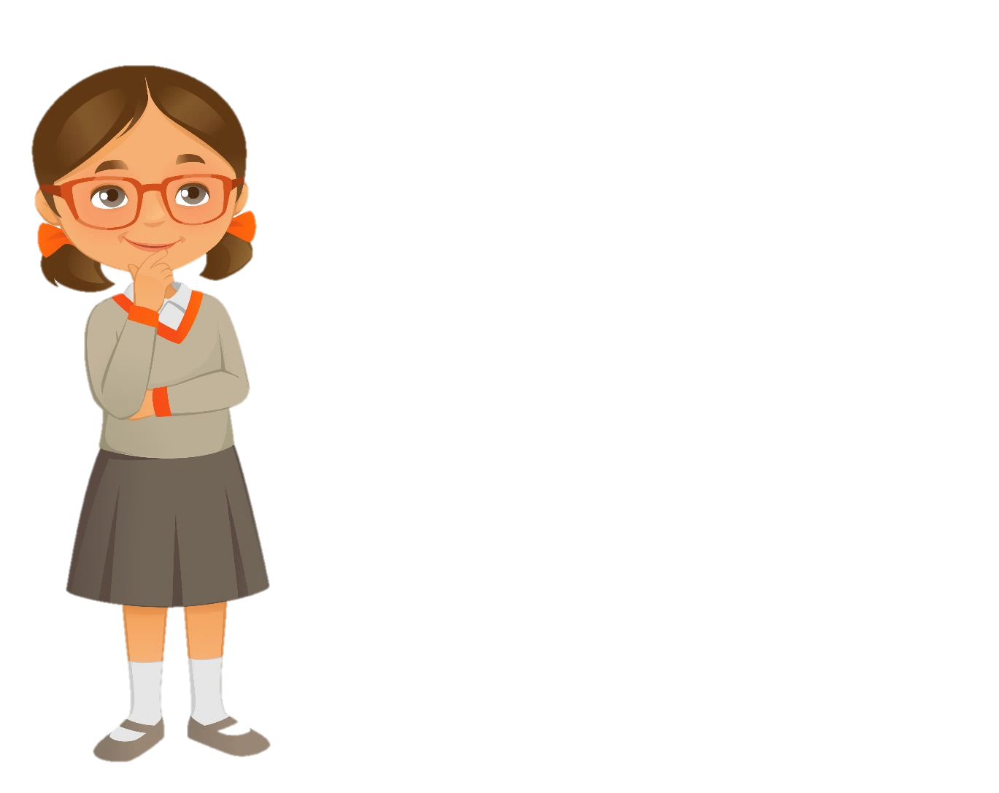
Quick check
Find mistakes in these sentences

Slide 14
1 Which do you play badminton with?
I play badminton with my dad.
-> Who do you play badminton with?

Slide 15
2 Who does you have lunch with?
I have lunch with my friends at school.
-> Who do you have lunch with?

Slide 16
3 Who do you plays games with on Sundays?
I play games with my brother.
-> Who do you play games with on Sundays?

Slide 17
4 Who you run with in the park?
I run with my friends.
-> Who do you run with in the park?

Slide 18
5 Who do you have dinner?
I have dinner with my family.
-> Who do you have dinner with?

Slide 19
4 Practice writing

Slide 20
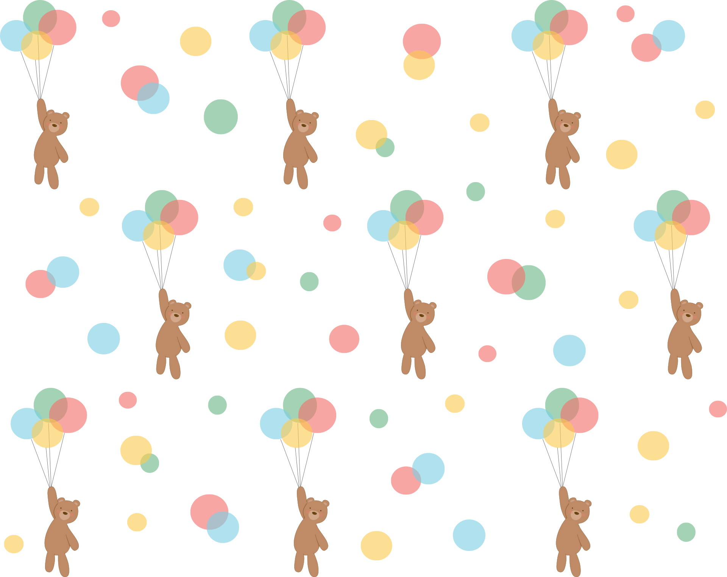
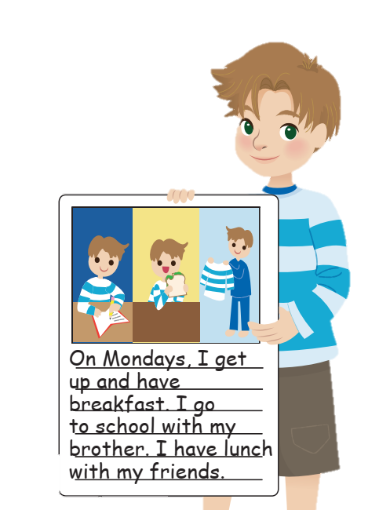
Task 9 Draw and write. Talk!

Slide 21

Task 9 Draw and write. Talk!
I get up, have breakfast, go to school and have lunch.
I go to school with
my brother.
I have lunch with
my friends.
What do you do on Mondays?
Who do you go to school with?
Who do you have lunch with on Mondays?

Slide 22
5 Assessment

Slide 23
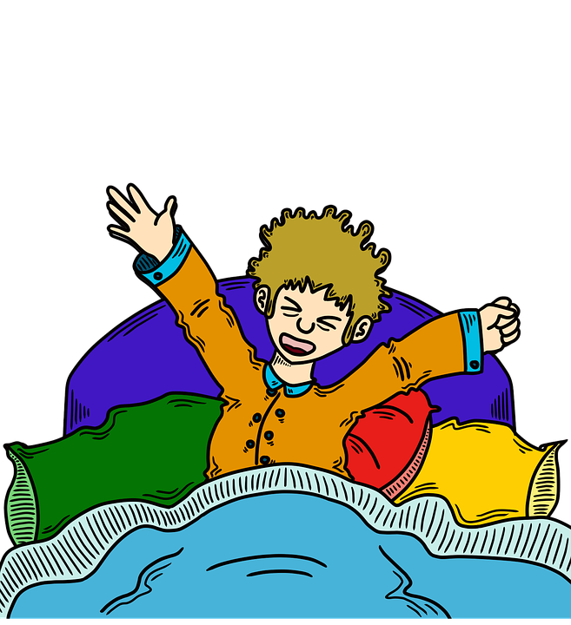

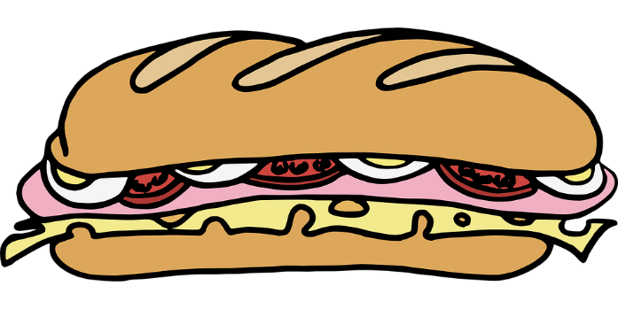
Look and write
go to school
get up
breakfast
have lunch
dance
In the morning, I _______ early, have _______ then ___________ with my sister.

Slide 24
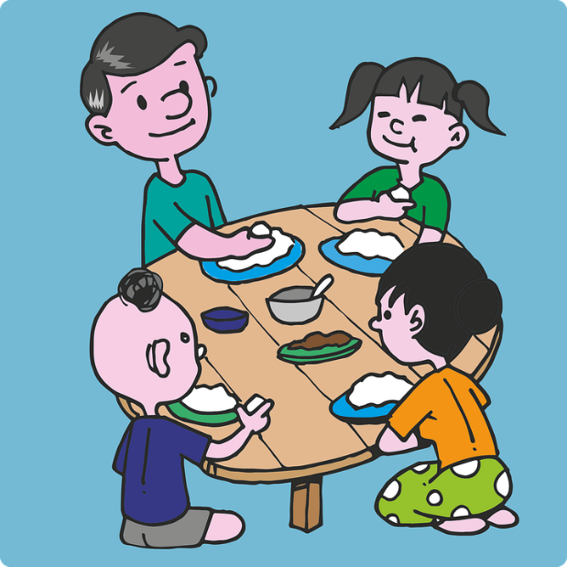
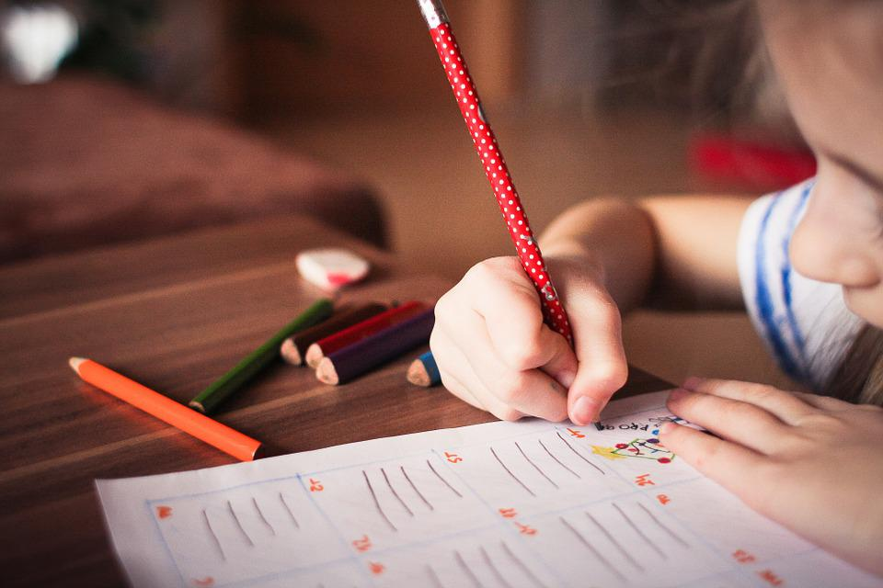
Look and write
do homework
get up
have breakfast
have dinner
play badminton
In the evening, I _________ with my family and _________.

Slide 25
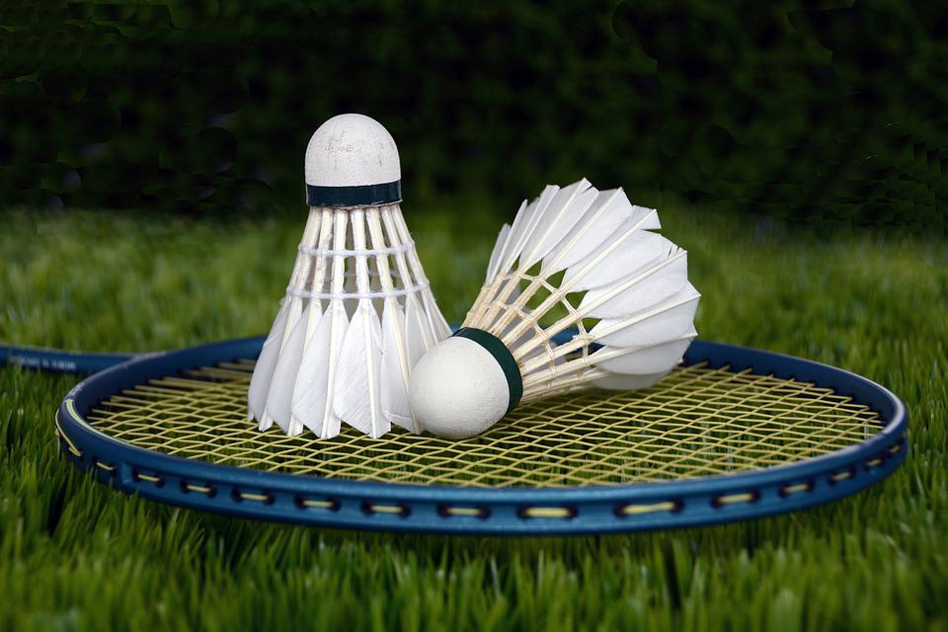
Look and write
go to bed
get up
breakfast
have lunch
play badminton
In the afternoon, I ___________ with my brother.

Slide 26




Thank you & goodbye!

