Slide 1









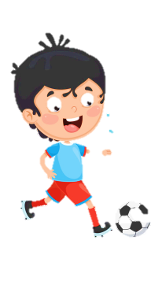
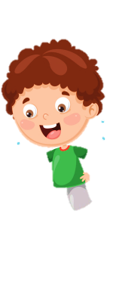
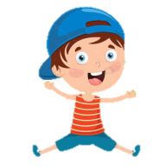
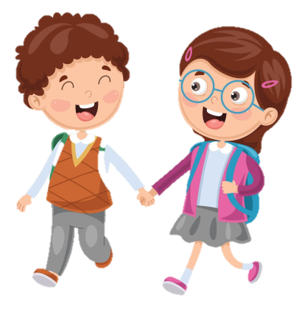
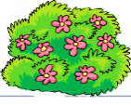



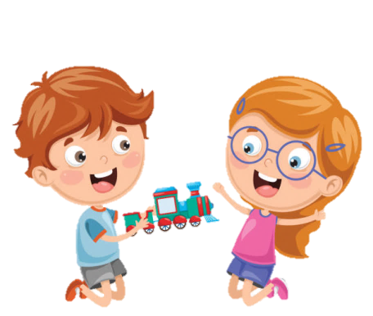




Notes:
Để nguyên trang bìa như này, chỉ thay đổi tên bài trong quá trình làm. Logo của sách Wonderful World

Slide 2
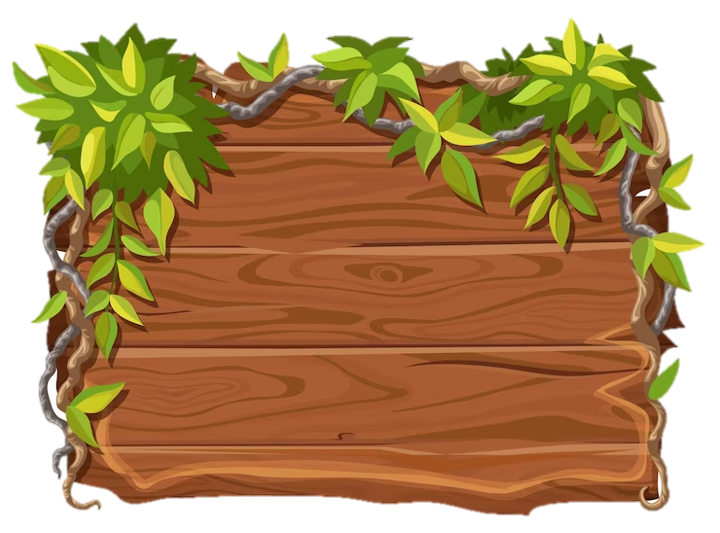
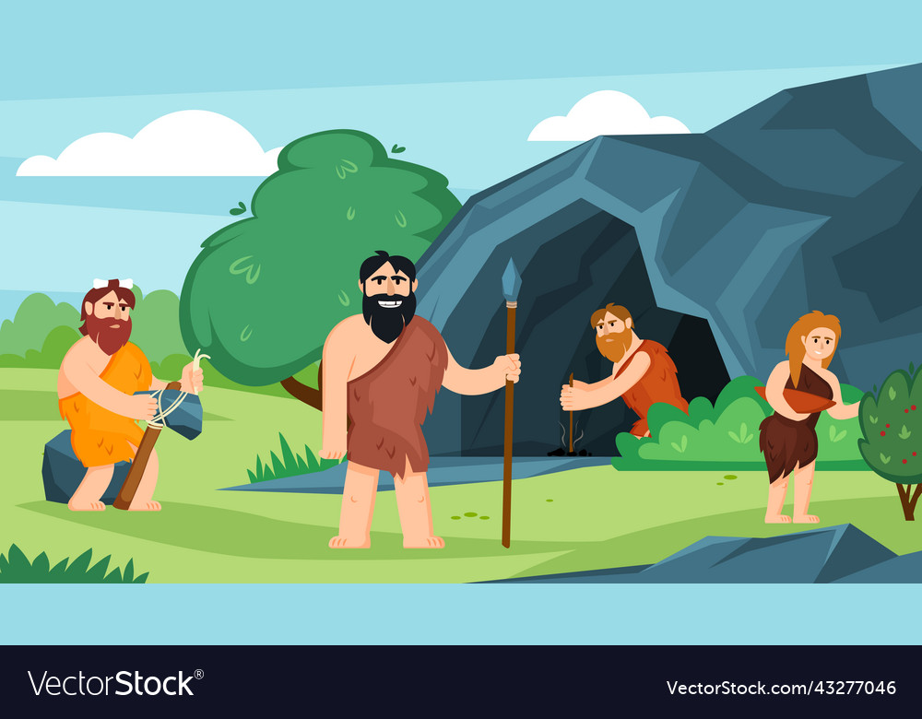
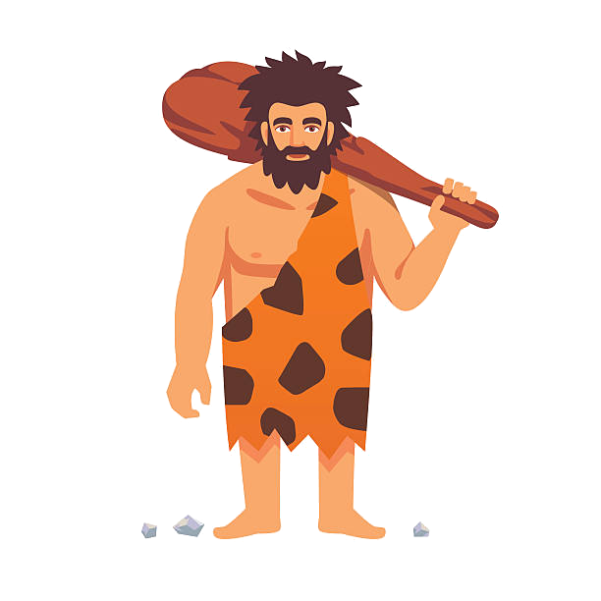
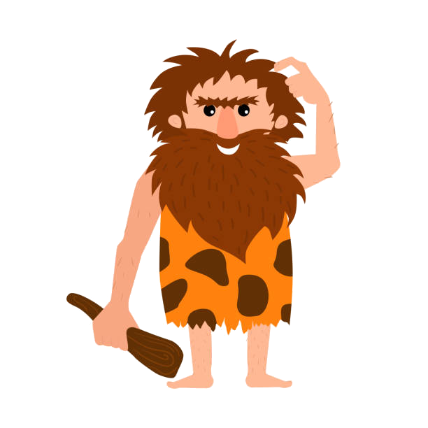
Unit 11: Before our time
Lesson 3
Task 4, 5, 6

Slide 3
1. Warm up
Cowboy game

Slide 4
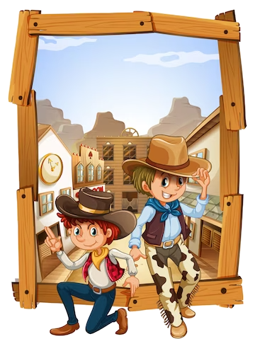
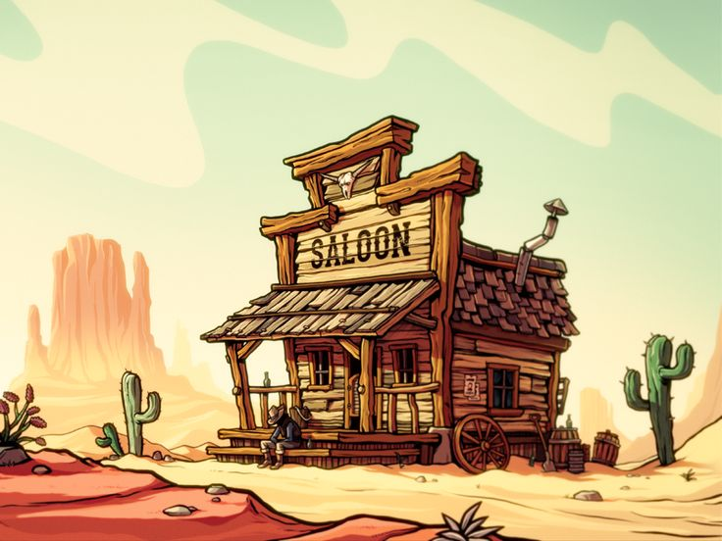
Cowboy game
Notes:
Cowboy game
Each turn will have two SS from each team. 2 SS stand, face their backs to each other. Each S will be given a picture.
When T counts 1,2,3, the two will turn back and look at the other’s picture and read that word aloud. Who read it correctly and faster will be the winner. –
The game will last for 7 rounds

Slide 5
2. PRESENTATION

Slide 6

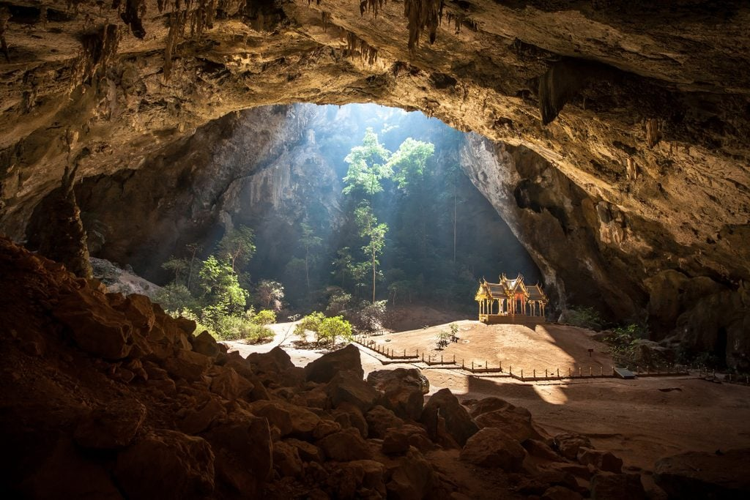
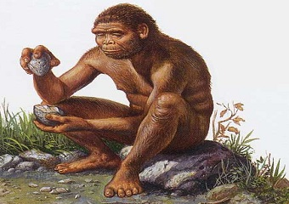
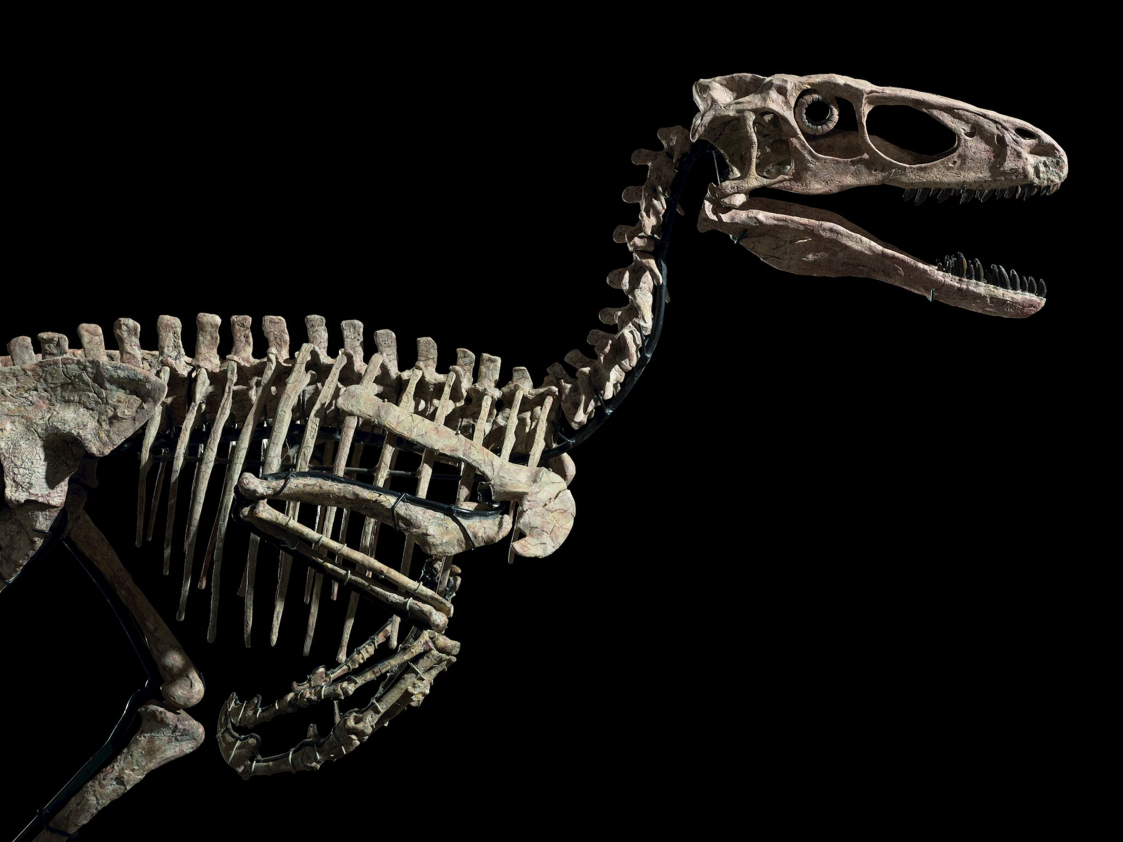
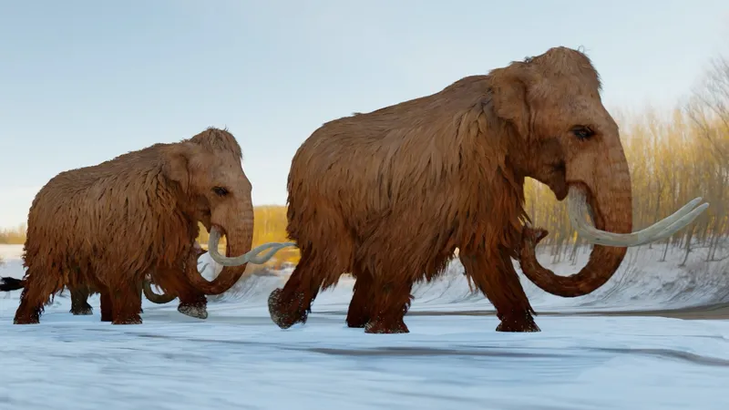
Listen and repeat.
Cave
Early people
Dinosaur bones
Mammoth
Notes:
Âm thanh bị quá nhỏ

Slide 7
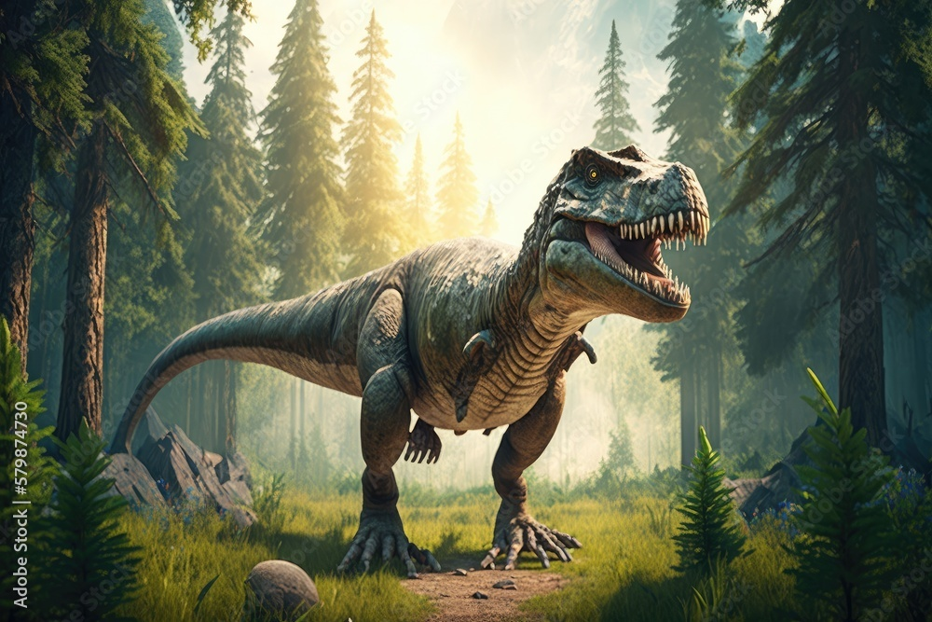
Look and listen.
The dinosaur wasn’t small.
The early people weren’t tall.
wasn’t = was not
weren‘t = were not
Notes:
Am thanh bị nhỏ

Slide 8
3. PRACTICE

Slide 9
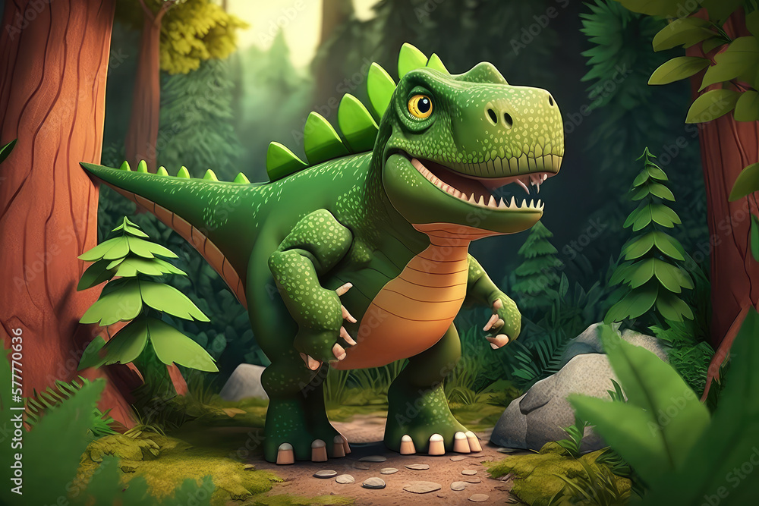
4. Listen and repeat. TR 11.11
1. The dinosaur wasn’t small.
2. Eαrly People weren’t tαll.

Slide 10
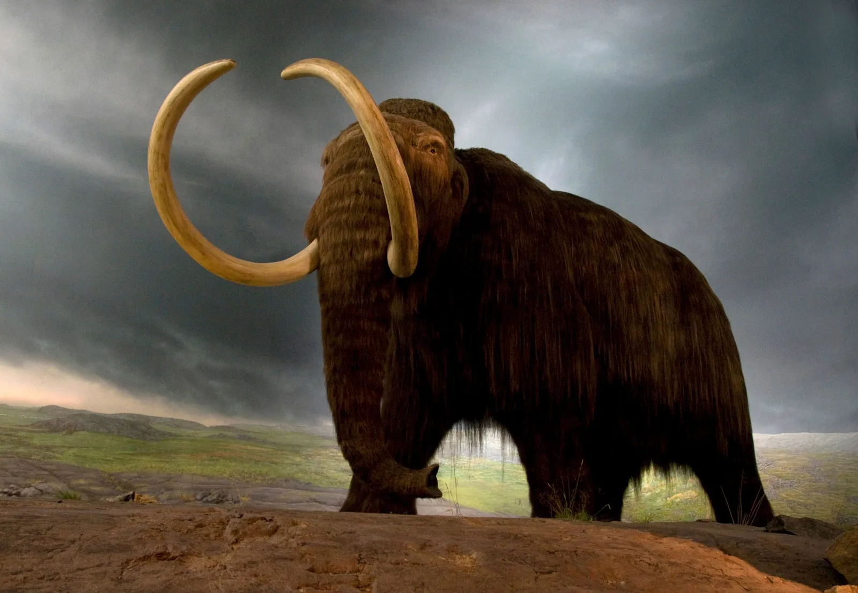
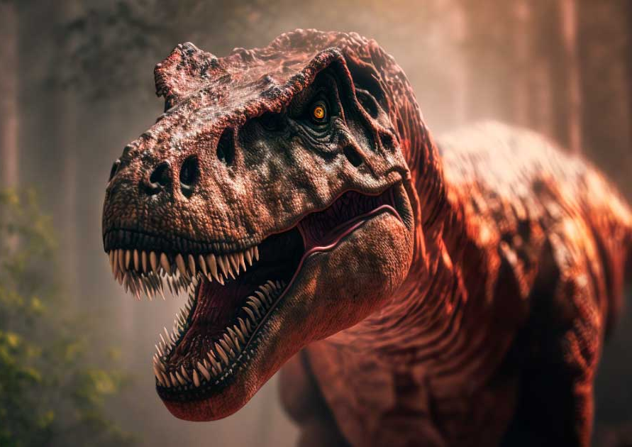
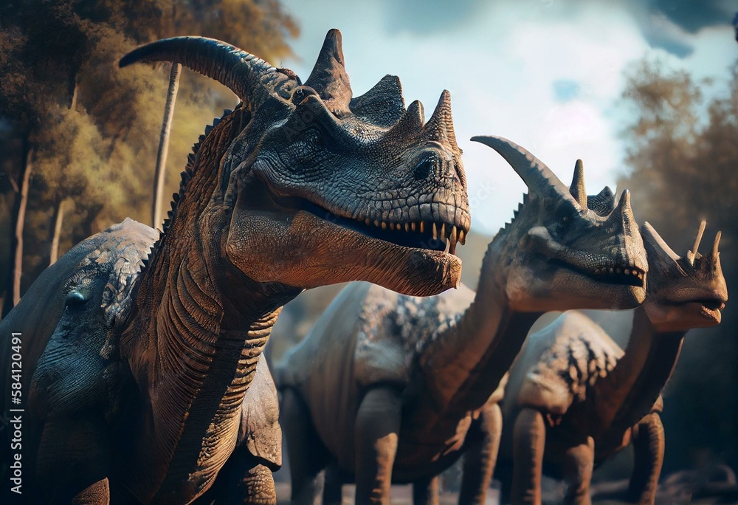
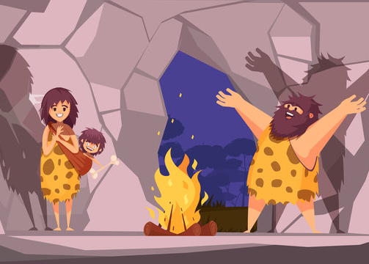
5. Look and say.
The T.rex wasn’t friendly.
Mammoths weren’t dinosaurs.
1. T.rex/ not/ friendly
2. mammoths/ not/ dinosaurs
Many dinosaurs were not small.
Early people were not tall.
3. Many dinosaurs/ not/ small
4. Early people/ not/ tall
Notes:
Cắt tách tranh ra thành 4 slide – tranh xuất hiện trc rồi cnu xuất hiện sau/

Slide 11
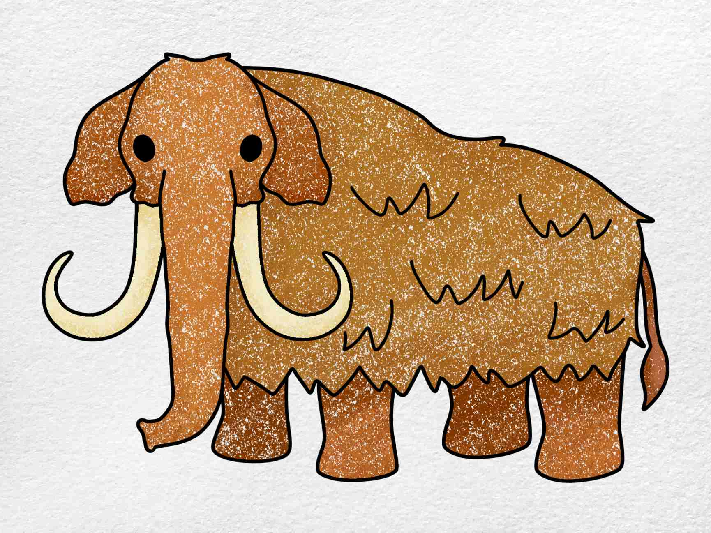
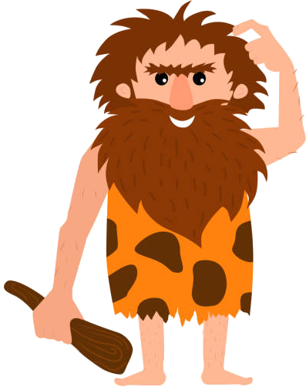
Before Drawing Look and fill in the missing words.
Look at the ____________. It wasn’t a _______ elephant.
It was ___________. It wasn’t ______

Slide 12
6. Draw and say.
Look at the mammoth. It wasn’t a big elephant.
It was friendly. It wasn’t scary.

Slide 13
4. PRODUCTION

Slide 14



Football game
Notes:
Football game
T divides the class into 2 groups.
Each group will choose a name and play rock, scissors, paper to decide which group goes first. The two groups will take turns to choose a letter answer the corresponding questions.
If the answer is correct, T will click on the ball to make it move. If not, the chance is given to the other team.
Which team can bring to ball to the goal, or closer to the goal, they will win.

Slide 15
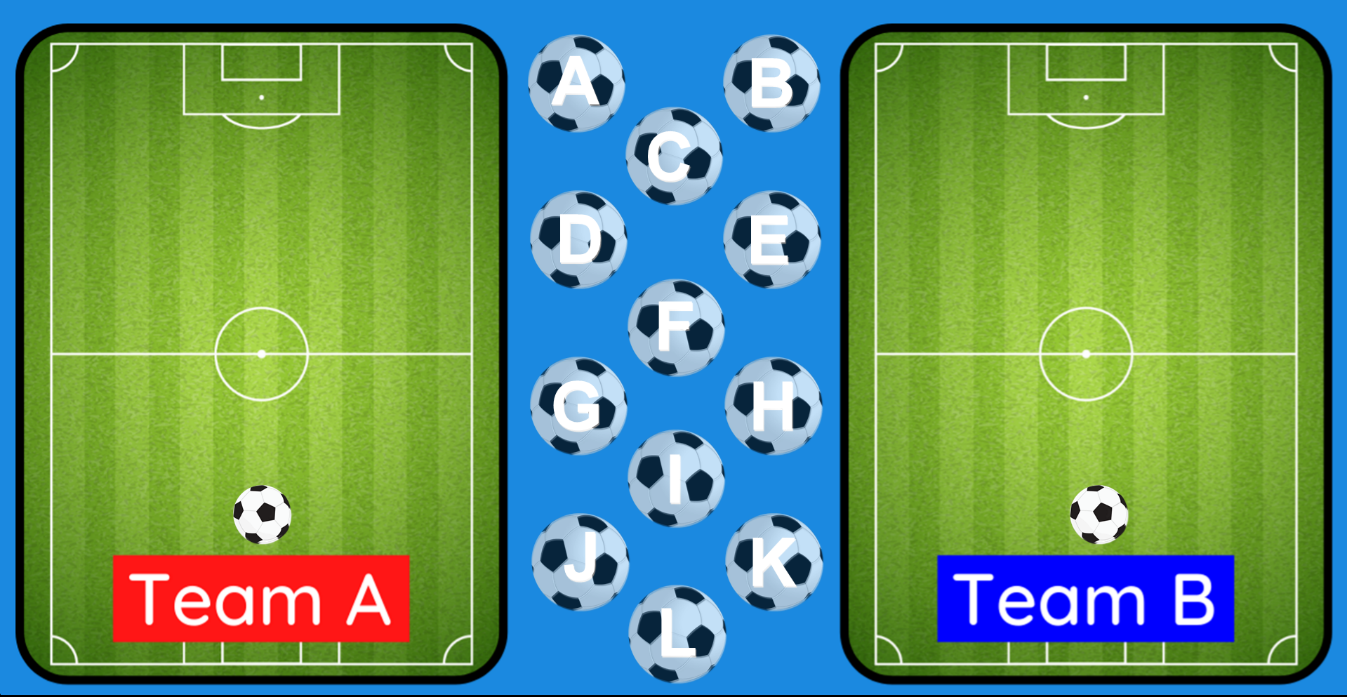
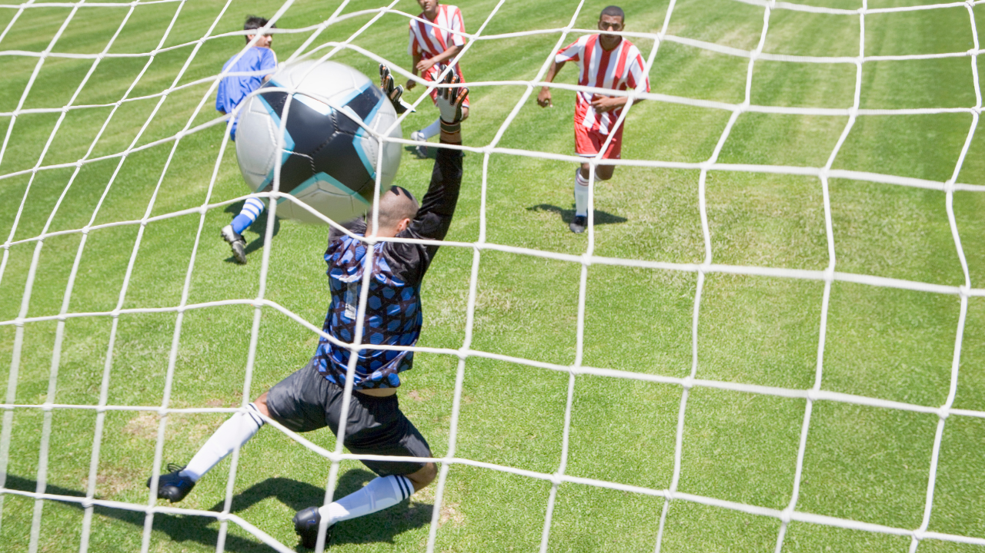
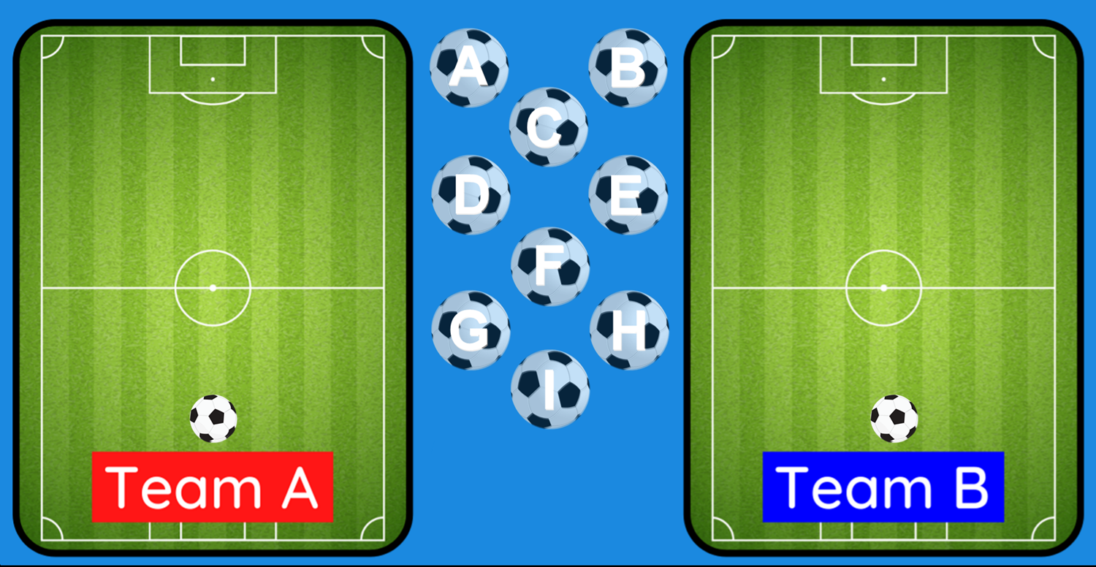


A
B
C
GOAL!!!!
GOAL!!!!
D
E
F
G
H
I
Notes:
T clicks on the ball to make it move

Slide 16
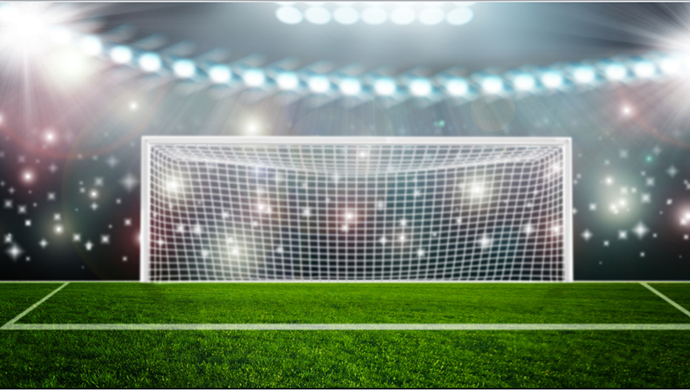

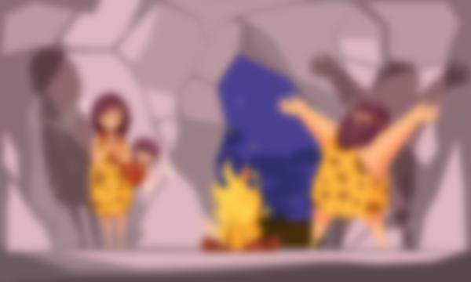
Can you guess what this is?
Early people

Slide 17
Use these words to make a sentence:
T.rex/ friendly
The T.rex was not friendly.

Slide 18
Unscramble the words:
not/ mammoths/ were/ The/ small
The mammoths were not small.

Slide 19
Listen. What can you hear?
The early people weren’t tall.

Slide 20
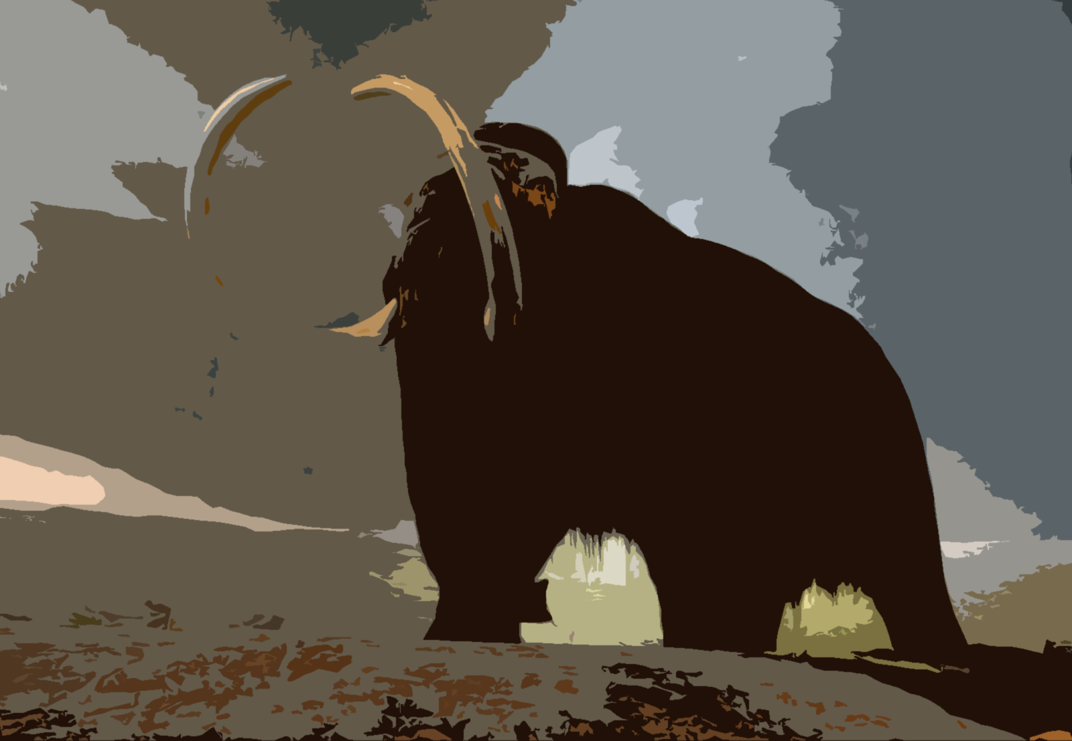
What is this?
A mammoth

Slide 21
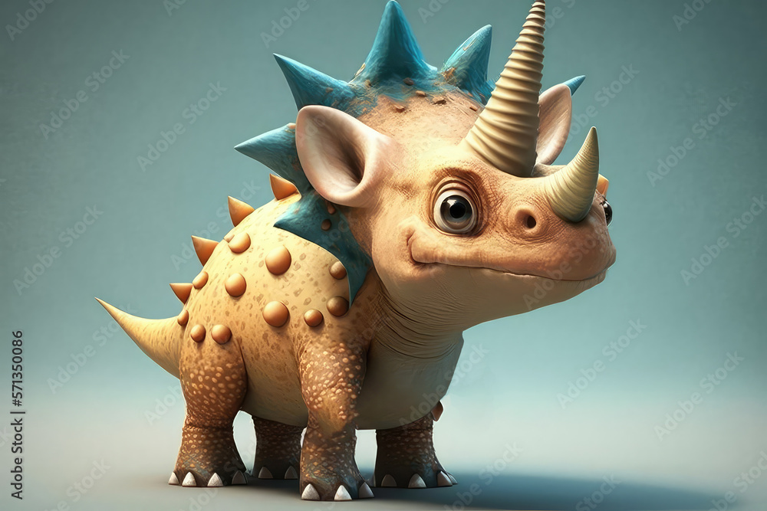
Fill in the blanks:
The dinosaurs ___ ___ friendly.
were not/ weren’t

Slide 22
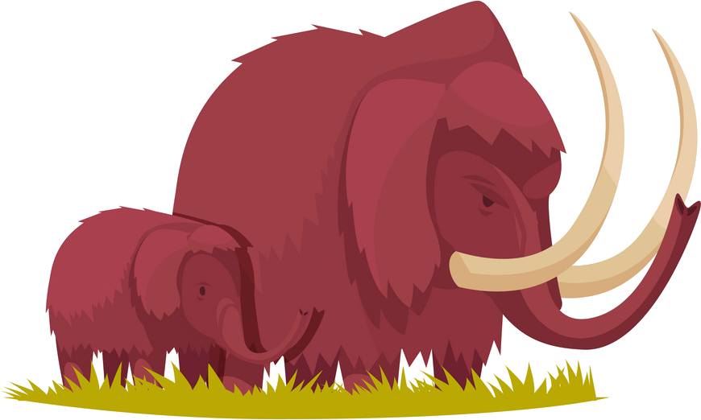
Make a sentence, using the words:
mammoths/not/ dinosaurs
Mammoths weren’t/ were not dinosaurs.

Slide 23
Make a sentence, using the words:
Many dinosaurs/ not/ small
Many dinosaurs were not small.

Slide 24
Listen. What can you hear?
Many dinosaurs were not small.

Slide 25
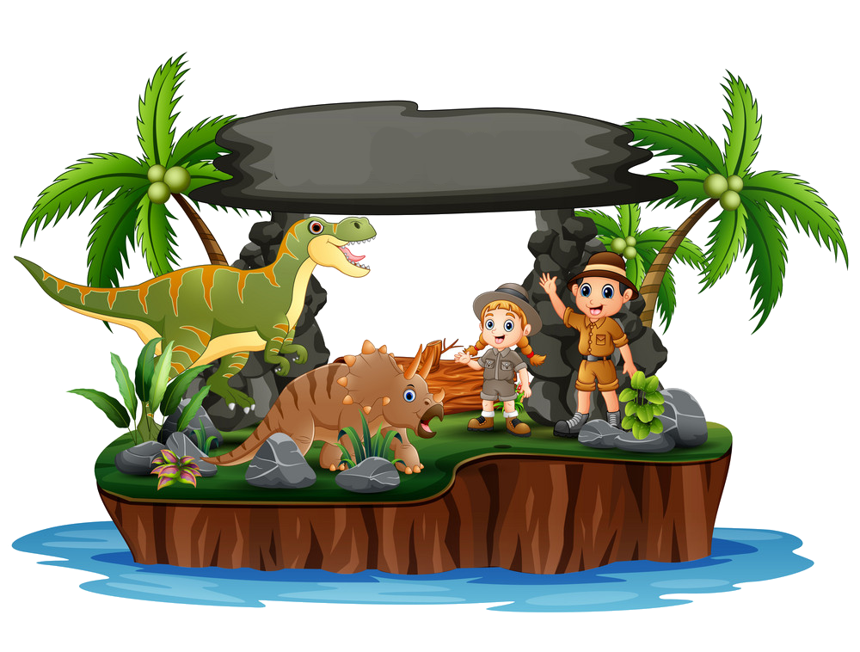
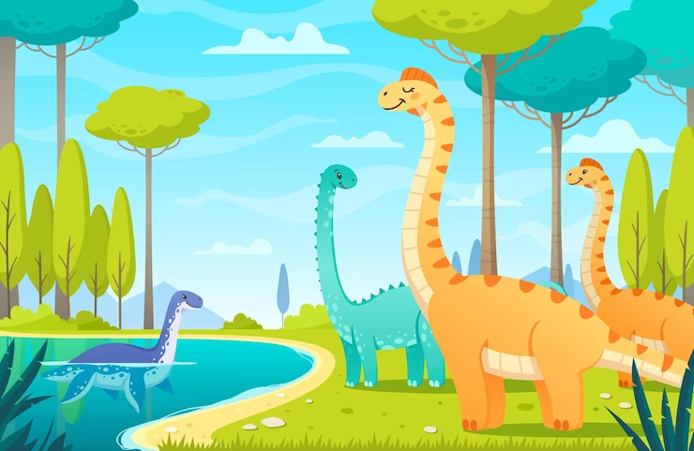
5. ASSESSMENT

Slide 26
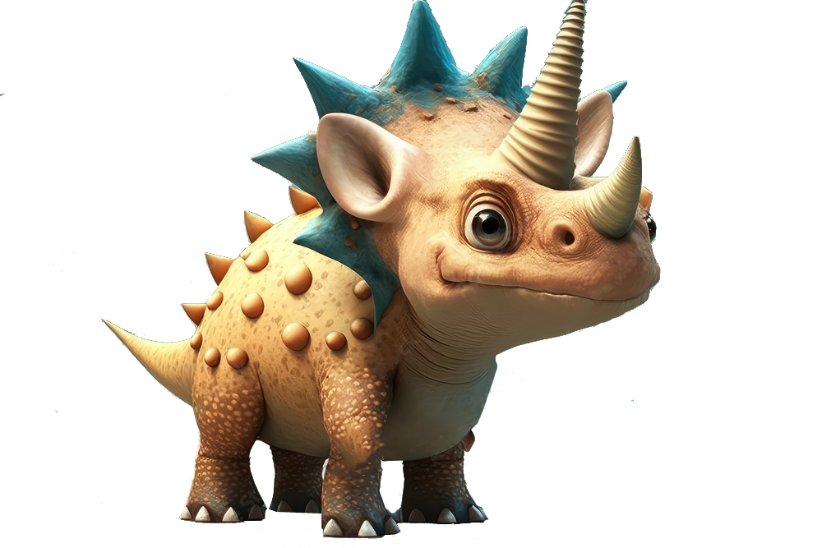
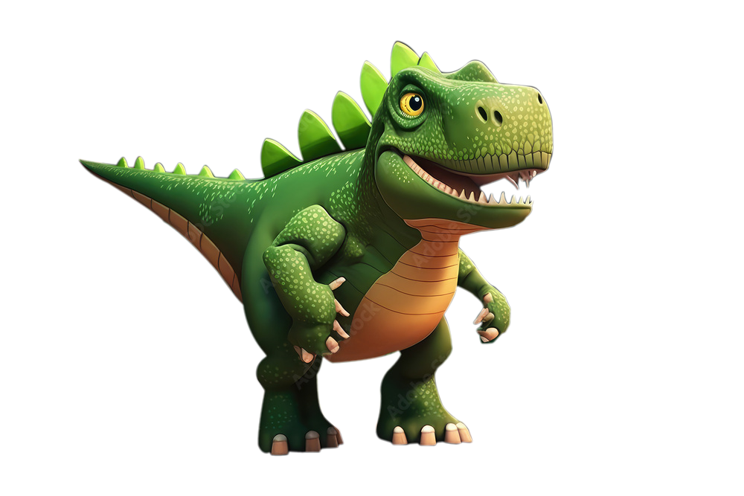
Write
cave dinosaur bones eαrly people mαmmoth
1. _________ weren’t tαll. They were small. They were in dark _____.
2. Some ___________ were really big.
3. Α _______ wαs α big elephant.
Early people
caves
dinosaur bones
mammoth

Slide 27
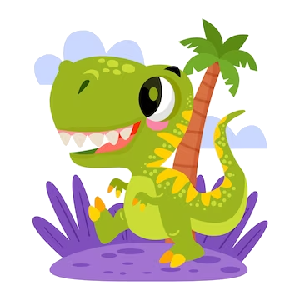
UNIT 11: BEFORE OUR TIME
LESSON 3: PERIOD 2
What we learnt today:
Review vocabulary:
- cave, early people, mammoth
dinosaur bones
Structure:
- The dinosaur wasn’t small.
- The early people weren’t tall.
- wasn’t = was not; weren’t = were not

Slide 28




Thank you & goodbye!

