Slide 1









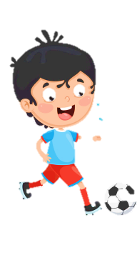
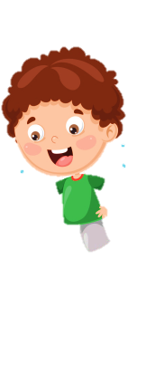










Notes:
Để nguyên trang bìa như này, chỉ thay đổi tên bài trong quá trình làm. Logo của sách Wonderful World

Slide 2
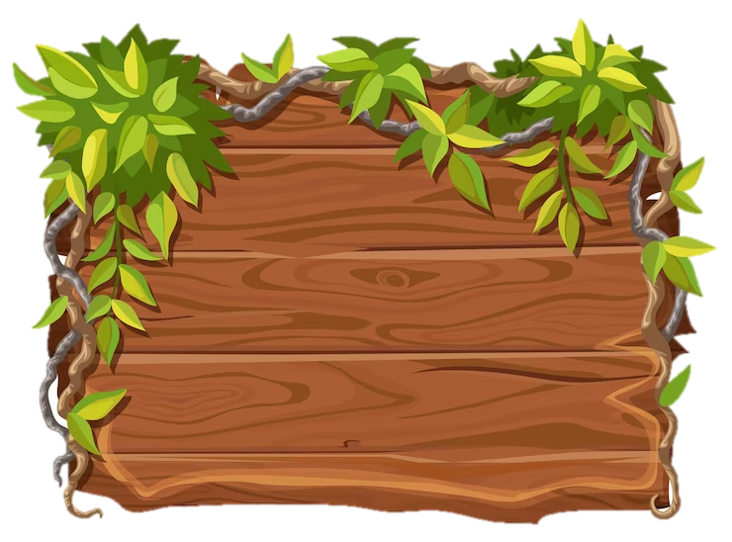
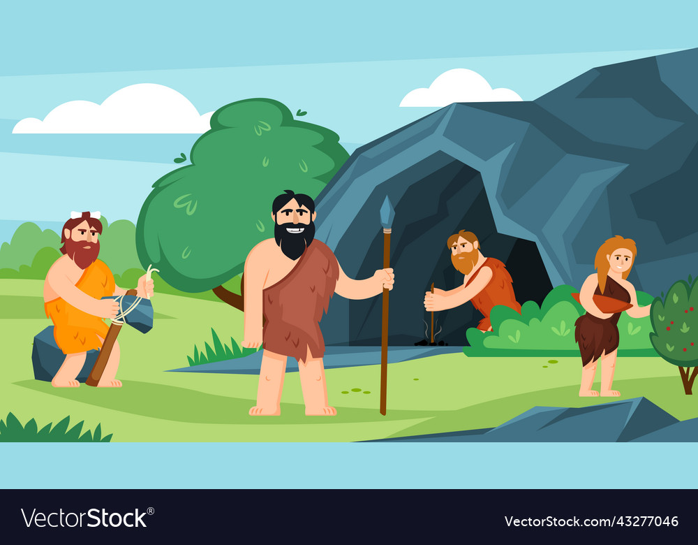
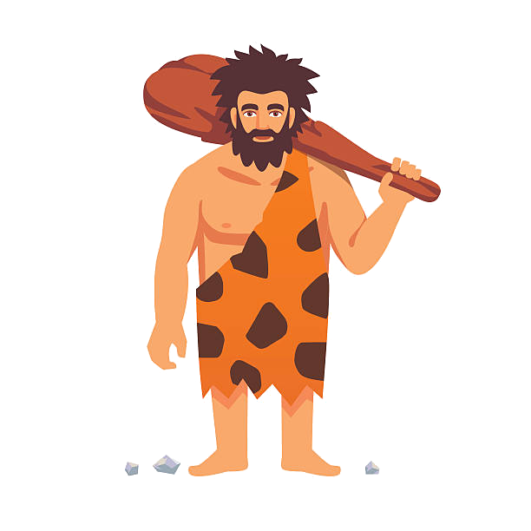
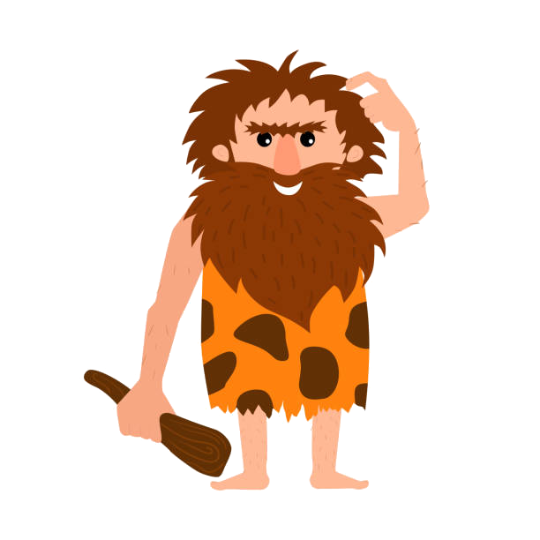
Unit 11
Lesson 3
Task 7, 8, 9

Slide 3
1. Warm up
Pass the bomb

Slide 4
2. PRESENTATION

Slide 5

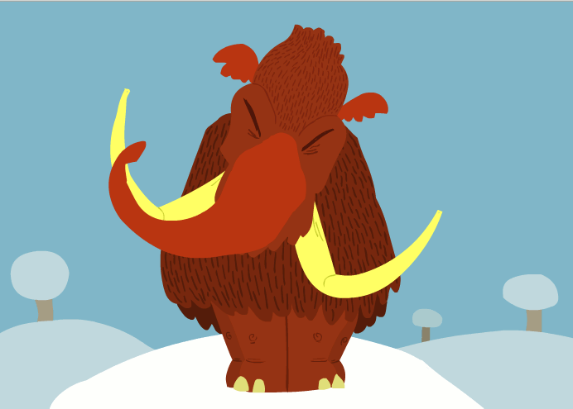
/ə/
mammoth

Slide 6

/ŋ/
strong

Slide 7
Let’s listen
/ə/
/ŋ/
Sounds
Words
mammoth
strong

Slide 8

7. Listen and repeat. TR 11.12
mammoth
strong
Mammoths were strong.

Slide 9
3. PRACTICE

Slide 10
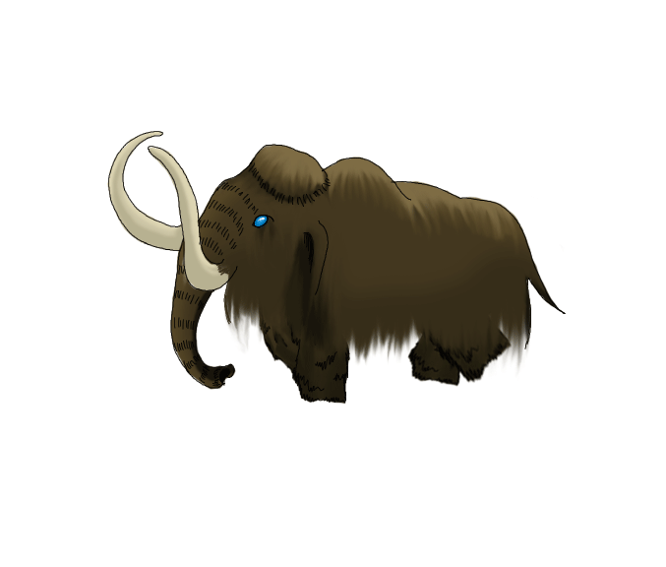
8. Listen and chant. TR 11.13
Mammoths, mammoths, mammoths!
Mammoths were big elephants.
Strong, strong, strong!
Mammoths were really strong.

Slide 11
4. PRODUCTION

Slide 12
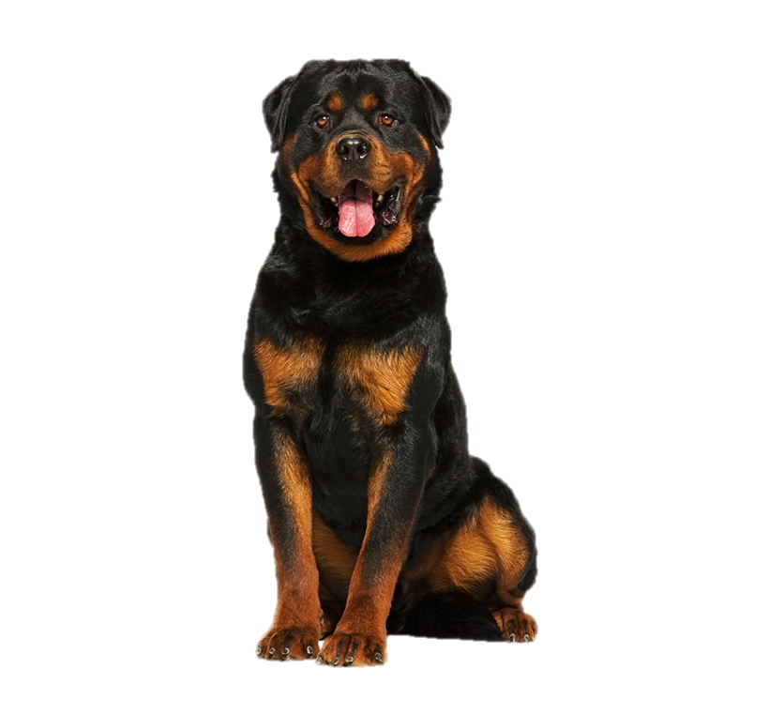
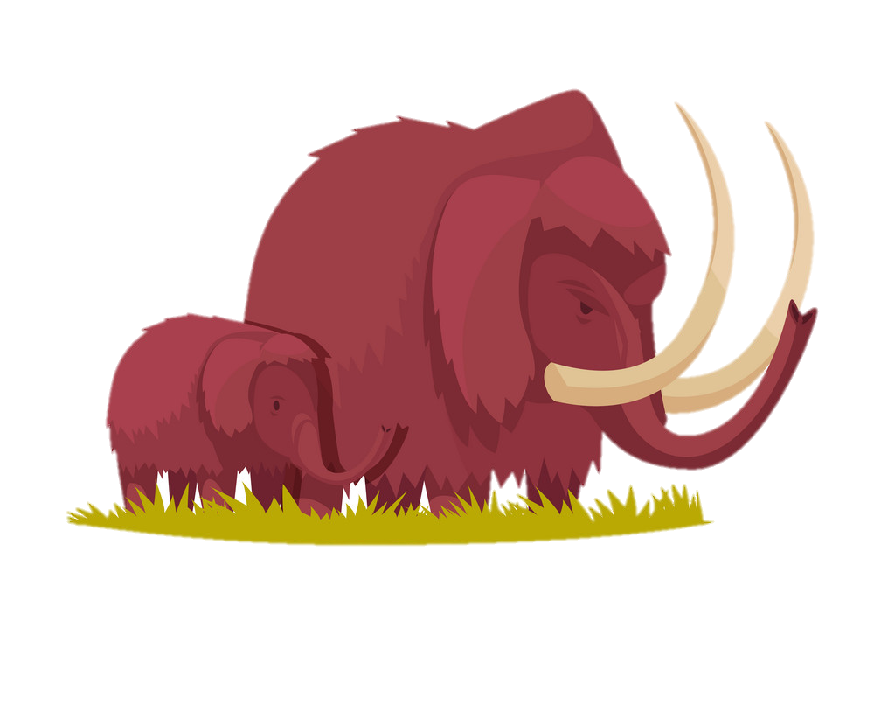
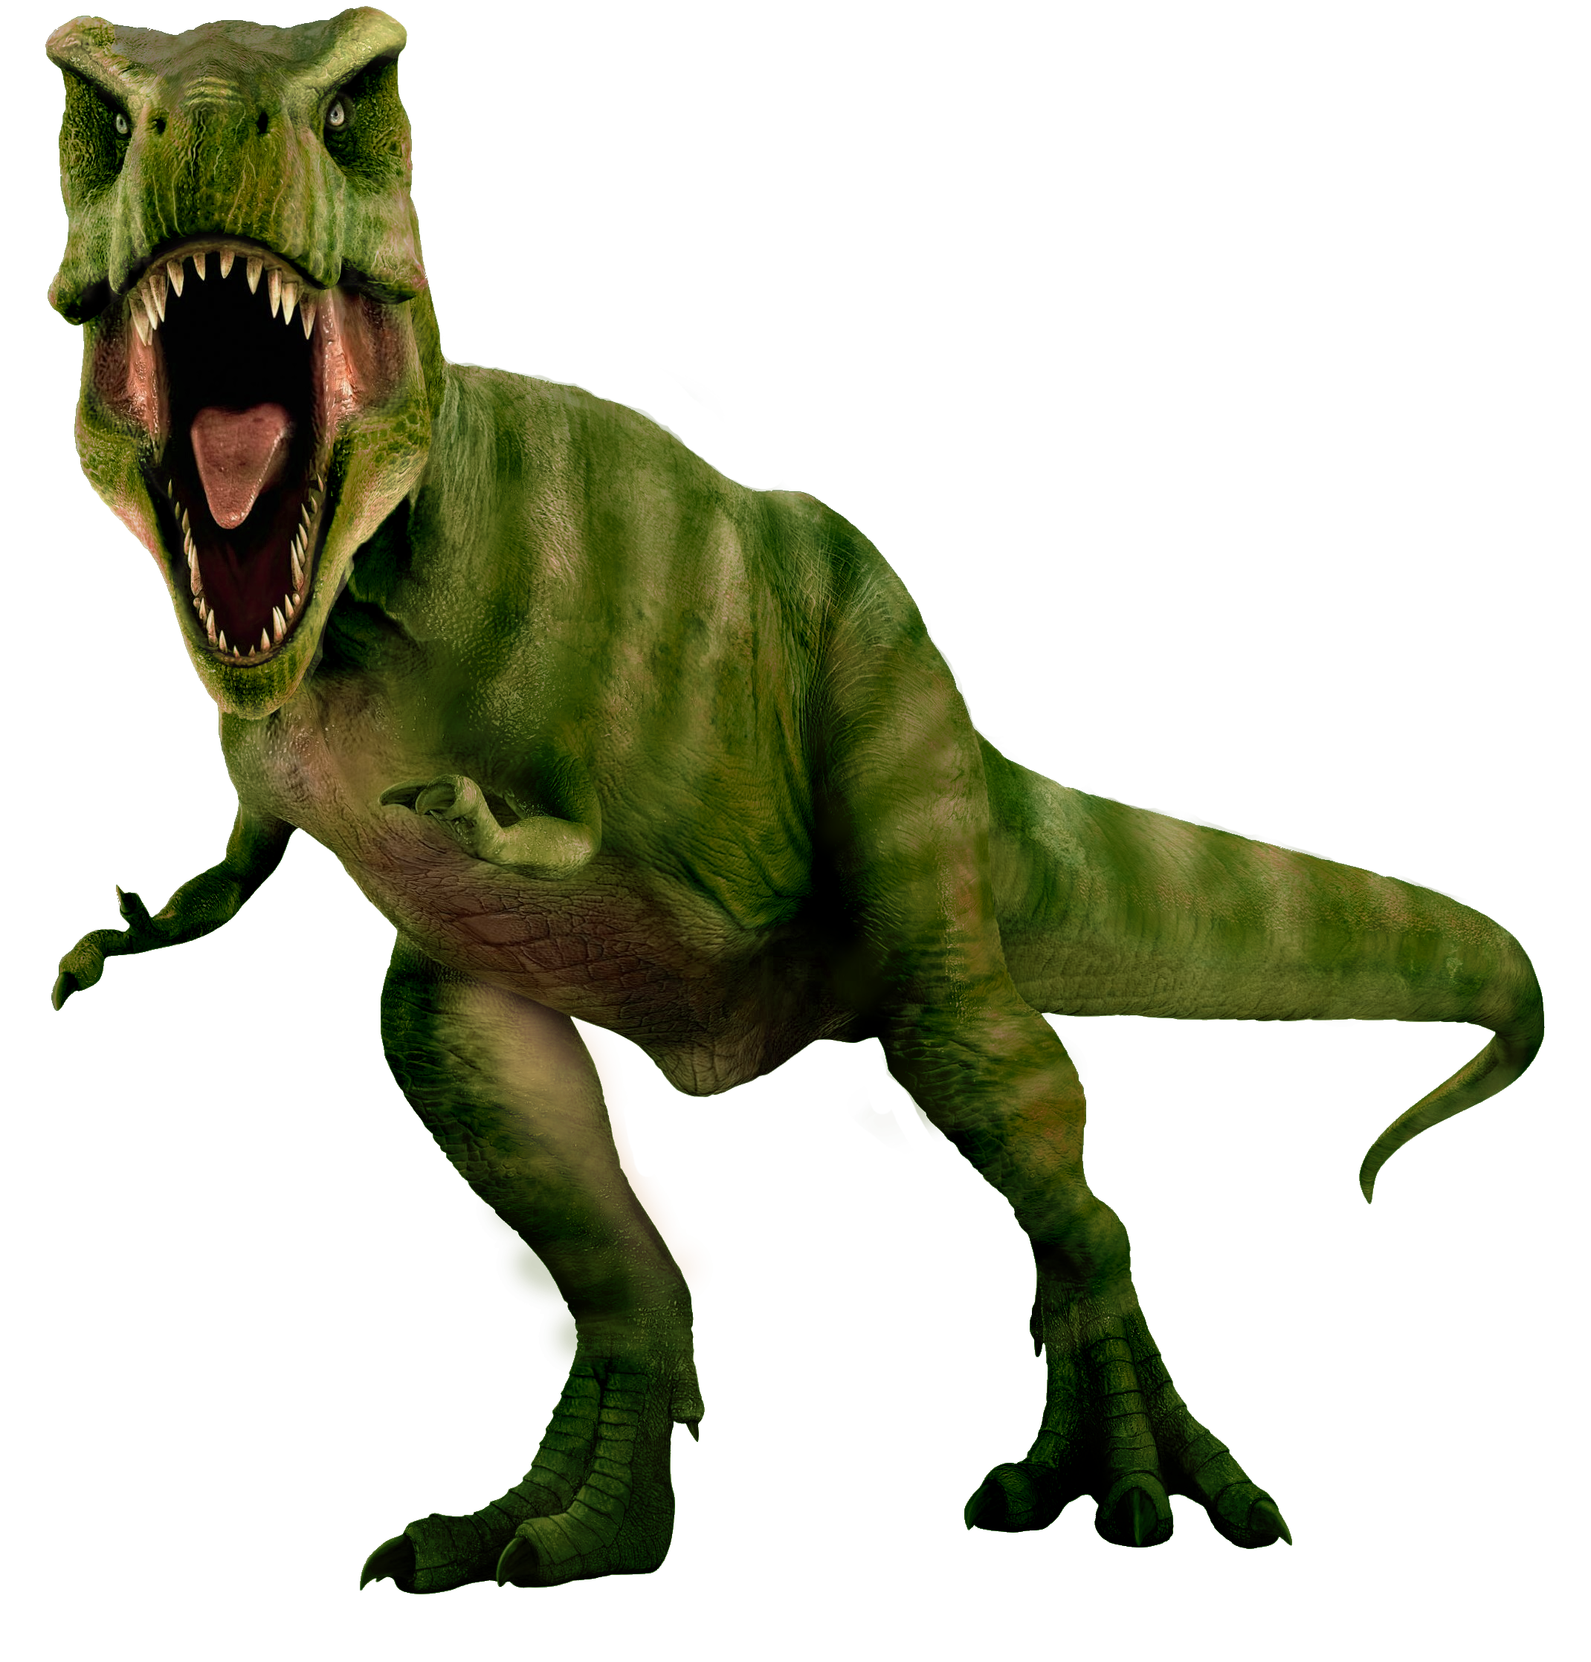
9. Say it!
My old dog was very strong and clever.
Early people were small but they were strong.
T.rex was a strong dinosaur.
Mammoths were strong.

Slide 13
Who's Who Game
Notes:
Who’s who game
T divides the class into 2 groups. Each group will choose a name and play rock, scissors, paper to decide which group goes first.
The two groups will take turns to answer the questions.
If the answer is correct, they will get the score. If not, the chance is given to the other team.
When the game finishes, the group with higher score will win.

Slide 14
Game 1
Fact Match-Up Game
Can you guess who we are?
Play now!

Slide 15
Game 2
Sentences about Animals
We’ll give you a text and you must fill in the blanks with appropriate words.
Play now!

Slide 16
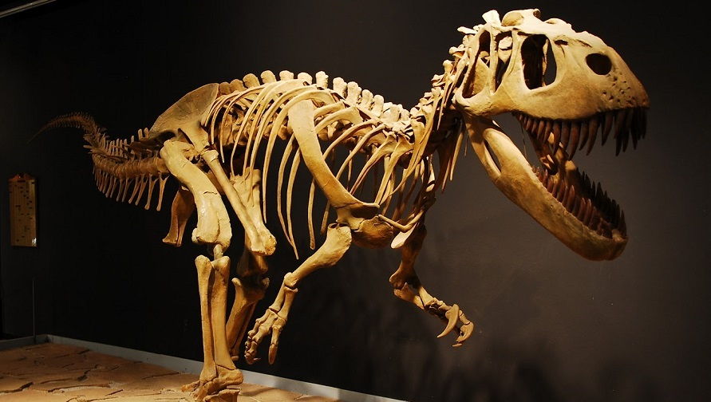
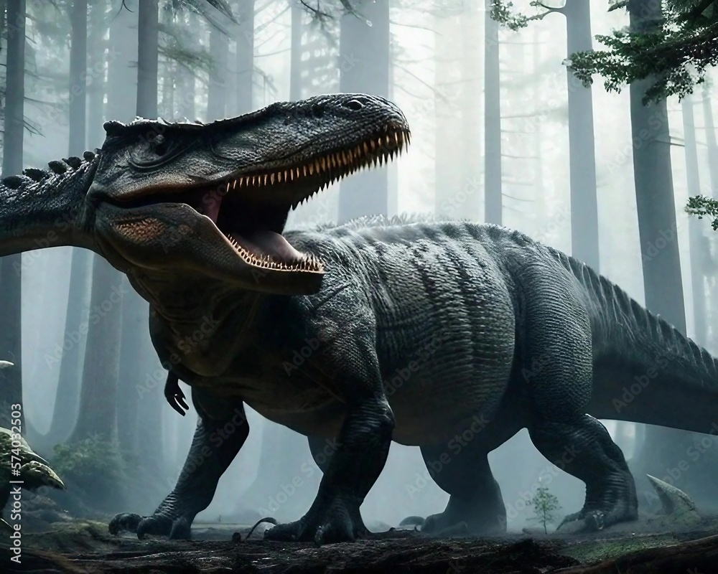
T.Rex was a .
It was a carnivore with a massive skull balanced by a , tail. It looked very . To know how big they were, you can visit some museums to see the .
scary
long
dinosaur
dinosaur bones
heavy
See the right answers

Slide 17
T.Rex was a . It was a carnivore with a massive skull balanced by a ,
tail. It looked very . To know how big they were, you can visit some museums to see the .
dinosaur
long
heavy
scary
dinosaur bones
Great job!

Slide 18
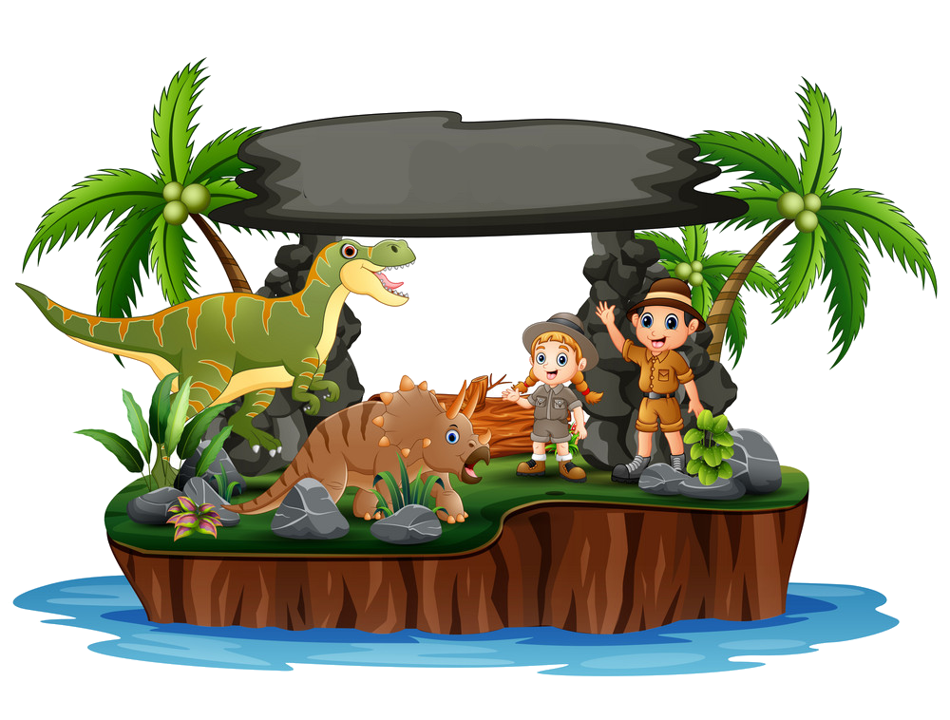
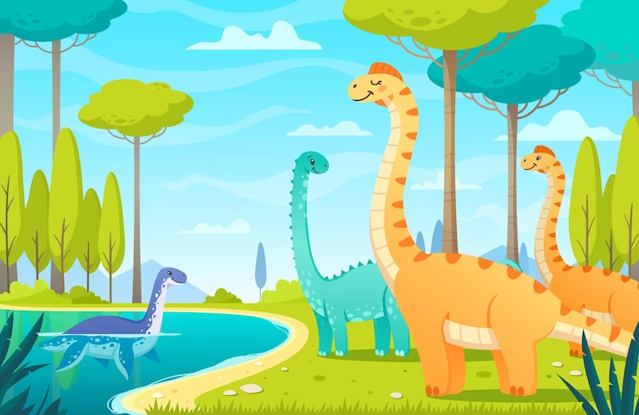
5. ASSESSMENT

Slide 19
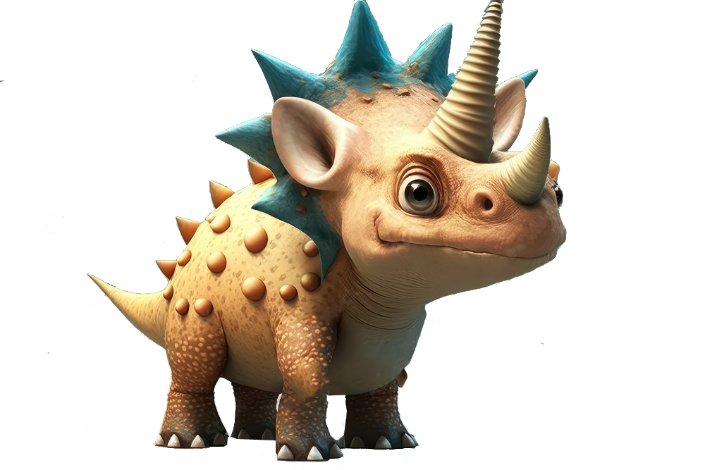
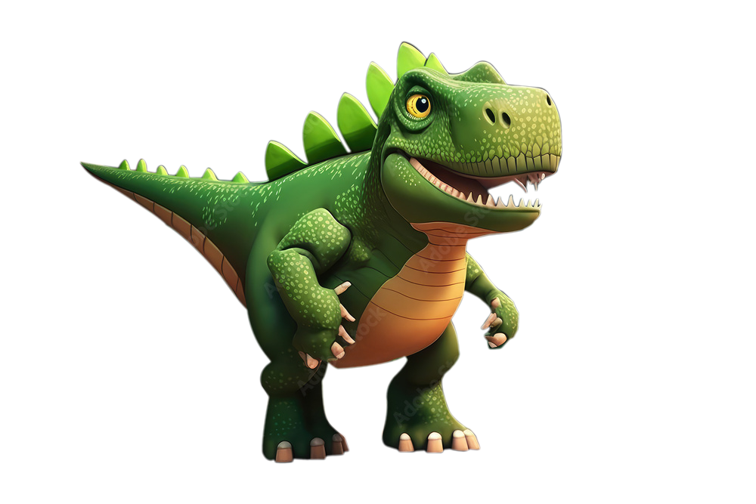
Write and say
1. dark caves/ Eαrly people/ in/ were
___________________________________________
2. not/ were/ tall/ Eαrly people/ but/ strong/ were/ they
___________________________________________
3. huge/ dinosaurs/ Some/ were/ reαlly
___________________________________________
4. big/ strong/ and/ Mammoths/ were
___________________________________________
5. Dinosaur bones/ long/ were/ and/ big
___________________________________________
Early people were in dark caves.
Early people were not tall but they were strong.
Some dinosaurs were really huge.
Mammoths were big and strong.
Dinosaur bones were big and long.

Slide 20
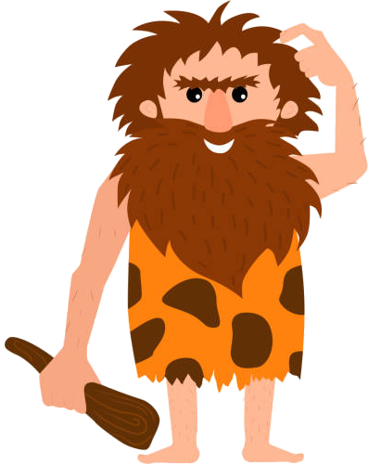
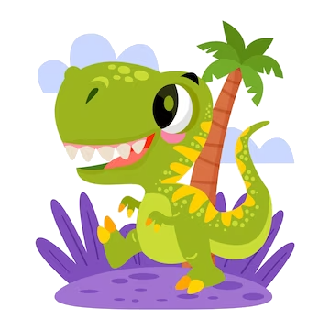
UNIT 11: BEFORE OUR TIME
LESSON 3: PERIOD 3
What we learnt today:
Review vocabulary:
- cave, early people,
dinosaur bones, mammoth
Review structure:
- The dinosaur wasn’t small.
- The early people weren’t tall.

Slide 21




Thank you & goodbye!

