Slide 1









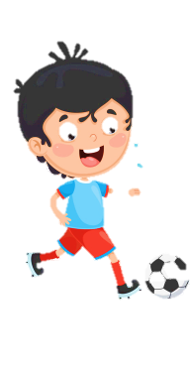
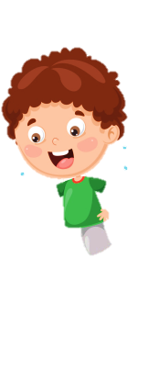
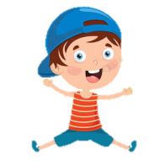
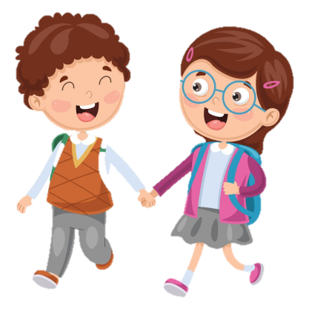
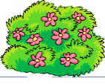


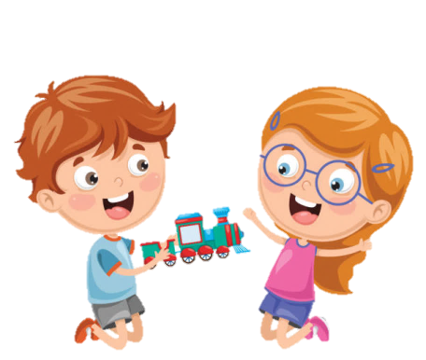
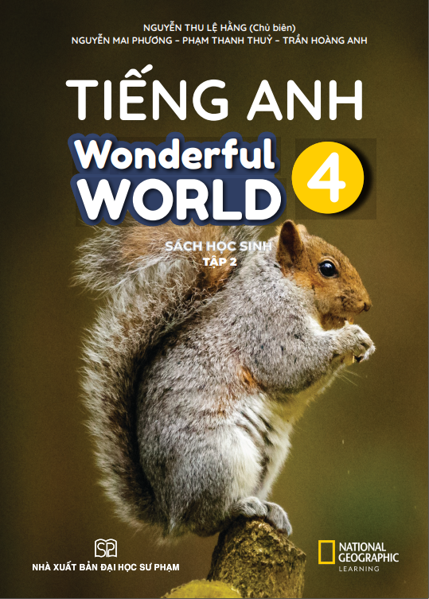




Notes:
Để nguyên trang bìa như này, chỉ thay đổi tên bài trong quá trình làm. Logo của sách Wonderful World

Slide 2
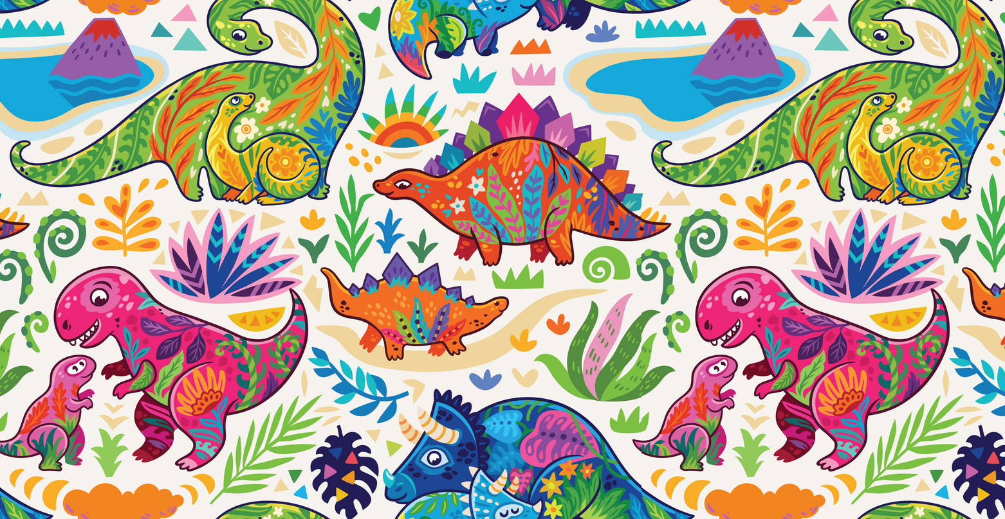
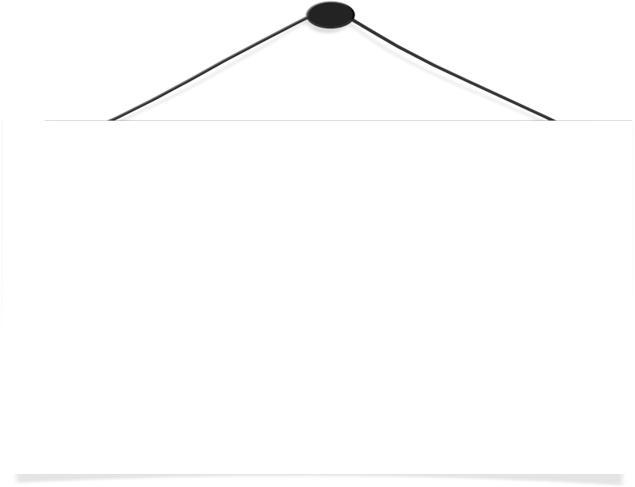
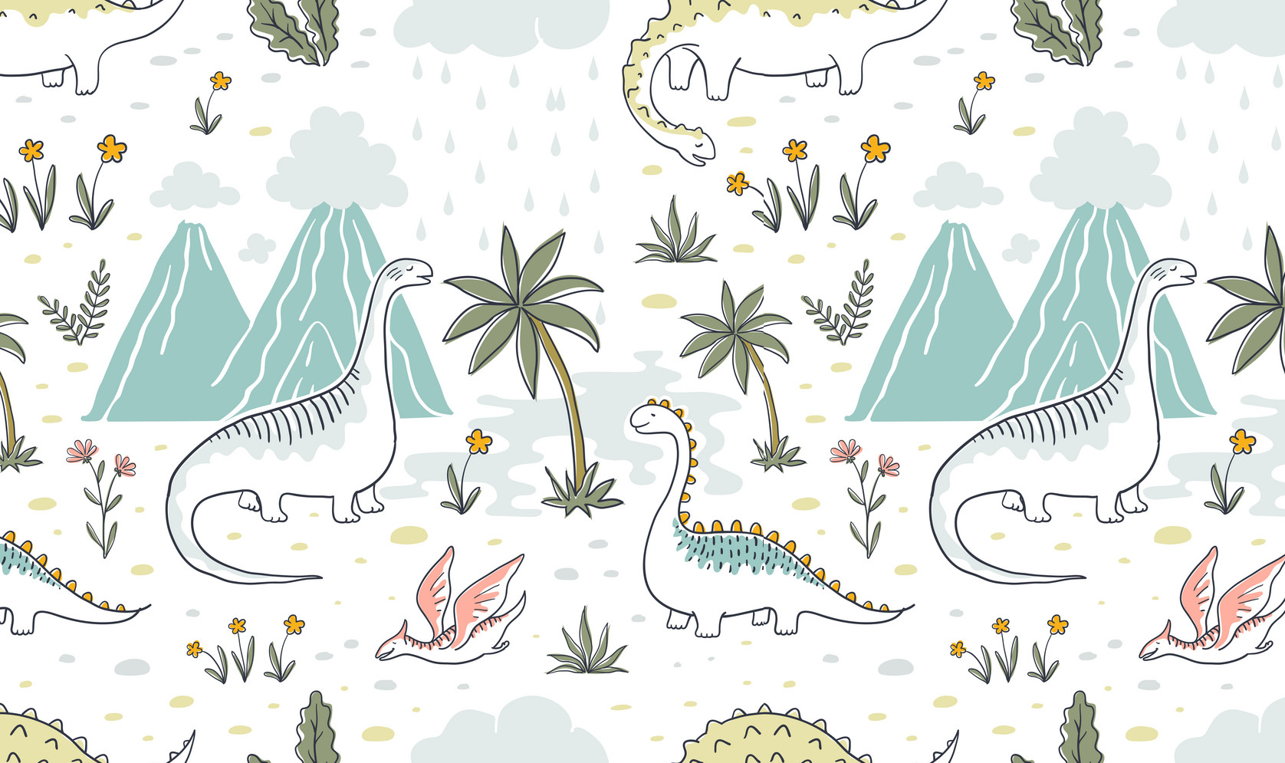
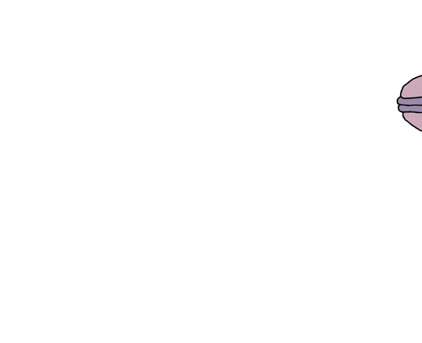
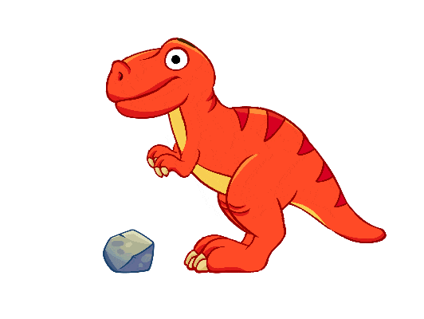
Unit 11: Before our time
FUN TIME
AND PROJECT

Slide 3
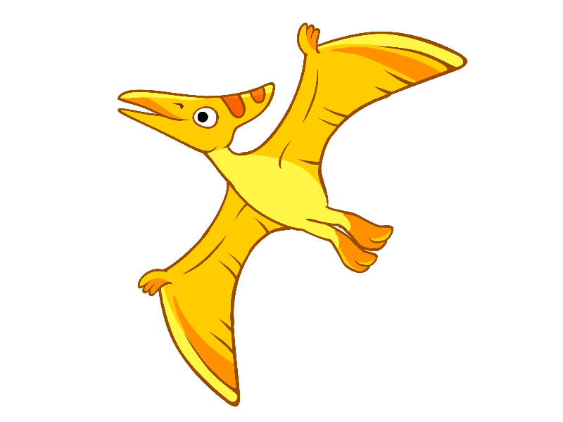
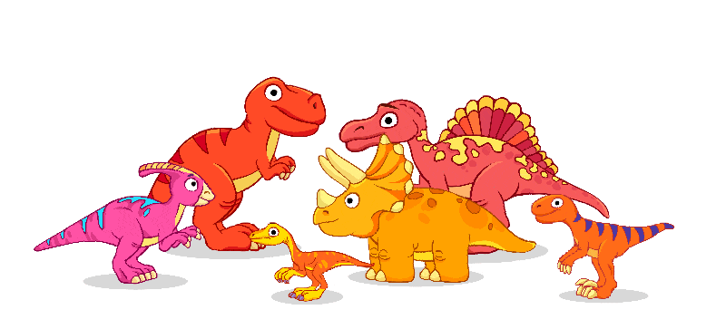
1. FUN TIME
Let’s sing a song

Slide 4

Notes:
https://www.youtube.com/watch?v=Wd9fGMQGlYg&ab_channel=JunyTony-SongsandStories

Slide 5
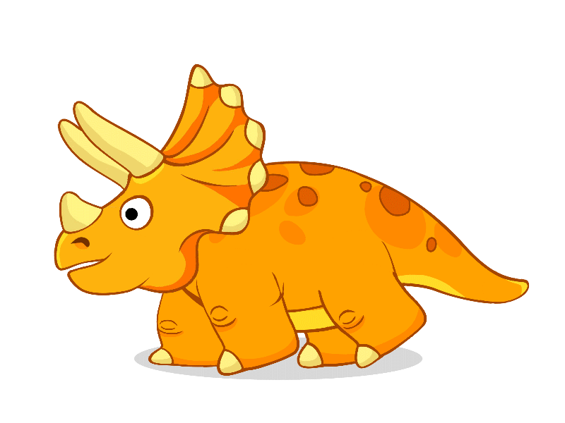
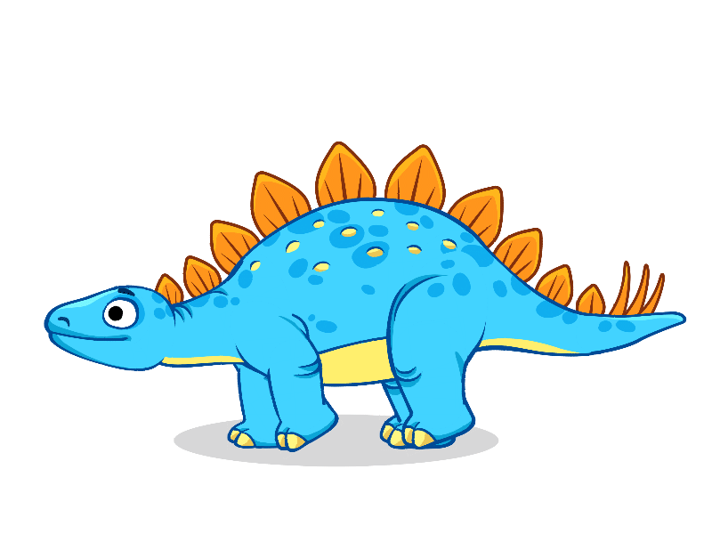
2. PRACTICE

Slide 6
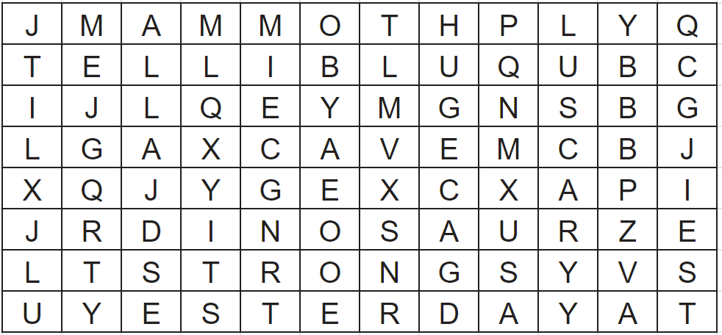
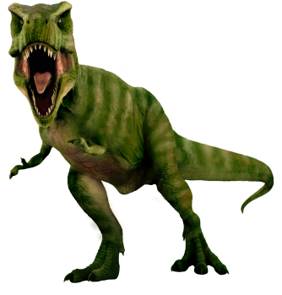
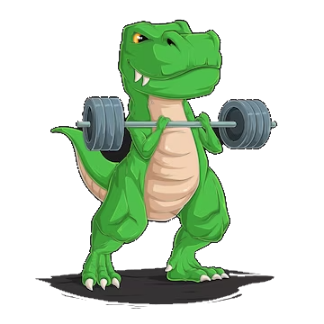
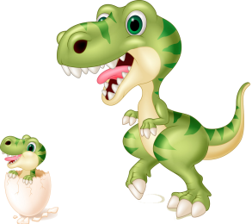
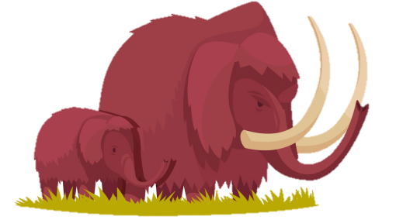
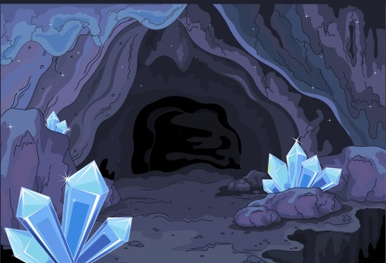

Find and circle
Notes:
STRONG – SCARY – HUGE - MAMMOTHS – CAVE – YESTERDAY - DINOSAUR

Slide 7
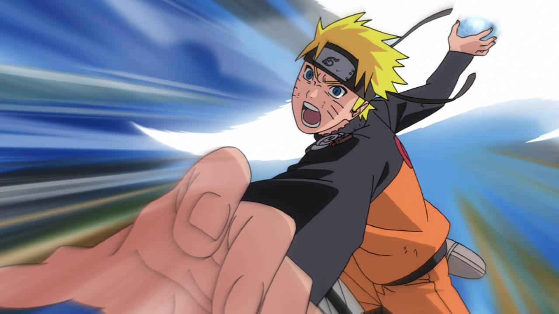


Slide 8
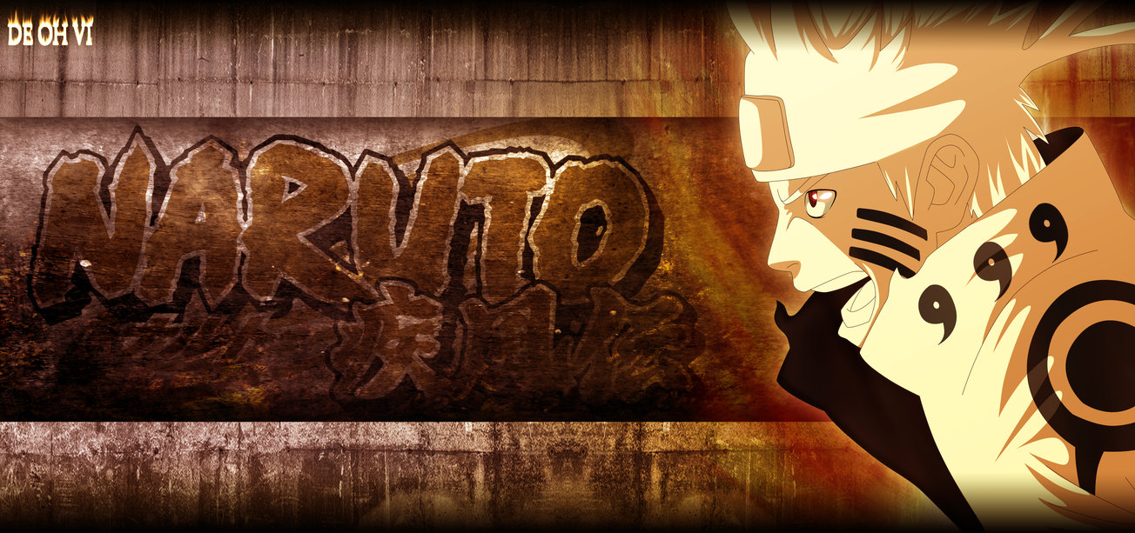

Welcome to the game!
Choose and answer a question.
Right answer: +2
Then you can open a mystery box
Notes:
T chia lớp thành 2 nhóm, các nhóm rung chuông để giành quyền trả lời. Nếu câu trả lời đúng thì giáo viên click vào màn hình để chuyển sang màn mở mystery box. Nếu câu trả lời sai thì click vào icon có dấu X ở góc dưới bên phải màn câu hỏi.

Slide 9
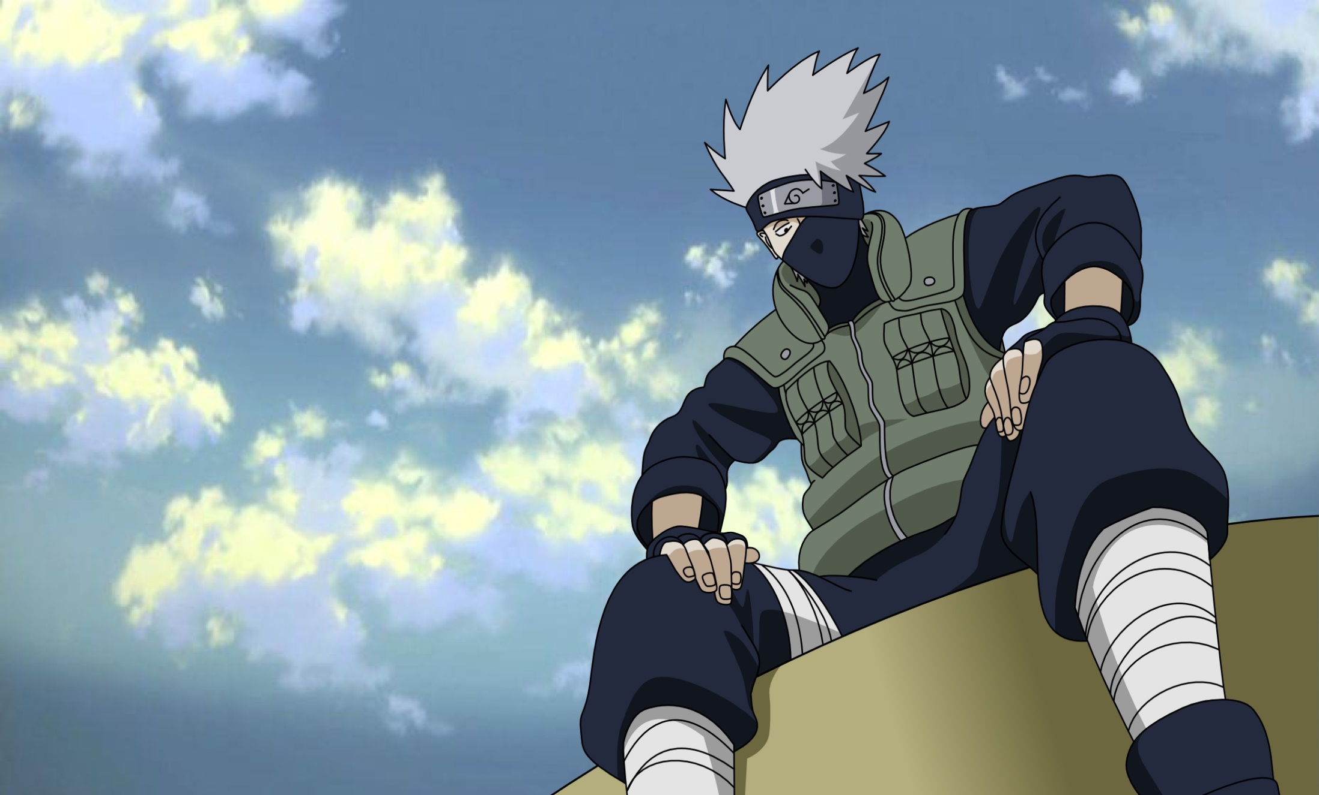
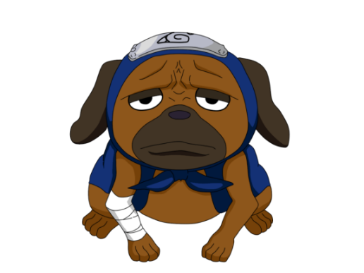
A
B
C
STOP
F
G
H
Notes:
Click on the respective letter box to go to the question page.
DO NOT CLICK on the dog. Nothing will happen!
Click STOP to move to the next part

Slide 10
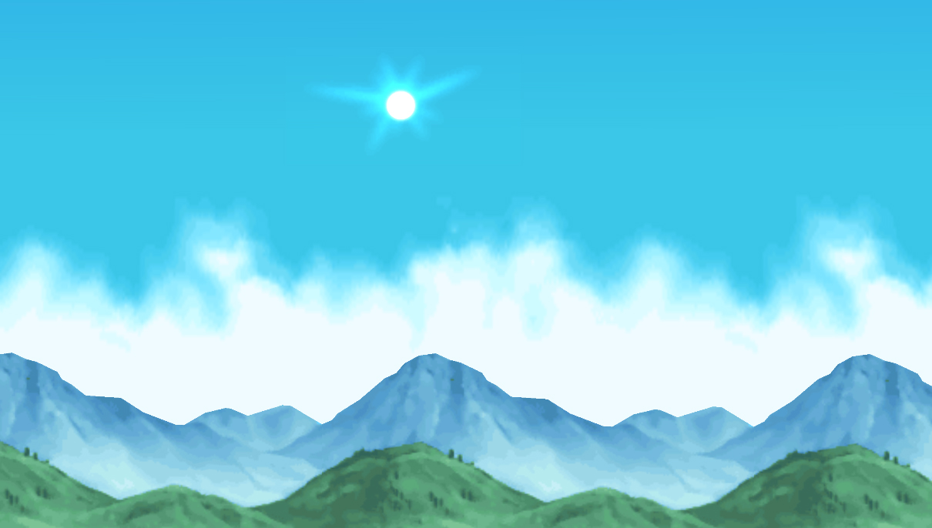
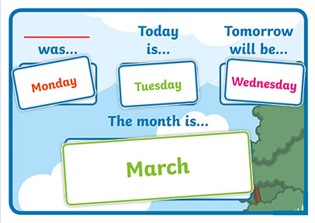

yesterday
Before “today” is ______
last month
last week
last year
Notes:
Click / Press the Right arrow button -> to show the answer.
If the students answer correctly, +2 points and then press the right arrow button again ->
Only click the Naruto Icon on the right hand side IF the team answered wrong. It will hyperlink back to the question page.

Slide 11
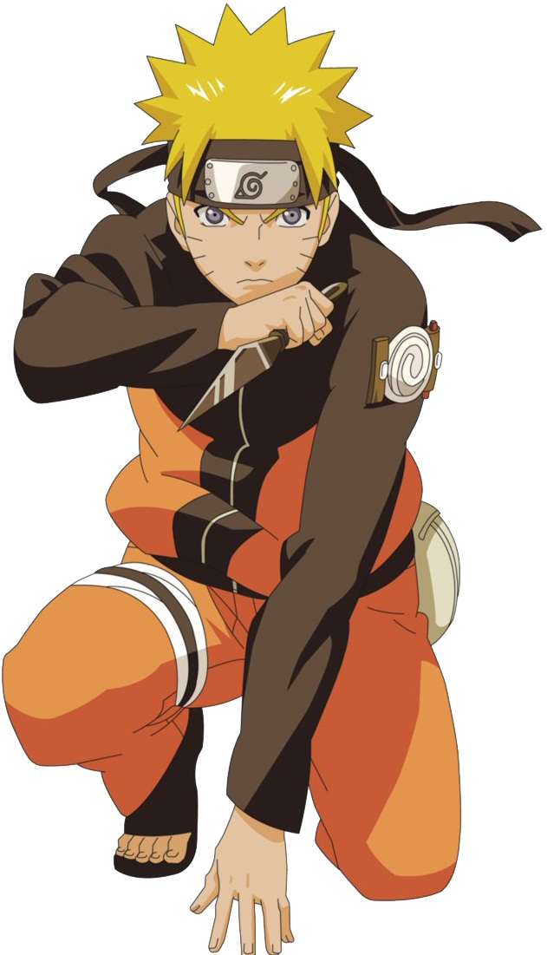
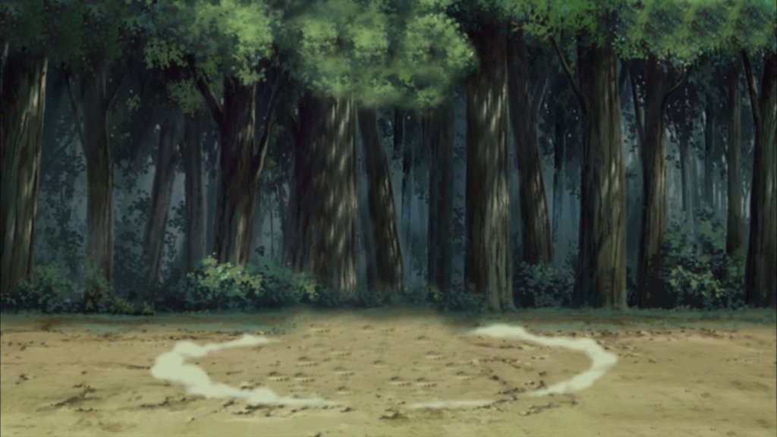


+4
+1
Bomb!
+3
Open the mystery box?
Notes:
-There is a set of mystery boxes set on this bonus game.
Học sinh có thể chọn số lần click để mở mystery box, số lần <5
-Students can choose how many they want to open. They DON’T have to open if they are happy with their points.
-Eventually there will be a bomb at the end, so students should keep in mind that they will get a bomb if they go too far!
-Students can stop anytime.
-Click the icon in the right hand corner to return to the question selection page.

Slide 12
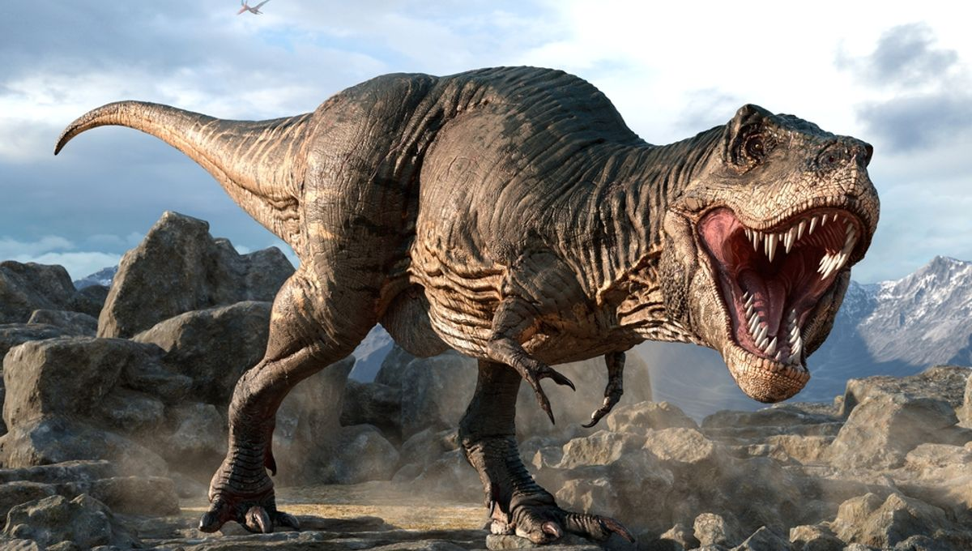
friendly
T.Rex was a ____ dinosaur.
small
strong
tiny
Notes:
Click / Press the Right arrow button -> to show the answer.
If the students answer correctly, +2 points and then press the right arrow button again ->
Only click the Naruto Icon on the right hand side IF the team answered wrong. It will hyperlink back to the question page.

Slide 13
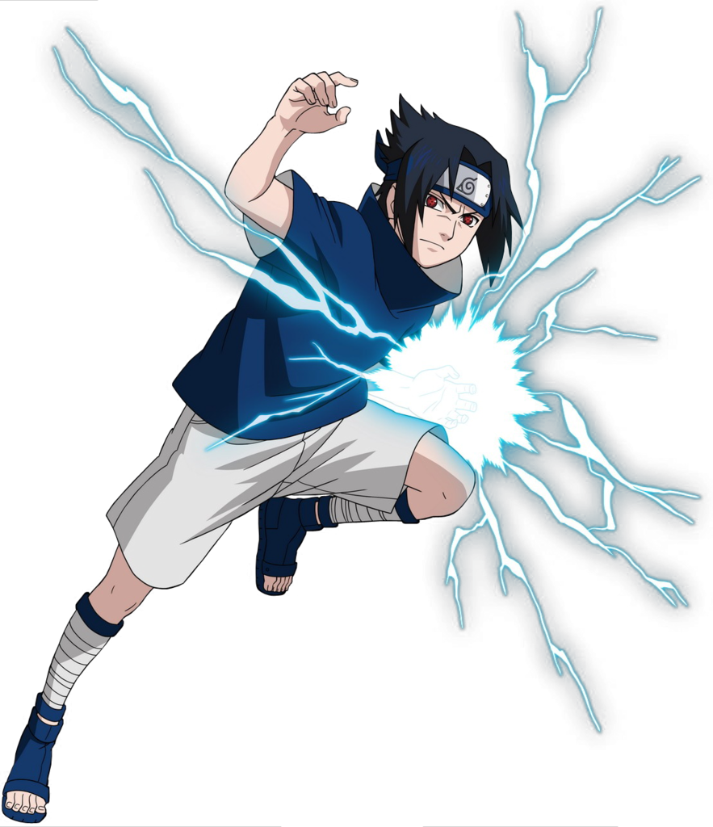
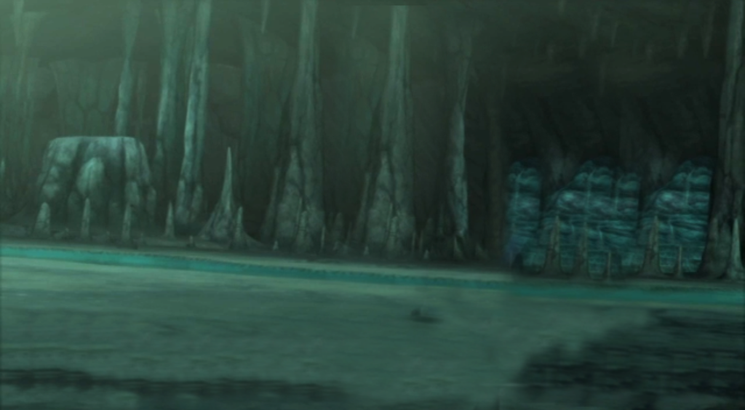
+1
BOMB!
+3
+1
+2
Open the mystery box?
Notes:
-Students can choose how many they want to open. They DON’T have to open if they are happy with their points.
-Eventually there will be a bomb at the end, so students should keep in mind that they will get a bomb if they go too far!
-Students can stop anytime.
-Click the icon in the right hand corner to return to the question selection page.

Slide 14
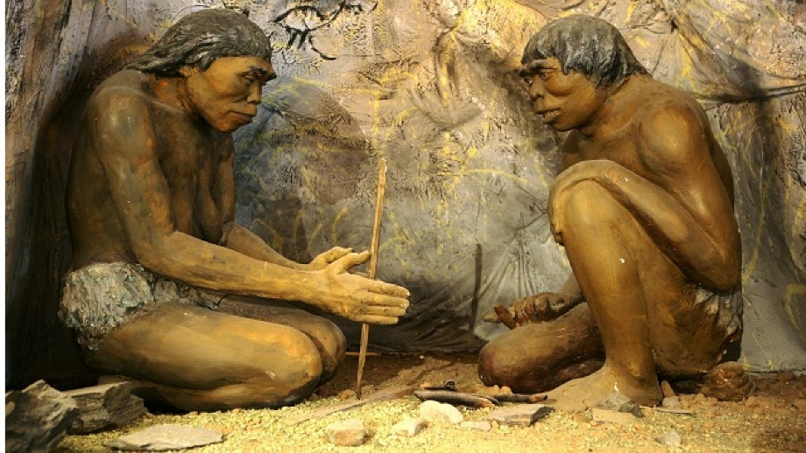
They lived on the tree.
Where did Early people live?
They lived in the castle.
They lived in the cave.
They lived in the house.
Notes:
Click / Press the Right arrow button -> to show the answer.
If the students answer correctly, +2 points and then press the right arrow button again ->
Only click the Naruto Icon on the right hand side IF the team answered wrong. It will hyperlink back to the question page.

Slide 15
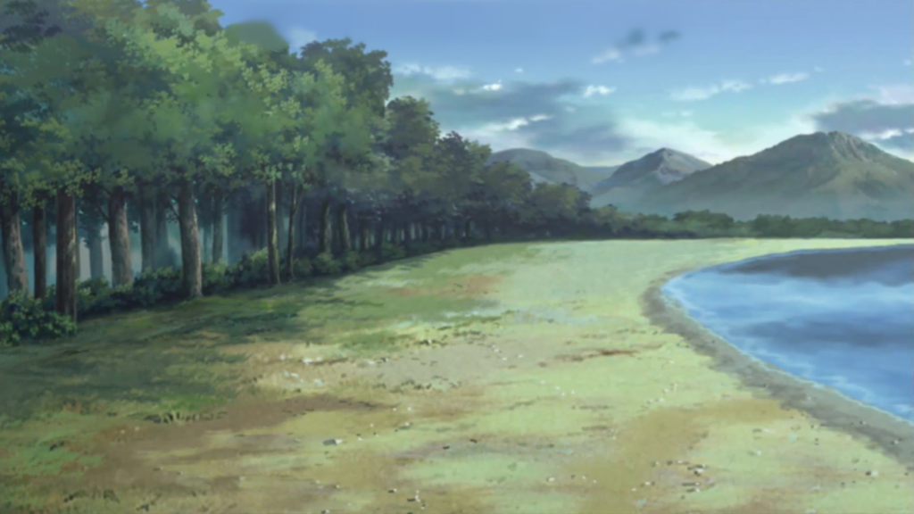
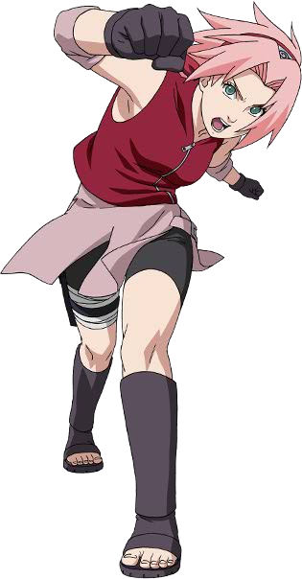
Bomb!
+2
+3
Open the mystery box?
Notes:
-Students can choose how many they want to open. They DON’T have to open if they are happy with their points.
-Eventually there will be a bomb at the end, so students should keep in mind that they will get a bomb if they go too far!
-Students can stop anytime.
-Click the icon in the right hand corner to return to the question selection page.

Slide 16
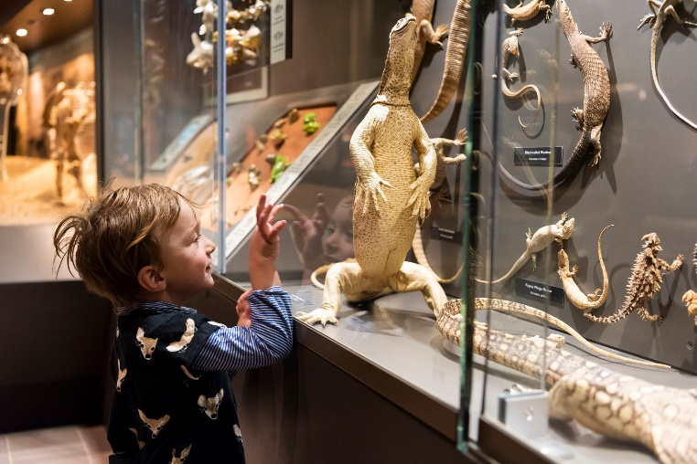
I was in the opera house.
Where were you last year?
I was in the school.
I was in the bank.
I was in the museum.
Notes:
Click / Press the Right arrow button -> to show the answer.
If the students answer correctly, +2 points and then press the right arrow button again ->
Only click the Naruto Icon on the right hand side IF the team answered wrong. It will hyperlink back to the question page.

Slide 17
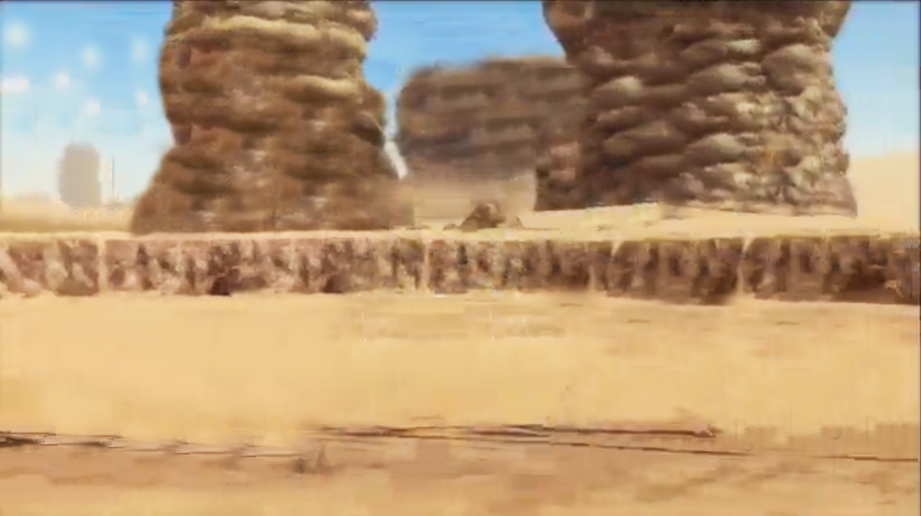
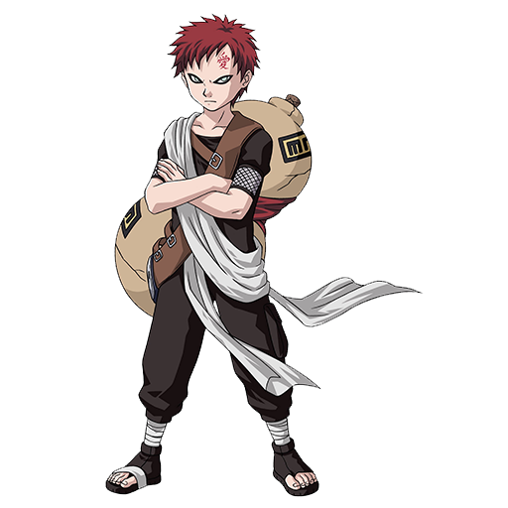
+2
Bomb!
+1
+1
+5
+1
Notes:
-Students can choose how many they want to open. They DON’T have to open if they are happy with their points.
-Eventually there will be a bomb at the end, so students should keep in mind that they will get a bomb if they go too far!
-Students can stop anytime.
-Click the icon in the right hand corner to return to the question selection page.

Slide 18
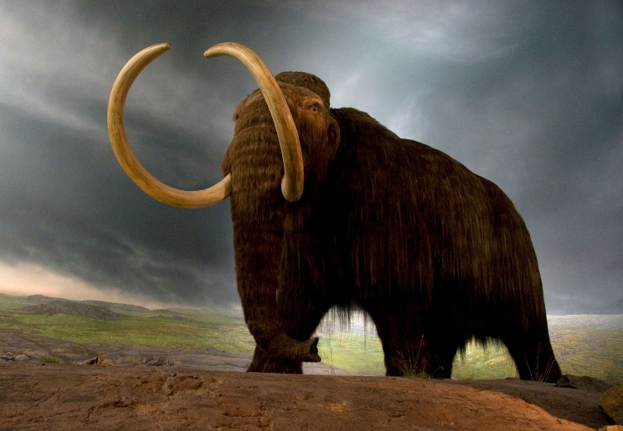
Dog
____ was big and strong.
Mammoth
Cat
Early people
Notes:
Click / Press the Right arrow button -> to show the answer.
If the students answer correctly, +2 points and then press the right arrow button again ->
Only click the Naruto Icon on the right hand side IF the team answered wrong. It will hyperlink back to the question page.

Slide 19
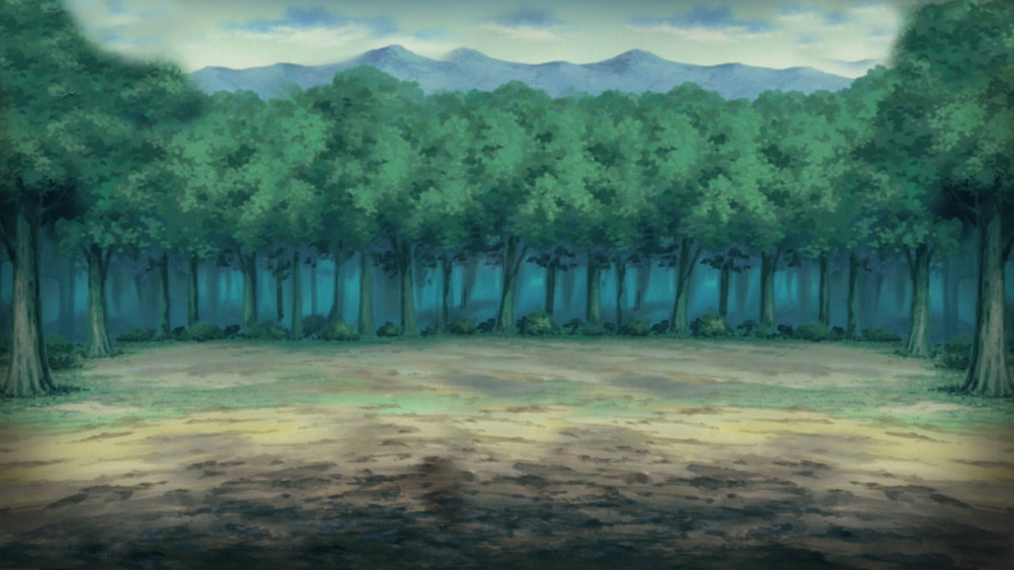
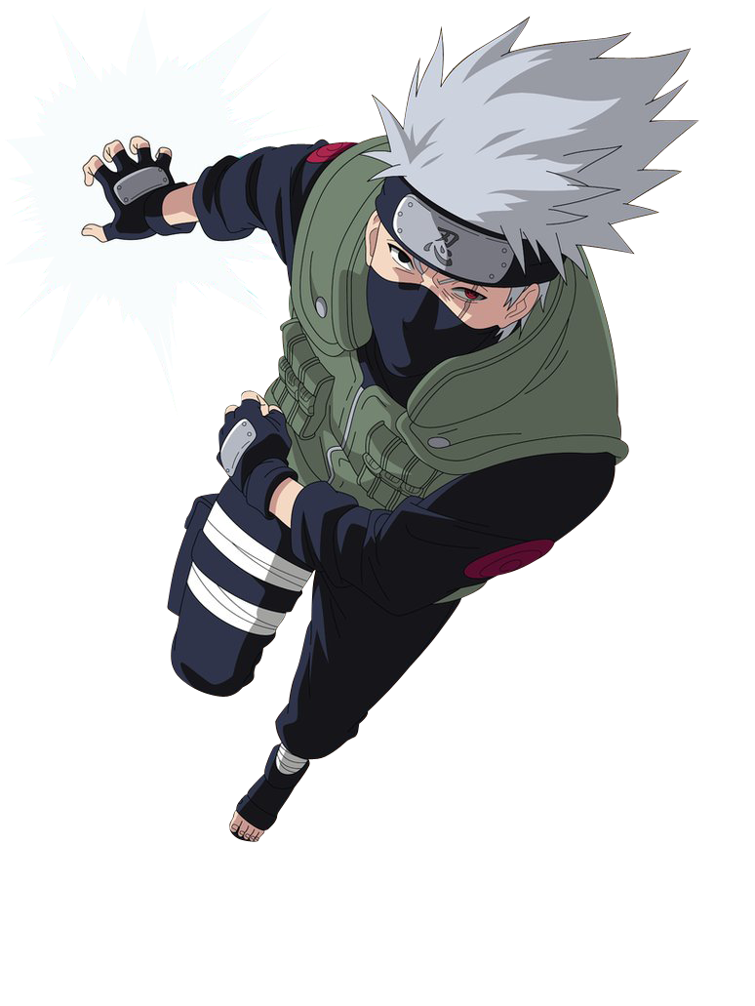
Change Points!!
Notes:
No bomb bonus here.
To keep it interesting I have some bonuses where students must destroy or change points.

Slide 20

tall
Early people weren’t ____.
small
short
scary
Notes:
Click / Press the Right arrow button -> to show the answer.
If the students answer correctly, +2 points and then press the right arrow button again ->
Only click the Naruto Icon on the right hand side IF the team answered wrong. It will hyperlink back to the question page.

Slide 21
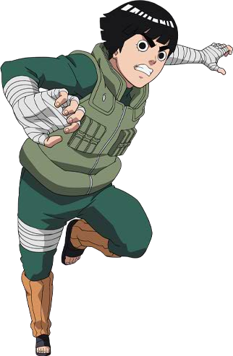
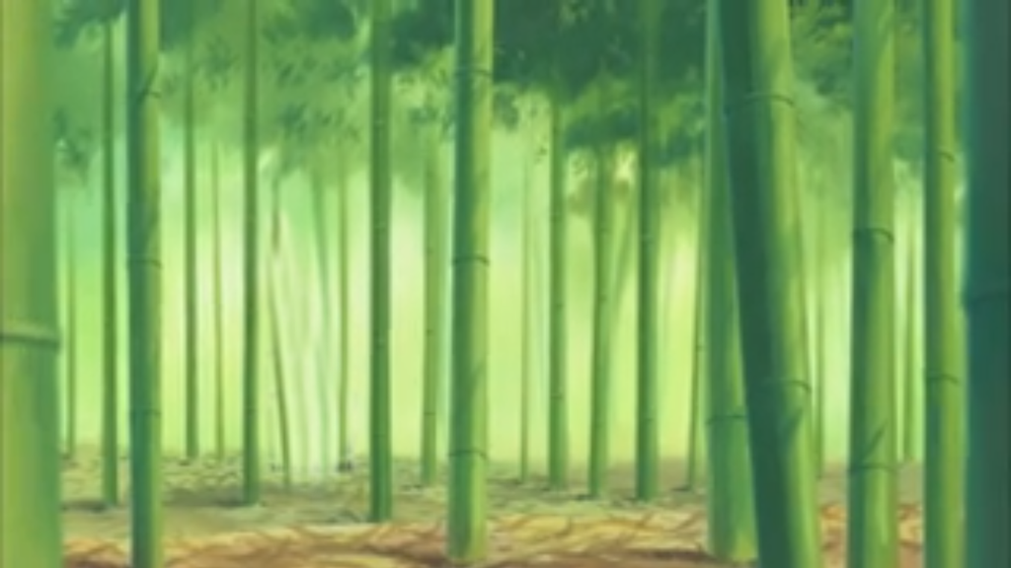
+2
+5
+2
+3
BOMB!
Open the mystery box?
Notes:
-Students can choose how many they want to open. They DON’T have to open if they are happy with their points.
-Eventually there will be a bomb at the end, so students should keep in mind that they will get a bomb if they go too far!
-Students can stop anytime.
-Click the icon in the right hand corner to return to the question selection page.

Slide 22
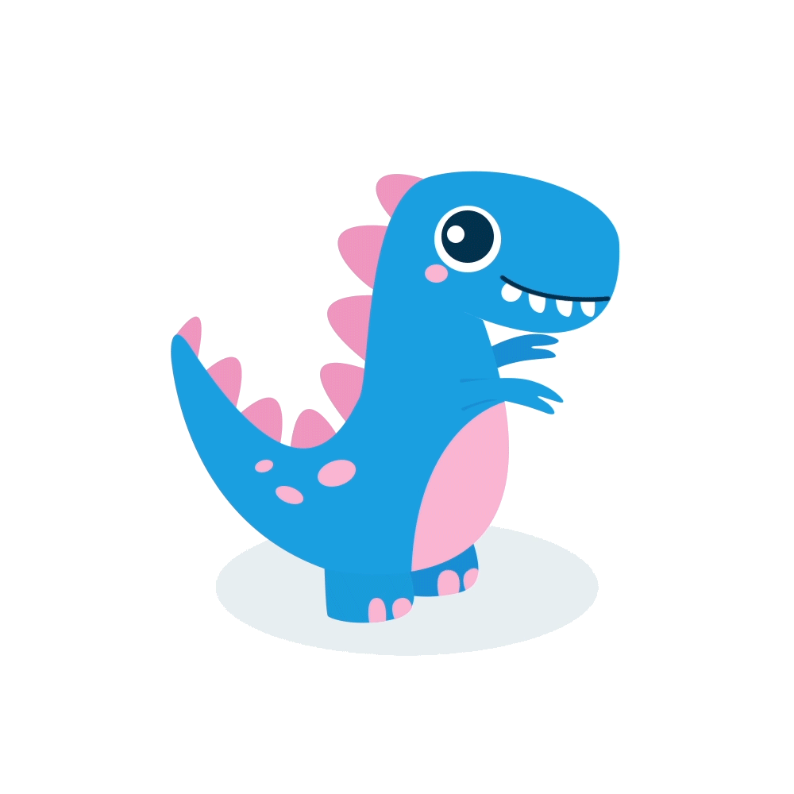
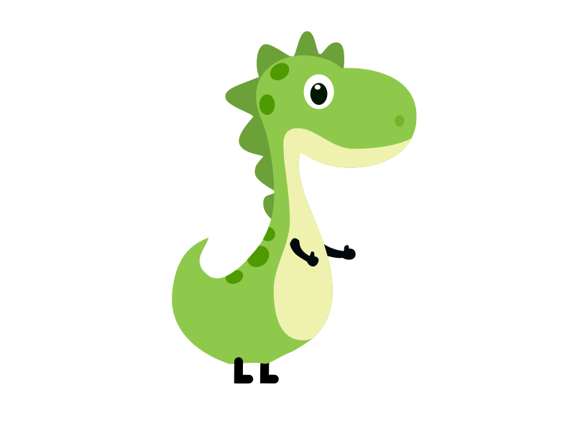
3. PROJECT

Slide 23
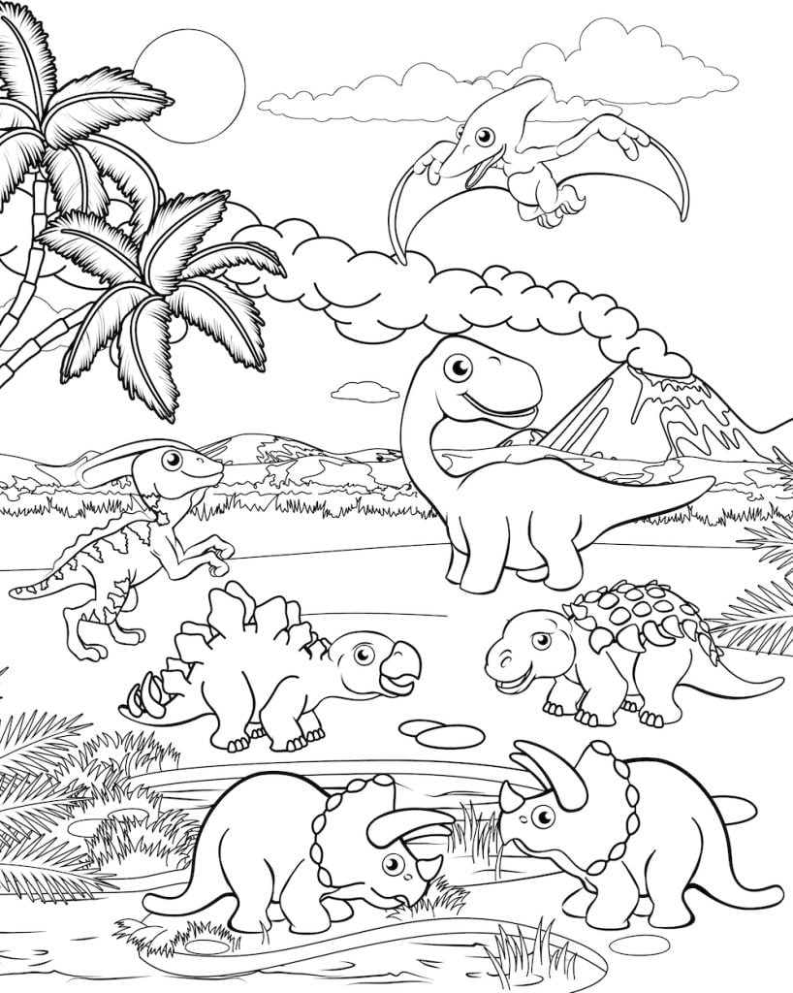
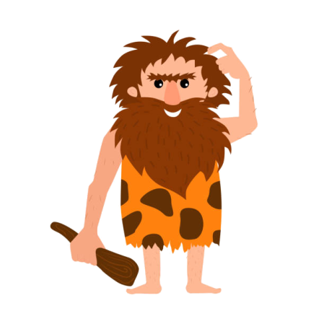
PROJECT: Before our time
Look at this dinosaur.
Its head was small.
Notes:
Image link: https://verbnow.com/wp-content/uploads/2021/04/dinosaur4-apr21.jpg

Slide 24
4. ASSESSMENT

Slide 25
Write and say.
1. my old schools / not / large and beautiful
_____________________________________
2. the old town / not / small and quiet
_____________________________________
3. my first piαno lesson / not / great
_____________________________________
4. our journey to the desert / not / cool
_____________________________________
5. her old gardens/ not / big _____________________________________
My old schools were not large and beautiful.
The old town was not small and quiet.
My first piano lesson was not great.
Our journey to the desert was not cool.
Her old gardens were not big.
Notes:
Image link: https://verbnow.com/wp-content/uploads/2021/04/dinosaur4-apr21.jpg

Slide 26
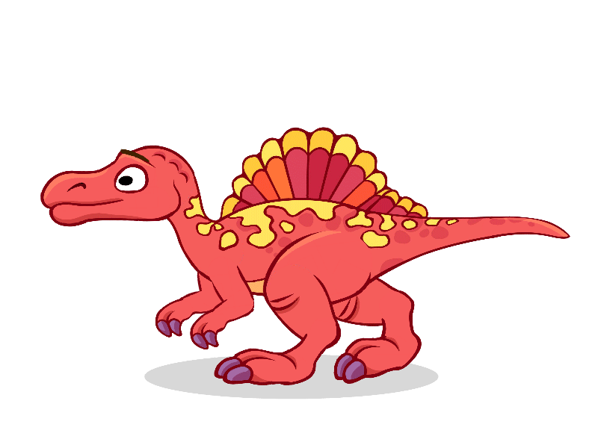
UNIT 11: BEFORE OUR TIME
FUN TIME AND PROJECT
What we learnt today:
Review vocabulary:
yesterday last week last month
last year dinosaur huge
strong mammoth early people
scary cave dinosaur bones
Project:
Before our time
Notes:
Image link: https://verbnow.com/wp-content/uploads/2021/04/dinosaur4-apr21.jpg

Slide 27




Thank you & goodbye!

