Slide 1









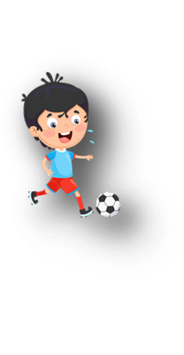












Unit 11
My day
Lesson 3 – Task 1,2,3

Slide 2






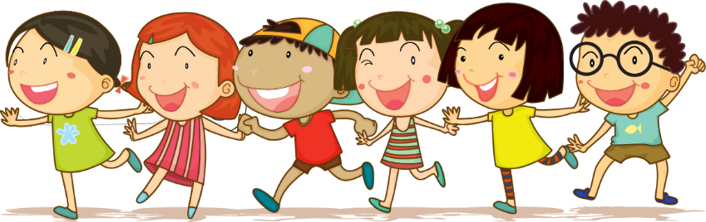



1 Warm up

Slide 3
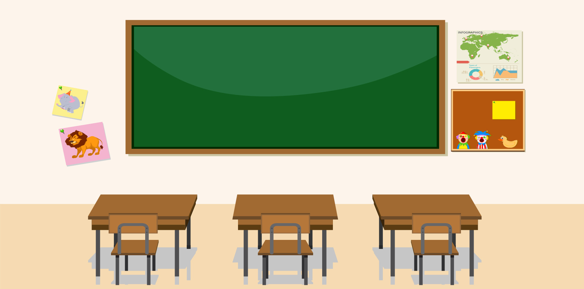


Game
Word connection
egg
giraffe
tea
apple

Slide 4
2 Presentation

Slide 5

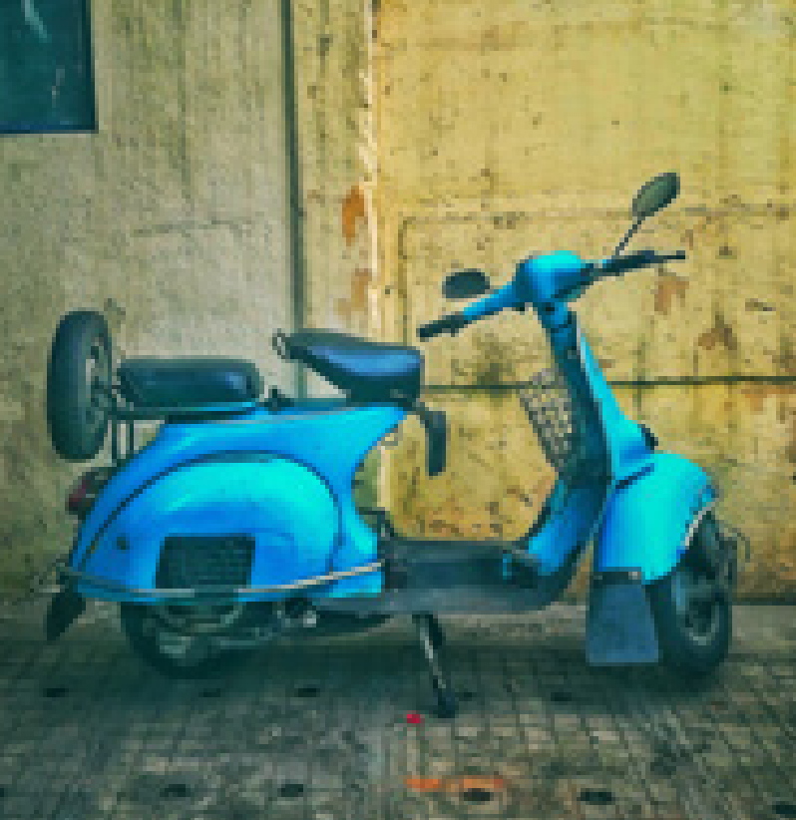
motorbike

Slide 6
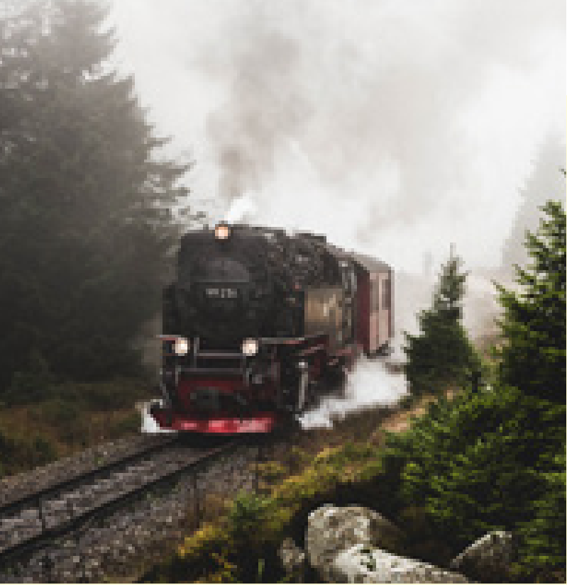
train

Slide 7
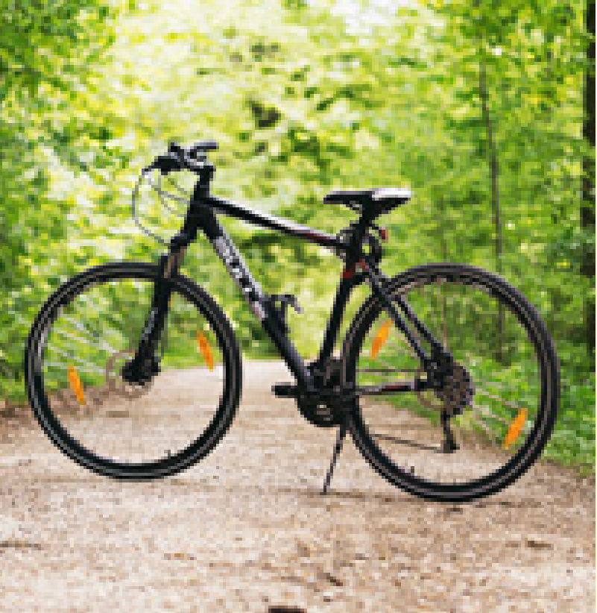
bike

Slide 8
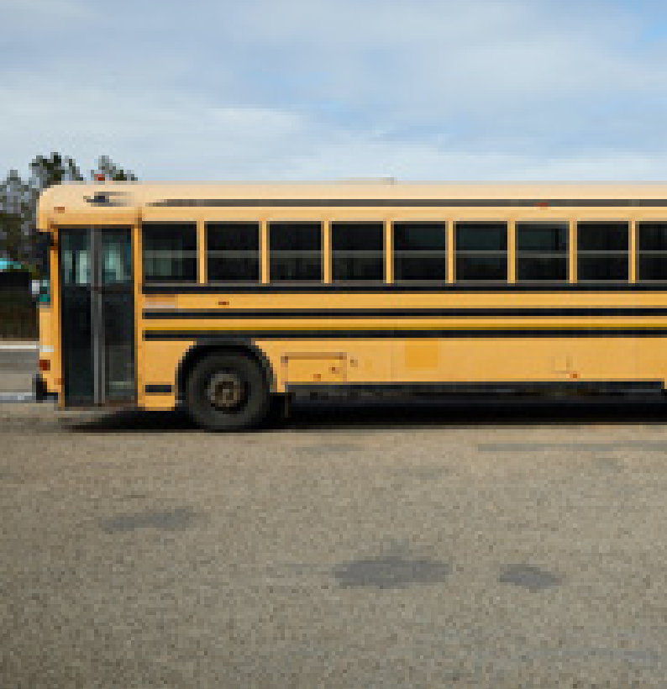
bus

Slide 9
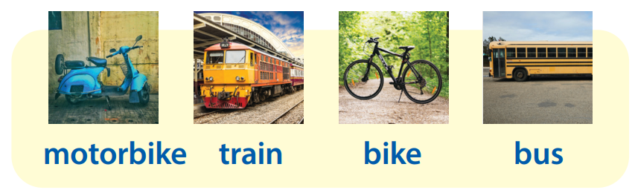
Task 1 Listen and point. Repeat.

Slide 10



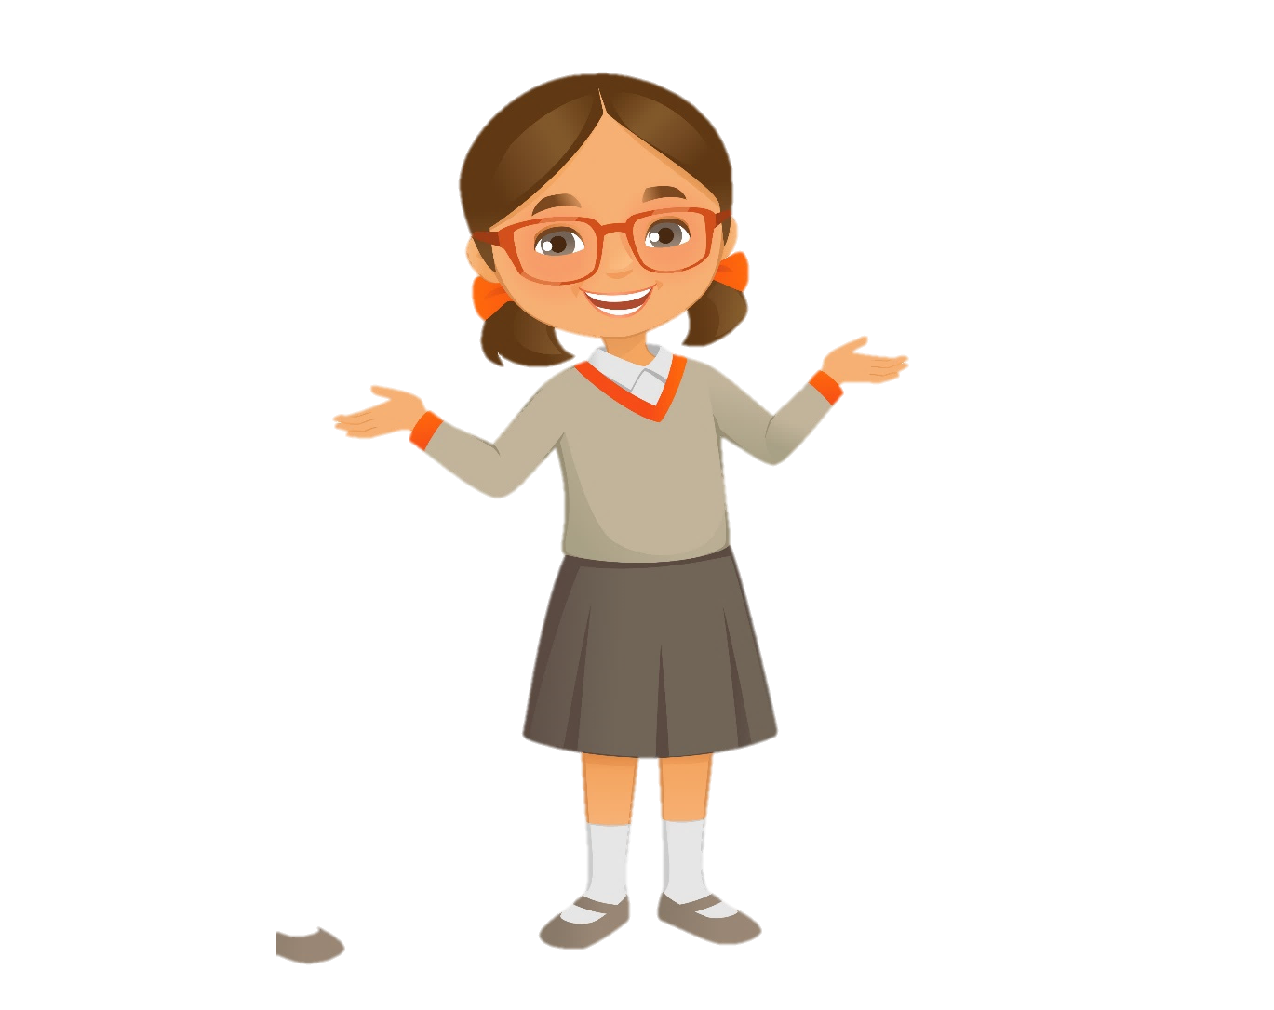
Checking game
Listen and tick

Slide 11
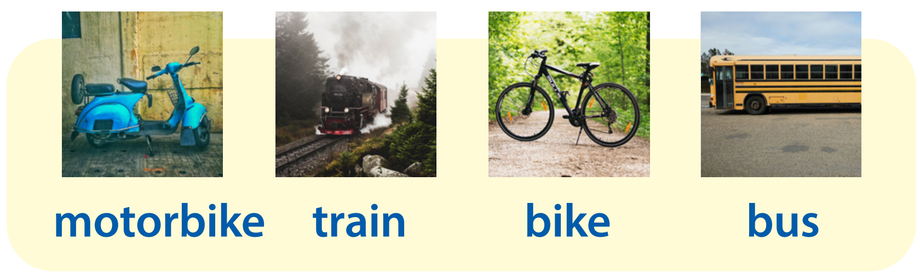
A
B
C
✓

Slide 12
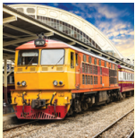
A
B
C
✓

Slide 13
A
B
C
✓

Slide 14
A
B
C
✓

Slide 15
3 Practice

Slide 16
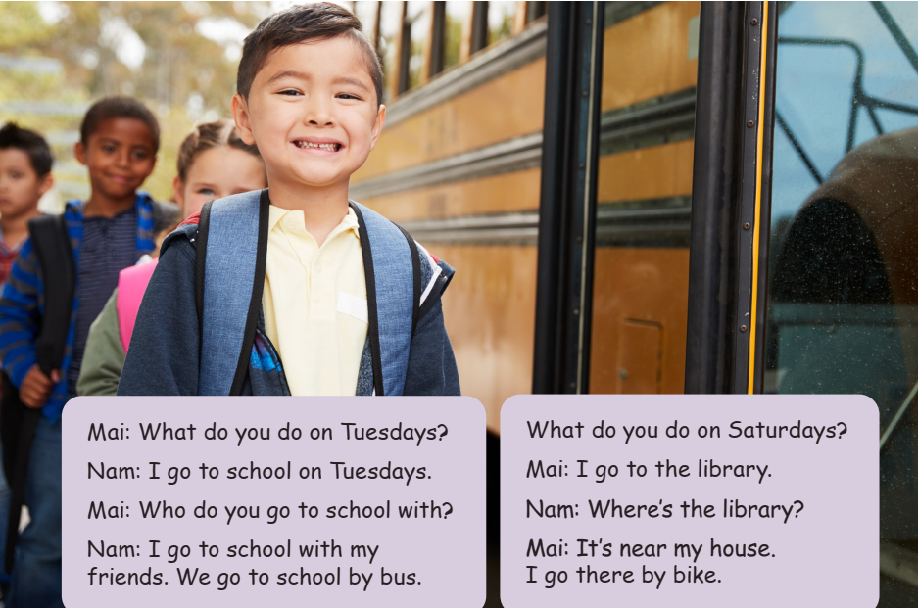
Task 2 Listen and match.
Who are they?
What do they do?
What is this?

Slide 17

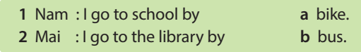
Task 2 Listen and match.

Slide 18
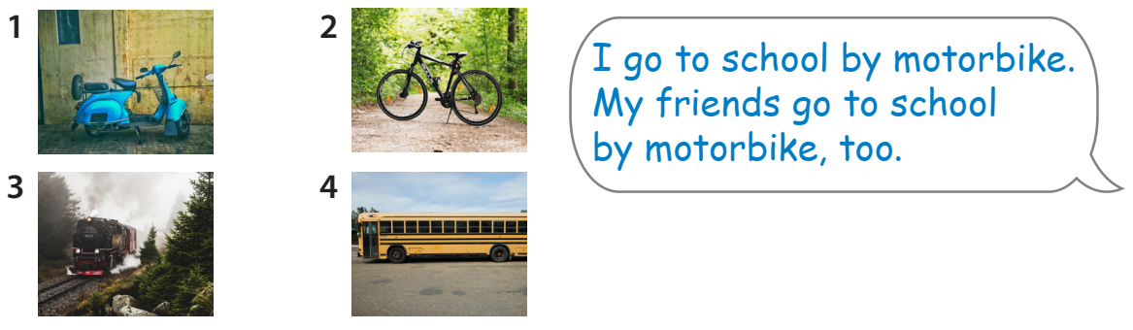
Task 3 Look and say.

Slide 19
4 Production

Slide 20
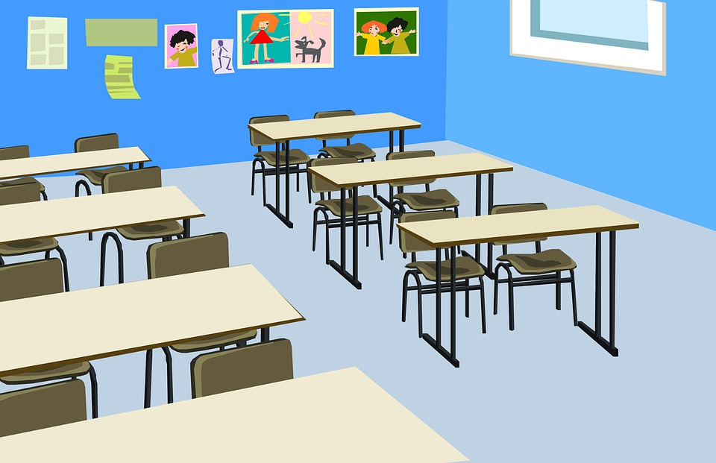

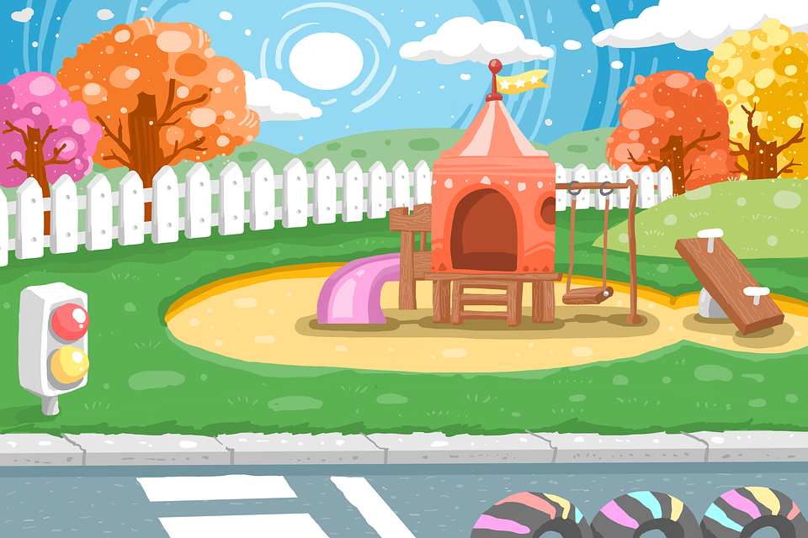

Draw and talk!
I go to
the playground by bus.

Slide 21
5 Assessment

Slide 22
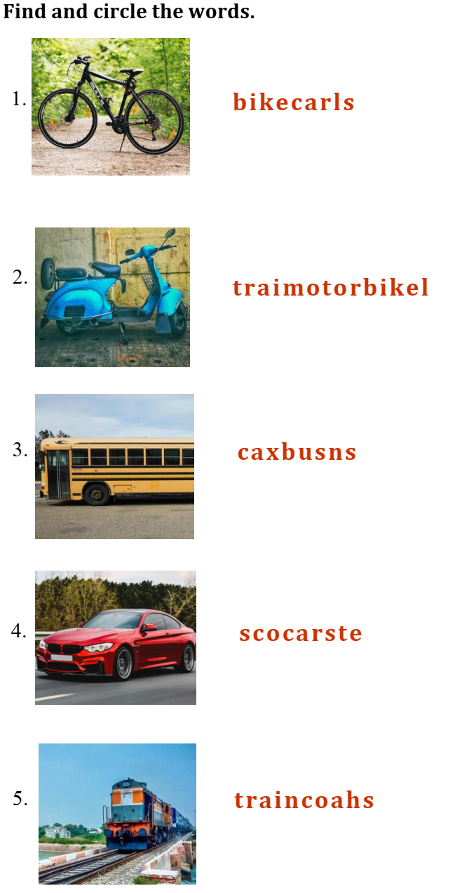
Reorder the letters to make the correct word.
sbu
-> bus
kbei
-> bike
rac
-> car
mtobkeroi
-> motorbike
riant
-> train

Slide 23




Thank you & goodbye!

