Slide 1





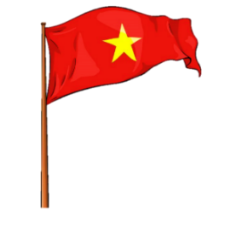















Unit 11
My day
Lesson 3 – Task 4,5,6

Slide 2







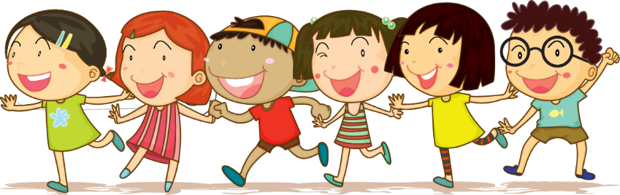



1 Warm up

Slide 3
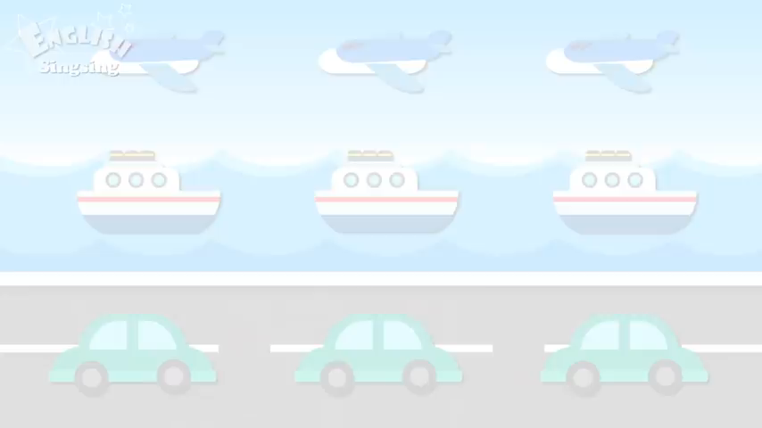

Slide 4


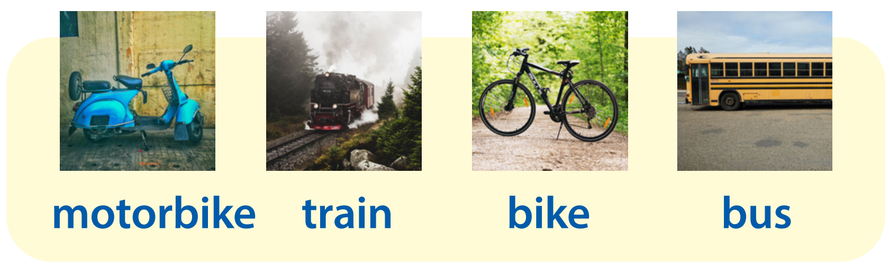
What is this?
motorbike
bus
bike
train

Slide 5


Jigsaw puzzle

Slide 6

1
2
motorbike
Word
3
4
a
b
c
d
Notes:
T clicks numbers to put the pieces of pictures come to right places.

Slide 7
1
2
bike
Word
3
4
a
b
c
d

Slide 8
1
2
bus
Word
3
4
a
b
c
d

Slide 9
1
2
train
Word
3
4
a
b
c
d

Slide 10
2 Presentation

Slide 11


New structure
How do you go to ______?
By _____.

Slide 12

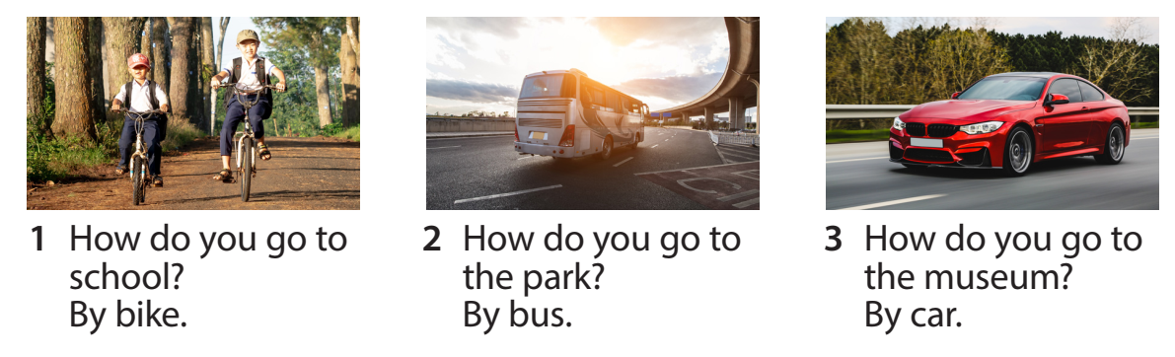
Task 4 Listen and repeat.

Slide 13
3 Practice

Slide 14
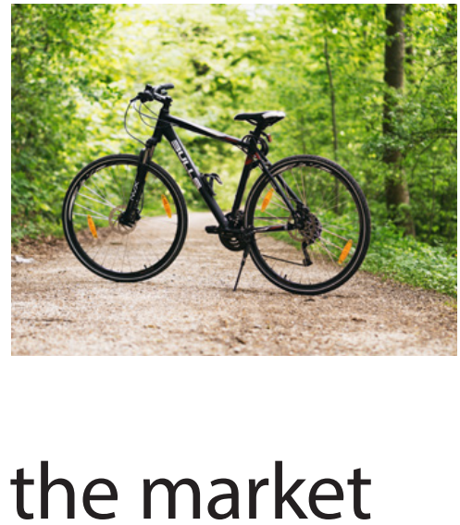
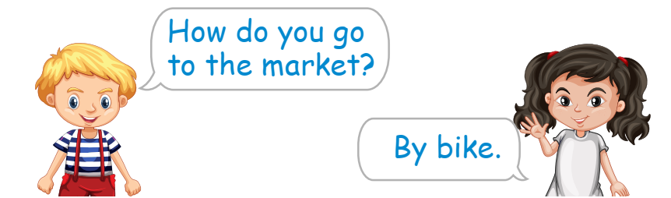
Task 5 Ask and answer.

Slide 15
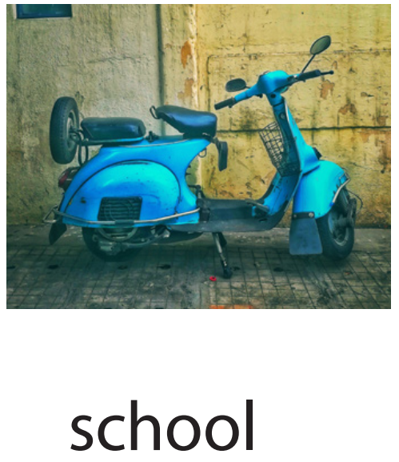
Task 5 Ask and answer.
How do you go to school?
By motorbike.

Slide 16
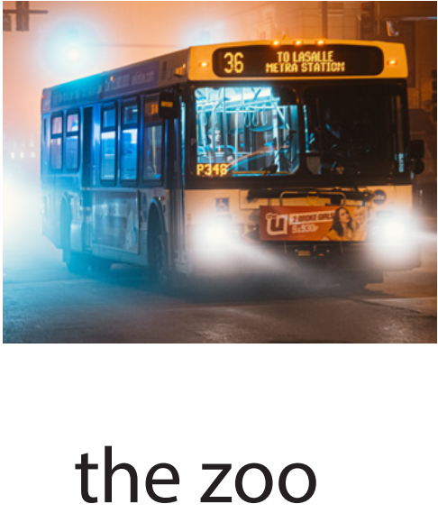
Task 5 Ask and answer.
How do you
go to the zoo?
By bus.

Slide 17
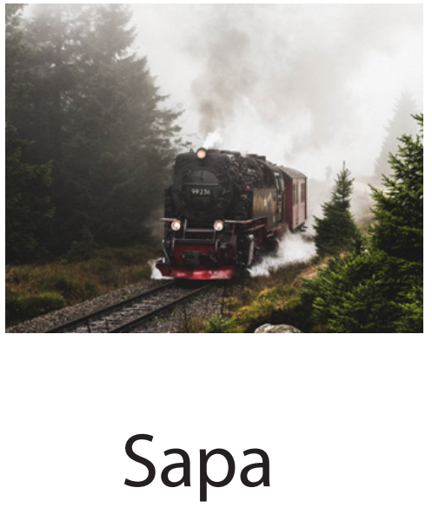
Task 5 Ask and answer.
How do you
go to Sapa?
By train.

Slide 18
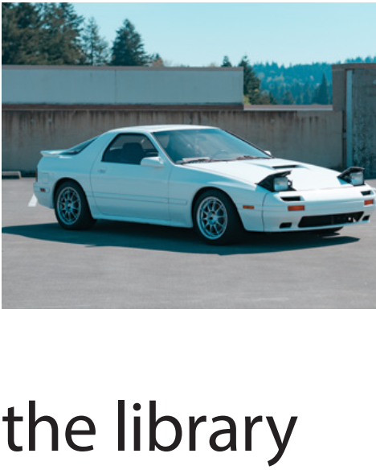
Task 5 Ask and answer.
How do you
go to the library?
By car.

Slide 19
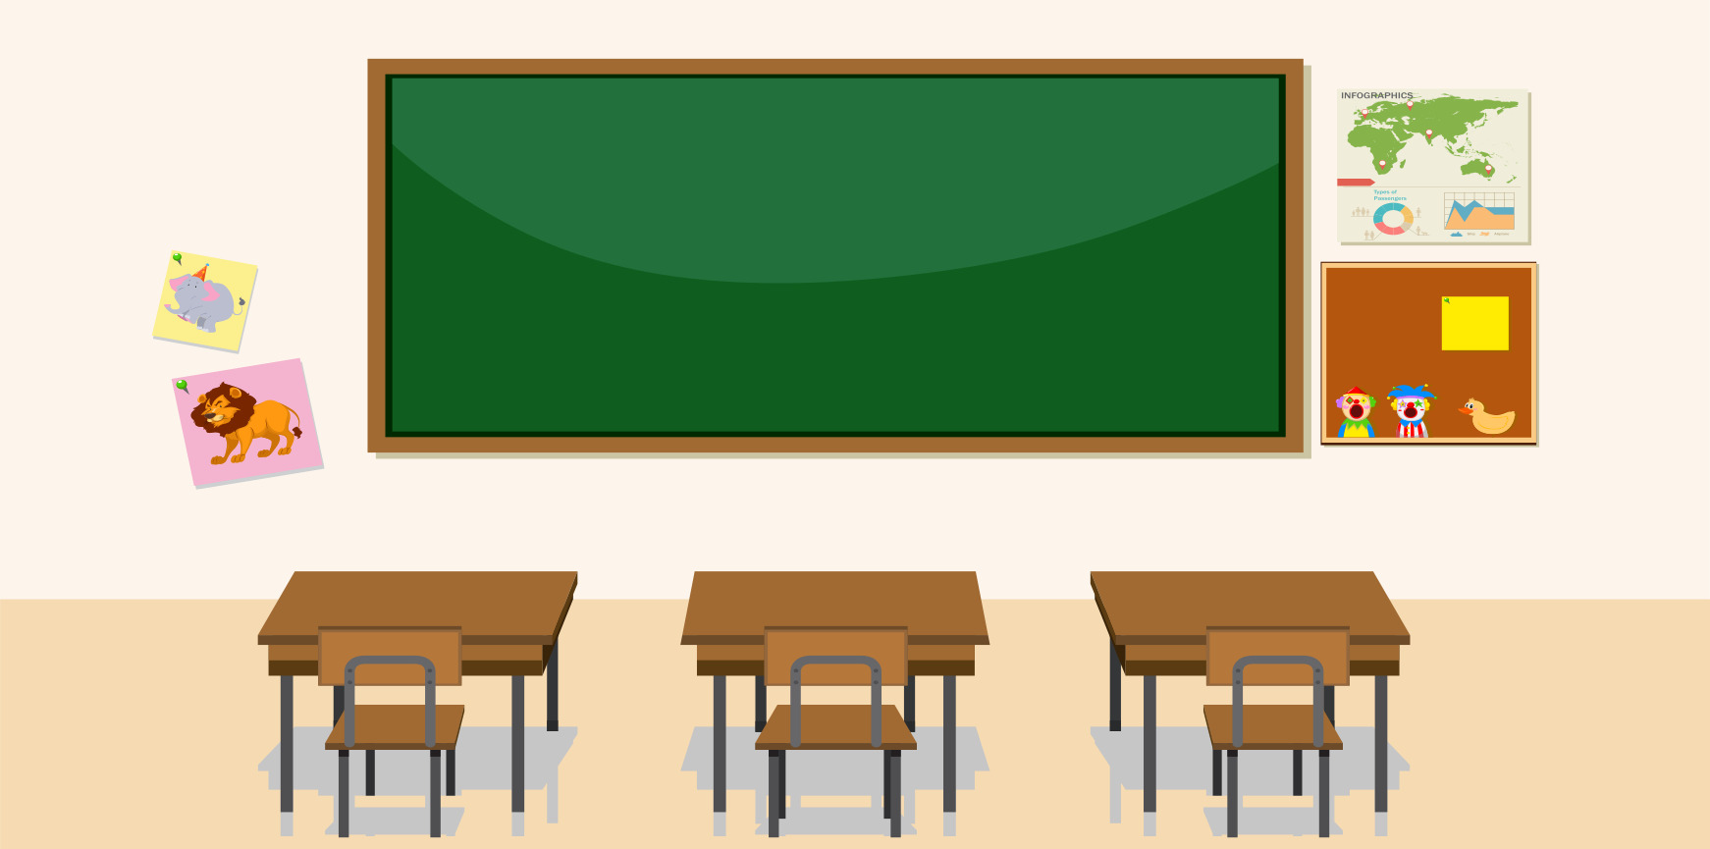

Game
Pass the ball
How do you
go to ____?
By _____.
Notes:
T plays music when Ss pass the ball. When music stops, the S holding the ball will answer the question.

Slide 20
4 Production

Slide 21
Task 6 Draw and write. Talk.
What do you do on _______?
Who do you ________ with?
How do you go to ________?

Slide 22
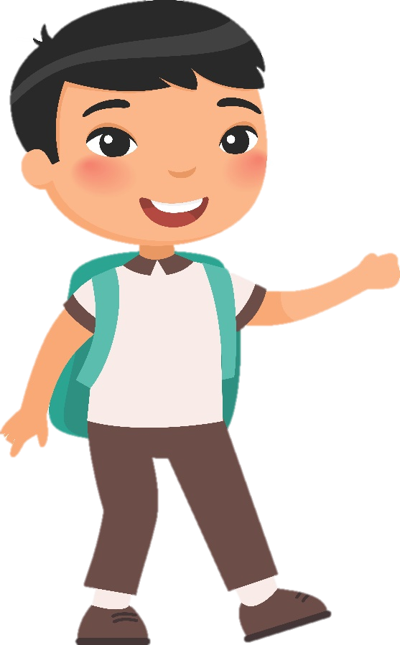
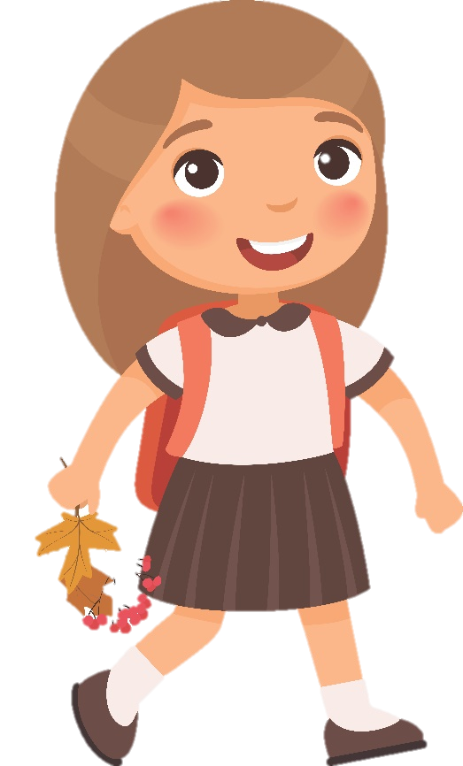
Task 6 Draw and write. Talk.
What do you do on Saturdays?
On Saturdays, I go to the library.

Slide 23
Task 6 Draw and write. Talk.
Who do you go to the library with?
I go to the library with my sister.

Slide 24
Task 6 Draw and write. Talk.
How do you go to the library?
I go to the library by bus.

Slide 25
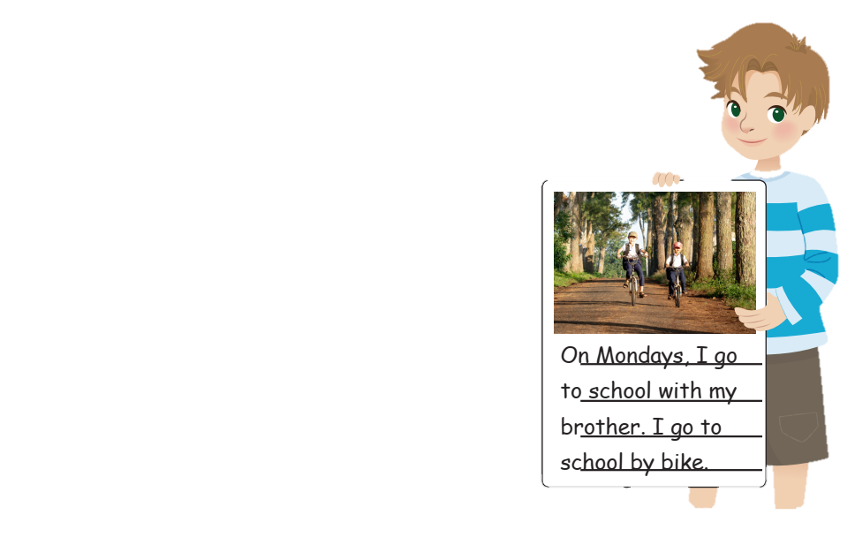
Task 6 Draw and write. Talk.

Slide 26
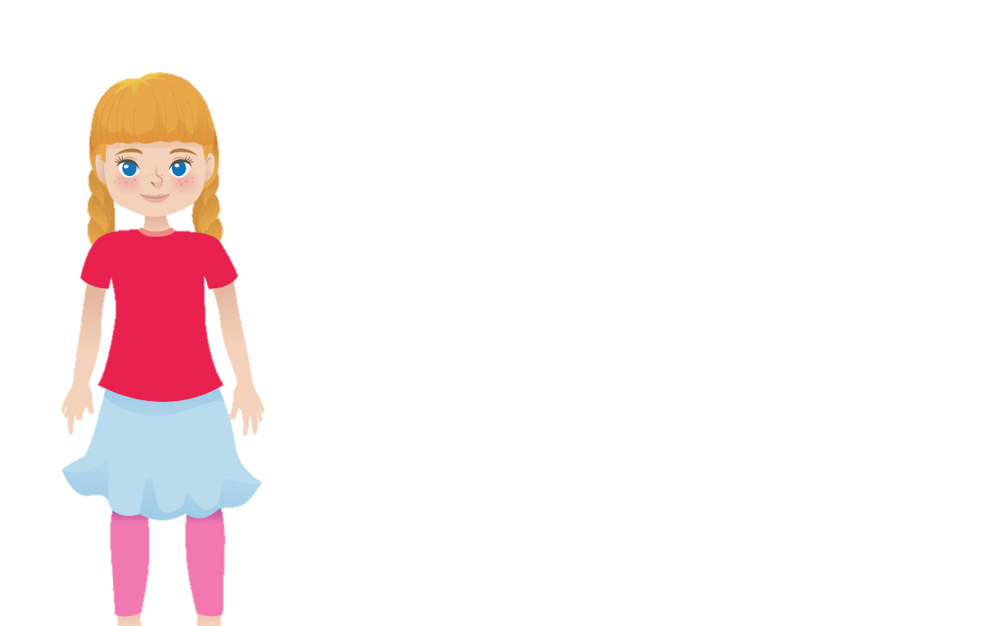
Task 6 Draw and write. Talk.
How do you go to school?
I go to school
by bike.

Slide 27
5 Assessment

Slide 28

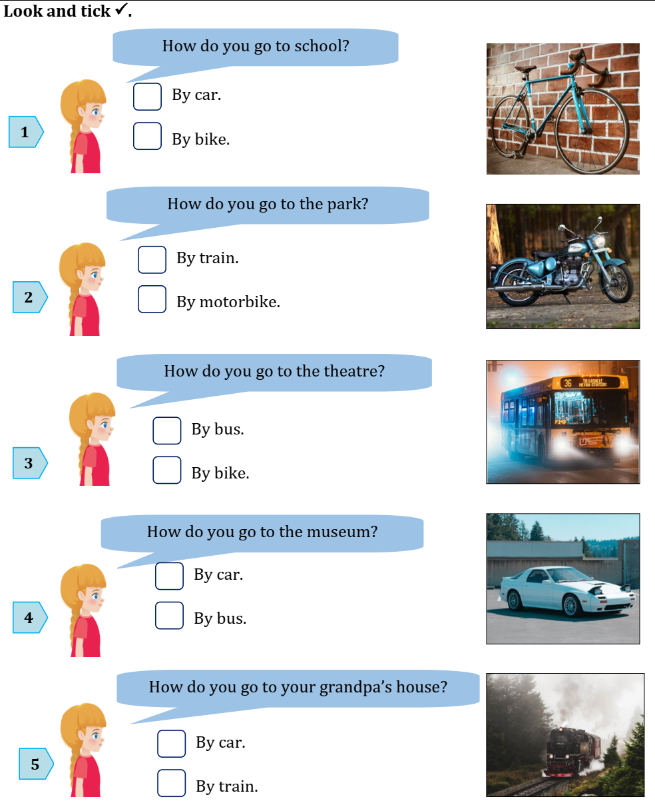
Look and tick
✓
✓
✓
✓

Slide 29
✓
Look and tick
✓
✓

Slide 30




Thank you & goodbye!

