Slide 1
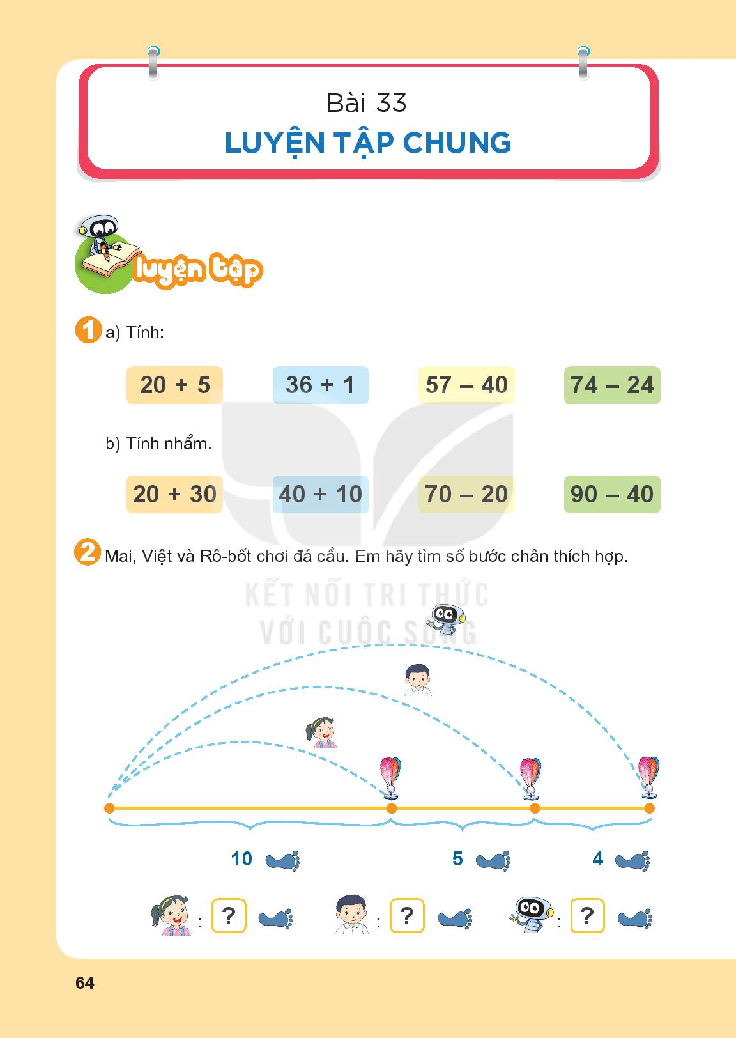

Slide 2

= 25
= 37
= 17
= 50
= 25
= 37
= 17
= 50
= 50
= 50
= 50
= 50

Slide 3
10
15
19

Slide 4
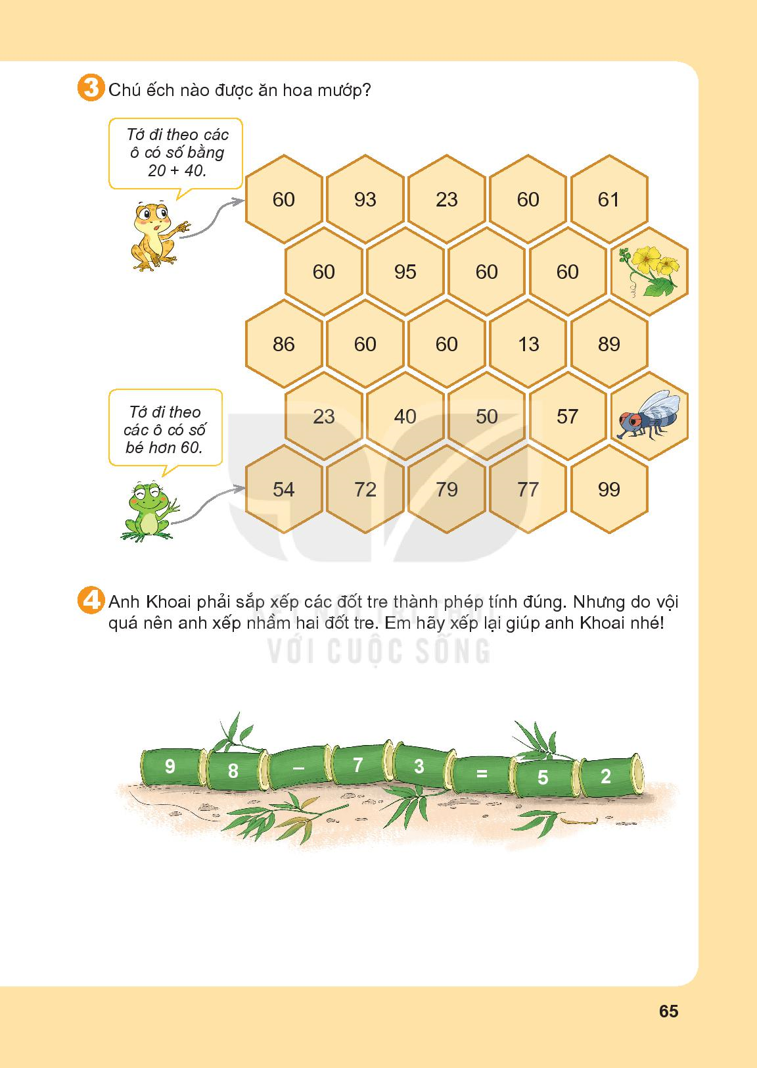

60
60
60
60
60
60
60
13
23
40
50
57
54

Slide 7
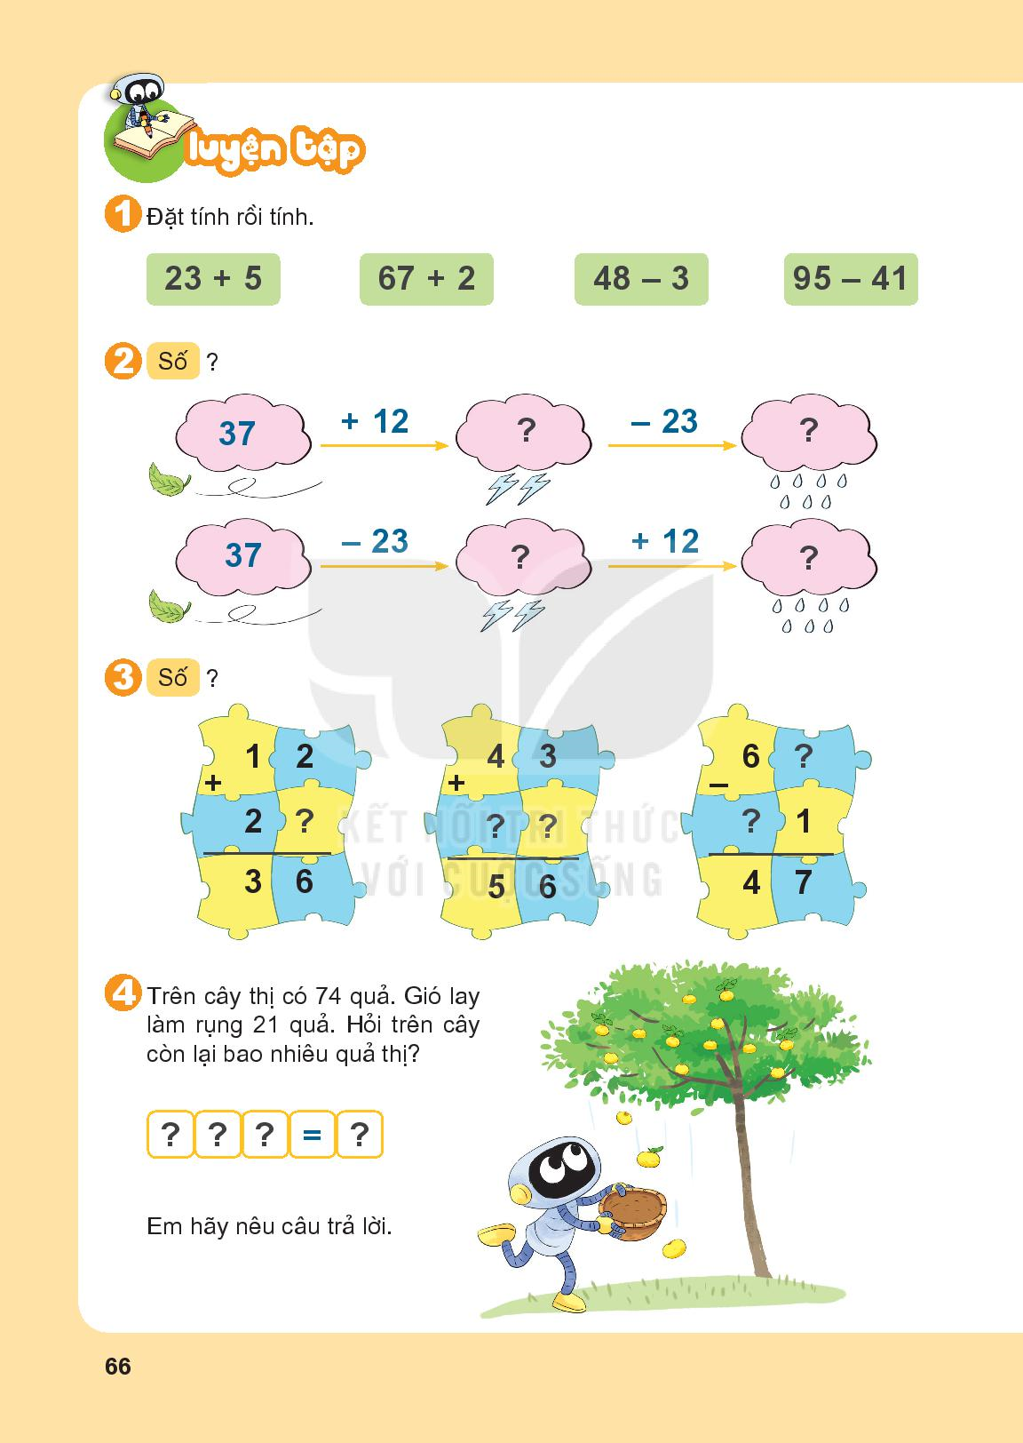

Slide 8
49
26
14
26

Slide 9
8
4
1
3
2

Slide 10
74
-
21
53

Slide 11
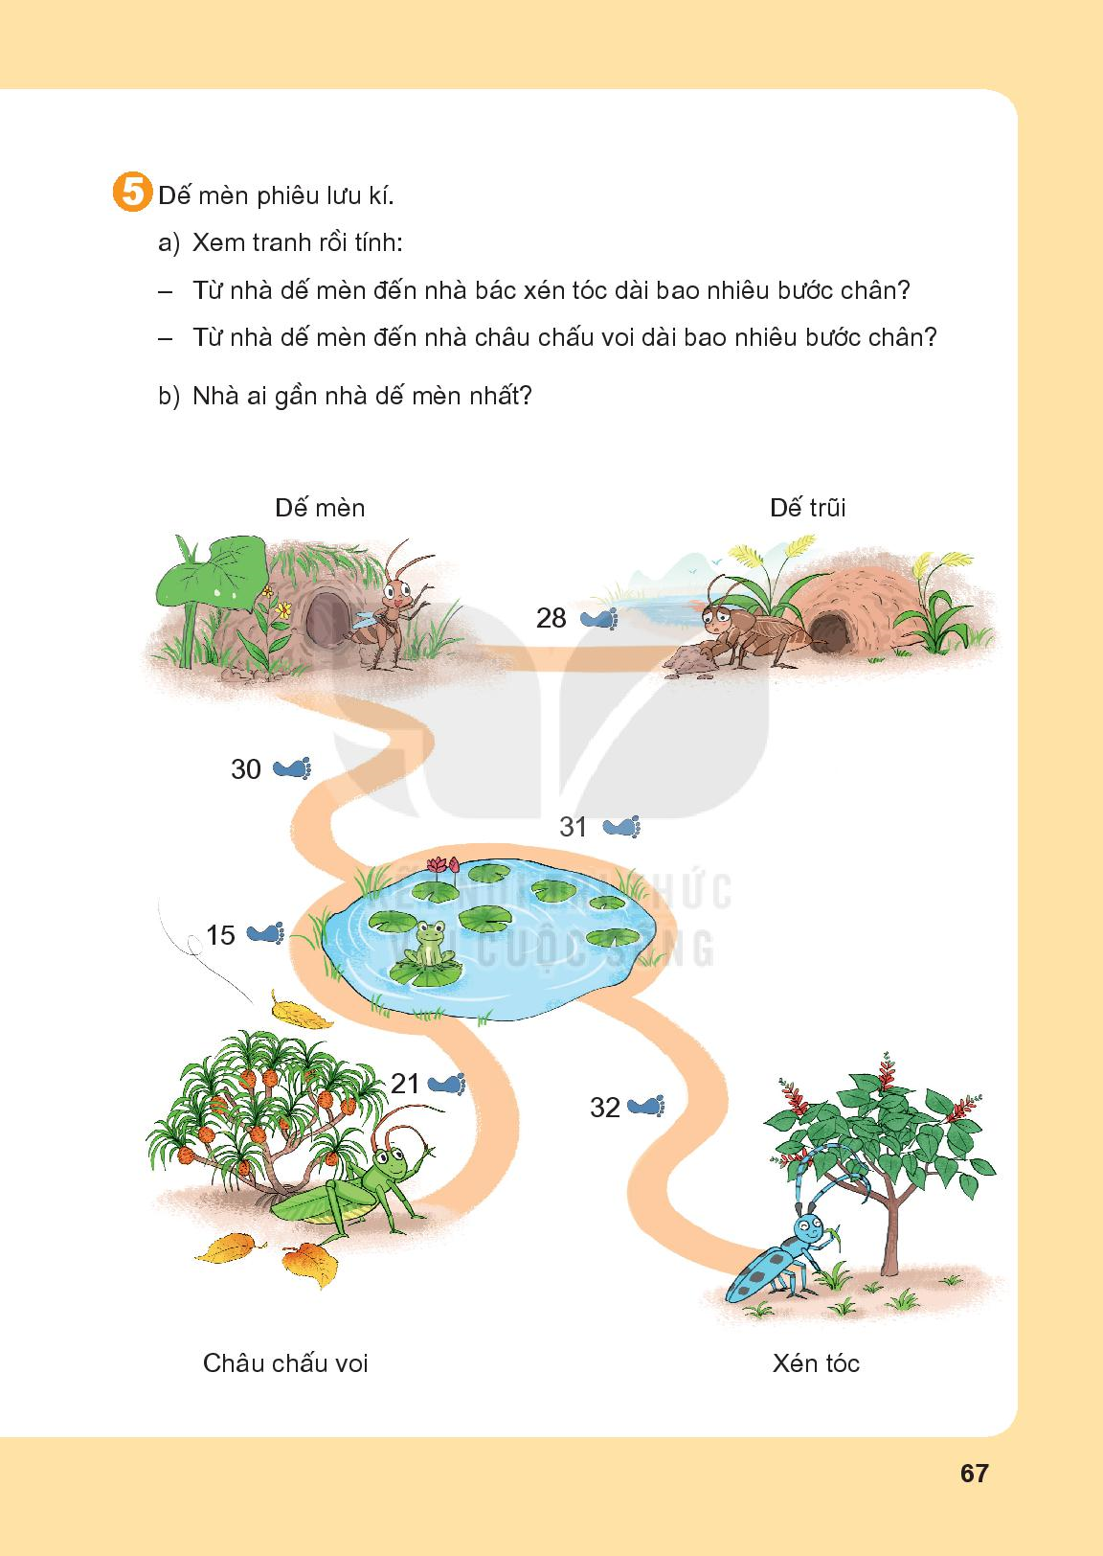

Slide 13
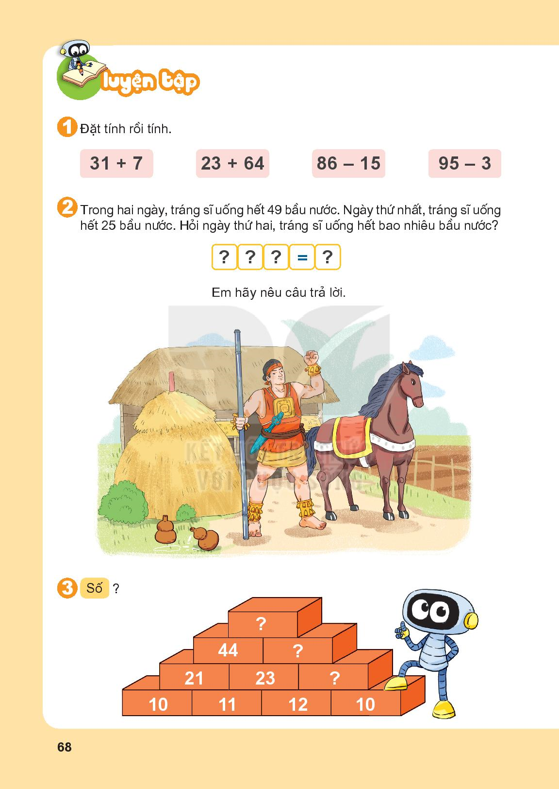

Slide 14
49
-
25
24

Slide 15
89
45
22

Slide 16
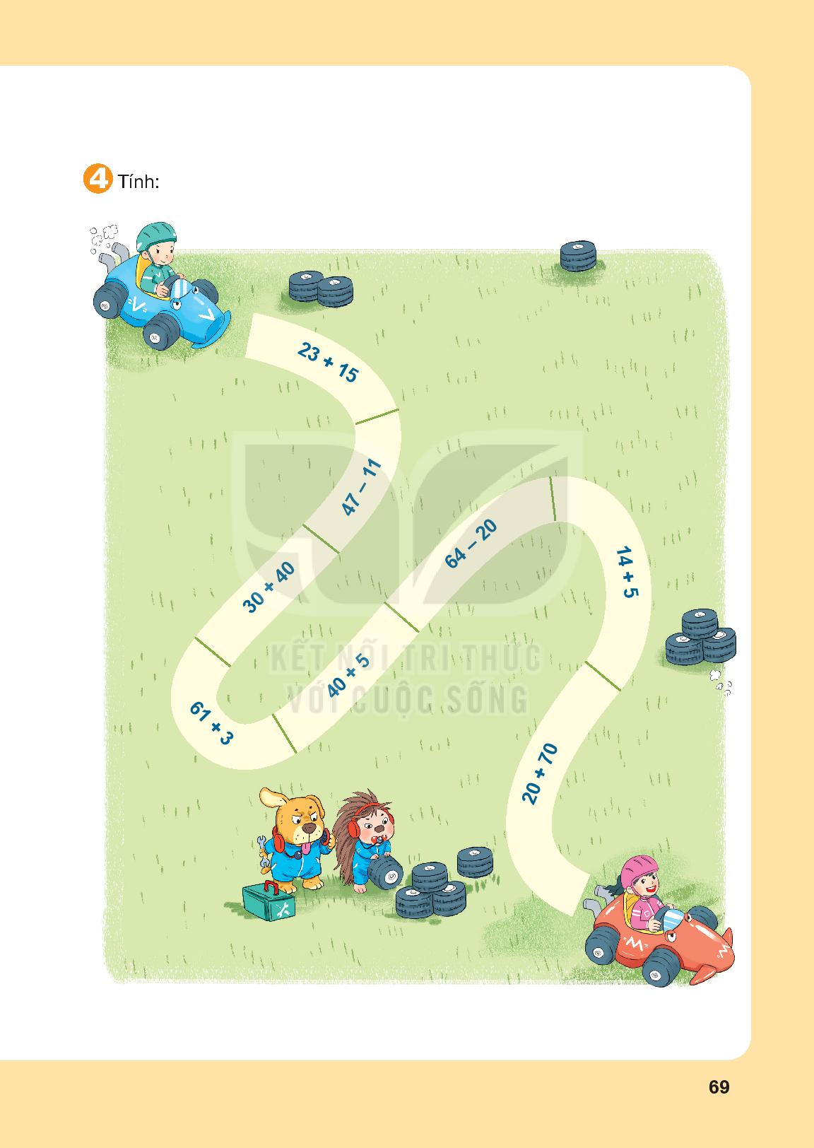
38
36
44
70
19
45
90
64

Slide 18
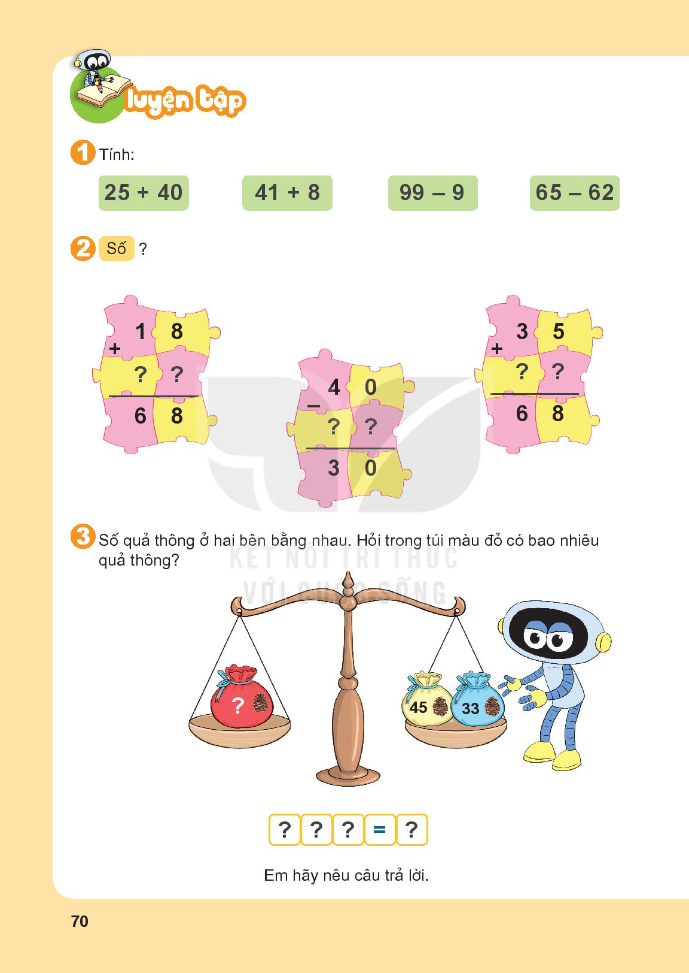
= 65
= 49
= 90
= 3

Slide 19
5
0
3
3
0
1
0

Slide 20
45
+
33
78

Slide 21
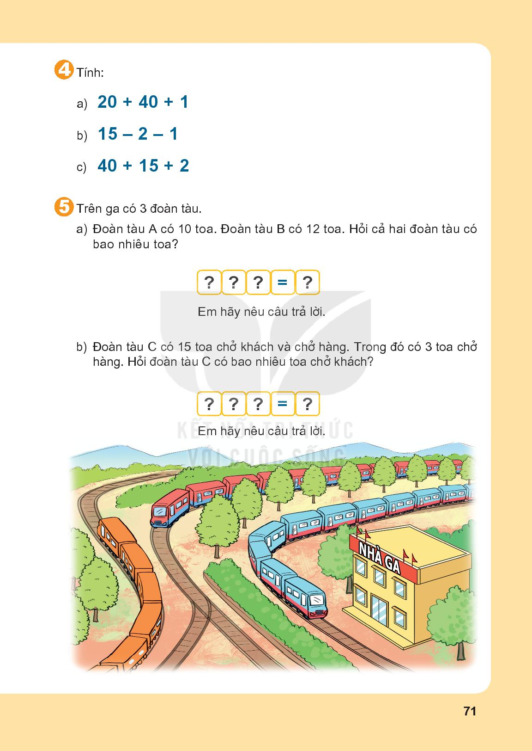
= 61
= 12
= 57

Slide 22
10
+
12
22

Slide 23
15
-
3
12

