Slide 1























Slide 2

Unit 1:
FAMILY AND FRIENDS
Lesson 2 – Part 1, 2, 3

Slide 3





Table of contents
01
02
Warm - up
Presentation
05
04
Wrap-up &
Assessment
Production
03
Practice

Slide 4



01
Warm up

Slide 5
02
Presentation

Slide 6
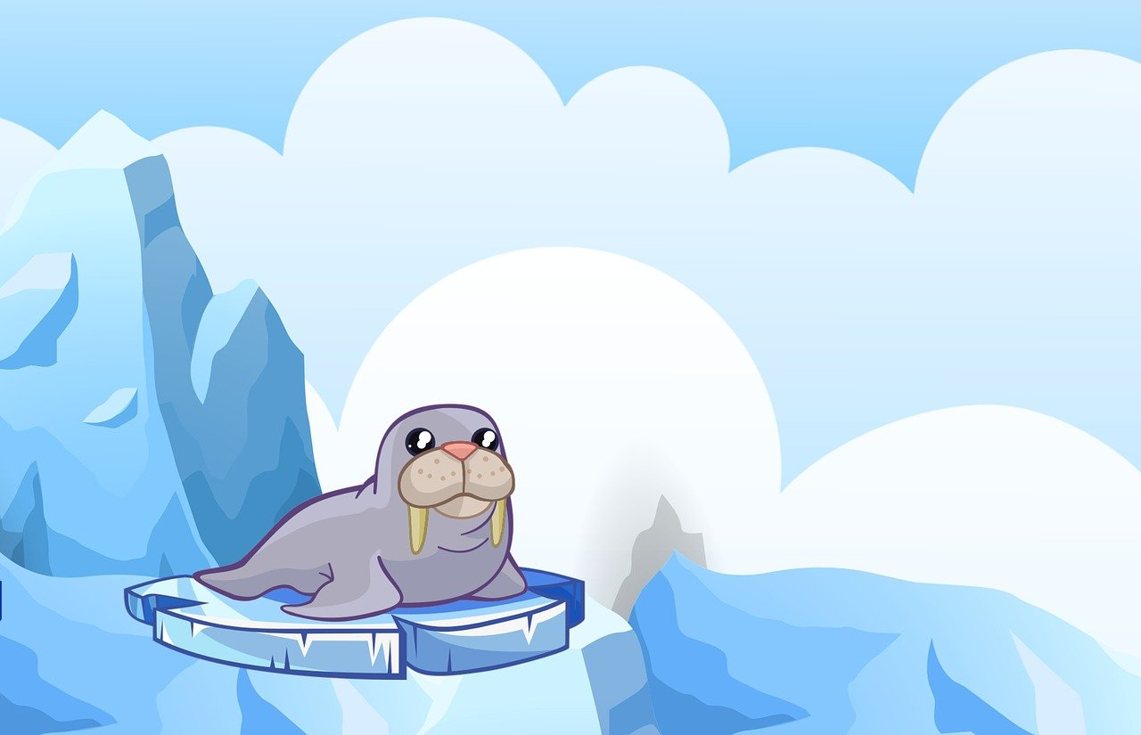
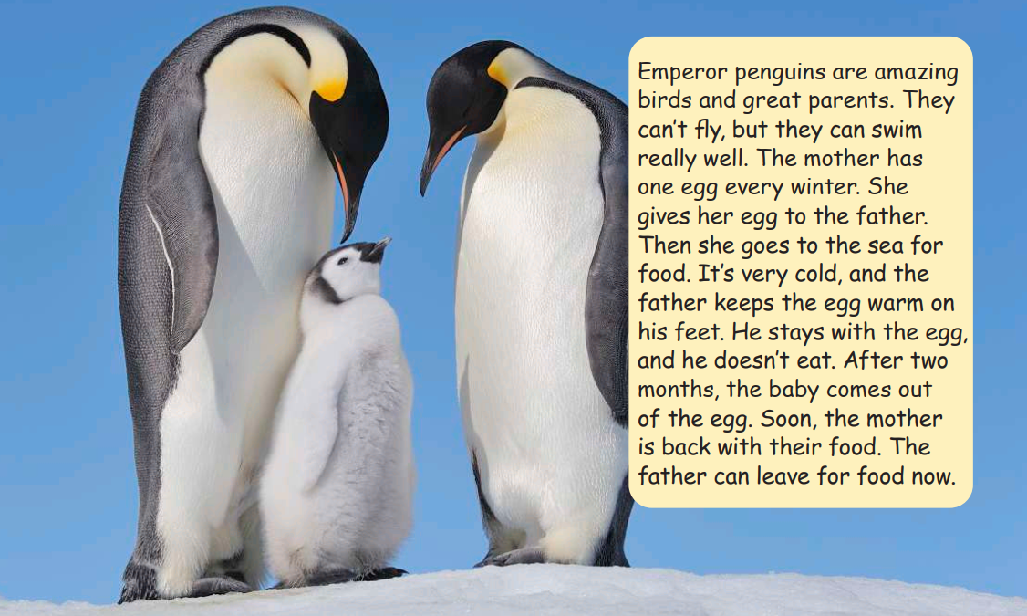
Emperor penguins are amazing birds and great parents. They can’t fly, but they can swim very well. The mother has one egg every winter. She gives her egg to the father. Then she goes to the sea for food. It’s very cold, and the father keep the egg warm on his feet. He stays with the egg, and he doesn’t eat. After two months, the baby comes out of the egg. Soon, the mother is back with their food. The father can leave for food now.

Slide 7


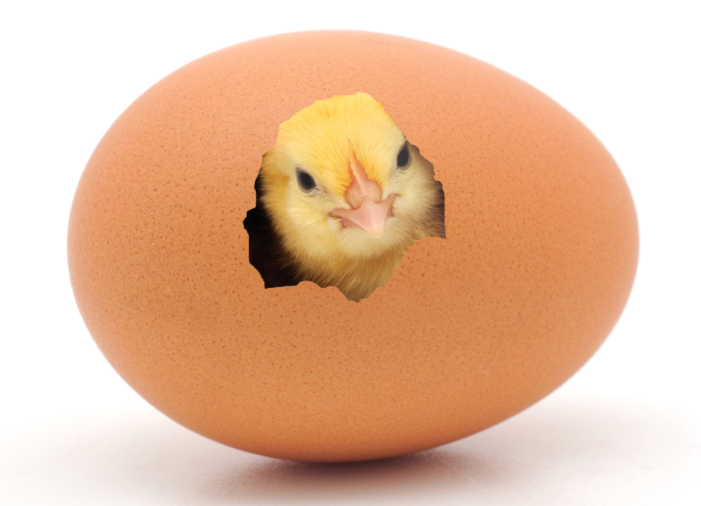

come out of

Slide 8

keep warm

Slide 9

leave

Slide 10


parents

Slide 11
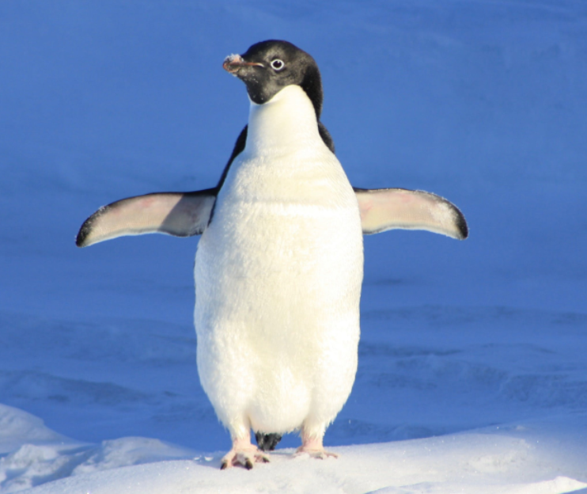
penguin

Slide 12

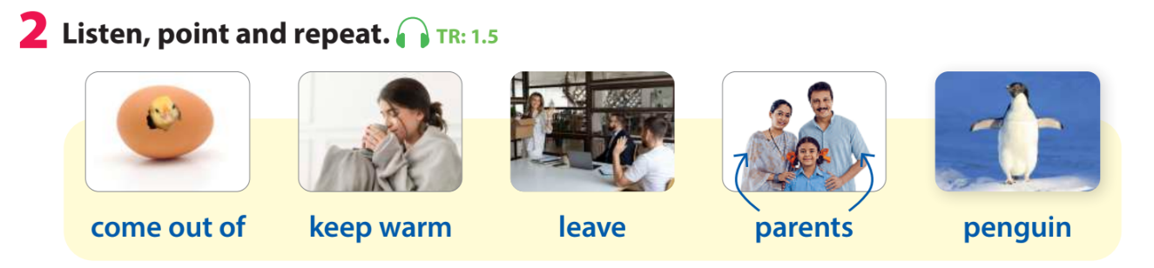


Slide 13


Let’s play a game!
Look and say the word

Slide 14
Look and say the word
leave

Slide 15
Look and say the word
parents

Slide 16
Look and say the word
Keep warm

Slide 17
Look and say the word
penguin

Slide 18
Look and say the word
come out of

Slide 19
03
Practice

Slide 20


Listen again. Then read.
Emperor penguins are amazing birds and great parents. They can’t fly, but they can swim very well. The mother has one egg every winter. She gives her egg to the father. Then she goes to the sea for food. It’s very cold, and the father keep the egg warm on his feet. He stays with the egg, and he doesn’t eat. After two months, the baby comes out of the egg. Soon, the mother is back with their food. The father can leave for food now.
How do emperor penguins keep their eggs warm?

Slide 21
Rearrange the sentences
?
The father can leave for food now.
?
The mother has one egg every winter.
?
He stays with the egg and he doesn’t eat.
?
The father keeps the egg warm on his feet.
?
After two months, the baby comes out of the egg.
?
She gives her egg to the father.

Slide 22
Rearrange the sentences
6
The father can leave for food now.
1
The mother has one egg every winter.
4
He stays with the egg and he doesn’t eat.
3
The father keeps the egg warm on his feet.
5
After two months, the baby comes out of the egg.
2
She gives her egg to the father.

Slide 23
Rearrange the sentences
1
The mother has one egg every winter.
2
She gives her egg to the father.
3
The father keeps the egg warm on his feet.
4
He stays with the egg and he doesn’t eat.
5
After two months, the baby comes out of the egg.
6
The father can leave for food now.

Slide 24
04
Production

Slide 25
05
Wrap-up &
Assessment

Slide 26


Thank you
& goodbye!

