Slide 1









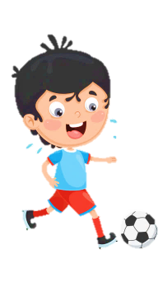













Slide 2
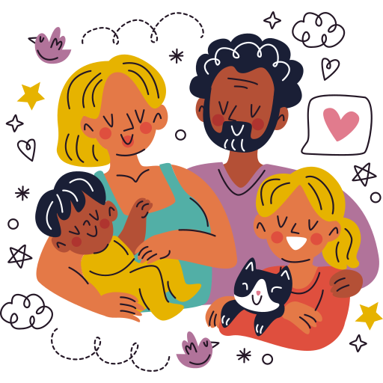
Unit 1:
FAMILY AND FRIENDS
Lesson 2 – Part 4, 5, 6

Slide 3





Table of contents
01
02
Warm - up
Presentation
05
04
Wrap-up & Assessment
Production
03
Practice

Slide 4


01 Warm up

Slide 5


Slide 6

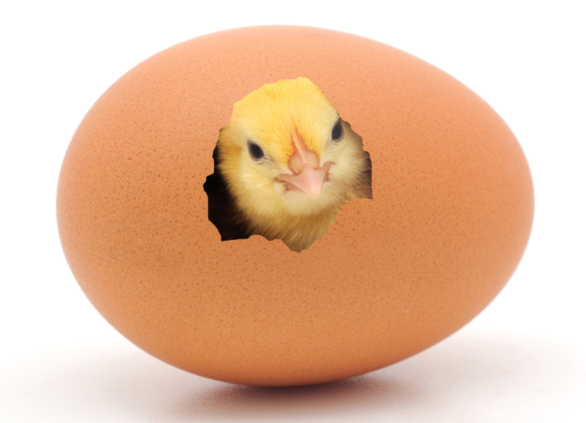
Order the words
moce tou fo
=> come out of

Slide 7
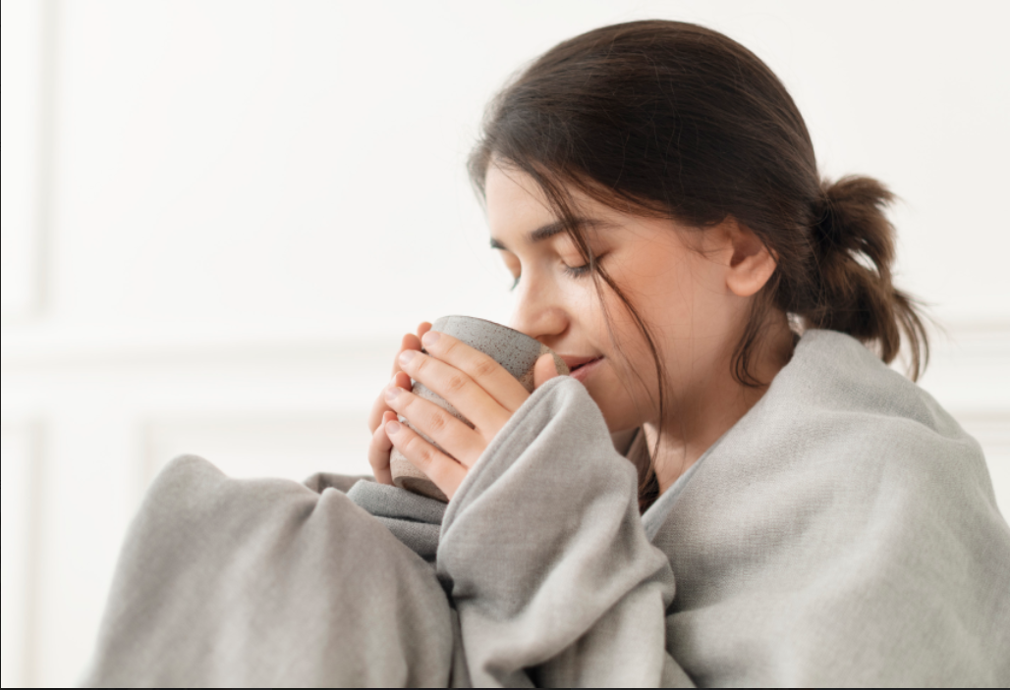
Order the word
peke rwma
=> keep warm

Slide 8

Order the word
veale
=> leave

Slide 9
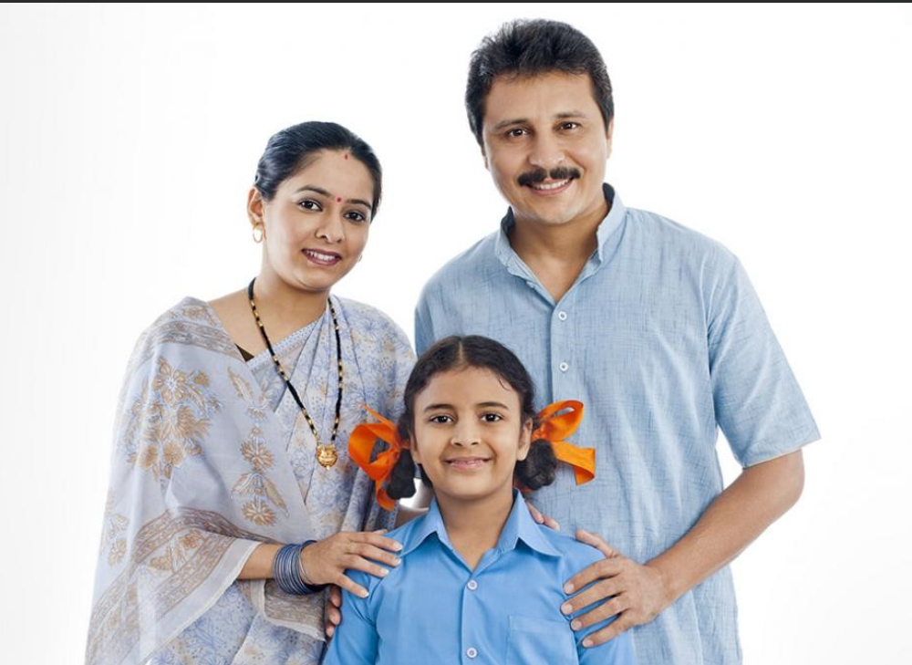
Order the word
srpetna
=> parents

Slide 10
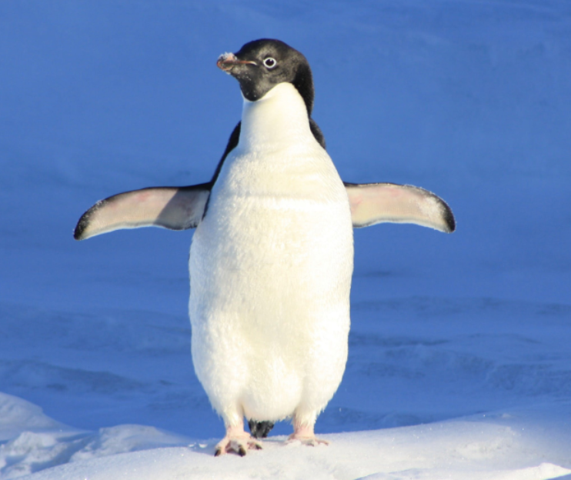
Order the word
ennpgiu
=> penguin

Slide 11
02 Presentation

Slide 12

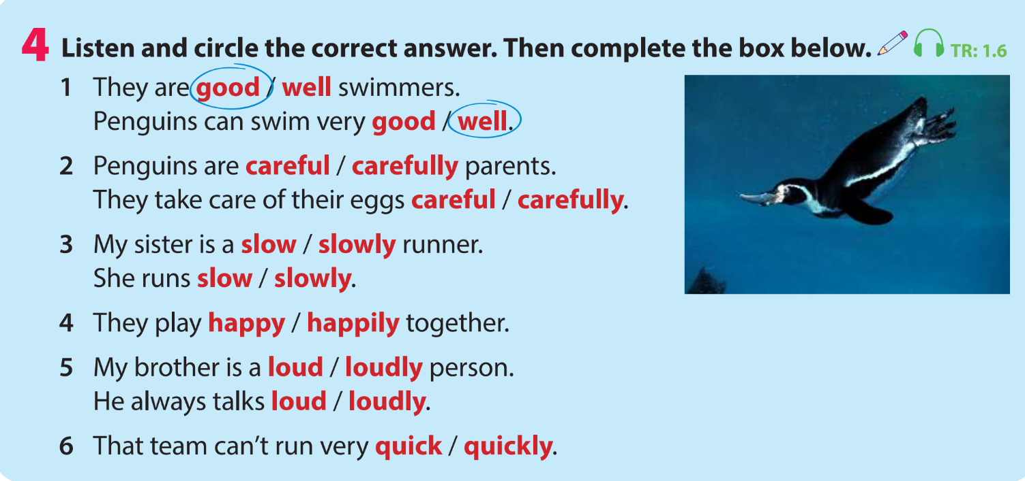

Slide 13

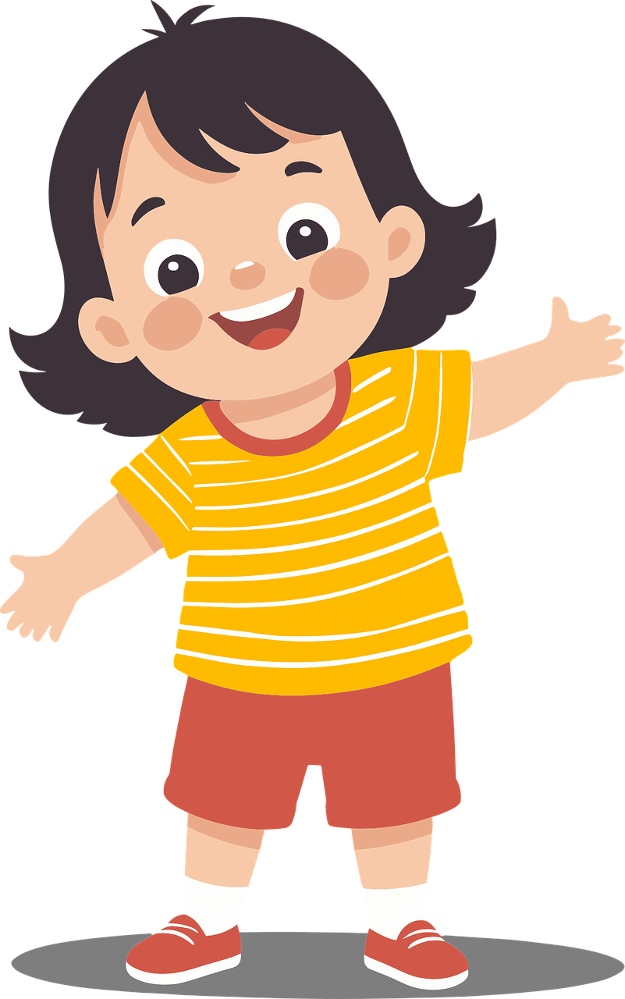
She is a happy girl.
noun
+
adjective
The adjective comes before the noun.

Slide 14

The cat dances happily.
verb
adverb
+
The adverb comes after the verb.

Slide 15


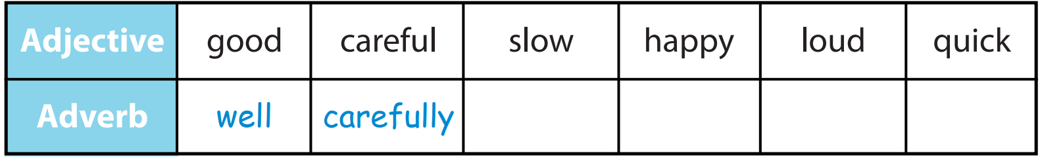

Complete the box below
slowly
loudly
quickly
happily

Slide 16
03 Practice

Slide 17

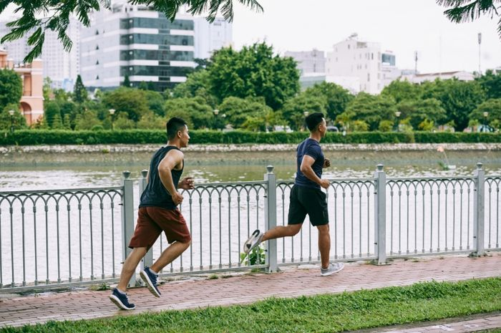

Who can run quickly?
Minh
Nam
Nam can run quickly.

Slide 18
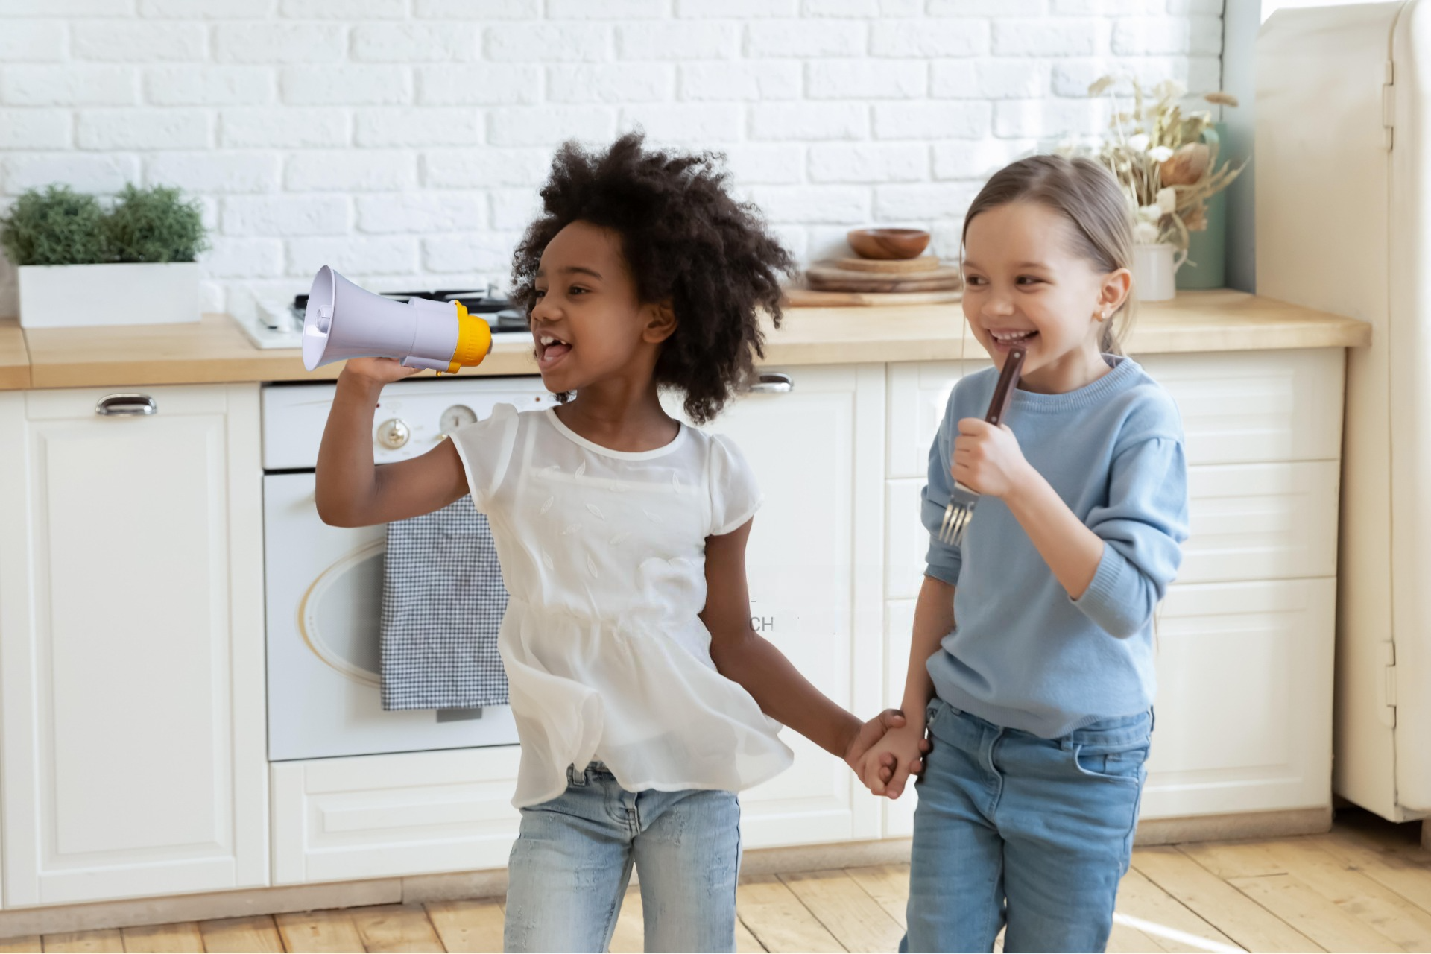

Who can sing loudly?
Mary
Mia
Mia can sing loudly.

Slide 19
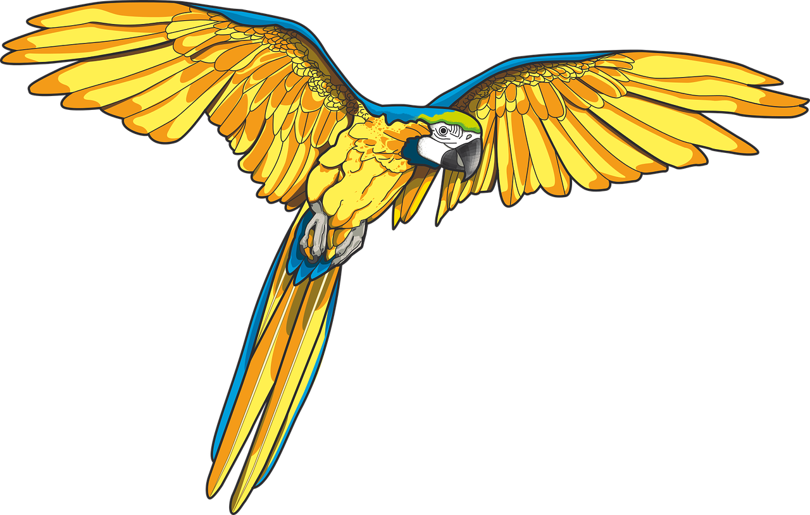


Which animal can fly well?
Parrots can fly well.

Slide 20
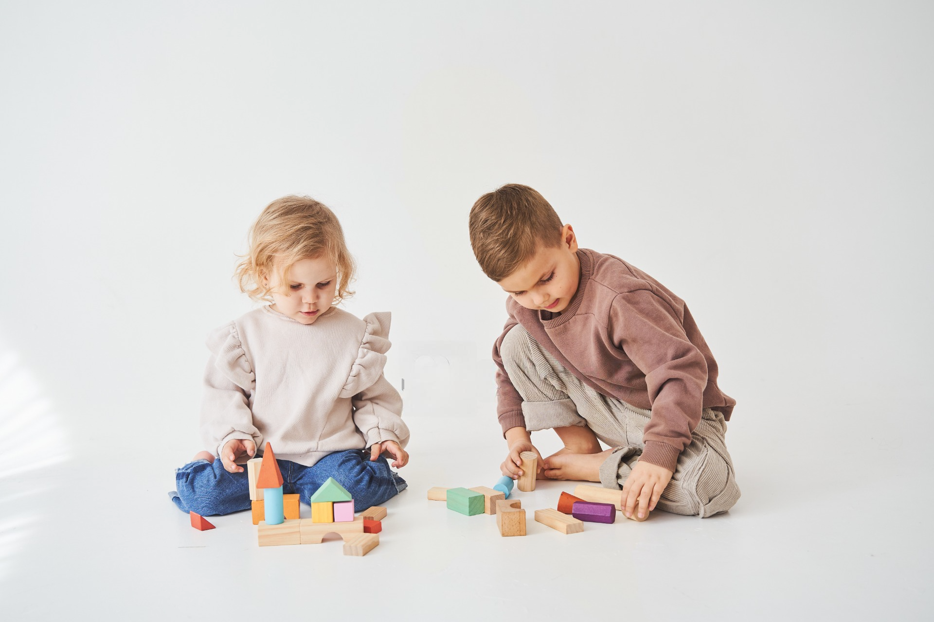
Who can build things carefully?
Peter
Anna
Anna can build things carefully.

Slide 21
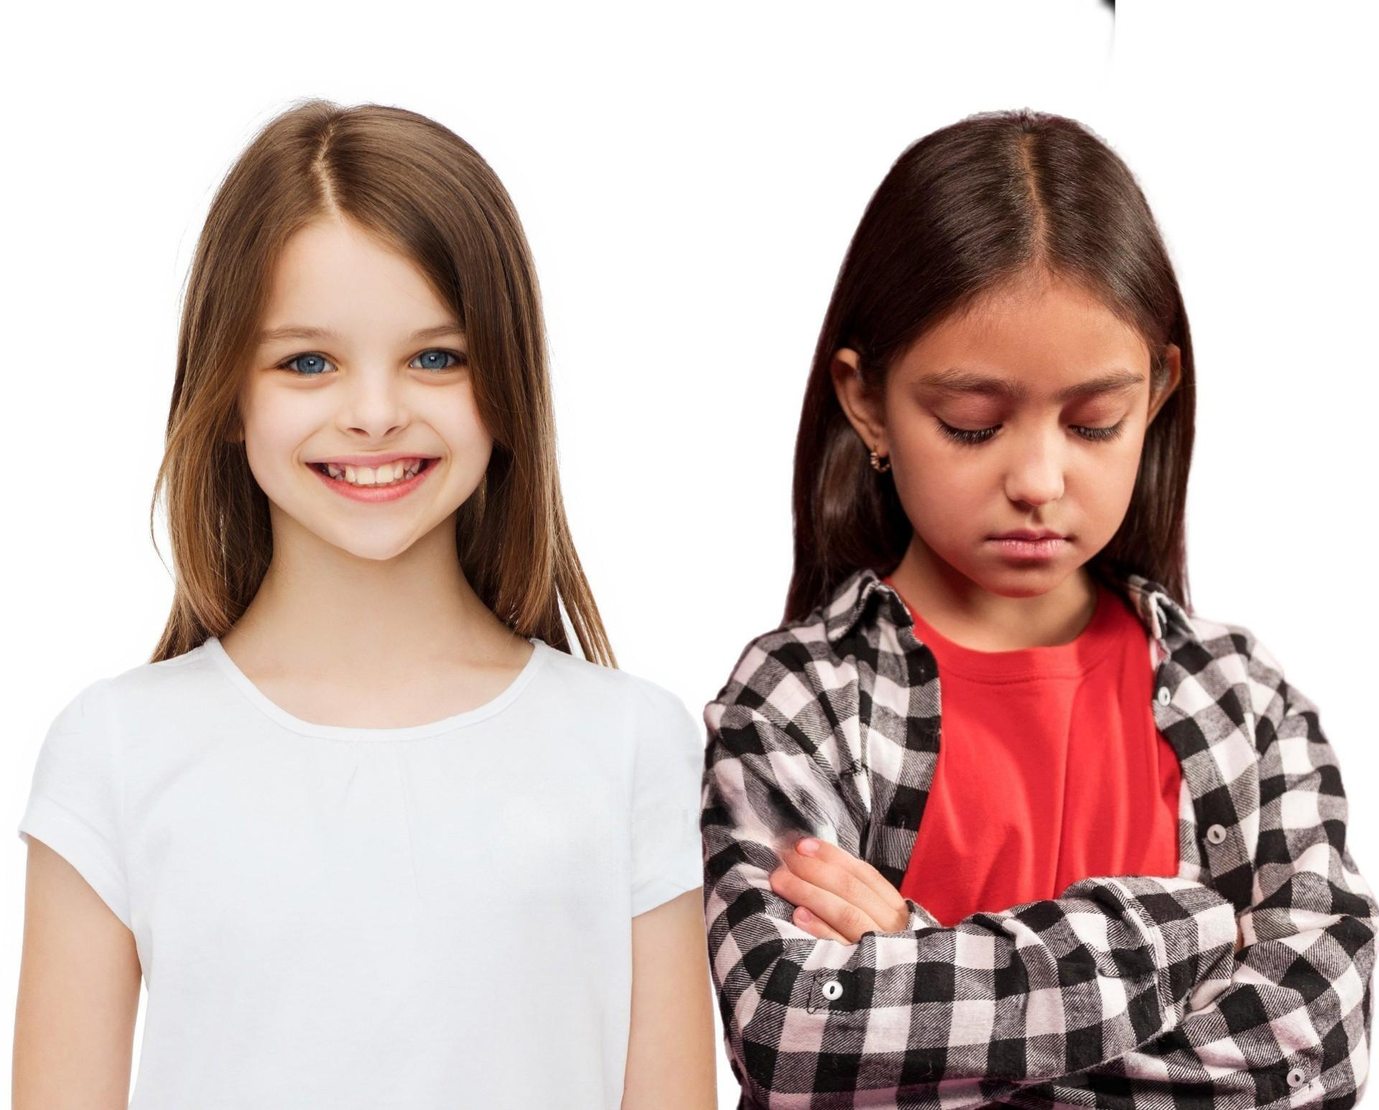

Who can smile happily?
Shally
Tina
Tina can smile happily.

Slide 22
04 Production

Slide 23

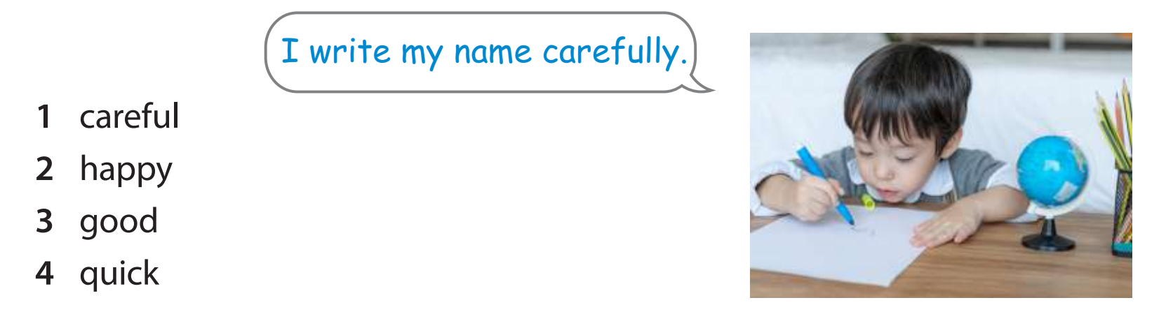
I laugh happily.
I cook well.
I can run quickly.

Slide 24
05 Wrap-up & Assessment

Slide 25


Listen and write
Listen and write
slowly
My dad walks ______.

Slide 26
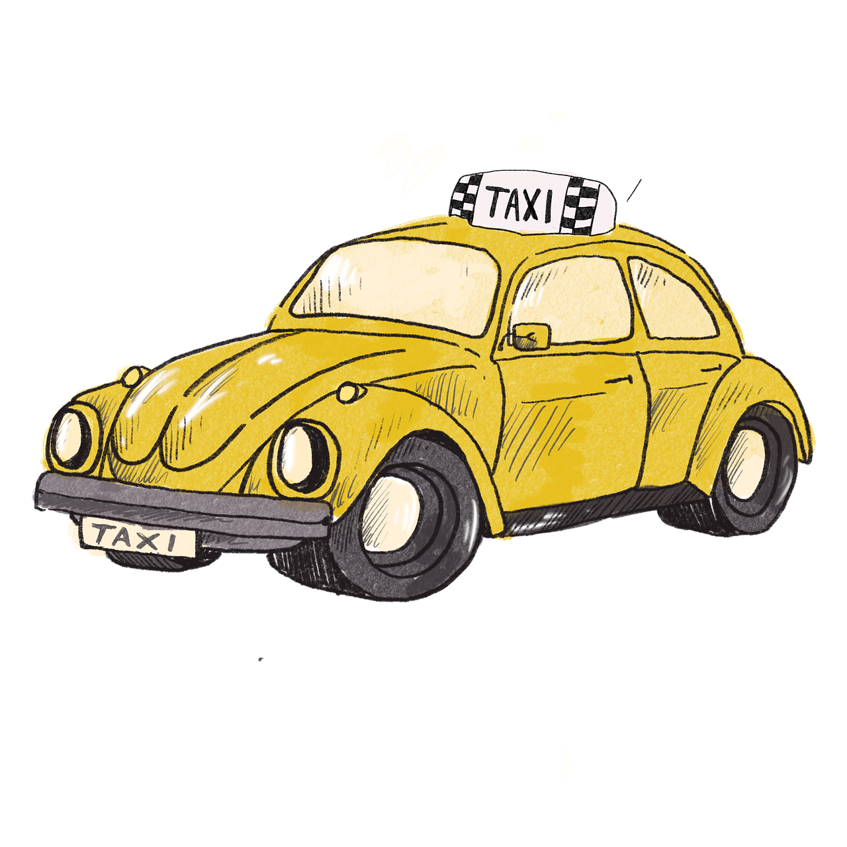
Listen and write
Listen and write
careful
John is a ______ taxi driver.

Slide 27

Listen and write
Listen and write
well
Anna can speak English very _____.

Slide 28
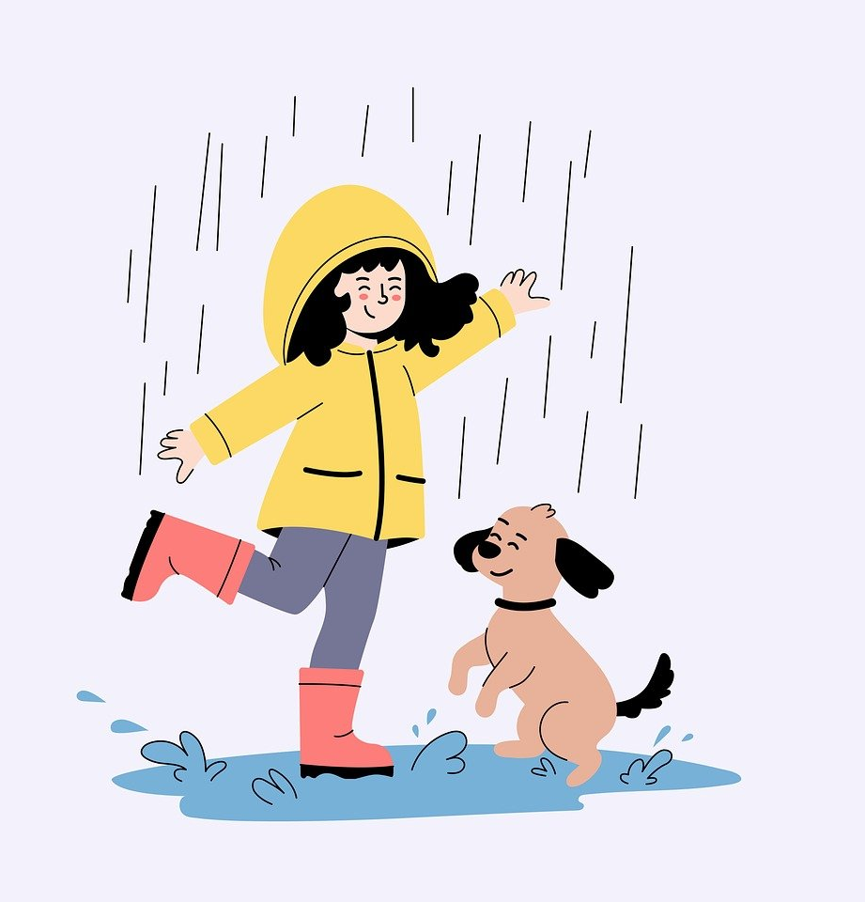
Listen and write
Listen and write
happily
They play ______ in the rain.

Slide 29

Wrap up
Unit 1: Family and friends Lesson 2 – Part 4,5,6
What have we learnt today?
Adverbs:
well, carefully, slowly, loudly, quickly

Slide 30

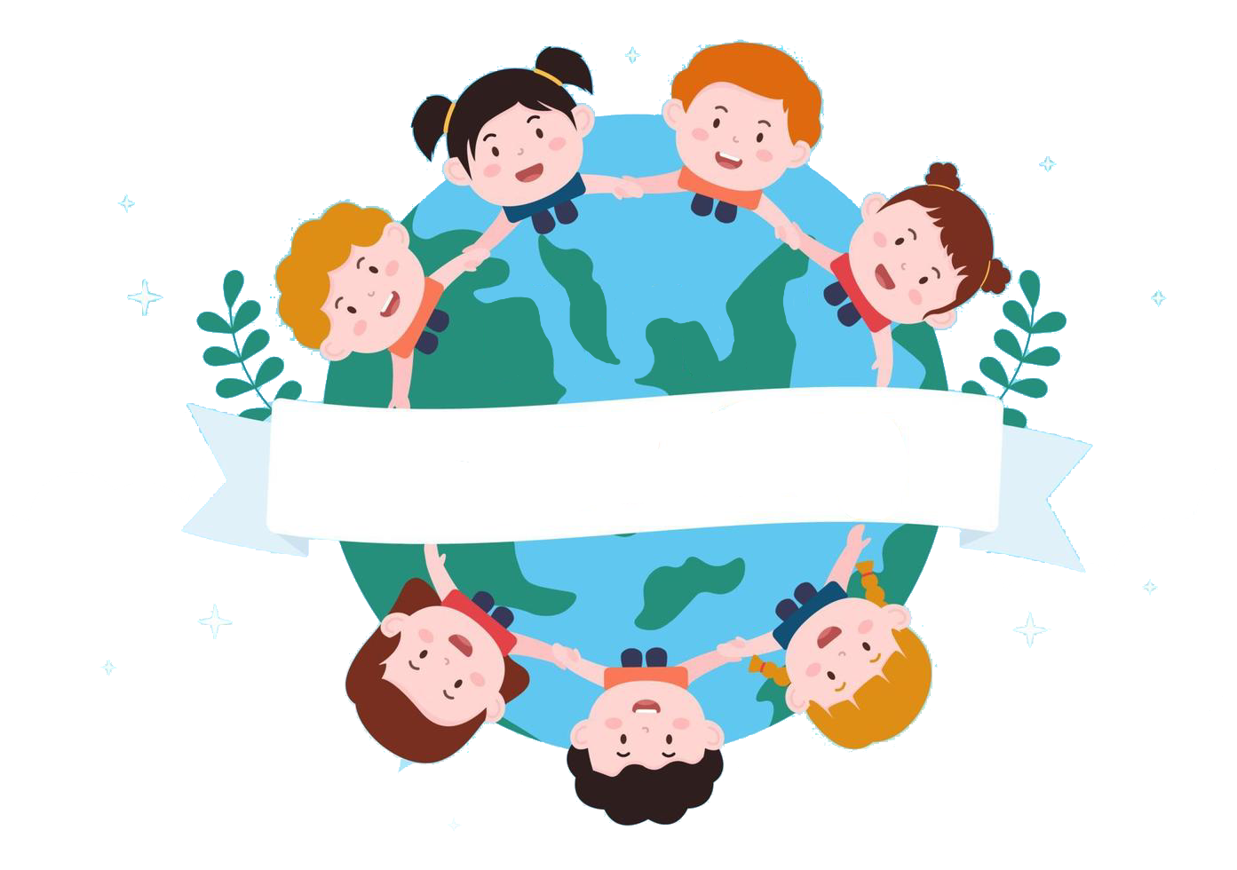
Thank you
& goodbye!

