Slide 1









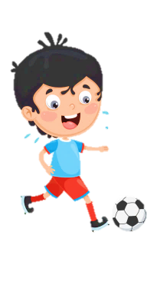













Slide 2
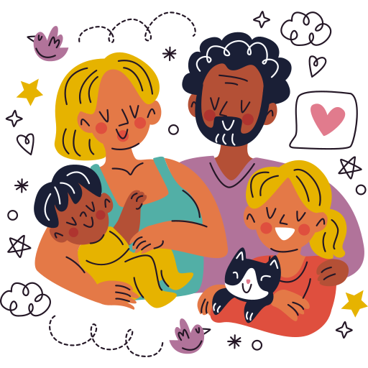
Unit 1:
FAMILY AND FRIENDS
Lesson 3 – Part 1, 2, 3

Slide 3





Table of contents
01
02
Warm - up
Presentation
05
04
Wrap-up & Assessment
Production
03
Practice

Slide 4
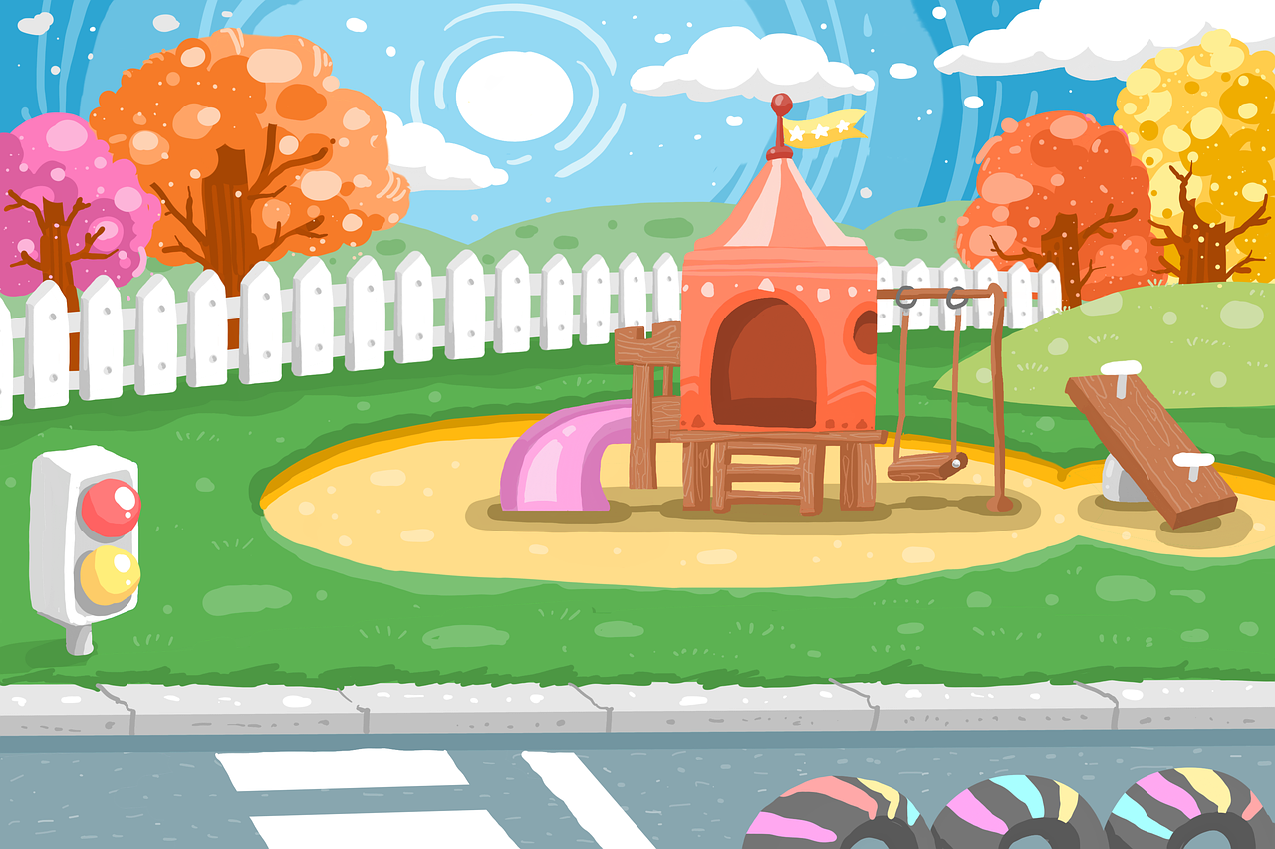


01
Warm up

Slide 5
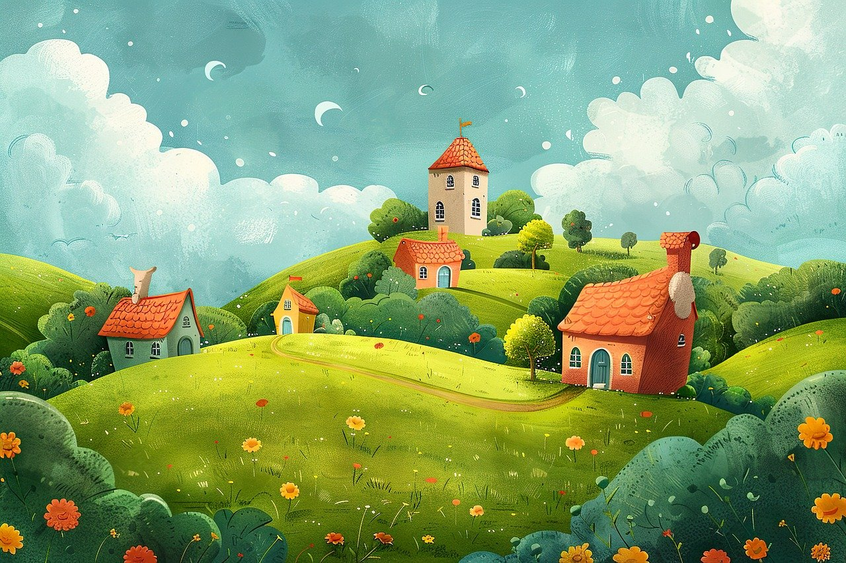

Look and choose
happy
good
careful
well
carefully
loudly
slow
loud
happily
slowly
adjectives
adverbs

Slide 6
02
Presentation

Slide 7

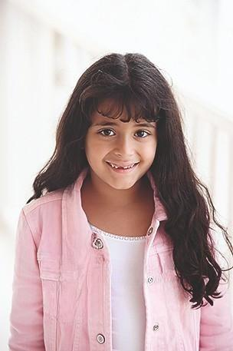
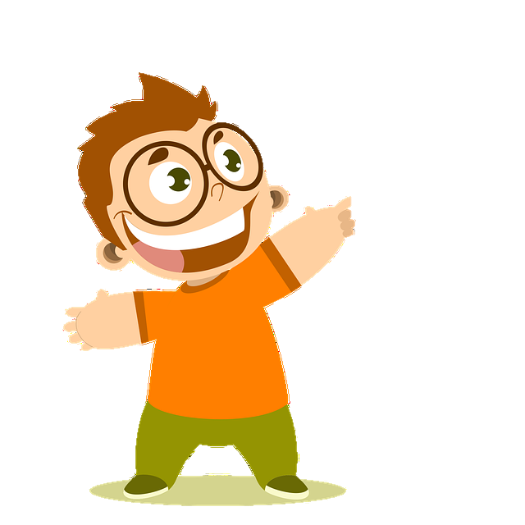
long

Slide 8
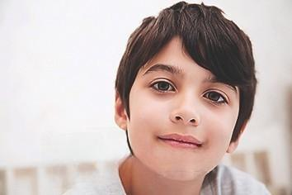
dark

Slide 9
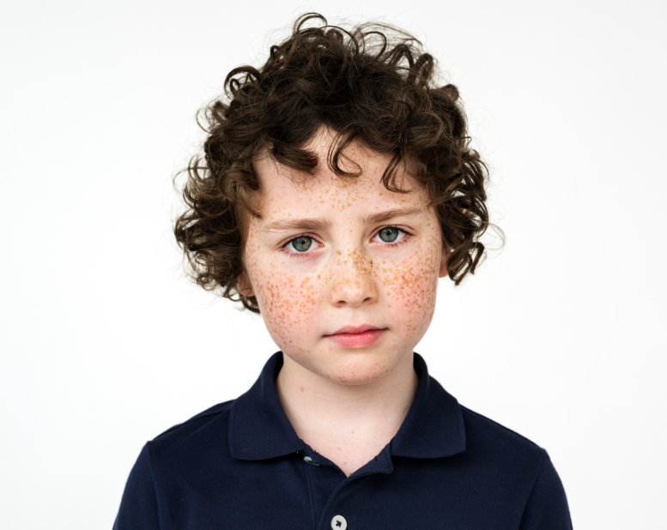
curly

Slide 10
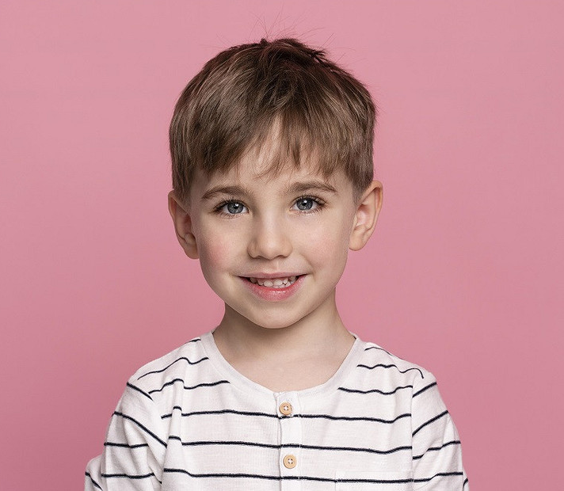
short

Slide 11
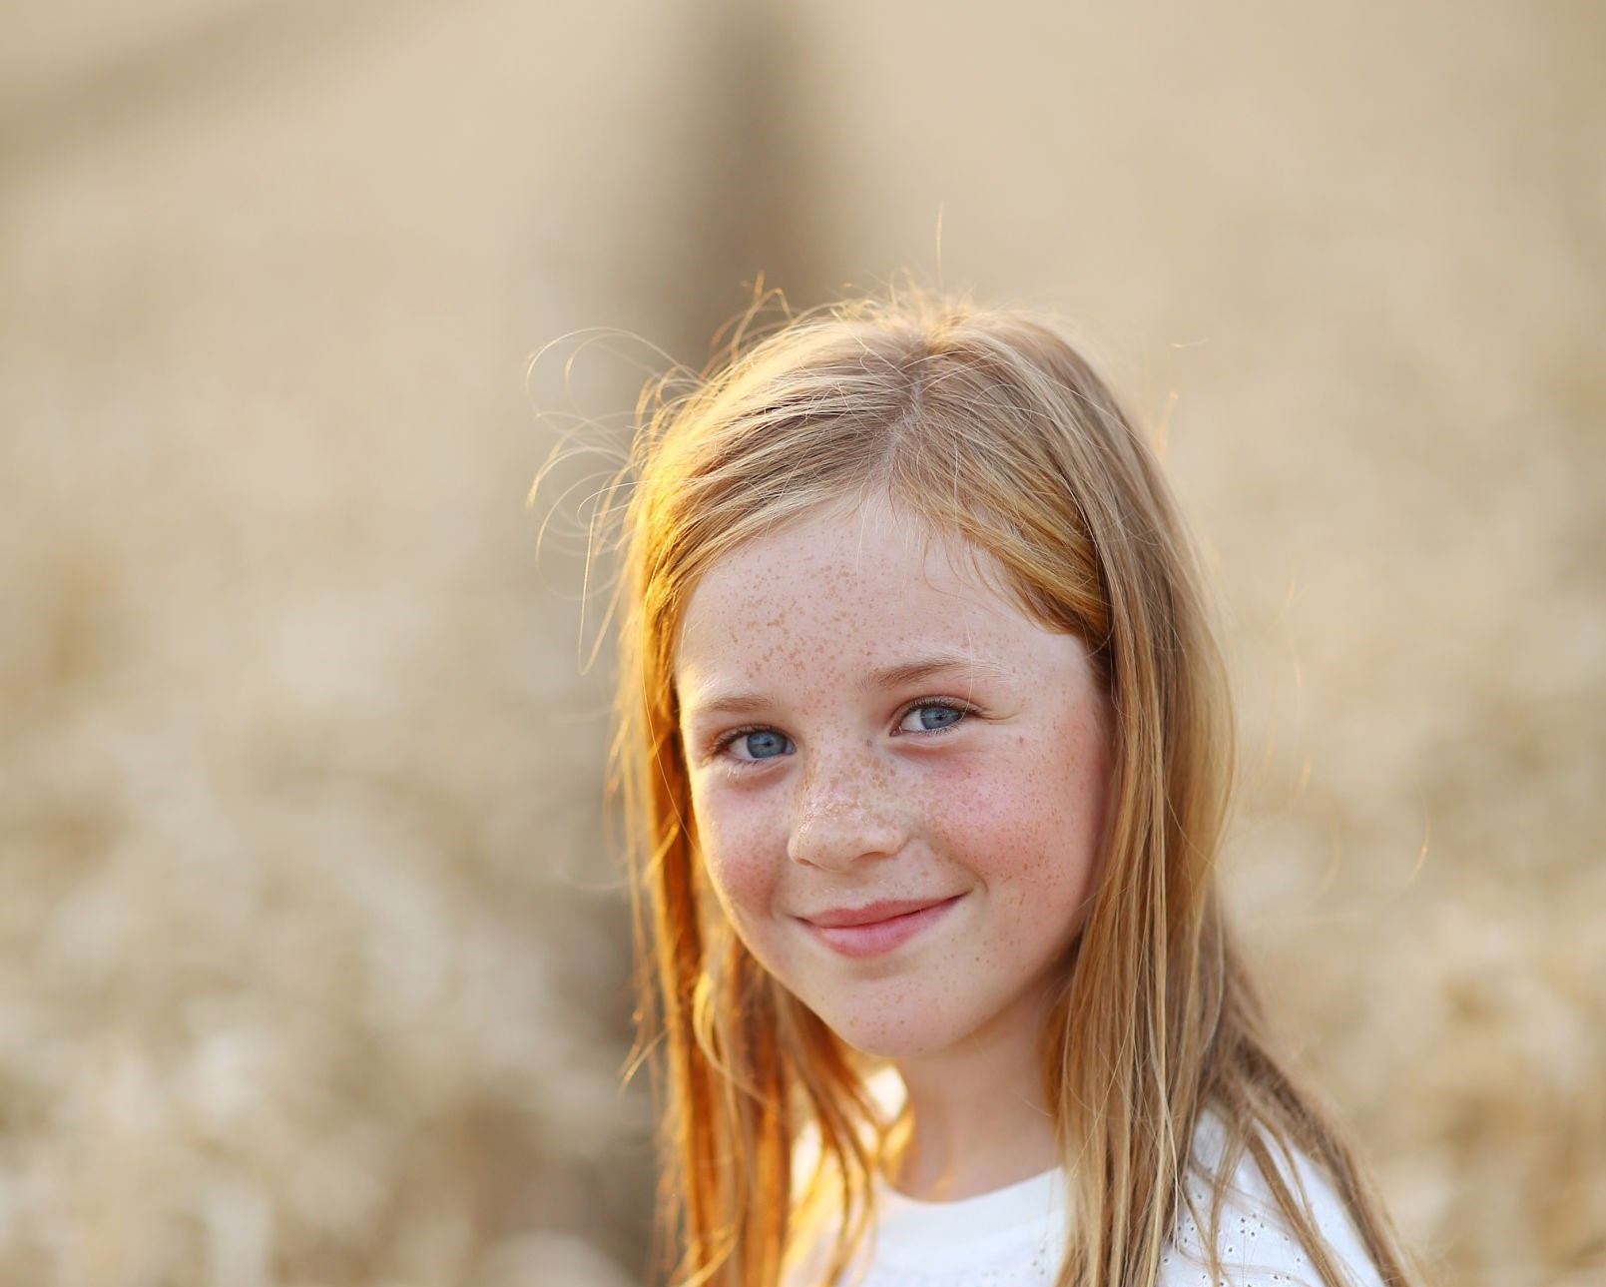
fair

Slide 12
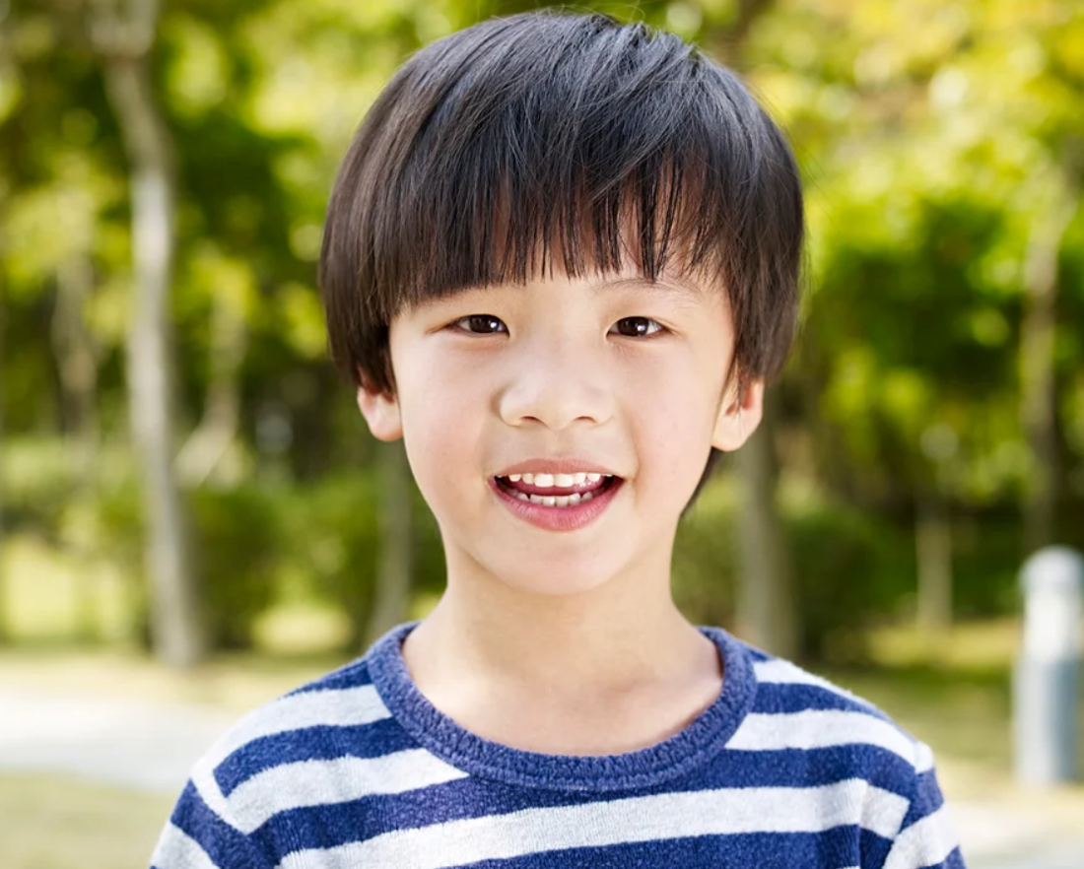
straight

Slide 13

Look at his hair?
It’s short.

Slide 14
Look at his hair?
It’s straight.

Slide 15
Look at her hair?
It’s fair.

Slide 16
Look at his hair?
It’s curly.

Slide 17
Look at his hair?
It’s dark.

Slide 18
Look at her hair?
It’s long.

Slide 19
03
Practice

Slide 20
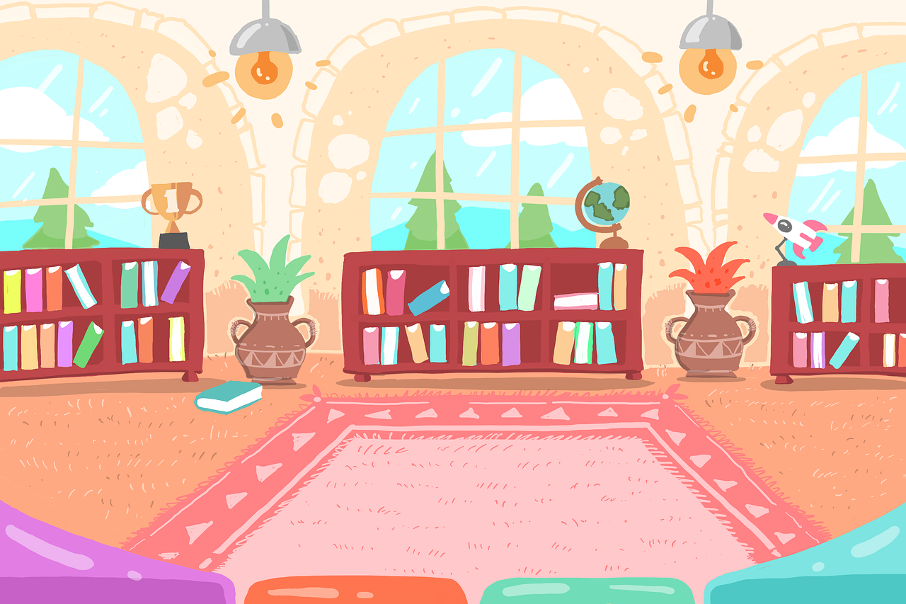

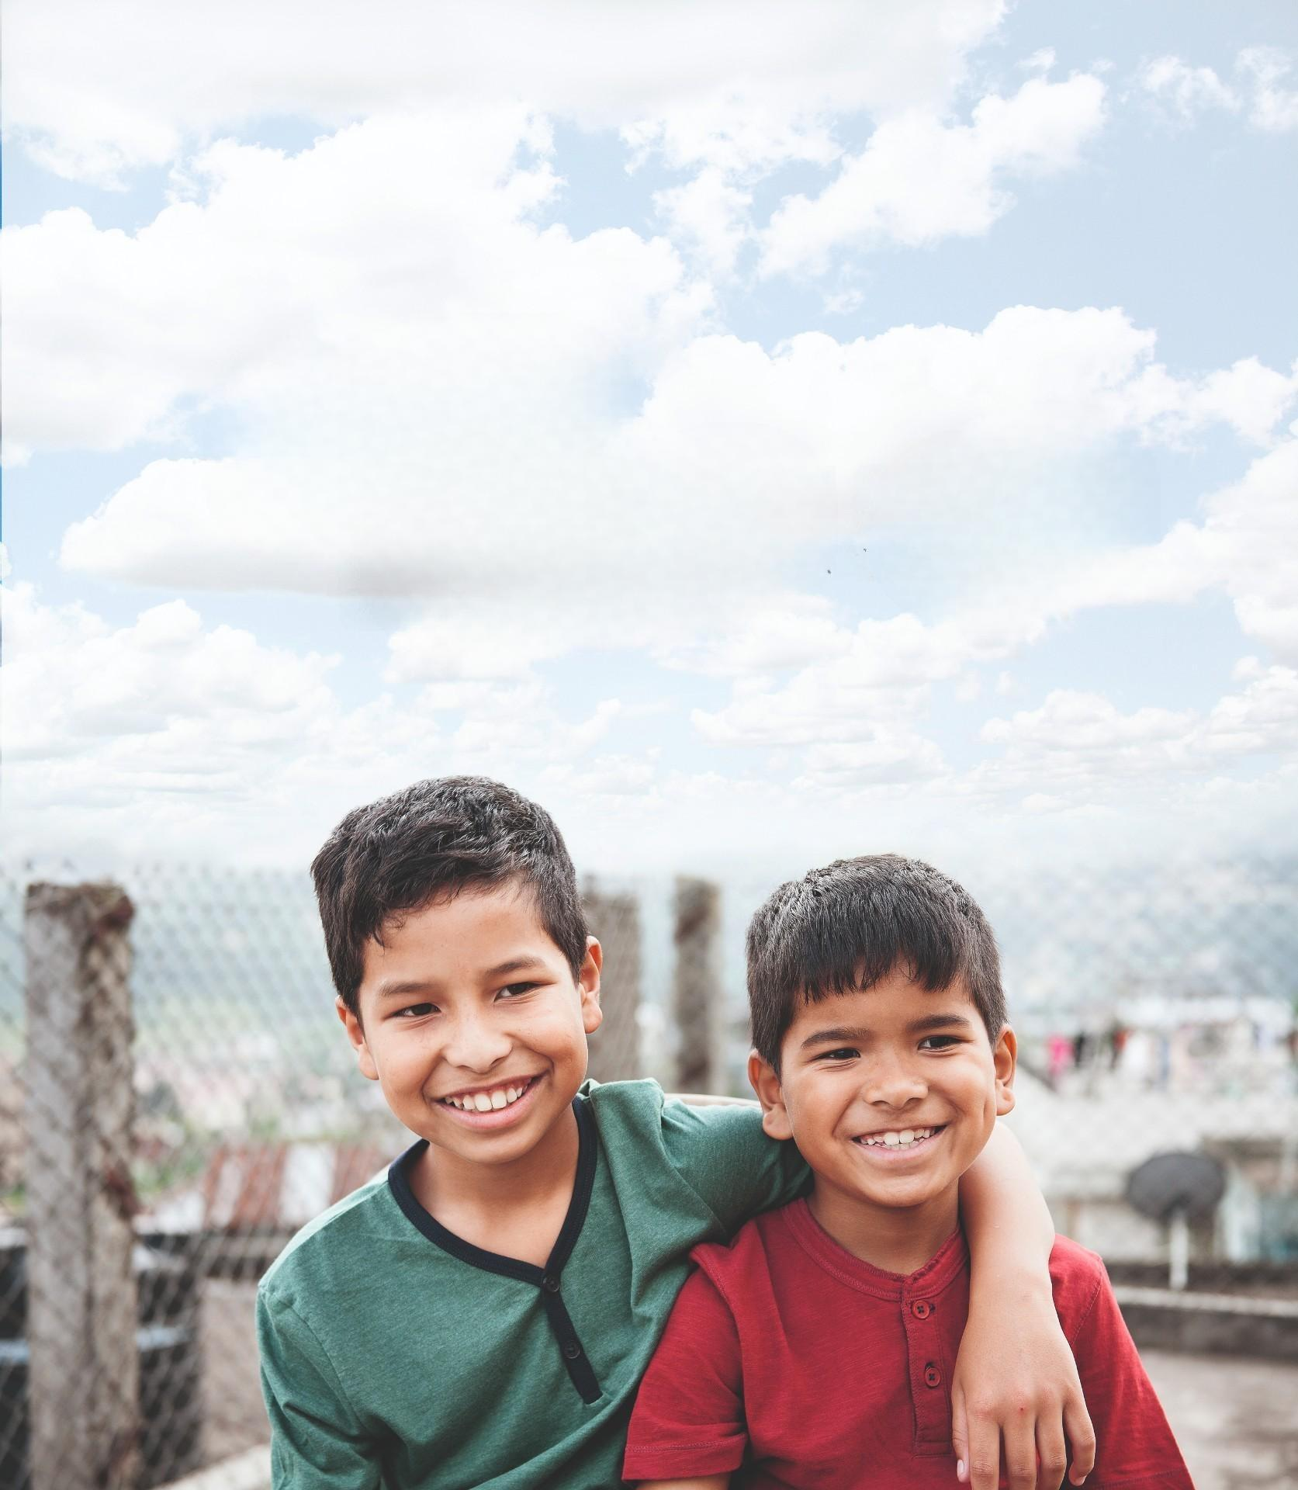

Pre-listening:
Look and guess
Who are they?
Where are they?
What do they look like?
Are they happy?

Slide 21

1 Errol is 11 years old.
2 Errol’s best friends are Eshan and Yann.
3 The brother has got fair hair.
4 Their birthdays are on different days.
✔
✔
✔

Slide 22
04
Production

Slide 23
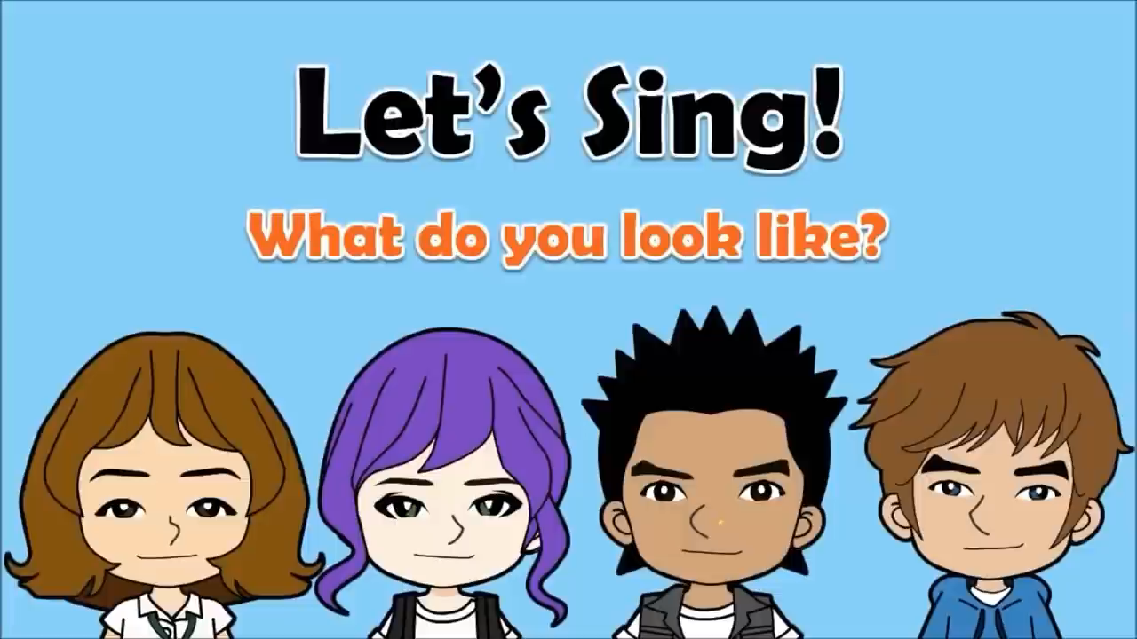

Slide 24
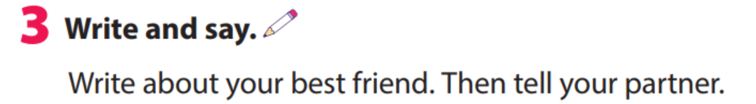

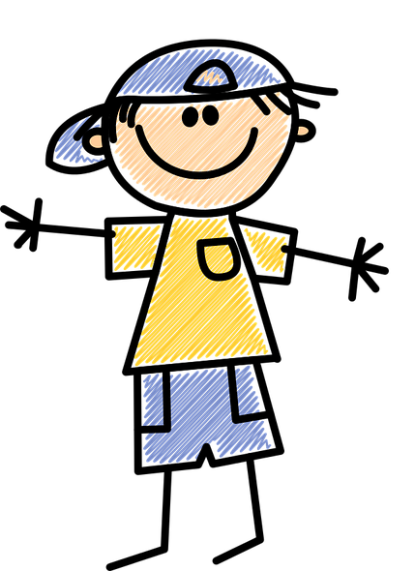
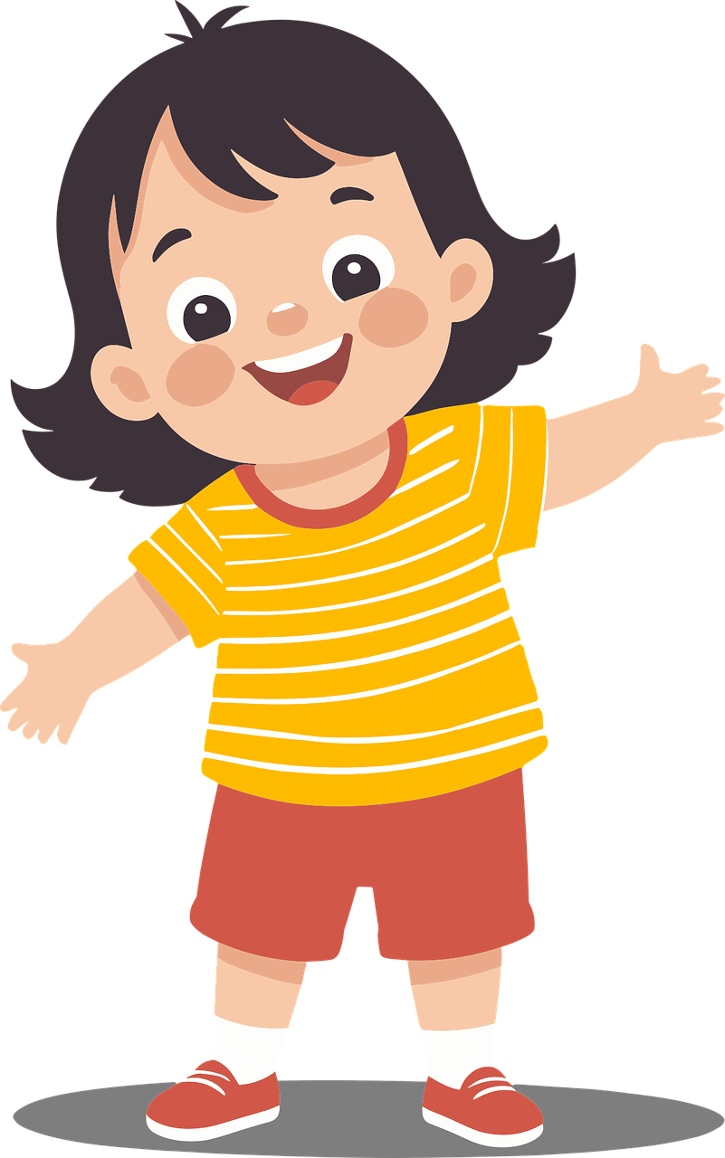
Hello,
My name is Lan.
I’m nine years old.
I’m from Vietnam.
My best friend is Minh.
His hair is dark, and his eyes are brown.
He’s very clever.

Slide 25

Hello!
My name is _____.
I’m _____ years old.
I’m from _______.
My best friend is ______.
Her/His hair is ____.
Her/His eyes are ____.
She/He’s very ____.

Slide 26
05
Wrap-up &
Assessment

Slide 27
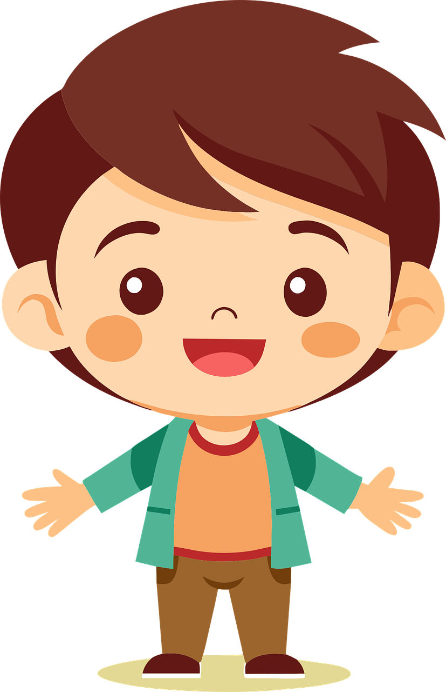
Look and choose
His hair is ______.
1. short and fair
2. long and dark
3. short and dark

Slide 28
Look and choose
He has ______ hair and ______ eyes.
1. curly/brown
2. short/ blue
3. straight/brown

Slide 29

Look and choose
He has ______ hair and he’s ______.
1. blue/loud
2. dark/ clever
3. short/tall

Slide 30

Look and choose
Jane’s hair is ______.
1. long/dark
2. curly/ dark
3. curly/fair

Slide 31

Wrap up
Unit 1: Family and friends Lesson 3 – Part 1,2,3
What have we learnt today?
- New words: curly, straight, long, short, fair, dark
- Writing and talking about a best friend

Slide 32

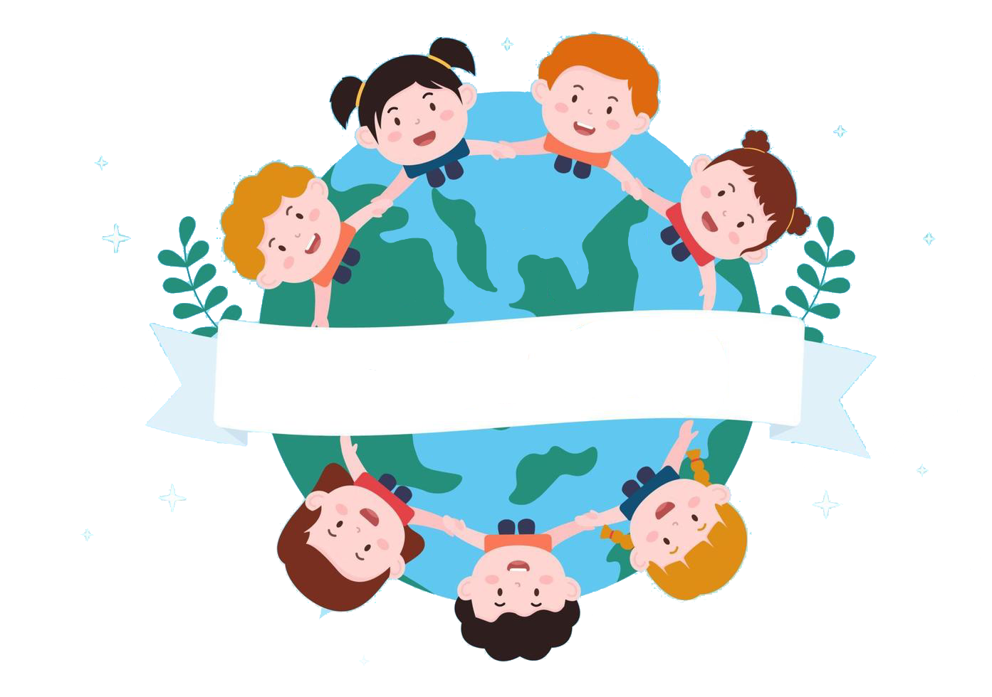
Thank you
& goodbye!

