Slide 1









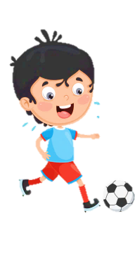











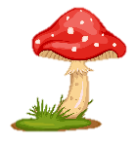

Slide 2
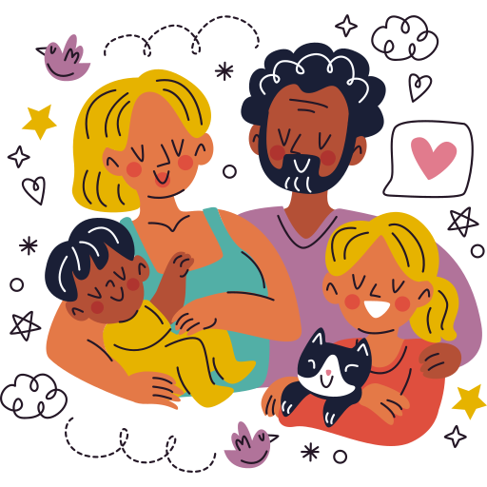
Unit 1:
FAMILY AND FRIENDS
Lesson 3 – Part 4, 5, 6

Slide 3





Table of contents
01
02
Warm - up
Presentation
05
04
Wrap - up &
Assessment
Production
03
Practice

Slide 4



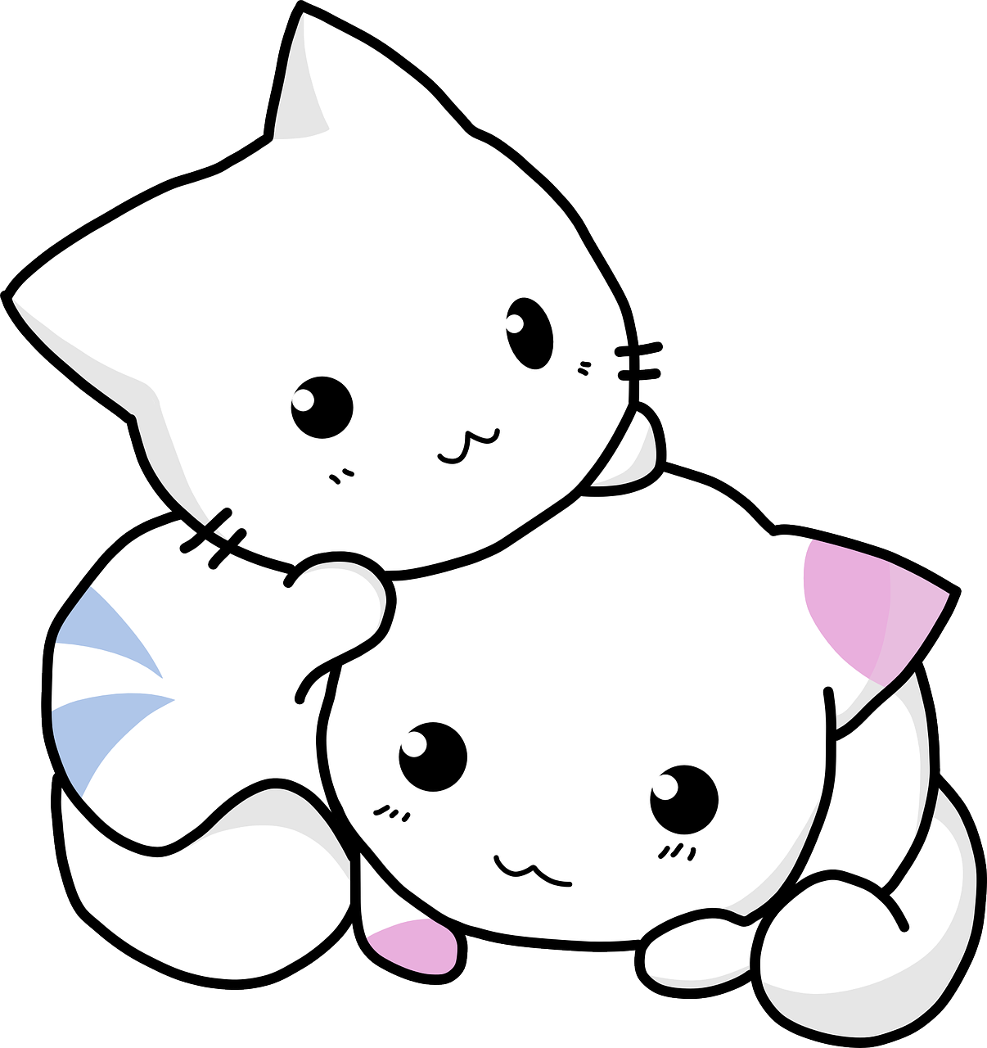
01
Warm up

Slide 5
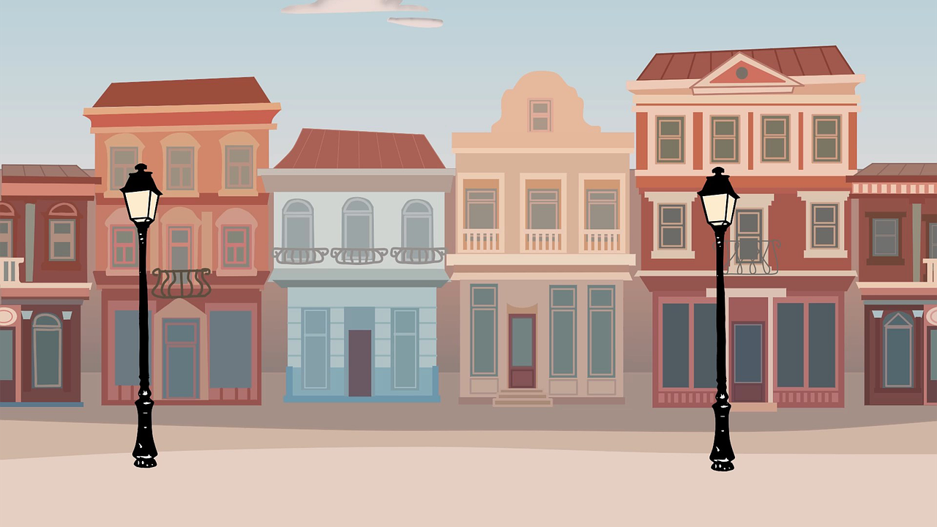
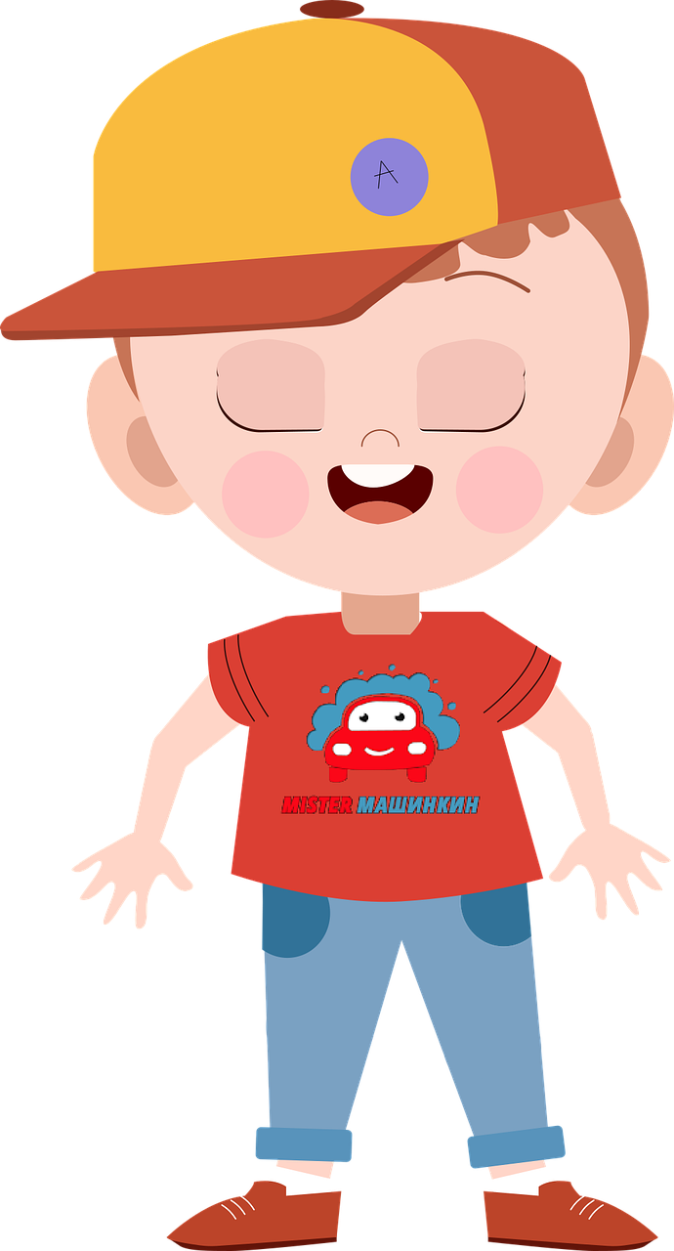
Who is it in a family?
co_s_n
u
i

Slide 6
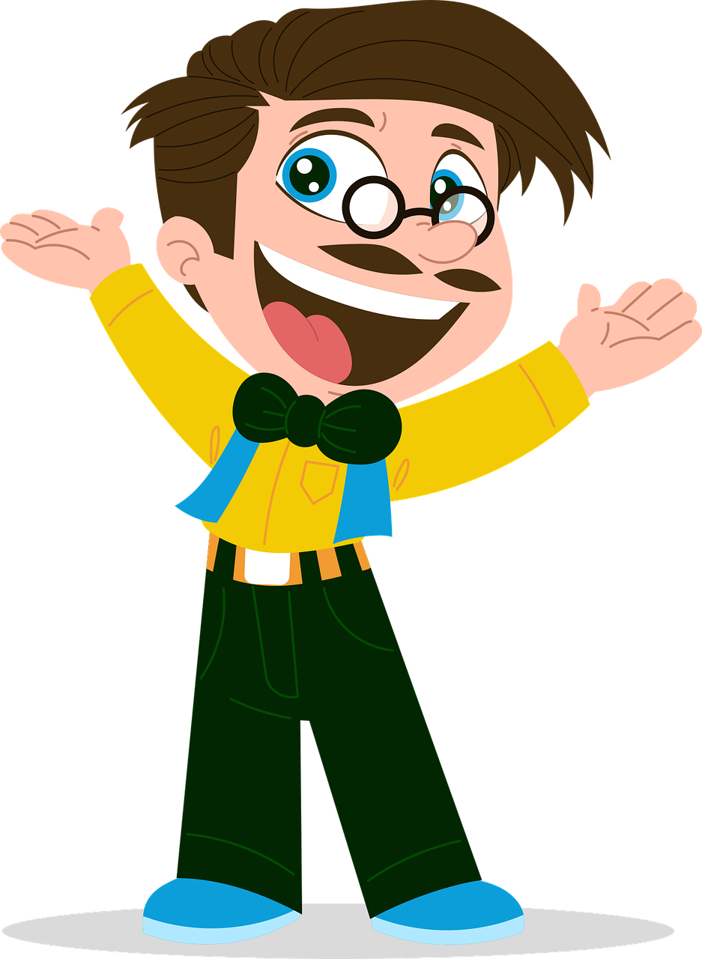
Who is it in a family?
un_ _ _
c
l
e

Slide 7

Who is it in a family?
a_n_
u
t

Slide 8

Who is it in a family?
n_p_e_
e
h
w

Slide 9
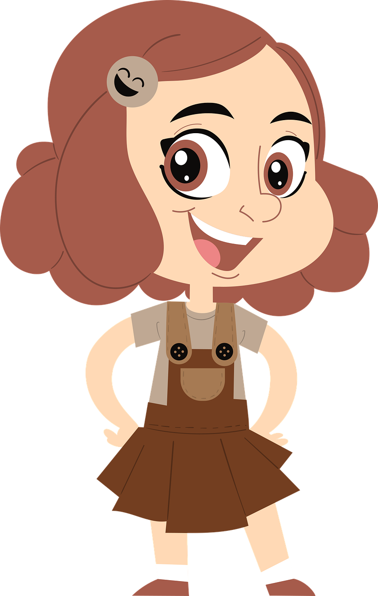
Who is it in a family?
n
_ie_ _
c
e

Slide 10
02
Presentation

Slide 11

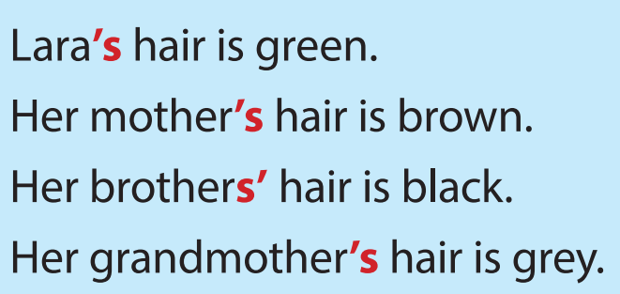



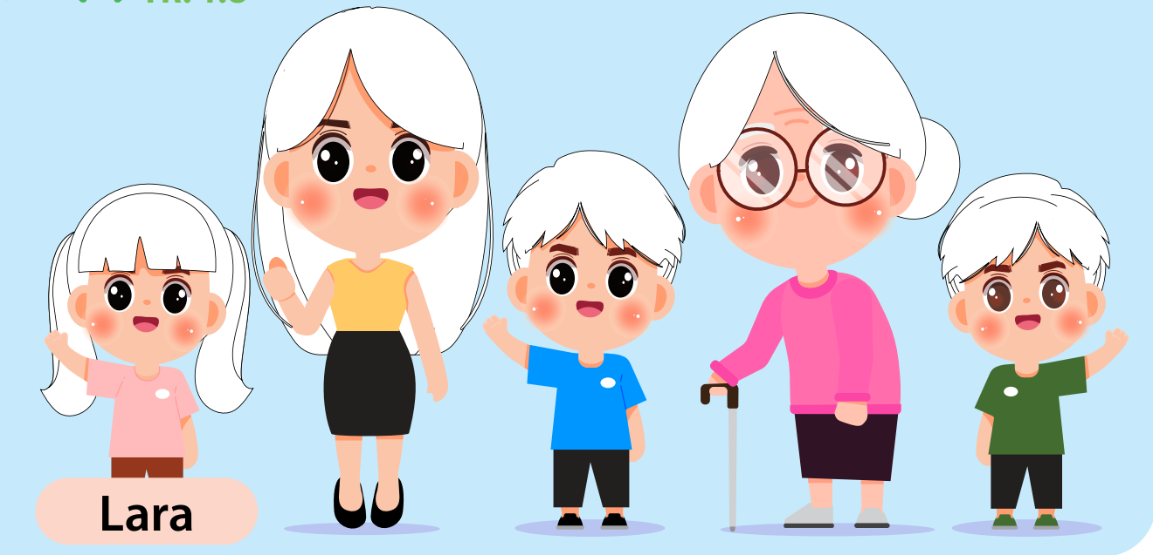




Slide 12
Possessives: ‘s
This camera belongs to my aunt.
=> This is my aunt’s camera.

Slide 13
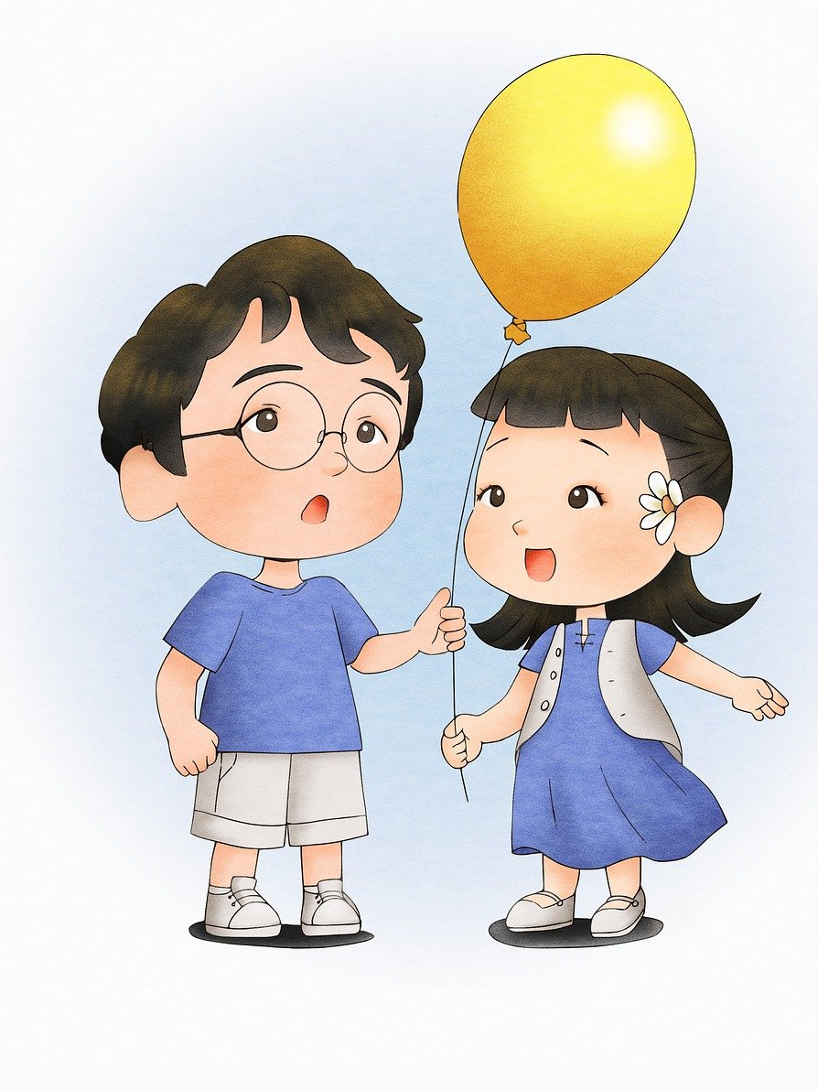
Possessive s’
That yellow balloon belongs to my cousins.
=> My cousins’ balloon is yellow.

Slide 14
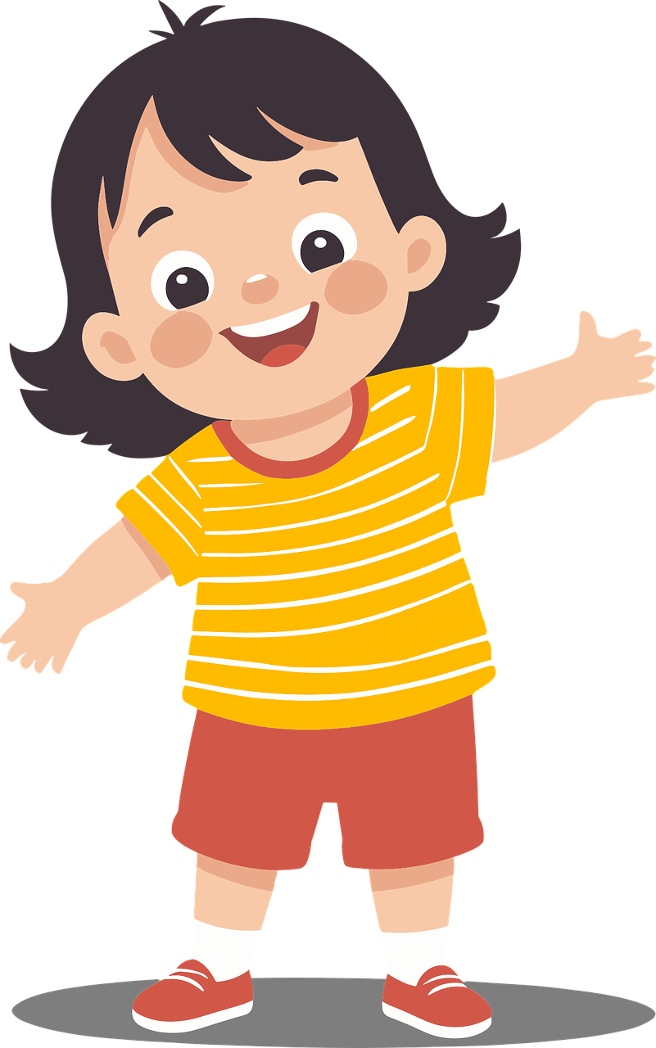
Look and say
These red shoes belong to Anna.
=> Anna…. shoes are red.
‘s

Slide 15
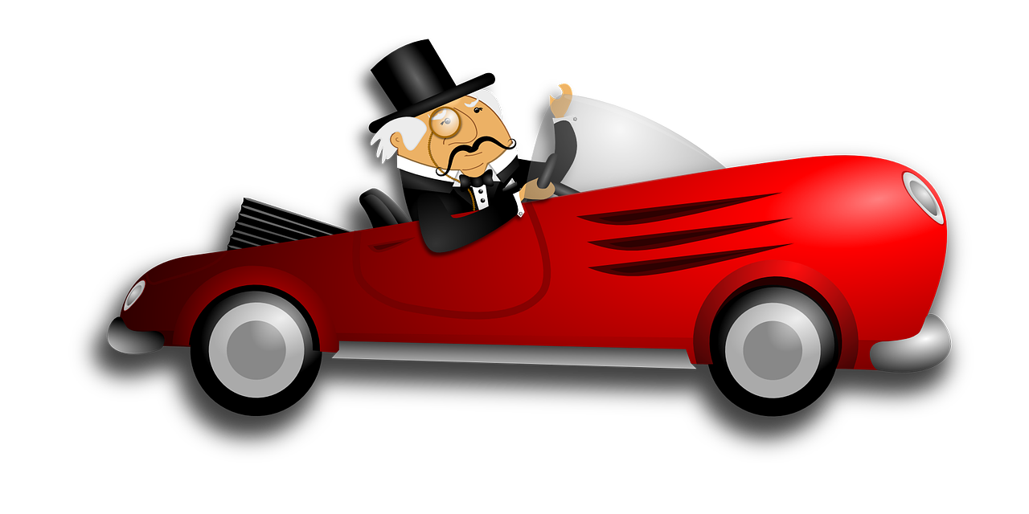
Look and say
That red car belongs to my grandpa.
=> That red car is my grandpa….
‘s

Slide 16
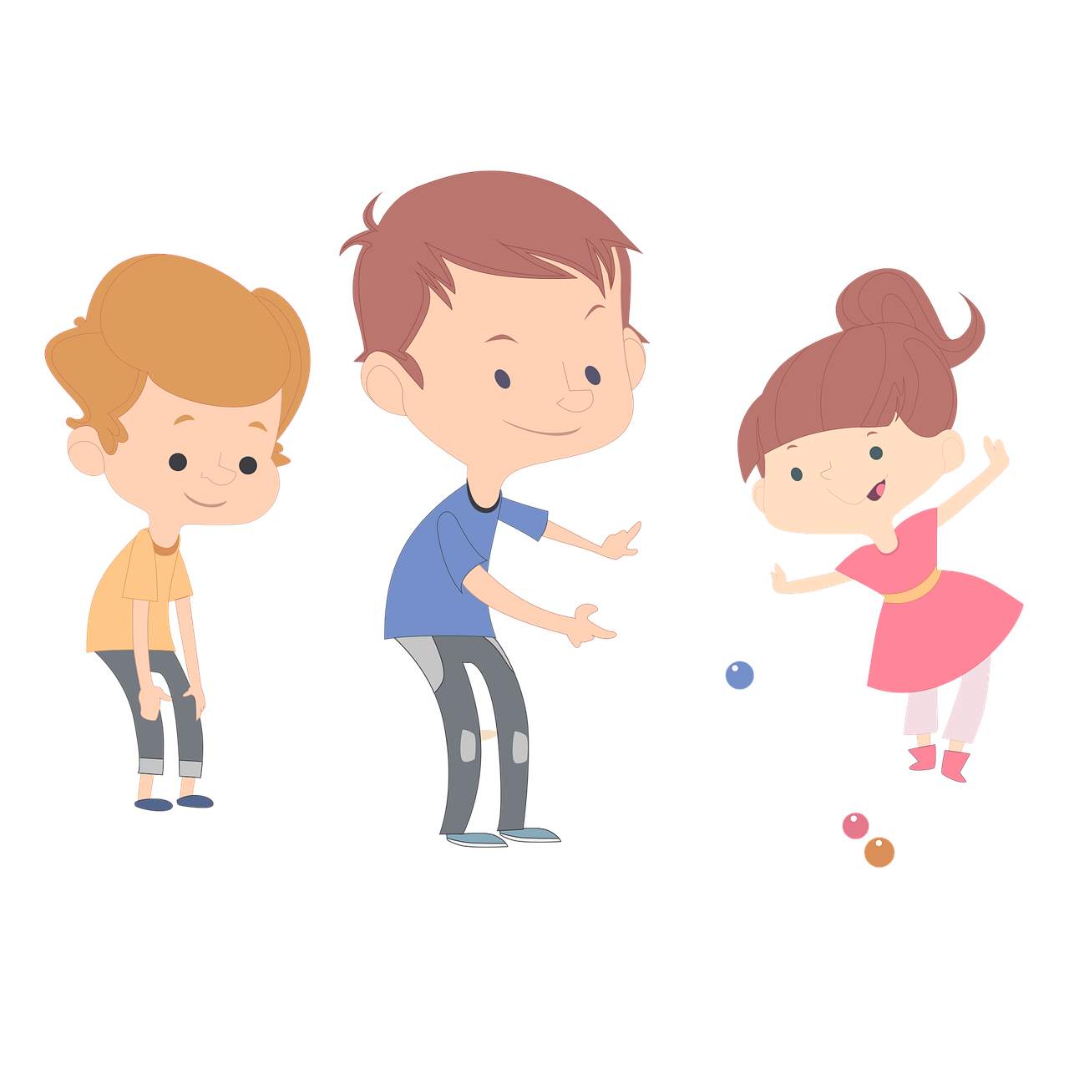
Look and say
The boys have a sister.
She is the boy…. sister.
s’

Slide 17
`
03
Practice

Slide 18
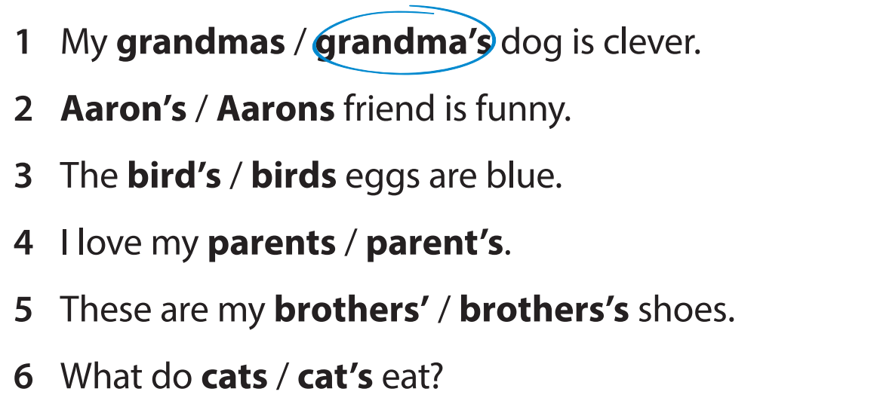



Slide 19
`
04
Production

Slide 20

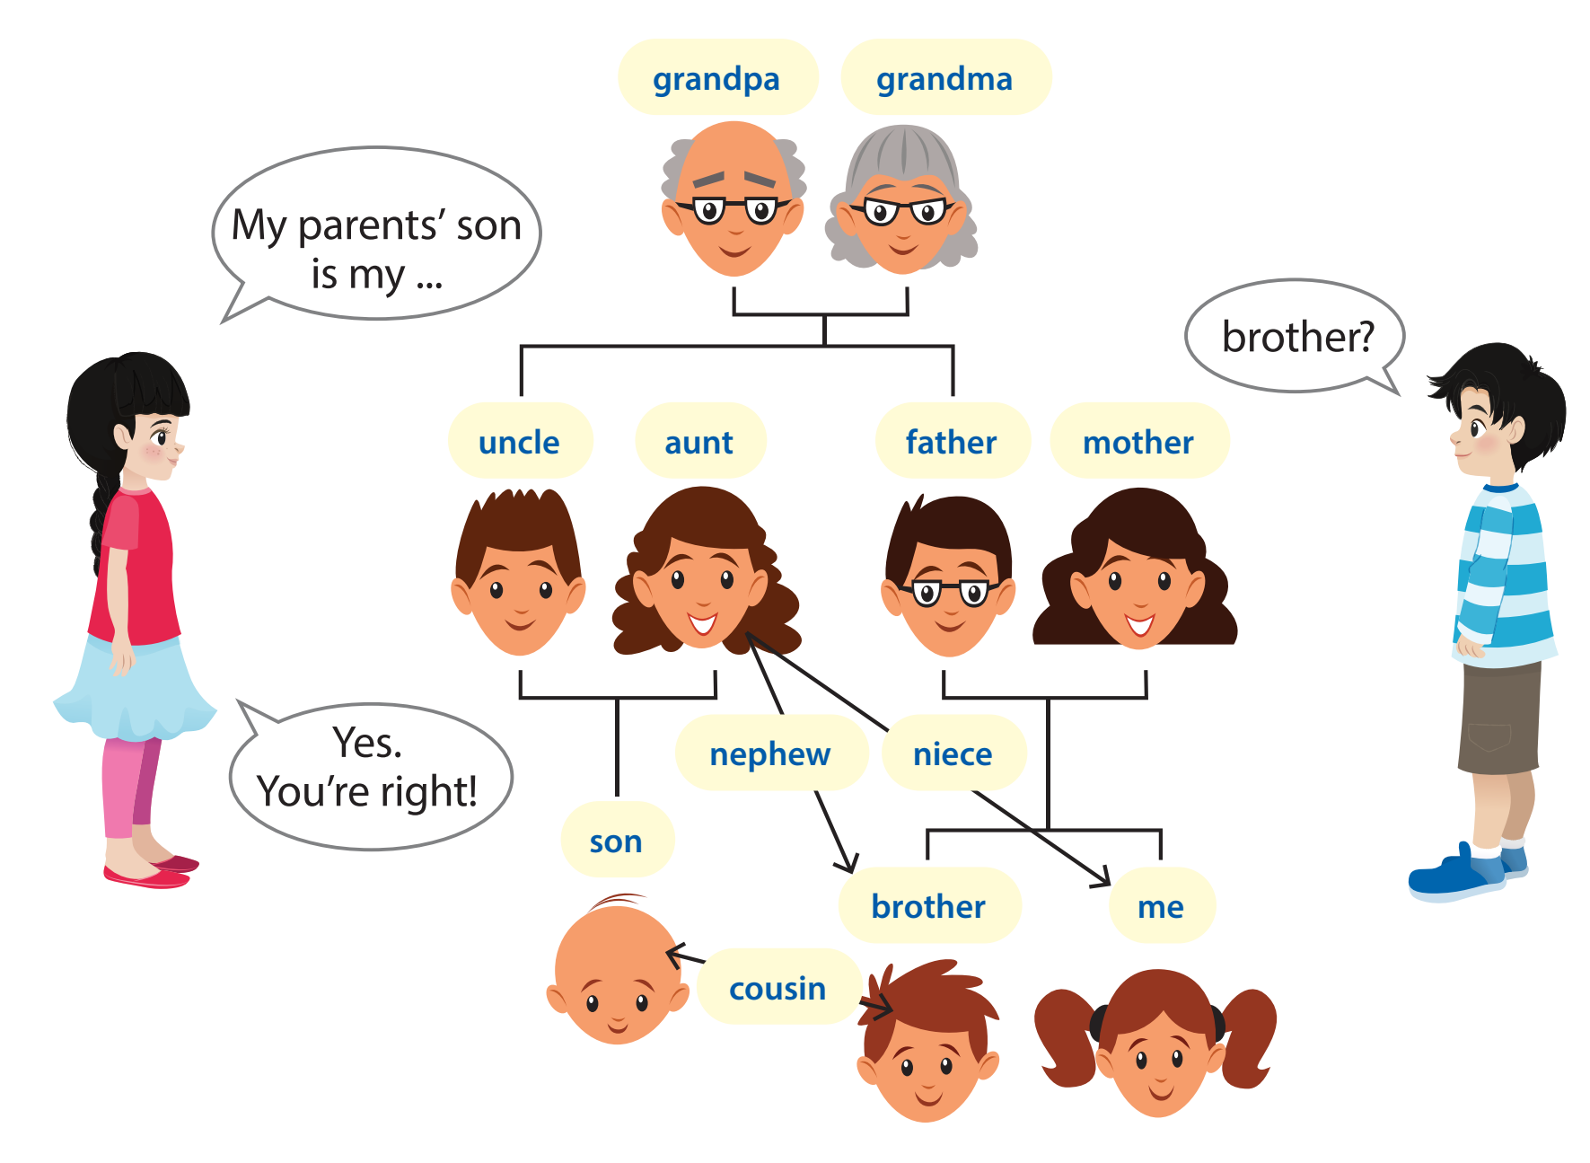
My parents’ son is my ….
brother?
Yes.
You’re right.

Slide 21
Who answers faster?
I’m my aunt’s ….
niece.
Notes:
T divides Ss into 2 teams. The team answers faster will get 1 star.

Slide 22
Who answers faster?
My grandpa’s son is my….
father.

Slide 23
Who answers faster?
My uncle’s son is my….
cousin.

Slide 24
Who answers faster?
My grandma is my uncle’s
mother.

Slide 25
Who answers faster?
My uncle is my father’s
brother.

Slide 26
Who answers faster?
Who answers faster?
My mother’s daughter is….
you.

Slide 27
`
05
Wrap-up &
Assessment

Slide 28

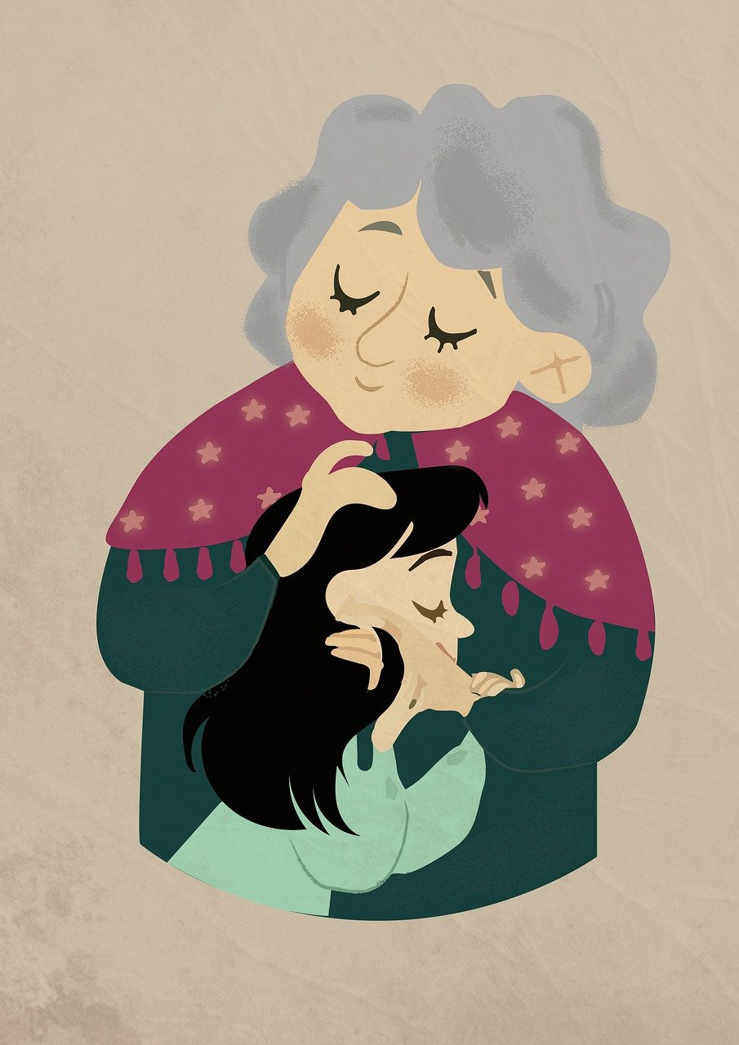
Find the mistake and correct it
Mary grandma really loves her.
Mary’s grandma really loves her.

Slide 29
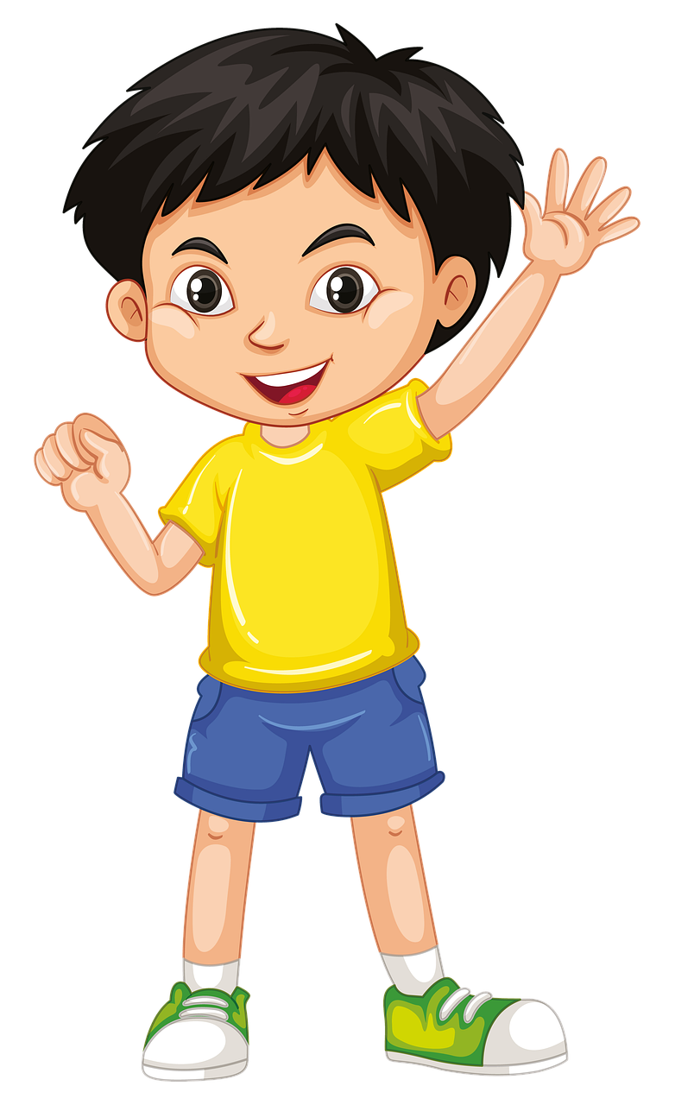
Find the mistake and correct it
John’s shorts is so comfortable.
John’s shorts are so comfortable.

Slide 30
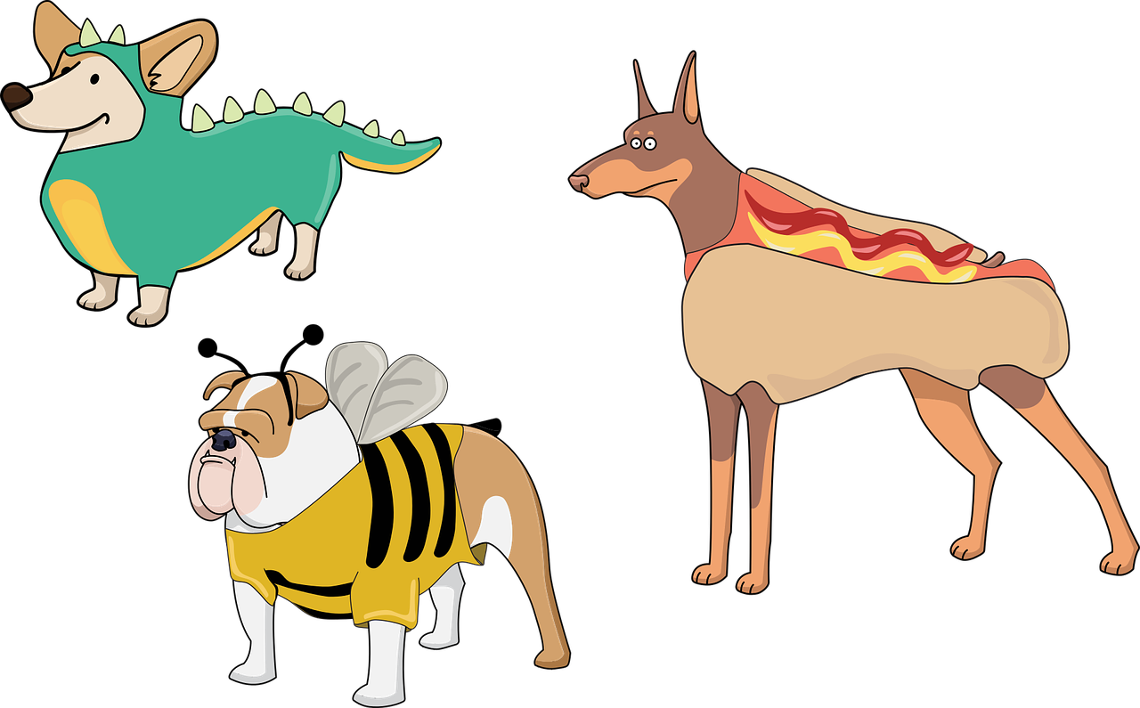

Find the mistake and correct it
Her dogs’s favourite food is meat.
=> Her dogs’ favourite food is meat.

Slide 31

Find the mistake and correct it
My parent’s house is beautiful.
=> My parents’ house is beautiful.

Slide 32


Wrap up
Unit 1: Family and friends
Lesson 3 – Part 4,5,6
What do we learn today?
Grammar: Possessive ‘s, s’
Lara’s hair is green.
Her brothers’ hair is black.

Slide 33


Thank you
& goodbye!

