Slide 1









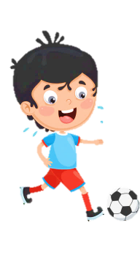













Slide 2
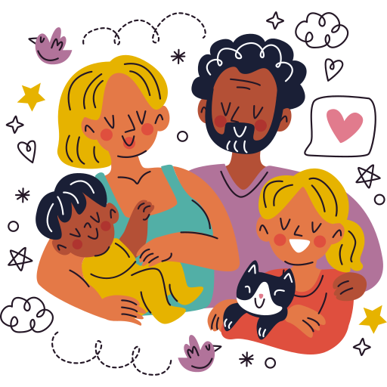
Unit 1:
FAMILY AND FRIENDS
Lesson 3 – Part 7, 8, 9,10

Slide 3





Table of contents
01
02
Warm - up
Presentation
05
04
Wrap-up & Assessment
Production
03
Practice

Slide 4




01
Warm up

Slide 5


Look and choose
________ are so beautiful.
1. Sams glasses
2. Sam glasses
3. Sam’s glasses
4. Sams’ glasses

Slide 6
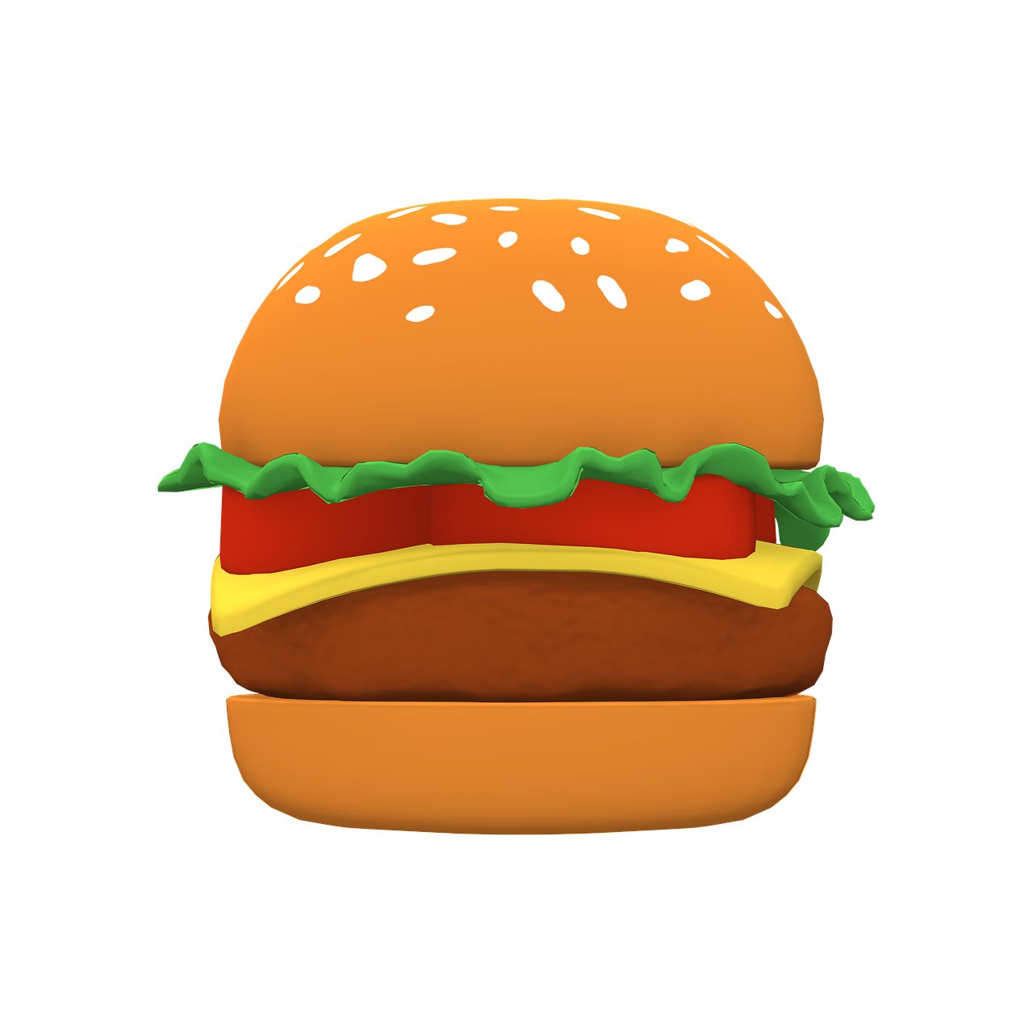
Look and choose
______ eat hamburgers twice a week.
1. Our friends
2. Our friend’s
3. Our friends’
4. Our friends’s

Slide 7

Look and choose
He can speak 3 _______.
1. language
2. language’s
3. languages’
4. languages

Slide 8

Look and choose
_______ travelled to Korea yesterday.
1. Jack uncle and aunt
2. Jacks’ uncle and aunt
3. Jacks uncle and aunt
4.Jack’s uncle and aunt

Slide 9

Look and choose
What are ____________?
1. your parent’s favourite TV show
2. your parents’ favourite TV shows
3. your parents’ favourite TV show
4. your parent’s favourite TV shows

Slide 10
02
Presentation

Slide 11


Slide 12


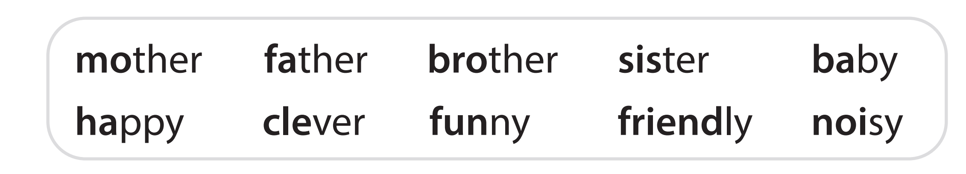
We say the stressed syllable longer, louder and clearer than other syllables in the word.

Slide 13
Word stress
What are they?
Nouns, verbs, adjectives or adverbs?
They’re nouns.
mother
father
baby
How many syllables do they have?
Two syllables.
Where the word stress?
First or second syllable?
The first syllable.

Slide 14
Word stress
What are they?
Nouns, verbs, adjectives or adverbs?
quiet
clever
happy
They’re adjectives.
How many syllables do they have?
Two syllables.
Where the word stress?
First or second syllable?
The first syllable.

Slide 15
Word stress
quiet
clever
happy
mother
father
baby
In two-syllable nouns and adjectives, normally the stress will be on the first syllable.

Slide 16
Some exceptions!
Japan
giraffe
balloon
alone
polite

Slide 17
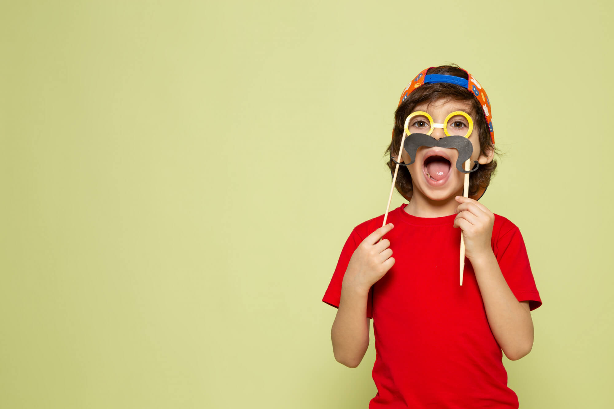

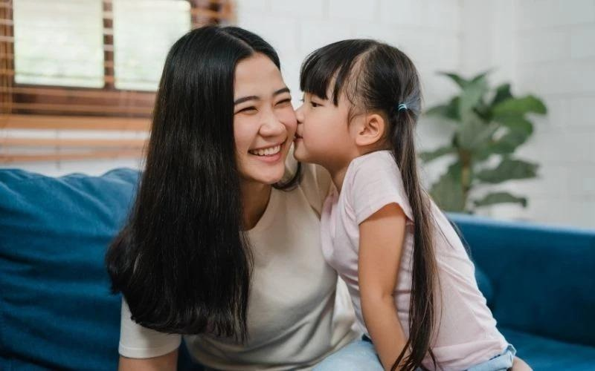

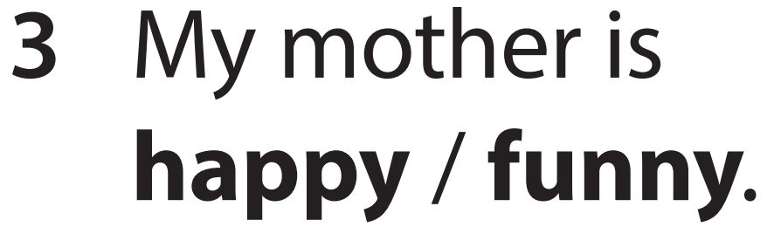
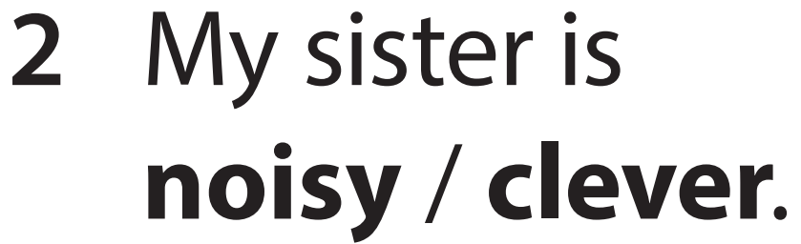


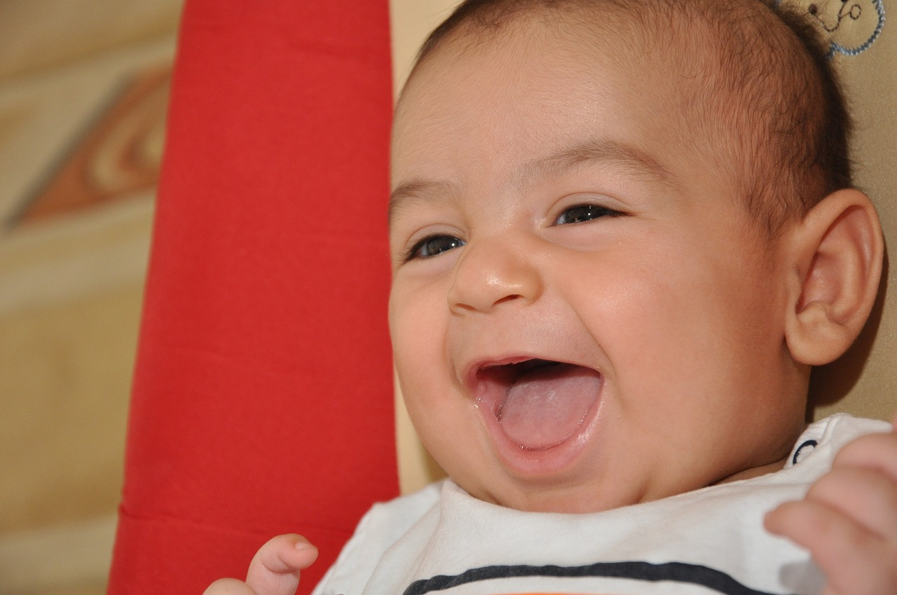
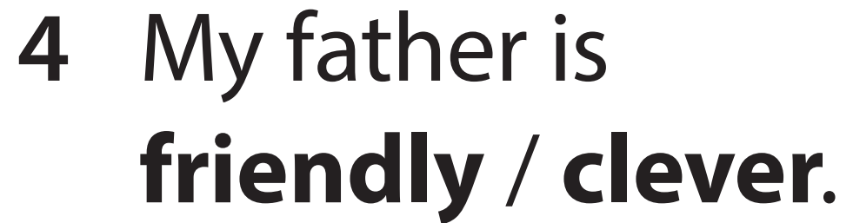
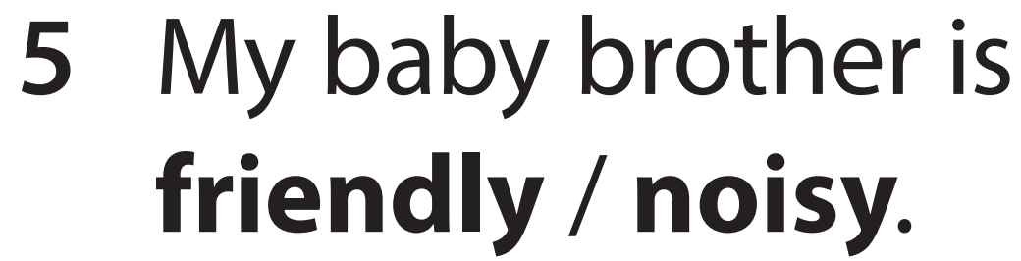

Slide 18
03
Practice

Slide 19


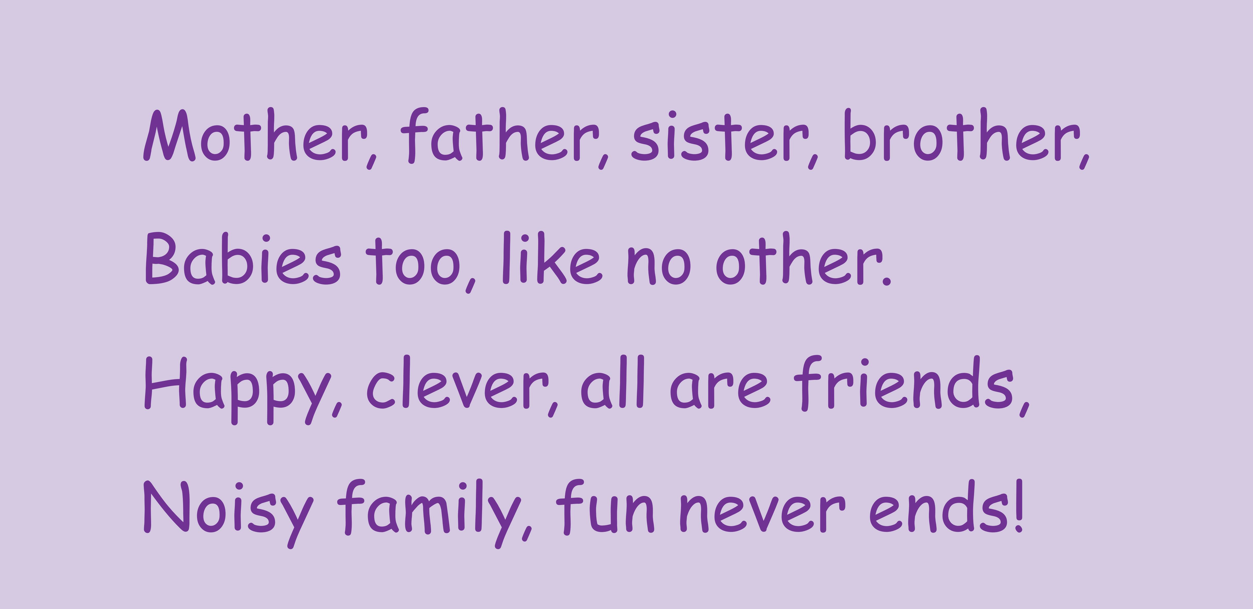




Slide 20
04
Production

Slide 21
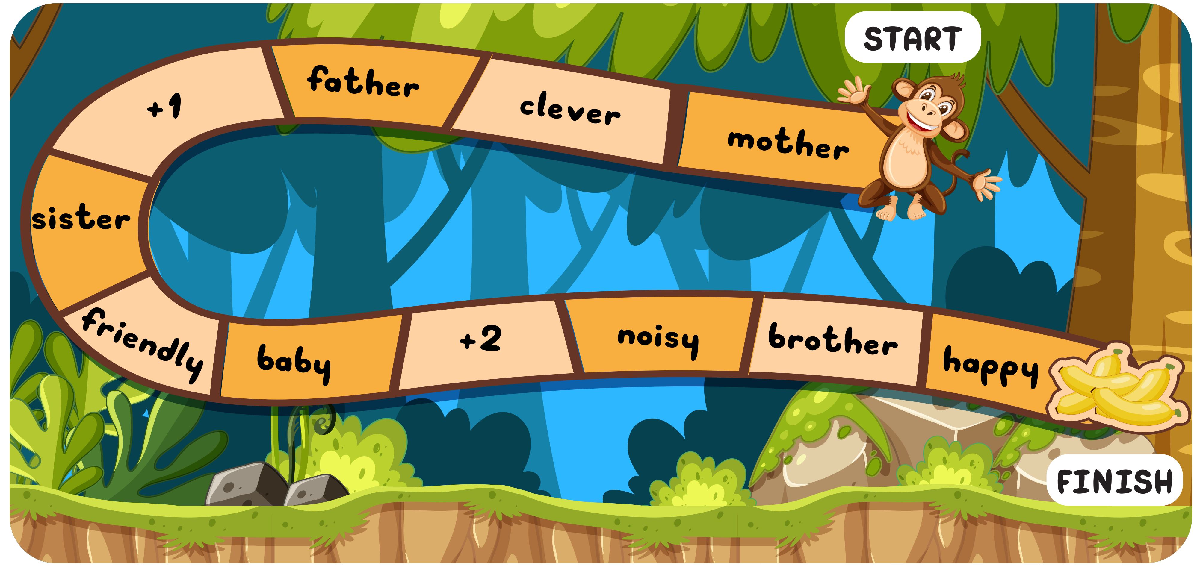


Slide 22
05
Wrap-up &
Assessment

Slide 23



Odd one out
1 teddy
2 balloon
3 robot
1 teddy
2 balloon
3 robot

Slide 24



Odd one out
1 quiet
1 teddy
2 clever
1 quiet
2 clever
3 alone
3 alone

Slide 25
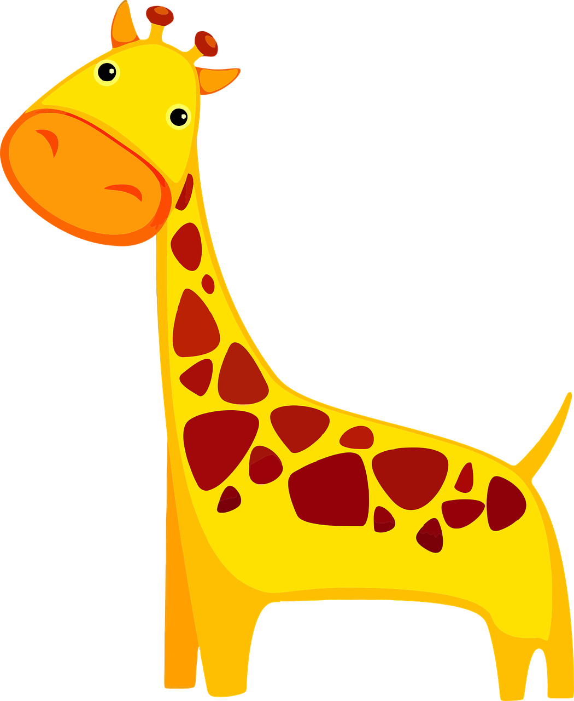
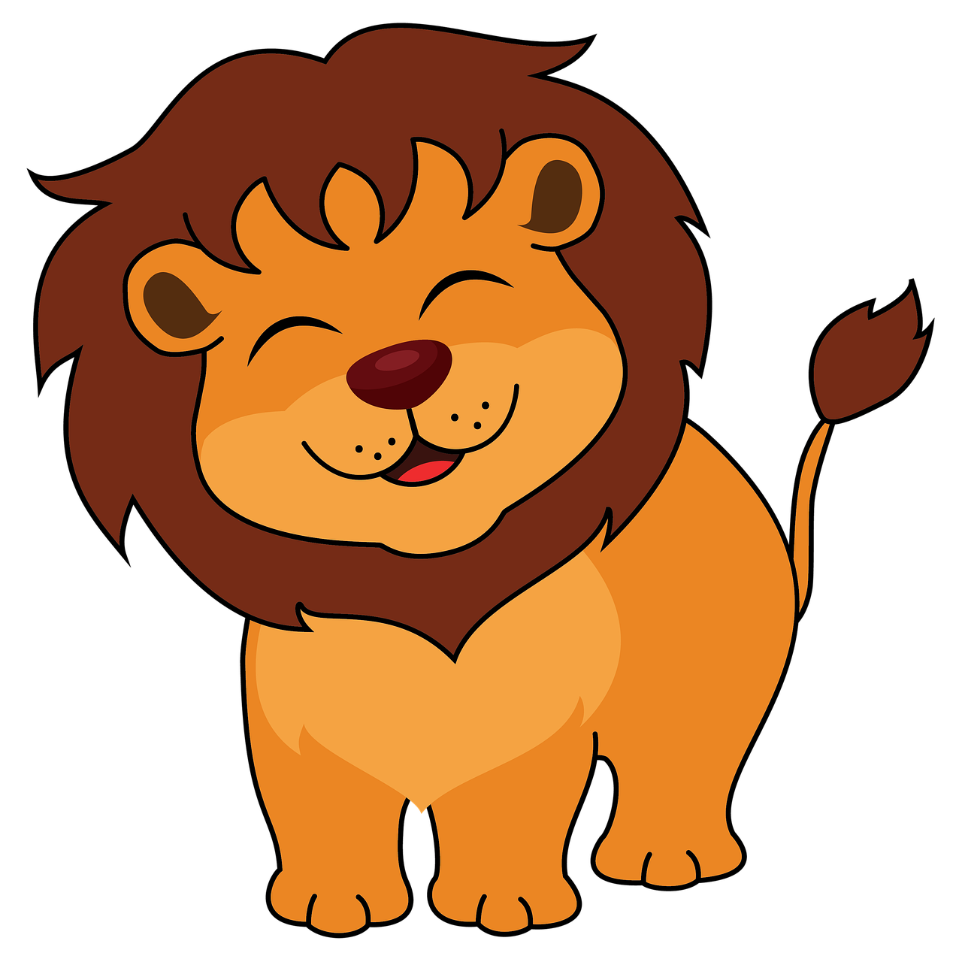
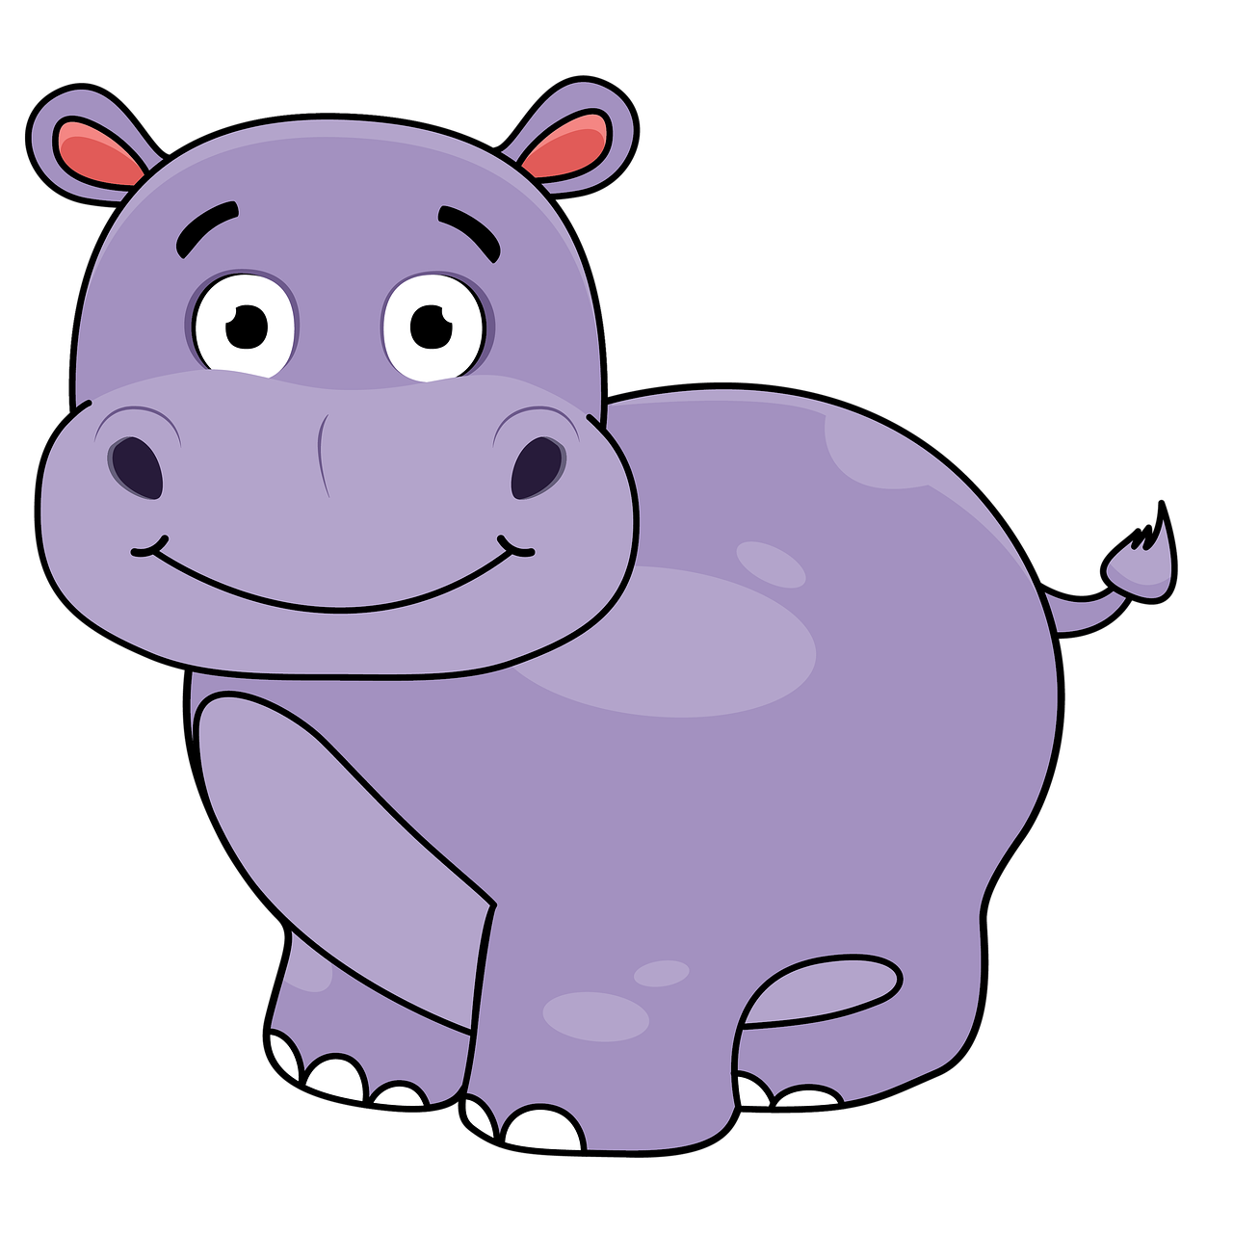
Odd one out
1 teddy
1 giraffe
1 giraffe
2 lion
3 hippo
2 lion
3 hippo

Slide 26



Odd one out
1 teddy
3 Russia
1 China
2 Japan
3 Russia
1 China
2 Japan

Slide 27


Wrap up
Unit 1: Family and friends Lesson 3 – Part 7,8,9,10
What have we learnt today?
Pronunciation: Learn stress:
Stressing on the first syllable

Slide 28

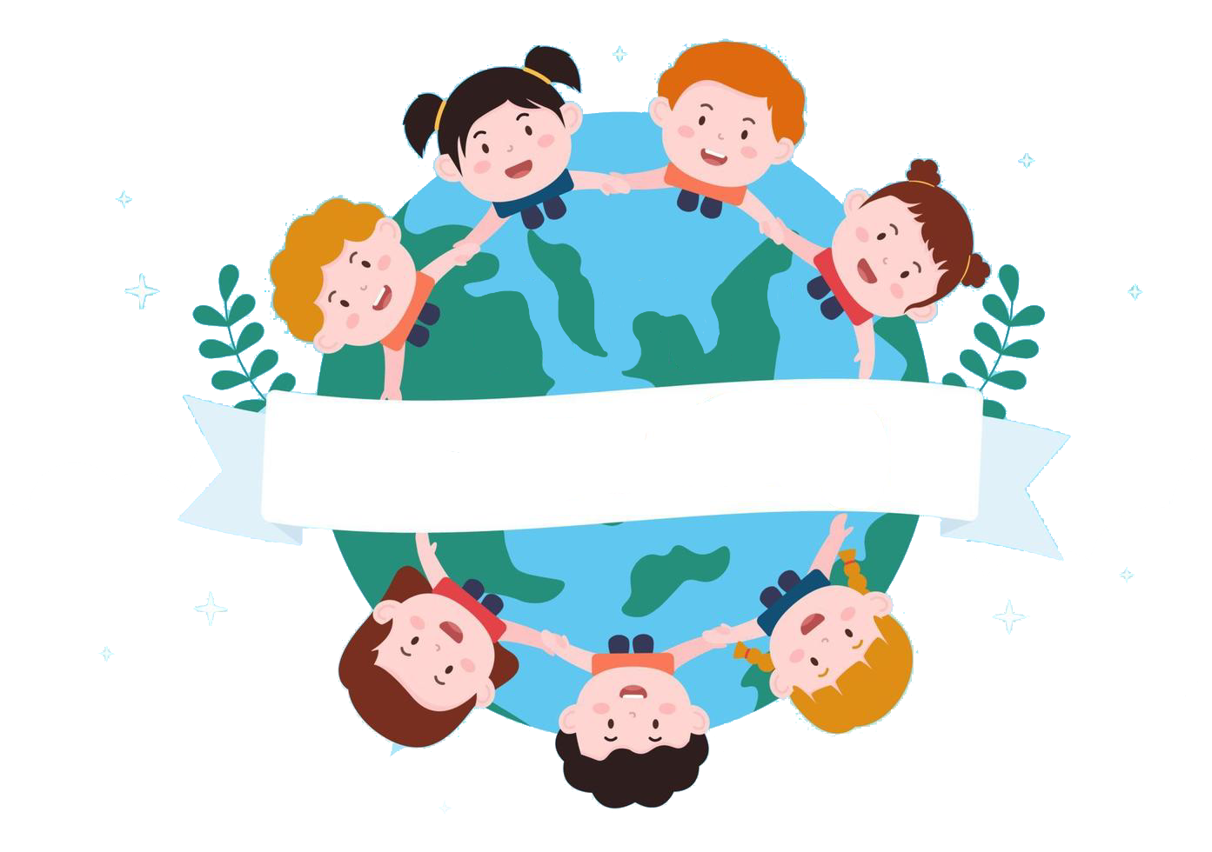
Thank you
& goodbye!

