Slide 1












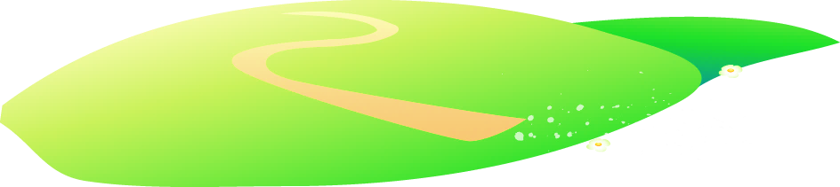






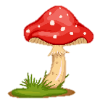
Notes:
Để nguyên trang bìa như này, chỉ thay đổi tên bài trong quá trình làm. Logo của sách Wonderful World

Slide 2
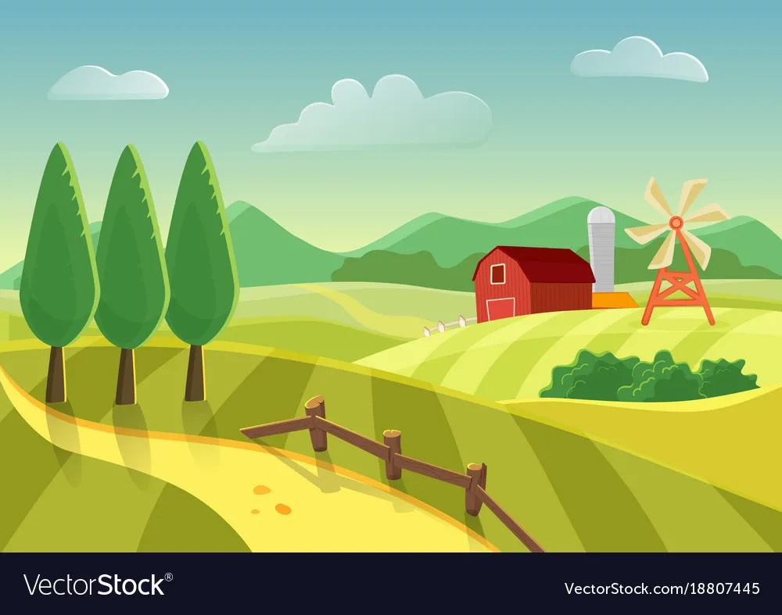

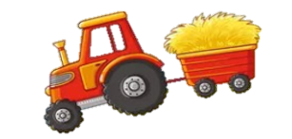
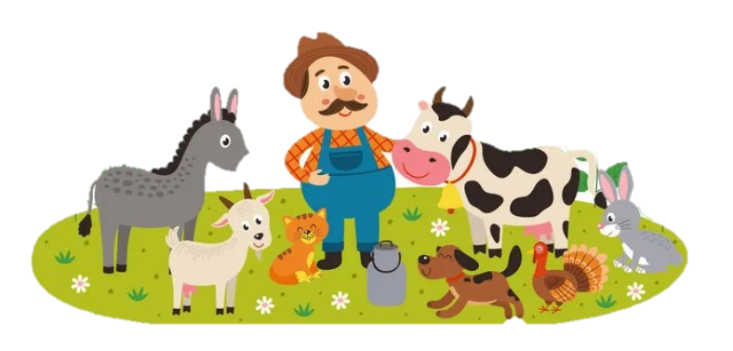
Unit 3. On the farm
Lesson 1. Task 4 5 6

Slide 3
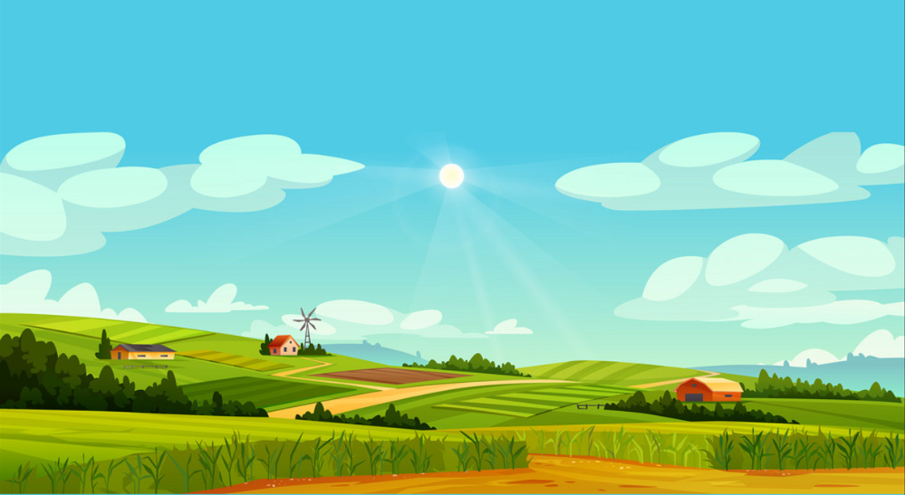
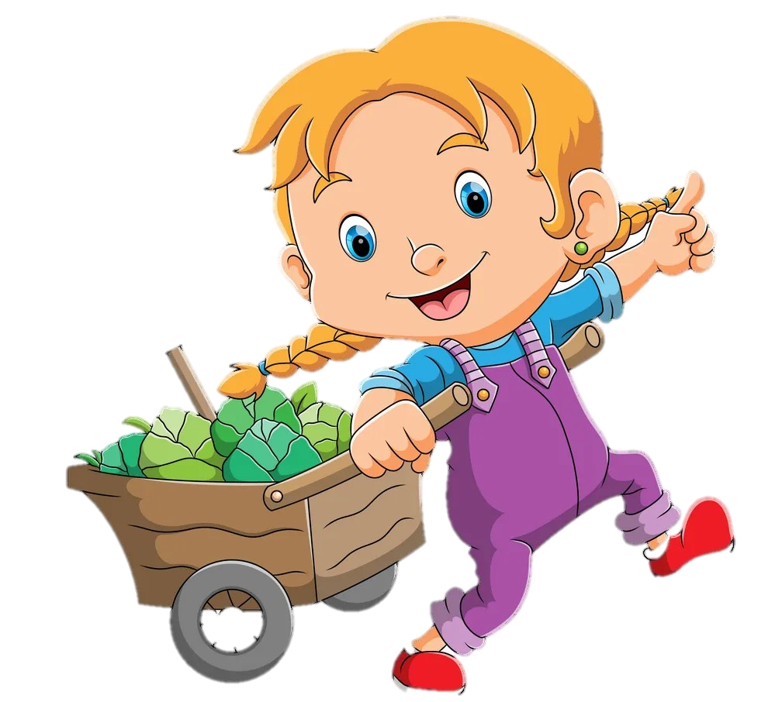

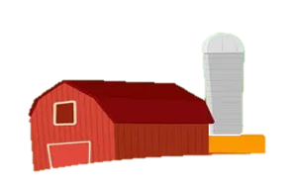
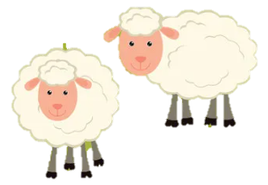

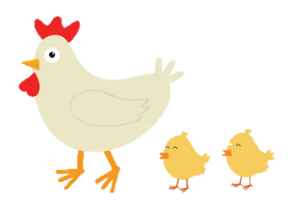
1
Warm Up

Slide 4
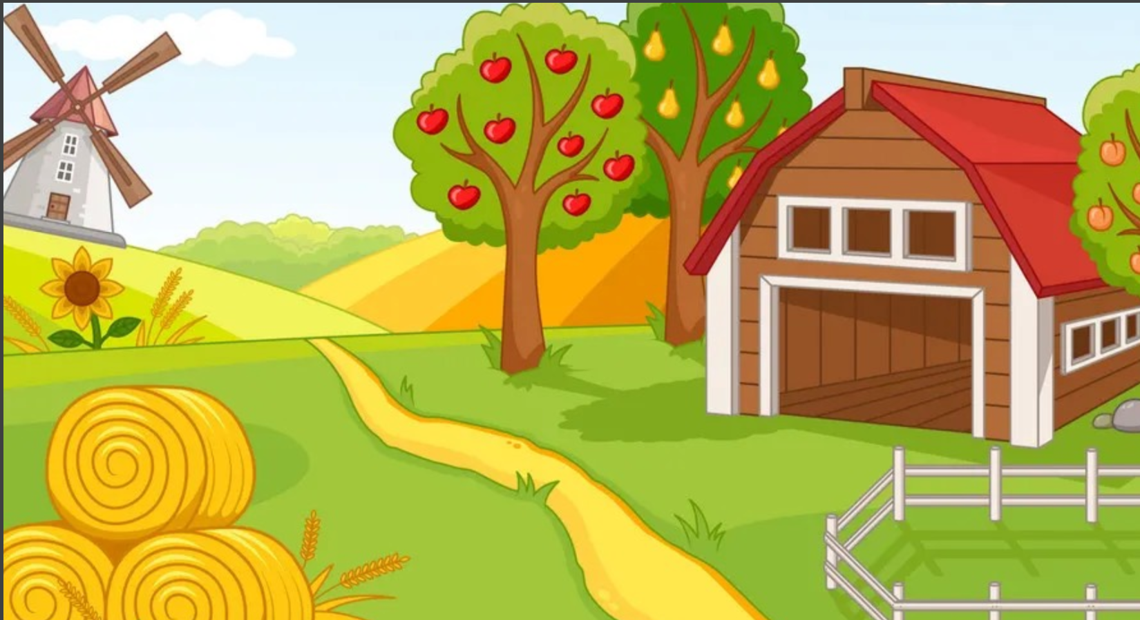

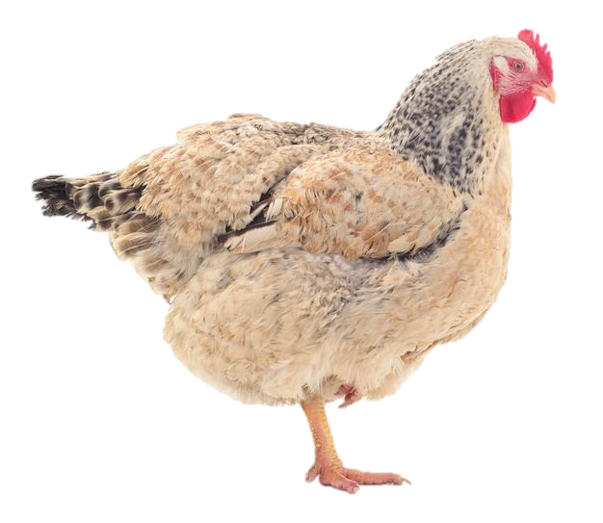

Challenge 1
Chicken
CHECK
Notes:
Một phần của con vật được đưa ra để hs đoán , Gv click vào “ CHECK” để đưa ra đáp án cho hs kèm âm thanh con vật xuất hiện đếinh động hơn.

Slide 5
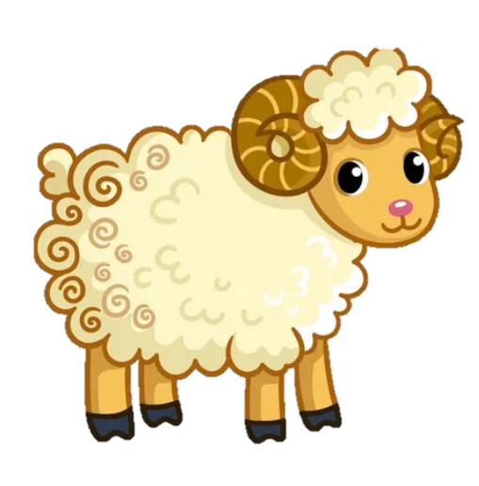
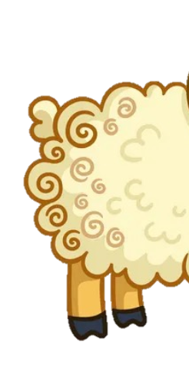
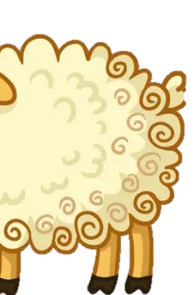
Challenge 2
sheep
CHECK

Slide 6
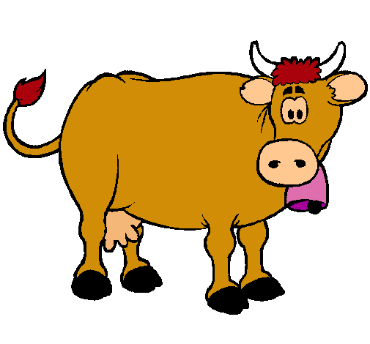
Challenge 3
cow
CHECK

Slide 7
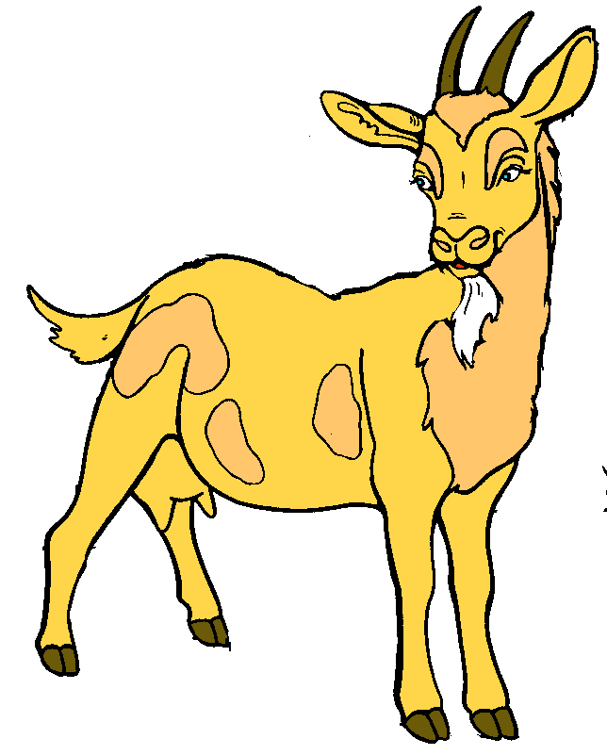
Challenge 4
goat
CHECK

Slide 8
Yes anyway I go to our farm.
2
Presentation

Slide 9
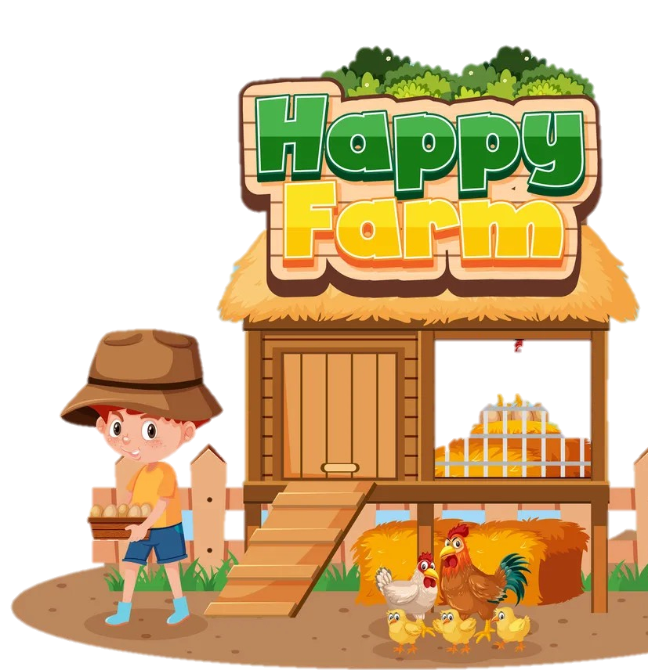
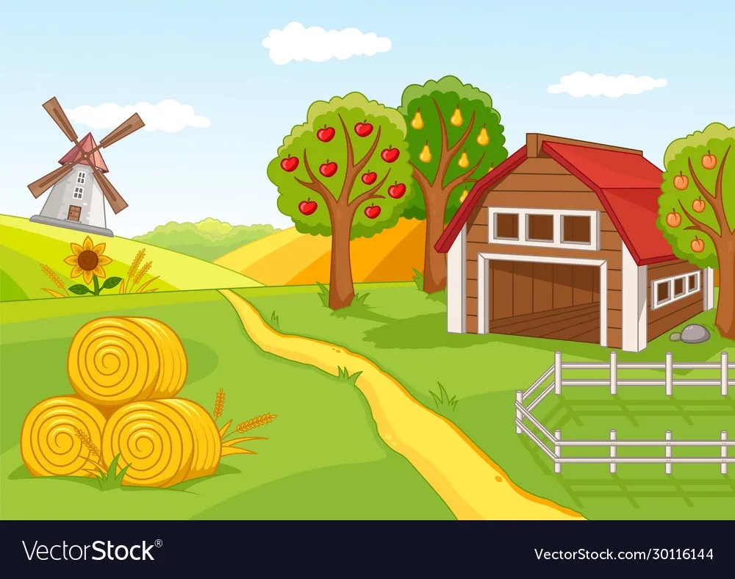
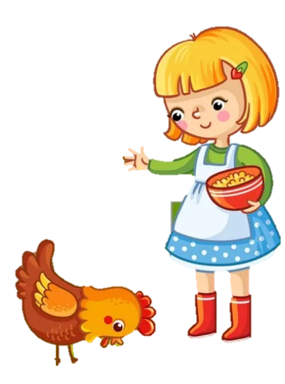
We’ve got
some chickens.

Slide 10
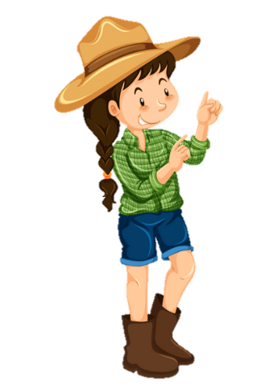

We’ve got some chickens.
We’ve got
some sheep.
We’ve got some sheep.
We’ve got a horse.

Slide 11
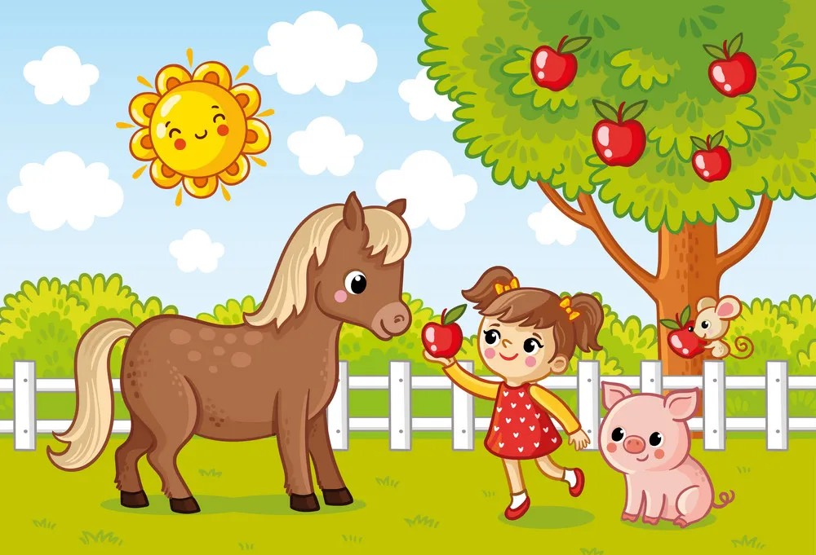
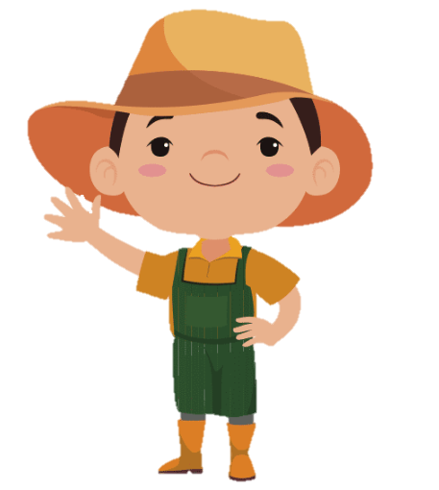
We’ve got
a horse.

Slide 12
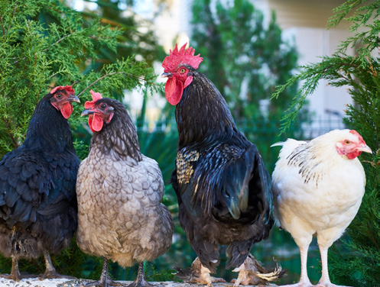
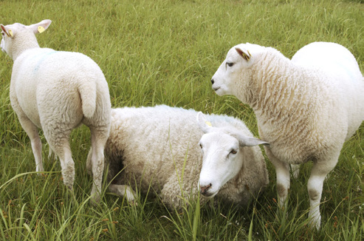
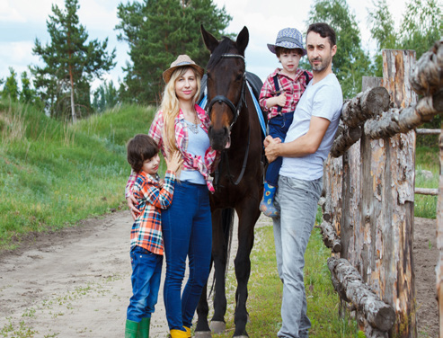
4 Listen and repeat.
’ve got = hαve got
1. We’ve got some chickens.
2. We’ve got some sheep.
3. We’ve got a horse.

Slide 13


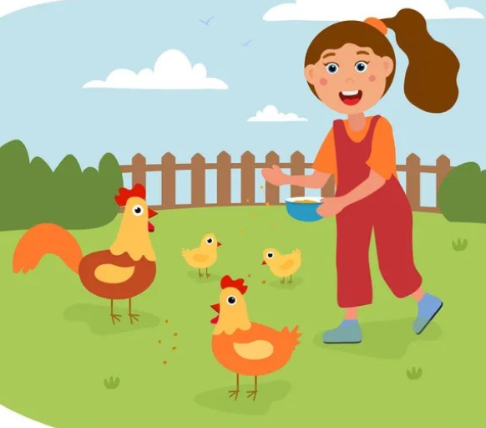
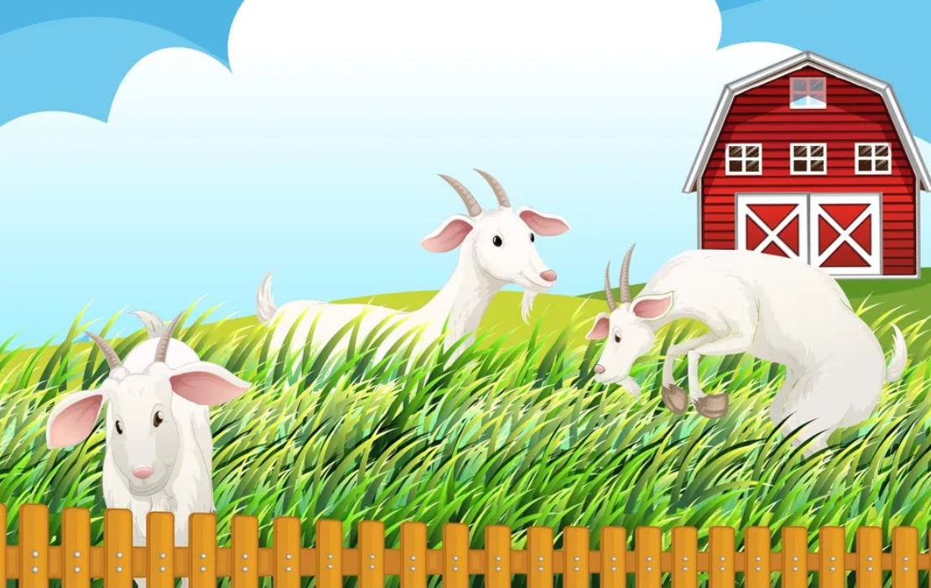
Listen and choose.
CHECKING
We’ve got some chickens/ goats.
✓

Slide 14
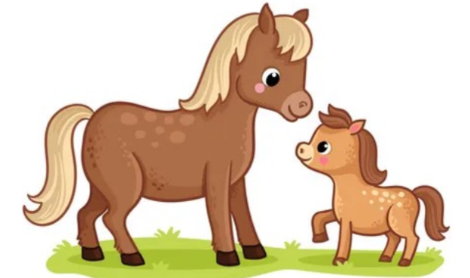
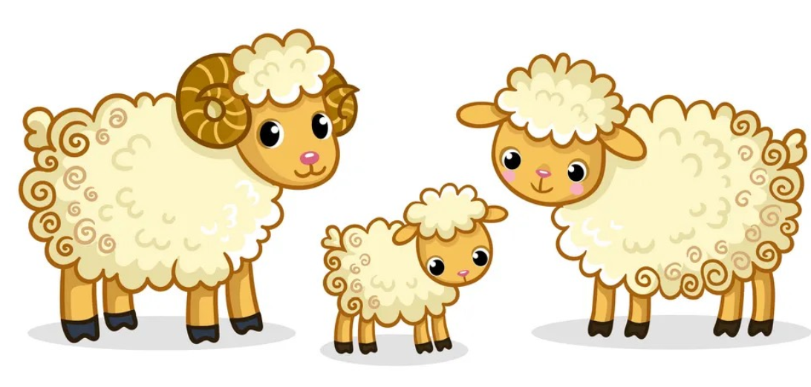
Listen and choose.
We’ve got some horses/ sheep.
✓

Slide 15
3
Practice

Slide 16
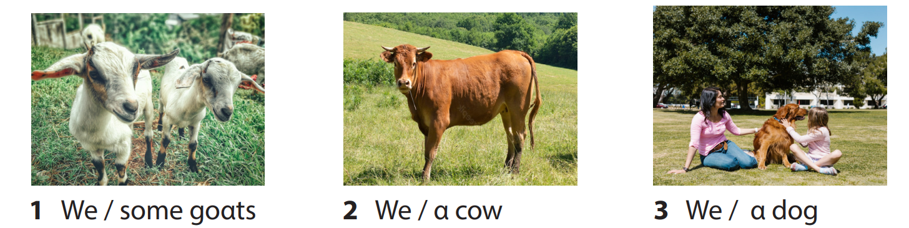
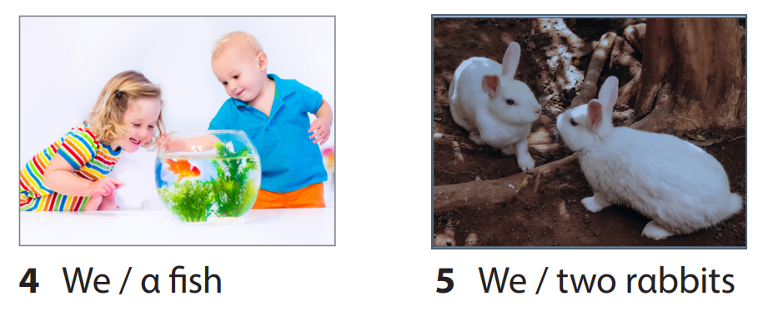
5 Point and Say.
1. We’ve got some goats.

Slide 17



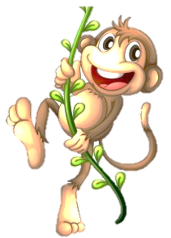

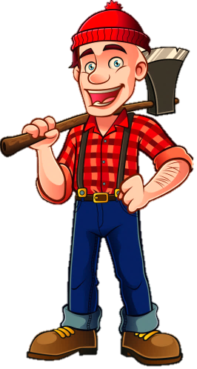
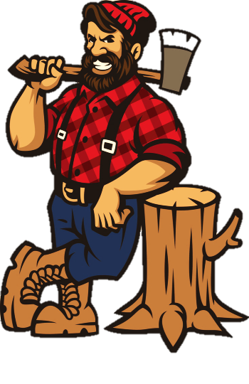

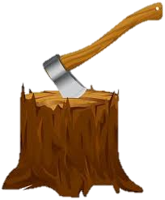
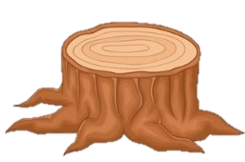

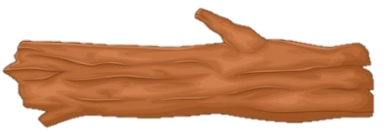

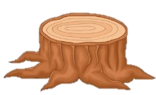
PROTECT
THE JUNGLE

Slide 18

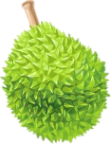



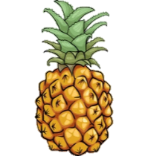
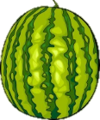


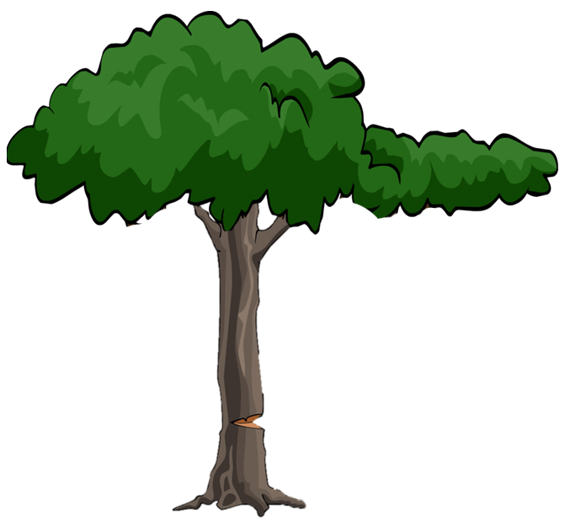










1
2
3
5
4
Notes:
Nhấn vào số để chọn câu hỏi. Sau khi trả lời đúng nhấn nút BACK để quay trở lại và thả quả để tiêu diệt lâm tặc bằng cách nhấn vào con khỉ trên cây tương ứng.

Slide 19

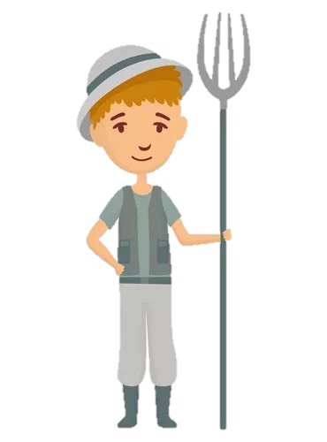
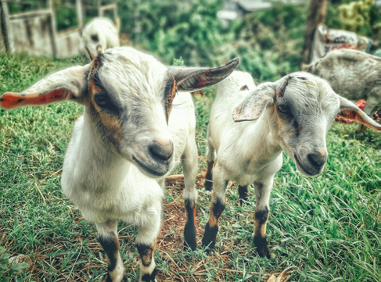
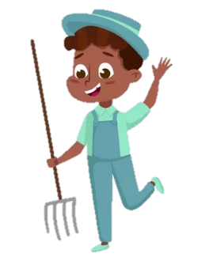
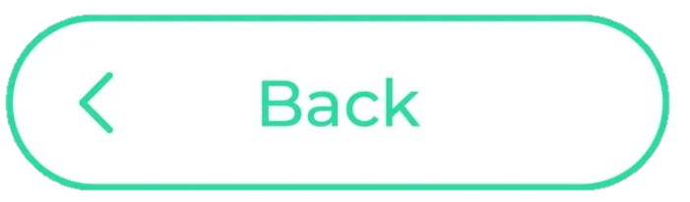
5
Point and say.
We/ some goats.
We’ve got some goats.

Slide 20
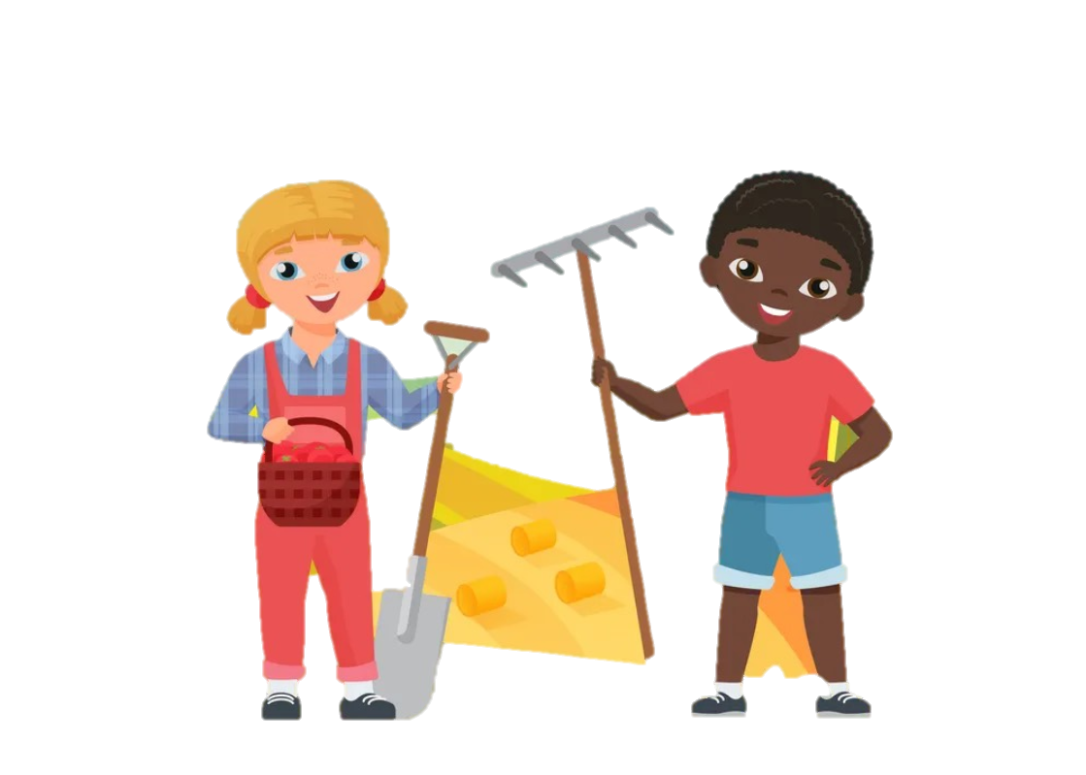
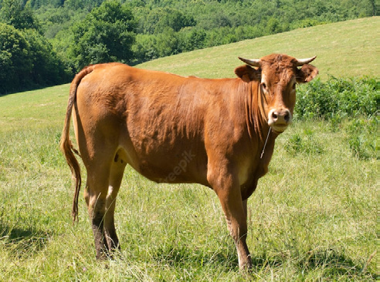
5
Point and say.
We’ve got a cow.
We/ a cow..

Slide 21
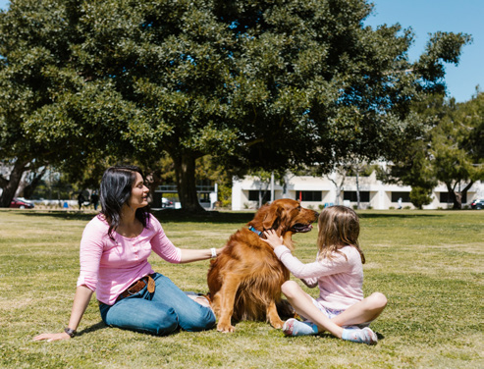
5
Point and say.
We/ a dog
We’ve got a dog.

Slide 22

5
Point and say.
We/ a fish
We’ve got a fish .

Slide 23



5
Point and say.
We/ two rabbits
We’ve got two rabbits.

Slide 24
4
Production

Slide 25

6. Let’s talk.
My farm
We’ve got α horse
on the fαrm. It’s
brown αnd tαll.

Slide 26



Song.
On the farm I see a dog, It runs and plays on the log. It says “woof woof” all day long, The happy dog sings a song!
On the farm I see a cat, Sleeping soft upon the mat. It says “meow meow” in the sun, The gentle cat has so much fun!
On the farm I see a sheep, Jumping high and counting sleep. It says “baa baa” loud and clear, The fluffy sheep lives near!

Slide 27
5
Assessment

Slide 28



Look, read and write.
1. We’ve got …………………….
a sheep
2. We’ve got …………………….
some chickens
3. We’ve got …………………….
a horse

Slide 29


Look and write.
We’ve got …………………… on the …………………. It’s big and tall.
a cow
farm

Slide 30





REMEMBER
Structures
We’ve got some goats.
‘ve got = have got

Slide 31


Thank you
& goodbye!

