Slide 1







ĐUỔI HÌNH
BẮT CHỮ

Slide 2

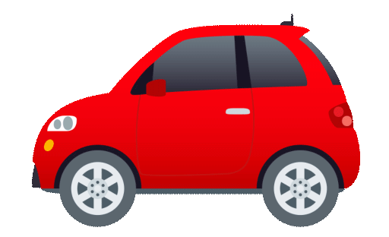


QUESTION 1
Show me a red ball
Red car
1
Red ball
2

Slide 3
QUESTION 1
Show me a red ball
Red ball
2

Slide 4

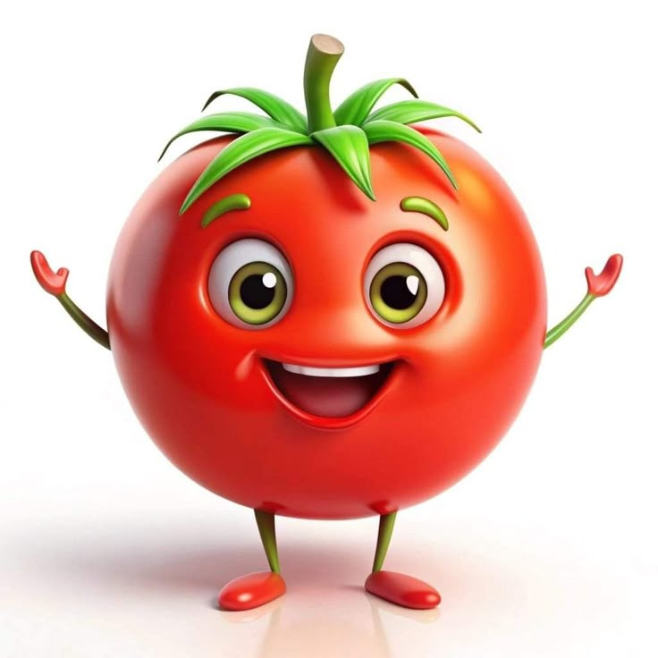
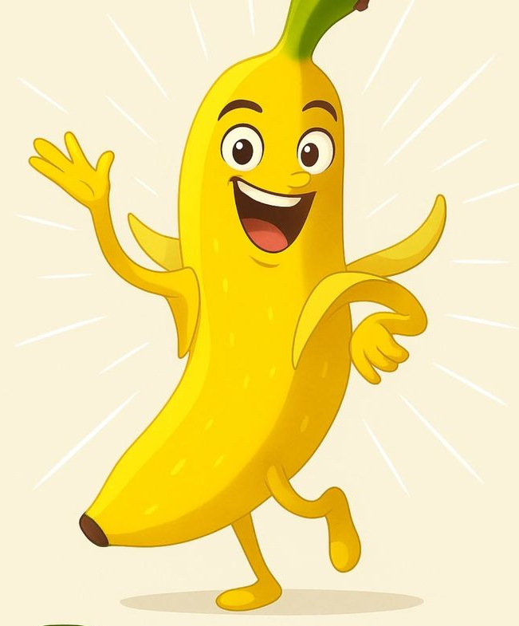
Show me a yellow banana
QUESTION 2
1
2
Banana
Tomato

Slide 5
Show me a yellow banana
QUESTION 2
2
banana

Slide 6



Show me a bule car
QUESTION 3
1. Motorbike
2. Car

Slide 7
Show me a bule car
QUESTION 3
2. Car

Slide 8
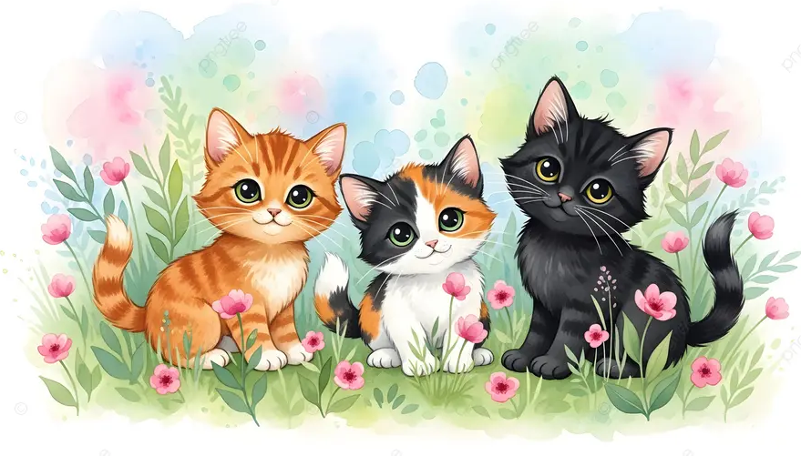
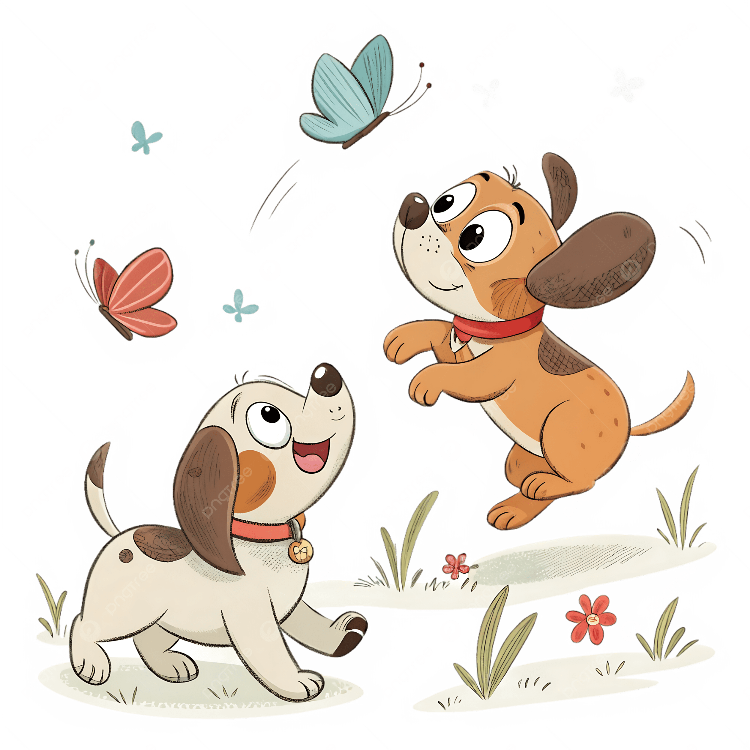
QUESTION 4
I see three cats
1
2

Slide 9
QUESTION 4
1

Slide 10
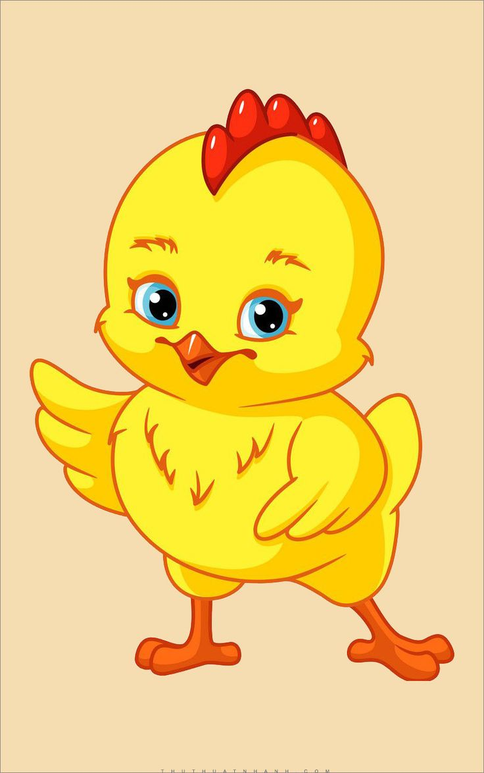
QUESTION 5
I see two dogs
1
2

Slide 11
QUESTION 5
1

Slide 12
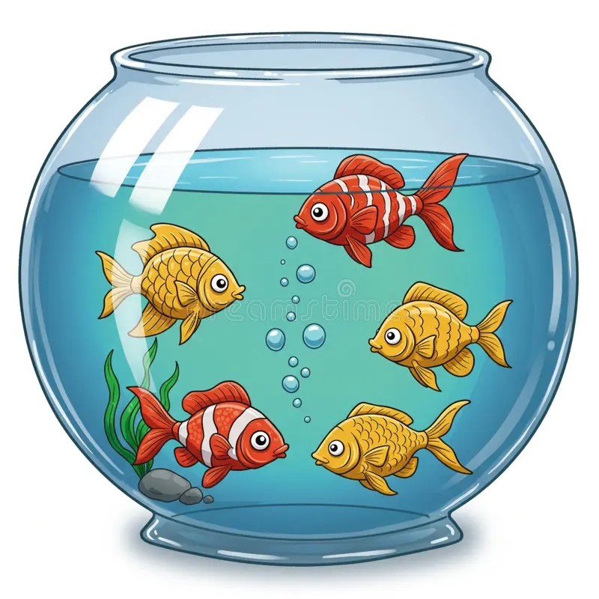
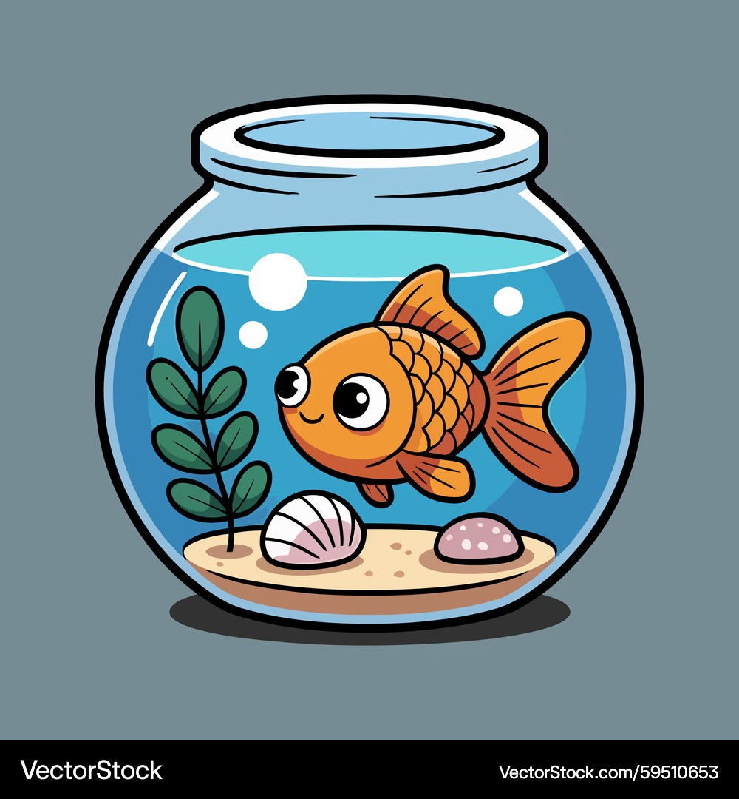
I see one fish
QUESTION 6
1
2

Slide 13
QUESTION 6
2

Slide 14


QUESTION 7
I see four flowers
1
2

Slide 15
QUESTION 7
2

Slide 16

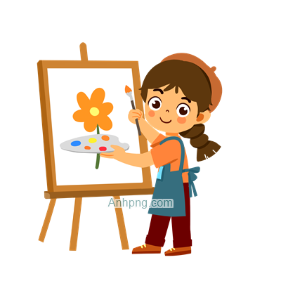
QUESTION 8
I like singing
1
2

Slide 17
QUESTION 8
I like singing
1

Slide 18

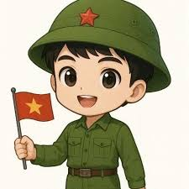
QUESTION 9
I see a doctor
1
2

Slide 19
QUESTION 9
I see a doctor
1

Slide 20
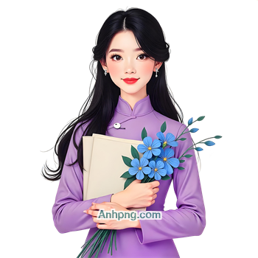
QUESTION 10
Isee a teacher
1
2

Slide 21
QUESTION 10
Isee a teacher
1

Slide 22

THANKS FOR PLAYING

