Slide 2

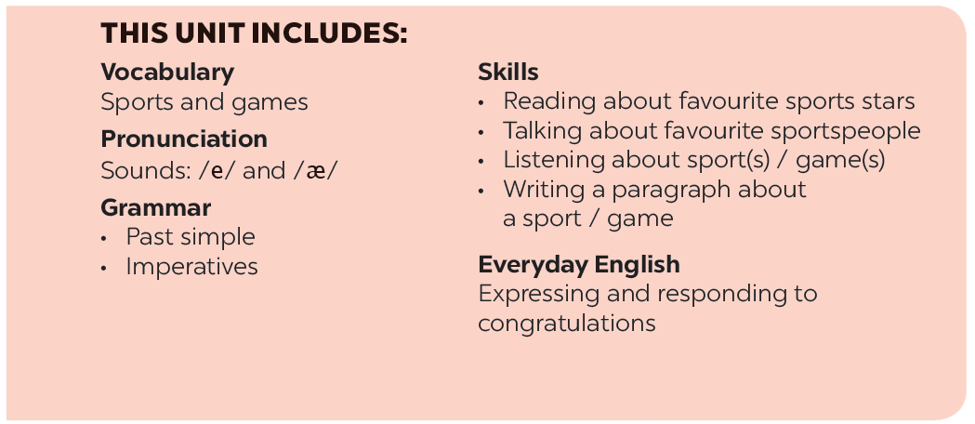

Slide 3






At the gym
Listen and read.
Name these sports and games, using the words from the box.
Put a word from the conversation in each gap.
Work in pairs. Ask your partner these questions to find out how sporty they are.

Slide 4
I. Vocabulary
- gym(n)/dʒɪm/: phòng tập thể dục
- equipment(n)/ɪˈkwɪp.mənt/: trang thiết bị
- do karate(v)/kəˈrɑː.ti/: tập võ karate
- do aerobics(v)/eəˈrəʊ.bɪk/: tập aerobics
- play table tennis(v): chơi bóng bàn
- play chess(v): chơi cờ vua
- play volleyball(v): chơi bóng chuyền
- go swimming(v): đi bơi
- have an idea(v): có 1 ý kiến
- the karate club(n): câu lạc bộ võ karate
- meet(v): gặp gỡ
- cycle(v): đạp xe

Slide 5
I. Vocabulary
- gym/dʒɪm/:
- equipment/ɪˈkwɪp.mənt/:
- do karate/kəˈrɑː.ti/:
- do aerobics/eəˈrəʊ.bɪk/:
- play table tennis:
- play chess:
- play volleyball:
- go swimming:
- have an idea:
- the karate club:
- meet:
- cycle:

Slide 6
I. Vocabulary
- phòng tập thể dục
- trang thiết bị
- tập võ karate
- tập
- chơi bóng bàn
- chơi cờ vua
- chơi bóng chuyền
- đi bơi
- có 1 ý kiến
- câu lạc bộ võ karate
- gặp gỡ
- đạp xe

Slide 7
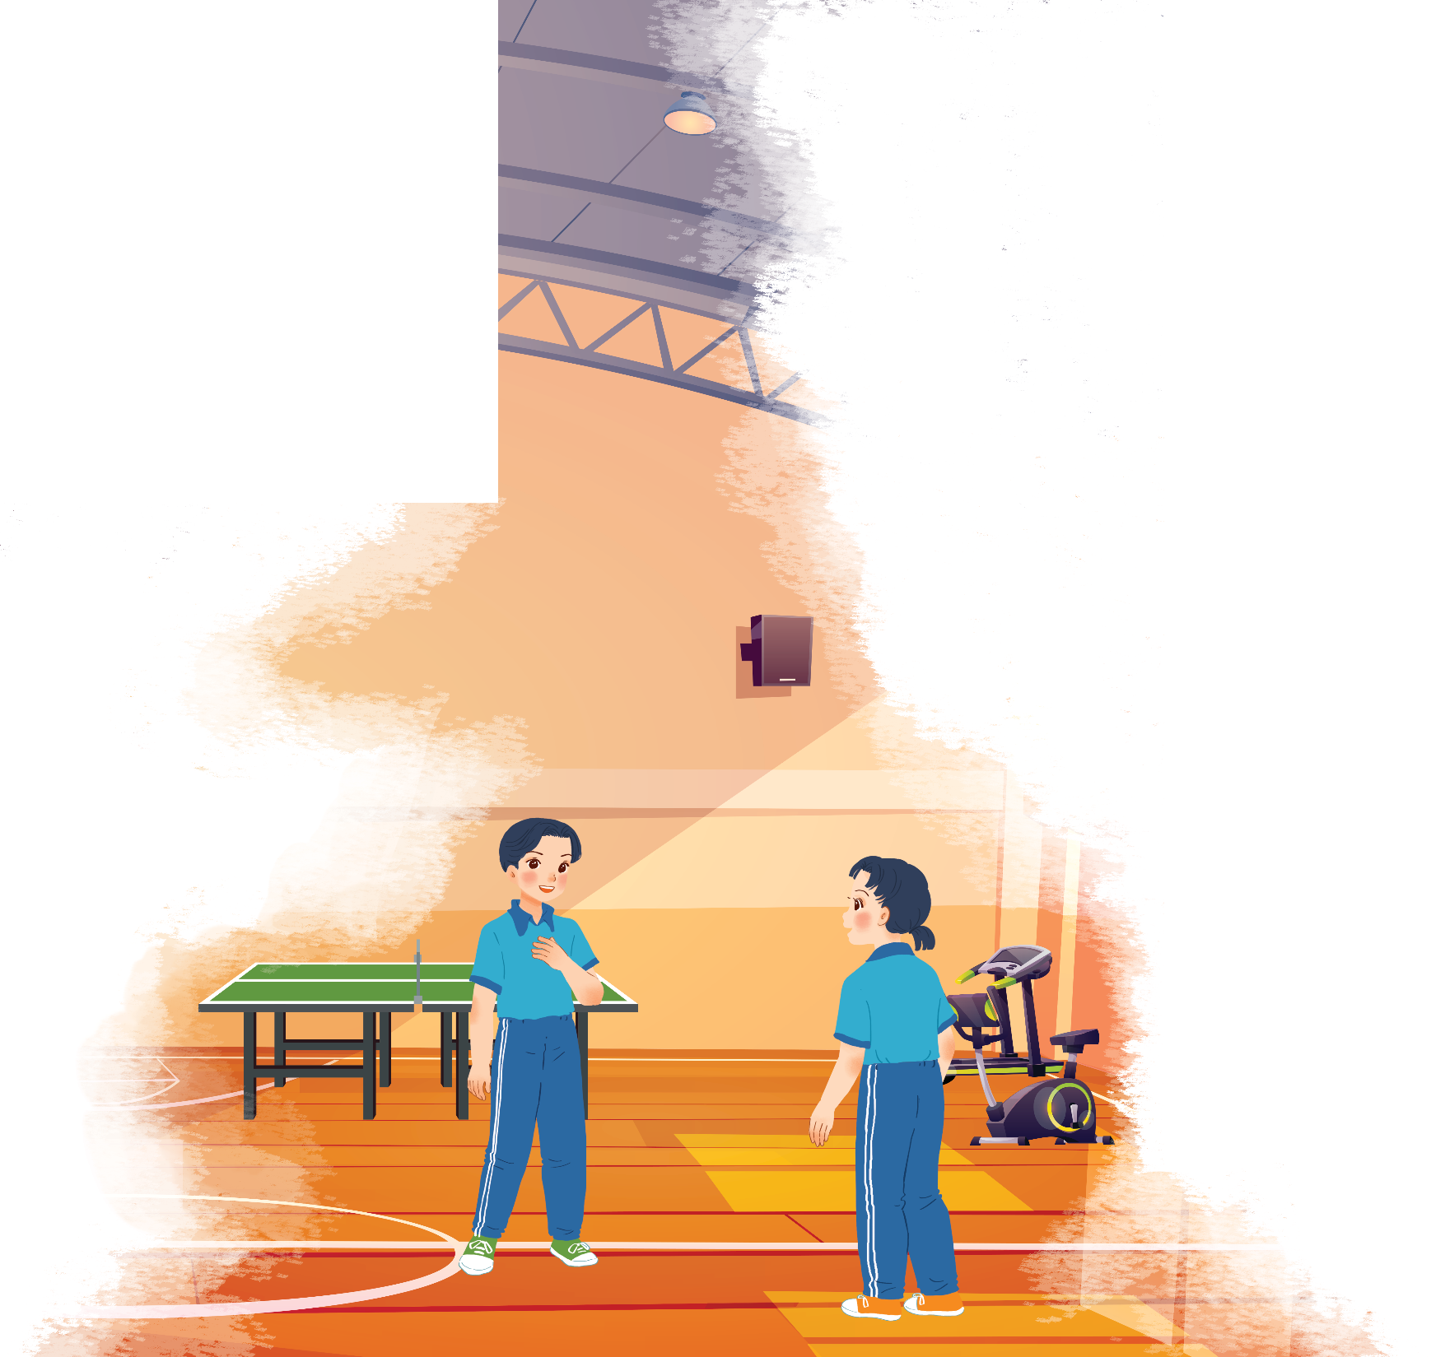



Listen and read.
At the gym

Slide 8
At the gym
Duong: Wow! This gym is big!
Mai: Yeah. The equipment is great. What sports do you do, Duong?
Duong: Well, I do karate, and I play table tennis. Yesterday I played with Duy, and I won!
Mai: Congratulations! You look f it! I’m not good at sports.
Duong: I have an idea – you can go to the karate club with me.
Mai: No, I can’t do karate.
Duong: But you can learn! You’ll love it.
Mai: Well ... OK.
Duong: Great! I’ll meet you there at 10 a.m. on Sunday.
Mai: Where’s the club?
Duong: It’s Superfit Club, in Pham Hung Road. You can cycle there.
Mai: OK. See you then.

Slide 9

Put a word from the conversation in each gap.
Duong looks
_______. He often does karate.
1.
fit. He often does karate.
2.
gym. The equipment there is great.
Mai likes coming to the
_______. The equipment there is great.
table tennis with Duy yesterday, and he won.
3.
Duong played
_______ with Duy yesterday, and he won.
Mai and Duong will meet at Superf it
Club on Sunday.
4.
_______ on Sunday.
5.
Mai will
cycle to Superf it Club.
_______ to Superf it Club.

Slide 10

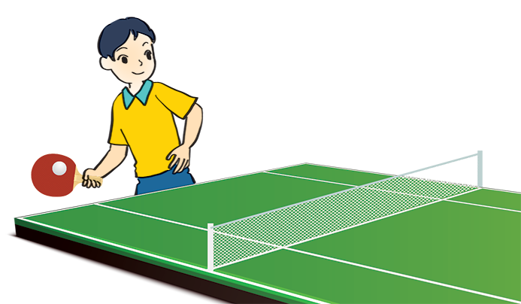

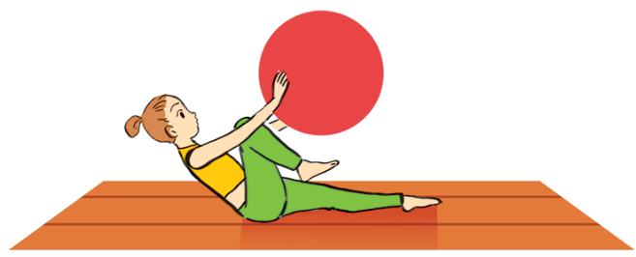
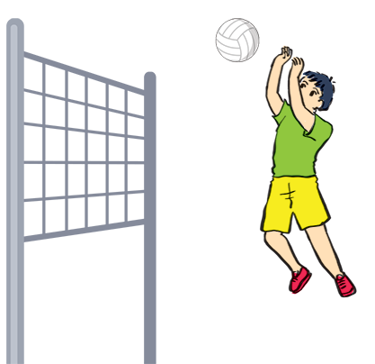
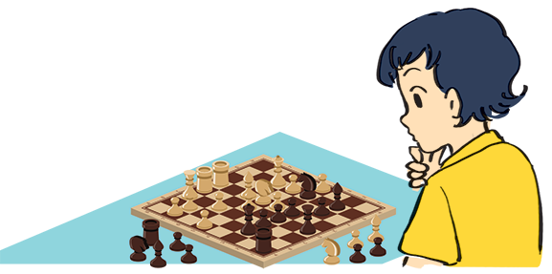
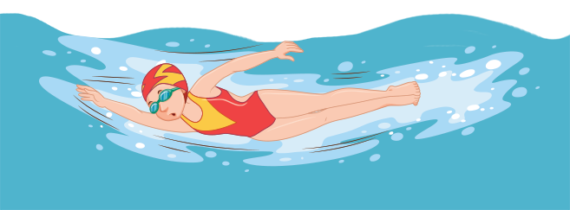
Name these sports and games, using the words from the box.
chess
cycling
aerobics
swimming
table tennis
volleyball
cycling
aerobics
3. table tennis
1.
2.
3.
swimming
5.
chess
6.
volleyball
4.

Slide 11
What is the diﬀerence between a sport and a game?

Slide 12

Work in pairs. Ask your partner these questions to find out how sporty they are.
1.
Can you swim?
If your answers to the questions are mostly “A”, you are sporty. If they are mostly “B”, do more sport and try to be more active.
A.
Yes.
B.
No.
2.
Do you play outdoors every day?
A.
Yes.
B.
No.
3.
Do you usually do morning excerise?
A.
Yes.
B.
No.
4.
What do you usually do at break time at school?
A.
Play in the school yard.
B.
Sit in the classroom.
5.
What do you think of sports and games?
A.
Very good.
B.
Not useful.

Slide 13







