Slide 2

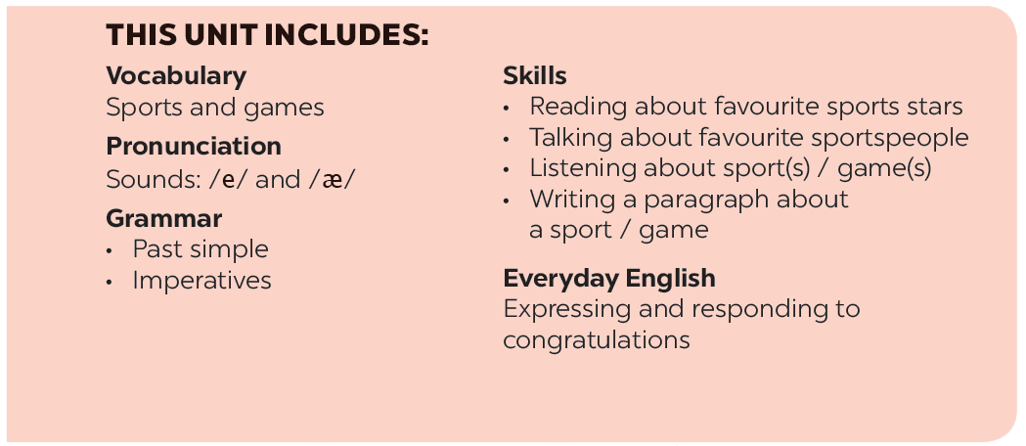

Slide 3







Grammar
The past simple
Imperatives
Choose the correct answer A, B, or C.
Look at each picture and choose the correct answer.
Write the correct form of the verbs to complete the conversation.
Tell your friends what to do and what not to do at the gym.
Work in groups. Ask and answer questions about your last weekend.

Slide 4
I. The past simple: thì quá khứ đơn
1. Cách dùng: Thì quá khứ đơn dùng để diễn tả những sự việc đã xảy ra trong quá khứ mà không còn liên quan đến hiện tại.
2. Dấu hiệu của thì QKĐ:
- Trong câu các trạng từ chỉ thời gian:
+ yesterday: ngày hôm qua
+ last night: tối hôm qua
+ last week: tuần trước
+ last month: tháng trước
+ last year: năm trước
+ last Sunday: chủ nhật trước
+ (two) years ago: cách đây 2 năm
+ in 2020: năm 2020

Slide 5
3. Cấu trúc
a. Với động từ tobe: ta chia thành 2 dạng: were và was
- FORM:
(+) S (They/ We/ You/ DTSN) + were + O
S (I / He/ She/ It/ DTS ít) + was + O
(-) S (They/ We/ You/ DTSN) + were not/ weren’t + O
S (He/ She/ It/ DTS ít) + was not/ wasn’t + O
(?) Were/ Was + S + O ?
VD: (+) They were in the city last year.
He was in the countryside yesterday.
(-) Lan and Hoa were not students in 2019.
She wasn’t a teacher in 1990.
(?) Were you a doctor in 2018?
Was he a worker in 1989?

Slide 6
b. Với động từ thường: ta chia thành 2 dạng: động từ theo quy tắc ta thêm “ed”, động từ không theo quy tắc ta lấy ở cột 2.
*VD động từ theo QT ta thêm “ed” như sau:
- start -> started - cook -> cooked - study ->studied
- need -> needed - stop-> stopped - play ->played
*VD động từ không theo QT ta lấy ở cột 2 như sau:
- go -> went -> gone: đi
- do -> did -> done: làm
- come -> came -> come: đến
- see -> saw -> seen: nhìn thấy
- eat -> ate -> eaten: ăn
- have -> had -> had: có

Slide 7
- FORM:
(+) S + V(ed/c2) + O
(-) S + did not/ didn’t + V + O
(?) Did + S + V + O ?
VD:
(+) I played football yesterday.
(-) She did not go to school last week.
(?) Did you watch TV last night?
Yes, I did./ No, I didn’t.

Slide 8

Grammar
The past simple
We use the past simple to talk about something that happened in the past.
Example:
I played badminton with Phong yesterday.

Slide 9


Choose the correct answer A, B, or C.
1.
There _______ an interesting match on TV last night.
A.
is
B.
were
C.
was
2.
My dad _______ a lot of tennis some years ago.
A.
plays
B.
played
C.
is playing
3.
I was at the gym last Sunday, but I _______ you there.
A.
B.
don’t see
C.
didn’t see
not saw
4.
The teacher _______ us about our homework this morning.
A.
B.
not asking
C.
doesn’t ask
didn’t ask
5.
_______ sleep well last night?
A.
B.
Did you
C.
Were you
Do you

Slide 10

Write the correct form of the verbs to complete the conversation.
Nick: Hi, there.
Sonny: Hello, Nick. Did you have a nice weekend?
Nick: Yeah, it was OK. On Sunday, I (1. go) _______ fishing with my dad. How about you?
Sonny: Oh, I (2. have) _______ a good weekend, too.
Nick: Really? What _______ you (3. do) _______?
Sonny: I (4. visit) _______ the museum with my family, then we (5. eat) _______ at my favourite restaurant.
Nick: Did you watch football last Sunday
Sonny: Oh, yeah! My favourite team (6. score) _______ a fantastic goal!

Slide 11
Write the correct form of the verbs to complete the conversation.
Nick: Hi, there.
Sonny: Hello, Nick. Did you have a nice weekend?
Nick: Yeah, it was OK. On Sunday, I (1. go) went fishing with
my dad. How about you?
Sonny: Oh, I (2. have) had a good weekend, too.
Nick: Really? What did you (3. do) do?
Sonny: I (4. visit) visited the museum with my family, then we
(5. eat) ate at my favourite restaurant.
Nick: Did you watch football last Sunday
Sonny: Oh, yeah! My favourite team (6. score) scored a
fantastic goal!

Slide 12

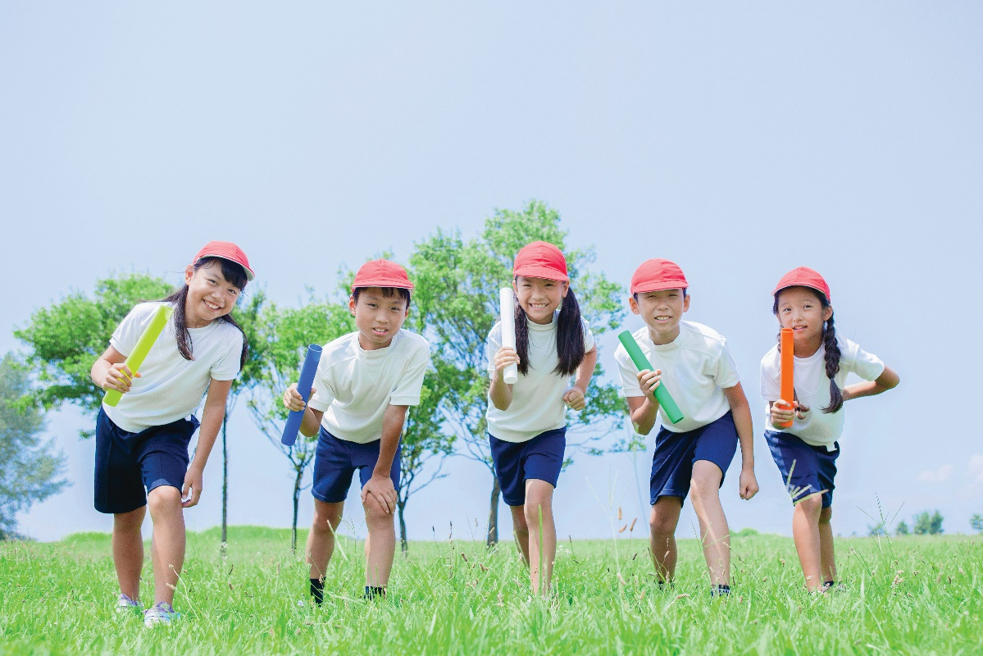
Work in groups. Ask and answer questions about your last weekend.
Example:
A: Did you do any sport last weekend?
B: Oh yes, and I was exhausted.
C: Really? What did you do?
…

Slide 13
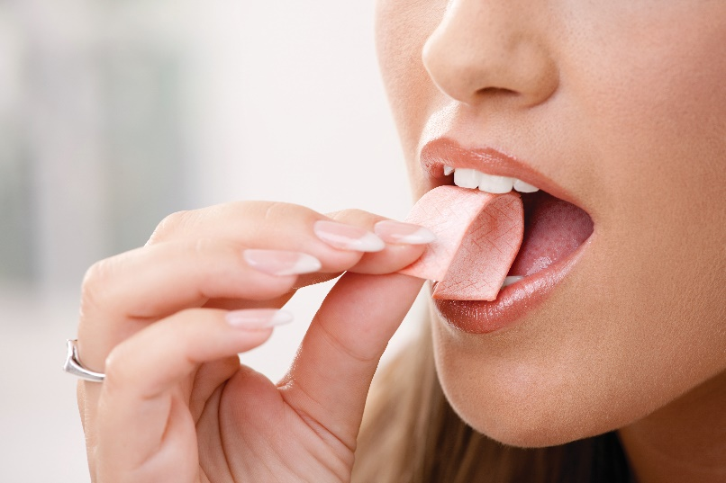
Grammar
Imperatives
We use imperatives to tell someone to do something, or to give a direct order.
It’s a chewing gum.
Chew it.
Don’t swallow it.
Positive: V
Negative: Don’t + V

Slide 14


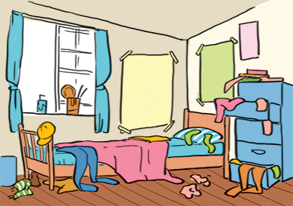


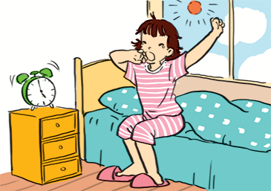
Look at each picture and choose the correct answer.

Slide 15
1.
(Park / Don’t park) here.
1. Don’t park here.

Slide 16
2.
(Close / Open) the window. It’s windy outside.
2. Close the window.
It’s windy outside.

Slide 17
3. Tidy up your room.
3.
(Tidy up / Don’t tidy up) your room.

Slide 18
4.
(Use / Don’t use) the lift when there is ﬁre.
4. Don’t use the flit
when there is fire.

Slide 19
5. Try to get up early
to do some exercise.
5.
(Try / Don’t try) to get up early to do some exercise.

Slide 20


Tell your friends what to do and what not to do at the gym.
GYM RULES
Example:
Change your clothes.
Don’t speak loudly.
_______
_______
_______

Slide 21







