Slide 1





Slide 2



Warm-up

Slide 3



Notes:
How many fingers?
Where’s daddy finger?
Which finger is mummy’s?
Thet’re a……
→ It’s also the title of today’s lesson. FAMILY

Slide 4





UNIT 11:
Y
M
F
A
M
I
L
Y
Lesson 1 - Period 1
Notes:
This row, please stand up and read aloud.

Slide 5

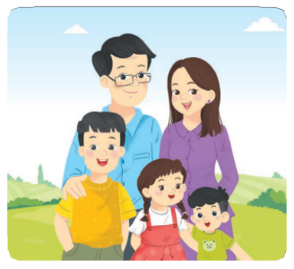
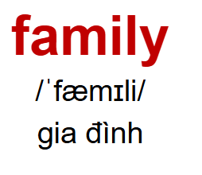
Vocabulary

Slide 6
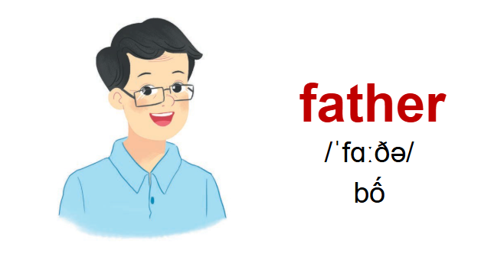

Vocabulary

Slide 7
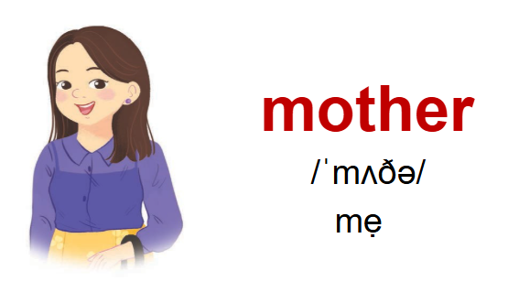
Vocabulary

Slide 8
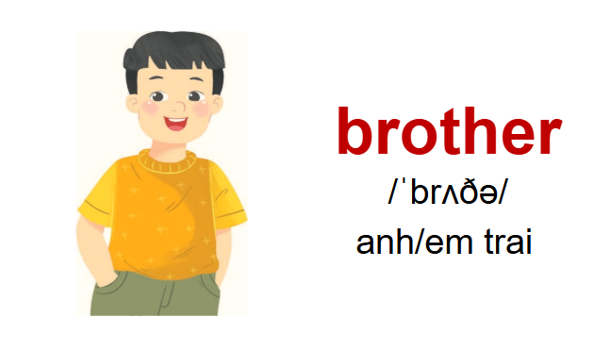
Vocabulary

Slide 9
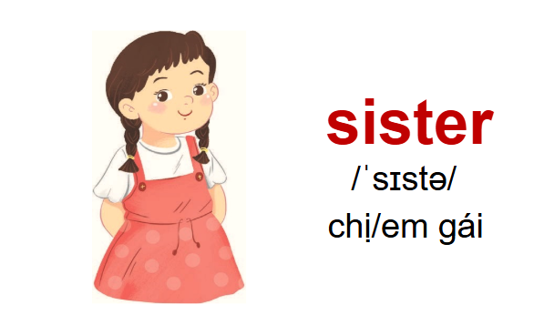
Vocabulary

Slide 10

Game:

Slide 11
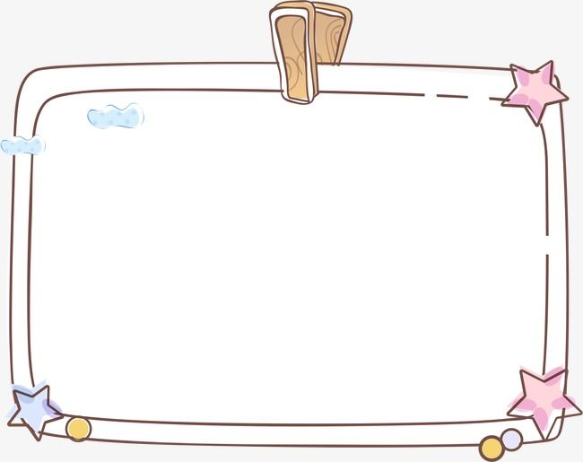

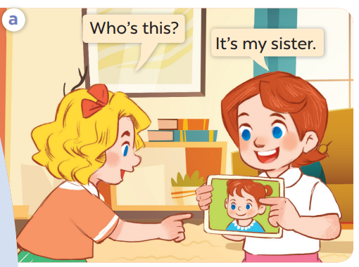
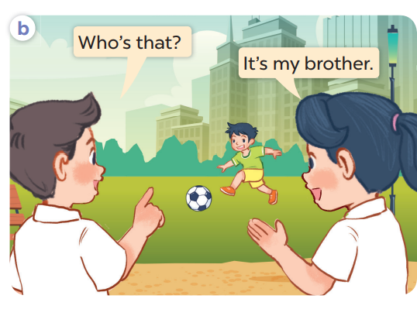
Look, listen and repeat.
Notes:
Hoclieu.com

Slide 12
Look, listen and repeat.
Notes:
Is this Lucy?

Slide 13
Look, listen and repeat.

Slide 14
Look, listen and repeat.
Notes:
Hoclieu.com

Slide 15

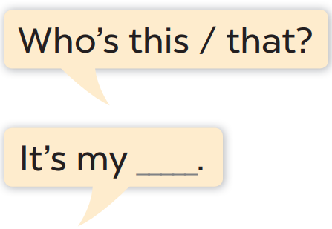
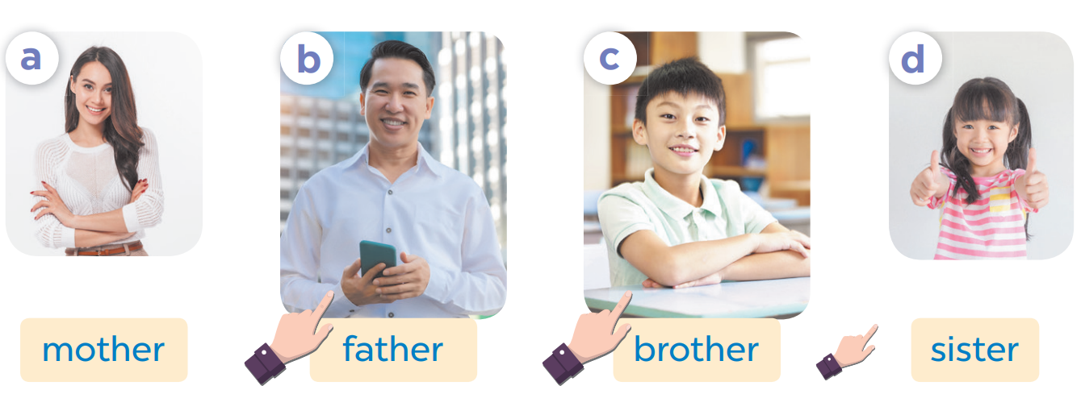

Who’s = Who is
Notes:
Hoclieu.com

Slide 16
Who’s that?
It’s my mother.
Notes:
Hoclieu.com

Slide 17
Game:
Pass the balls

Slide 18
Who’s that?
It’s my mother.
Notes:
Hoclieu.com

Slide 19
Who’s this?
It’s my father.
Notes:
Hoclieu.com

Slide 20
Who’s this?
It’s my brother.
Notes:
Hoclieu.com

Slide 21
Who’s that?
It’s my sister.
Notes:
Hoclieu.com

Slide 22
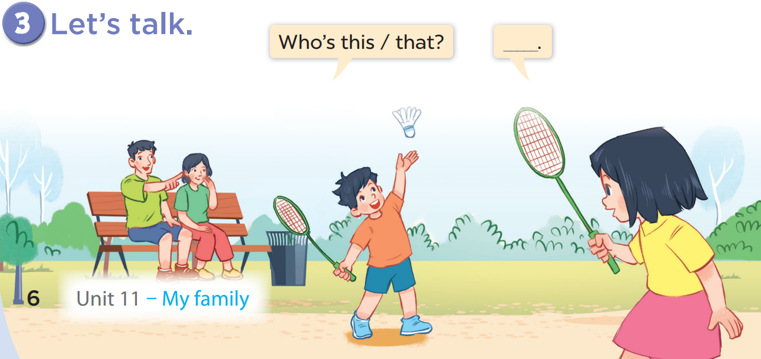

Slide 23
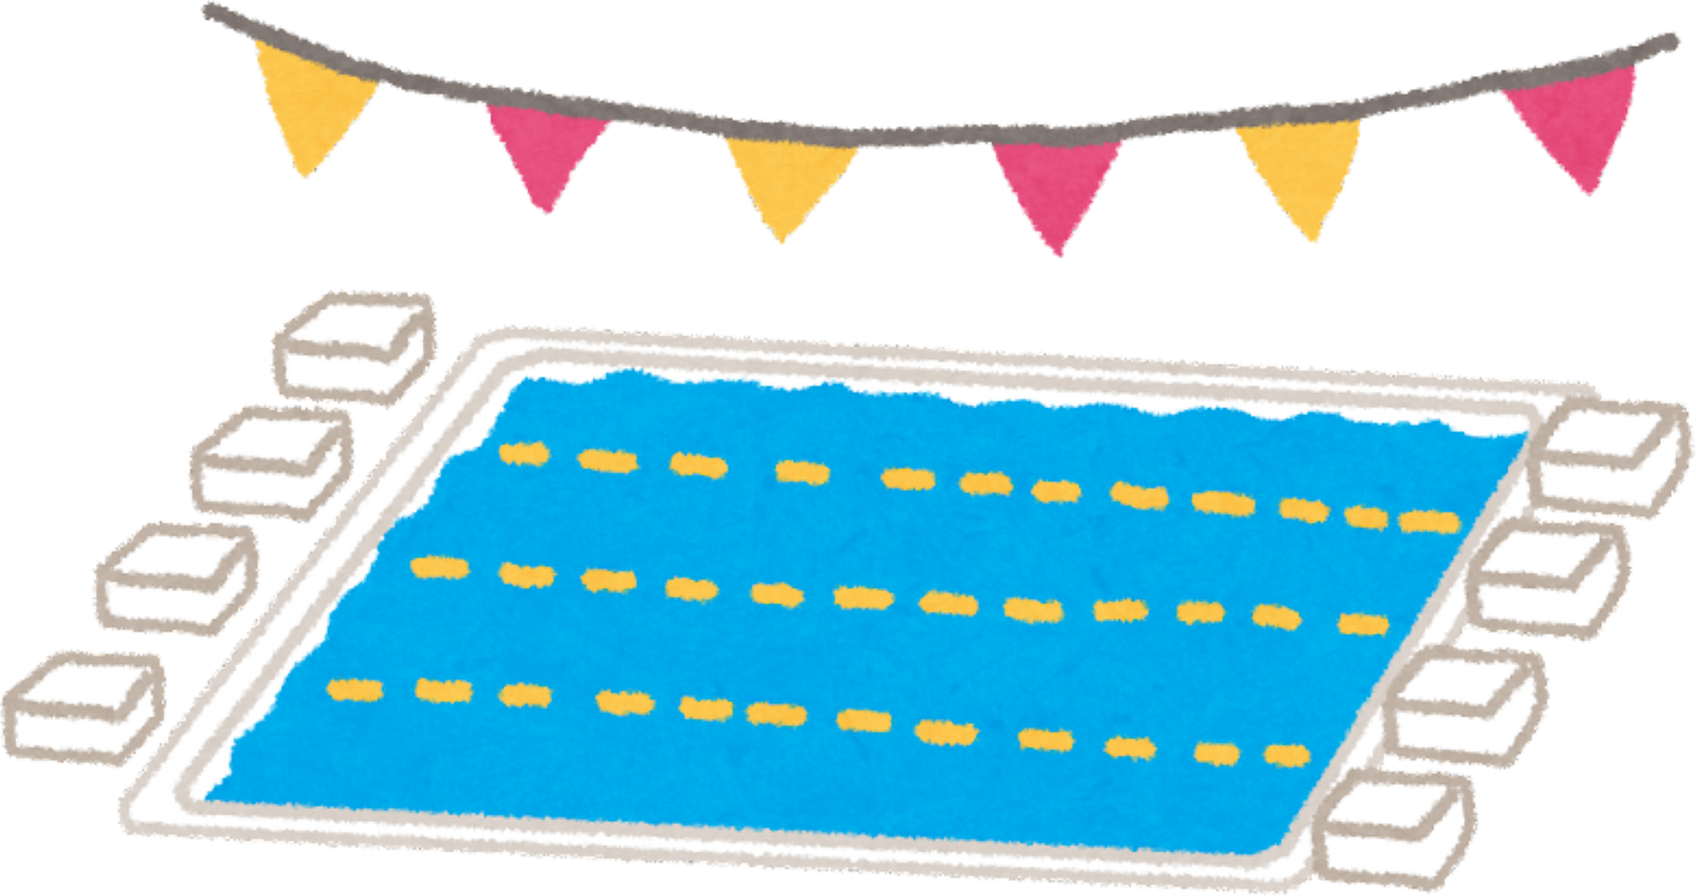
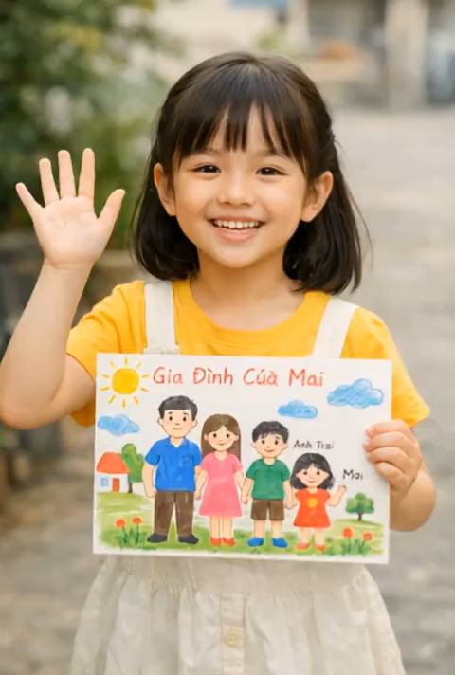
AI video
Watch video and answer the questions:
1. Who’s this?
2. How many people are there in her family?

Slide 24

Let’s talk
Hello. My name’s …………. I’m ……. years old. There are …... people in my family.
Look at the picture.
This is my father. His name’s ……...
This is my mother. Her name’s ………
And this is my brother/ sister, ……………. He’s/ She’s ………….. years old.
I love my family very much. What about you?

Slide 25

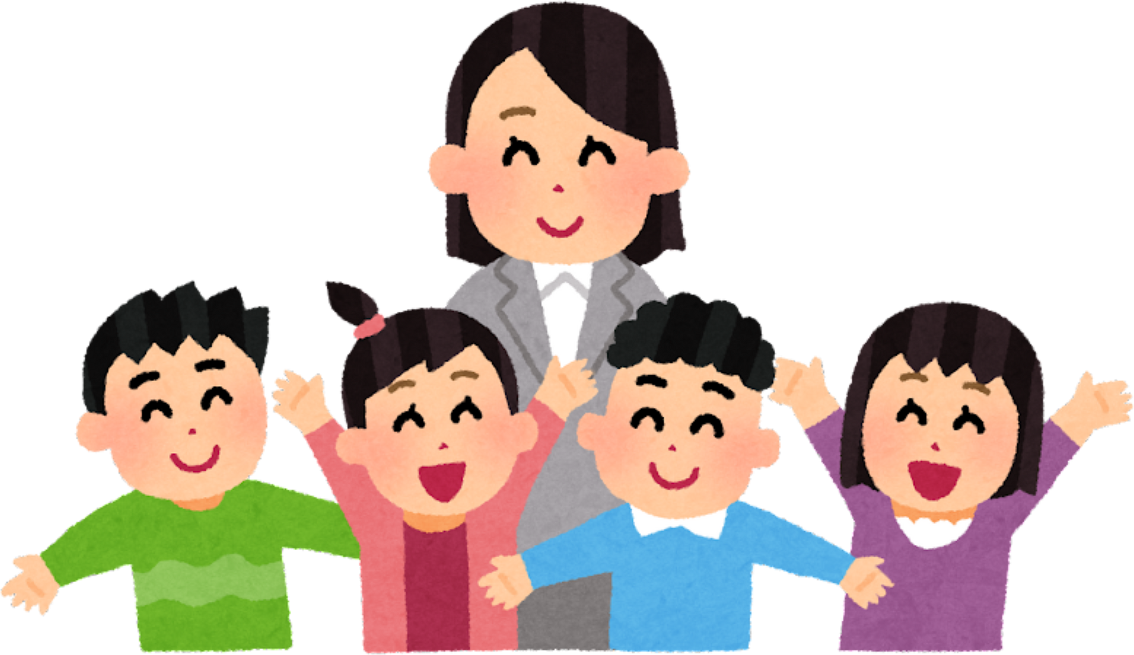
THANK YOU!

