Slide 1





Slide 2
Unit 11: My home
Lesson 2 - period 3

Slide 3
Table of Contents
01
02
03
04
Warm-up
Look, listen and repeat.
Listen, point and say.
Let’s talk.
fun corner
& Wrap-up
05

Slide 4
01
Warm-up

Slide 5

Notes:
https://www.youtube.com/watch?v=L08bVyhfKpg&list=PL8_ETpRL2xNY6ptJqBTgFUP3I654rZ9bv&index=21

Slide 6
02
Look, listen and repeat.

Slide 7
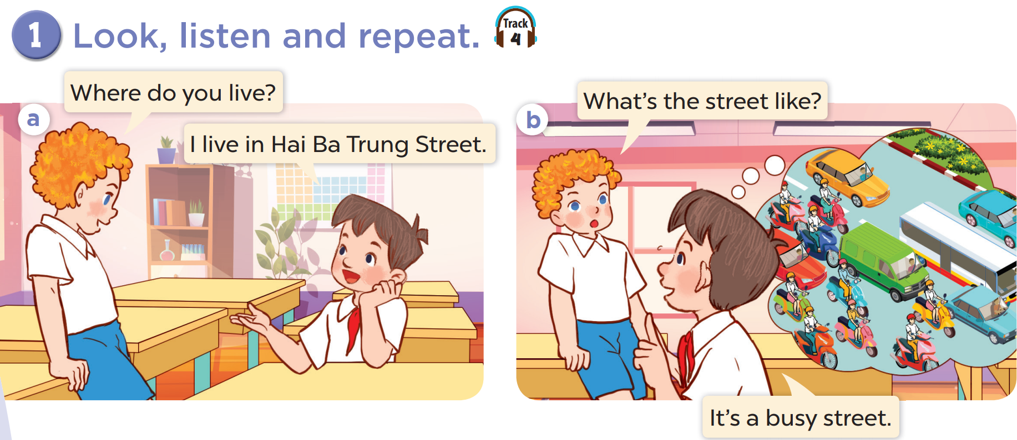


Slide 8
03
Listen, point and say.

Slide 9
vocabulary

Slide 10
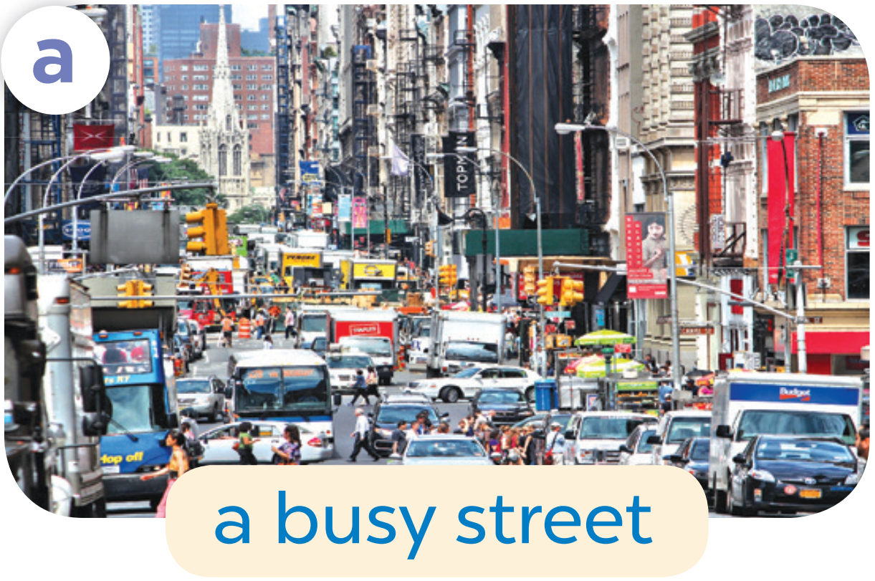

Slide 11


Slide 12
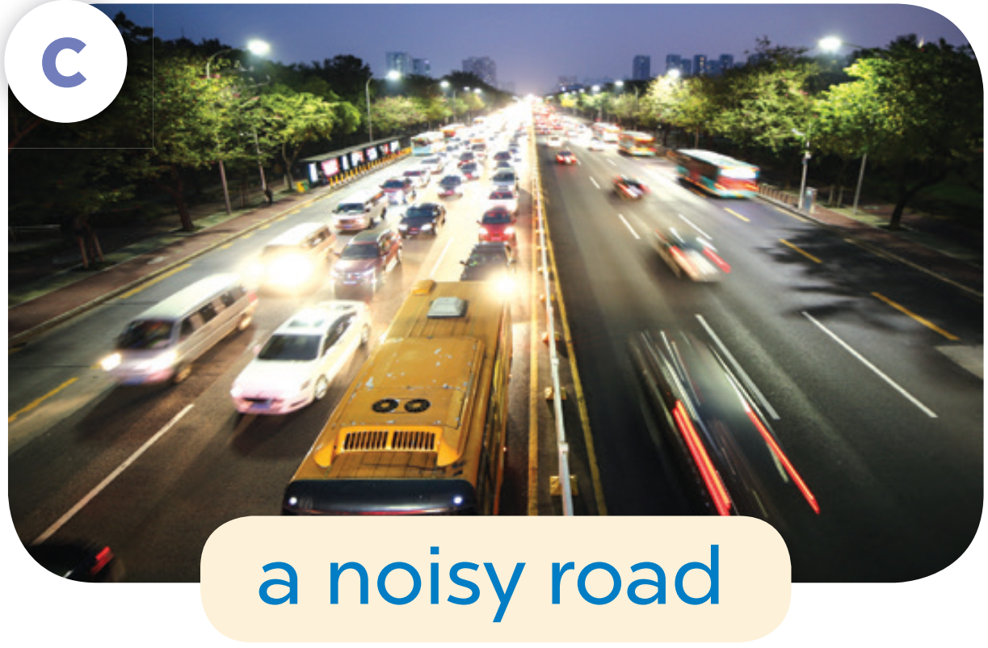

Slide 13


Slide 14
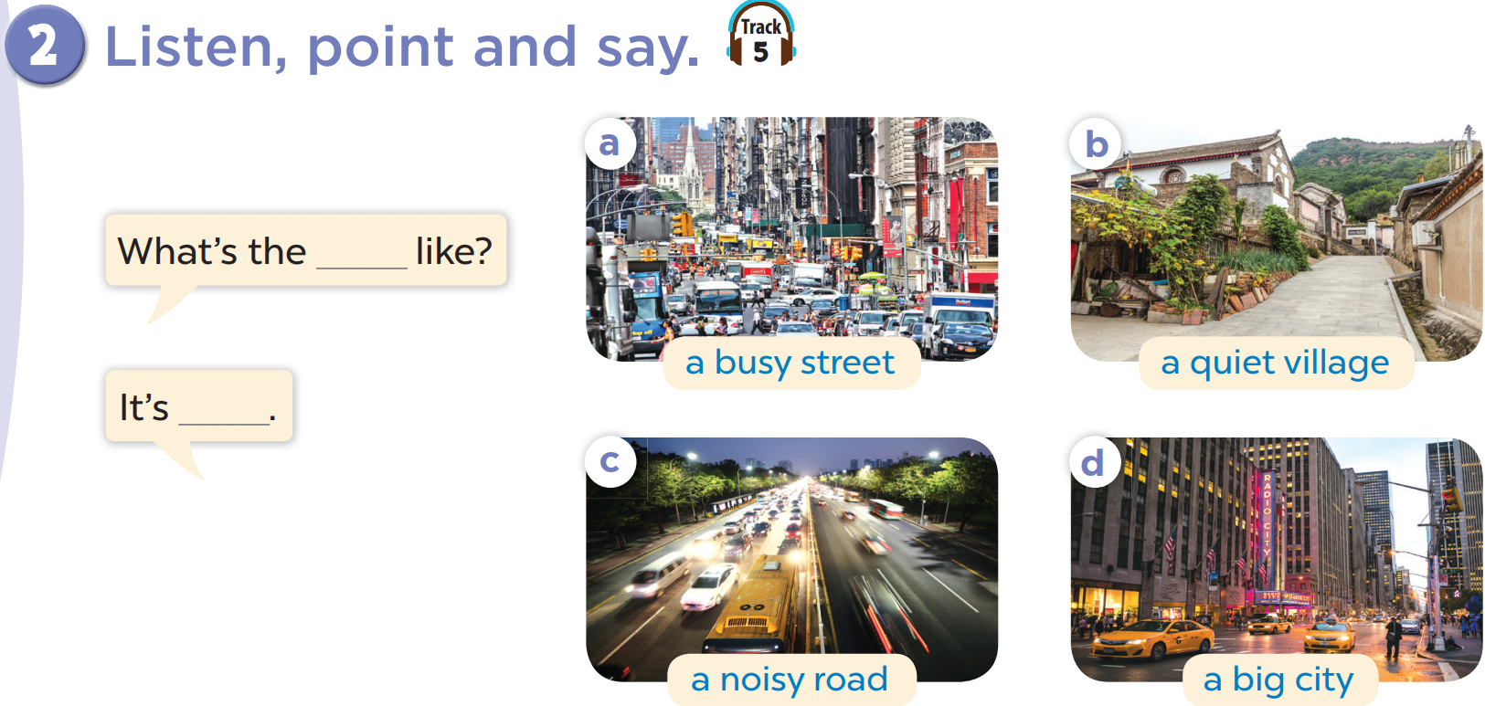

Slide 15
What the street like?
It’s a busy street.

Slide 16
04
Let’s talk.

Slide 17
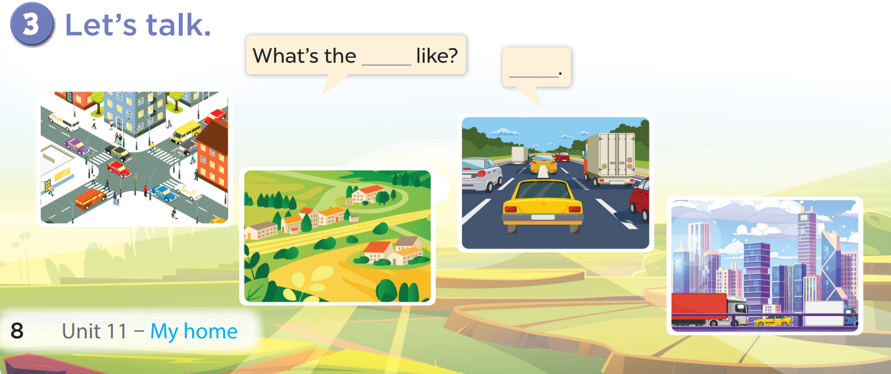

Slide 18
05
fun corner
& Wrap-up

Slide 19




Game
Can you guess what it is?
a quiet village
1
2
3
4
5
6
7
8
9
answer

Slide 20

Game
Can you guess what it is ?
a big city
1
2
3
4
5
6
7
8
9
answer

Slide 21

Game
a busy street
1
2
3
4
5
6
7
8
9
answer

Slide 22
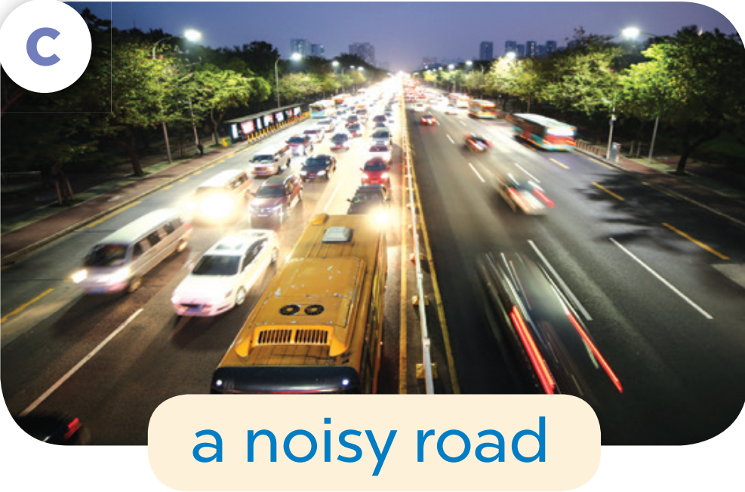
Game
a noisy road
1
2
3
4
5
6
7
8
9
answer

Slide 23
What have you learnt today?

Slide 24
THANK YOU

