Slide 1



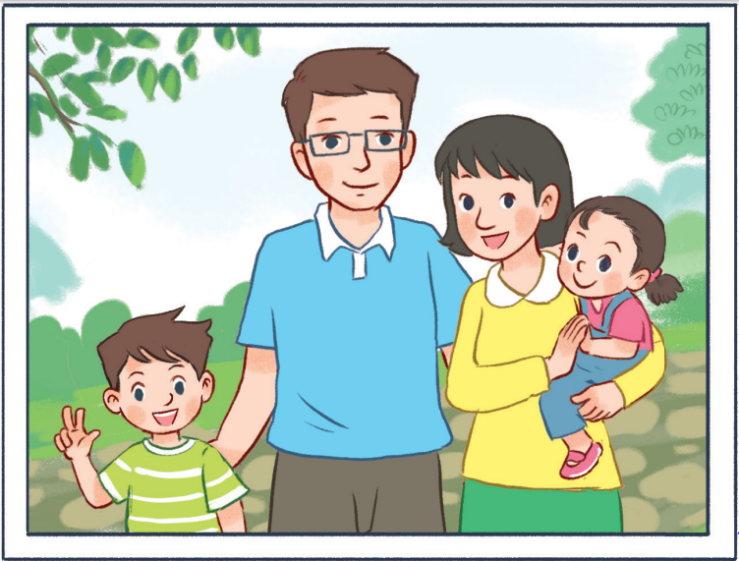
11
My family
LESSON 2 – PERIOD 4

Slide 2
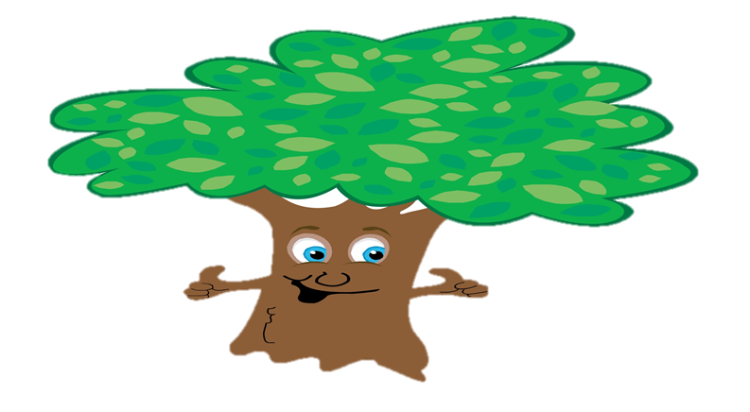
My family
Listen, point
and say.
Let’s talk.
Look, listen
and repeat.
Warm-up
and review
Fun corner
& wrap-up

Slide 3







A
B
BINGO
Notes:
- Divide the class into 2 teams to play “Bingo”.
- Have pupils read the numbers on two bingo cards quickly.
- Have pupils listen and choose the right bingo cards.
- Back to the menu for pupils another question.
- Pupils continue their turn until there are not any balls.
- The one who gets most points is the winner.

Slide 4
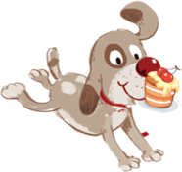




BINGO
BINGO
twelve | forty | sixteen
eleven | thirty | nineteen
Click on the winner card
BINGO
twenty | fourteen | sixteen
eleven | thirteen | nineteen
20
14
13
16
19
11
Notes:
The recording will automatically play.
Let students listen the choose one card.
Click on the “bingo” button on top left to go back.

Slide 5
BINGO
BINGO
twelve | fourteen | fifteen
eleven | thirteen | nineteen
Click on the winner card
BINGO
twelve | forty | fifty
eleven | thirty | nineteen
14
12
19
15
13
11
Notes:
The recording will automatically play.
Let students listen the choose one card.
Click on the “bingo” button on top left to go back.

Slide 6
BINGO
BINGO
eighteen | seventy | sixty
eleven | thirty | ninety
Click on the winner card
BINGO
eighteen | seventeen | sixteen
eleven | thirteen | nineteen
18
17
16
11
13
19
Notes:
The recording will automatically play.
Let students listen the choose one card.
Click on the “bingo” button on top left to go back.

Slide 7
BINGO
BINGO
twelve | fourteen | fifteen
eleven | eighteen | twenty
Click on the winner card
BINGO
twelve | forty | fifty
eleven | eighty | nineteen
14
11
12
18
20
15
Notes:
The recording will automatically play.
Let students listen the choose one card.
Click on the “bingo” button on top left to go back.

Slide 8
BINGO
BINGO
eighteen | seventy | sixty
eleven | thirty | forty
Click on the winner card
BINGO
eighteen | seventeen | sixteen
fifteen | thirteen | fourteen
17
14
18
13
15
16
Notes:
The recording will automatically play.
Let students listen the choose one card.
Click on the “bingo” button on top left to go back.

Slide 9
BINGO
BINGO
eleven | twelve | fifteen
fourteen | thirteen | sixteen
Click on the winner card
BINGO
13
eleven | twenty | fifty
forty | thirty | sixteen
12
15
14
11
16
Notes:
The recording will automatically play.
Let students listen the choose one card.
Click on the “bingo” button on top left to go back.

Slide 10
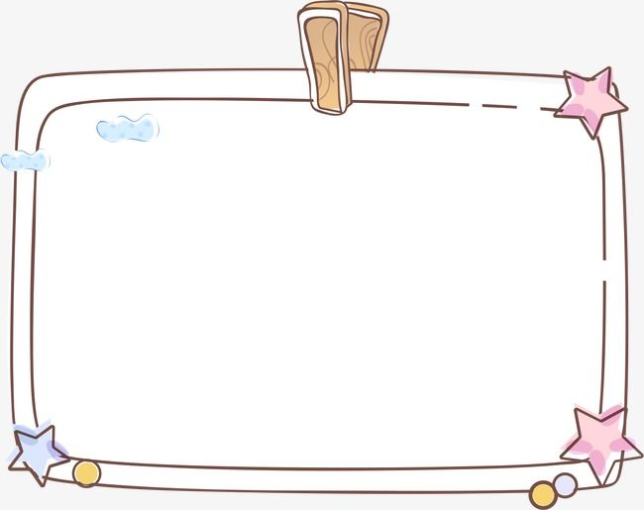

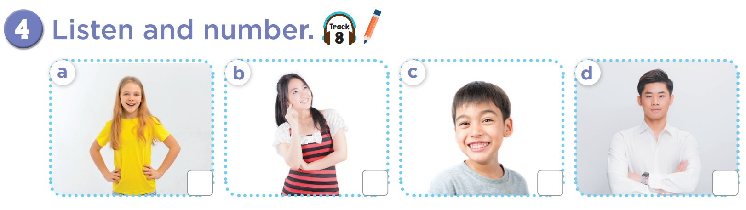

1
3
4
2

Slide 11

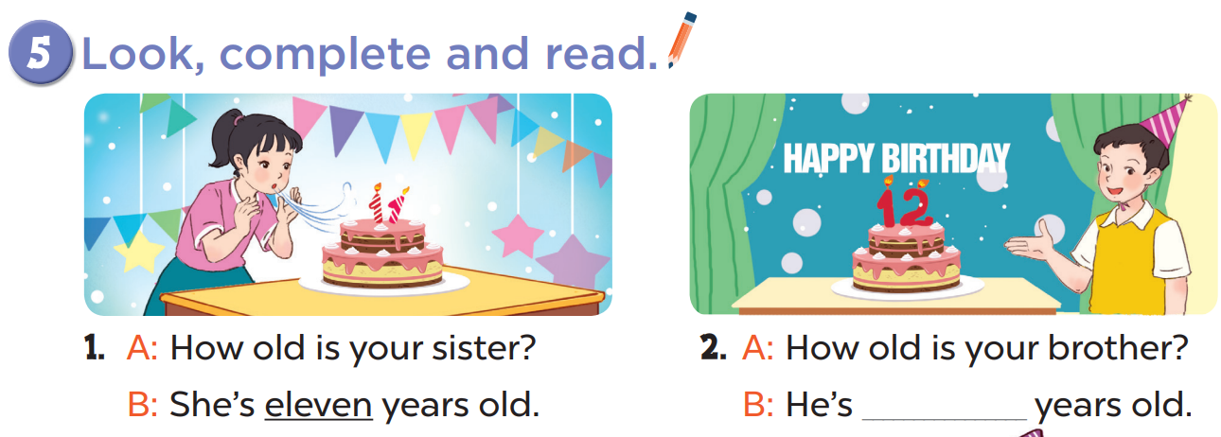
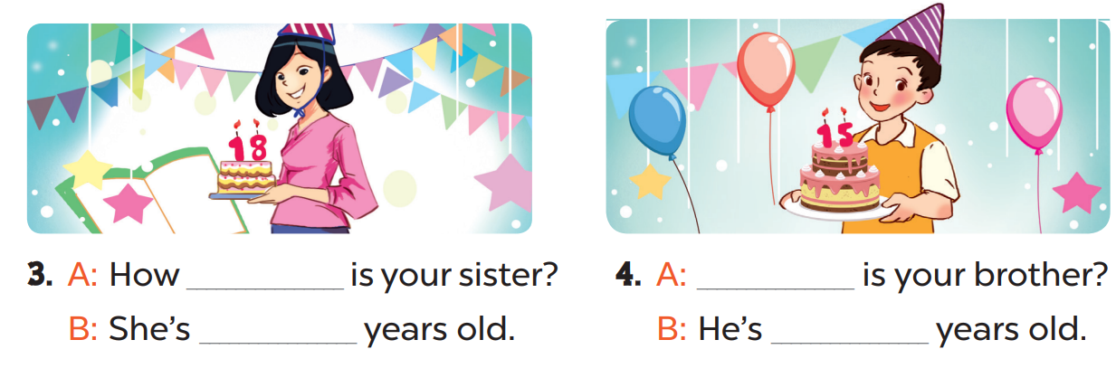
twelve
old
How
eighteen
fifteen

Slide 12

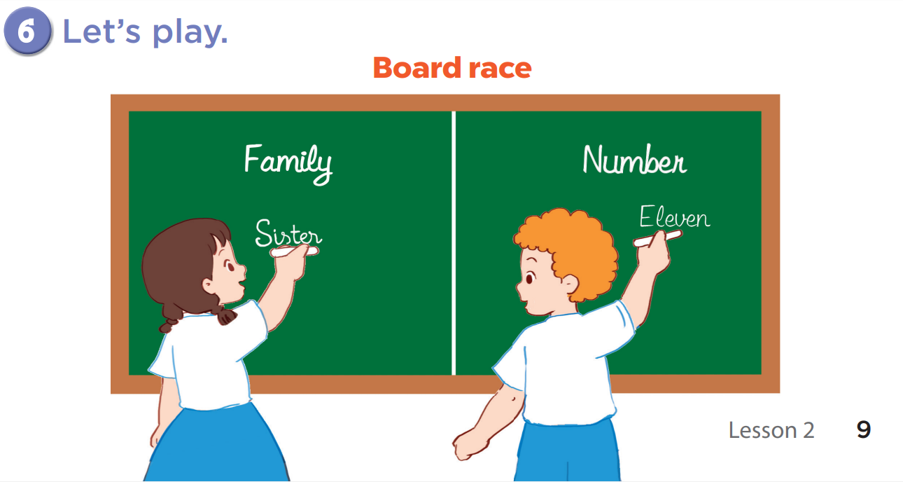

Slide 13

Fun corner and wrap-up
Water the garden
0
1
2
3
4
5
6
7
8
0
9
1
2
3
4
5
6
7
8
0
9
1
2
3
4
5
6
7
8
GIRLS
9
0
1
2
3
4
5
6
7
8
0
9
1
2
3
4
5
6
7
8
0
9
1
2
3
4
5
6
7
8
BOYS
9
A
B
C
D
E
F
G
H
Notes:
- Divide the class into 2 teams to play “Water the garden”.
- Each team choose one letter to go to the question.
- Have pupils look, read and answer the questions.
- Back to the menu for another question.
- Pupils continue their turns until there are not any letters.
- The one who gets the most points is the winner.

Slide 14



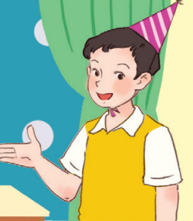
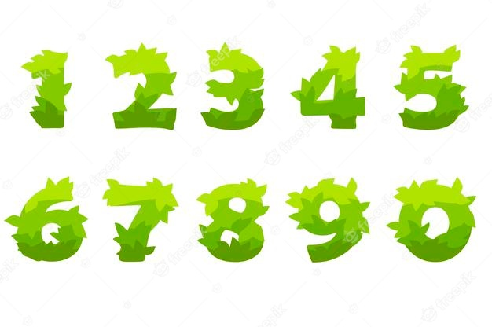

How old is he?
He’s twelve years old.
20
He’s twenty years old.

Slide 15


How old is she?
20
She’s sixty years old.
She’s twenty years old.

Slide 16
How old is he?
10
He’s fourteen years old.
He’s forty years old.

Slide 17

How old is she?
40
She’s eighty years old.
She’s eighteen years old.

Slide 18

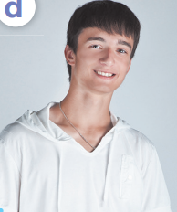
How old is he?
30
He’s nineteen years old.
He’s ninety years old.

Slide 19
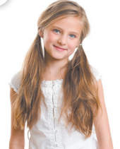
How old is she?
30
She’s thirty years old.
She’s thirteen years old.

Slide 20

How old is he?
20
He’s fifteen years old.
He’s fifty years old.

Slide 21
How old is she?
10
She’s seventeen years old.
She’s eleven years old.

