Slide 1

Unit 10
Lesson 2 - Period 2

Slide 2




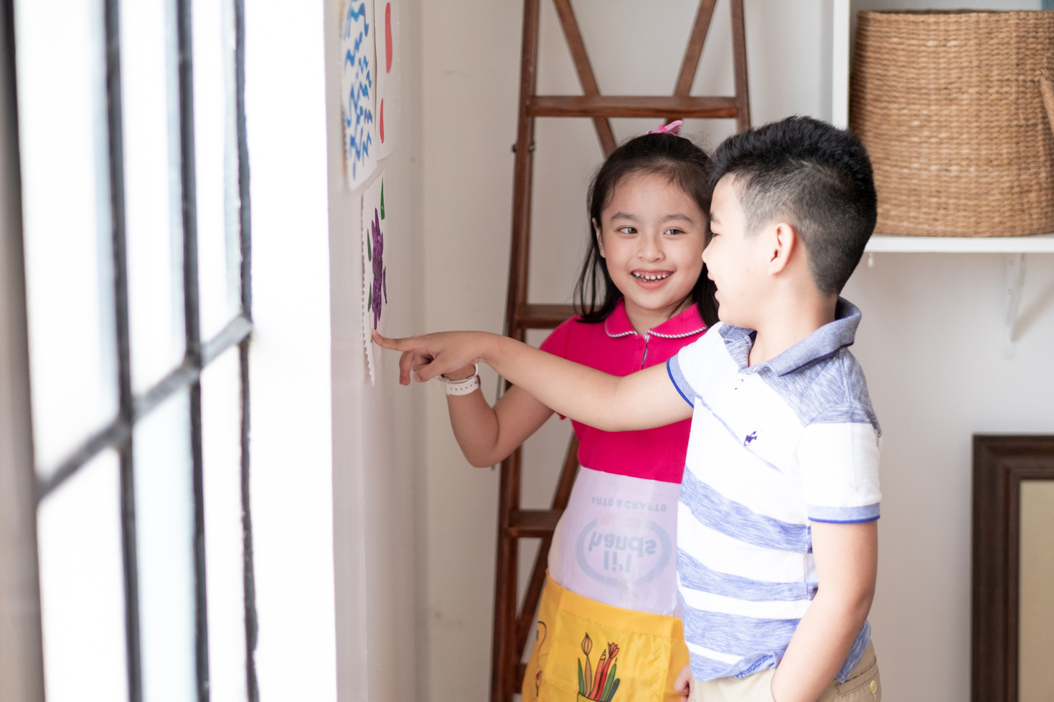



Rule 1
Listen to
your friend
talking in front.

Slide 3


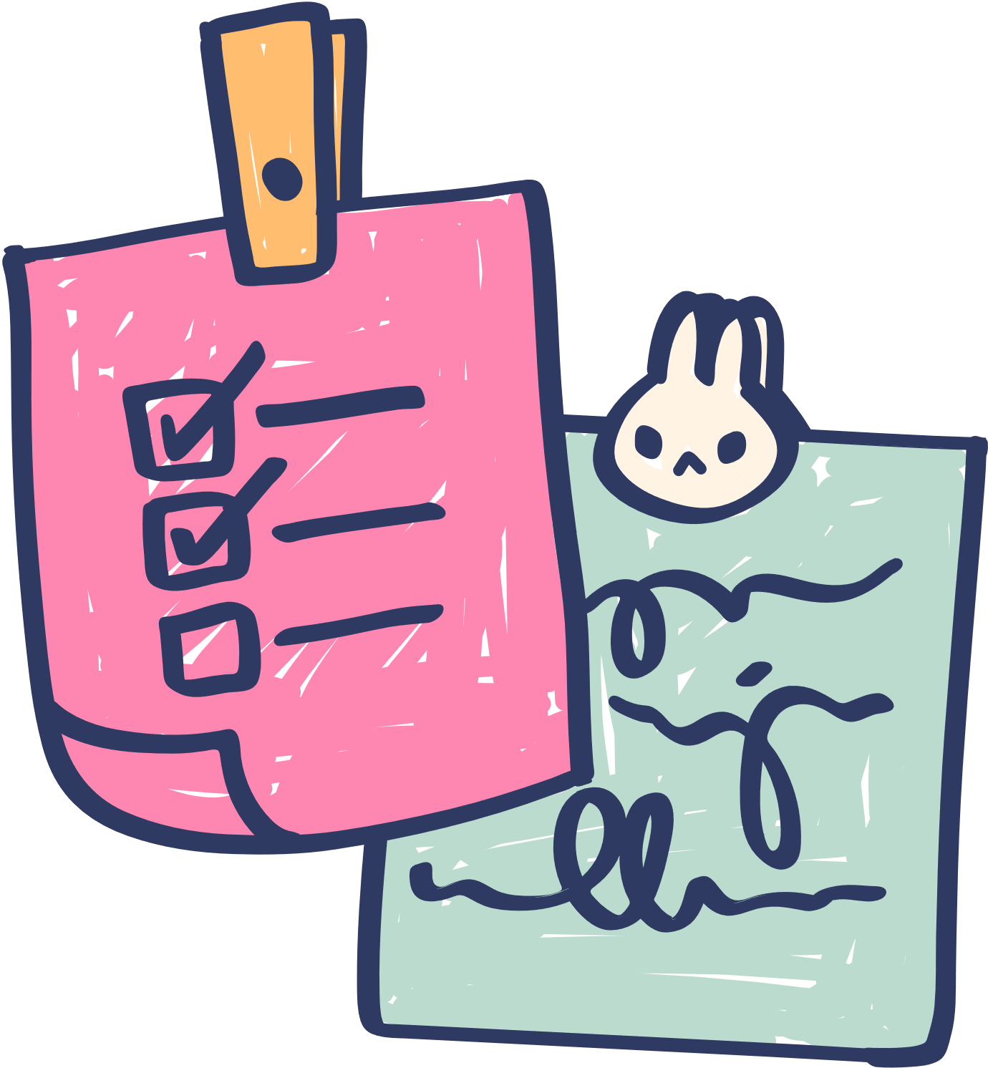





Rule 2
Raise your hand
if you have a question.

Slide 4




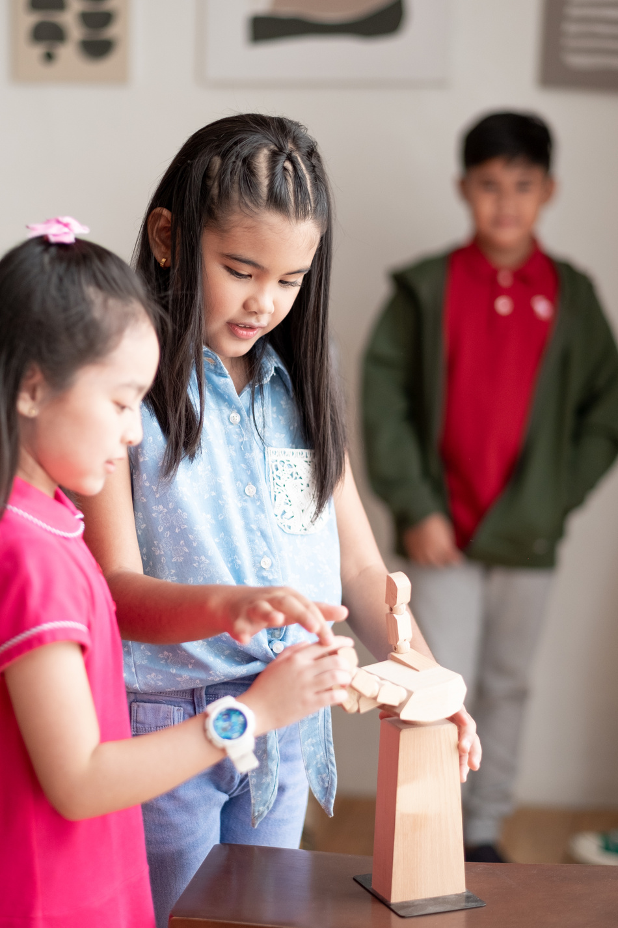



Rule 3
Wait for
your turn.

Slide 5




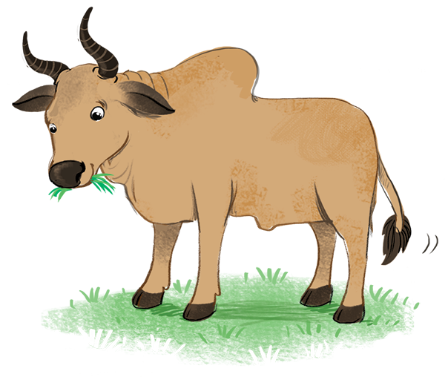

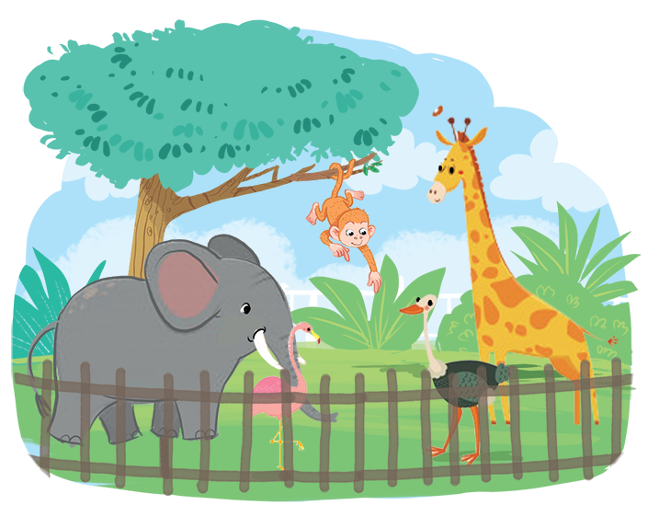









Slide 6


Slide 7


Slide 8
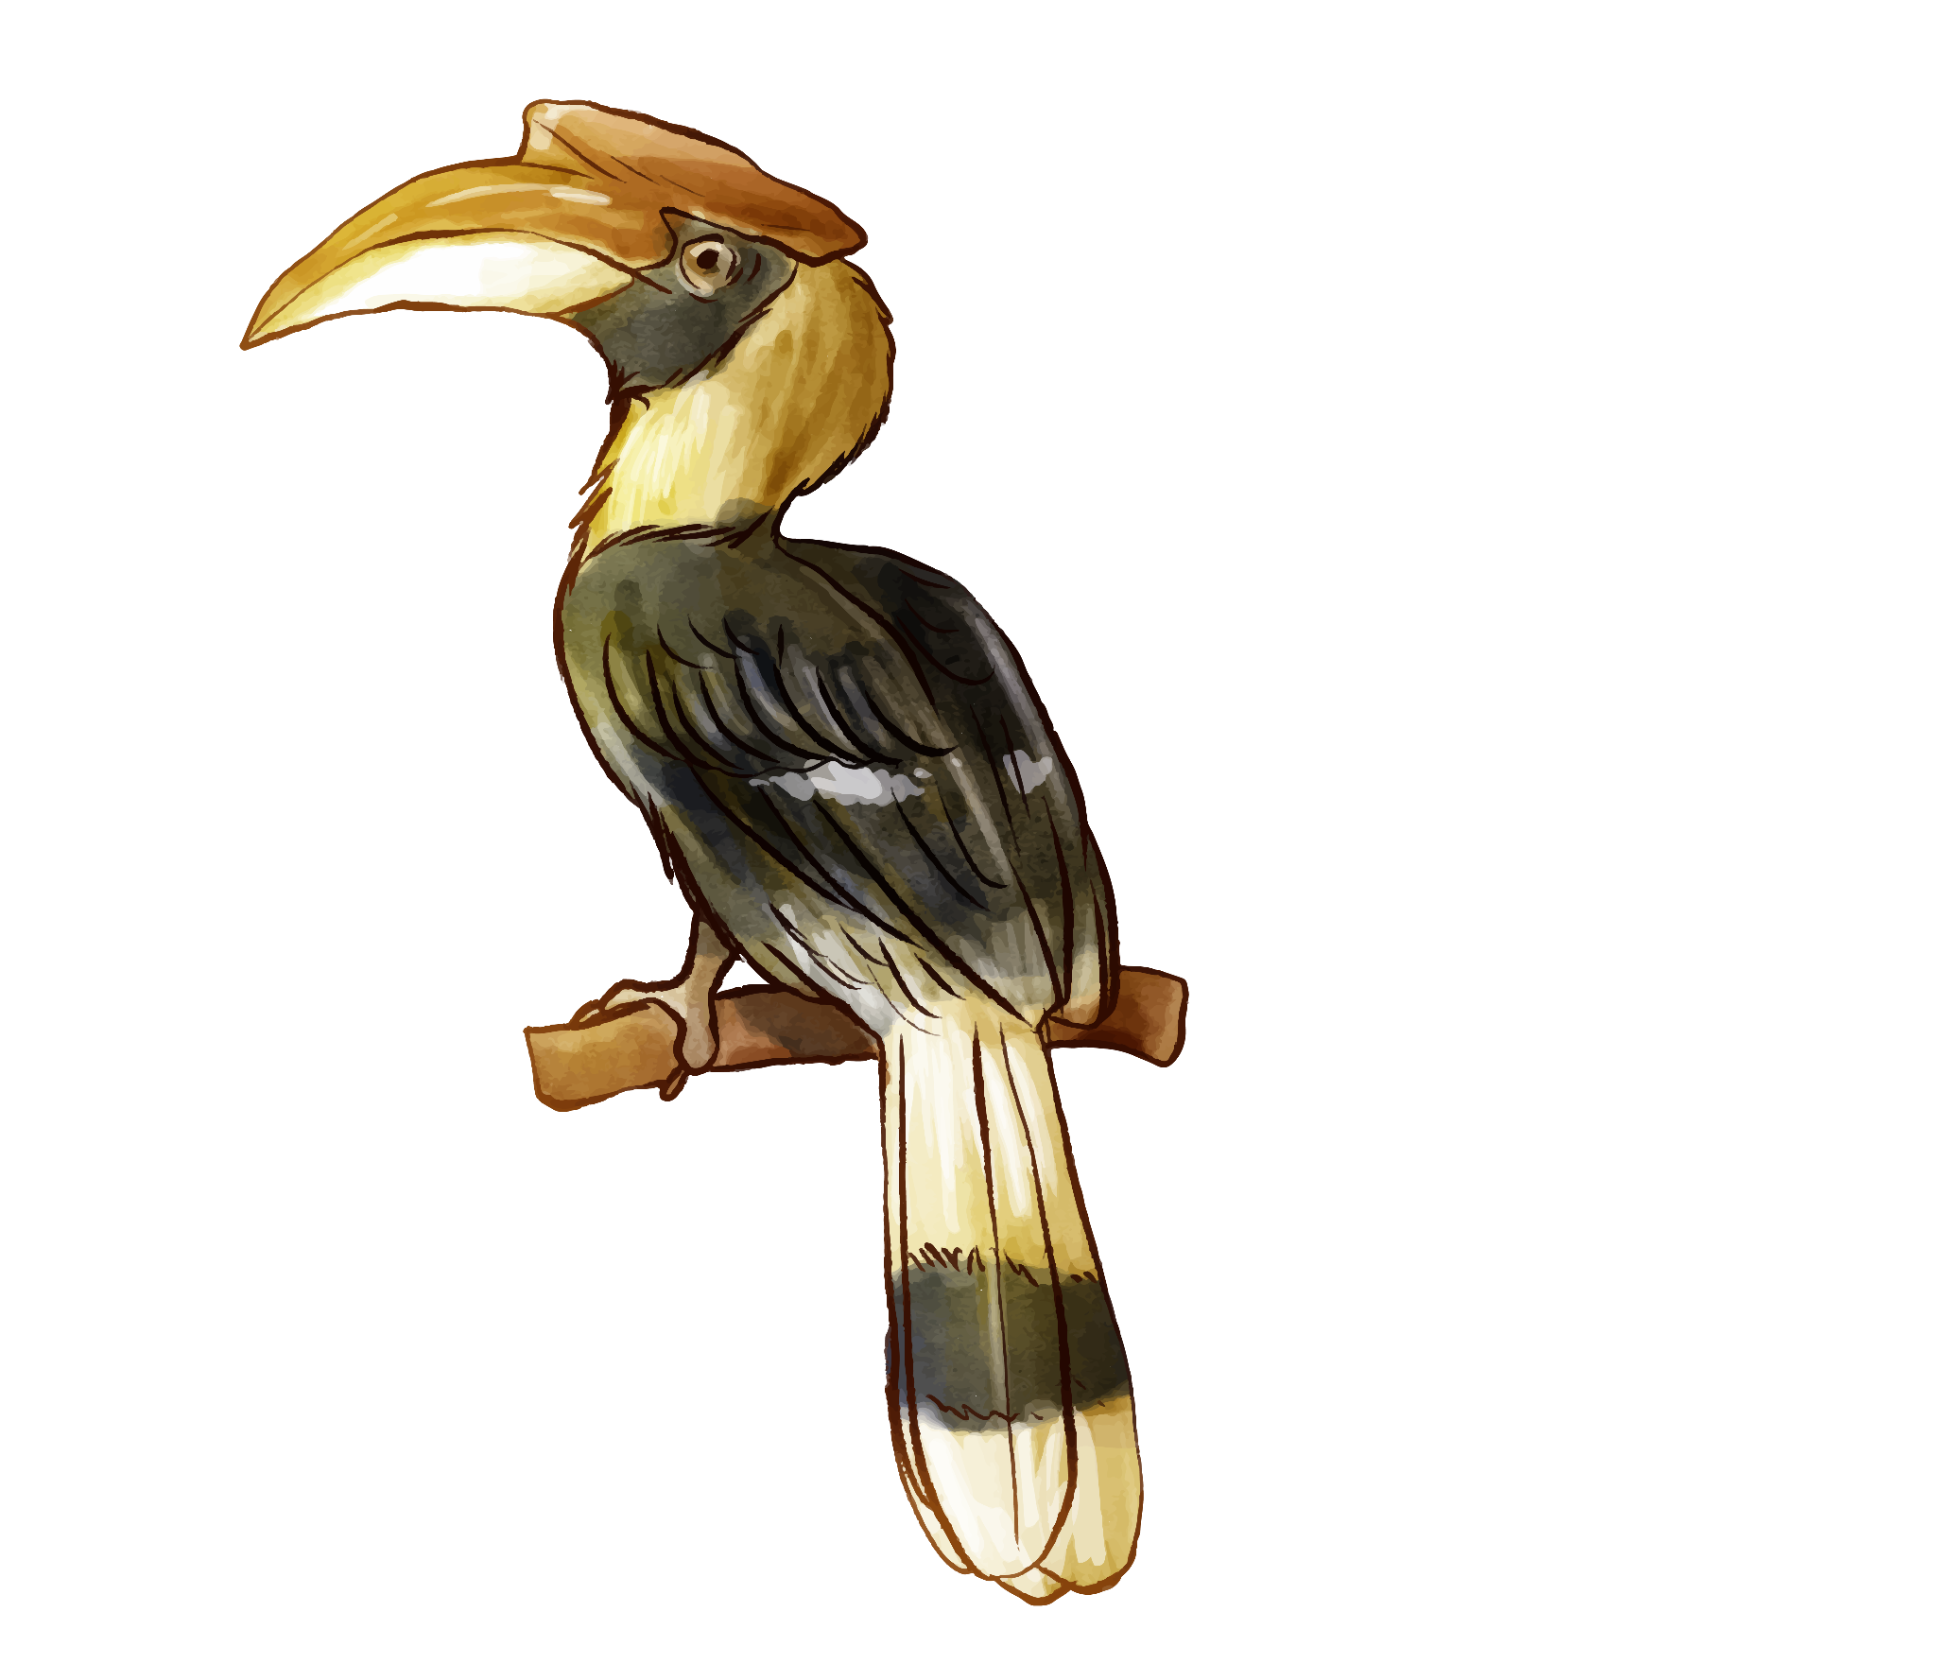
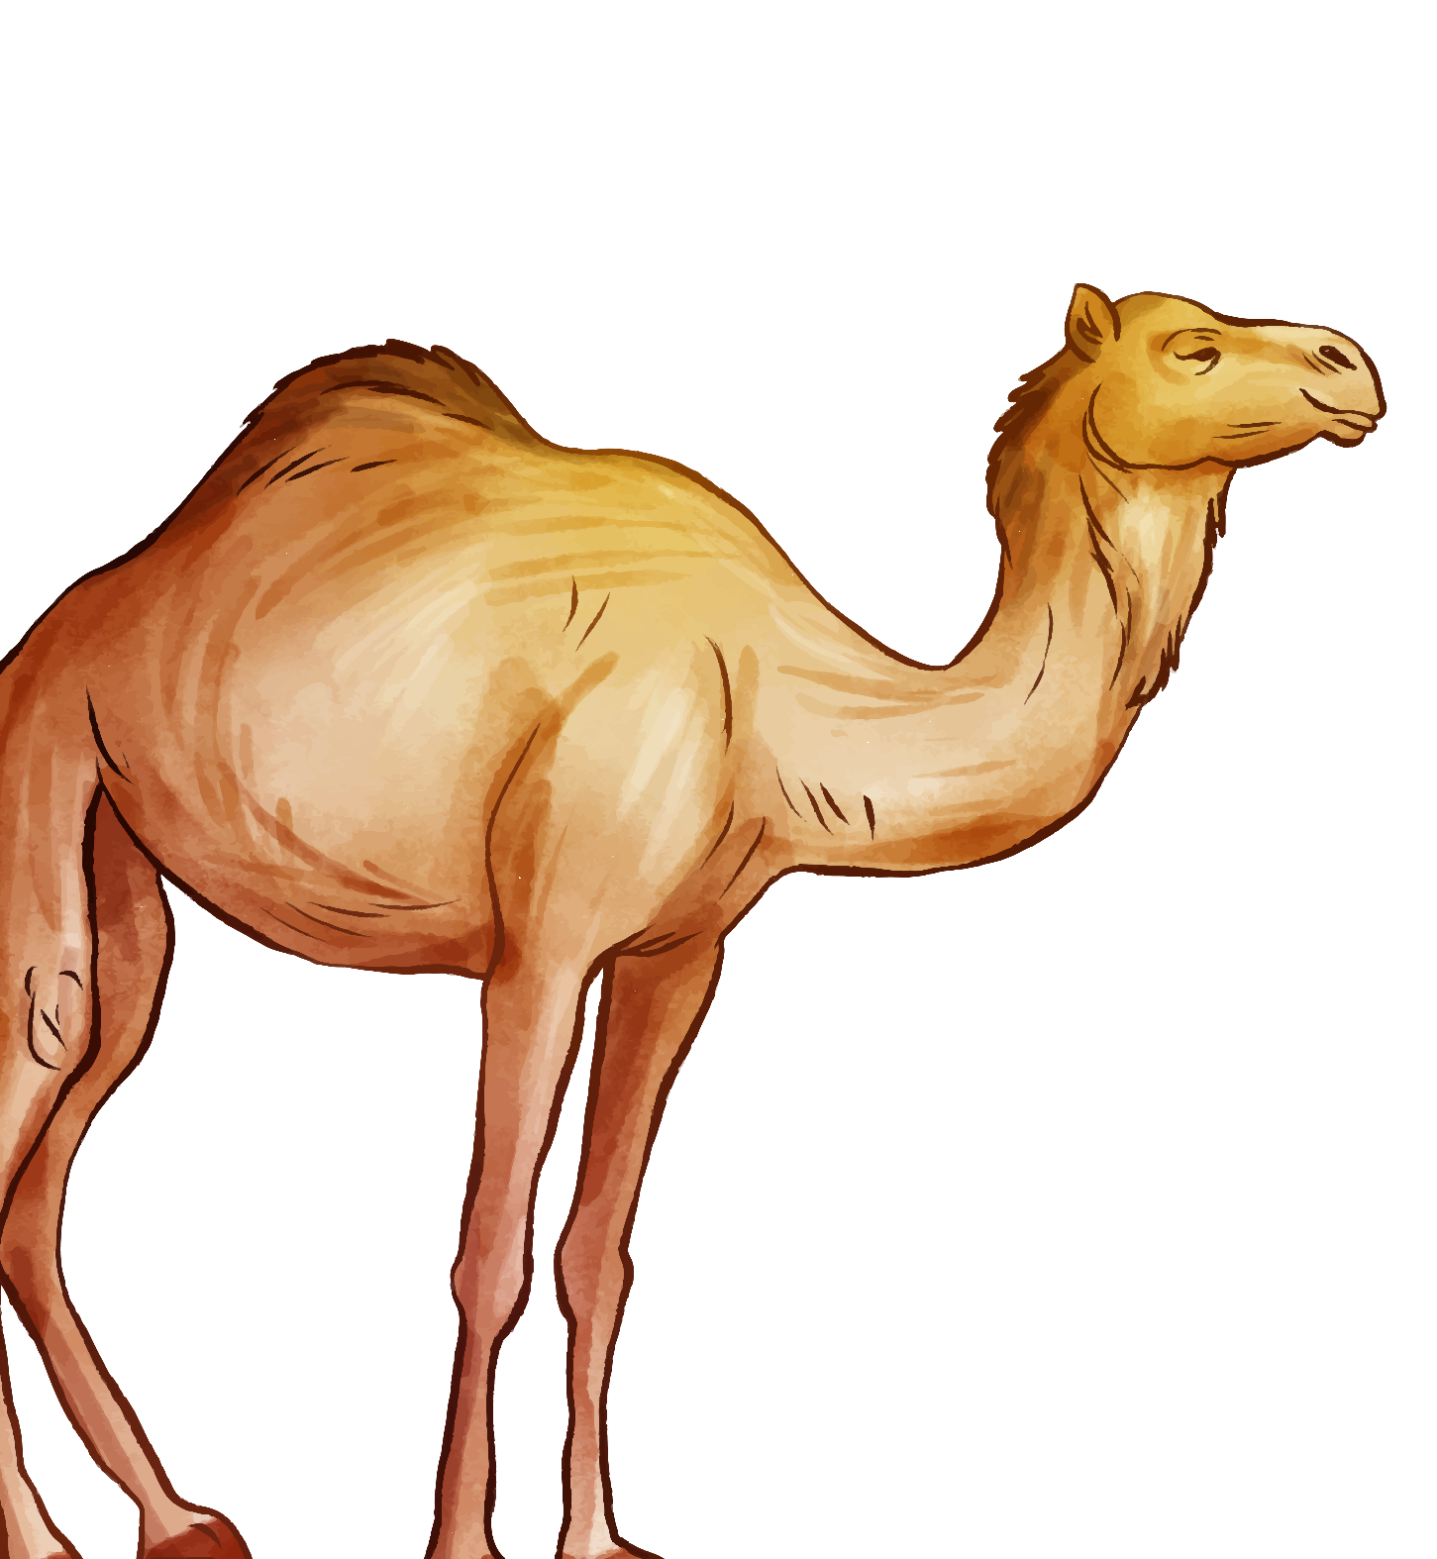
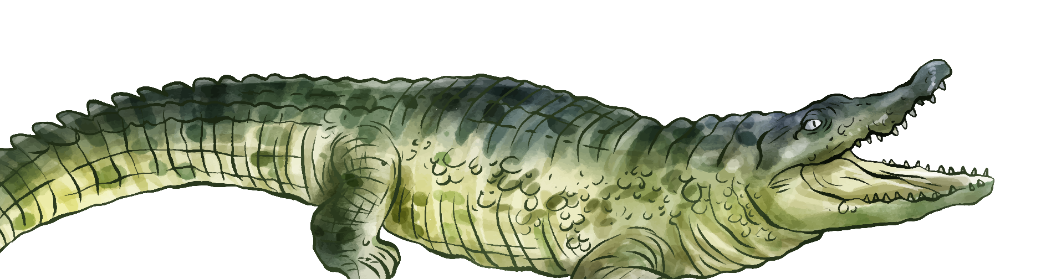
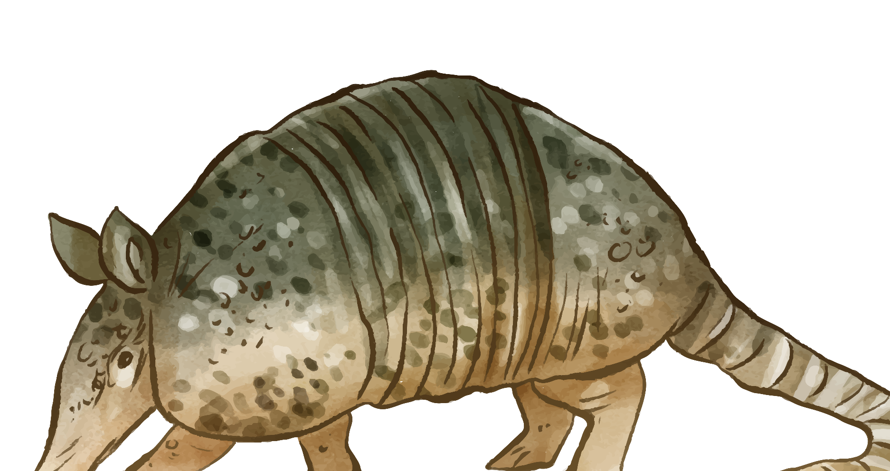
02
Listen and chant.
Activity 3

Slide 9

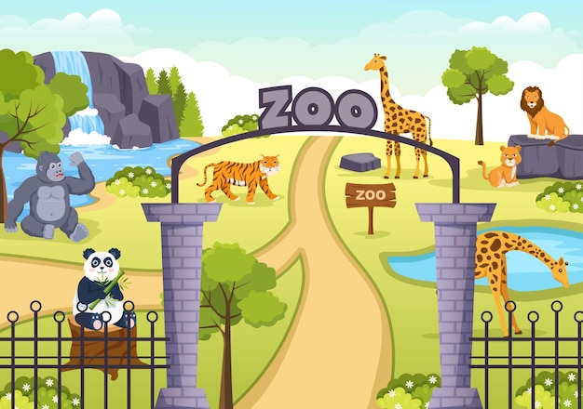
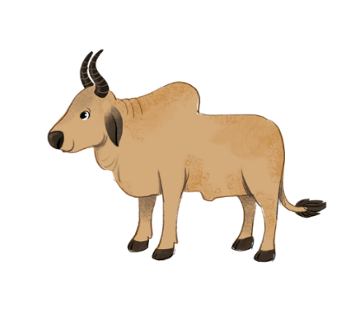


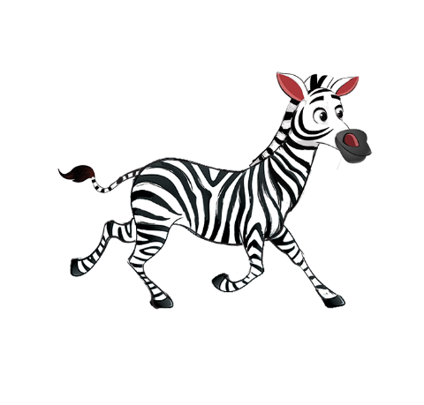
Listen and chant.
Z, z, zoo.
Z, z, zoo.
Z, z, zoo.
Z, z, zoo.
We’re at the zoo.
We’re at the zoo.
We’re at the zoo.
We’re at the zoo.
Z, z, zebra.
Z, z, zebra.
Z, z, zebra.
Z, z, zebra.
That’s a zebra.
That’s a zebra.
That’s a zebra.
That’s a zebra.
Z, z, zebu.
Z, z, zebu.
Z, z, zebu.
Z, z, zebu.
That’s a zebu.
That’s a zebu.
That’s a zebu.
That’s a zebu.

Slide 10



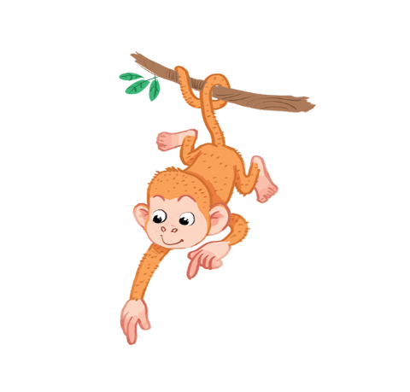

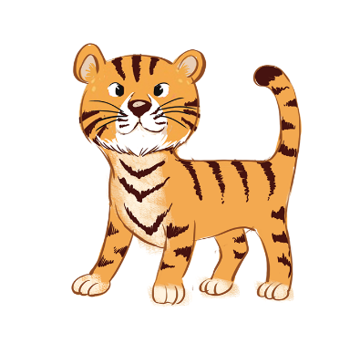


Listen and circle.
1
2

