Slide 1
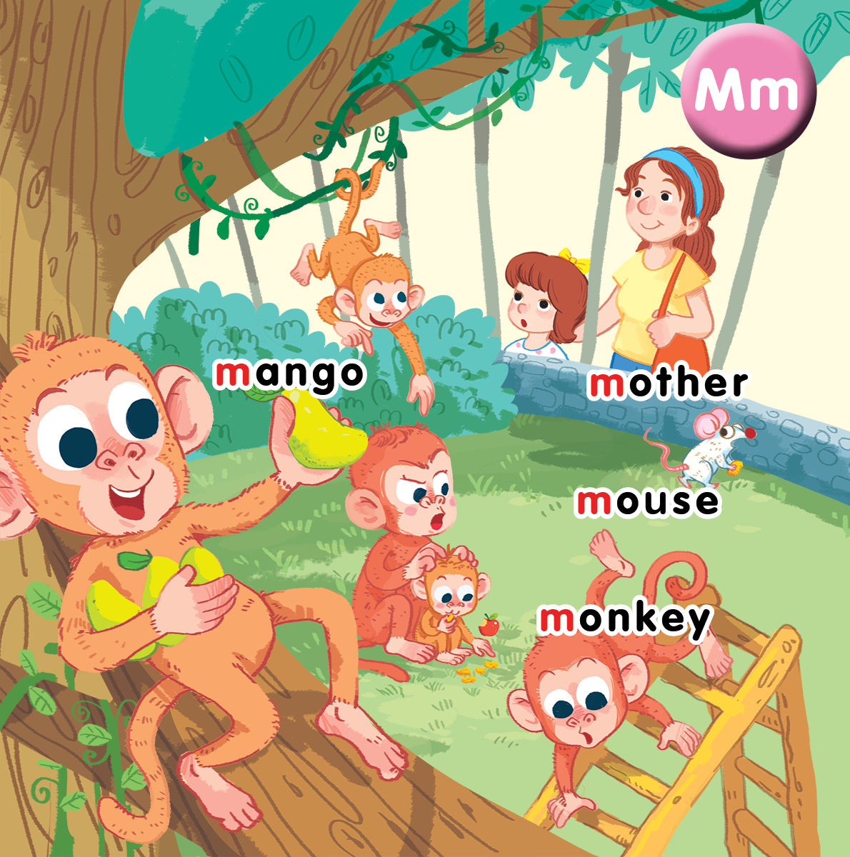
Unit 10
At the zoo
Lesson 1
Notes:
By the end of the unit, pupils will be able to:
- pronounce the sound of the letter M/m in isolation and in the words.
mango, monkey, mother and mouse correctly.
- say the sound of the letter M/m and the words mango, monkey, mother and mouse in a chant.
- recognize the words in different situations when listening.
- use ”That’s a _____.” to identify someone or something.
- trace the letter M/m and complete the words __ango, __other, ___onkey, ___ouse.
- sing a song with the structure ”That’s a/my _____.”
Lesson 1
By the end of the lesson, pupils will be able to:
pronounce the sound of the letter m in isolation and in the words mother, mouse, mango, monkey.
listen and recognize the words mother, mouse, mango, monkey.
recognize and say the words.

Slide 2
1
2
3
                M
4
5
6

Slide 3

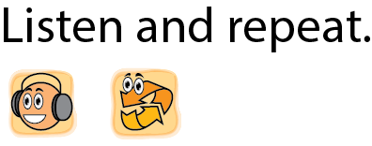

Notes:
Listen and repeat is divided into 4 steps.

Slide 4


m
Notes:
Step 1
Goal: Listen and repeat the sound u and introduce the context.
Time: 3 minutes
Say Open your book! with a TPR action. Have pupils open the book, Unit 10 At the zoo. Teacher opens the digital book.
Stick the card with letter m and say the sound.
Play the recording or say and have pupils listen and repeat.
Say Today we will learn four words having the sound m.
Introduce the context of the picture by eliciting from pupils.

Slide 5

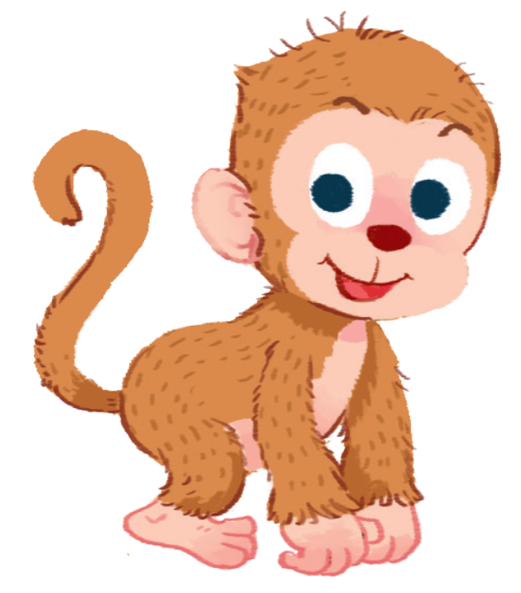
mother
monkey
Notes:
Step 2
Goals: Pupils will be able to listen and repeat the unit key words mother and monkey.
Recognize and say the words with flashcards.
Time: 3 minutes
Introduce the unit keywords mother and monkey with flashcards.
On the board, there are two flashcards for mother and monkey. The flashcard for mother is above the flashcard for monkey.
Teacher points to the mother, says the word and has pupils repeat the word.
Do the same with monkey.
Have pupils guess the word and repeat by pointing to mother and monkey. Hold your hand up or down to the position of the flashcard.
Turn over the cards, have pupils guess the card and shout out the word.
Swap the cards and have pupils guess.

Slide 6

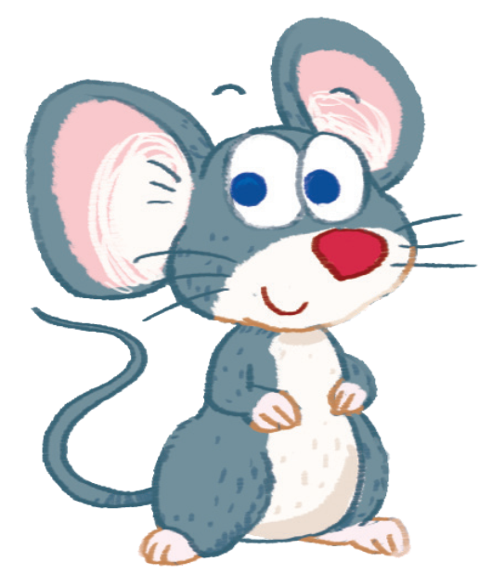
mango
mouse
Notes:
Step 3
Goals: Pupils will be able to listen and repeat the Unit keywords mango and mouse.
Recognize and say the words with flashcards.
Time 3 minutes.
Do the same with step 2.

Slide 7
mango
mother
monkey
mouse
Notes:
Step 4
Goals: Pupils will practice more the new words.
Time 3 minutes.
Memory game
Show the slide for the first time.
Then show the next slides that the order of the 2 words has been changed.
Have pupils find out what words have been changed and say.

