Slide 1
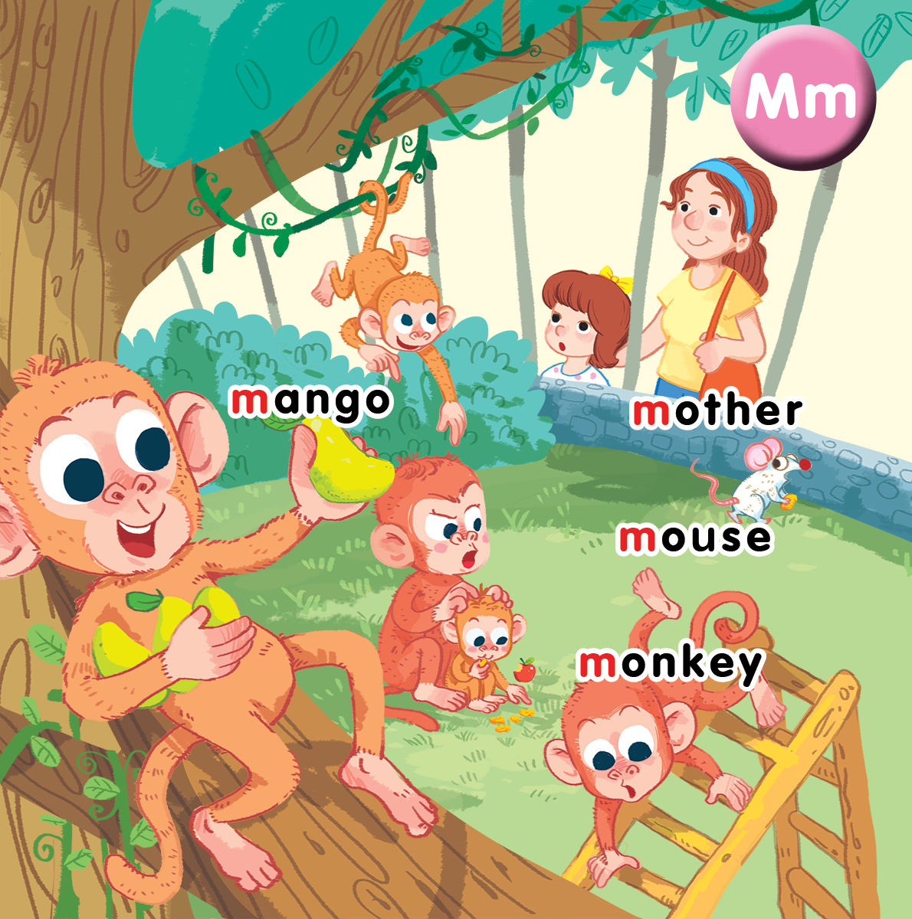
Unit 10
At the zoo
Lesson 2
Notes:
By the end of the unit, pupils will be able to:
- say the sound of the letter M/m, the words mother, mouse, monkey, mango in a chant.
- listen, recognize the words and tick the correct boxes.
- trace the letter M/ m and complete the words _other, _onkey, _ouse, _ango.

Slide 2
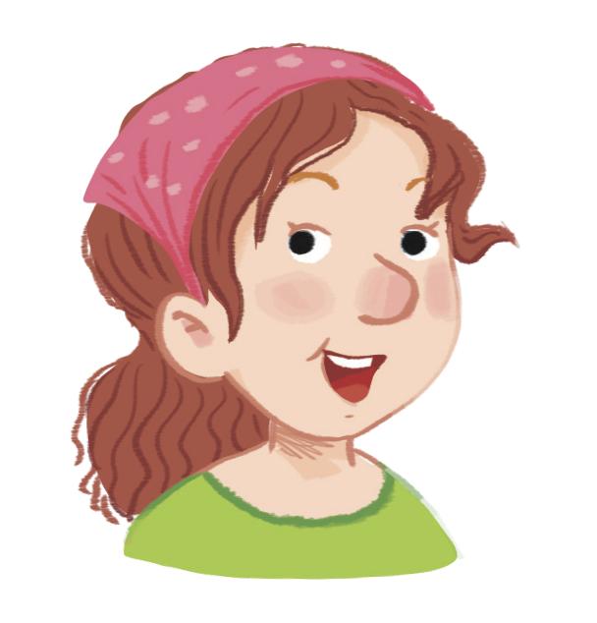
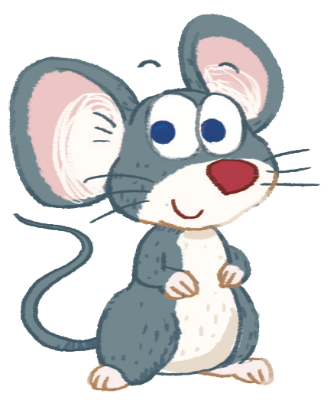
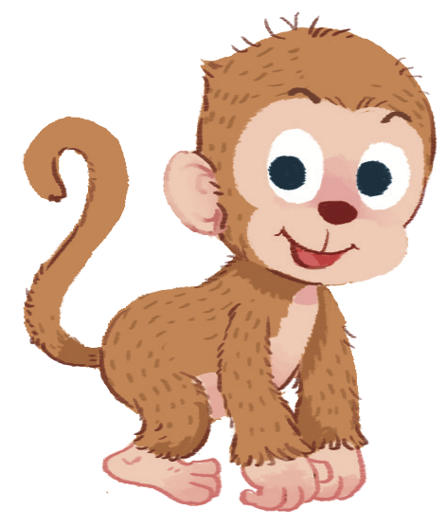


Slide 3


Listen and chant
Notes:
Listen and chant is divided into 3 steps.
Step 1
Goal: Pupils will be able to read the chant lyrics.
Time: 3 minutes.
Have pupils read the chant lyrics in chorus, then in groups.
Step 2
Goal: Pupils will be able to listen, chant and clap along.
Time: 3 minutes
Play the recording, have pupils listen and clap along.
Play the recording, have pupils listen, clap and chant along.
+ Round 1. Have pupils listen and clap along.
+ Round 2. Have pupils listen and do the TPR actions with teacher.
+ Round 3. Have pupils listen and do the actions and chant along.
+ Repeat round 3 several times.
Step 3
Goal: Pupils will be able to chant and clap along in pairs.
Time: 3 minutes
Have pupils chant along in pairs.

Slide 4

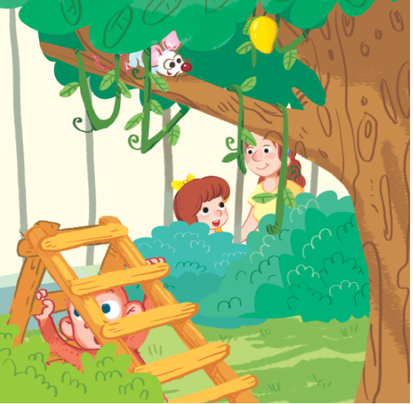
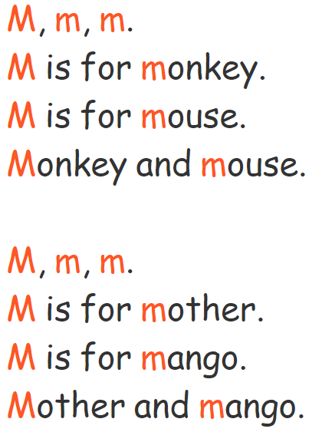
Listen and chant

Slide 5

Listen and tick
Notes:
Listen and tick is divided into 2 steps.
Step 1
Goal: Pupils will be able to listen and choose the correct pictures.
Time: 5 minutes
Say Listen and tick with the TPR actions.
Play the recording and demonstrate the example.
Play the recording and have pupils do the task.
Step 2
Goal: Check
Time: 5 minutes
Play the recording and have pupils say the answer.
Play the recording again and have pupils repeat then give correct answer.

Slide 6
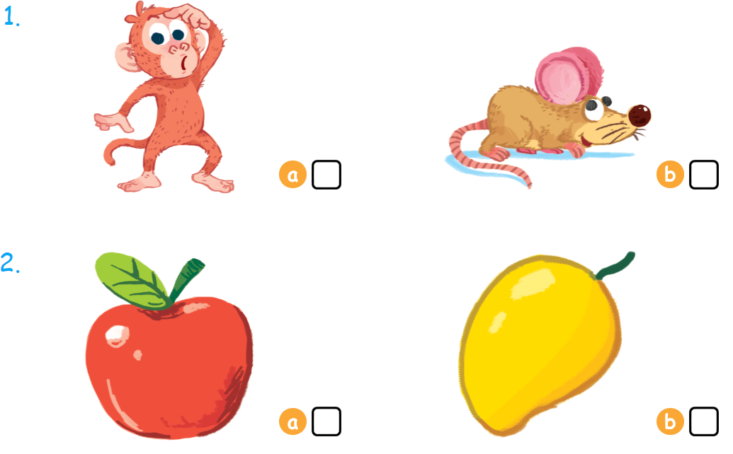

Listen and tick

