Slide 1
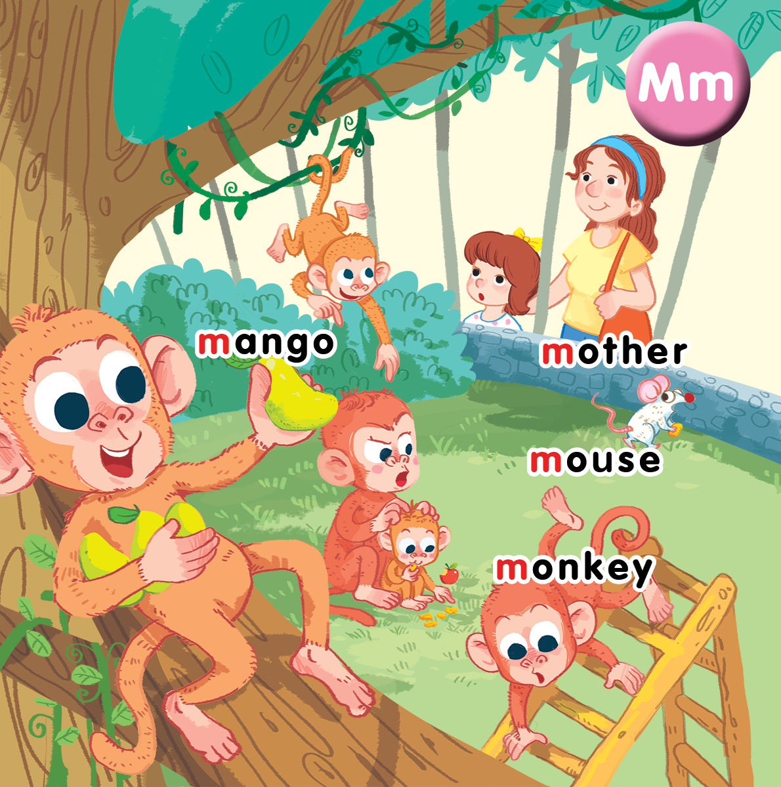
Unit 10 At the zoo Lesson 3
Notes:
By the end of the lesson, pupils will be able to:
- introduce a thing with the structure “That’s a/my____” .
- sing along the unit song.

Slide 2


Listen and repeat
Notes:
Listen and repeat is divided in to 2 steps.
Step 1
Goal: Introduce the sound and the meaning of the structure That’s_____?
Time: 5 minutes.
Introduce the structure and have pupils listen.
Point to a flash card for mother and say That’s a mother. Repeat the sentence many times.
Do the same with other words.
Ask pupils if they understand the sentence and explain in mother tongue if it is needed.
Step 2
Goal: Pupils will be able to repeat the structure That’s a…
Time: 3 minutes.
Have pupils open the book, listen and repeat in chorus, group and in pairs.

Slide 3
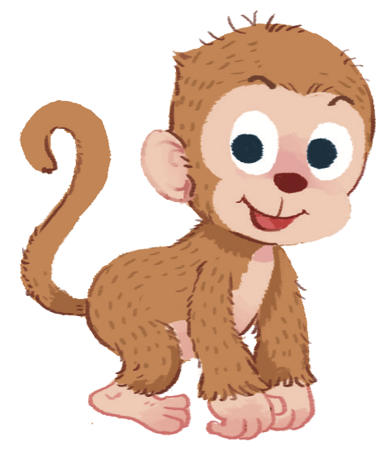
That’s
a monkey

Slide 4

That’s
a mother

Slide 5
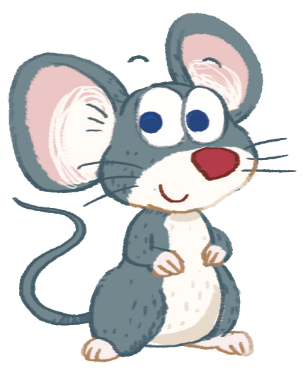
That’s
a mouse

Slide 6
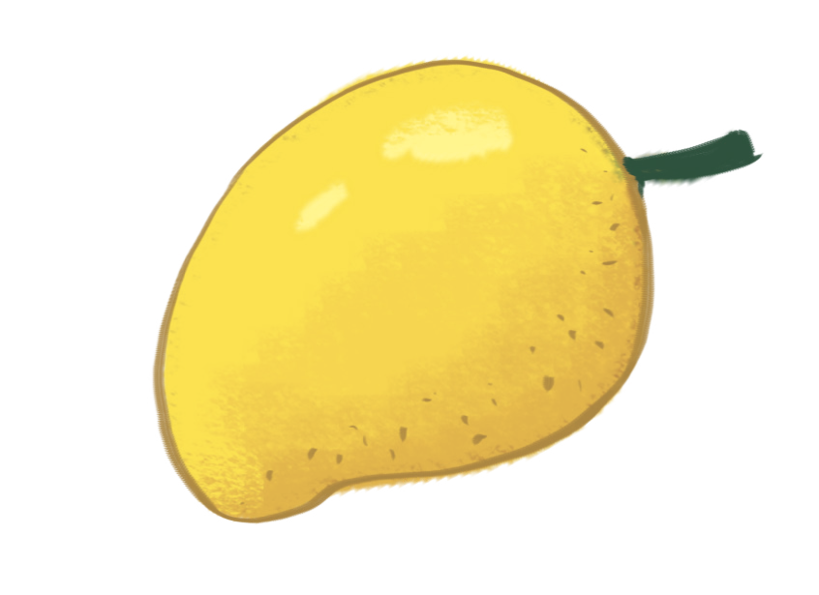
That’s
a mango

Slide 7


Let’s talk
Notes:
Let’s talk is divided into 2 steps.

Slide 8
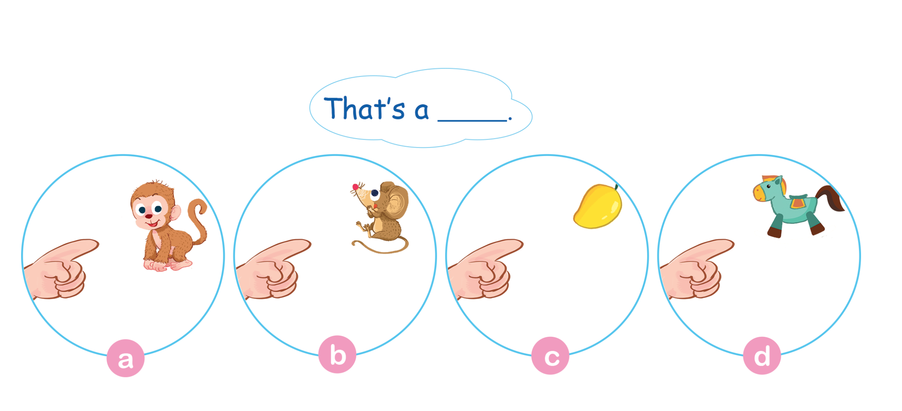
Let’s talk.
Notes:
Step 1.
Goal: Pupils will practice speaking the structure That’s a… in groups.
Time: 5 minutes
Make a model with 1 pupil then have pupils work in group of 4 to do the task on Let’s talk.
Pupil will take turn to say the sentence.

Slide 9
1
2
3
4
5
6
7
8

Slide 10
That’s a monkey.

Slide 11
That’s a mouse.

