Slide 1




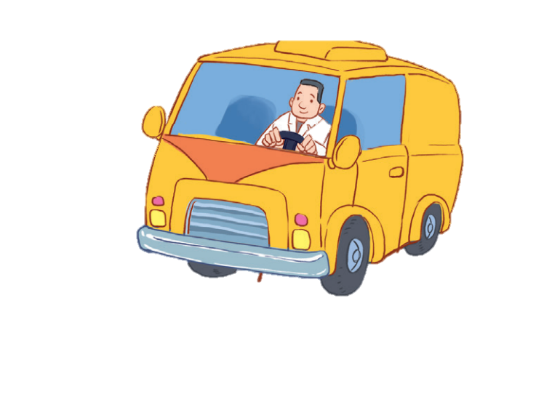


12
LESSON 1 – Period 1

Slide 2
Contents
2
3
1
Warm-up and review
Look, listen and repeat.
Listen, point and say.
4
Let’s talk.
5
Fun corner and wrap-up

Slide 3
1
Warm-up and review
Game: Memory game
Notes:
Step 1: Divide the class into 2 teams.
Step 2: Each pupil from each team goes to the front and touches 2 squares. If they match the right word with the correct picture, they will score one point for their team.
Step 3: Encourage pupils to join in the game.
Step 4: Give points for pupils.

Slide 4





MEMORY GAME
brother
father
grandpa
mother
grandma

Slide 5







EXIT
mother
father
brother
grandma
grandpa

Slide 6
Look, listen and repeat.
2

Slide 7

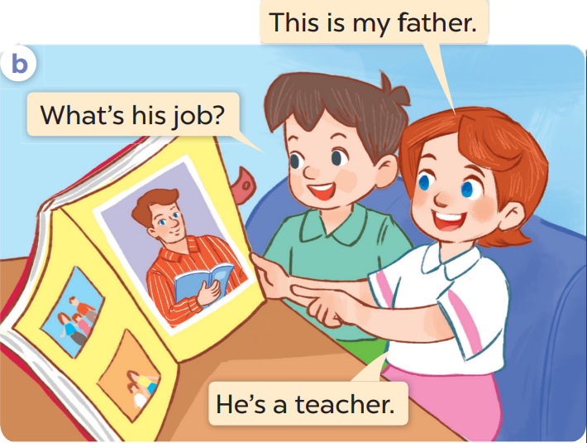
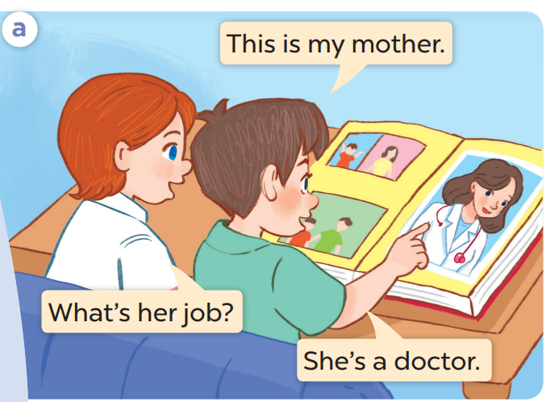

Slide 9
Listen, point and say.
3

Slide 10
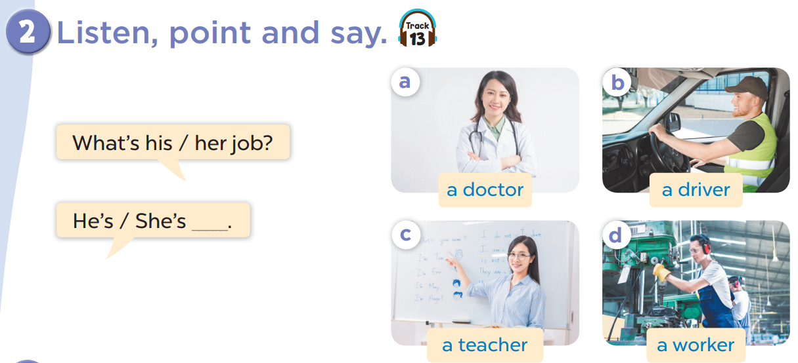

Slide 11


Listen and choose.

Slide 12


Listen and choose.

Slide 13
Listen and choose.

Slide 14
Listen and choose.

Slide 15
Listen and choose.

Slide 16
Listen and choose.

Slide 17
Listen and choose.

Slide 18
4
Let’s talk.

Slide 19
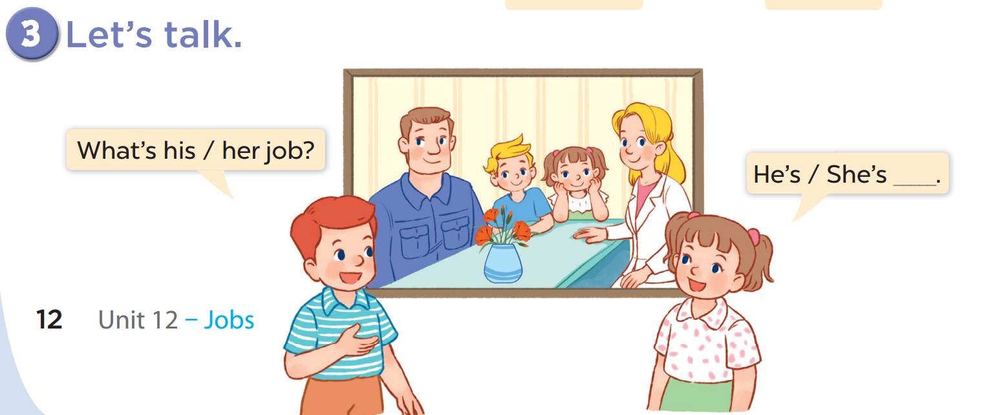

Slide 20
Look and say.
Notes:
Ask two pupils to look at the pictures and practise speaking with the structure of the lesson.
One pupil asks, the other answers the question. (This can be more interesting when teacher lets pupils play rock, scissors, paper. Who wins will ask, the other has to answer.)

Slide 21




What’s her job?
She’s a doctor.

Slide 22


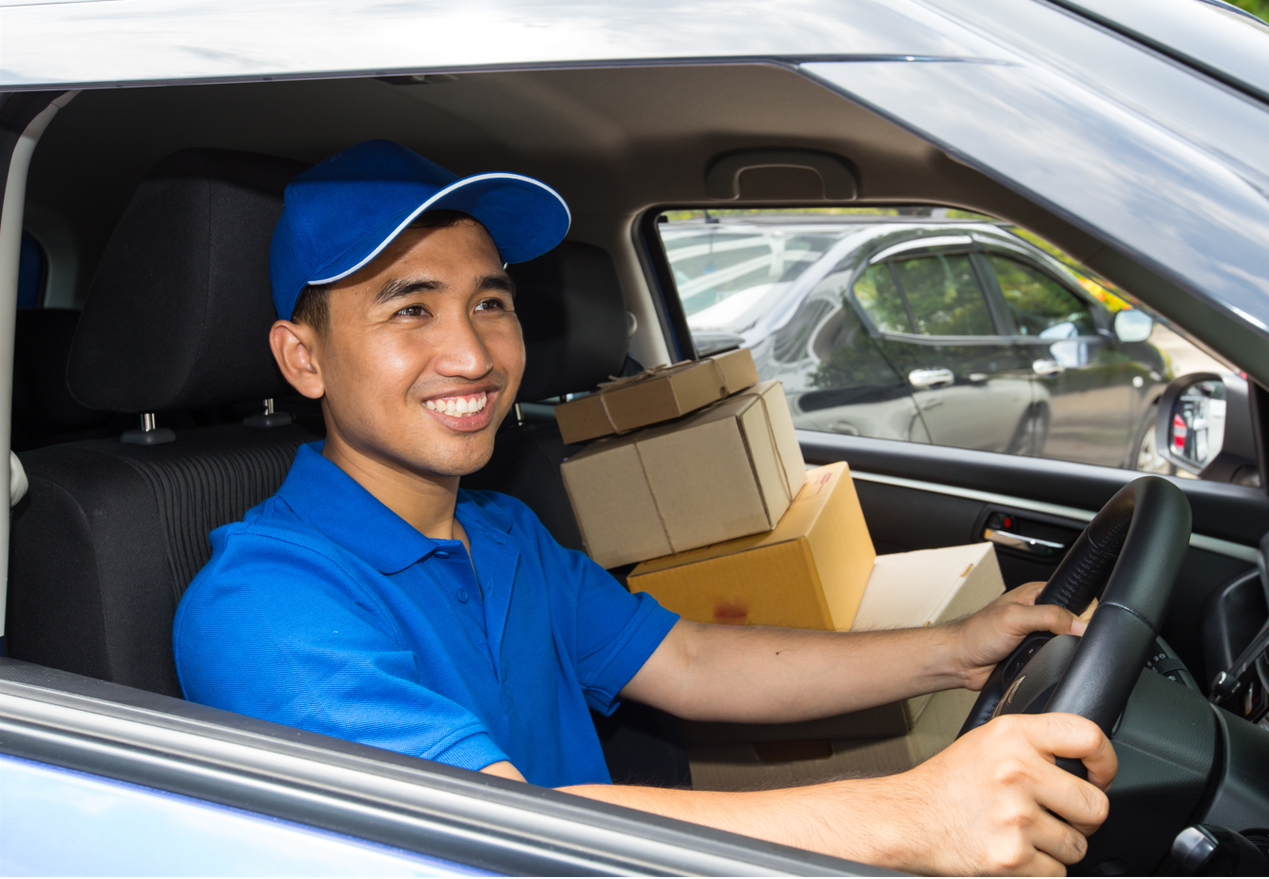
What’s his job?
He’s a driver.

Slide 23


What’s her job?
She’s a teacher.

Slide 24


What’s his job?
He’s a worker.

Slide 25
What’s his job?
He’s a teacher.

Slide 26
What’s her job?
She’s a doctor.

Slide 27
What’s his job?
He’s a driver.

Slide 28
What’s his job?
He’s a worker.

Slide 29
5
Fun corner and wrap-up

Slide 30
Game time!!!
Matching
Notes:
T uses pictures and flashcards.
Ask pupils to find and match. Praise the ones who finish matching.
Then ask the class to look and say aloud.

Slide 31





