Slide 1







12
LESSON 2 – Period 3

Slide 2
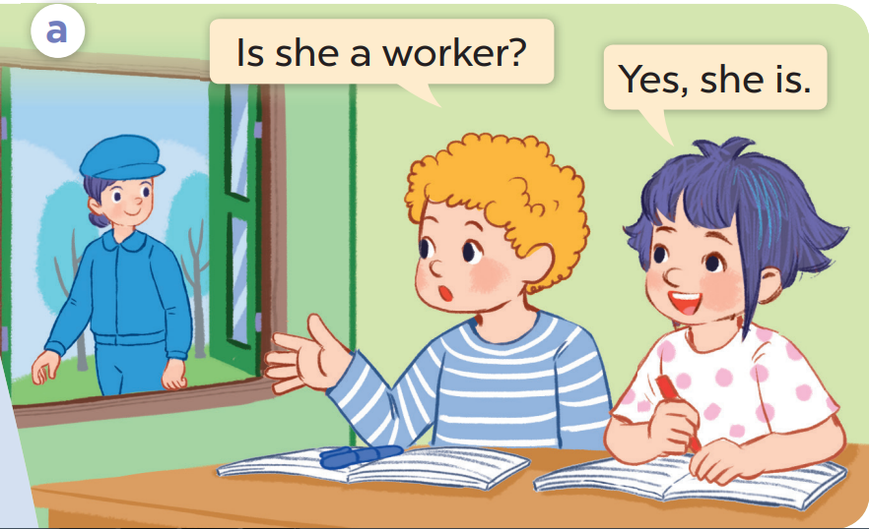
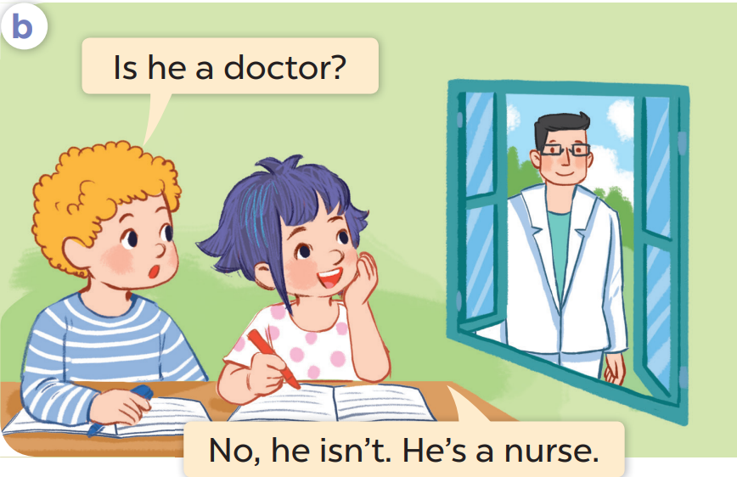

Slide 3

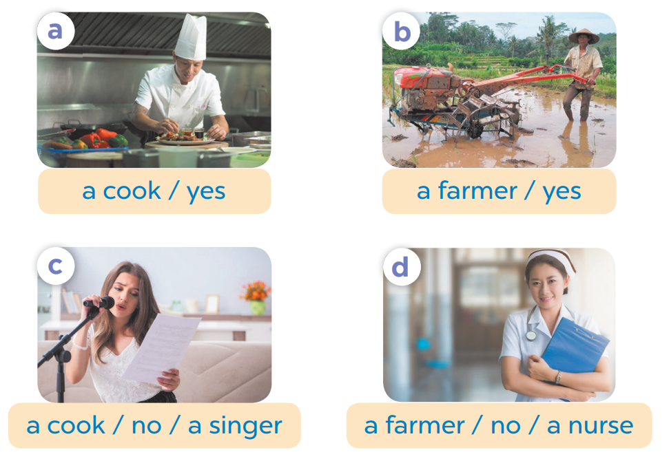
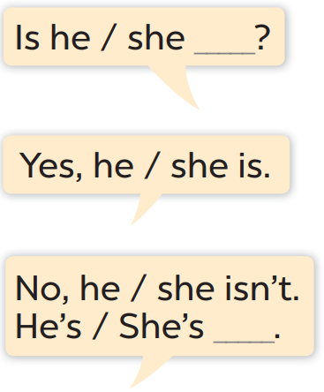

Slide 4

Yes, she is.
No, she isn’t.

Slide 5

Yes, she is.
No, she isn’t.

Slide 6


Game:
Let’s go fishing!
Notes:
Step 1: Divide the class into 4 teams.
Step 2: Invite 2 pupils from each team to go to the board, choose one question and practice speaking “Is he/ she ________? – Yes, he/she is – No, he/ she isn’t.”.
Step 3: Encourage pupils to practice speaking English.
Step 4: Give points to pupils.

Slide 7














Team 1
Team 2
Next

