Slide 1

Unit 10
Lesson 1 - Period 1

Slide 2










Classroom Rules

Slide 3



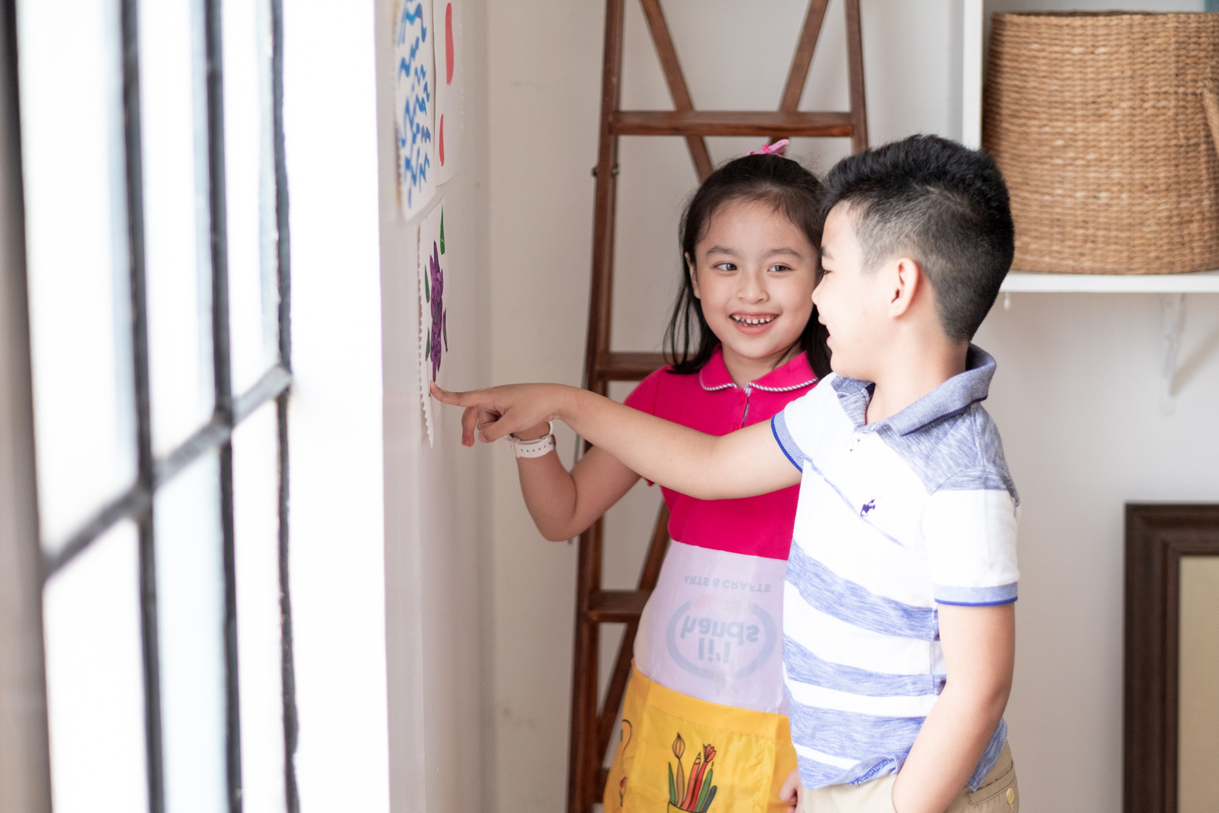



Rule 1
Listen to
your friend
talking in front.

Slide 4


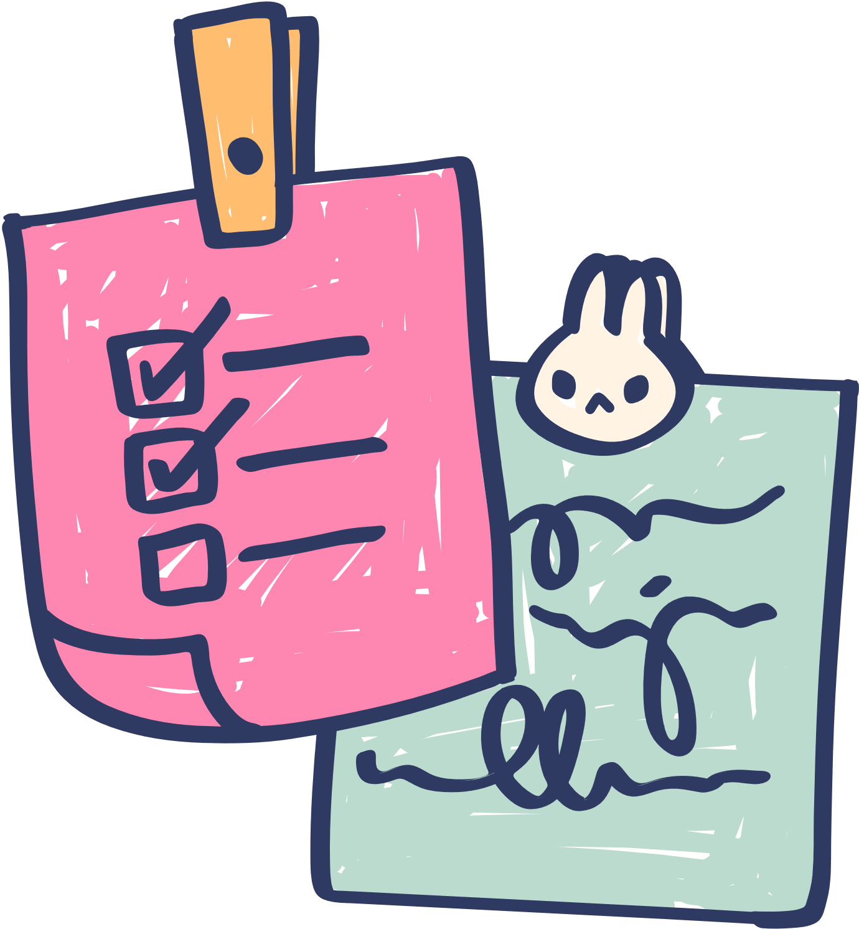





Rule 2
Raise your hand
if you have a question.

Slide 5




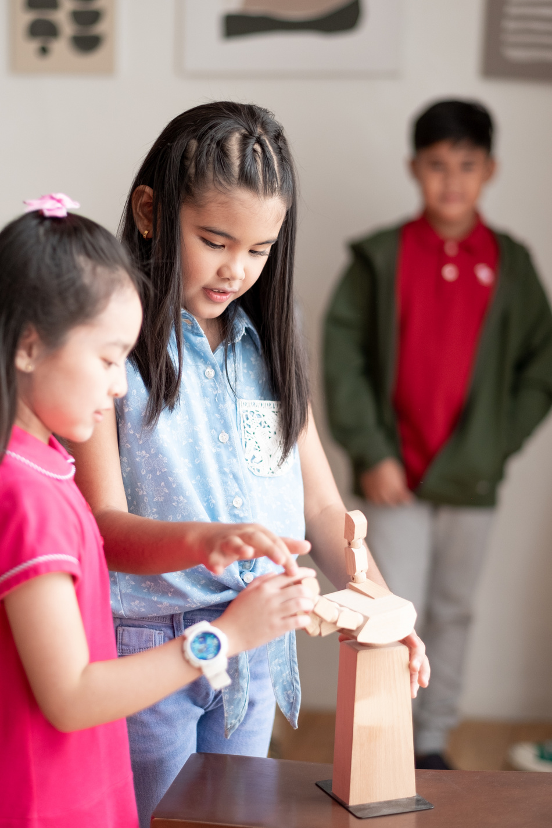


Rule 3
Wait for
your turn.

Slide 6


Table of contents
1.
2.
3.
Warm-up and review.
Activity 1: Listen and repeat.
Activity 2: Point and say.
4.
Fun corner and wrap-up.

Slide 7
Warm up and Review.
01

Slide 8
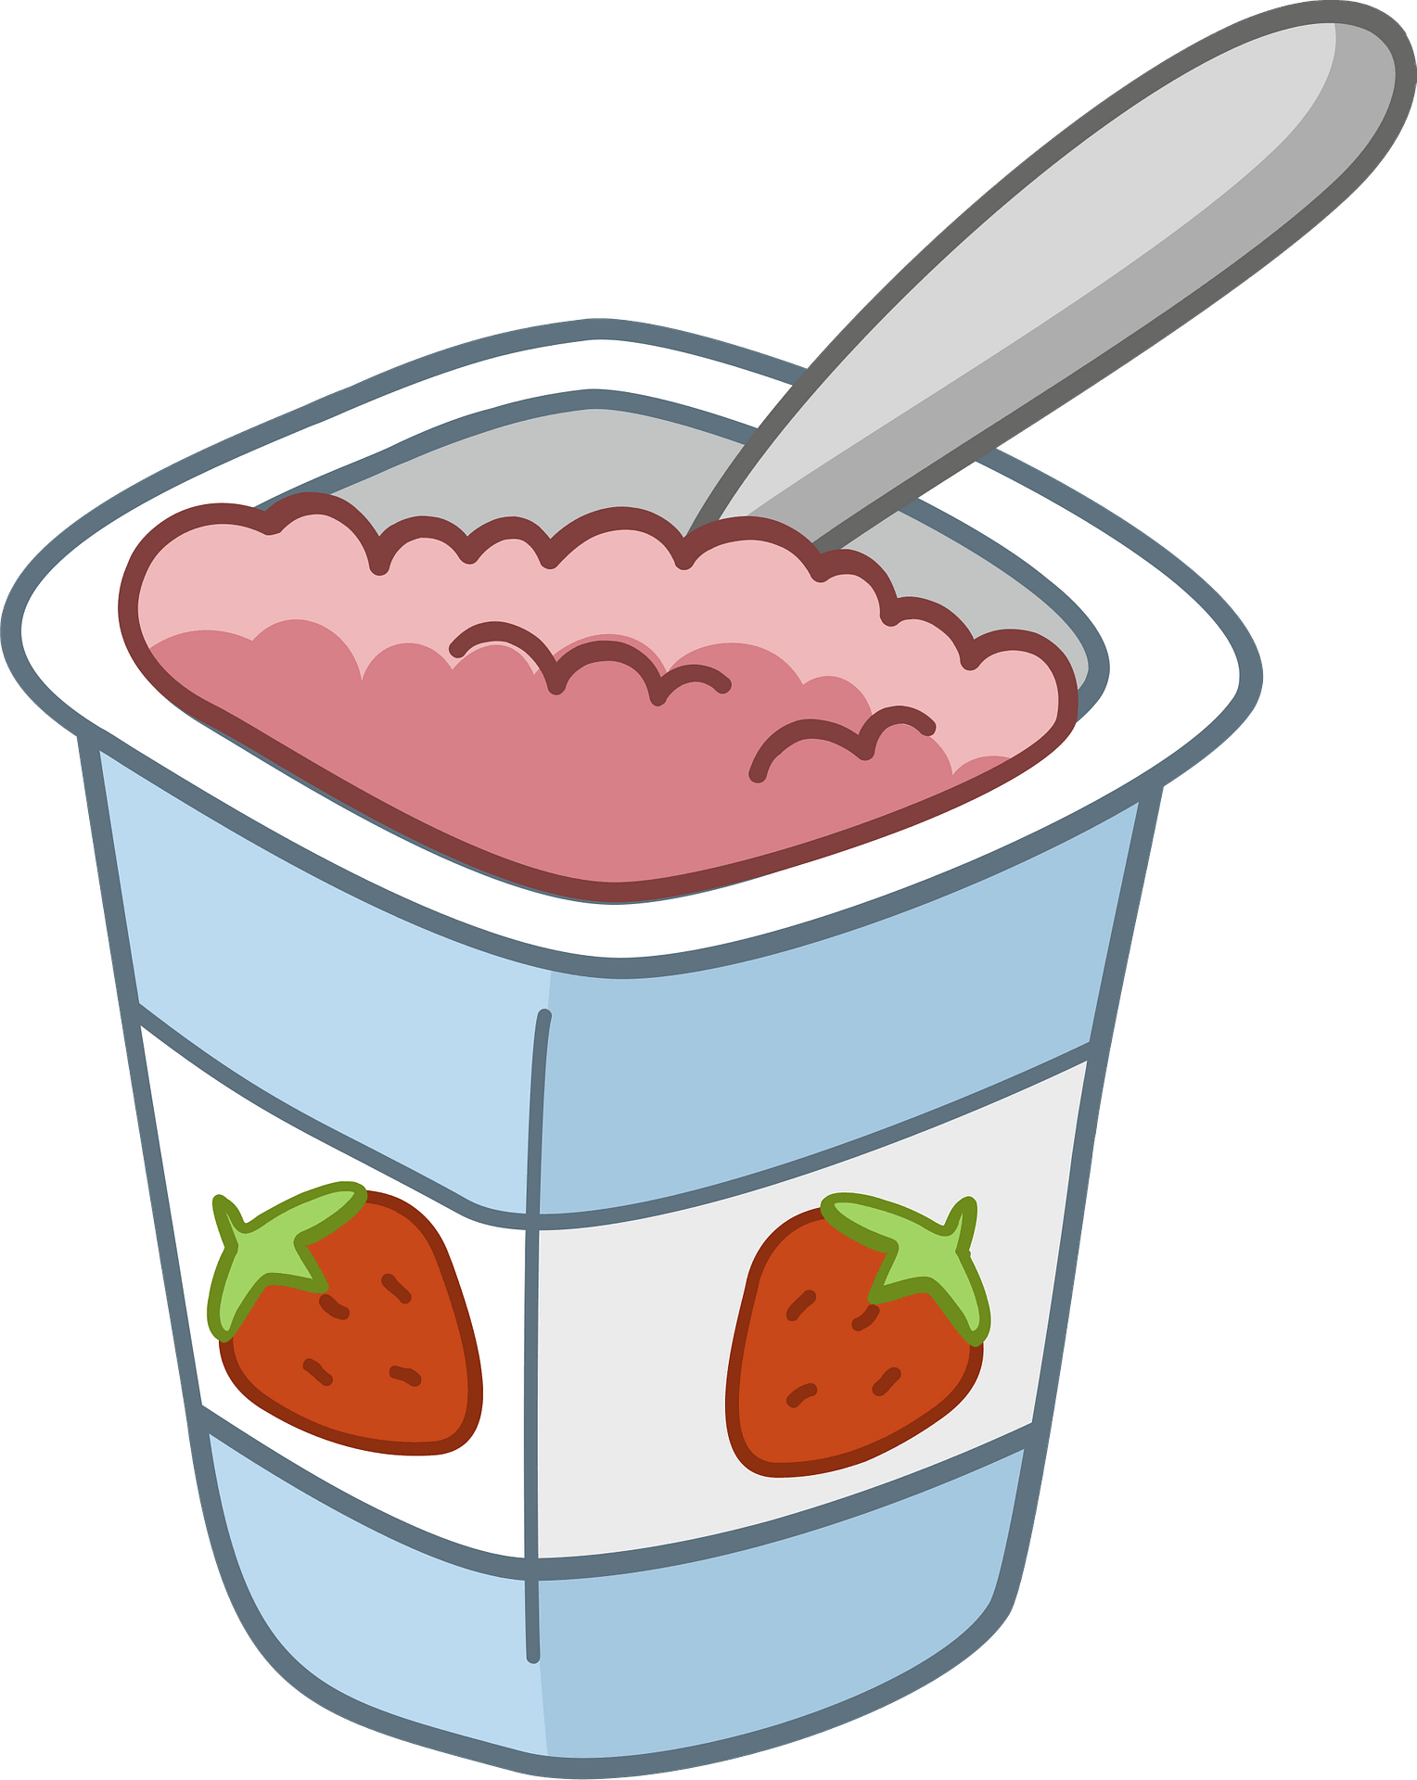
PICTURE GUESSING
yogurt

Slide 9

yams

Slide 10

yo-yos

