Slide 1

Unit 10
Lesson 2 - Period 2

Slide 2










Classroom Rules

Slide 3



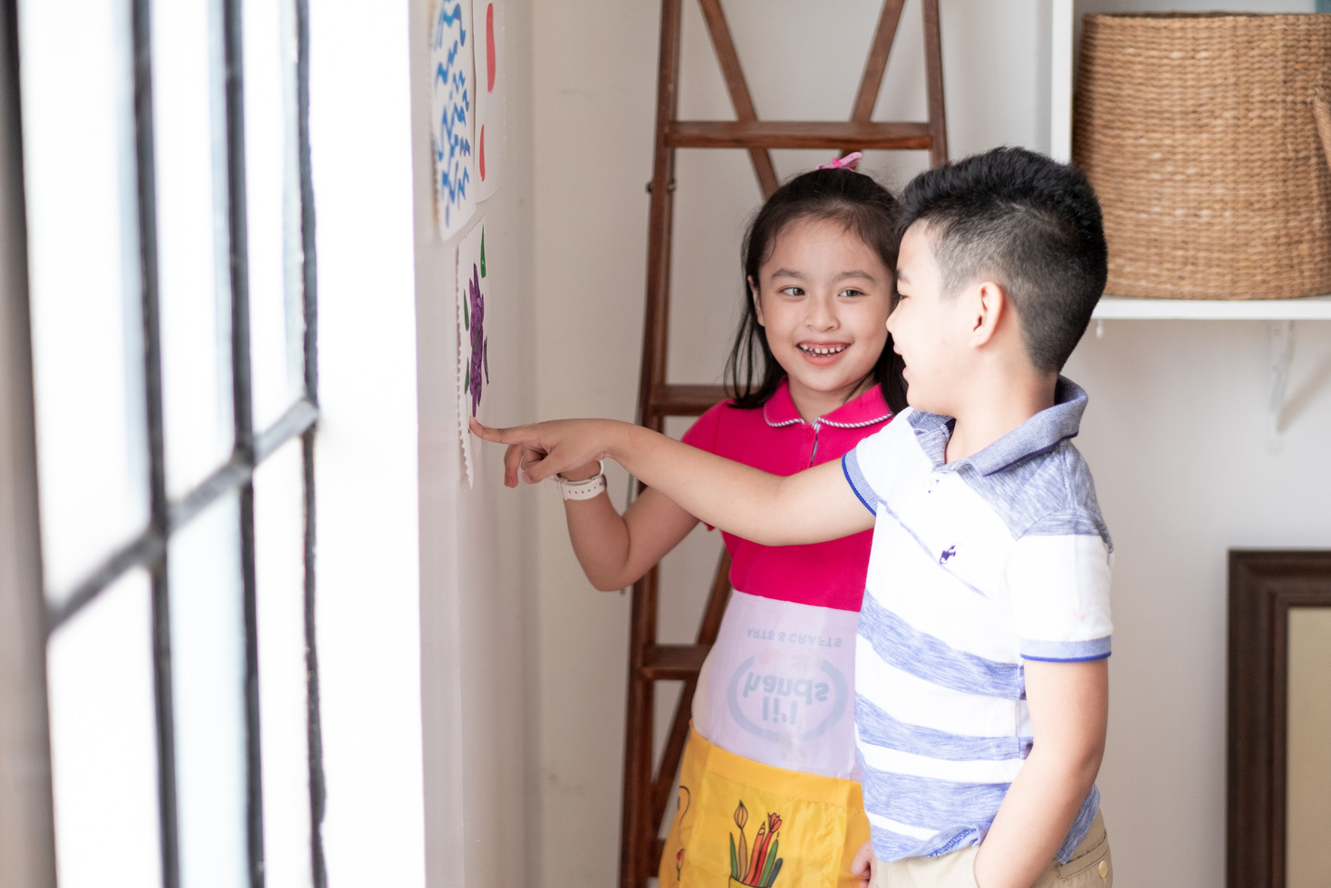



Rule 1
Listen to
your friend
talking in front.

Slide 4








Rule 2
Raise your hand
if you have a question.

Slide 5




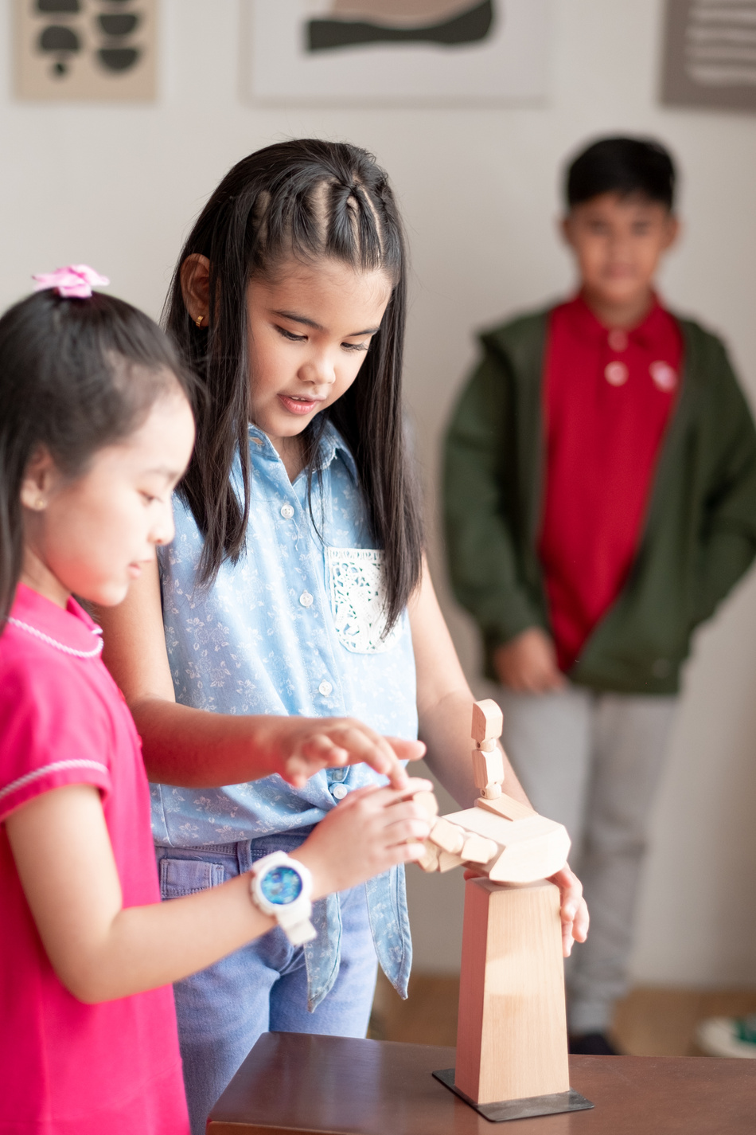


Rule 3
Wait for
your turn.

Slide 6


Table of contents
1.
2.
3.
4.
Warm-up and review.
Activity 3: Listen and chant.
Activity 4: Listen and circle.
Activity 5: Look and write.
5.
Fun corner and wrap-up.

Slide 7
01
Warm up and Review.

Slide 8
Vanishing Flashcards
Notes:
Tell the class they are remembering the pictures and say the pictures’ names.
- Divide the class into four teams.
- Place pictures on the board.
- Give them a moment to memorize the pictures and then tell them to close their eyes.
- Take away one of the pictures and then tell the pupils to open their eyes again. The first pupil who guesses and says the missing picture correctly get one point for his/her team.
The team with the most points to win.

Slide 9




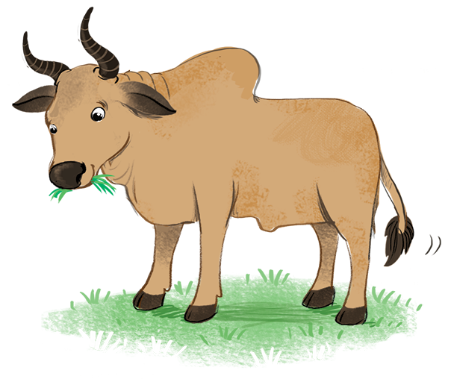











Slide 10


