Slide 1

Unit 10
Lesson 3 - Period 3

Slide 2










Classroom Rules

Slide 3



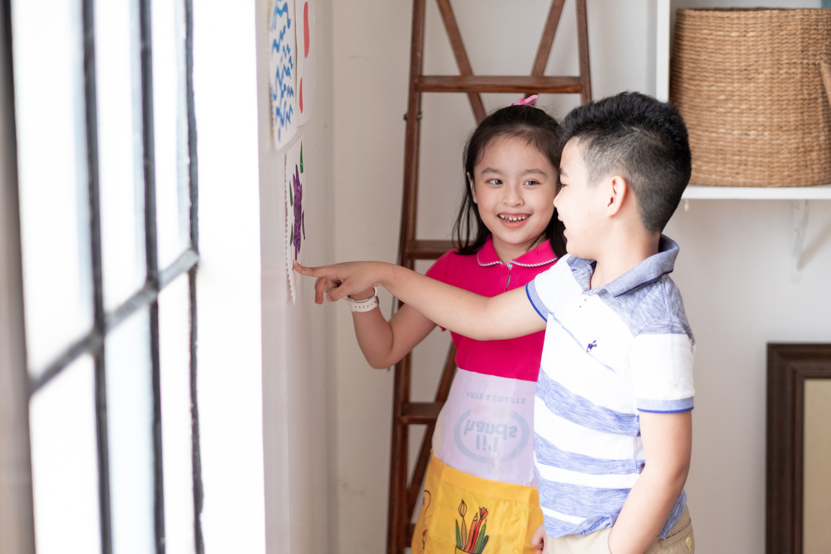



Rule 1
Listen to
your friend
talking in front.

Slide 4








Rule 2
Raise your hand
if you have a question.

Slide 5




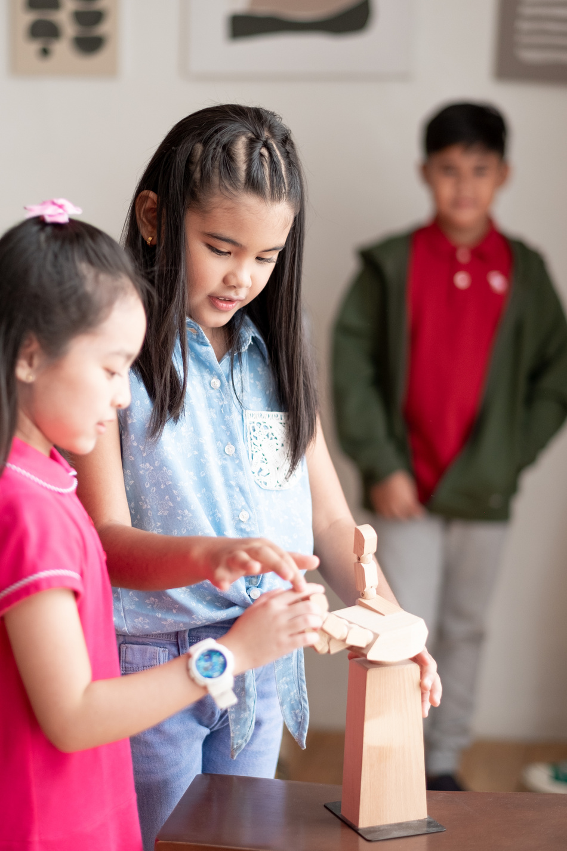


Rule 3
Wait for
your turn.

Slide 6


Table of contents
1.
2.
3.
4.
Warm-up and review.
Activity 6: Listen and repeat.
Activity 7: Let’s talk.
Activity 8: Let’s sing.
5.
Fun corner and wrap-up.

Slide 7
Warm up and Review.
01

Slide 8











Notes:
Click vào chú khỉ bất kì để hái chuối
Khi quả chuối rơi, GV click vào hình quả chuối để đi đến câu hỏi tương ứng.

Slide 9


?
zoo

Slide 10

zebu

