Slide 1
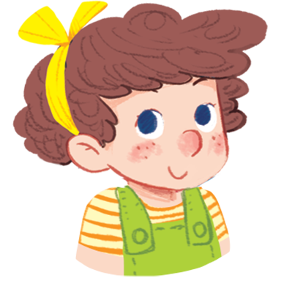
Hi, I’m Lucy.

Slide 2

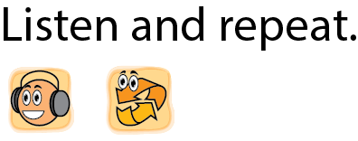

Notes:
Listen and repeat is divided into 3 steps.
Step 1
Goal: Introduce the sound of letter L/l.
Time: 3 minutes
Say Open your book! with a TPR action. Have pupils open the book, Unit 12, At the lake. Teacher opens the digital book.
Stick the card with letter “L” and say the sound.
Play the recording and have pupils listen and repeat in chorus, groups then individuals.

Slide 3

L

Slide 4



Lemons
Lucy
Leaf
Lake
Notes:
Step 2
Goals: Pupils will be able to listen and repeat the unit keywords.
Recognize and say the words with flashcards.
Time: 4 minutes
Introduce the unit keywords Lucy, lemons, leaf and lake with flashcards.
On the board, there are four flashcards for Lucy, lemons, leaf and lake.
Teacher points to the flashcard of Lucy, say the word and have pupils repeat the word.
Do the same with other words .
May have pupils guess the word when teacher says the 1st time.

Slide 5
Notes:
Step 3
Listen and point
Goal: Pupils will recognize the unit keywords Lucy, lemons, leaf and lake
Time 5 minutes.
Make a model with a pupil. Teacher says, pupil points.
One pupil says the word and randomly calls another pupil to point.
Then pupils practice in pairs.

Slide 6



Notes:
Point and say is divided into 2 main steps.
Step 1
Goal: Pupils will be able to point and say the words in chorus.
Time: 4 minutes
Have pupils listen, point and say the words.
1st time:
Point the picture of Lucy and say Lucy. Ask pupils to repeat.
Do the same with other words.
2nd time:
Point to the picture and have pupils say the words.
Step 2
Goal: Pupils will be able to listen and point to the pictures in pairs.
Time: 5 minutes
Have pupils work in pairs and do the activity in the textbook.

Slide 7
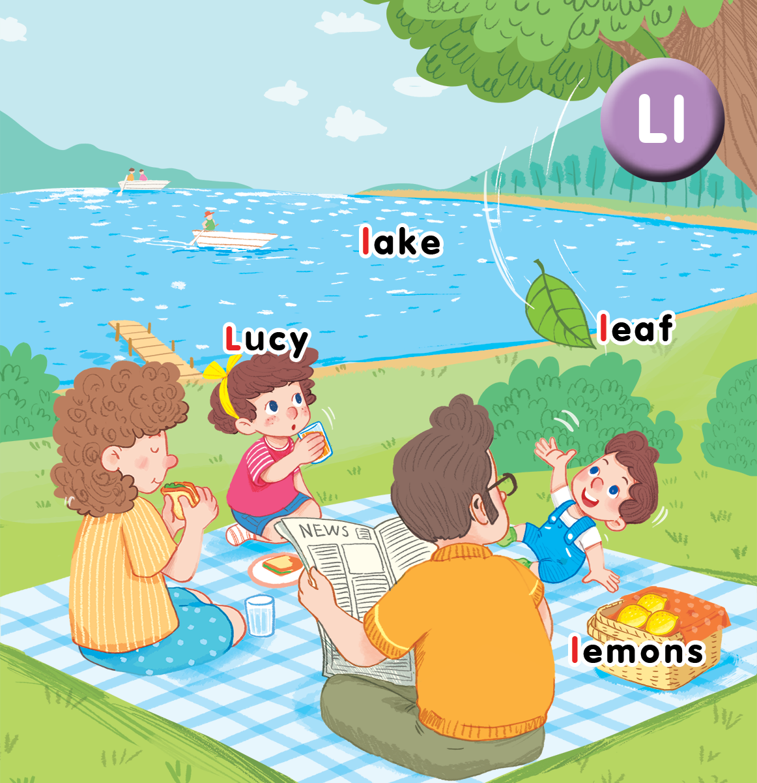

Slide 8
Notes:
Step 3. Whisper Game
Goal: Pupils will be able to recognize the unit words through pictures, meaning.
Time: 6 minutes
Divide class into 4 teams.
Stand in the line.
Have the first pupils in the line look at the picture and whisper to the next one until the last pupil in the line, who will come to the board, point to the word and say.
Repeat the game until all pupils come to the board, point and say.
After the game, have the whole class repeat the word in chorus.

