Slide 1

Unit 13
In the school canteen
Lesson 2
Notes:
Goal:
By the end of the lesson, pupils will be able to:
- say the sound of the letter N/n and the words nuts, noodles and bananas in a chant.
- listen, recognize the words and tick the correct boxes.
- trace the letter N/n and complete the words.

Slide 2

Slap the board
Notes:
Goal: Warm up and revise the unit keywords.
Time: 5 minutes
Play: Slap the board
Use the flashcards of previous lessons to play.
Have pupils say the words aloud at the end of the game.

Slide 3


Listen and chant
Notes:
Listen and chant is divided into 3 steps.

Slide 4
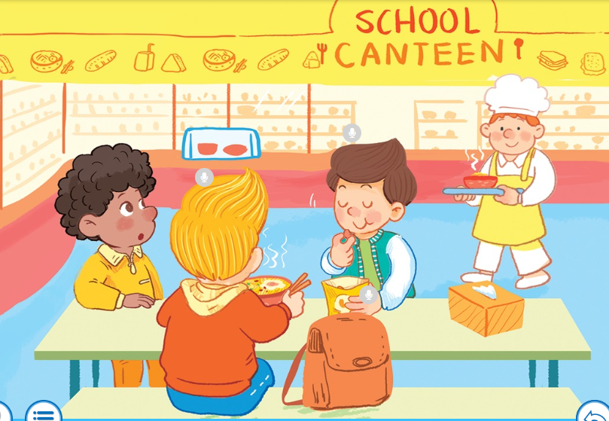
Notes:
Step 1
Goal: Lead in and understand the lyrics
Time: 3 mins
Ask pupils:
Who are they? – Nam and Nick.
Where are they? – In the school canteen.
What are they doing? Nam’s having nuts; Nick’s having noodle.
(Vietnamese when needed)
Have people read the lyrics in chorus, in group or groups take turn to read the sentences of the lyrics.

Slide 5
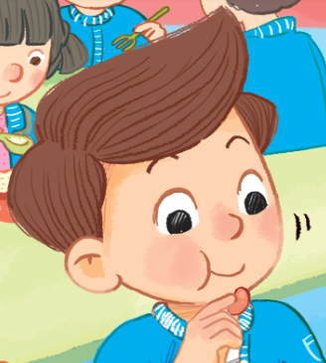

Nam’s having nuts.

Slide 6


Nick’s having noodles.

Slide 7


Listen and chant
Notes:
Step 2
Goal: Pupils will be able to listen, chant and clap along.
Time: 3 minutes
Play the recording 2 times, have pupils listen and clap along.
Play the recording 2 times more, have pupils listen, clap and chant along.
Have group of pupils say the chant.

Slide 8

Notes:
Step 3 (optional)
Goal: Pupils are able to make a new chant lyrics
Time: 3 mins
Have people work in groups to replace 1 to 2 words of the chant.
(Ex: Nam’s having moon – crazy and fun word is accepted).
Have pupils read their group’s new chant in front of the class.
Have pupils vote for the funniest chant.

Slide 9

Listen and tick
Notes:
Listen and tick is divided into 2 steps.
Step 1
Goal: Pupils will be able to listen and choose the correct pictures.
Time: 5 minutes
Say Listen and tick with the TPR actions.
Play the recording and demonstrate the example.
Play the recording and have pupils do the task.
Step 2
Goal: Check
Time: 5 minutes
Play the recording and have pupils say the answer.
Play the recording again and have pupils repeat then give correct answer.

Slide 10
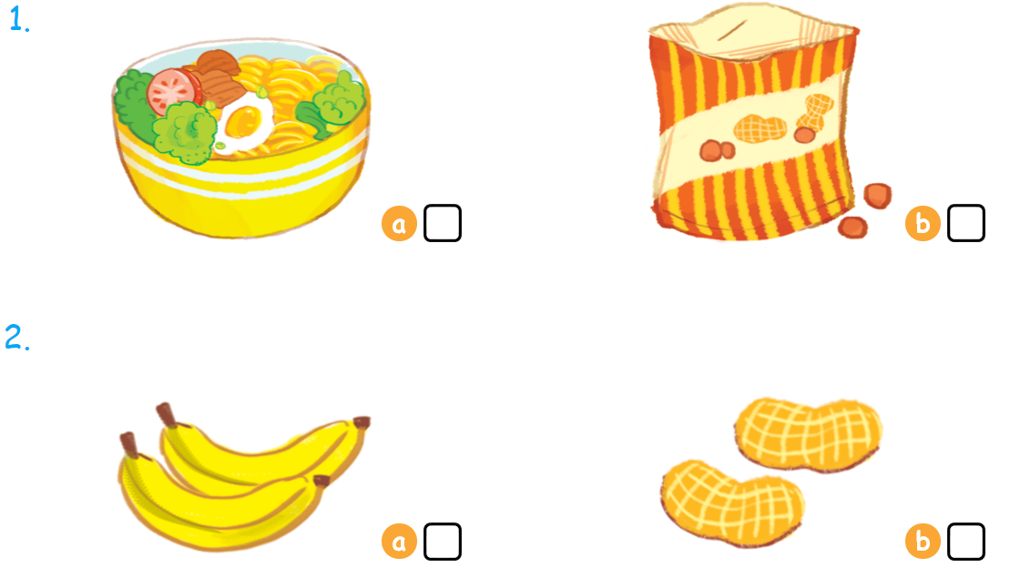

Listen and tick

Slide 11



Look, trace and write
Notes:
Goal: Pupils will be able to trace the letter.
Time: 5 minutes
Have pupils write the word by air tracing and say the word.
Demonstrate how to trace the word and have pupils do the task.
Ask: Today we are learning letter …? -> N
What is the sound of letter N ? -> /n/
Introduce upper case N ( or big N), have pupils repeat /n/ 3 times.
Introduce lowercase n ( or little n) have pupils repeat /n/ 3 times, too.
Do you know how to write letter n? Let’s watch a video.
https://www.youtube.com/watch?v=wJYCLfzSOQE
Teacher acts as models, writes the letter in the air.
Have pupils open the book and trace.

Slide 12
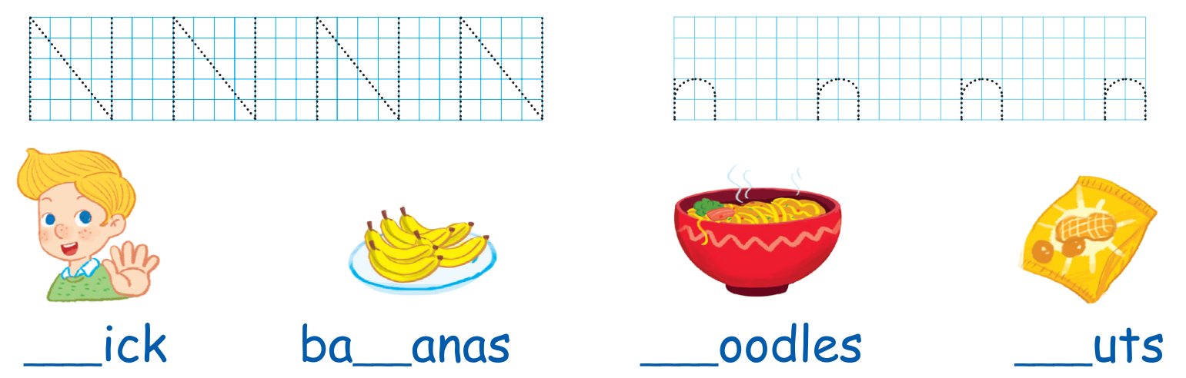
Look and trace
Chờ Xuân gửi file sách giáo khoa để add

Slide 13






Slide 14


