Slide 1







Unit 14
AT HOME
Lesson 2

Slide 2










Table of contents
  Warm-up and review.
  Listen and chant.
  Listen and circle.
  Write and say.
  Fun corner and wrap-up.

Slide 3







Warm-up and Review.

Slide 4





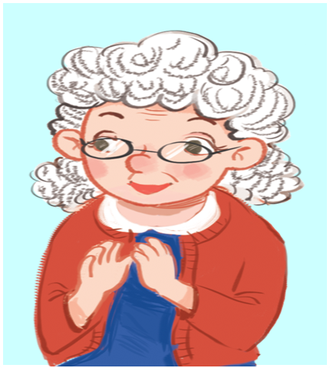
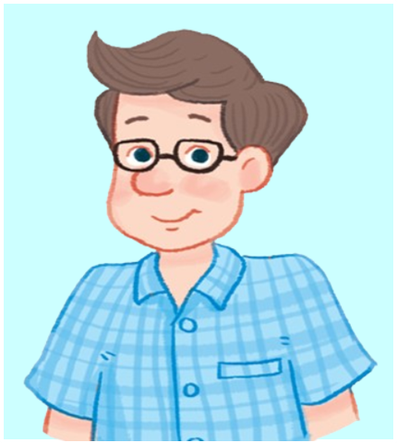

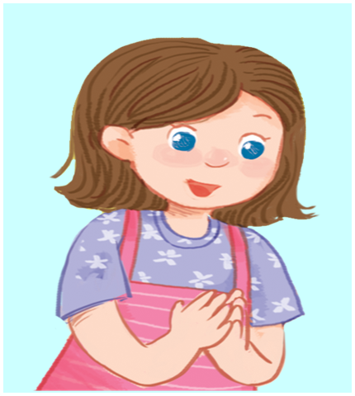
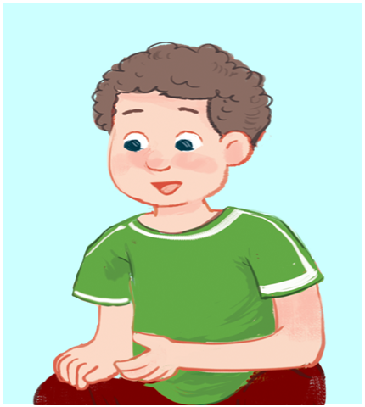

Review
grandmother
father
mother
sister
brother

Slide 5







What’s missing?
Game

Slide 6

What’s missing?
sister

Slide 7
What’s missing?
father

Slide 8
What’s missing?
brother

Slide 9
What’s missing?
grandmother

Slide 10
What’s missing?
mother

Slide 11


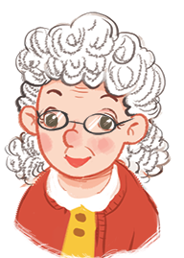
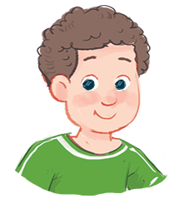
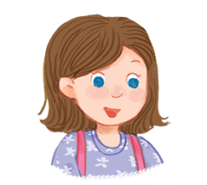


5. Write and say.
grandmoth__ __
broth__ __
sist__ __

Slide 12
Check the answers.
grandmoth__ __
e
r
broth__ __
e
r
sist__ __
e
r

Slide 13
Say the words.
grandmoth__ __
e
r
broth__ __
e
r
sist__ __
e
r

Slide 14









GAME

