Slide 1







Unit 14
AT HOME
Lesson 3

Slide 2










Table of contents
  Warm-up and review.
  Listen and repeat.
  Let’s talk.
  Let’s sing.
  Fun corner and wrap-up.

Slide 3







Warm-up and Review.

Slide 4




Let’s Play
This or That

Slide 5




sixteen
that
16
19
or
✓
✗
this
Notes:
Click the numbers to choose

Slide 6



twenty
that
13
20
or
✗
✓
this
Notes:
Click the numbers to choose

Slide 7



eighteen
that
15
18
or
✗
✓
this
Notes:
Click the numbers to choose

Slide 8



seventeen
that
17
14
or
✓
✗
this
Notes:
Click the numbers to choose

Slide 9



nineteen
that
20
19
or
✗
✓
this
Notes:
Click the numbers to choose

Slide 10

Thanks for playing!

Slide 11
Listen and repeat.

Slide 12

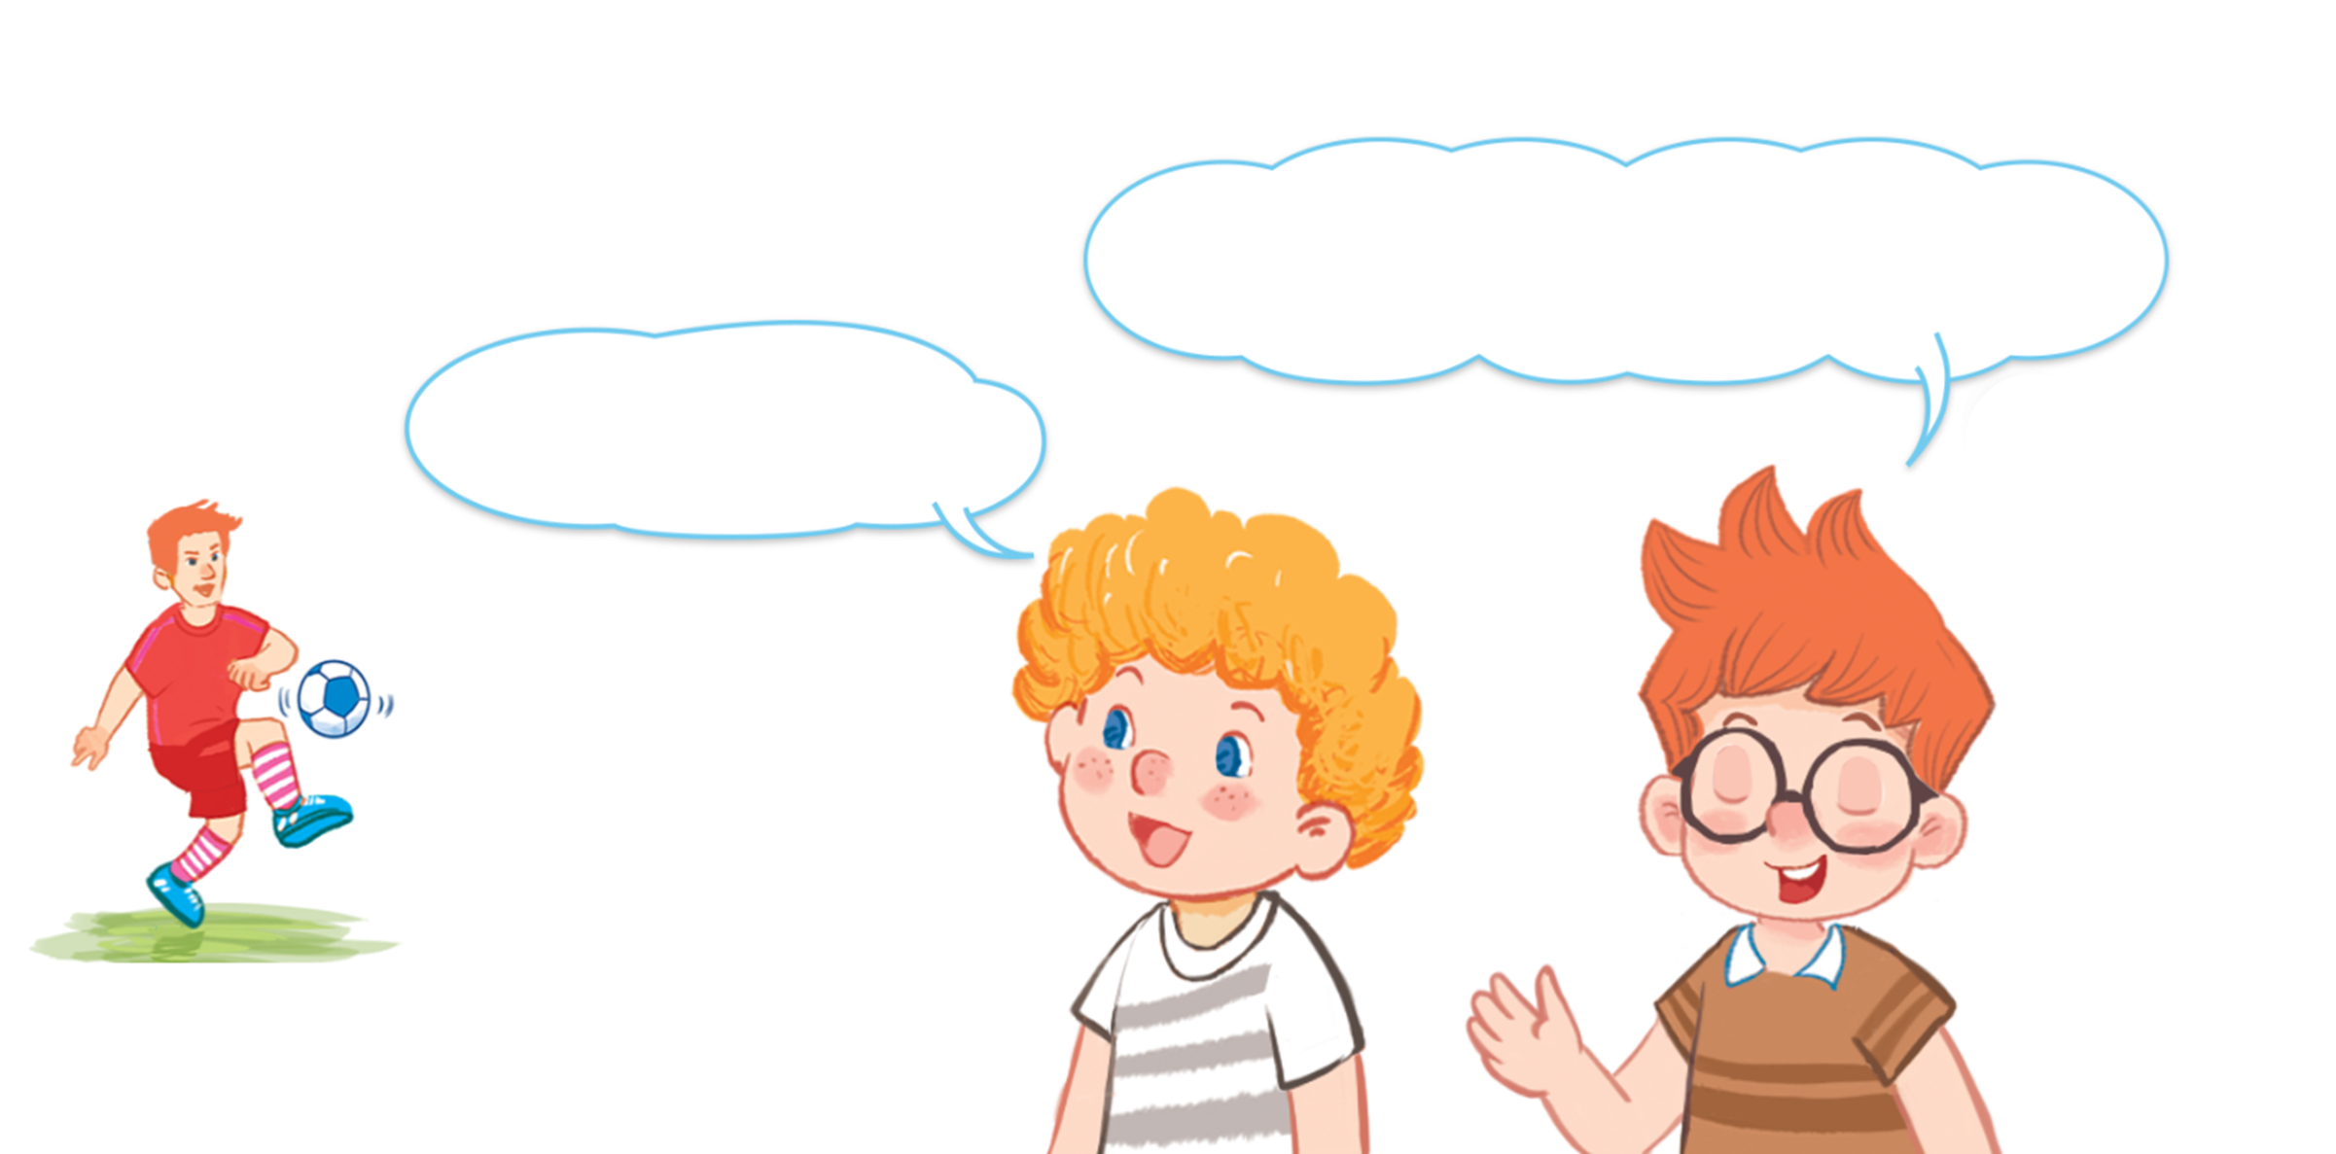
Look and say.

Slide 13

6. Listen and repeat.
How old is your brother?
How old is your brother?
How old is your brother?
How old is your brother?
He’s nineteen.
He’s nineteen.
He’s nineteen.
He’s nineteen.

Slide 14
Let’s talk.

Slide 15


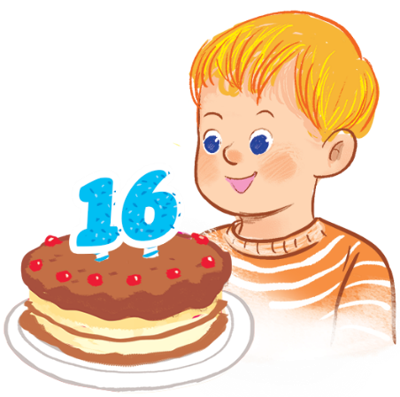
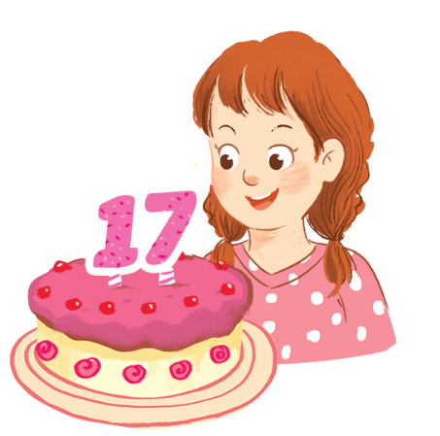

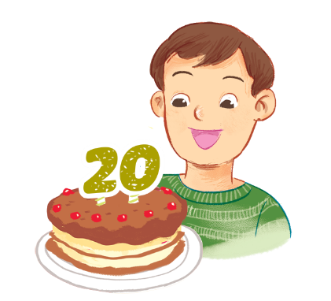
Look and say.
How old ______?
______.
a
b
c
d

