Slide 1



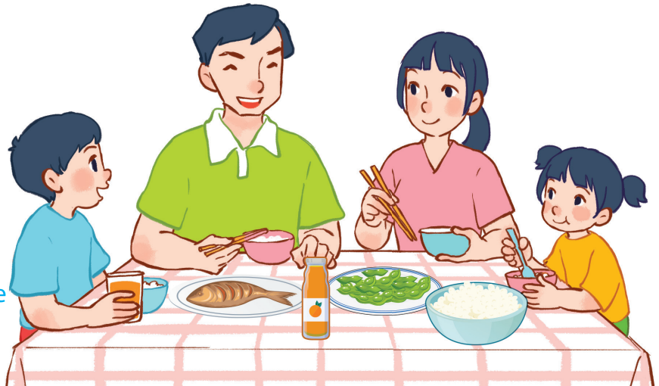
15
At the dining table
LESSON 1 – PERIOD 2

Slide 2
At the dining table
Warm-up
and review
Look, complete and read.
Fun corner
and wrap-up
Listen and tick.
Let’s sing.

Slide 3








FRUIT JUICE
Team A
Team B
Warm-up
and review
Notes:
Divide the class into 2 teams.
Each team chooses one jar mug of juice to go to the question. Have pupils look, read and choose the right option.
Click the score mug to get back to the menu for pupils to choose another question.
Pupils continue their turns until there is no mug left.

Slide 4


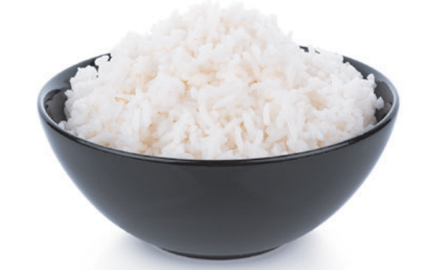


Would you like some ……………?
Yes, please.
40
bread
rice
cake

Slide 5


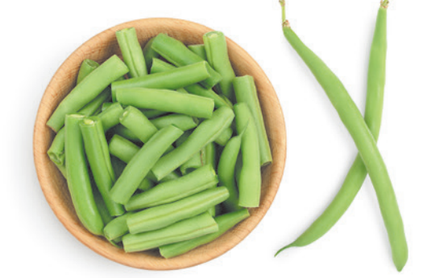
Would you like some ……………?
No, thanks.
30
beans
apples
pears

Slide 6

Would you like some ……………?
No, thanks.
20
beans
meat
fish

Slide 7
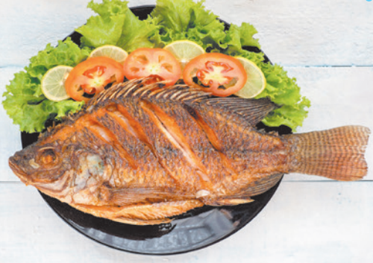
Would you like some ……………?
Yes, please.
60
meat
fish
chicken

Slide 8

Would you like some ……………?
Yes, please.
40
water
juice
milk

Slide 9
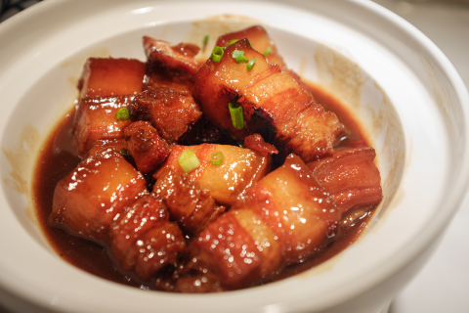
Would you like some ……………?
No, thanks.
20
meat
fish
chicken

Slide 10

Would you like some ……………?
Yes, please.
30
milk
juice
water

Slide 11

Would you like some ……………?
Yes, please.
50
water
milk
juice

Slide 12


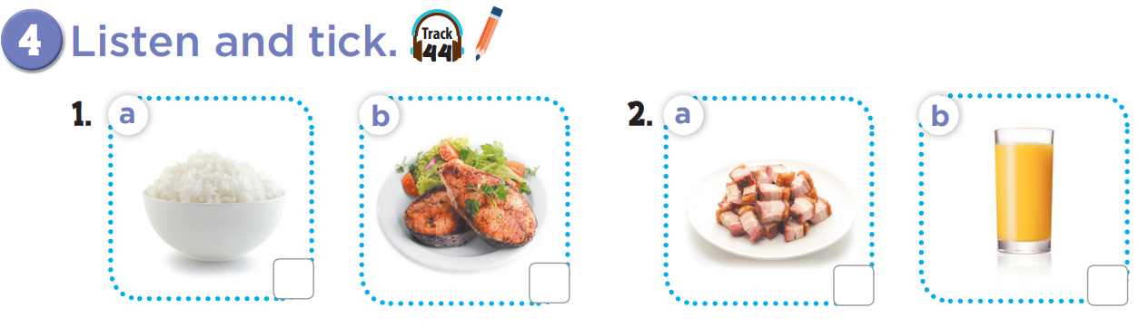

Slide 13
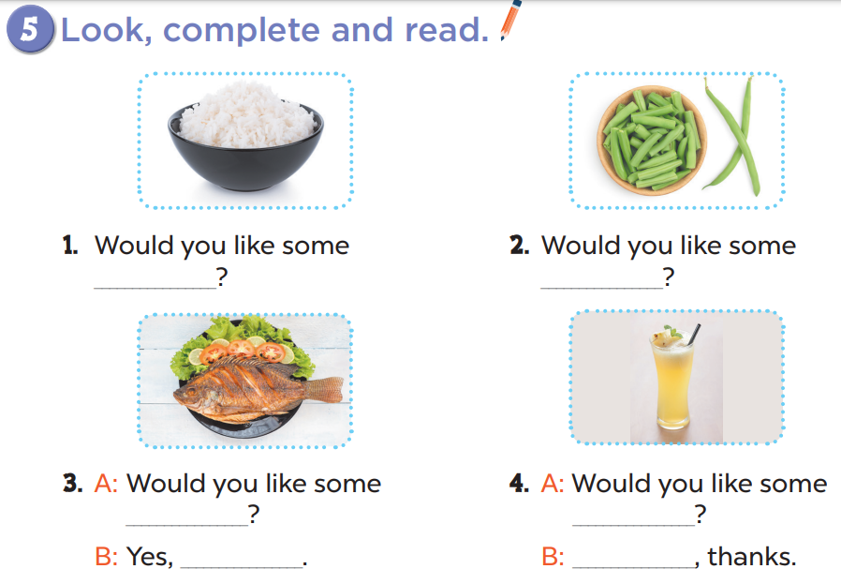
rice
beans
fish
juice
please
No

Slide 14
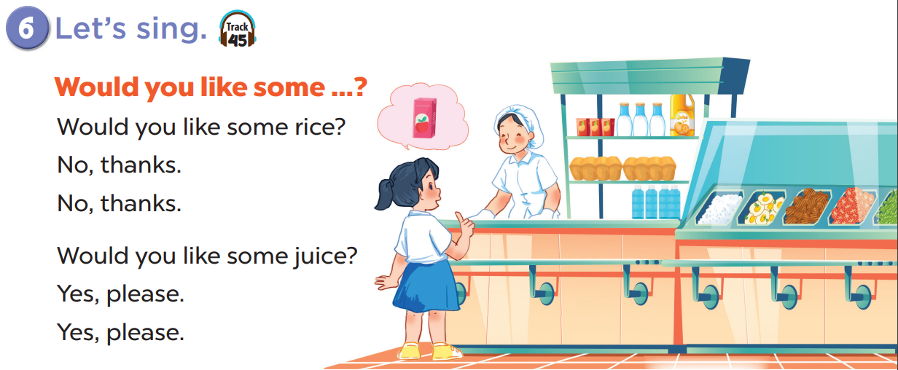

Slide 15
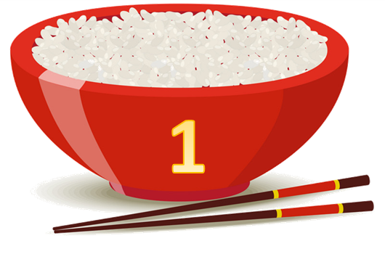
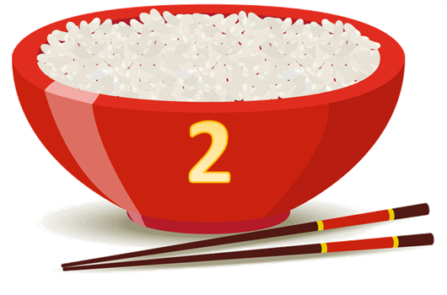






Yummy
Team A
Team B
Fun corner
and wrap-up
Notes:
Divide the class into 2 teams.
Each team chooses one bowl to go to the question. Have pupils look, read and choose the right option.
Click the ‘score’ bowl to get back to the menu for pupils to choose another question.
Pupils continue their turns until there is no bowl left.

Slide 16

Listen and choose.
60
apples
beans
pears
Notes:
Click the character on the left side to listen and choose the right options. Click the character on the right side to hear the answer.

Slide 17
Listen and choose.
30
rice
soup
noodles
Notes:
Click the characters to listen and choose the right options.

Slide 18
Listen and choose.
40
chicken
meat
fish
Notes:
Click the characters to listen and choose the right options.

Slide 19
Listen and choose.
30
chicken
meat
fish
Notes:
Click the characters to listen and choose the right options.

Slide 20
Listen and choose.
30
juice
milk
water
Notes:
Click the characters to listen and choose the right options.

Slide 21

Listen and choose.
40
juice
water
milk
Notes:
Click the characters to listen and choose the right options.

Slide 22

Listen and choose.
20
milk
water
juice
Notes:
Click the characters to listen and choose the right options.

Slide 23

Listen and choose.
10
apple juice
water
milk
Notes:
Click the characters to listen and choose the right options.

