Slide 1



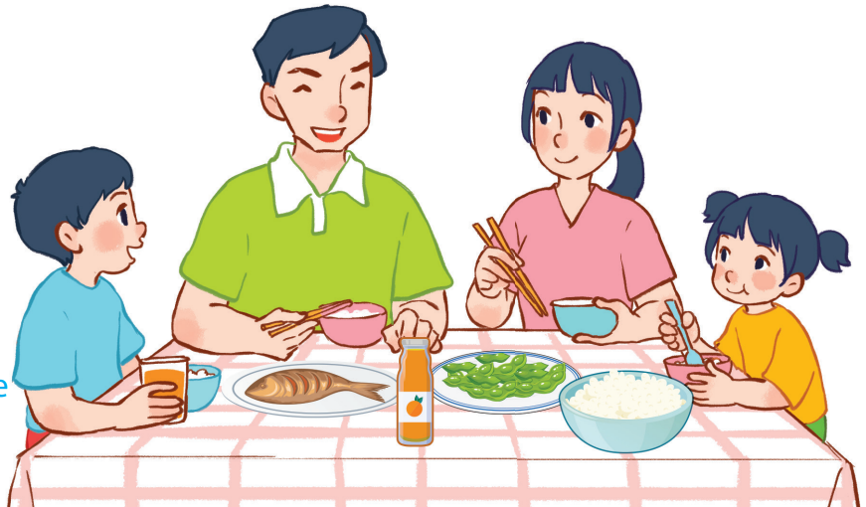
15
At the dining table
LESSON 2 – PERIOD 3

Slide 2
At the dining table
Warm-up
and review
Listen, point and say.
Fun corner
and wrap-up
Look, listen
and repeat.
Let’s talk.

Slide 3

Warm-up
and review

Slide 4


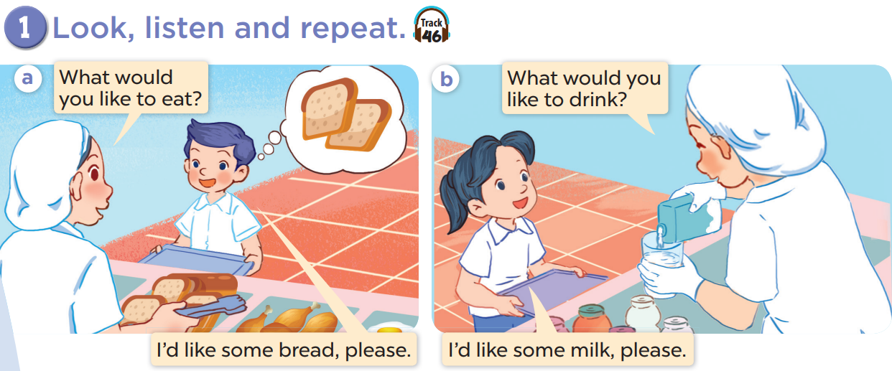

Slide 5
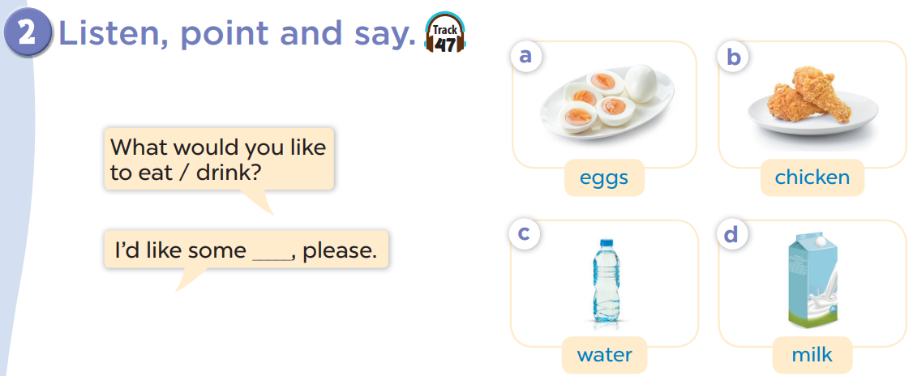

Slide 6








What’s missing?
Team A
Team B
Notes:
Divide the class into 2 teams.
Each team chooses one jar mug of juice to go to the question.
Have pupils find what is missing and say out loud the name of the missing food or drinks.
Back to the menu for pupils to choose another question.
Pupils continue their turns until there is no mug left.
The team that gets the most points is the winner.

Slide 7
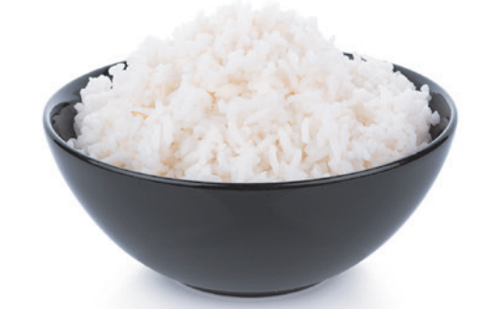


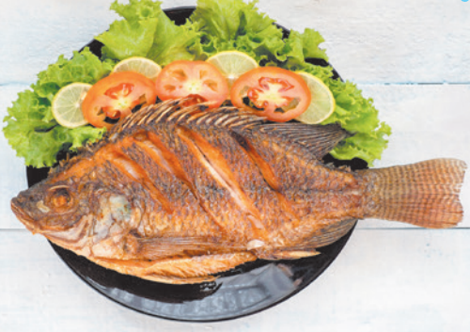
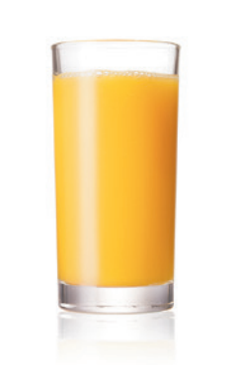
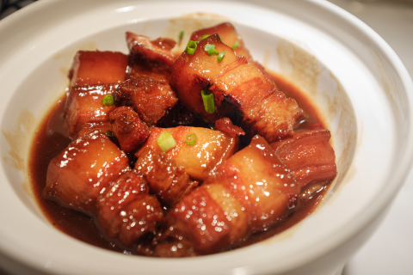


What’s missing on the table?

Slide 8
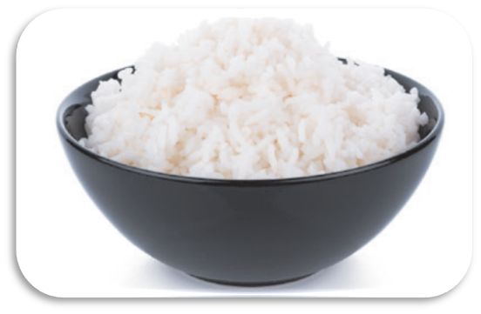
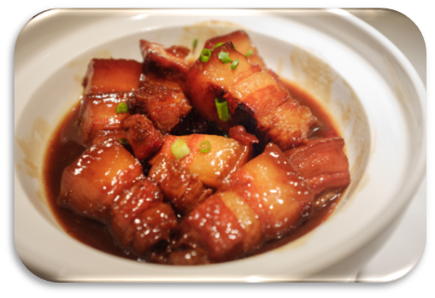

Choose and get points!
20
30
50
Notes:
Let students choose one dish to get points for their team.

Slide 9

What’s missing on the table?

Slide 10
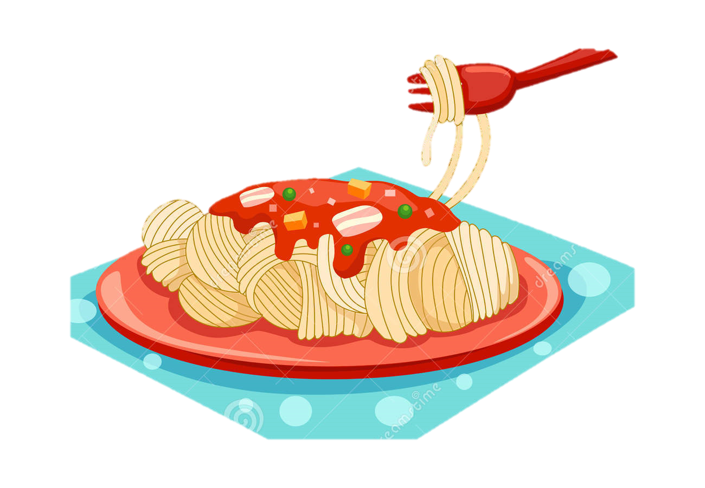


Choose and get points!
10
30
20
Notes:
Let students choose one dish to get points for their team.

Slide 11
What’s missing on the table?

Slide 12
Choose and get points!
60
40
50
Notes:
Let students choose one dish to get points for their team.

Slide 13
What’s missing on the table?

