Slide 1



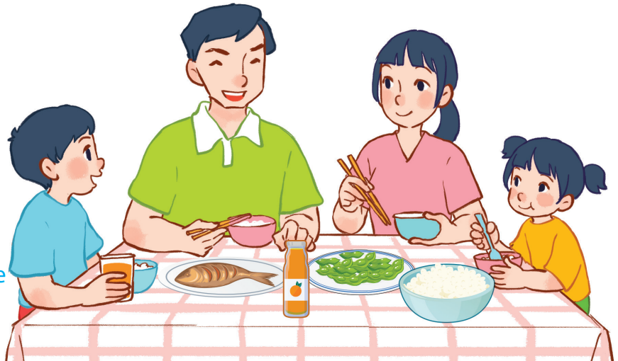
15
At the dining table
LESSON 3 – PERIOD 6

Slide 2
At the dining table
Warm-up
and review
Let’s write.
Fun corner
and wrap-up
Read and complete.
Project

Slide 3



HANGMAN
Warm-up
and review
Notes:
Divide the class into 2 teams.
Have pupils guess the word letter by letter.
Whenever the pupils guess a letter that is in the secret word, click on the letter to fill it into the blank where it occurs.
The team that has more correct answers is the winner.

Slide 4



r
i
c
e
RICE
a
g
h
b
c
d
e
f
o
p
i
j
k
m
n
l
r
q
s
t
u
v
w
x
y
z
Notes:
Let pupils guess letter by letter. If they guess a wrong letter, press the X icon once. If they find out the word, press the trophy.

Slide 5
BEANS
b
e
a
n
s
a
g
h
b
c
d
e
f
o
p
i
j
k
m
n
l
r
q
s
t
u
v
w
x
y
z
Notes:
Let pupils guess letter by letter. If they guess a wrong letter, press the X icon once. If they find out the word, press the trophy.

Slide 6
m
i
l
k
MILK
a
g
h
b
c
d
e
f
o
p
i
j
k
m
n
l
r
q
s
t
u
v
w
x
y
z
Notes:
Let pupils guess letter by letter. If they guess a wrong letter, press the X icon once. If they find out the word, press the trophy.

Slide 7
m
e
a
t
MEAT
a
g
h
b
c
d
e
f
o
p
i
j
k
m
n
l
r
q
s
t
u
v
w
x
y
z
Notes:
Let pupils guess letter by letter. If they guess a wrong letter, press the X icon once. If they find out the word, press the trophy.

Slide 8
j
u
i
c
e
JUICE
a
g
h
b
c
d
e
f
o
p
i
j
k
m
n
l
r
q
s
t
u
v
w
x
y
z
Notes:
Let pupils guess letter by letter. If they guess a wrong letter, press the X icon once. If they find out the word, press the trophy.

Slide 9
b
r
e
a
d
BREAD
a
g
h
b
c
d
e
f
o
p
i
j
k
m
n
l
r
q
s
t
u
v
w
x
y
z
Notes:
Let pupils guess letter by letter. If they guess a wrong letter, press the X icon once. If they find out the word, press the trophy.

Slide 10

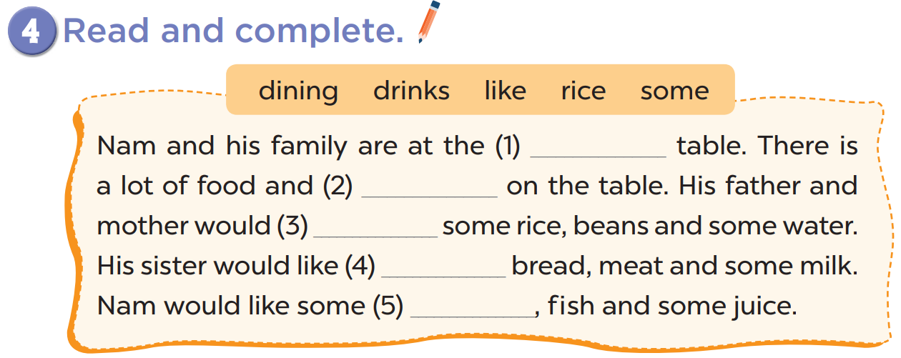
dining
drinks
like
some
rice

Slide 11
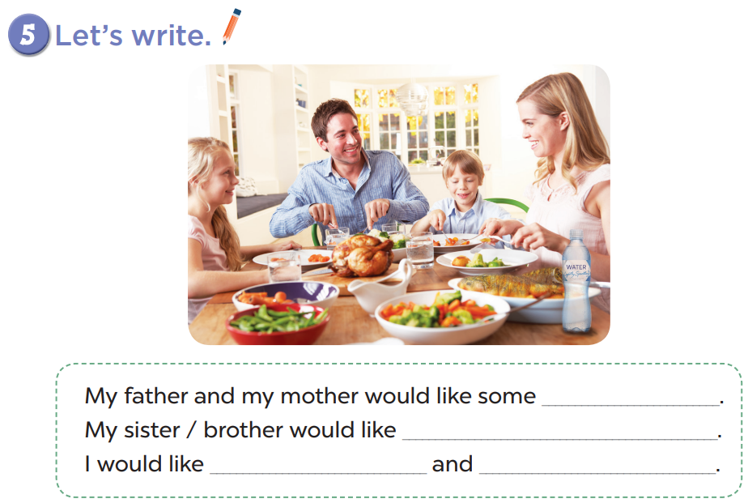

Slide 12


Slide 13
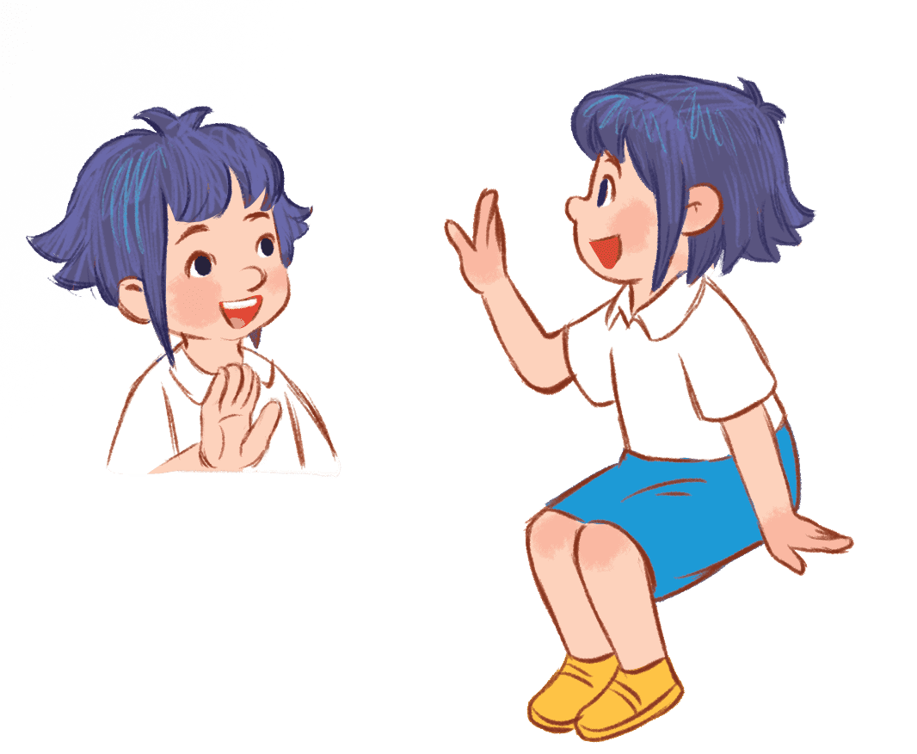
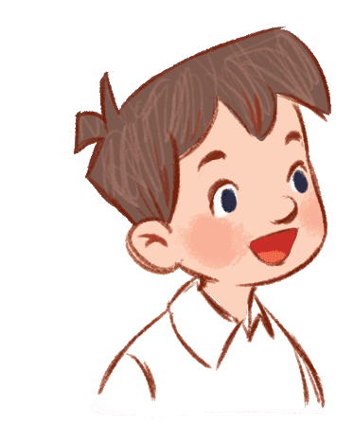
Fun corner
and wrap-up
Let’s play memory game!
That’s a great idea!
Notes:
Divide the class into 2 teams.
Have pupils turn any two cards picture-side-up.
Give pupils points if these two cards are identical. Turn the cards back down if they are not identical.
The game continues until all cards have been matched.
The one who gets the most points is the winner.

Slide 14



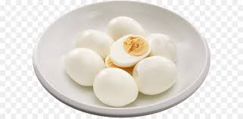







A
B
C
D
E
F
1
beans
milk
meat
bread
juice
eggs
Turn Card
Turn Card
Turn Card
Turn Card
Turn Card
Turn Card
2
eggs
milk
fish
chicken
meat
chicken
Turn Card
Turn Card
Turn Card
Turn Card
Turn Card
Turn Card
3
beans
juice
bread
fish
water
water
Turn Card
Turn Card
Turn Card
Turn Card
Turn Card
Turn Card

