Slide 1






Unit 15
IN THE CLOTHES SHOP
Lesson 1

Slide 2



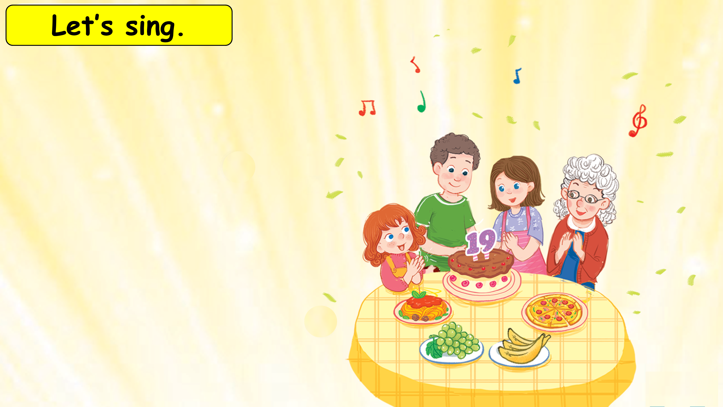






That’s my brother.
How old is he?
He’s nineteen.
My grandmother is here.
My sister is here.
We are all here.
At his birthday party.

Slide 3
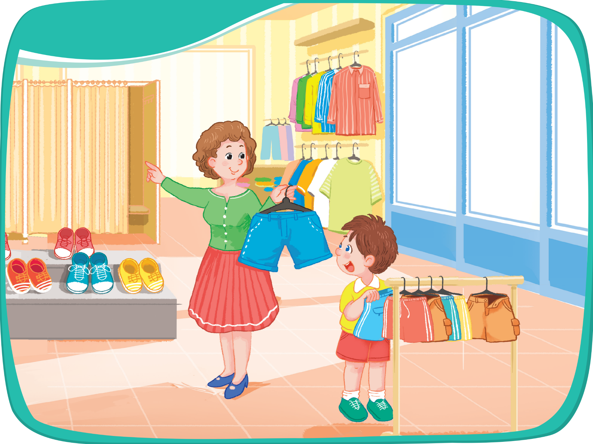
Look and say.

Slide 4


Listen and repeat.

Slide 5
Listen and repeat.
shirts
shorts
shoes

