Slide 1






Unit 15
IN THE CLOTHES SHOP
Lesson 2

Slide 2






TABLE OF CONTENTS
1
  Warm-up and review.
  2
  Listen and chant.
  3
  Listen and tick.
  4
  Write and say.
  5
  Fun corner and wrap-up.

Slide 3






1
  Warm-up and review.

Slide 4

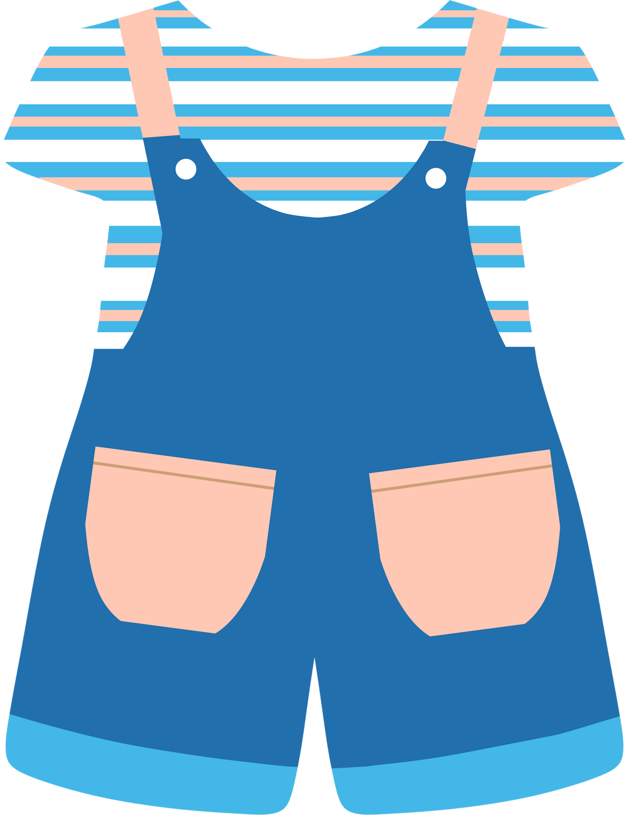
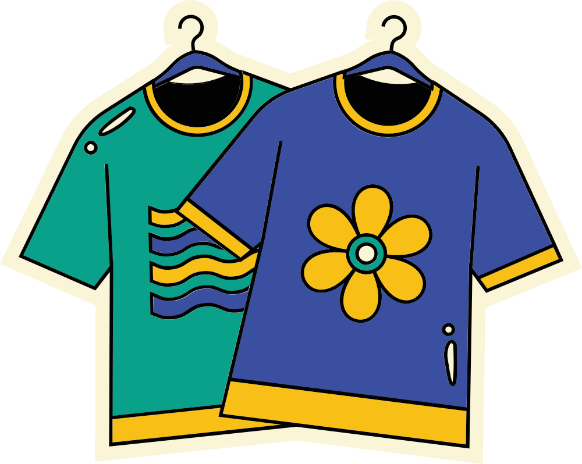
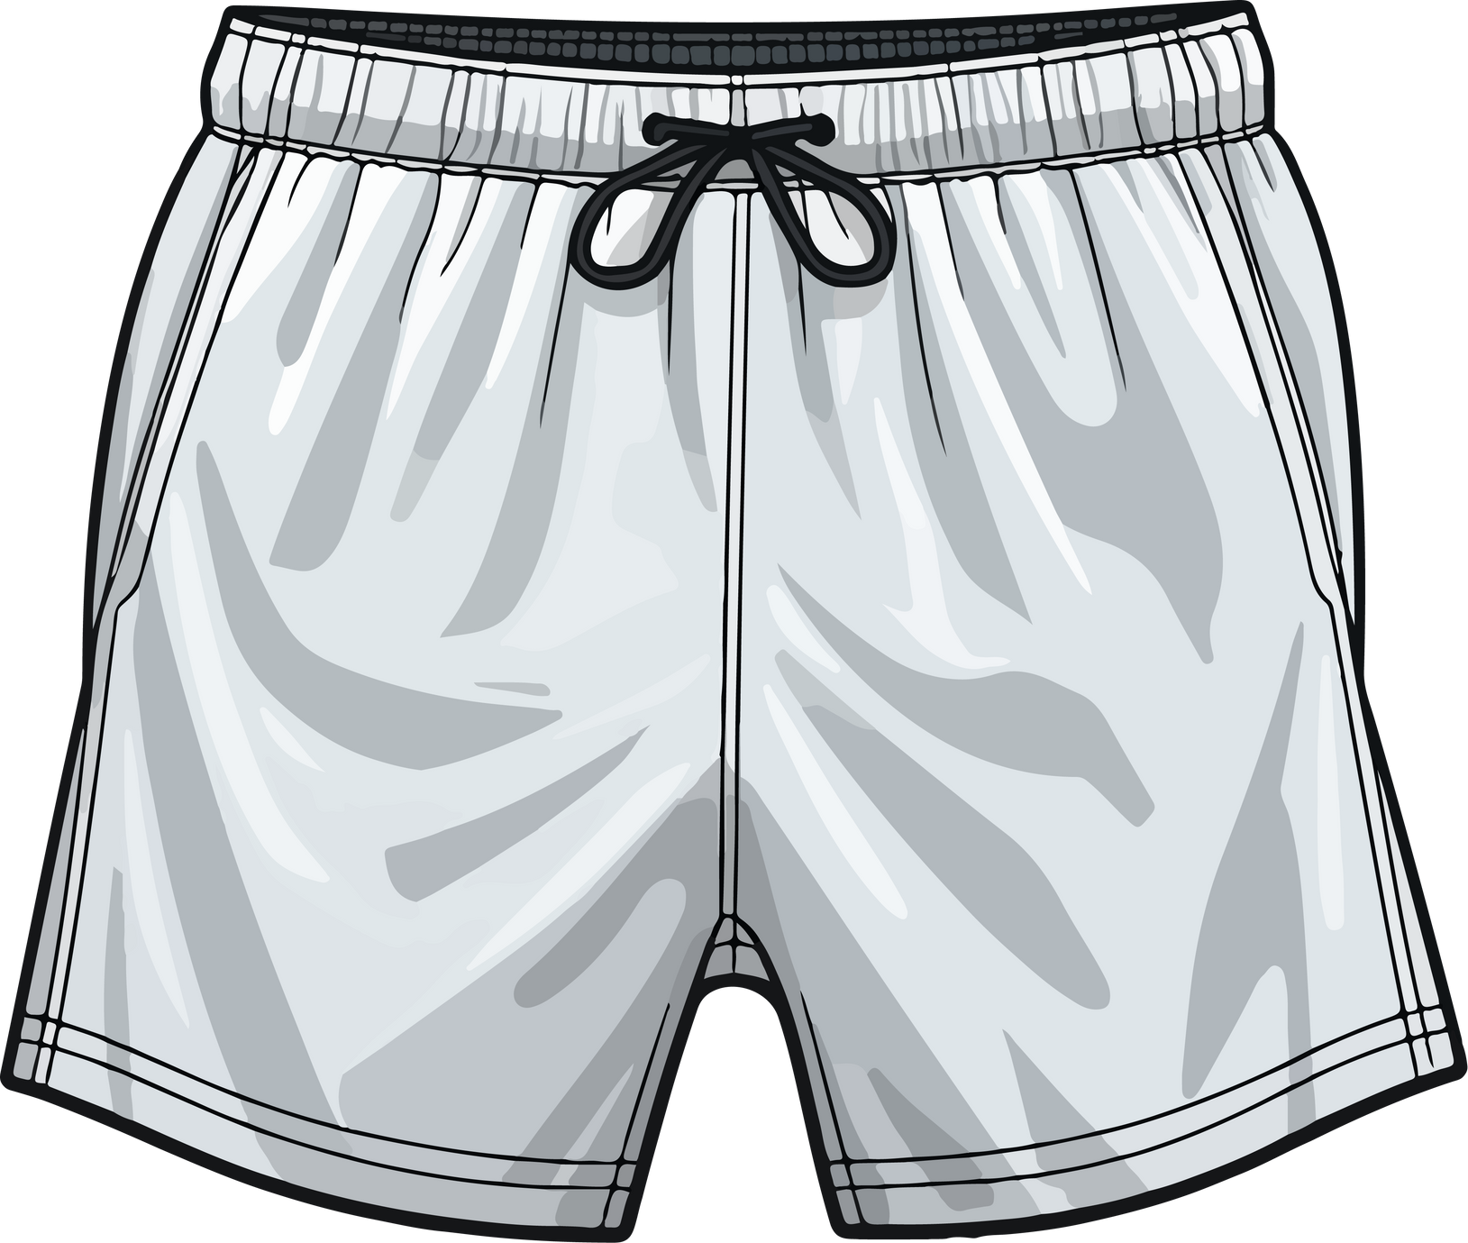
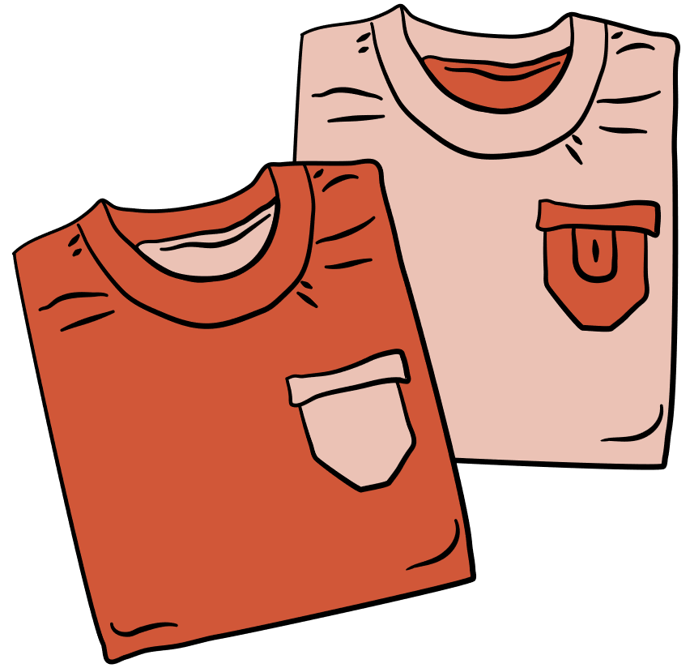



CLOTHES QUIZ

Slide 5


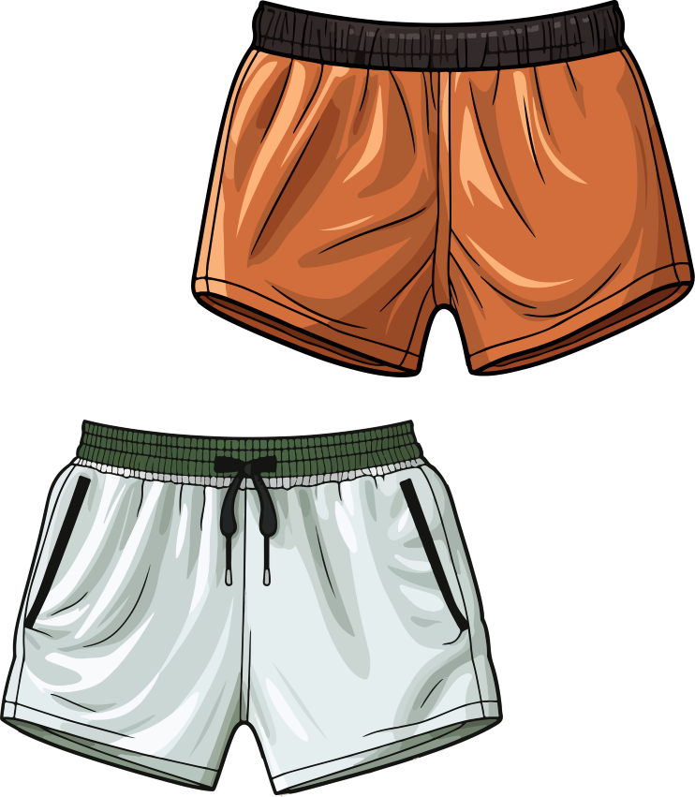
shorts
shorts
A
A
shirts
B
shoes
C

