Slide 1



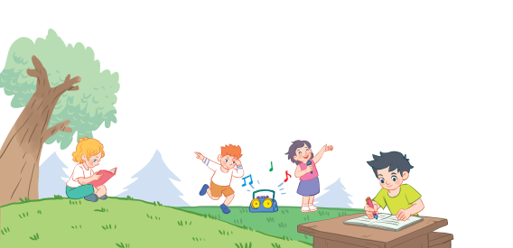
18
Period 4

Slide 2
Contents
1
Warm-up and review
2
3
4
Listen and number.
Look, complete and read.
Let’s sing.
5
Fun corner and wrap-up

Slide 3
1. Warm-up and review

Slide 4

Notes:
Game: Matching pairs
Divide the class into two teams. (Boys and Girls)
Ask pupils to choose the matching pairs. (words with pictures)
Pupils come to the front and choose the pictures in order to match with the words. Who can make it will have points for the team.
Give points for the pupils. Encourage the pupils to join the activity.

Slide 5

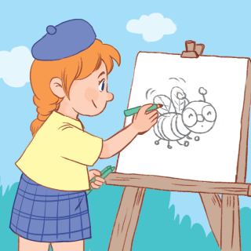
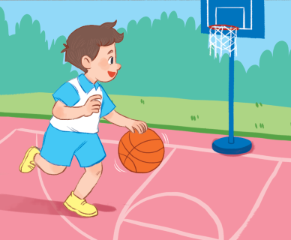
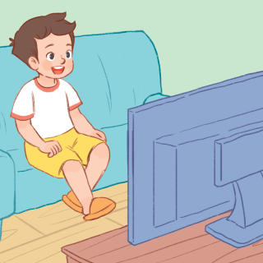
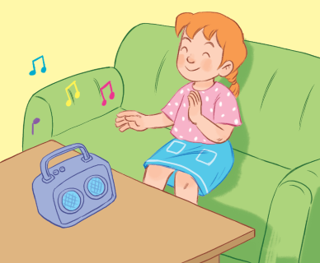
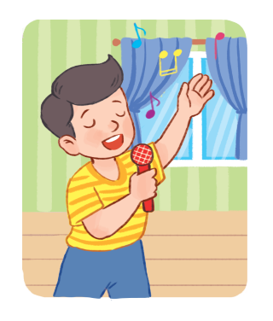
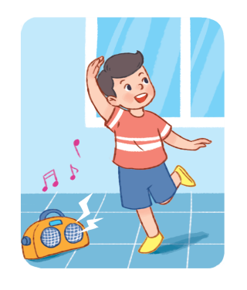
listening
to music
singing
dancing
playing basketball
drawing a picture
watching TV

Slide 6
2.Listen and number.

Slide 7
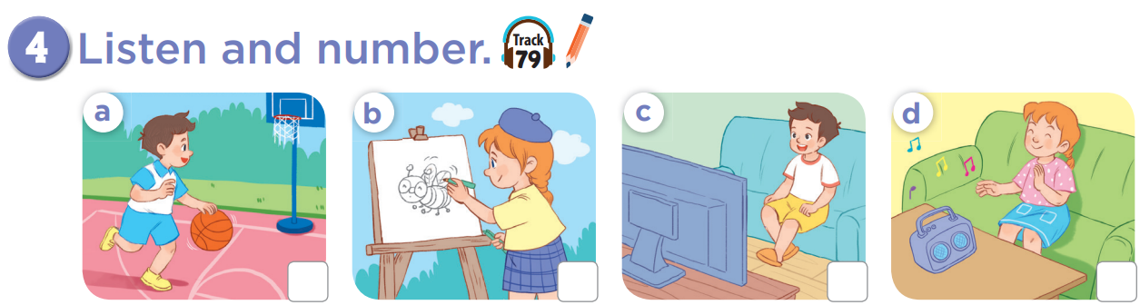


Slide 8
3
2
1
4

Slide 9

Game: What’s missing?
Notes:
Ask pupils to look at the pictures.
One picture is missing, they have to say quickly what the picture is.
This game will become harder when there are 2 pictures missing.
This game can be play in groups or by the whole class.

Slide 10
Game: What’s missing?
watching TV

Slide 11
What’s missing?
playing basketball

Slide 12
What’s missing?
drawing
a picture

Slide 13
What’s missing?
listening
to music

Slide 14
What’s missing?
playing basketball
watching TV

Slide 15
What’s missing?
drawing
a picture
listening
to music

Slide 16
What’s missing?
playing basketball
drawing
a picture

Slide 17
What’s missing?
watching TV
listening
to music

Slide 18
3. Look, complete and read.

Slide 19
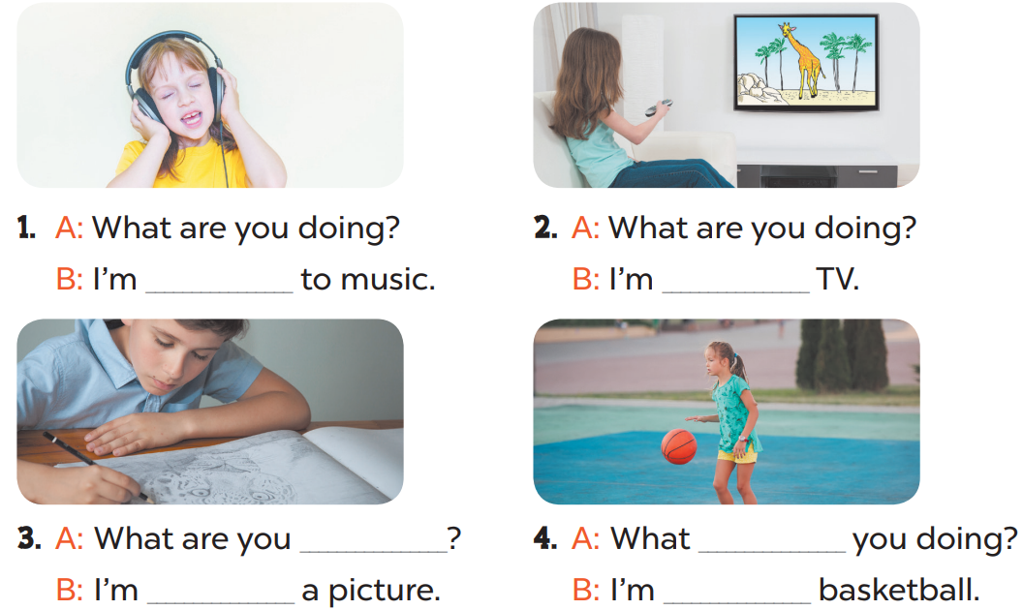

Slide 20
listening
watching
doing
are
drawing
playing

Slide 21


Game:
are
watching TV
doing
you
Notes:
Game: Slap the board
T divides the class into 2 teams: BOYS and GIRLS.
T shows 1 sentence on the TV, 1 boy and 1 girl of each team come to the board, look at the sentences and choose the best words to make correct sentences. (Pupils slap the words on the board)

Slide 22
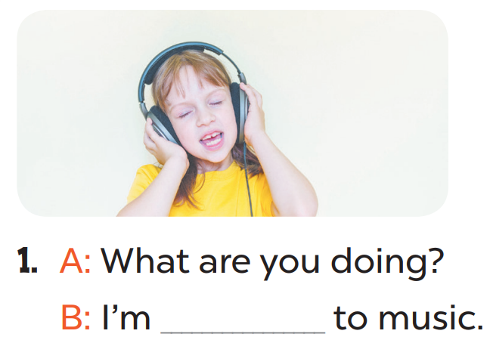
watching
you
doing
listening

Slide 23
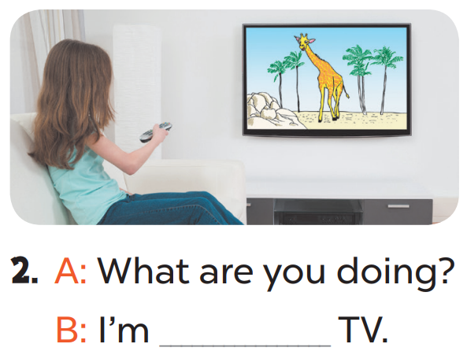
watching
doing
playing
drawing a picture

Slide 24
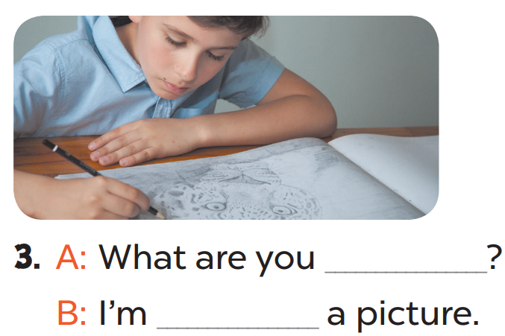
doing/ playing
doing/ drawing
doing/ are

Slide 25
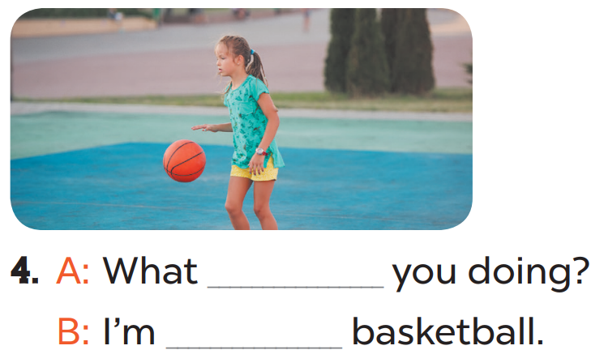
are/playing
are/ playing
Is/doing
Is/listening

Slide 26
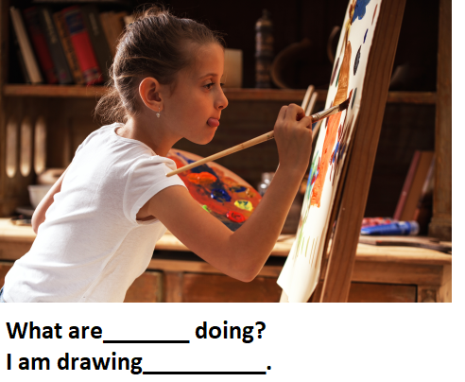
watching
are
doing
you/ a picture

Slide 27
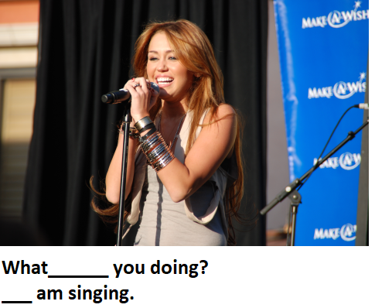
Are / I
Is/ I
Is/ You
Are / you

Slide 28
4. Let’s sing.

Slide 29
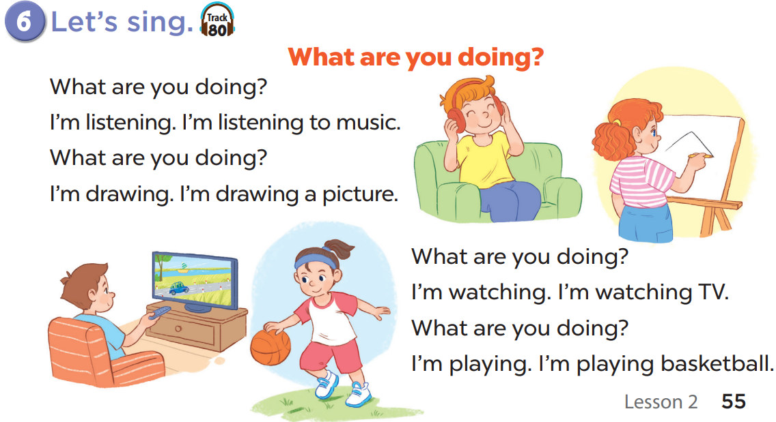

Slide 31
5. Fun corner and wrap-up

Slide 32

Notes:
Step 1: Tell pupils that they are going to look at the cards in 60 seconds, memorise the words, then remember as many of the words as possible. Explain how the game is played. Check comprehension.
Step 2: Put the cards on a desk or stick them on the board. Then cover them with a piece of cloth. Do not let pupils see what is beneath the piece of cloth.
Step 3: Divide the class into 2 or 4 groups. Remove the cloth and show the cards for 60 seconds. Then cover them again. In their groups, pupils try to say as many of the words as they can remember.
Step 4: Have the groups say the names of the things aloud. For each correct word, give them a star or a point. The group with the most stars / points wins.
Option 3: Teacher tells pupils to make sentences with I’m...........

Slide 33
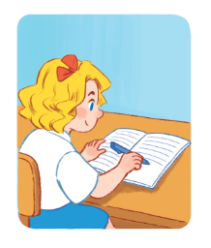

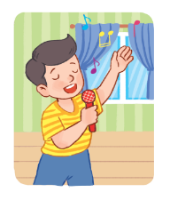






Slide 34


