Slide 1
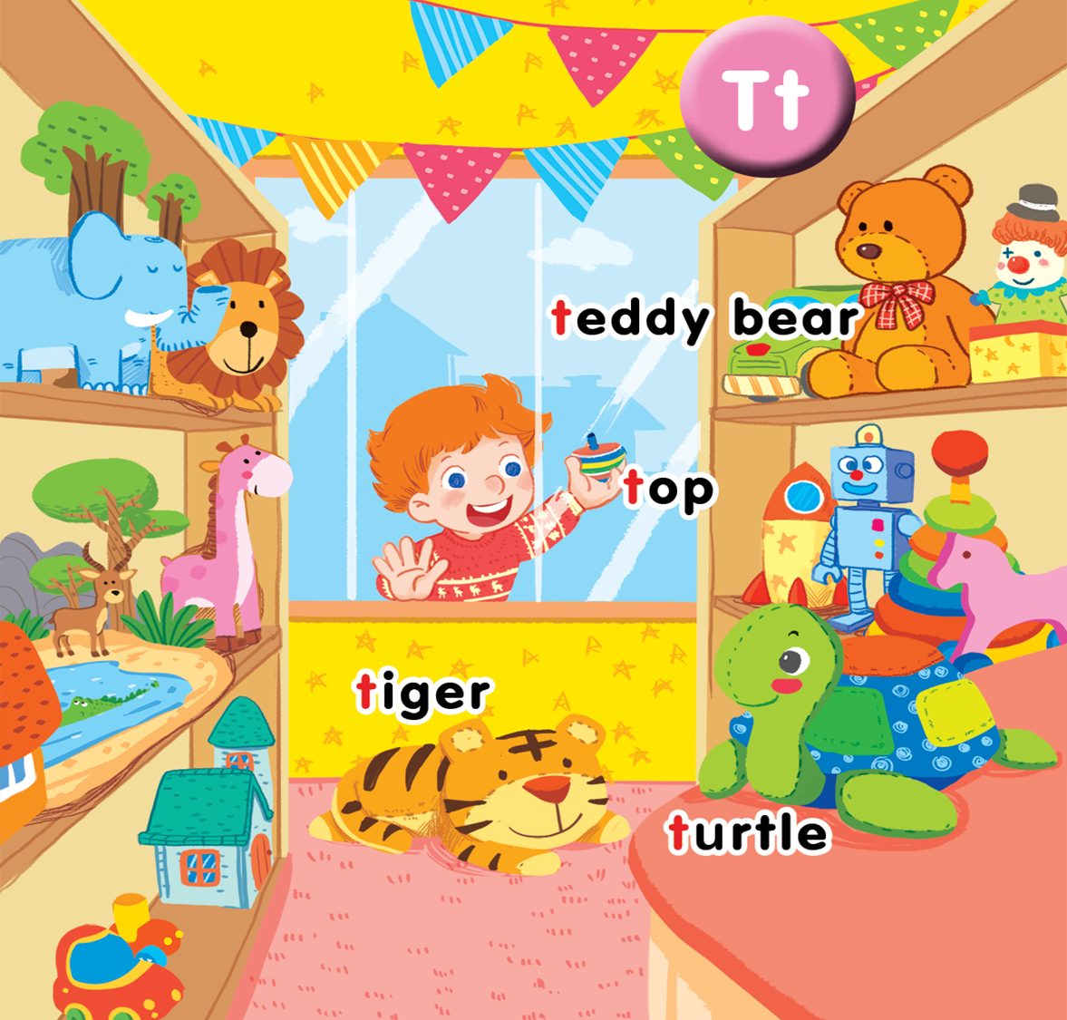
Unit 14
In the toy shop
Lesson 2
Notes:
By the end of the lesson, pupils will be able to
- say the sound of the letter T/t, the words teddy bear, tiger, turtle and top in a chant.
- listen, recognize the words and tick the correct boxes.
- trace the letter T/t

Slide 2

Notes:
Goal: Warm up and revise the unit keywords.
Time: 5 minutes
Use flashcards from previous lesson(s).
Open a part of the card to let pupil guess the words and do the TPR actions.
Each correct answer gets 3 points.

Slide 3


Listen and chant
Notes:
Listen and chant is divided into 2 steps.
Step 1
Goal: Pupils will be able to listen, chant and clap along.
Time: 5 minutes
Play the recording
Round 1. Have pupils listen and clap along.
Round 2. Have pupils listen chant.
Round 3. Have pupils listen, chant and do the TPR actions with teacher.
Round 4. Have pupils chant and do the actions (in chorus then in group).

Slide 4

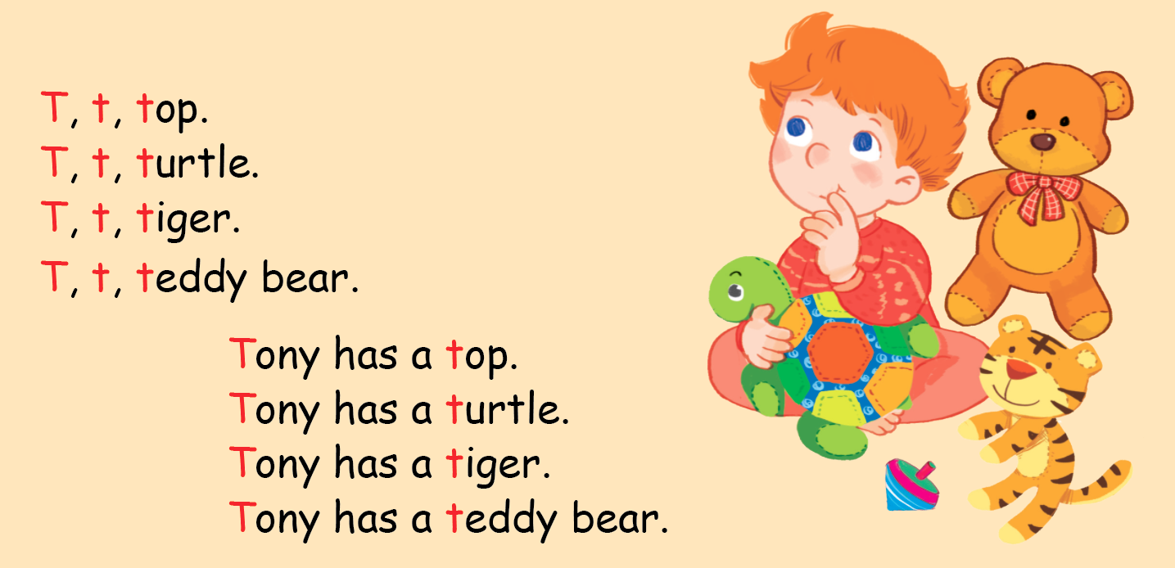
Listen and chant

Slide 5

Notes:
Step 2
Goal: Pupils are able to create their own chant.
Time: 5 minutes
Have pupils work in groups.
In group, pupils replace the lyrics of the chant (name of toys only).
Practice in group then present.

Slide 6

Listen and tick
Notes:
Step 1
Goal: Pupils will be able to listen and choose the correct pictures.
Time: 5 minutes
Say Listen and tick with the TPR actions.
Play the recording and demonstrate the example.
Play the recording and have pupils do the task.
Step 2
Goal: Check
Time: 5 minutes
Play the recording and have pupils say the answer.
Play the recording again and have pupils repeat then give correct answer.

Slide 7
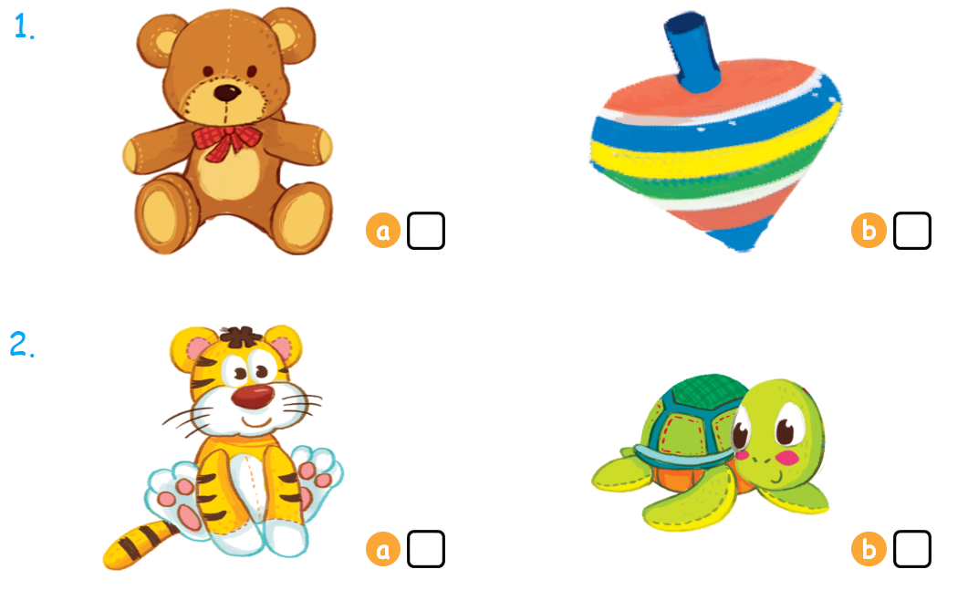

Listen and tick

Slide 8



Look, trace and write
Notes:
Goal: Pupils will be able to trace the letter.
Time: 5 minutes
Here’s the suggestion website teacher may use: https://www.youtube.com/watch?v=93mdB3_GgSo
Demonstrate how to trace the word
Have pupils write the word by air tracing and say the word.
Have pupils do the task.

Slide 9
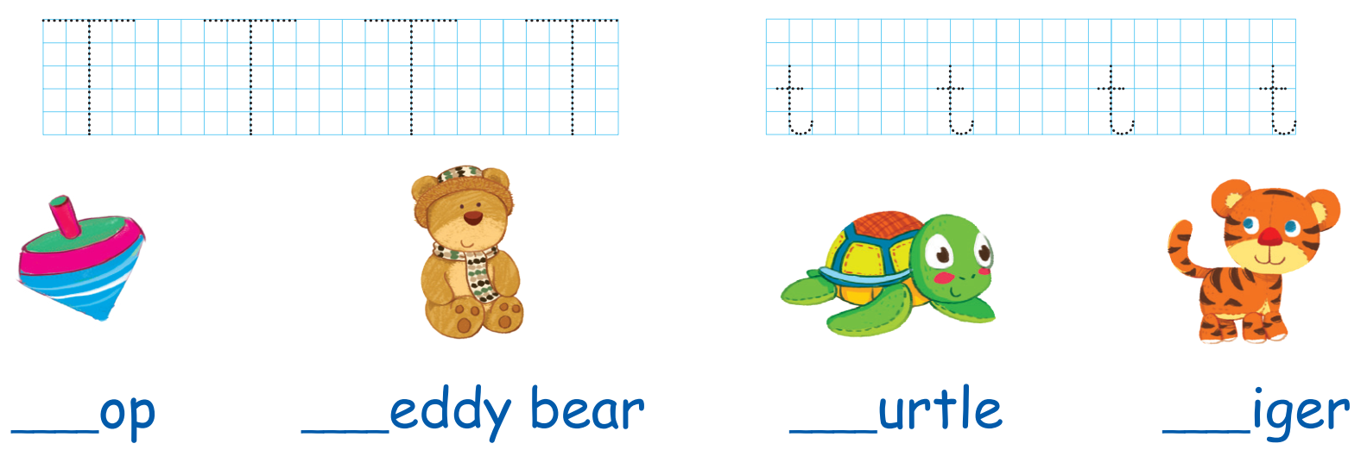

Slide 10
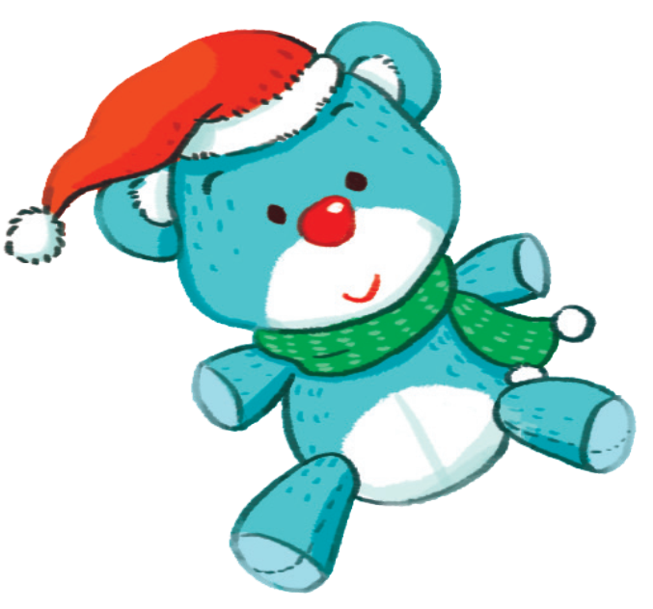
Goodbye
Notes:
Goodbye
Time: 2 minutes
Teacher and pupils say goodbye to the words.

Slide 11
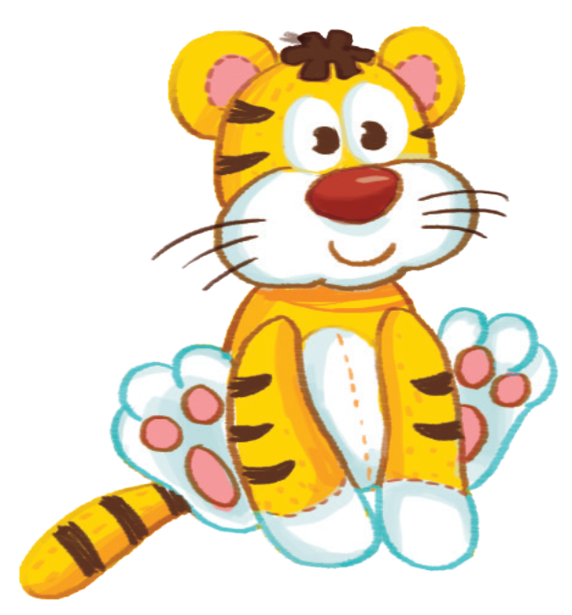
Goodbye
Notes:
Goodbye
Time: 2 minutes
Teacher and pupils say goodbye to the words.

Slide 12
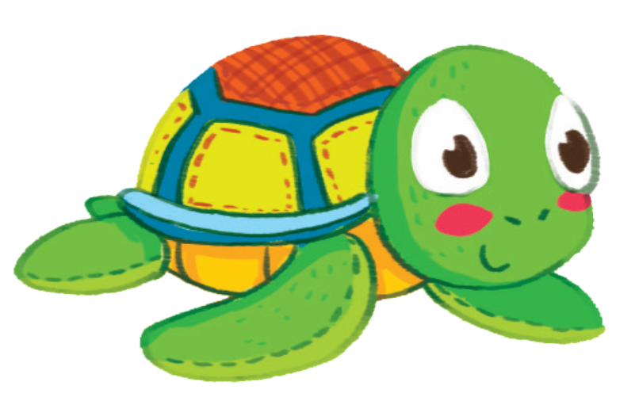
Goodbye

Slide 13

Goodbye

