Slide 1
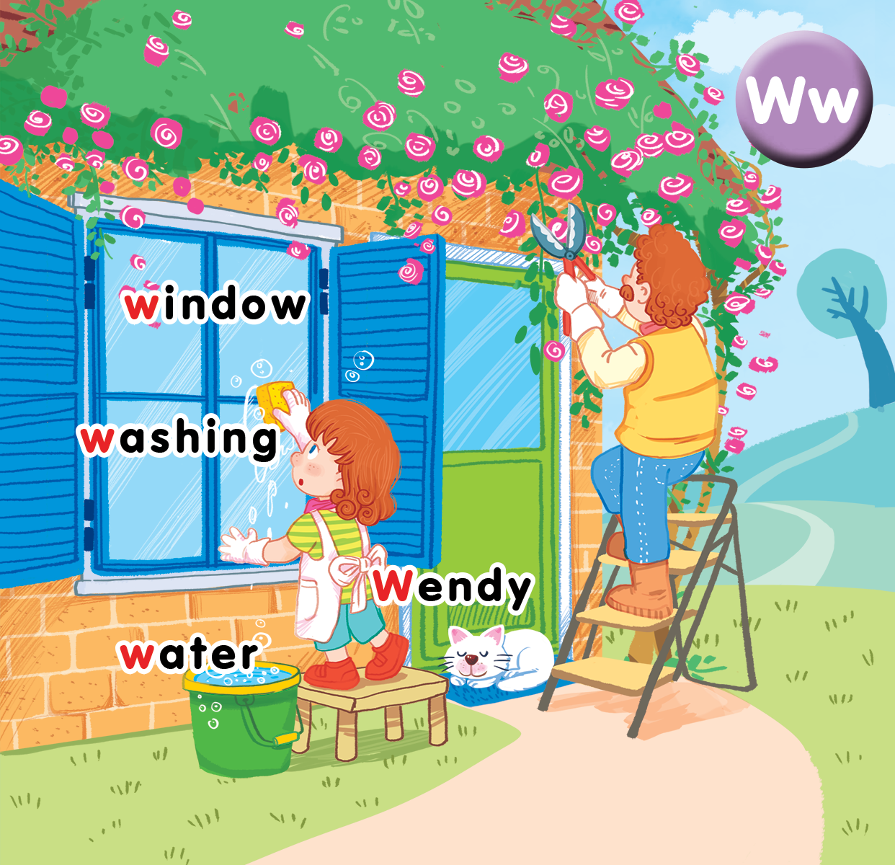
Unit 16 At home Lesson 1
Notes:
By the end of the unit, pupils will be able to:
pronounce the sound of the letter W/w in isolation and in the words Wendy, window, washing, water correctly.
say the sound of the letter W/w and the words Wendy, window, washing, water in a chant.
recognize the words in different situations when listening.
use “How many ___________can you see? – I can see__________” to ask and answer about quantity.
trace the letter W/w using a song with the structure “How many ___________can you see? – I can see__________”
Lesson 1
By the end of the lesson, pupils will be able to:
pronounce the sound of the letter w in isolation and in the words Wendy, window, washing, water.
understand the meaning, say the words Wendy, window, washing, water.

Slide 2

Warm-up
Notes:
Goals: Warm up the class, review the previous lesson and get pupils ready for the new lesson.
Time: 5 minutes
Sing the song from the previous lesson for the 1st time
At the second time, use flashcard and have pupils change the lyrics of the song.
Ex:
1st time:
That’s your face.
That’s your foot.
Point to your face.
Point to your foot…
2nd time:
(Show the flashcard of hand)
Pupils: That’s your hand.
(Show the flashcard of hair)
Pupils: That’s your hair.
Point to your hand.
Point to your hair.
…

Slide 3


Let’s sing
Bài hat trang 67

Slide 4



Notes:
Listen and repeat is divided into 3 steps.
Step 1
Goal: Set up the context and introduce the sound of letter Ww.
Time: 4 minutes
Open digital book, point the girl and say: This is Wendy, Wendy, Wendy . Can you say Hi to Wendy?
Have pupils say Hi to Wendy.
Ask pupils to describe the picture (both in English and Vietnamese) by raising some questions:
Who is this? (It’s Wendy’s father).
What can you see in the picture? (a cat, a house…)
What are Wendy and her father they are doing?
Show the flashcard of Wendy and ask: What does the word Wendy begin with? (W)
Say w then have pupils repeat many time in chorus, groups then individuals.
Say Today we will learn some words beginning with W.

Slide 6

washing
Notes:
Step 2:
Goal: Pupils are able to understand the meaning, listen and repeat the unit words.
Time: 4 minutes
Show the slide to pupils.
Say washing and do the TPR.
Repeat again and ask pupils to repeat in chorus, groups, individuals.
Do the same with other words. May change the volume to make the reading fun.

Slide 7

window

Slide 8

water

Slide 9
Notes:
Step 3
Goal: Pupils will be able to listen and repeat the unit keywords.
Time: 4 minutes
Open digital book, click on the pictures. Pupils listen and repeat again but do TPR when repeat.
Vary the ways pupils saying the words to make the activity more fun.
Example: Team 1: repeat in loud voice/ team 2: repeat in soft voice etc.
If possible, ask pupils to find more words which have got letter w or the /w/ sound.

Slide 10



Notes:
Point and say is divided into 2 main steps.
Step 1
Goal: Pupils remember the meaning and say the word
Time: 5 minutes
Have pupils look at the picture.
Point to Windy and say Windy.
Then point to other things and have pupils say.
Have pupils do the same thing in pairs, 1 points and the other says.

Slide 11
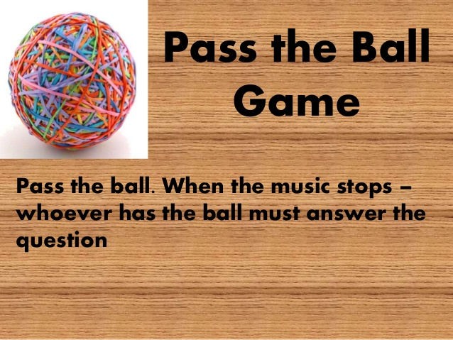
Notes:
Step 2
Goal: Pupils are able to understand and say the word in a game.
Time: 5 minutes
Game: Pass the ball
Play a song.
At the time the song stops, who is taking the ball has to act to describe a word. Then he/she asks a friend to say the word. If it’s correct, they can continue the game. If not, the answerer has to leave the game.

Slide 13
Word remember challenge
Notes:
Goal: Check the memory
Time: 5 minutes
Have pupils play word build, close all the books, guess the letter to make words.
For wrong guessing, 1 part of the UFO will be built.
Pupils will lose the game if the UFO is completed.

Slide 14












A
B
C
D
E
F
G
H
I
J
K
L
M
N
O
P
Q
R
S
T
U
V
W
X
W
e
n
d
y
Y
Z
BUILD
Notes:
Nguồn : internet

Slide 15
A
B
C
D
E
F
G
H
I
J
K
L
M
N
O
P
Q
R
S
T
U
V
W
X
w
a
s
h
i
n
g
Y
Z
BUILD

Slide 16
A
B
C
D
E
F
G
H
I
J
K
L
M
N
O
P
Q
R
S
T
U
V
W
X
w
i
n
d
o
w
Y
Z
BUILD

Slide 17
A
B
C
D
E
F
G
H
I
J
K
L
M
N
O
P
Q
R
S
T
U
V
W
X
n
o
o
d
l
e
s
Y
Z
BUILD
Notes:
Write the answer here

Slide 18
A
B
C
D
E
F
G
H
I
J
K
L
M
N
O
P
Q
R
S
T
U
V
W
X
w
a
t
e
r
Y
Z
BUILD

Slide 19
A
B
C
D
E
F
G
H
I
J
K
L
M
N
O
P
Q
R
S
T
U
V
W
X
f
o
o
t
b
a
l
l
Y
Z
BUILD
Notes:
Write the answer here

Slide 20
A
B
C
D
E
F
G
H
I
J
K
L
M
N
O
P
Q
R
S
T
U
V
W
X
t
i
g
e
r
Y
Z
BUILD
Notes:
Write the answer here

Slide 21
Goodbye
water
Notes:
Teacher shows the vocabulary of the lesson on slide.
Pupils say goodbye.

Slide 22

Goodbye
Wendy

Slide 23
Goodbye
window

Slide 24

Goodbye
wash

Slide 25
Website: hoclieu.vn
Fanpage: facebook.com/www.tienganhglobalsuccess.vn

