Slide 1
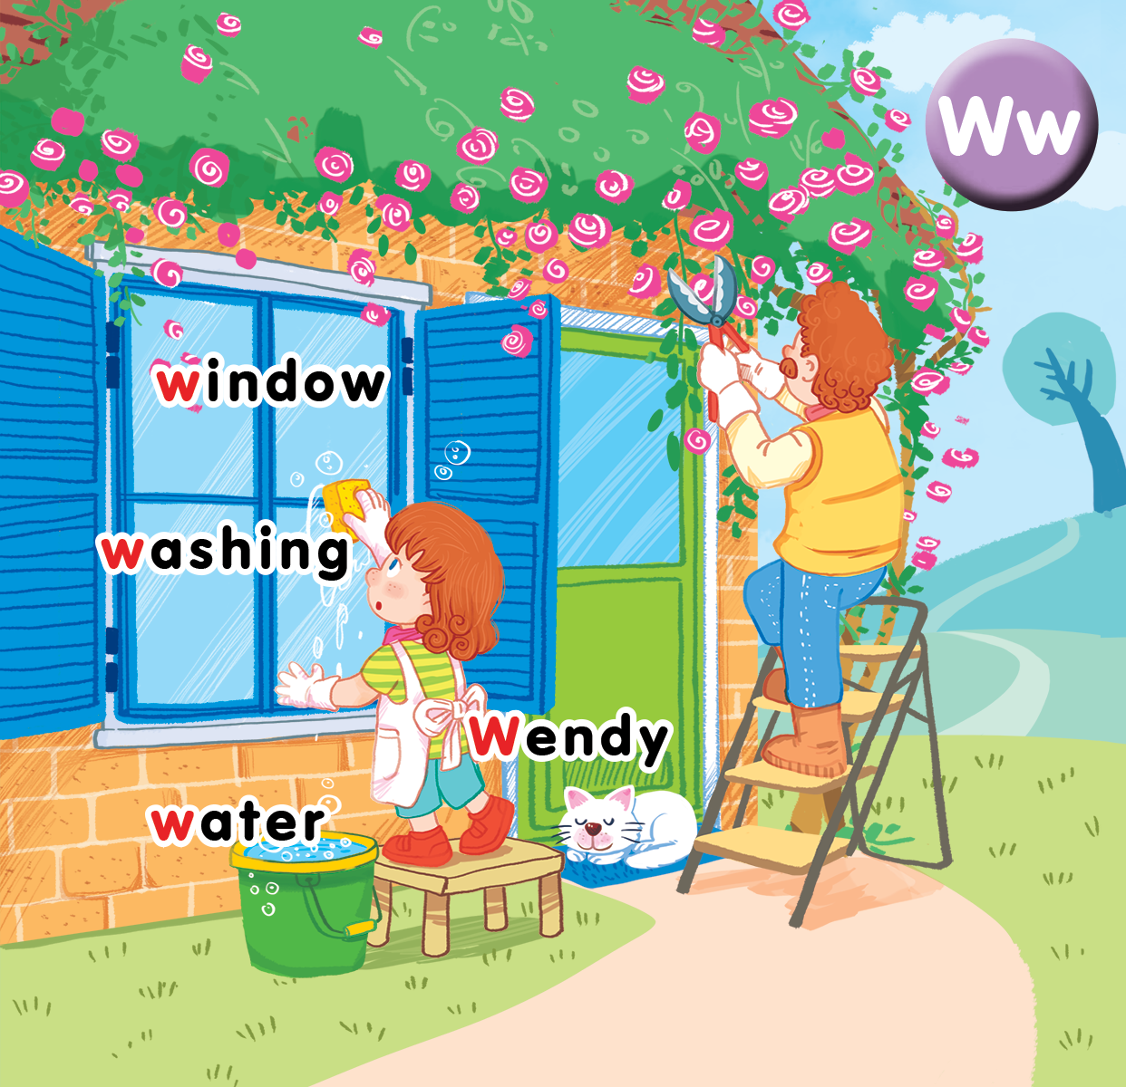
Unit 16
At home
Lesson 3
Notes:
By the end of the lesson, pupils will be able to
- Ask and answer about quantity, using the structure: How many______can you see? – I can see____.
- sing along the unit song.

Slide 2

Warm-up
Notes:
Goal: Warm up and revise the number
Time: 4 minutes
Game: I need
Have pupils play in groups.
Say I need some books.
Pupils ask in chorus: How many books?
Say the number of the books, ex: eight.
Pupils in group have to gather enough 8 books and give to teacher.
Fastest group wins the game.

Slide 3


Listen and repeat
Notes:
Listen and repeat is divided in to 2 steps.
Step 1
Goal: Pupils will be able to understand the structure How many …..can you see? I can see…….
Time: 7 minutes.
Have pupils watch the video: HOW MANY by a song: https://www.youtube.com/watch?v=i7bjpemlfxc
Ask pupils in Vietnamese what question they use when they want to ask about the quantity.
Confirm the answer of the pupils: Yes, they ask How many.
Show 5 pencils and ask: How many pencils can you see?
Then count, 1, 2, 3, 4, 5 – I can see 5 pencils.
Repeat the question and answer many times and have pupils repeat.

Slide 4

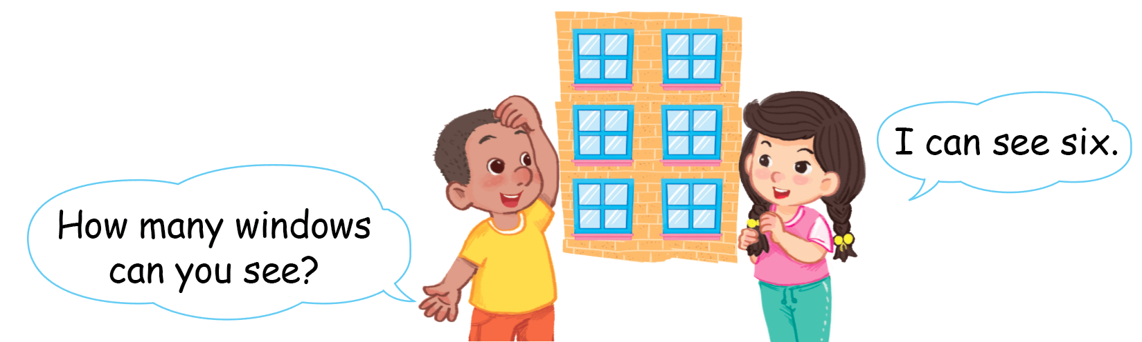
Listen and repeat
Notes:
Step 2
Goal: Pupils will be able to practice listen and repeat the question and answer.
Time: 5 minutes
Have pupils open the book, listen and repeat.
Repeat in chorus.
Repeat in group, 1 group ask, the other answer.
Repeat in pairs

Slide 5


Let’s talk
Notes:
Let’s talk is divided into 2 steps.

Slide 6
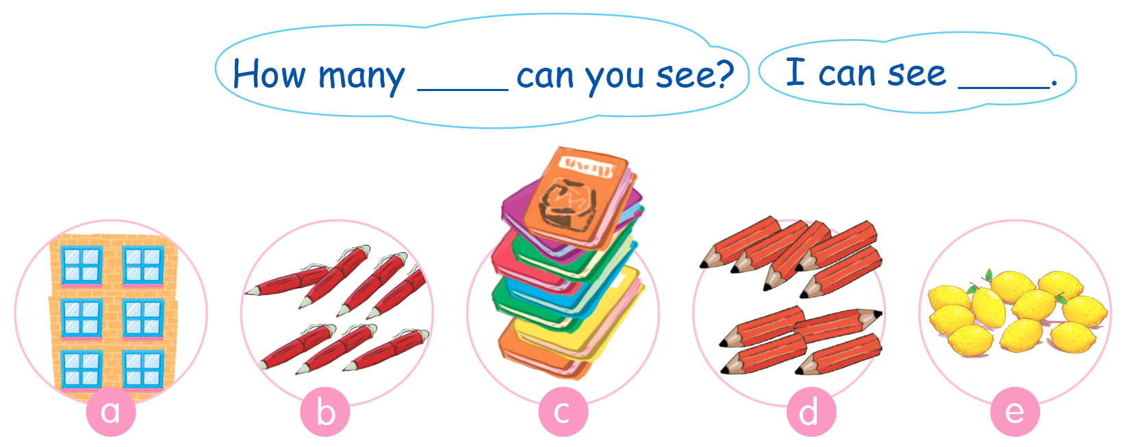
Let’s talk
Hình bài 7 trang70
Notes:
Step 1
Goal: Pupils practice speaking, using the question How many…can you see? – I can see..
Time: 4 minutes
Have pupils open the book, activity 7.
Point to the pictures and have pupils say (review the words window, red pens, book, red pencils, lemons).
Point to the picture of the window and ask How many window can you see? Invite a pupil to answer.
Have pupils repeat again.
Then ask pupils to do the same with other pictures in group then in pairs.

Slide 7











TEAM 1:
TEAM 2:
TEAM 3:
TEAM 4:
Notes:
Step 2
Goal: Pupils are able to ask and answer more using the new structure
Times: 5 minutes
Lucky number game
Pupils play in groups
When a pupil chooses a number and clicks, he/she has to make a question with the picture, using How many …can you see.
Then he/she can call another pupil of other group to answer. Correct question and answer can bring star to the group.

Slide 8

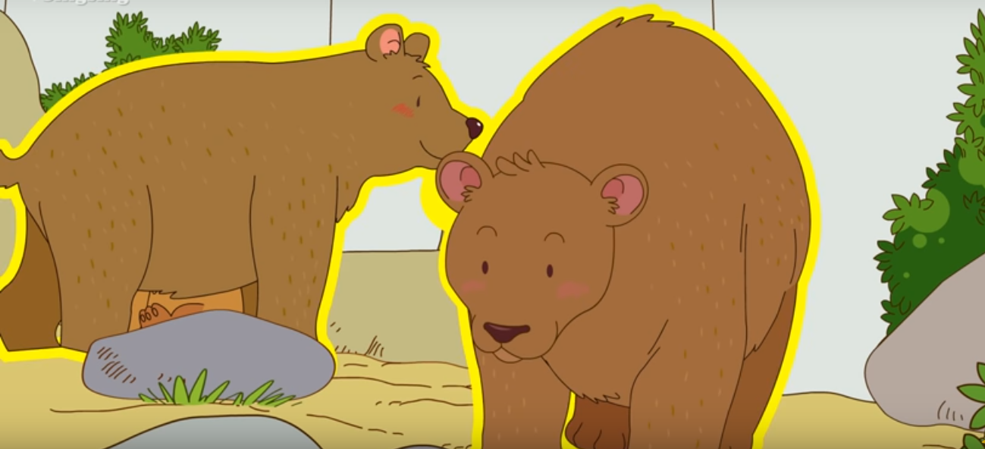
How many bears can you see?.
I can see two bears..

Slide 9
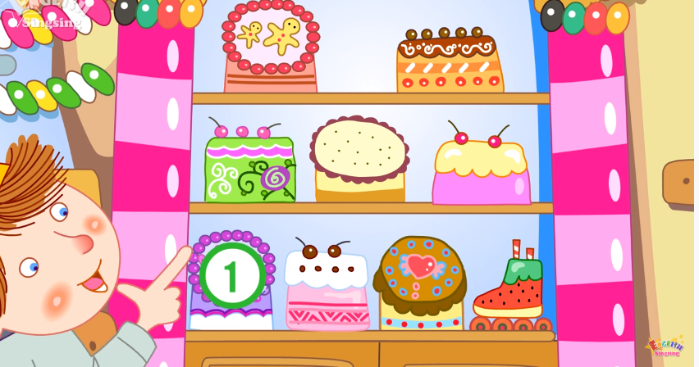
How many cakes can you see?.
I can see nine cakes..

Slide 10
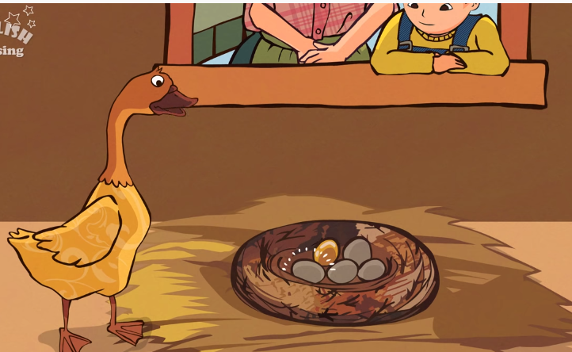

How many eggs can you see?.
I can see five eggs..

Slide 11
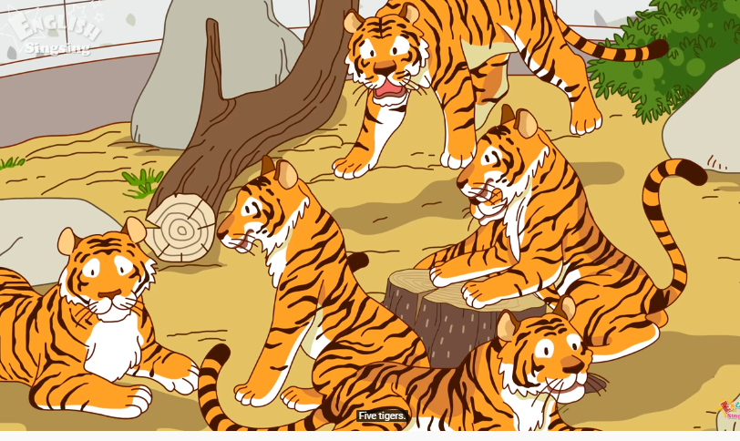

How many tigers can you see?.
I can see five tigers..

Slide 12
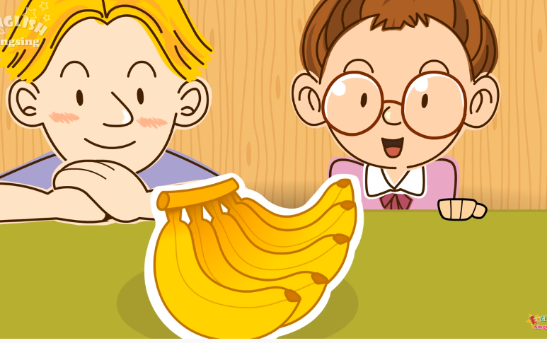
How many bananas can you see?.
I can see five bananas..

Slide 13

How many pencils can you see?.
I can see four pencils..

Slide 14
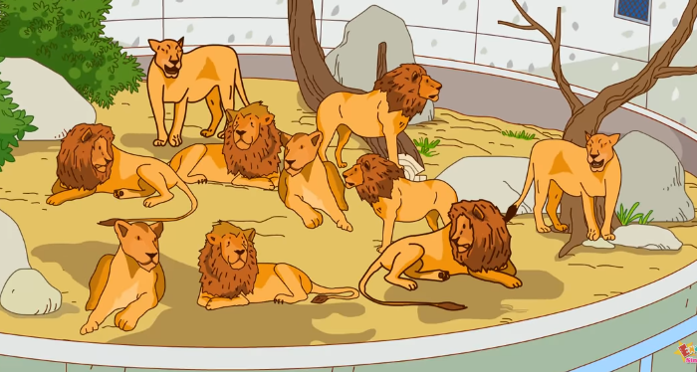
How many lions can you see?.
I can see ten lions..

Slide 15

How many pens can you see?.
I can see three pens..

Slide 16

How many pencils can you see?.
I can see three pencils..

Slide 17
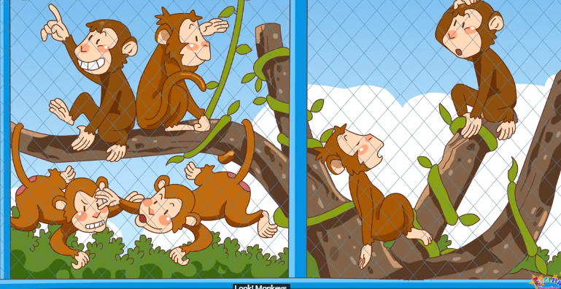
How many monkeys can you see?.
I can see six monkeys..

Slide 18
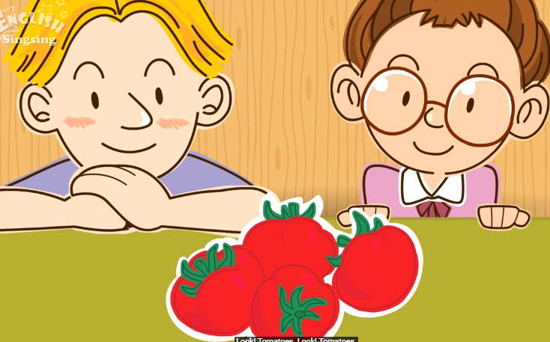
How many tomatoes can you see?.
I can see four tomatoes..

Slide 19

How many notebooks can you see?.
I can see two notebooks..

Slide 20


Let’s sing
Notes:
Let’s sing is divided into 2 steps.
Goal: Pupils will be able to read the song lyrics.
Time: 2 minutes
Have pupils read the song lyrics in chorus then in groups.
Step 2:
Goal: Pupils will be able to sing along the song.
Time: 3 minutes
Have pupils listen and sing a long the song in chorus then in groups.
Step 3
Goal: Pupils will be able to sing the song with TPR.
Time: 3 minutes
Have groups create their own TPR for the song then present.
Finish the song with the TRP for High five and fist bump.
If possible, teacher could have pupils create their own song lyrics and perform.

Slide 21
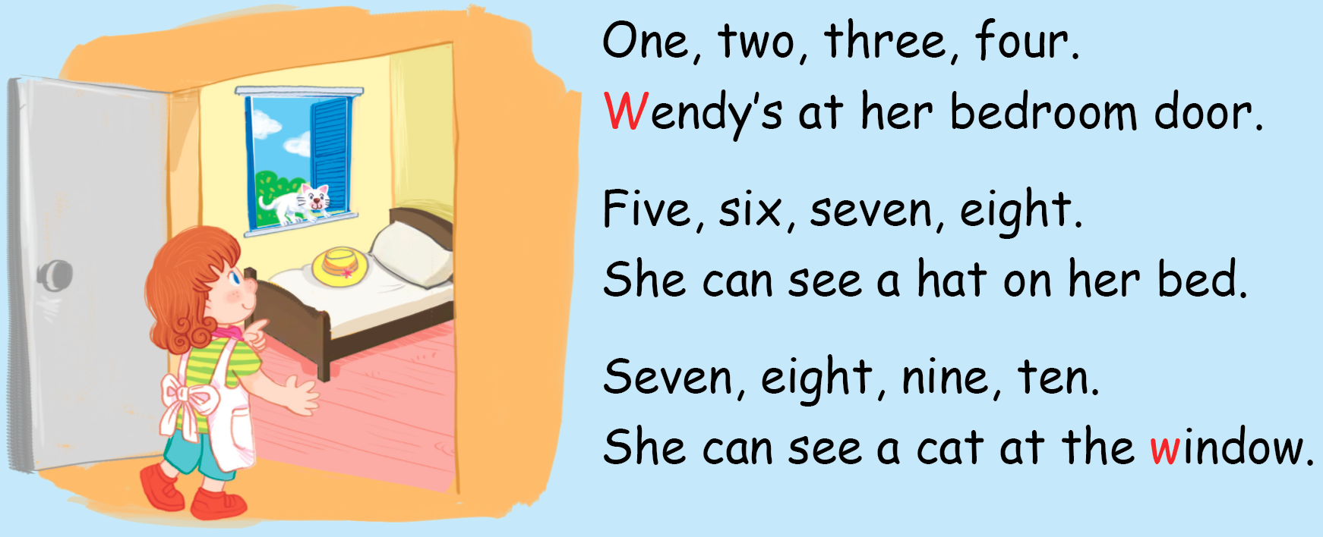
Let’s sing

Slide 22
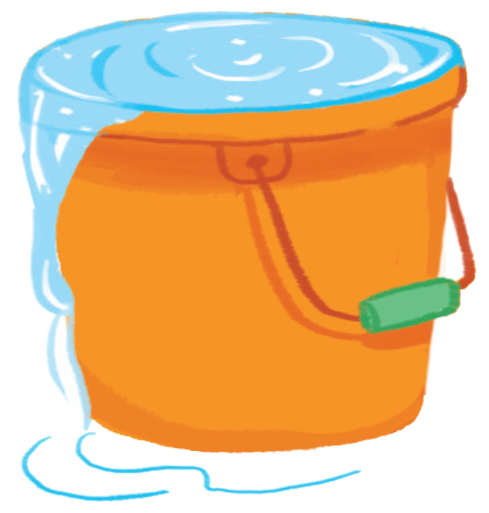
Goodbye
water
Notes:
Teacher shows the vocabulary of the lesson on slide.
Pupils say goodbye.

Slide 23

Goodbye
Wendy

Slide 24

Goodbye
window

Slide 25

Goodbye
wash

Slide 26
Website: hoclieu.vn
Fanpage: facebook.com/www.tienganhglobalsuccess.vn

