Slide 1

UNIT 16
AT THE CAMPSITE
Lesson 1

Slide 2
TABLE OF CONTENTS
1
Warm-up and review.
2
Listen and repeat.
3
Point and say.
4
Fun corner and wrap-up.

Slide 3

1
Warm-up
and review.

Slide 4

Jumbled Letters!
FISH THEME

Slide 5
ARE YOU READY?
Let's get started!

Slide 6
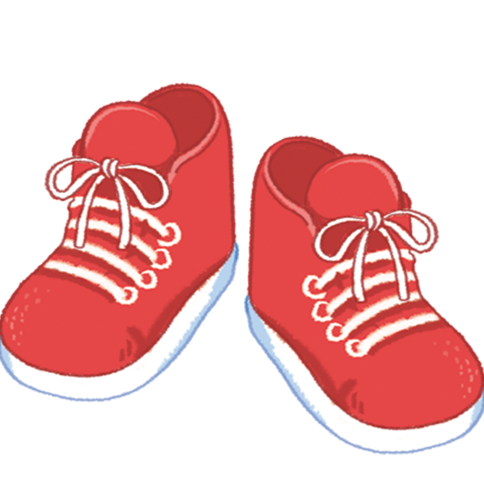
QUESTION 1
s
o
h
e
s

Slide 7
The answer is...
shoes

Slide 8
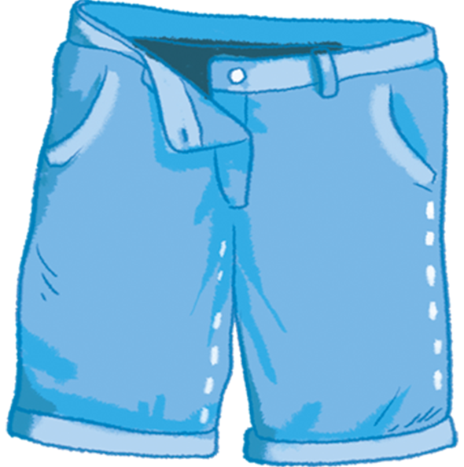
QUESTION 2
t
s
o
h
r
s

Slide 9
The answer is...
shorts

Slide 10
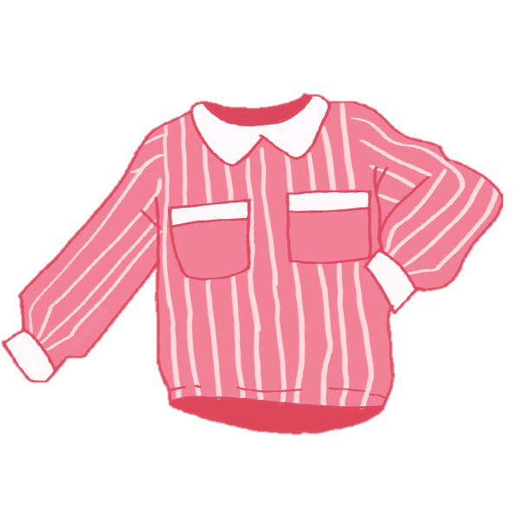
QUESTION 3
s
s
i
t
r
h

Slide 11
The answer is...
shirts

Slide 12
THANK YOU
FOR PLAYING!

Slide 13
2
Listen
and repeat.

Slide 14

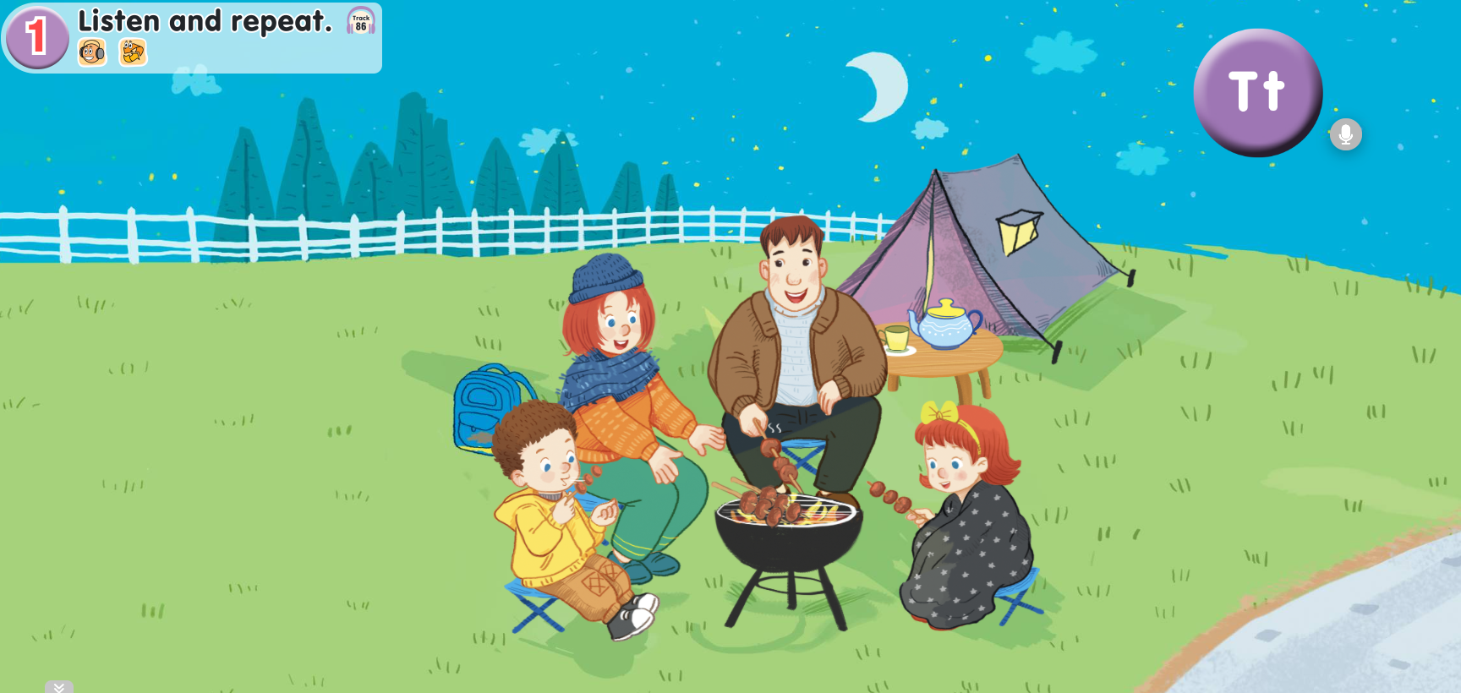

Look and answer.
Notes:
- Click on the purple circle which has Tt to hear the recording “Tt”.

Slide 15
Listen and repeat.
Notes:
- Click on the purple circle which has Tt to hear the recording “Tt”.

Slide 16
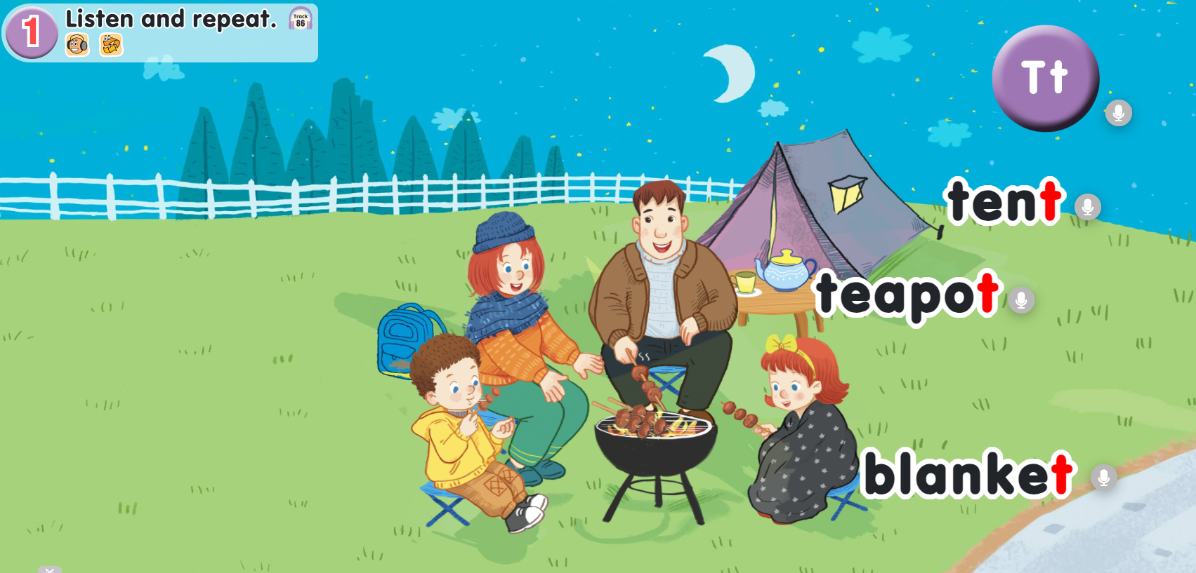


Listen and repeat.
Notes:
Click on the purple circle which has Tt.
Click “tent” to listen to the recording of tent.

Slide 17

Listen and repeat.
tent

Slide 18

Listen and repeat.
Notes:
Click on the purple circle which has Tt.
Click “teapot” to listen to the recording of teapot.

Slide 19

Listen and repeat.
teapot

Slide 20

Listen and repeat.
Notes:
Click on the purple circle which has Tt.
Click “blanket” to listen to the recording of blanket.

Slide 21
Listen and repeat.
blanket

Slide 22
Listen and repeat.
Notes:
- Click on the purple circle which has Tt to hear the full recording of track 86.

Slide 23

GOOD JOB!

Slide 24
3
Point
and say.

Slide 25
Point and say.

Slide 26
Point and say.

Slide 27



Point and say.
Work in pairs.

Slide 28
GOOD JOB!

Slide 29
4
Fun corner
and wrap-up.

Slide 30
MATCHING GAME

Slide 31
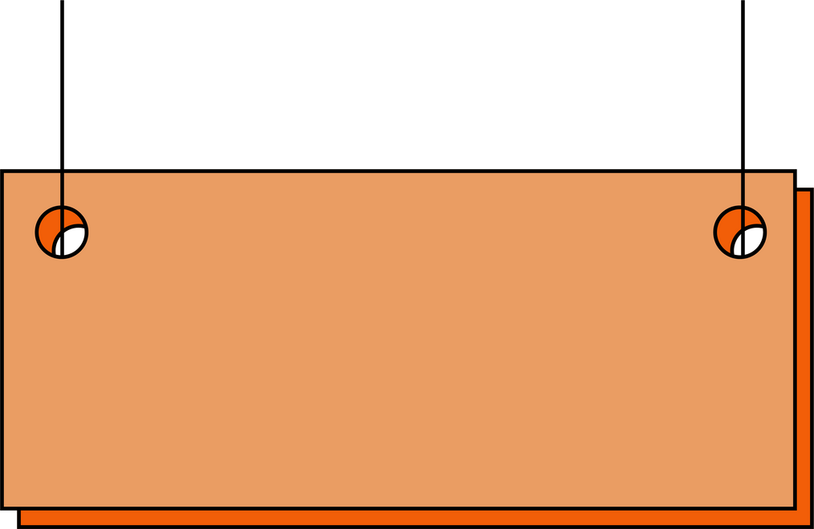

1
2
3
4
teapot
table
blanket
tent
A
B
C
D

Slide 32
Thank you
for
playing!

