Slide 1
TABLE OF CONTENTS
1
Warm-up and review.
2
Listen and chant.
3
Listen and circle.
4
Write and say.
5
Fun corner and wrap-up.

Slide 2






d
1
2
3
4
table
teapot
tent
blanket

Slide 3

2
Listen
and chant.

Slide 4

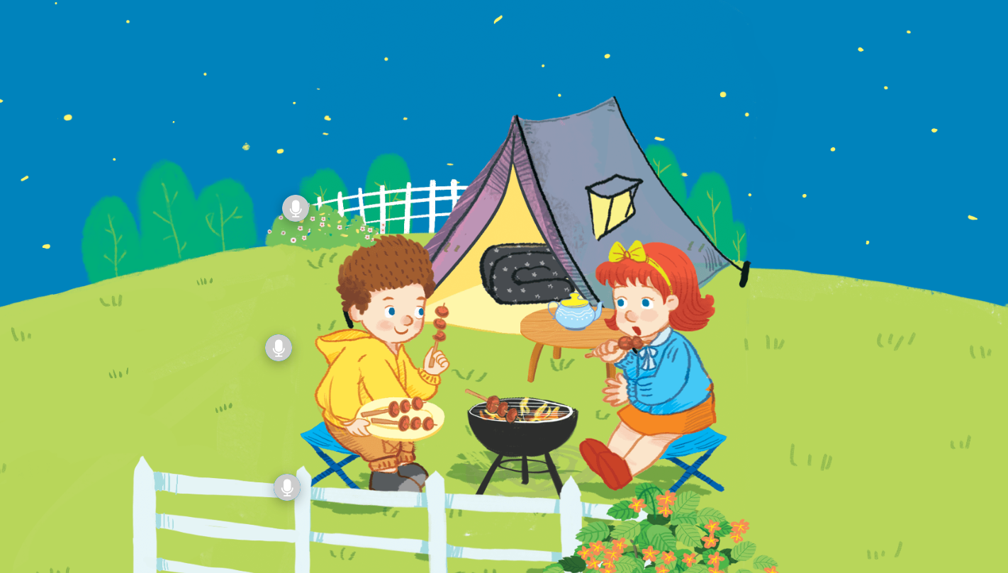
Look and answer.

Slide 5

Listen and chant.
T, t, tent.
T, t, tent.
T, t, tent.
T, t, tent.
The tent is near the fence.
The tent is near the fence.
The tent is near the fence.
The tent is near the fence.
T, t, blanket.
T, t, blanket.
T, t, blanket.
T, t, blanket.
The blanket is in the tent.
The blanket is in the tent.
The blanket is in the tent.
The blanket is in the tent.
T, t, teapot.
T, t, teapot.
T, t, teapot.
T, t, teapot.
The teapot is on the table.
The teapot is on the table.
The teapot is on the table.
The teapot is on the table.
Notes:
Click on the purple circle which has Tt.
Click “tent” to listen to the recording of tent.

