Slide 1

UNIT 16
AT THE CAMPSITE
Lesson 3

Slide 2


brother
grapes
teapot
zebu

Slide 3
brother
cake
yogurt
zebu

Slide 4
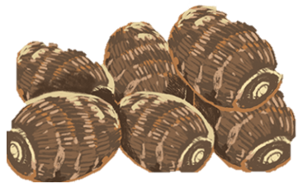
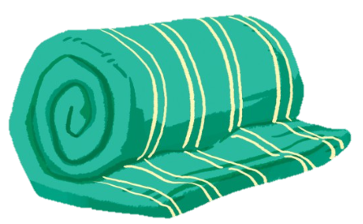
yams
blanket
grapes
cake

Slide 5
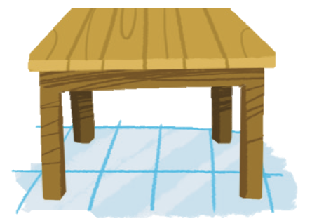
zebu
table
brother
cake

