Slide 1



Unit 4:
Lesson 1 – Task 1, 2, 3

Slide 2
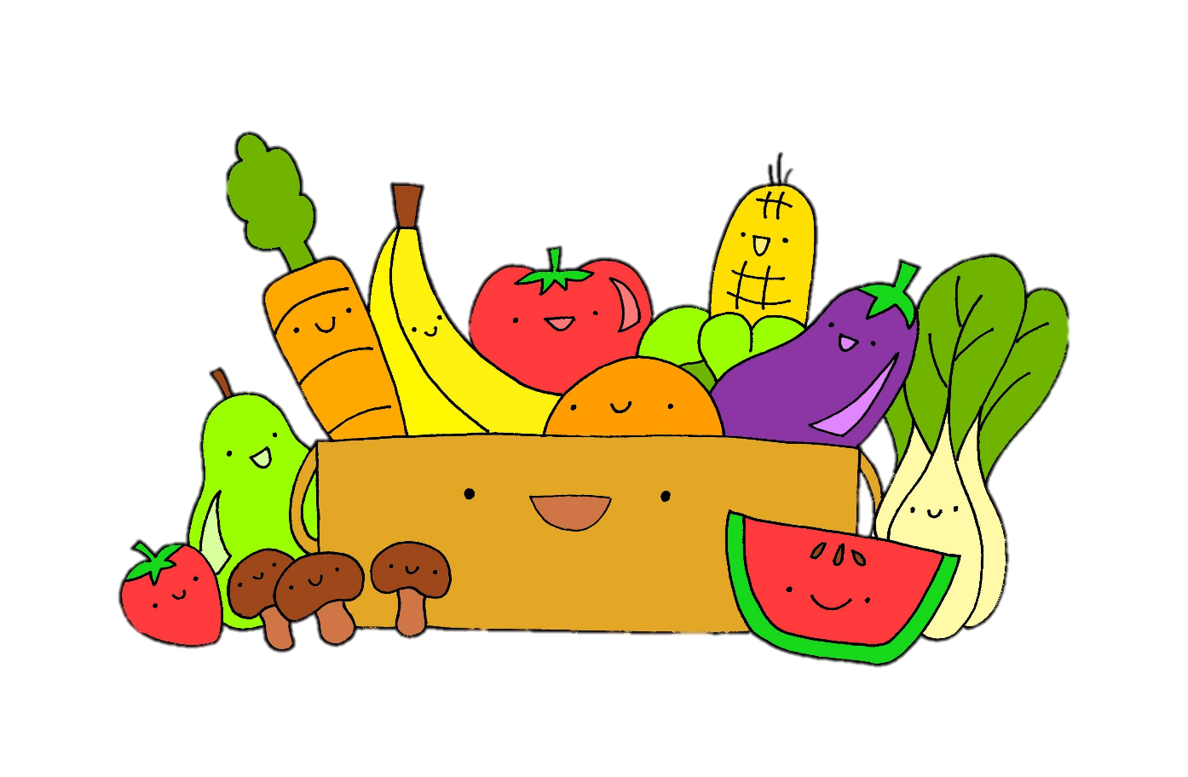
1 WARM UP
Listen and sing along.

Slide 3
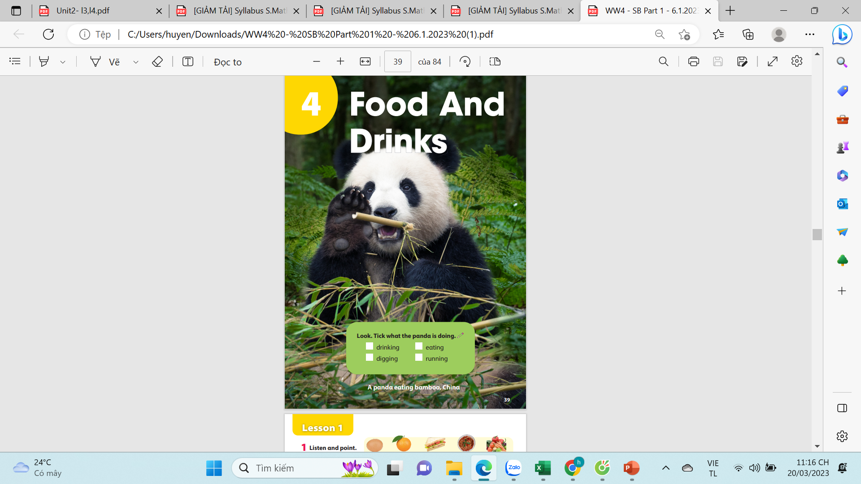
Look. Tick what the panda is doing.
drinking
eating
digging
running
A panda eating bamboo, China
Notes:
Ko hiện lên dc dấu tick

Slide 4





2 PRESENTATION
Task 1 Listen and point. Repeat.

Slide 5
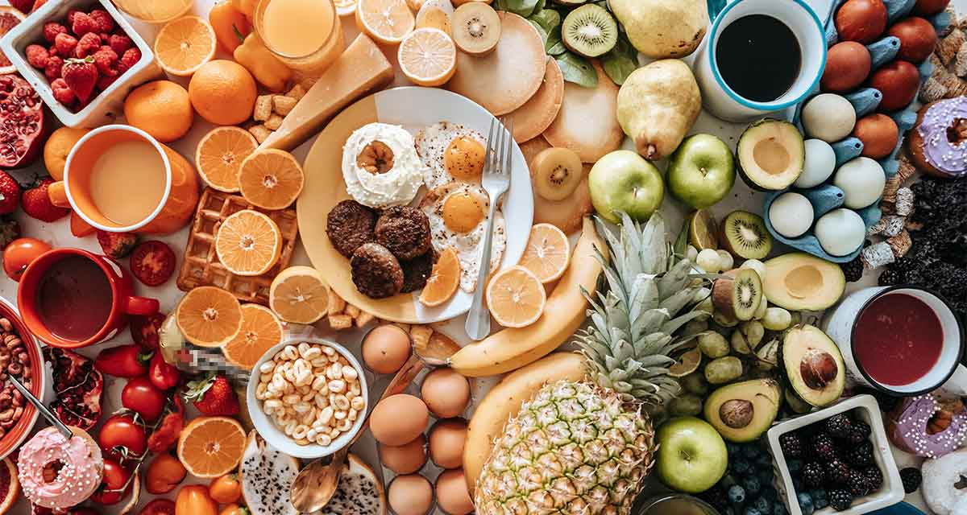

Slide 6
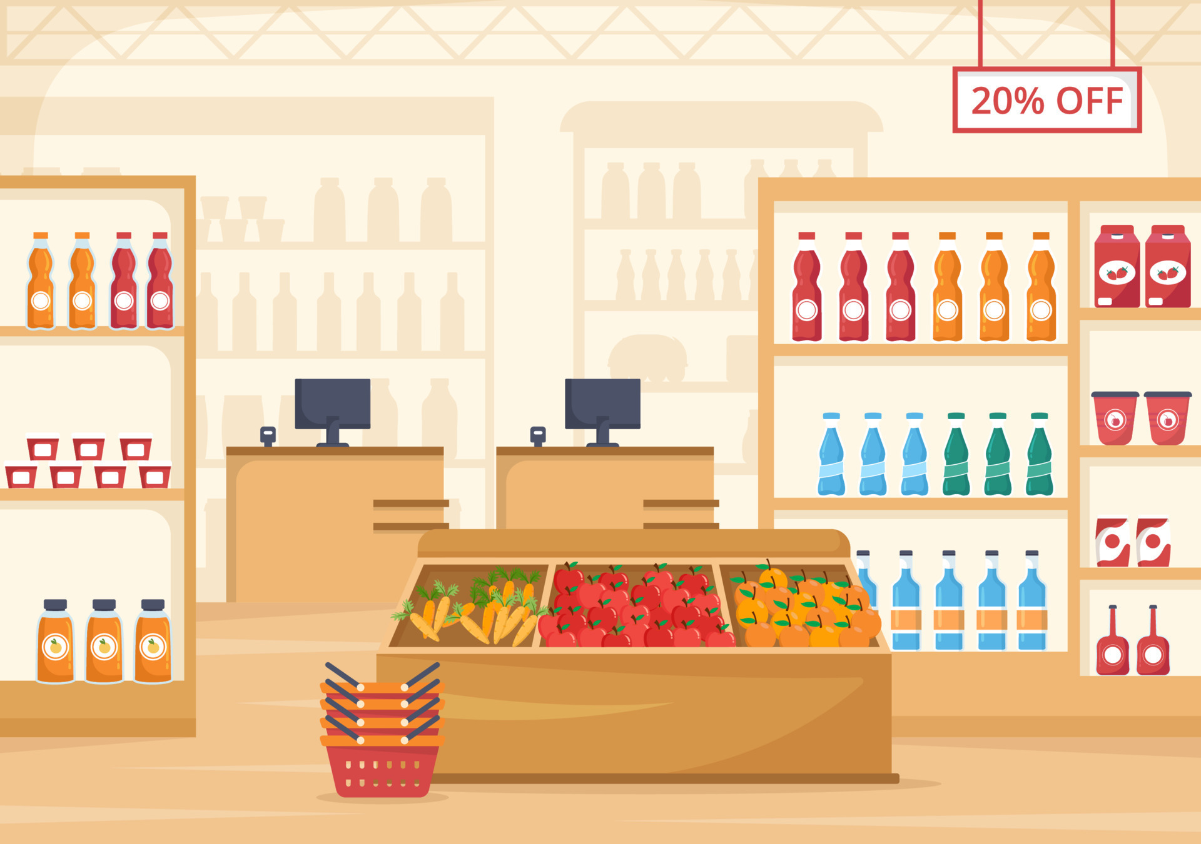
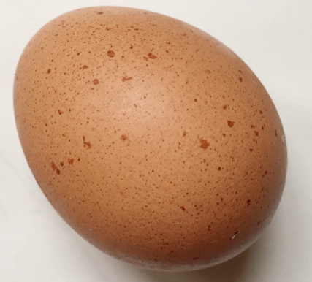
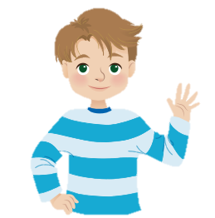
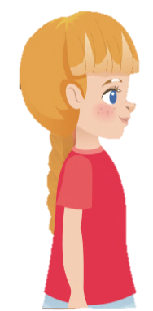
New words
an egg
Sophie
Alex

Slide 7
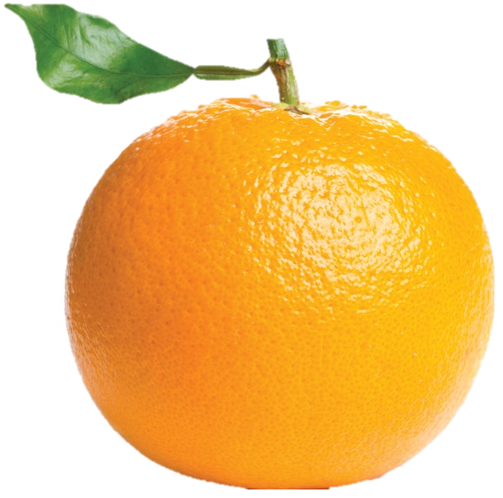
New words
an orange
Sophie
Alex

Slide 8
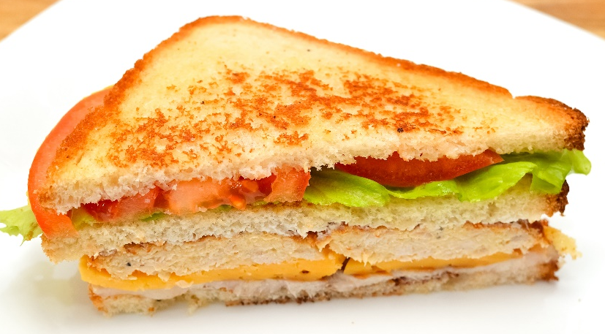
New words
a sandwich
Sophie
Alex

Slide 9
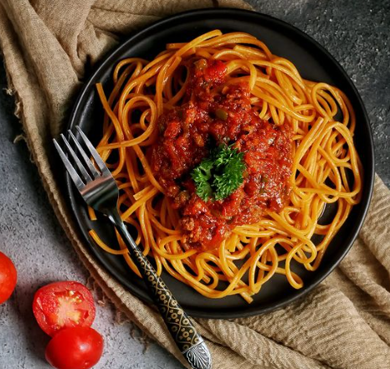
New words
spaghetti
Sophie
Alex

Slide 10
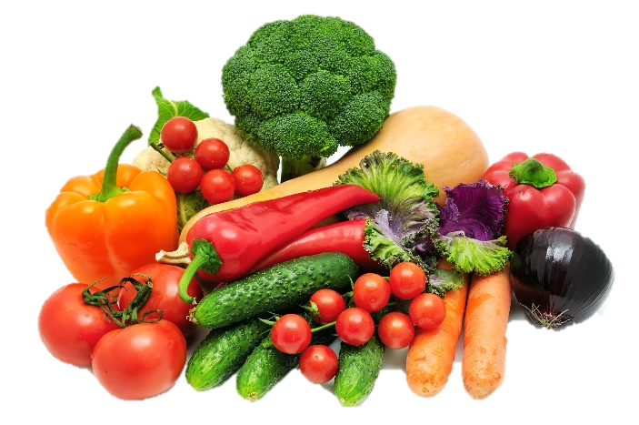
New words
vegetables
Sophie
Alex

Slide 11

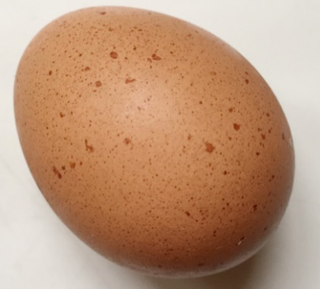



Listen and point. Repeat.
an egg
an orange
a sandwich
spaghetti
vegetables

Slide 12

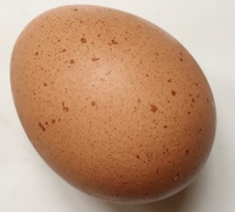
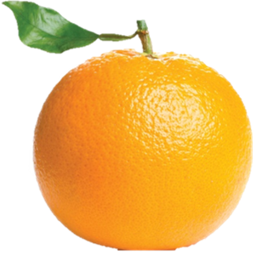

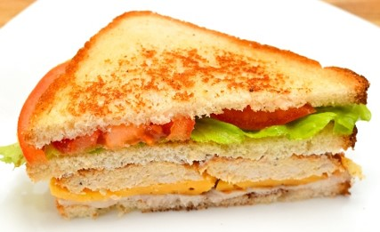
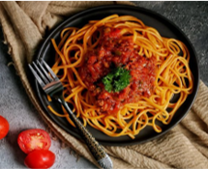
What’s disappeared?
vegetables
TIME’S UP

Slide 13
What’s disappeared?
orange
TIME’S UP

Slide 14
What’s disappeared?
spaghetti
TIME’S UP

Slide 15
What’s disappeared?
vegetables
TIME’S UP

Slide 16
What’s disappeared?
sandwich
TIME’S UP

Slide 17
What’s disappeared?
egg
TIME’S UP

Slide 18
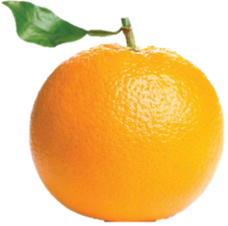

What are disappeared?
orange
TIME’S UP
sandwich

Slide 19
What are disappeared?
egg
TIME’S UP
sandwich

Slide 20
What are disappeared?
spaghetti
TIME’S UP
vegetables

