Slide 1
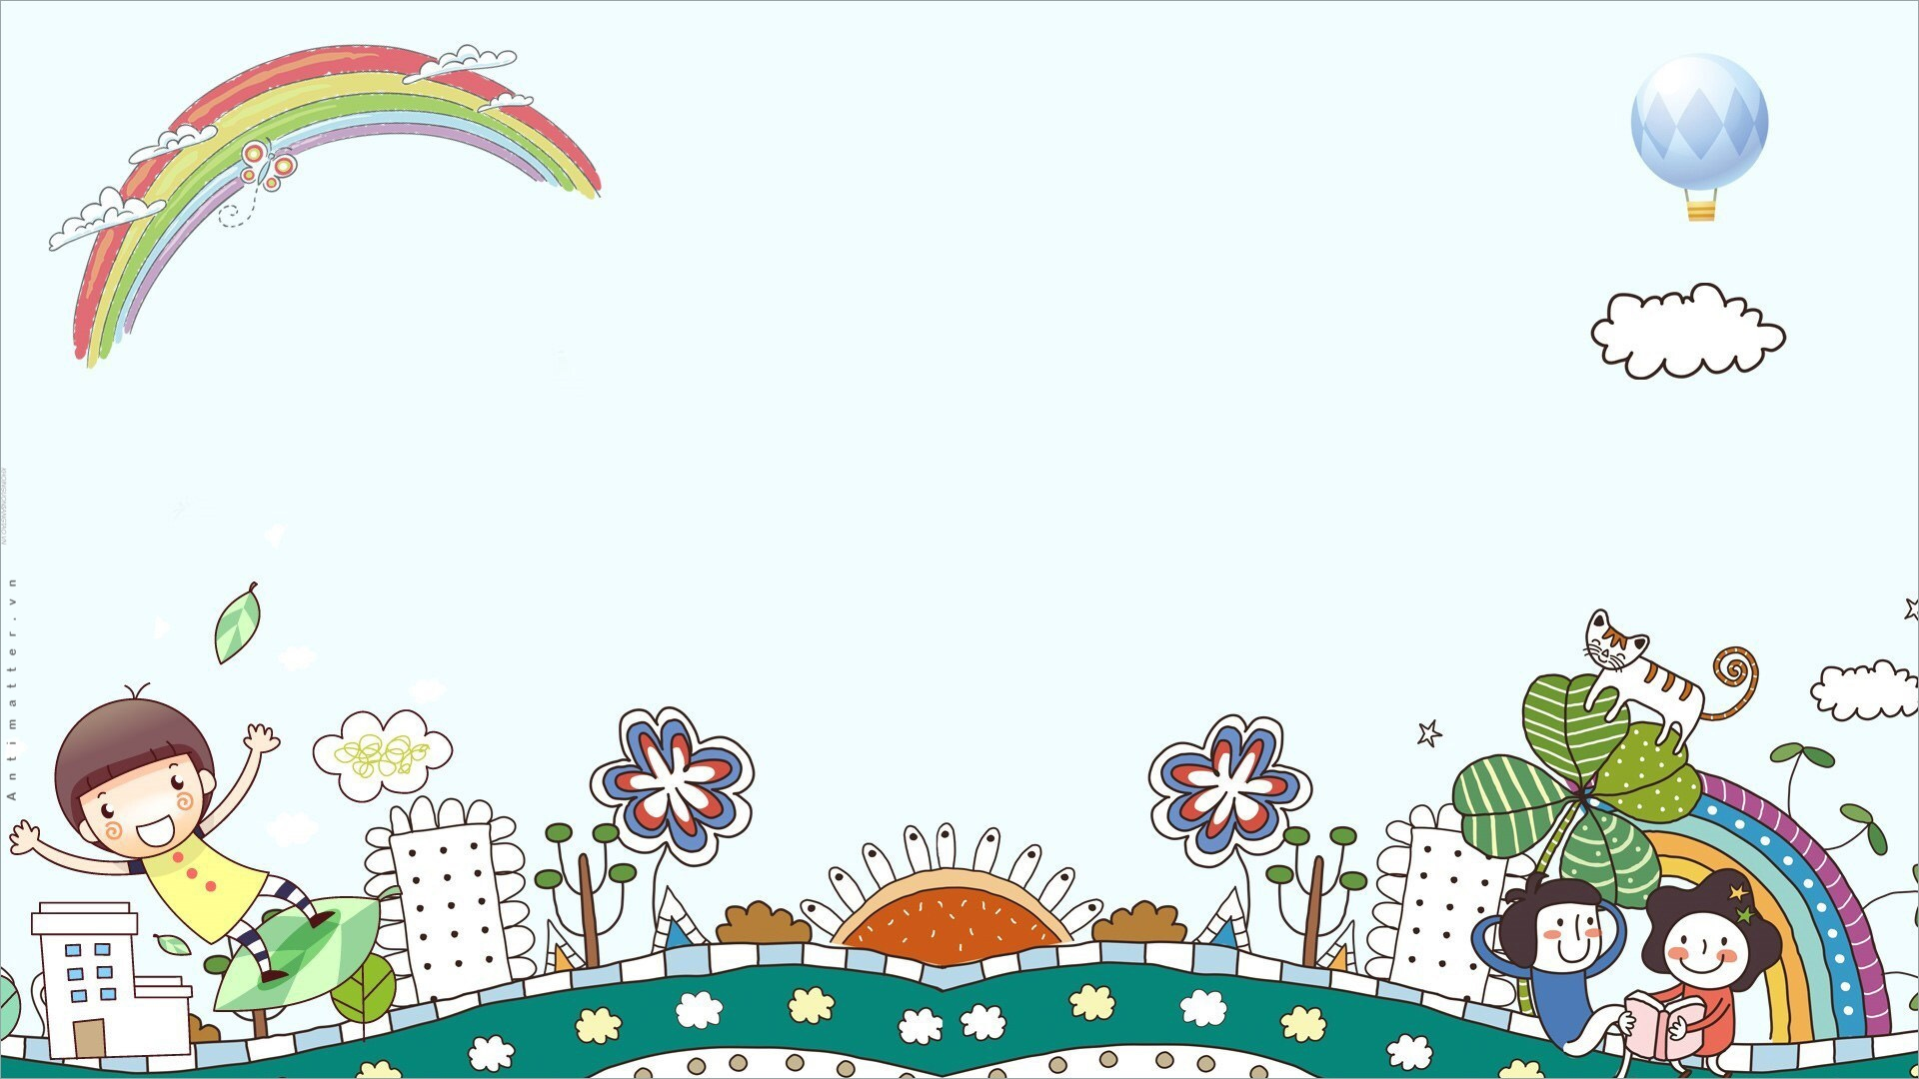





Unit: 4
FREE TIME
Lesson 2: Part 4, 5, 6

Slide 2













Lucky the colors
10 stars
4 stars
2 stars
1 star
20 stars
1 star
15 stars
8 stars
10 stars
1
2
3
4
Notes:
Ấn vào trái tim link với các bức tranh để làm hội thoại.
Bấm vào mũi tên chuyển học phần tiếp theo.

Slide 3
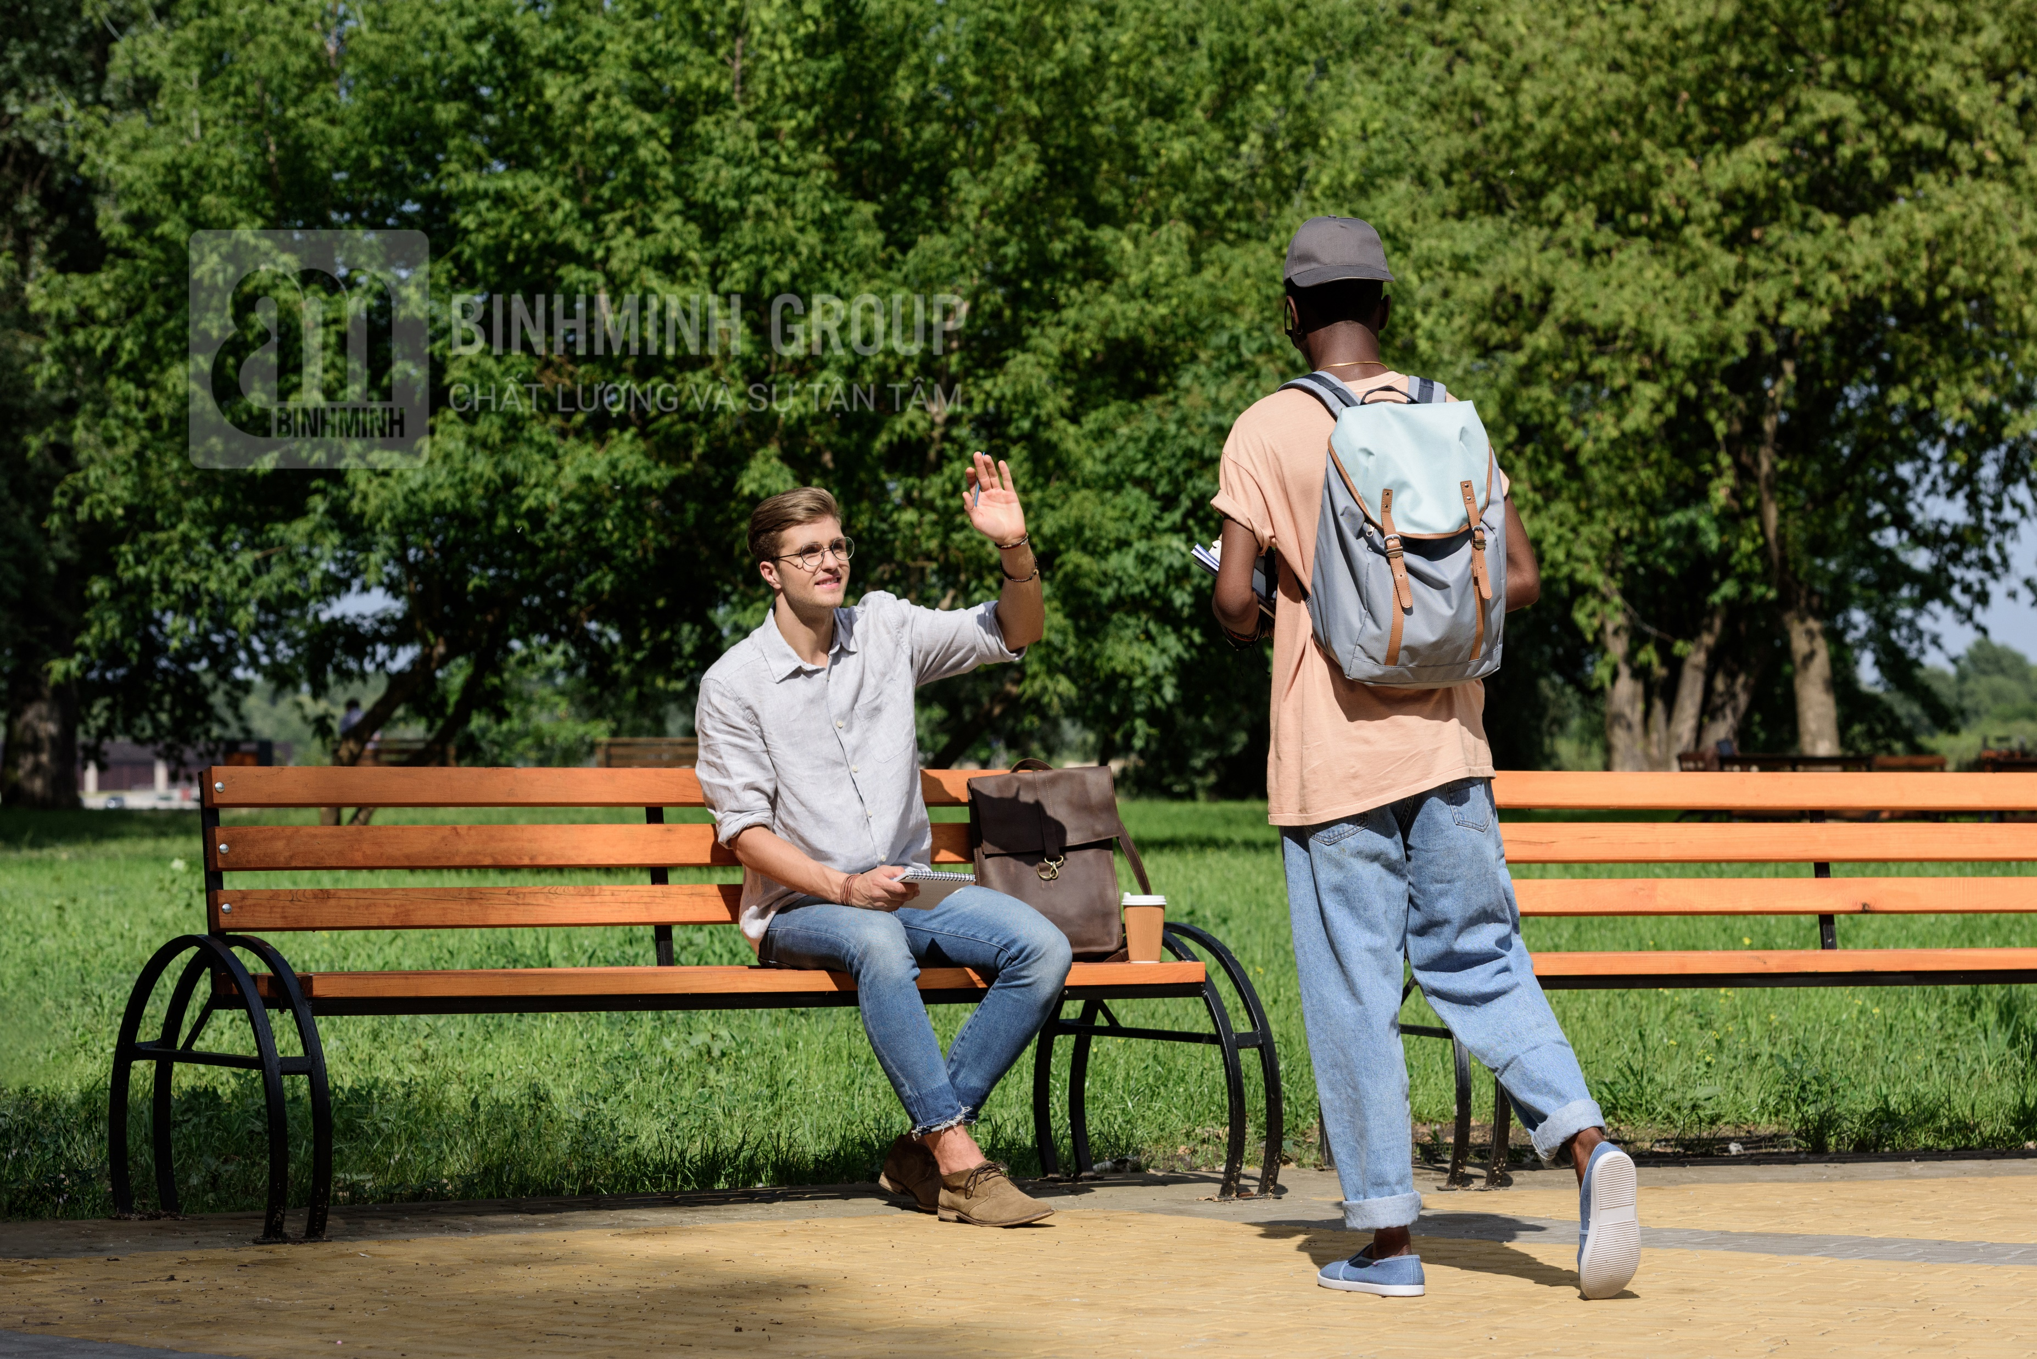

Sure, go ahead.
Excuse me,
can I sit here?
Notes:
Bấm vào bông hoa quay trở lại chọn màu lấy sao cho đội.

Slide 4

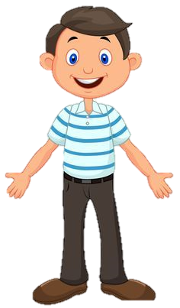

Yes, you can.
Dad, I need some books.
Can I go to the bookshop now?

Slide 5
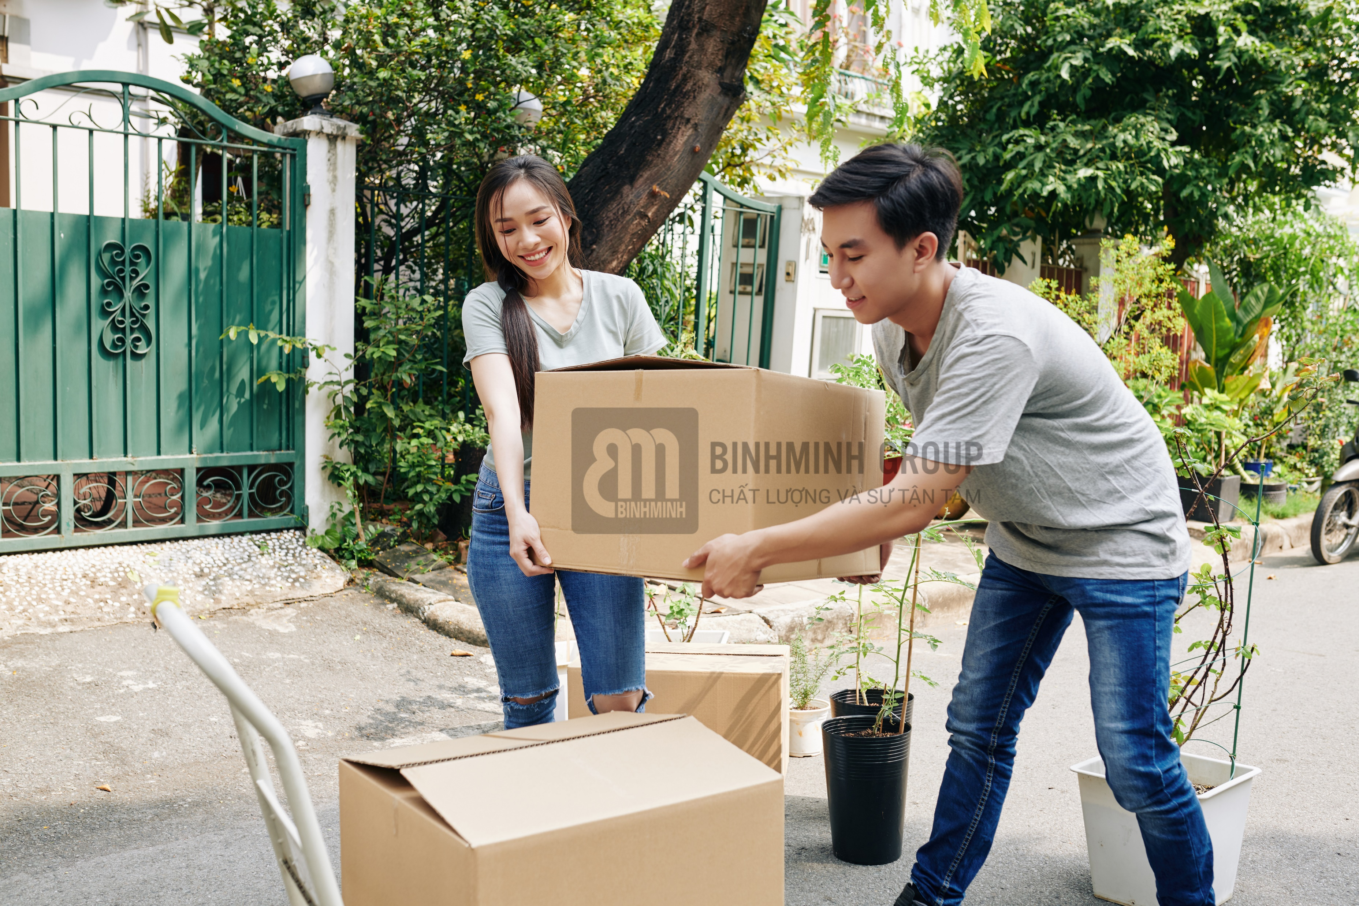
Yes, of course.
Excuse me!
These boxes are so heavy. Can we put them here for a few minutes?

Slide 6
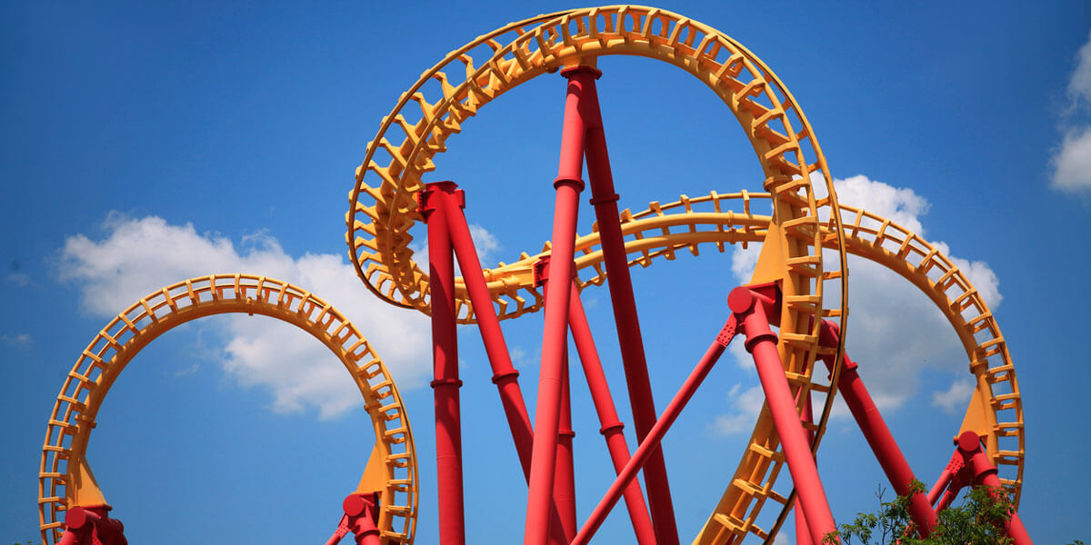
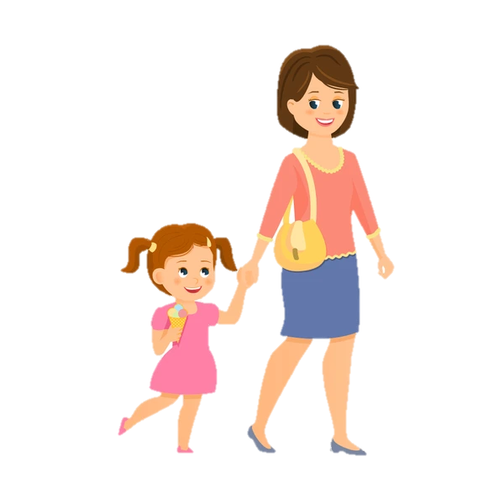
Mum, can we go on a ride?
No, you can’t. It’s scary.

Slide 7




5 Complete with can / can’t.
1 A: Mum, ____ Sarah and Mifa go on a ride with me?
B: No, they ____ . They’re too young.
2 A: Excuse me, ____ I move your bag a little bit, sir?
B: Yes, I’m sorry.
3 A: Oh, no. I don’t have my pencil with me. ____ I borrow
your pencil, Mai?
B: Sure! Here it is.
4 A: Teacher, ____ I go out for 5 minutes?
B: I’m sorry, you ____ .
can
can’t
can
Can
can
can’t

Slide 8
6 Write the correct questions to ask for your mother’s permission.
go to the park go to the bookshop go to the museum
go to the cinema play the piano

Slide 9
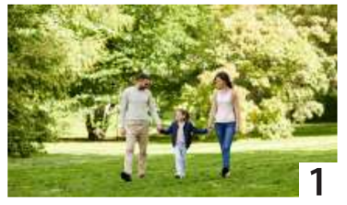

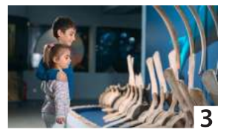
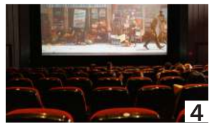
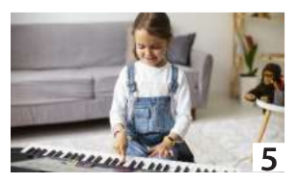
6 Write the correct questions to ask for your mother’s permission.
go to the park go to the bookshop go to the museum
go to the cinema play the piano
Mum, can I go to the museum?
Mum, can I go to the park?
Mum, can I go to the bookshop?
Mum, can I go to the cinema?
Mum, can I play the piano?

Slide 10

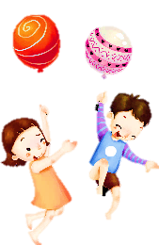
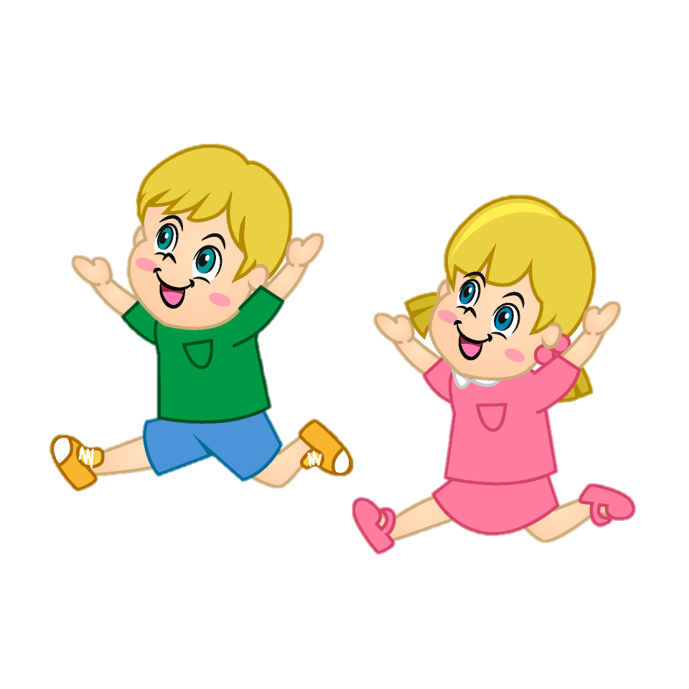



Production
04

Slide 11
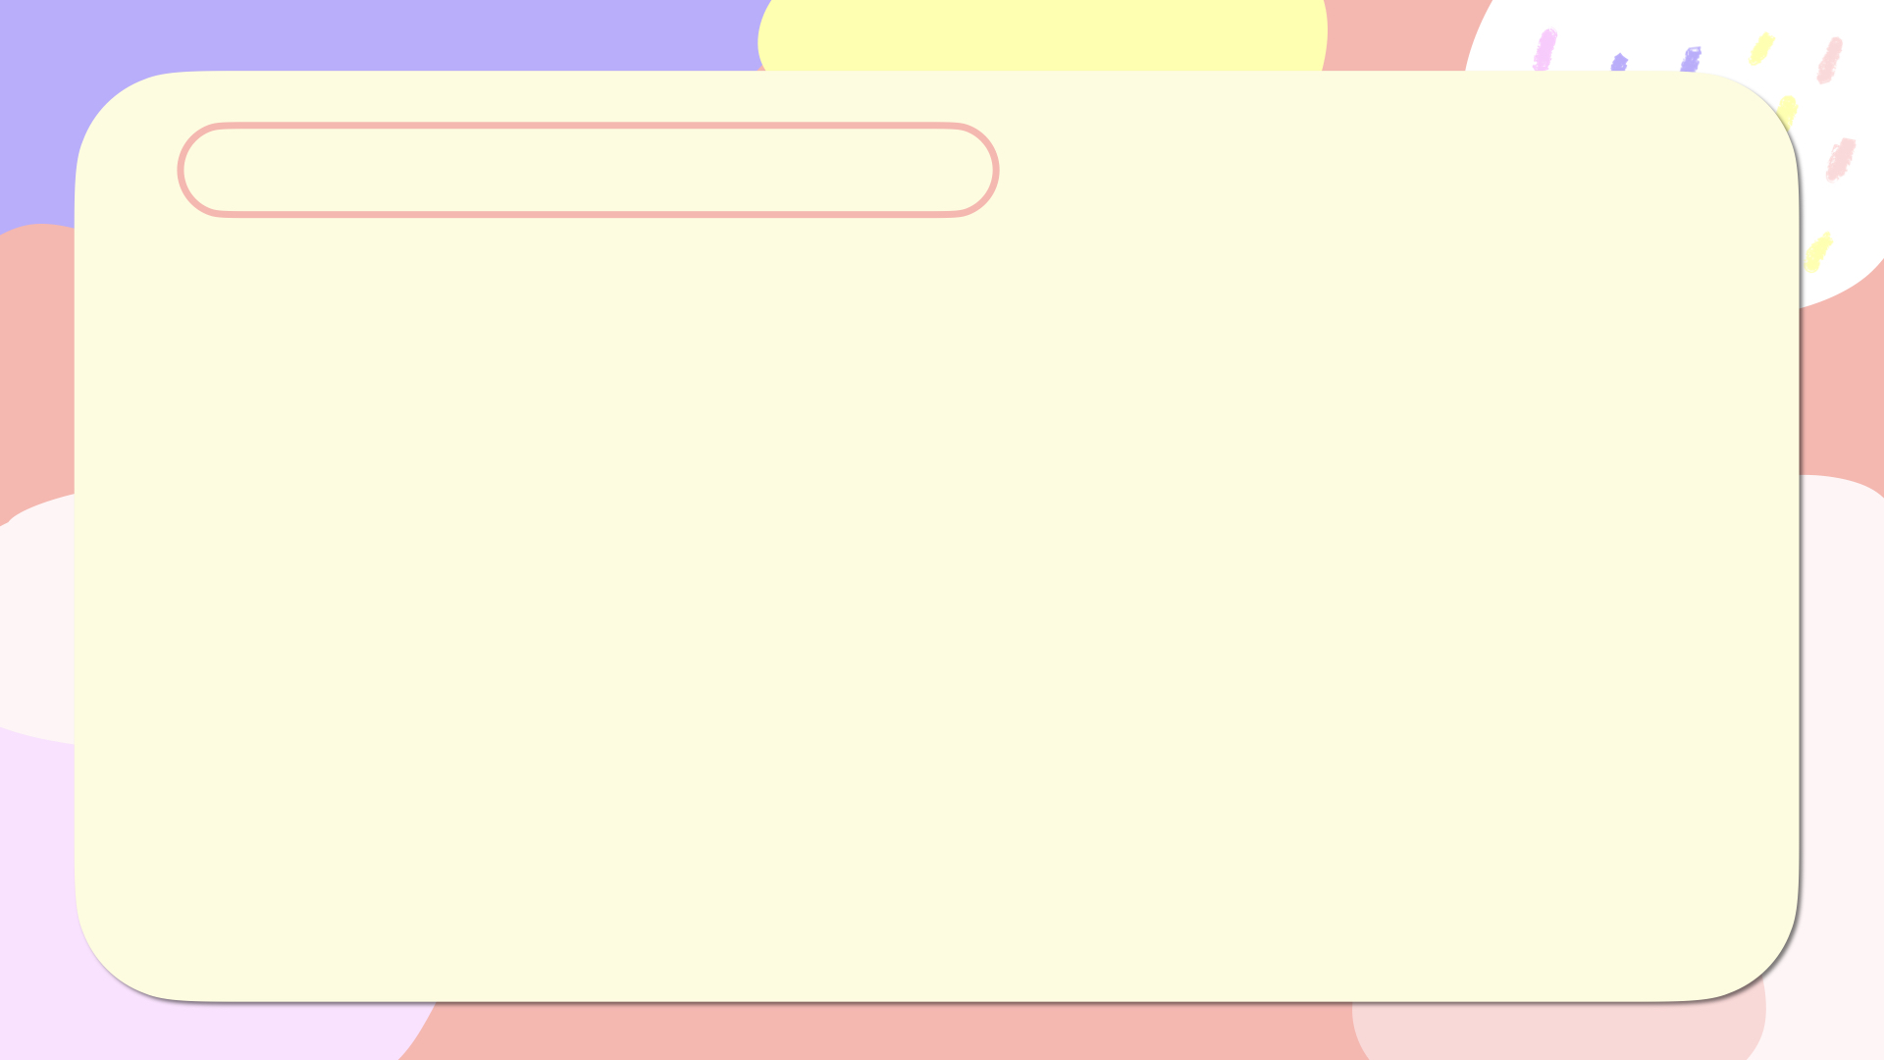
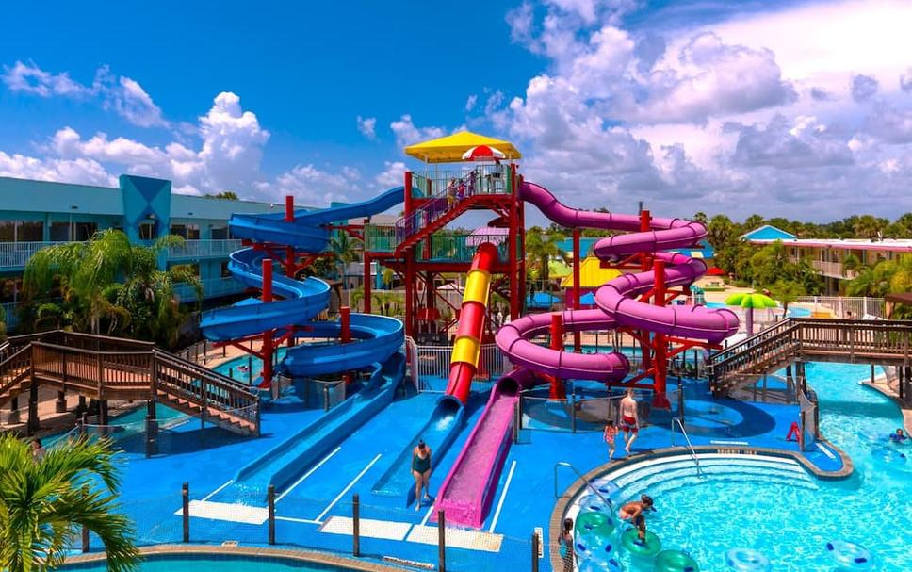
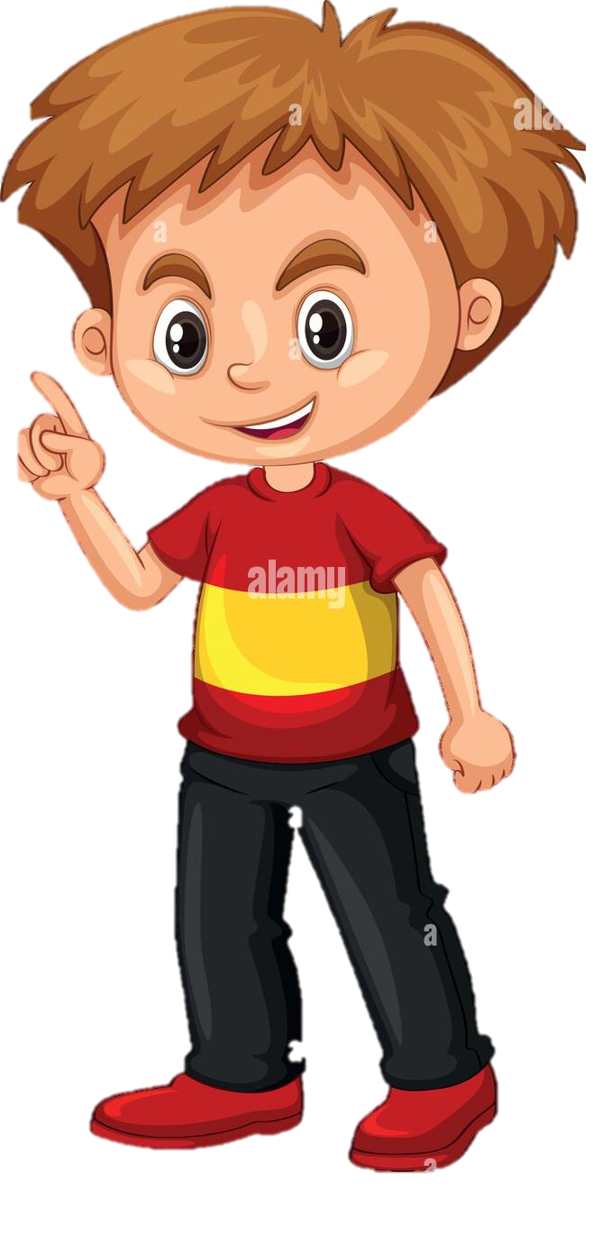
Yes, we can.
Dad, the weather is so hot. Can we go to the water park?

Slide 12
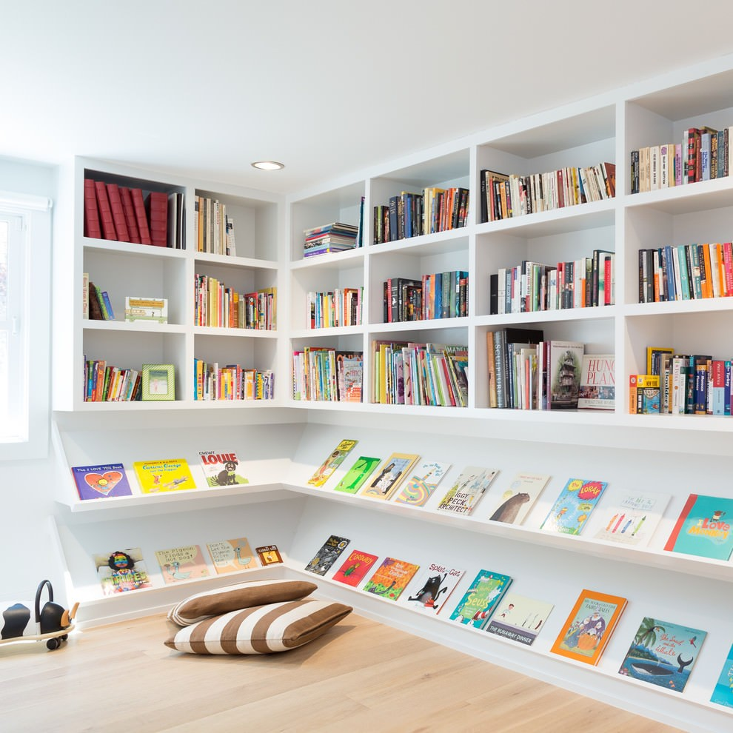
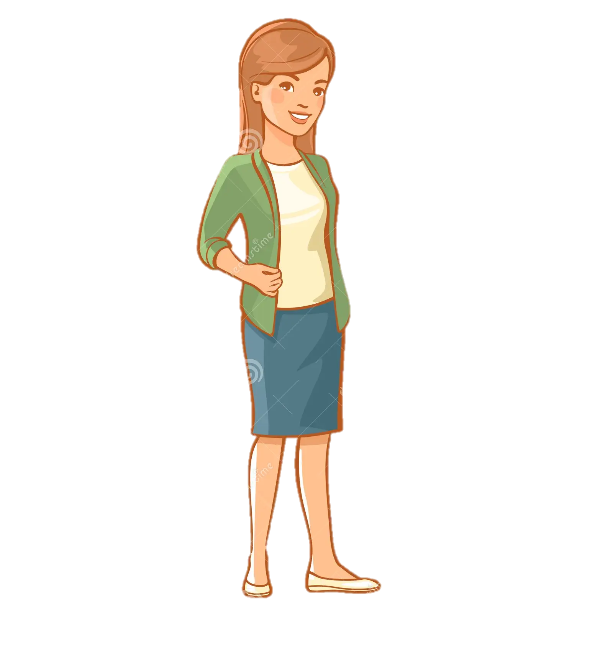
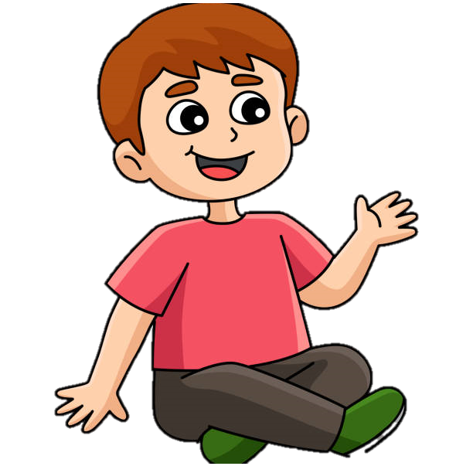
Yes, of course.
Mum, can you get the red book for me, please?

